Slide 1
Post-Challenge Team Photos (except for Century College – sorry!)
Photos by James Flaten

Slide 2
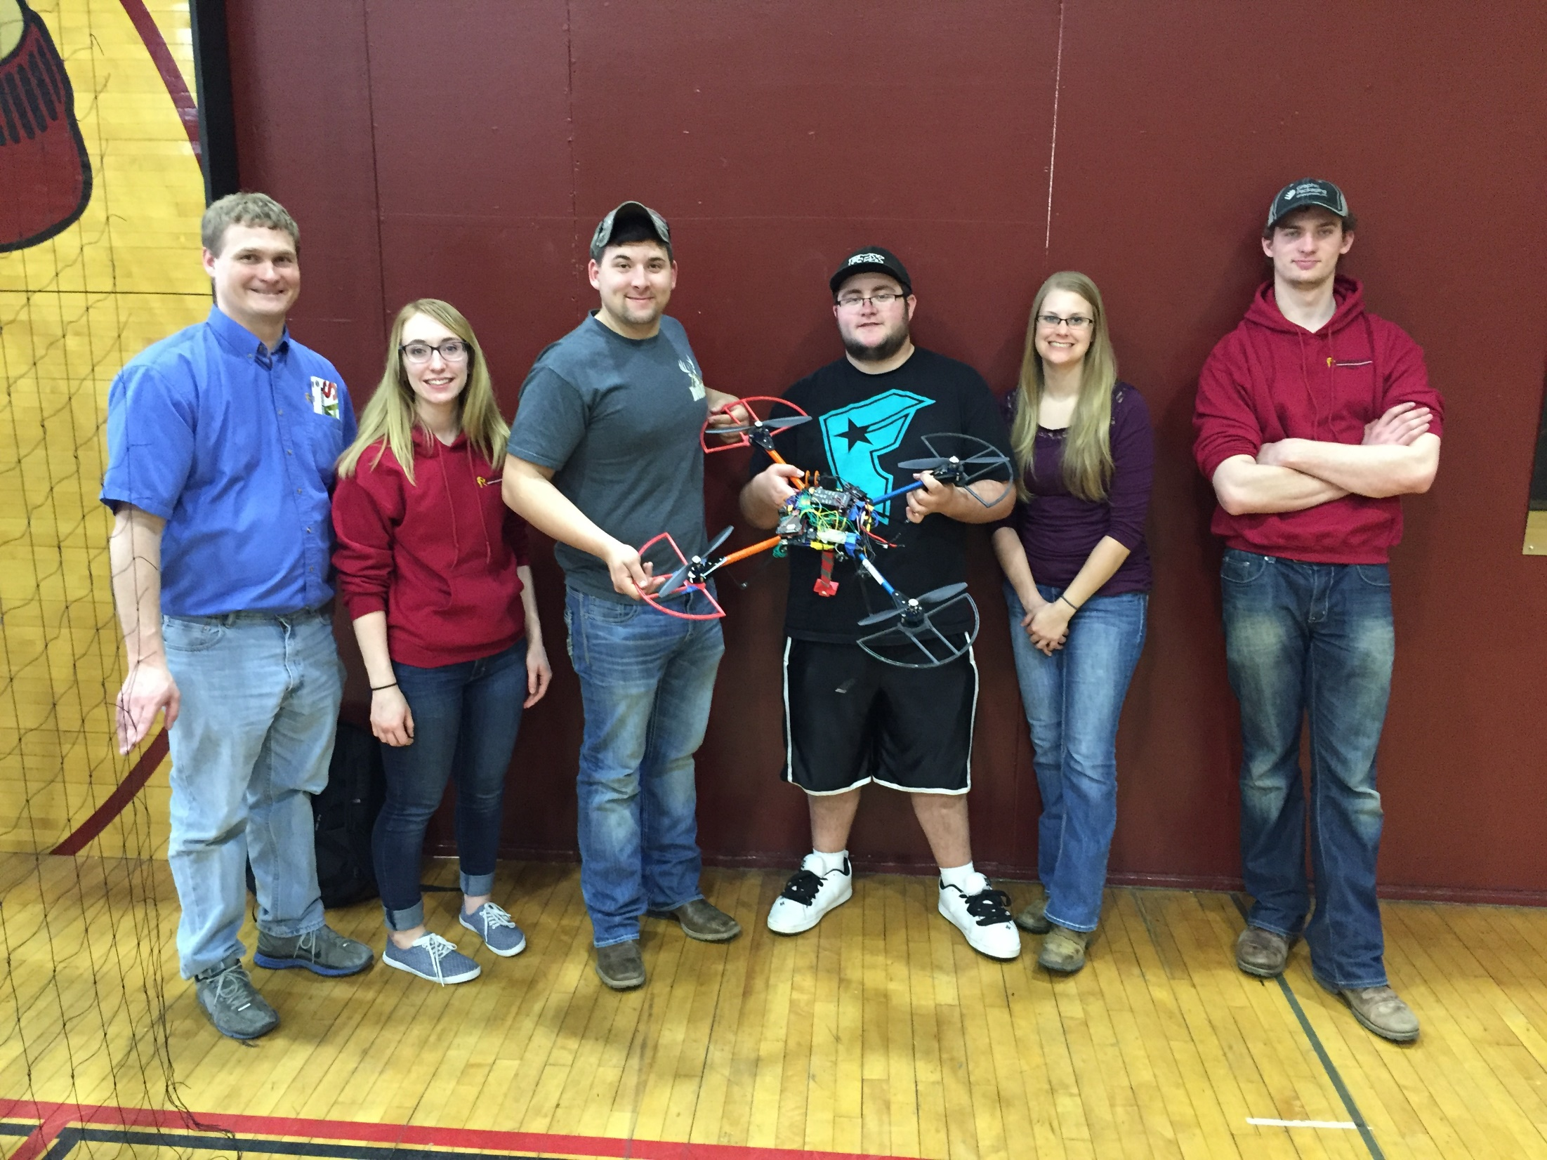

Slide 3
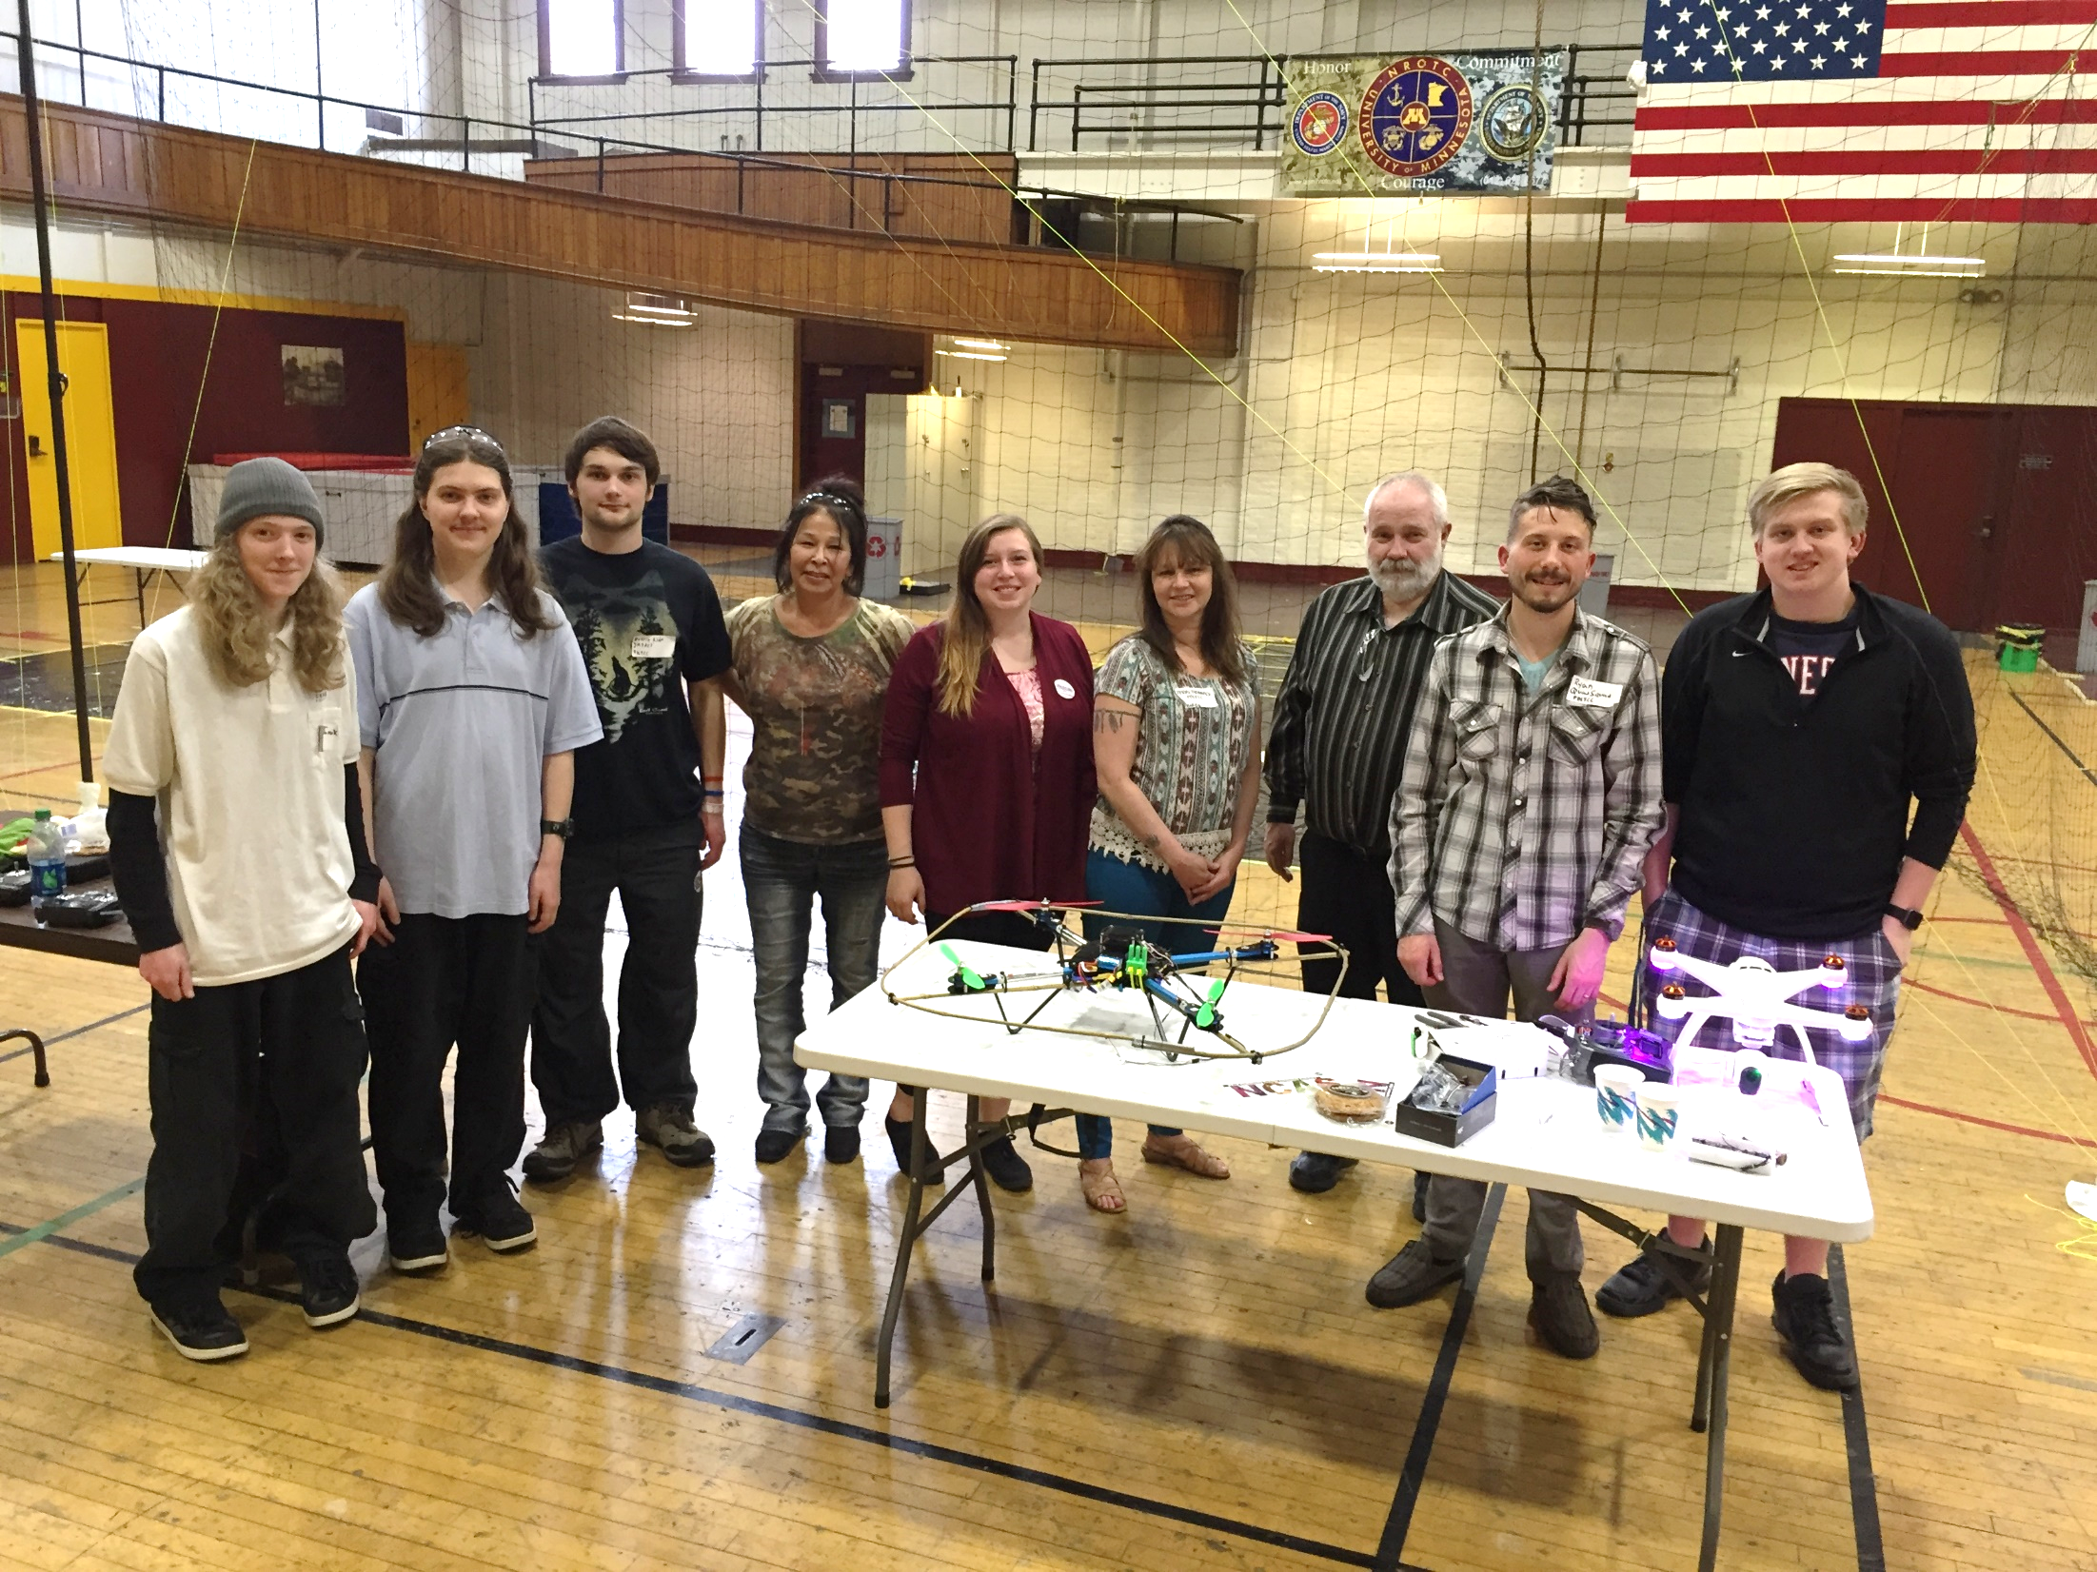

Slide 4
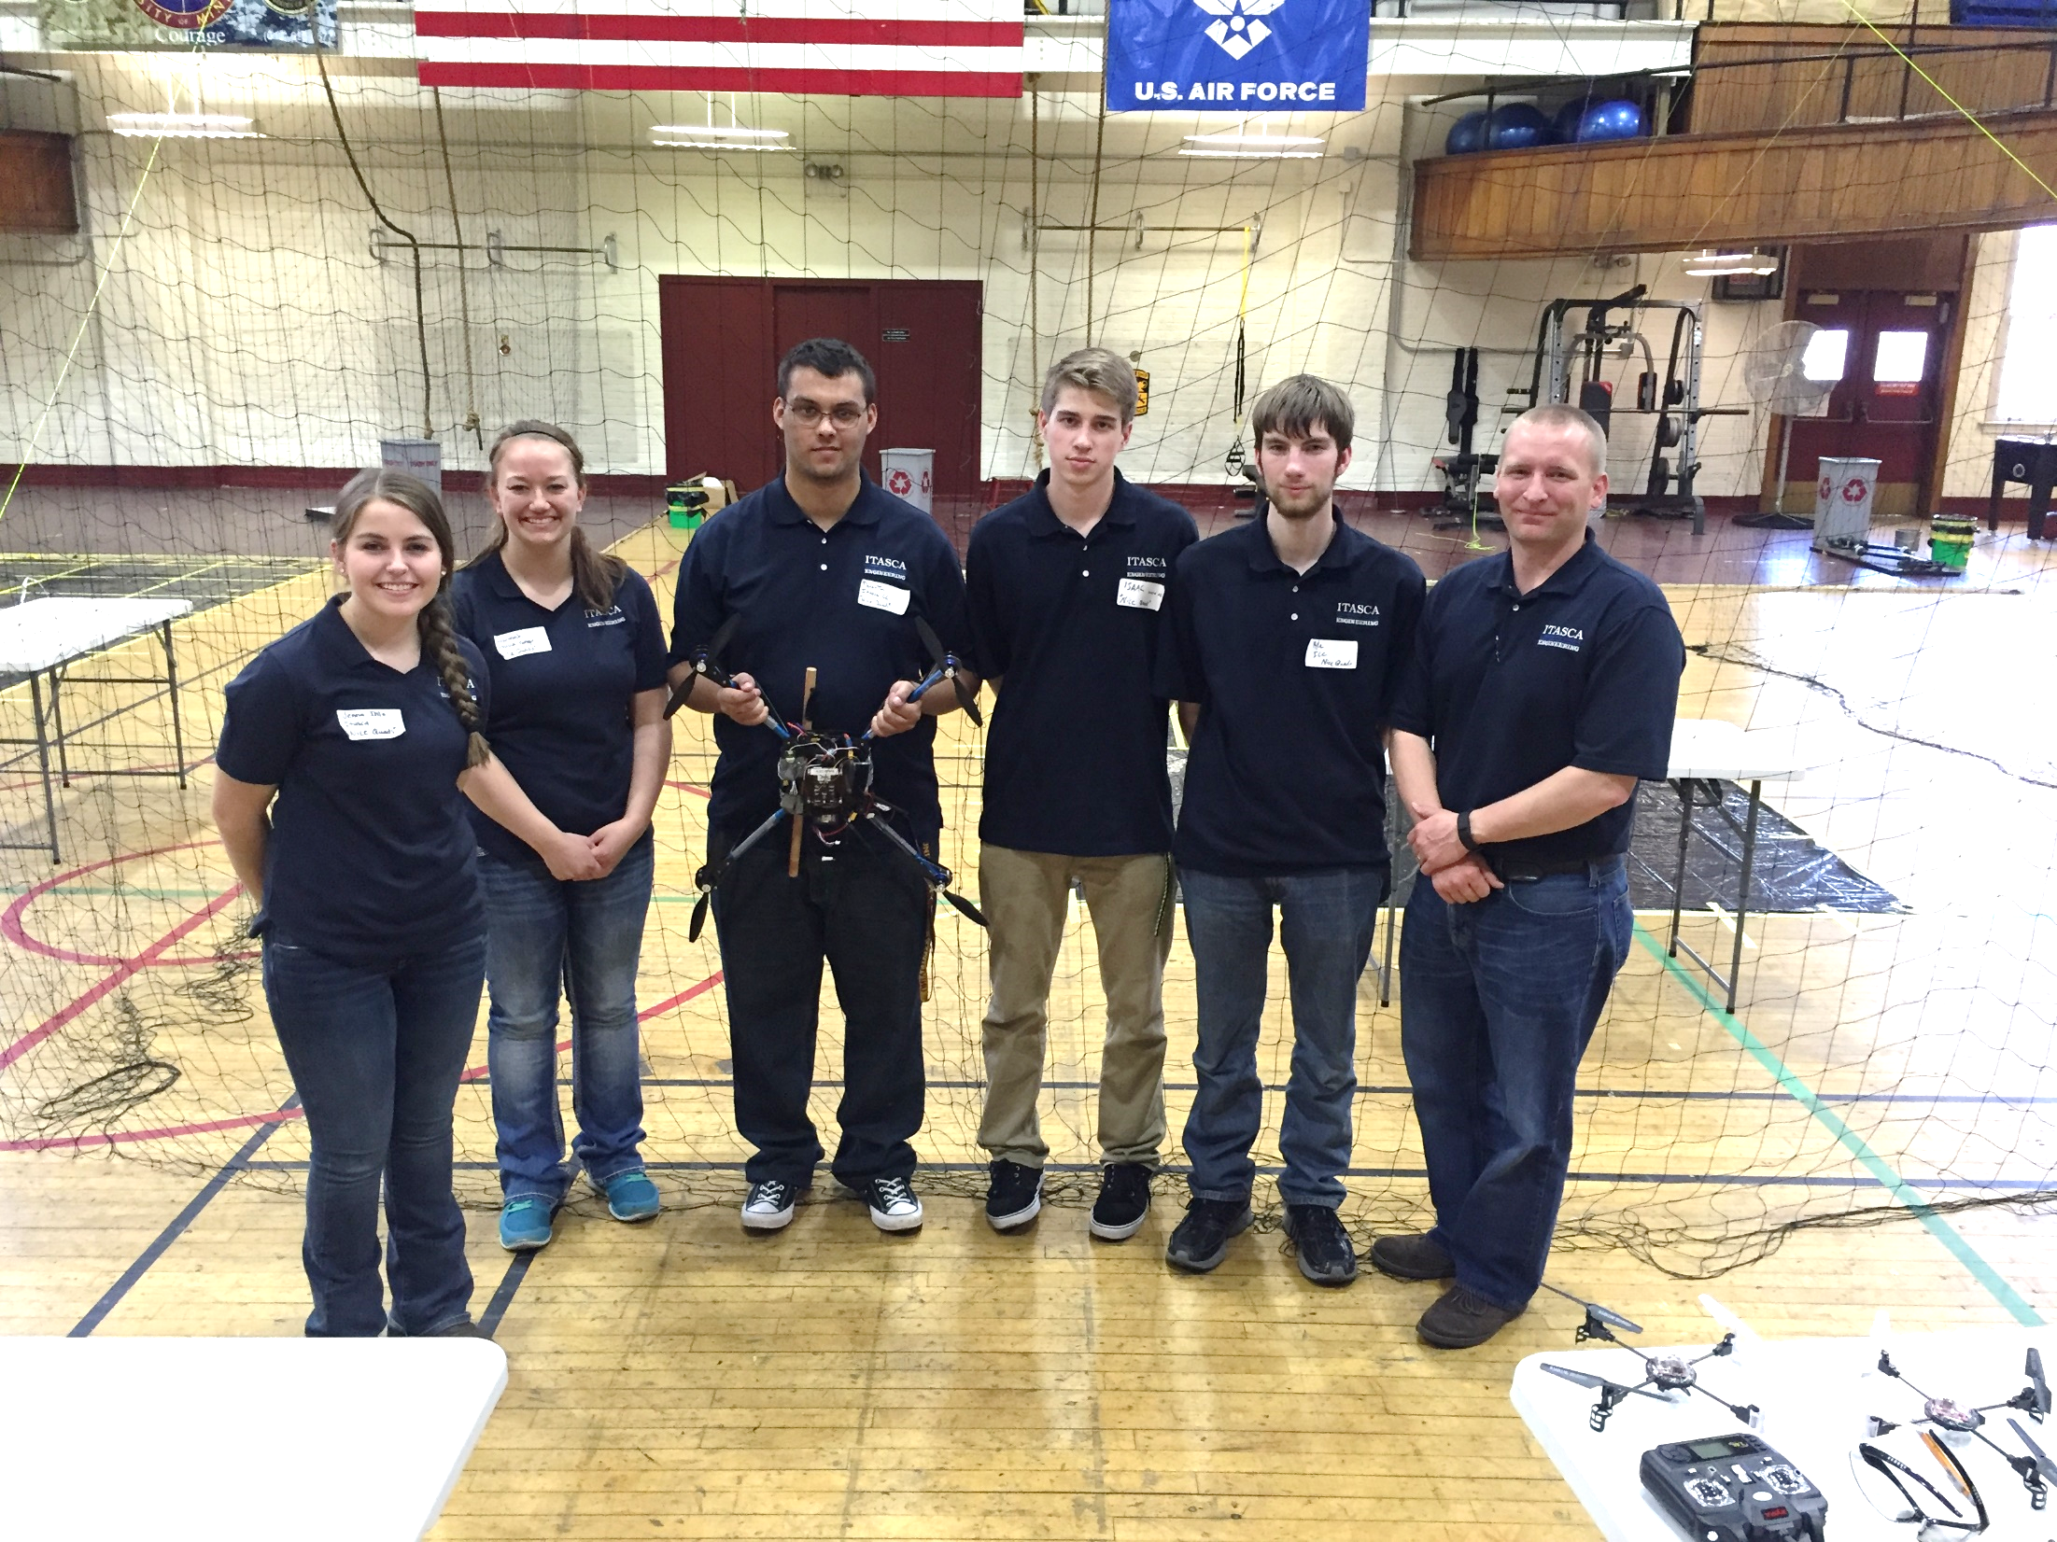

Slide 5
