Slide 1
NASA’s MN Space Grant Consortium (MnSGC) Community College Quadcopter Initiative
Participating Institutions
Central Lakes College, Brainerd
Century College, White Bear Lake (2 teams)
Fond du Lac Tribal and Community College, Cloquet (2 teams)
Itasca Community College, Grand Rapids
MN West Community and Technical College, Worthington
MnSGC / U of MN Contacts
Professor James Flaten, MnSGC Associate Director, U of MN Aerospace Engineering Department, flate001@umn.edu
Stephanie Wegner, U of MN aerospace 2nd-year student, wegne135@umn.edu
Alex Pratt, U of MN aerospace 2nd-year student, pratt268@umn.edu

Slide 2
NASA’s MN Space Grant Consortium (MnSGC) Community College Quadcopter Initiative
Underlying goals of the program
(STEM stands for “Science, Technology, Engineering, & Mathematics”
Increase the number of community college students who graduate with STEM degrees and get jobs in STEM areas or transfer to STEM programs at four-year institutions
Increase the ability of community college faculty members to deliver aerospace-related content in areas of interest to NASA
Enhance the diversity of students pursing STEM education at Minnesota community colleges.
The bottom line
We hope that in this program you will learn lots, have fun, and be even more motivated to stay in STEM after completing your current course of students, going into to a STEM job or else further studies in a STEM area.
Work with us, and with each other, to go even farther in STEM!

Slide 3
Overview of how the Competition/Challenge will work
Fall semester
Pre-program survey
Attend “Kick-off” (training)
Learn to solder
Learn to use CAD software
Learn to program Arduino microcontrollers
Learn to do 3D printing / laser cutting
Build an ELEV-8 quadcopter kit
Design, CAD, build, install rotor protection on ELEV-8
Learn to fly quadcopters, possibly starting with toys, possibly using simulation software
Design modifications to accomplish competition goals
Write Preliminary Design Review (PDR): ELEV-8 progress, plans for accomplishing goals
Fall “Educational Enhancement” event
Spring semester
Implement and test modifications to accomplish competition goals
Mid-program in-person interviews (assessment) with Professor Flaten
Spring “Educational Enhancement” event
“On-campus” and “off-campus” outreach event (at least one of each)
Write Critical Design Review(CDR): update on ELEV-8 modifications and testing
Demonstrate quadcopter capabilities at competition in April 2015
Oral Flight-Readiness Review(FRR): modified ELEV-8, test results
Write Post-competition Final Report: present competition results (e.g. maps, sensor data, etc.)
Post-program survey
NASA longitudinal tracking through “first step” (beyond current institution)

Slide 4
Competition/Challenge Goals
(in addition to building the ELEV-8 kit
and generating required reports)
10% Video: 1-2 minutes long, to possibly post on YouTube, peer-rated at the April competition
10% Rotor protection: CAD-drawn (at least), required while learning to fly ELEV-8 quadcopter
10% Multi-pilot: at least 3 team members must demonstrate basic flying skills, not timed
10% Camera mount: CAD-drawn, must use 3-D printing or laser cutting, out view & down view
10% Close-up imaging: take images (while in flight) of targets on horizontal and vertical surfaces
40% Exploration: explore a region (about 5m x 5m; timed ~10 minutes), take photos to generate maps (including elevations, real units), use Arduino-based sensors and SD-card logging to measure base values and anomalies in physical parameters (air pressure, air temperature, relative humidity, surface temperature of ground targets, magnetic field, etc.), plus sample return from fluid (water) or granular (sand/soil) targets; do as many things (well) as possible; allowed to swap out equipment
10% Unique capability: implement and demonstrate at least one unique capability, allowed to
(but not required to) help accomplish other goals, must involve flying, may be swapped equipment

Slide 5
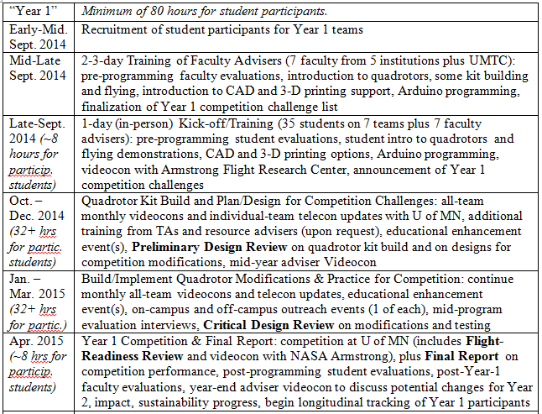
Competition/Challenge Timeline
(generic, as described in the funded proposal)

Slide 6
Quadcopter Competition/Challenge tentative dates
Sept. 6-7, 2014: Adviser training at Fond du Lac Tribal and Comm. College
Monday, Oct. 13, 2014: All-team “Kick-off” training at Century College
Monthly all-team telecons (dates and times TBA)
Bi-weekly individual team telecons (dates and time TBA)
Build ELEV-8, learn to fly it with rotor protection; no later than PDR due date
Fall enhancement activities (select date(s) yourself)
Tuesday, Dec. 23, 2014: Preliminary Design Review (PDR) due
Mid-program evaluation interviews (late Jan. or mid-Feb. 2015, dates TBA)
Spring enhancement activities (select date(s) yourself)
Spring outreach activities (select date(s) yourself; no later than CDR due date)
Tuesday, March 31: Critical Design Review (CDR) due
Thursday, April 16, 2015: Competition in Twin Cities (location TBA)
Includes oral Flight Readiness Review (all team members share in the delivery, 12 minutes max, plus 3 minutes for questions)
Includes peer-review of team videos (must be posted by Thursday, April 9)
Includes demonstrating hardware, multi-pilot flying, imaging, exploration, unique capabilities, etc.
Thursday, April 30, 2015: Final Report due & Post-Program Surveys

Slide 7
NASA’s MN Space Grant Consortium (MnSGC) Community College Quadcopter Initiative
Questions / Discussion

