Slide 1
MnSGC Community College Quadcopter Competition April 26, 2015
Photos by Jeff Abel
Century College (Team B) adviser

Slide 2
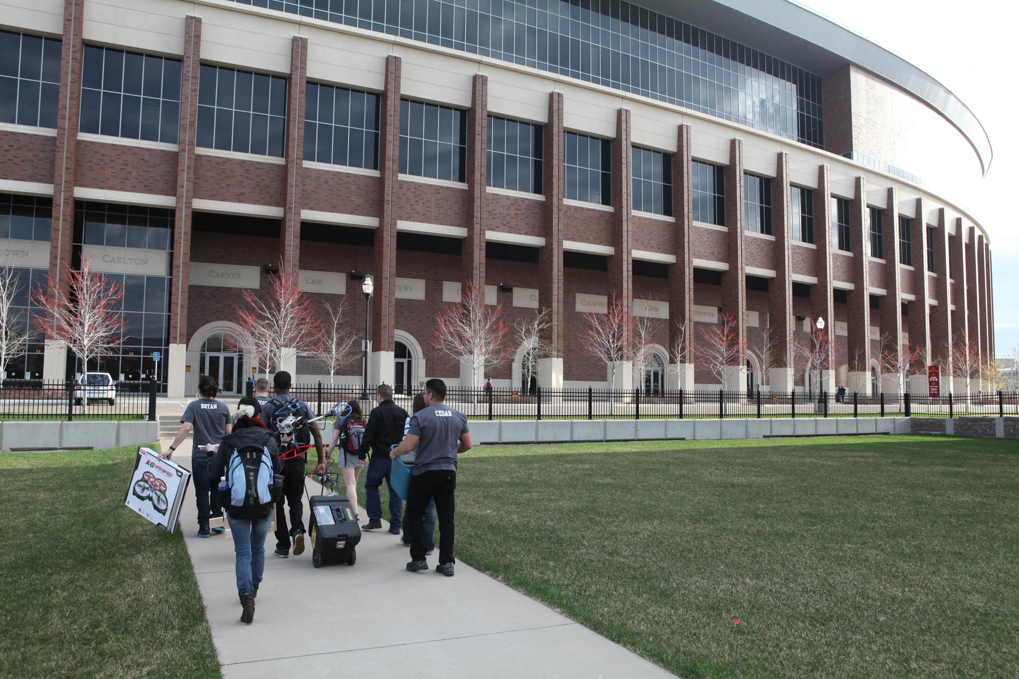
Approaching TCF Bank Stadium – University of Minnesota – Twin Cities.

Slide 3
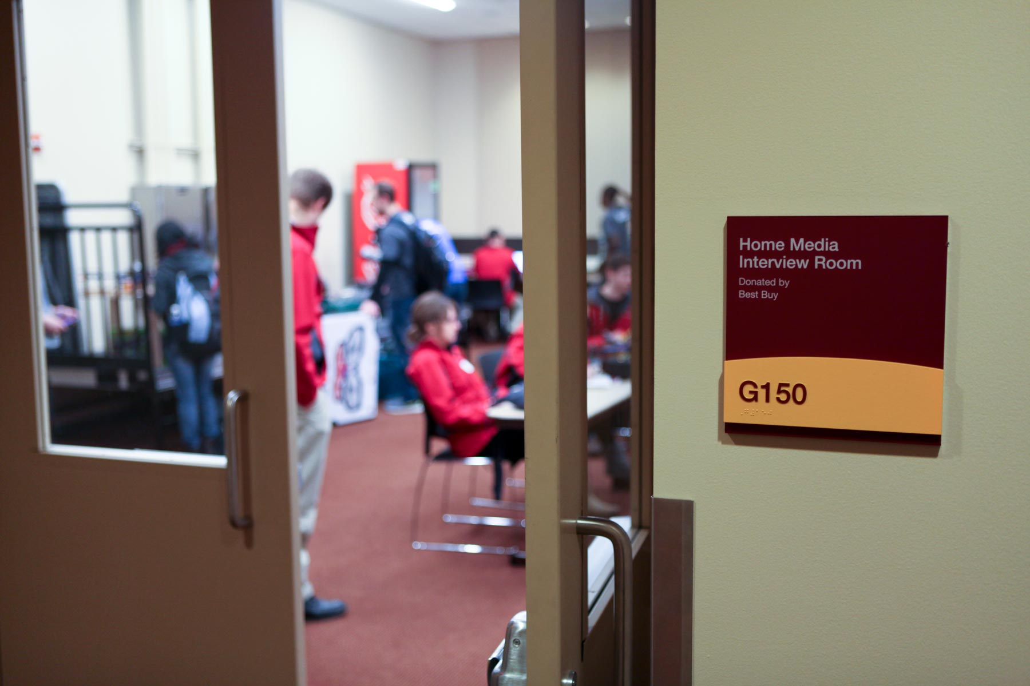
Oral presentations in TCF Bank Stadium.

Slide 4
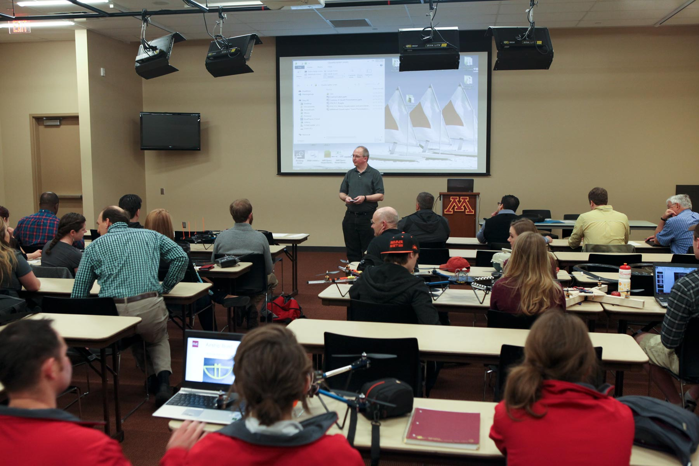
Welcome from Prof. James Flaten, Assoc. Dir. of MN Space Grant, U of MN Aerospace Eng. Dept.

Slide 5
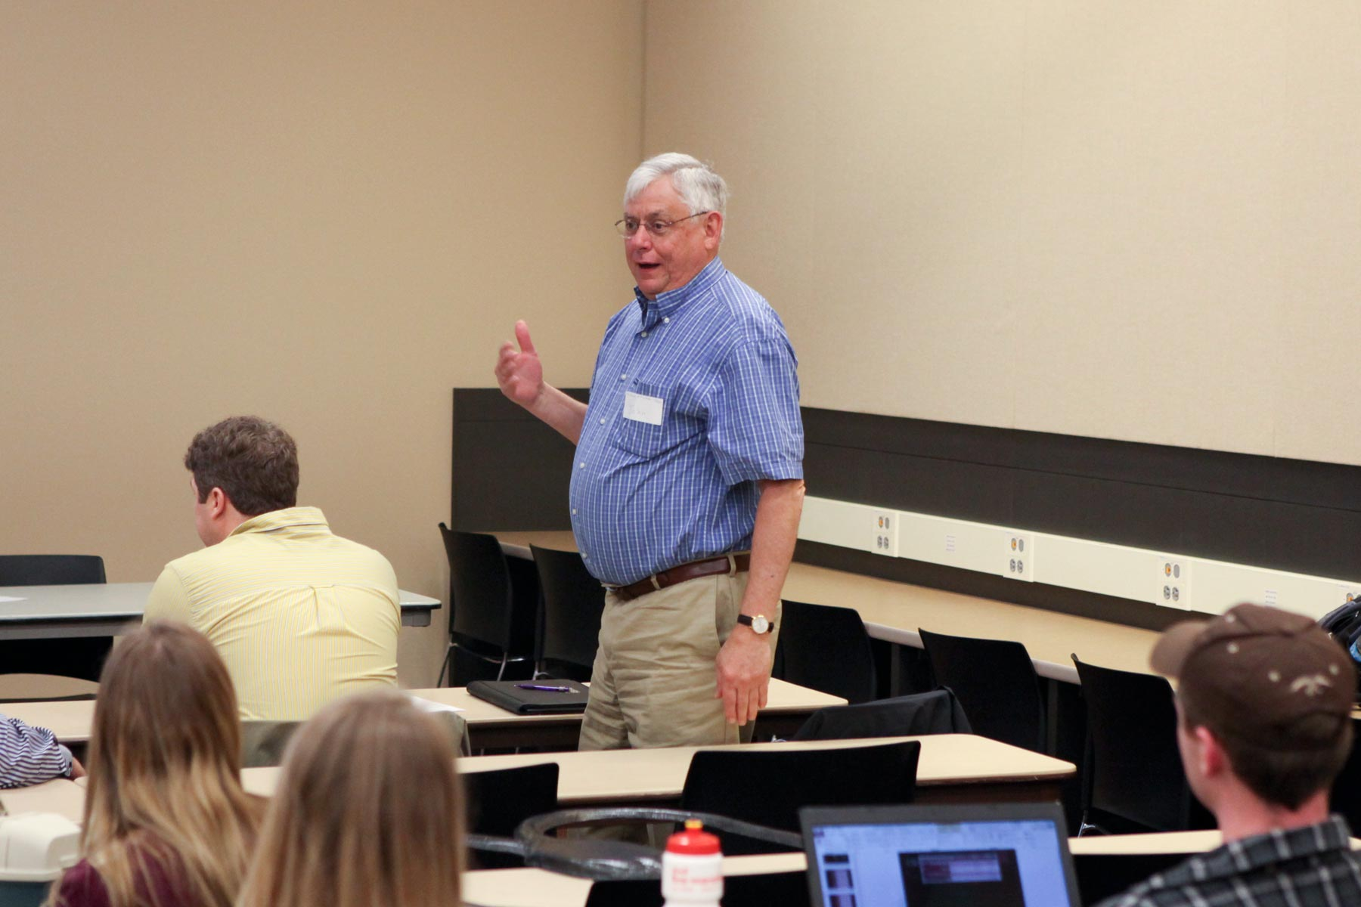
Judge/Prof. John Weyrauch, ATK and other companies (retired), U of MN.

Slide 6
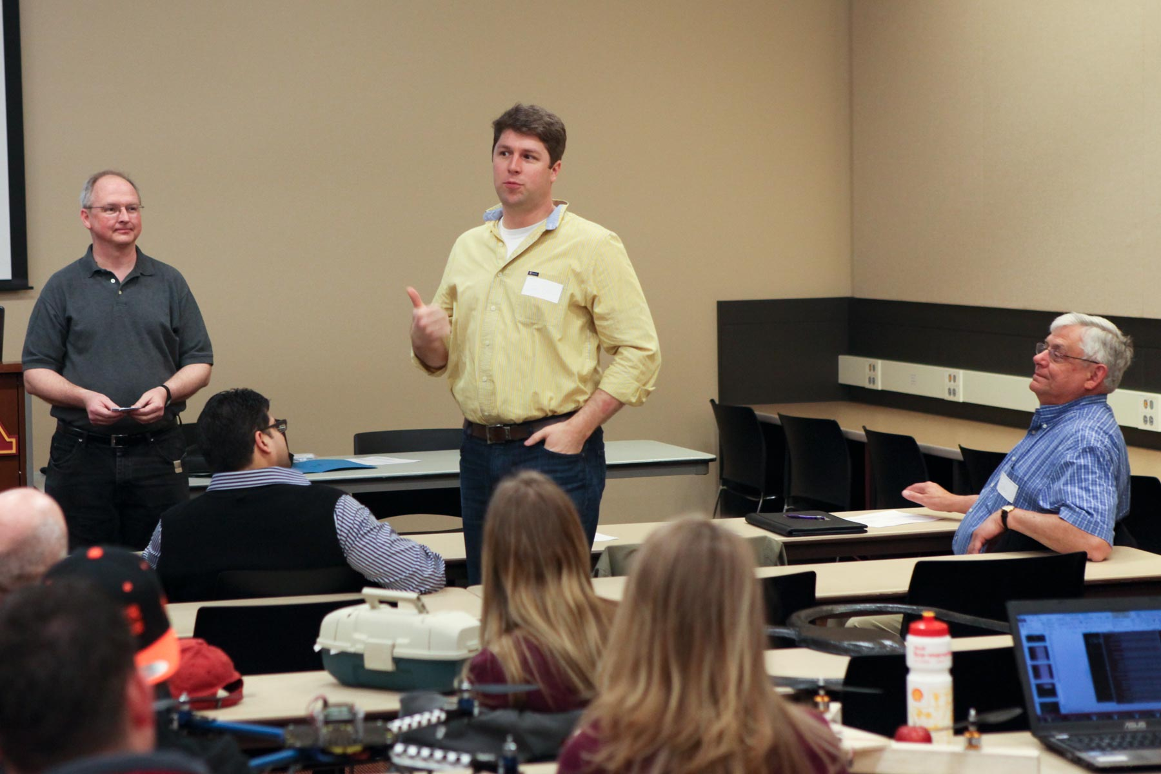
Judge Todd Colten, Sentera (precision agriculture quadcopters).

Slide 7
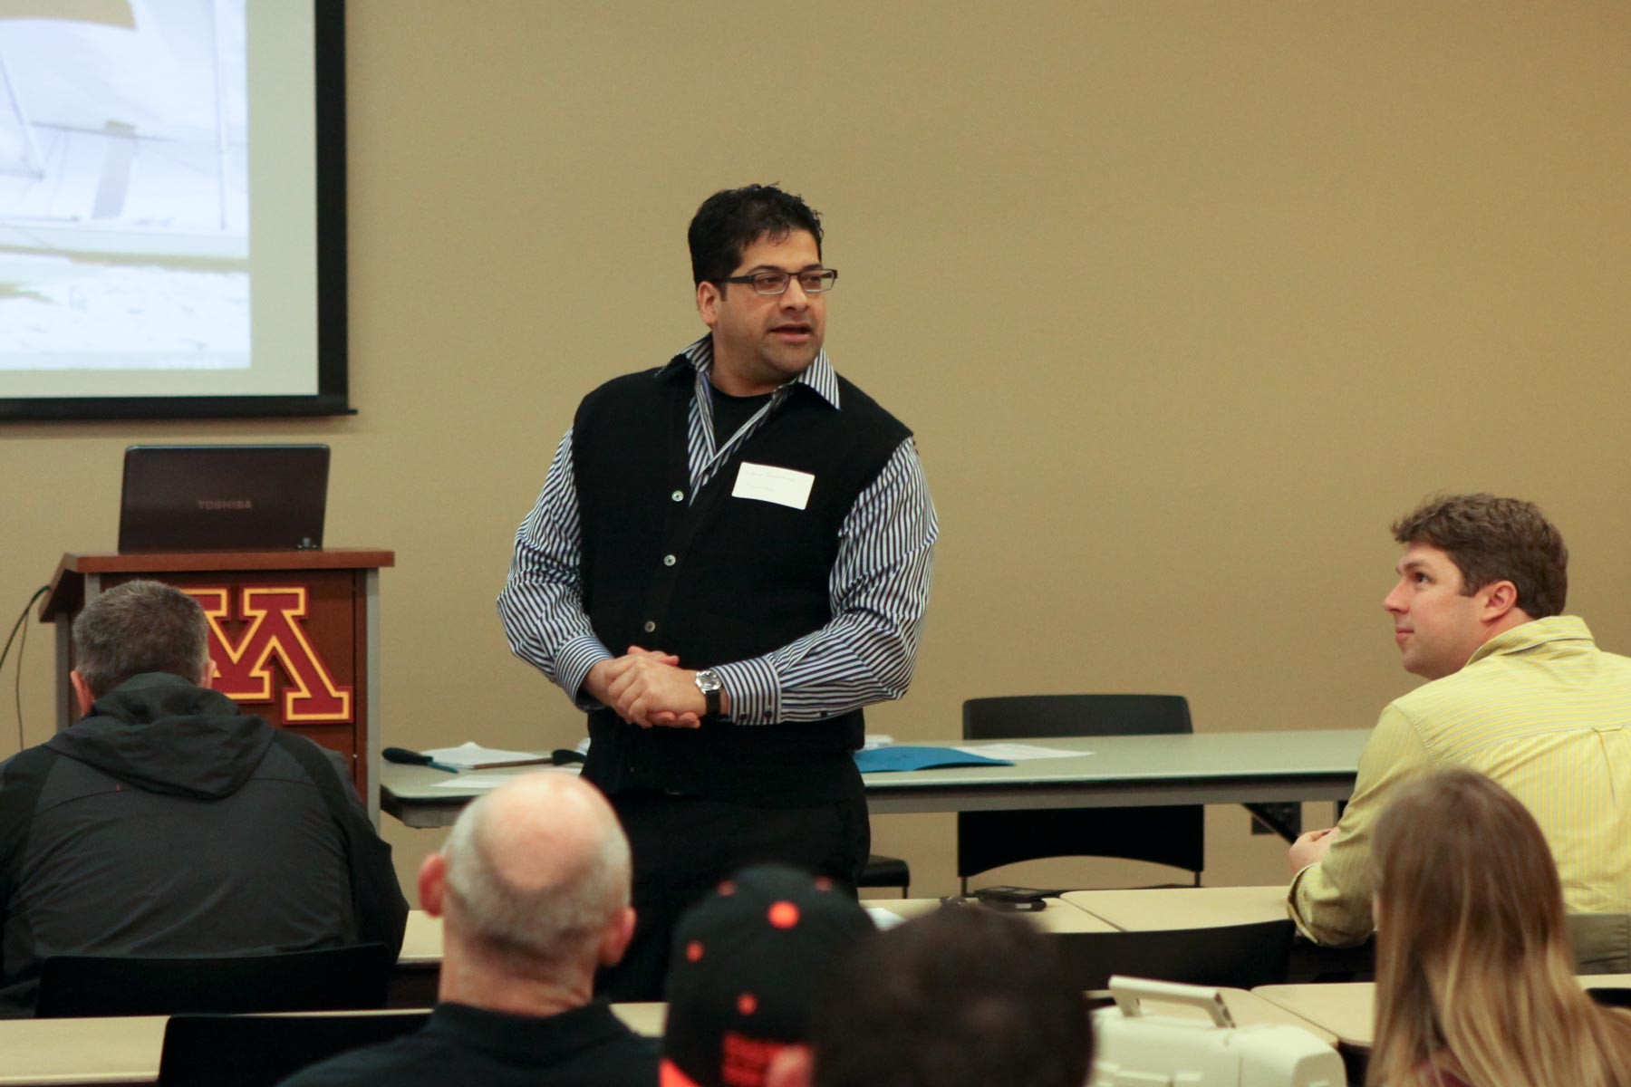
Judge Vibhor Bageshwar, Honeywell.

Slide 8
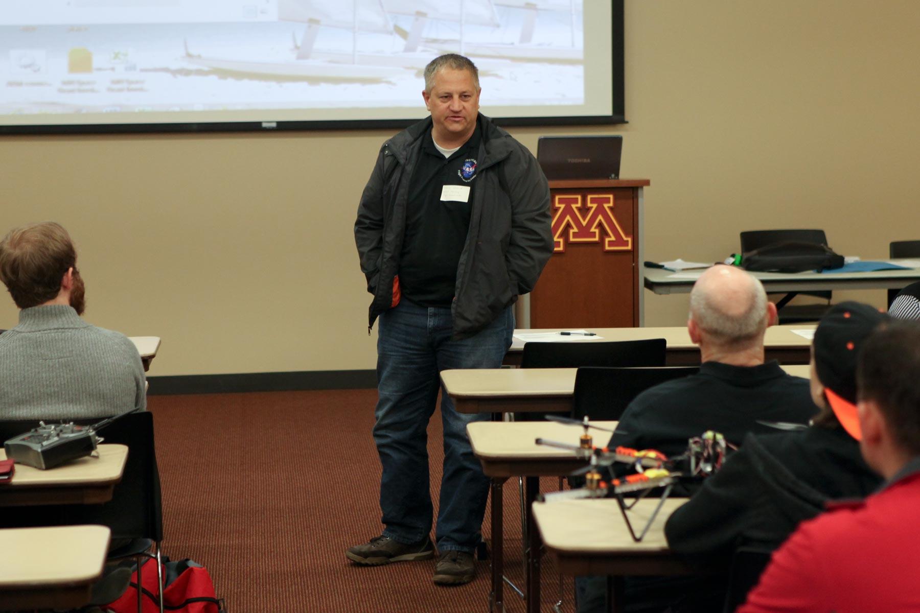
Judge Dave Voracek, Chief Technologist at NASA Armstrong.

Slide 9
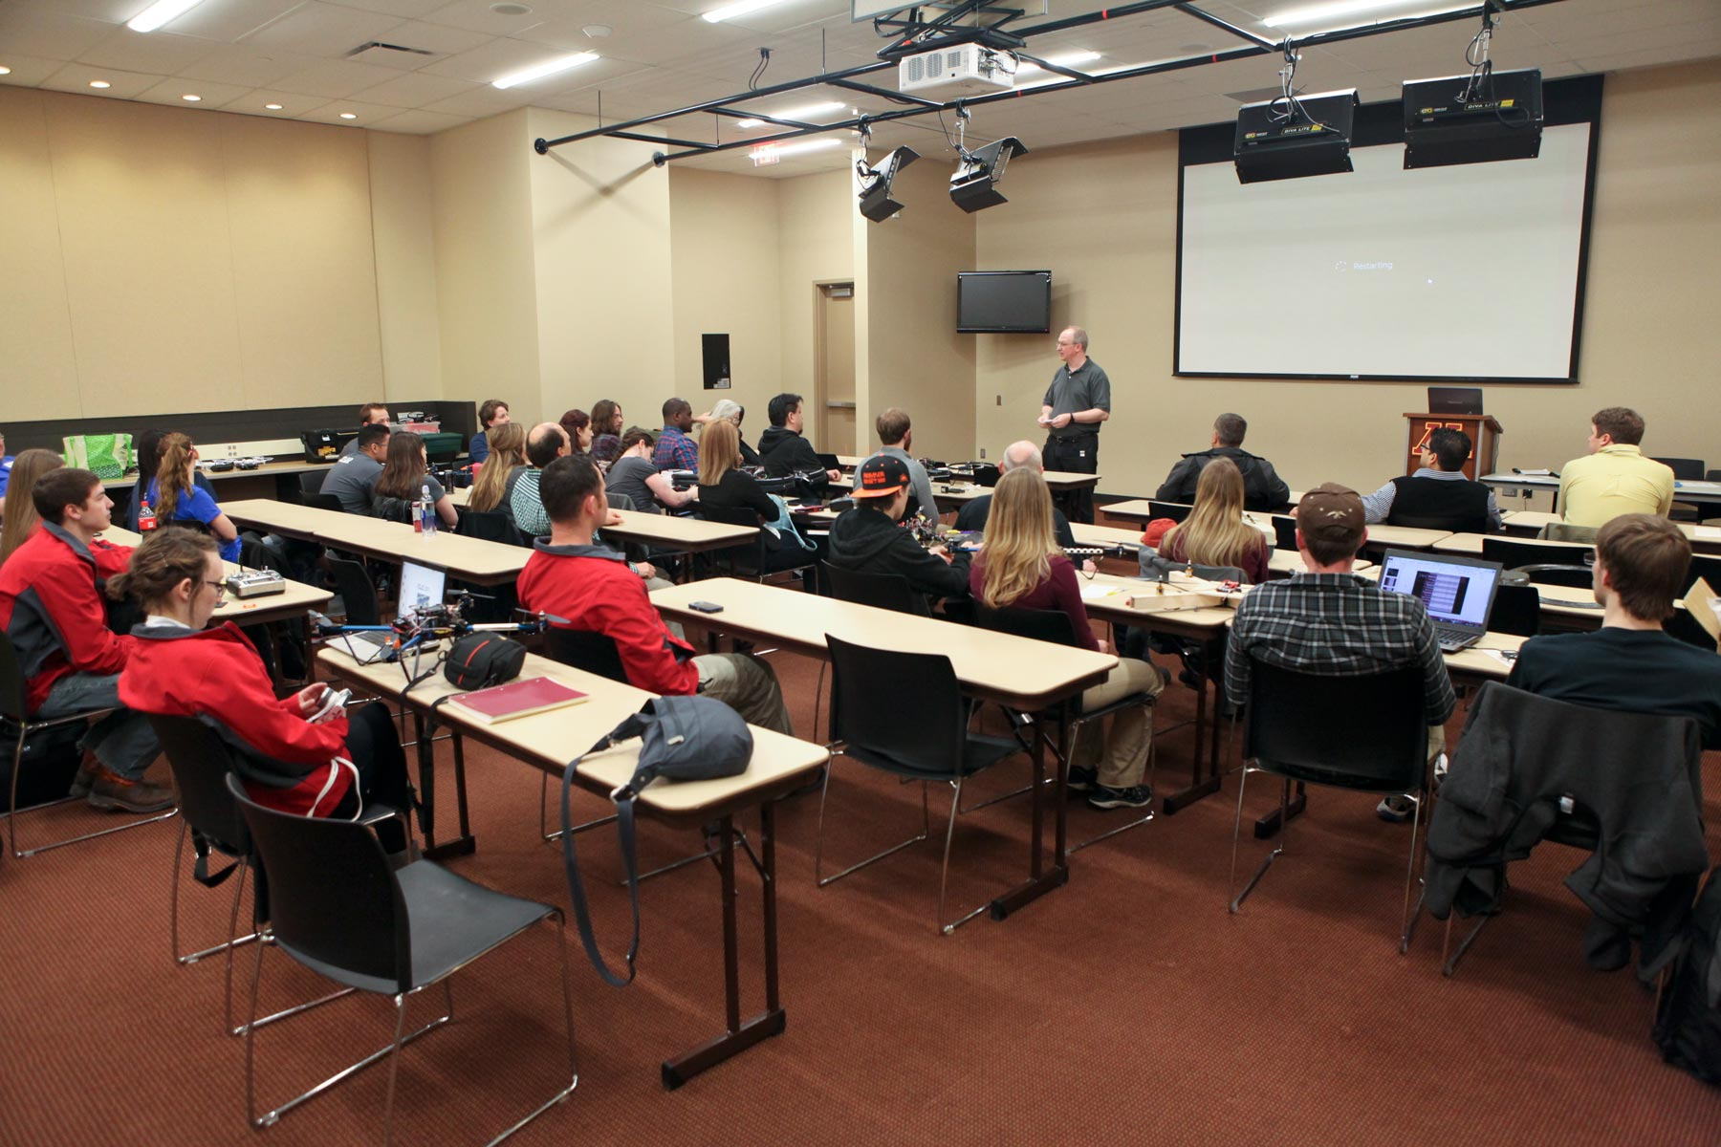
Announcements and random draw for presentation order.

Slide 10
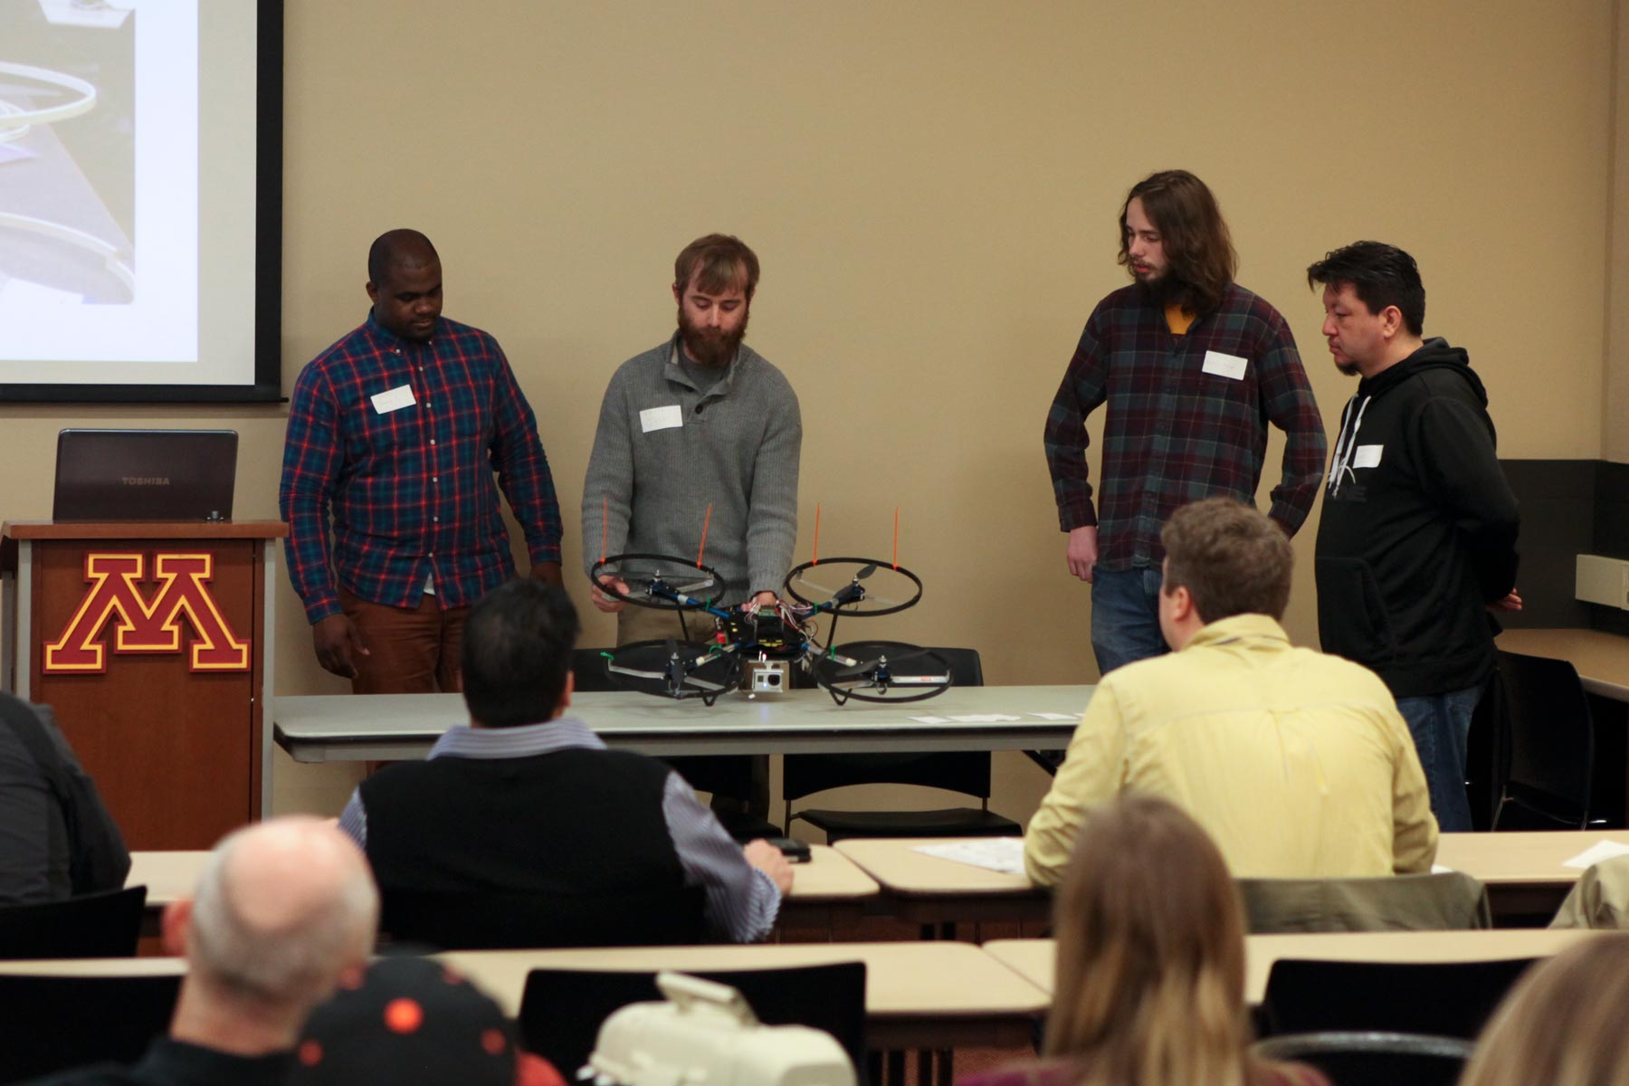
Fond du Lac Tribal and Community College, Team A (men’s team), Cloquet.

Slide 11
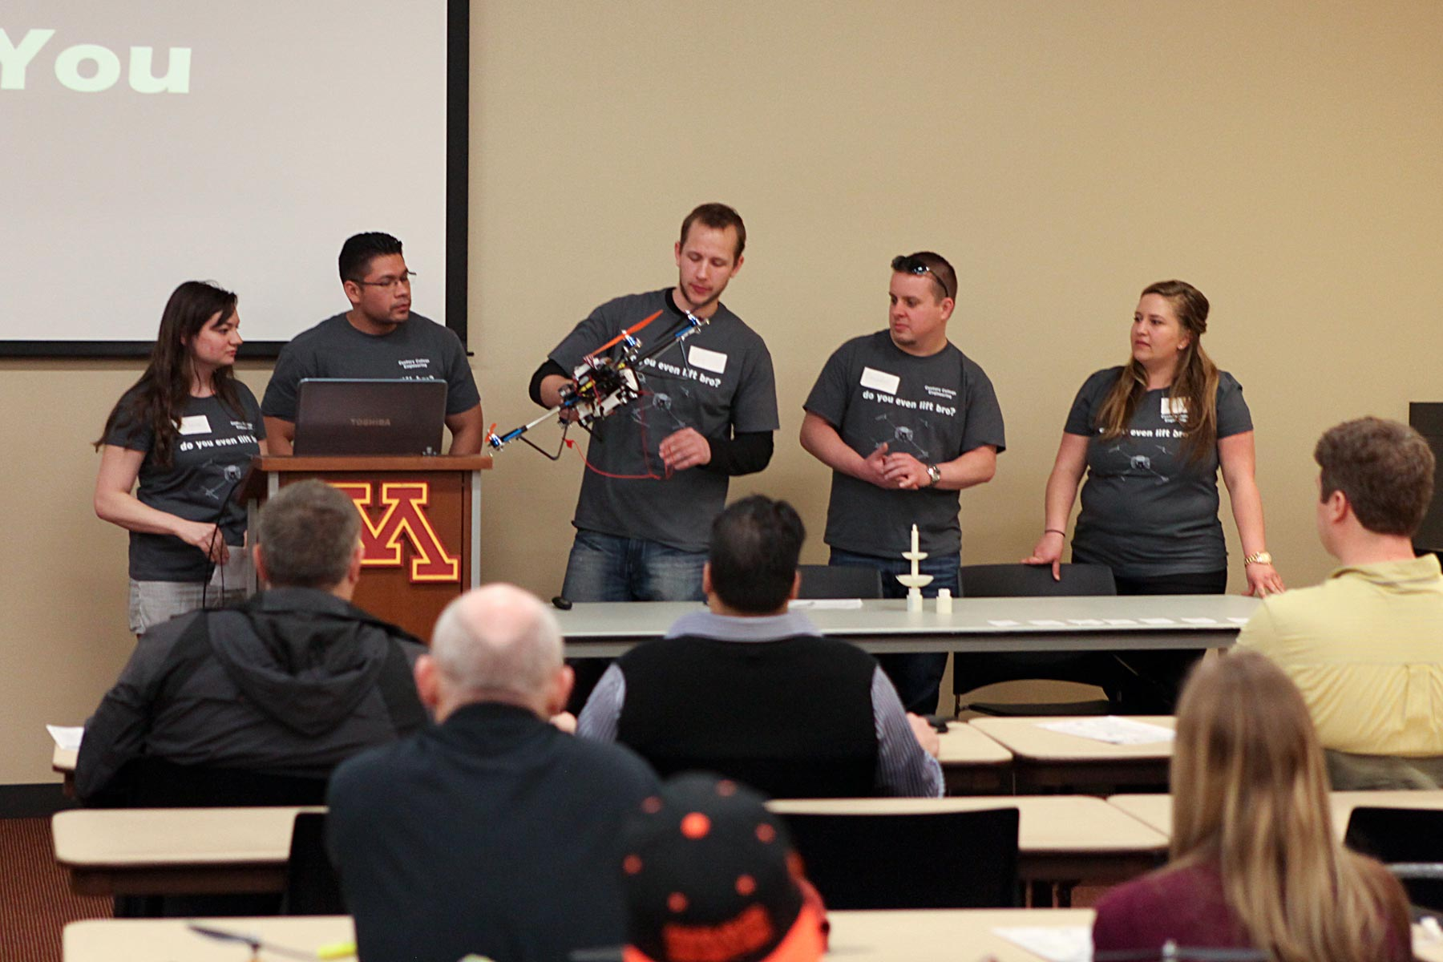
Century College, Team A (Grebner’s team), White Bear Lake.

Slide 12
Welcome from Prof. Bill Garrard, Dir. of MN Space Grant, U of MN Aerospace Eng. Dept.

Slide 13
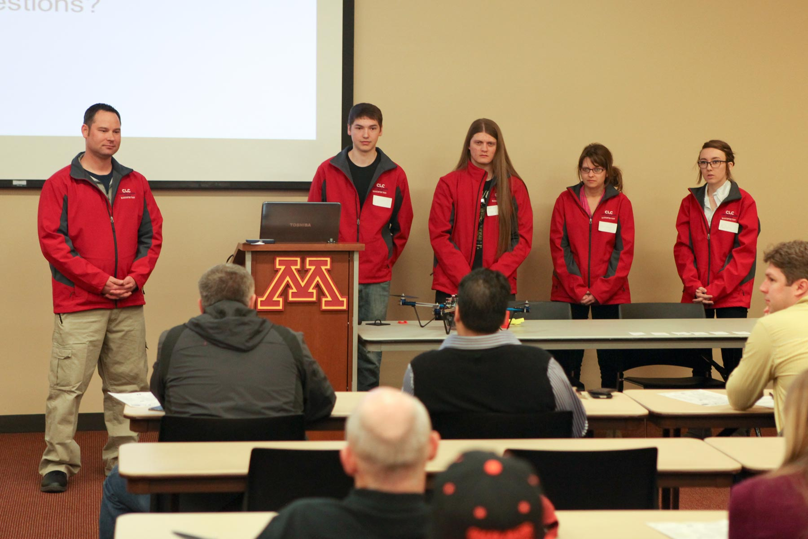
Central Lakes College, Brainerd/Staples.

Slide 14
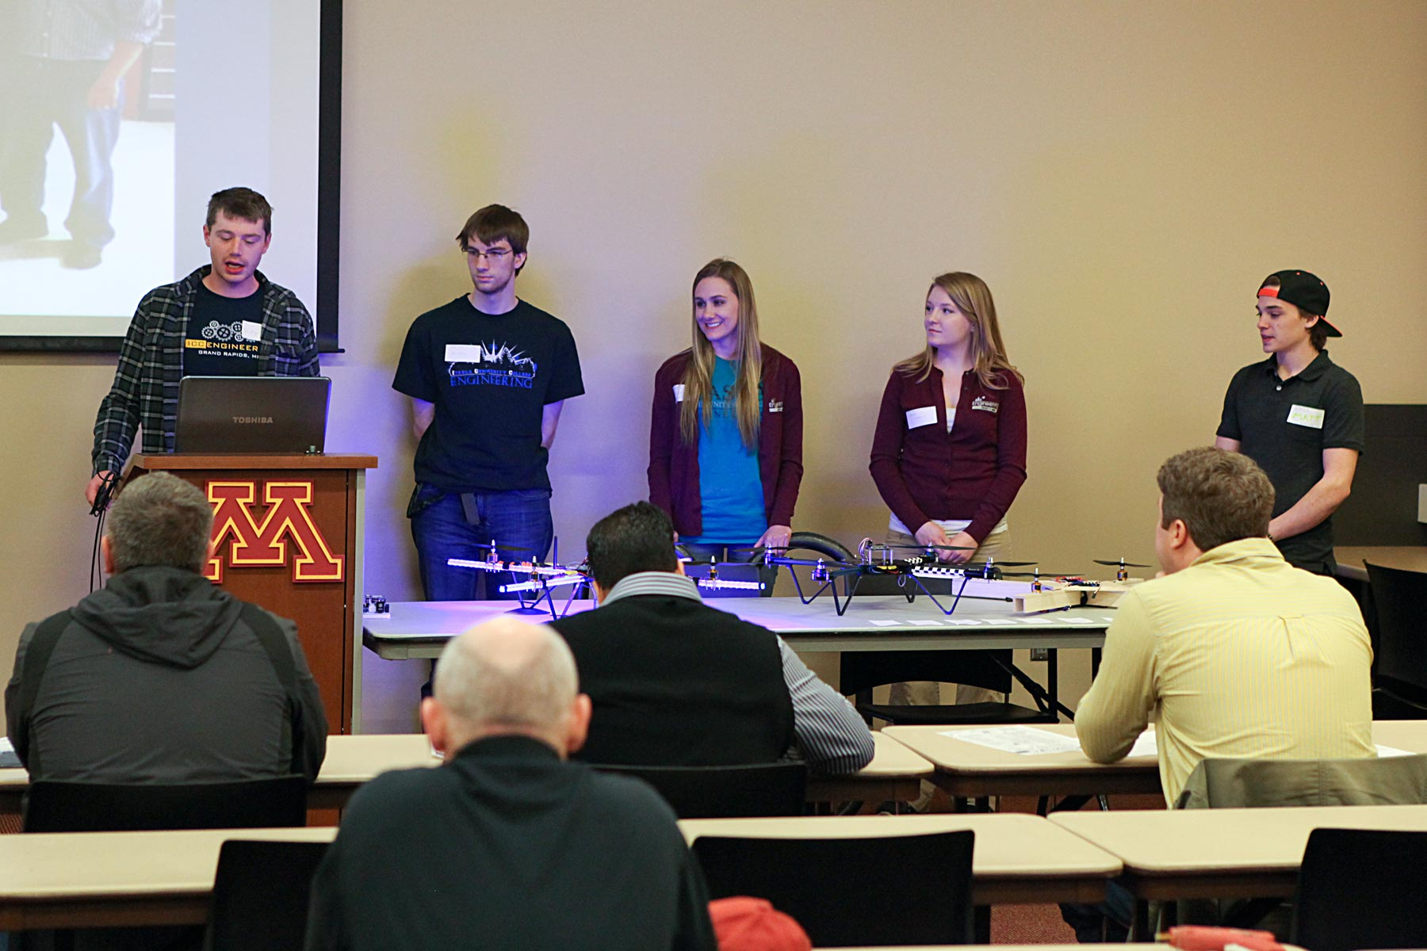
Itasca Community College, Grand Rapids.

Slide 15
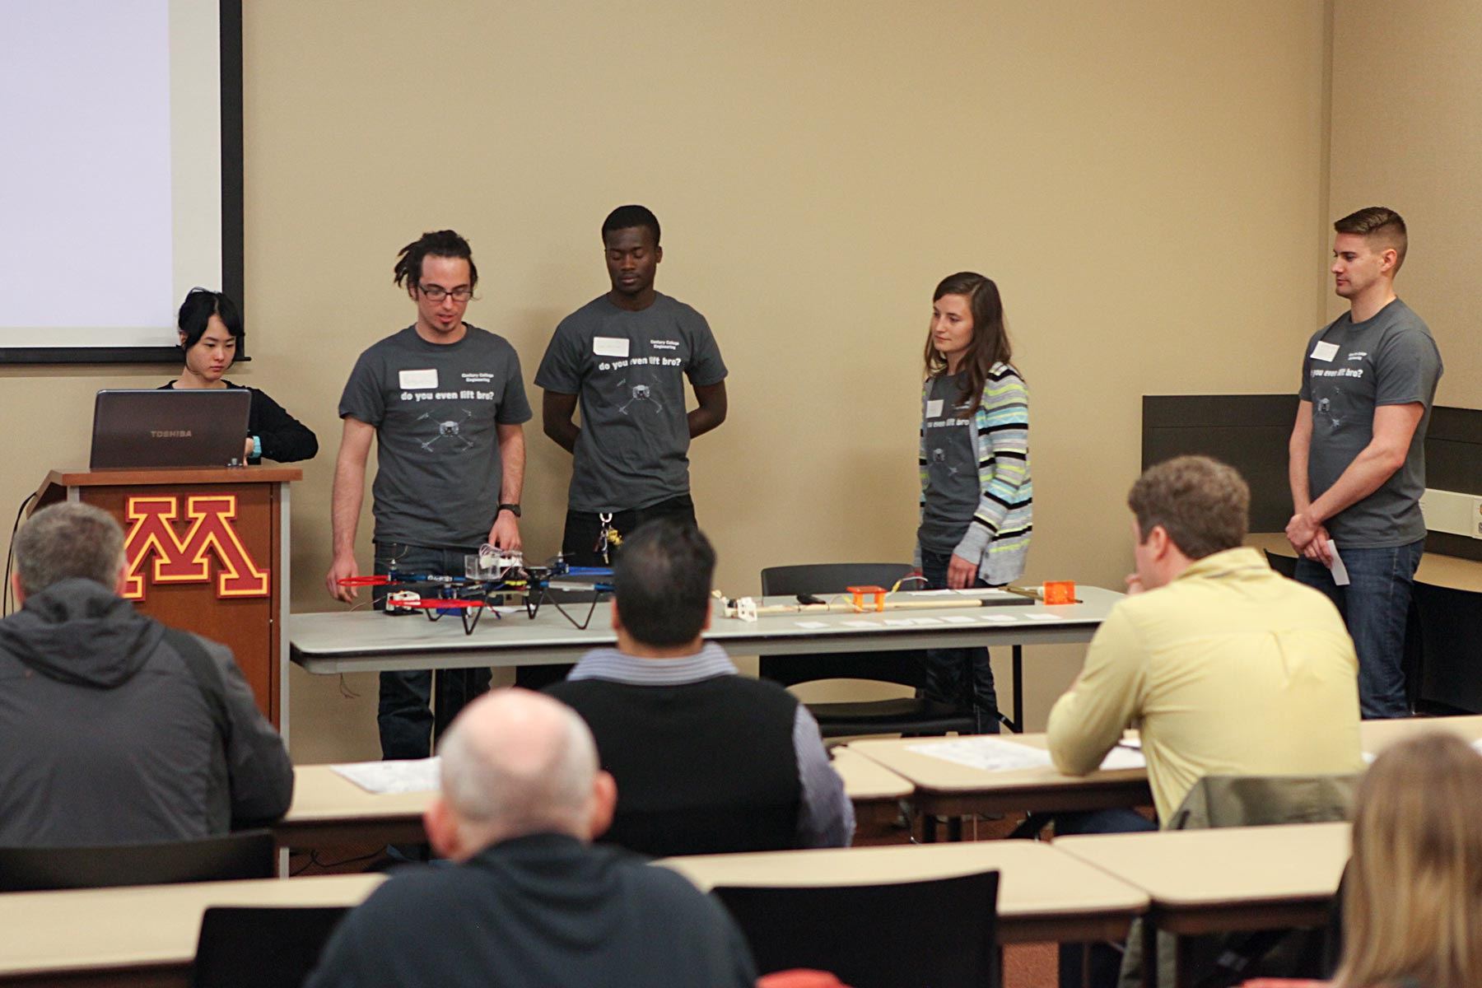
Century College, Team B (Abel’s team), White Bear Lake.

Slide 16
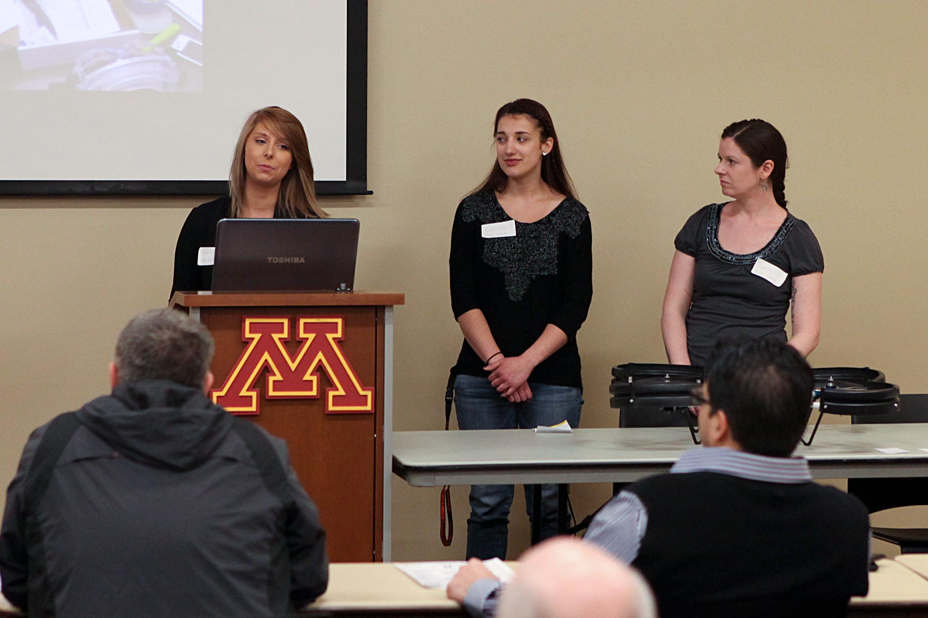
Fond du Lac Tribal and Community College, Team B (women’s team), Cloquet.

Slide 17
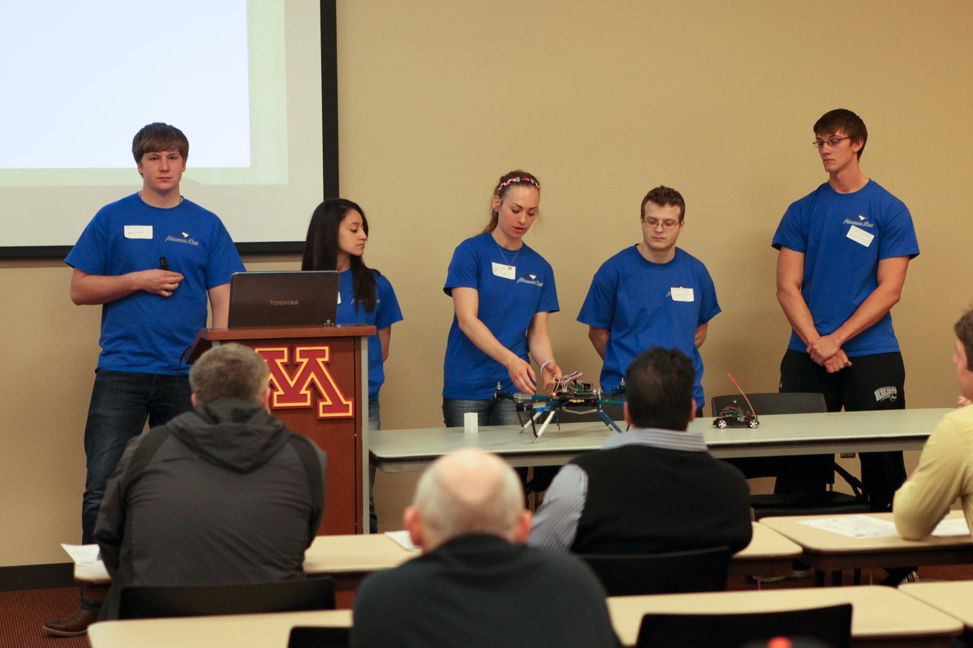
Minnesota West Community and Technical College, Worthington.

Slide 18
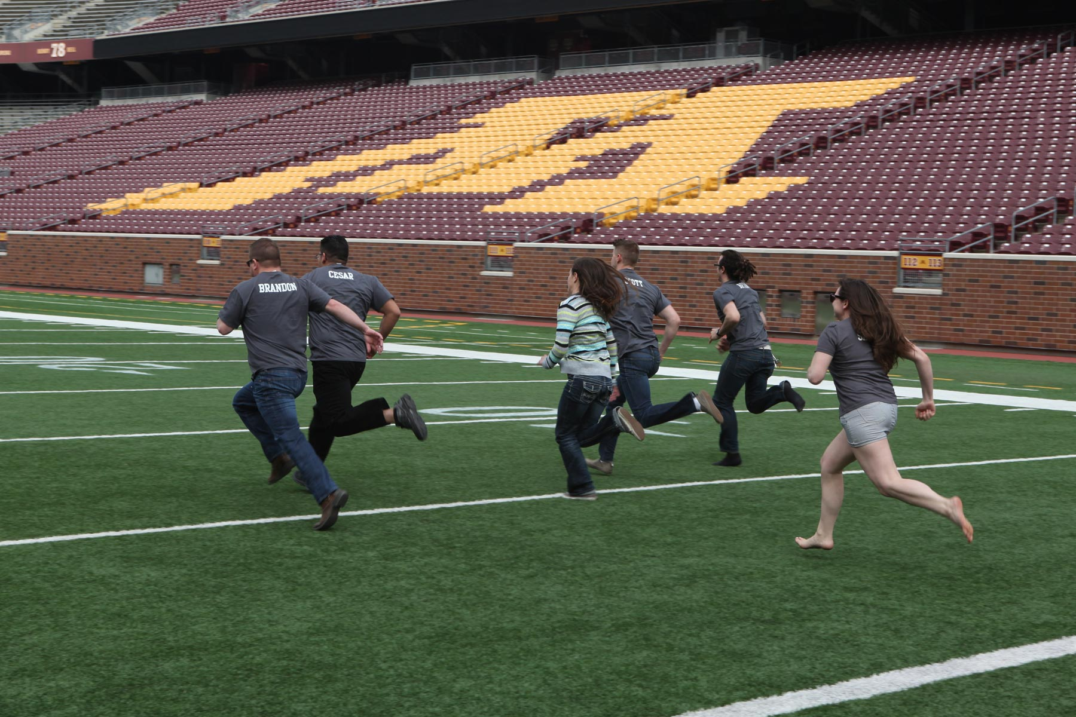
Enjoying the TCF Bank Stadium field.

Slide 19
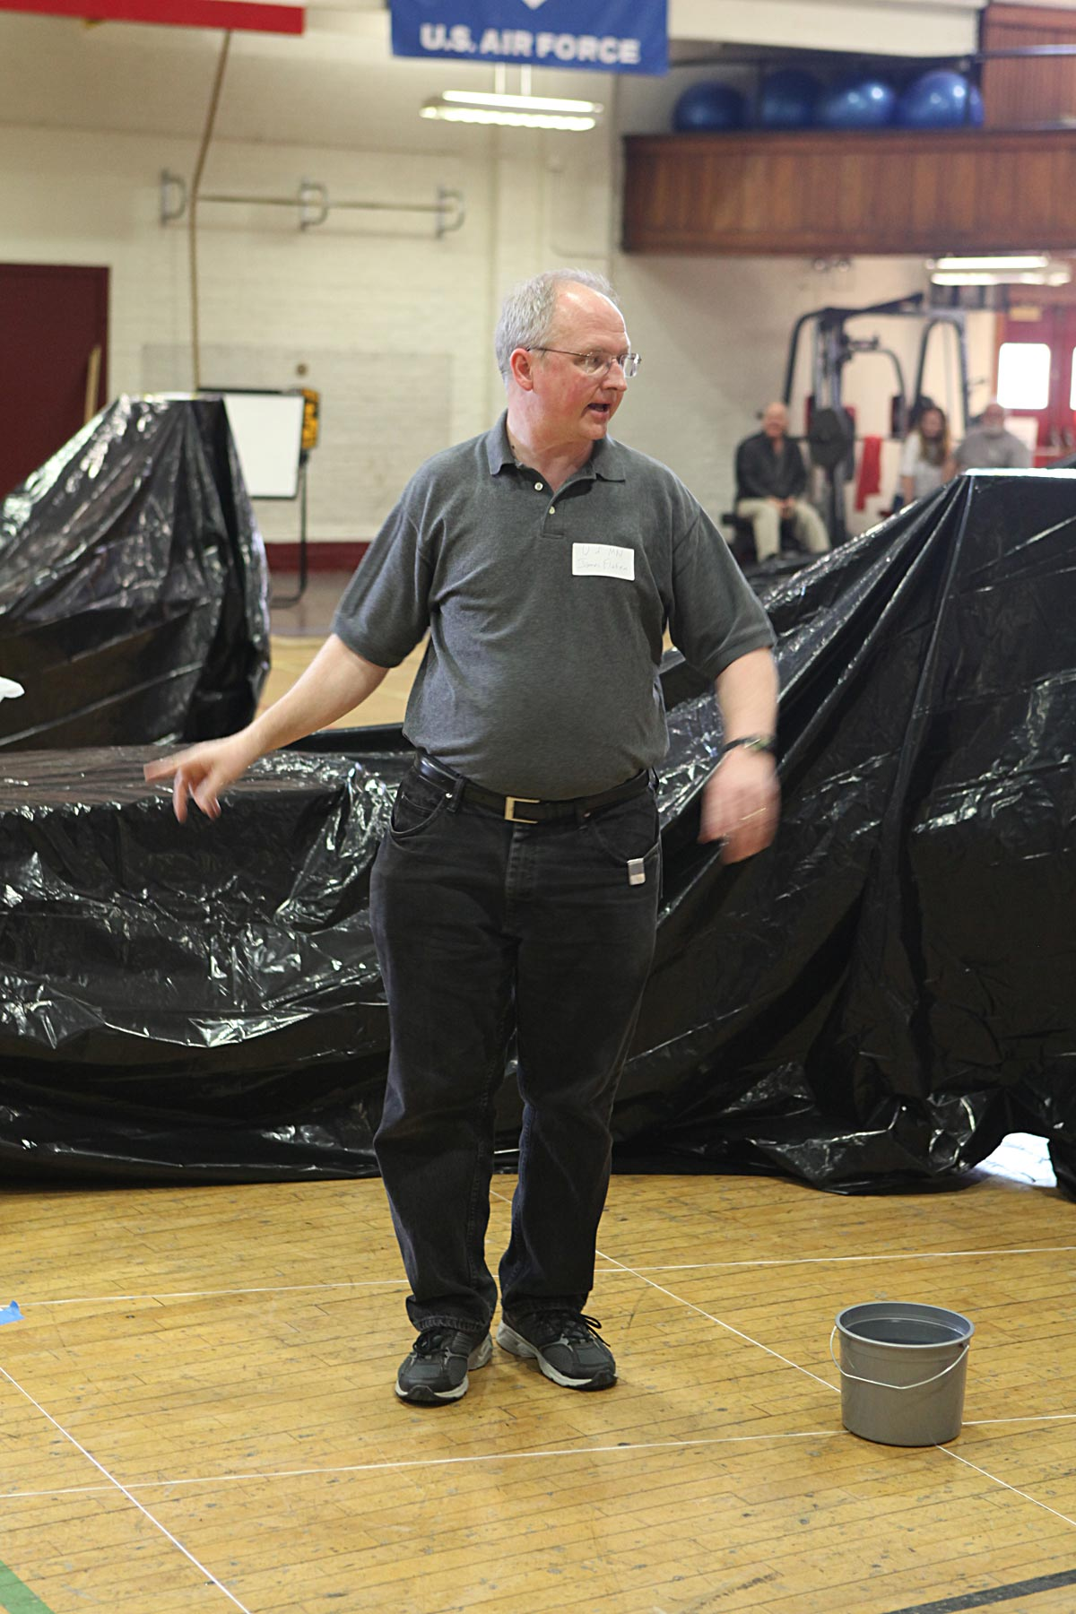
Flying courses in the Armory gymnasium – University of Minnesota – Twin Cities.

Slide 20
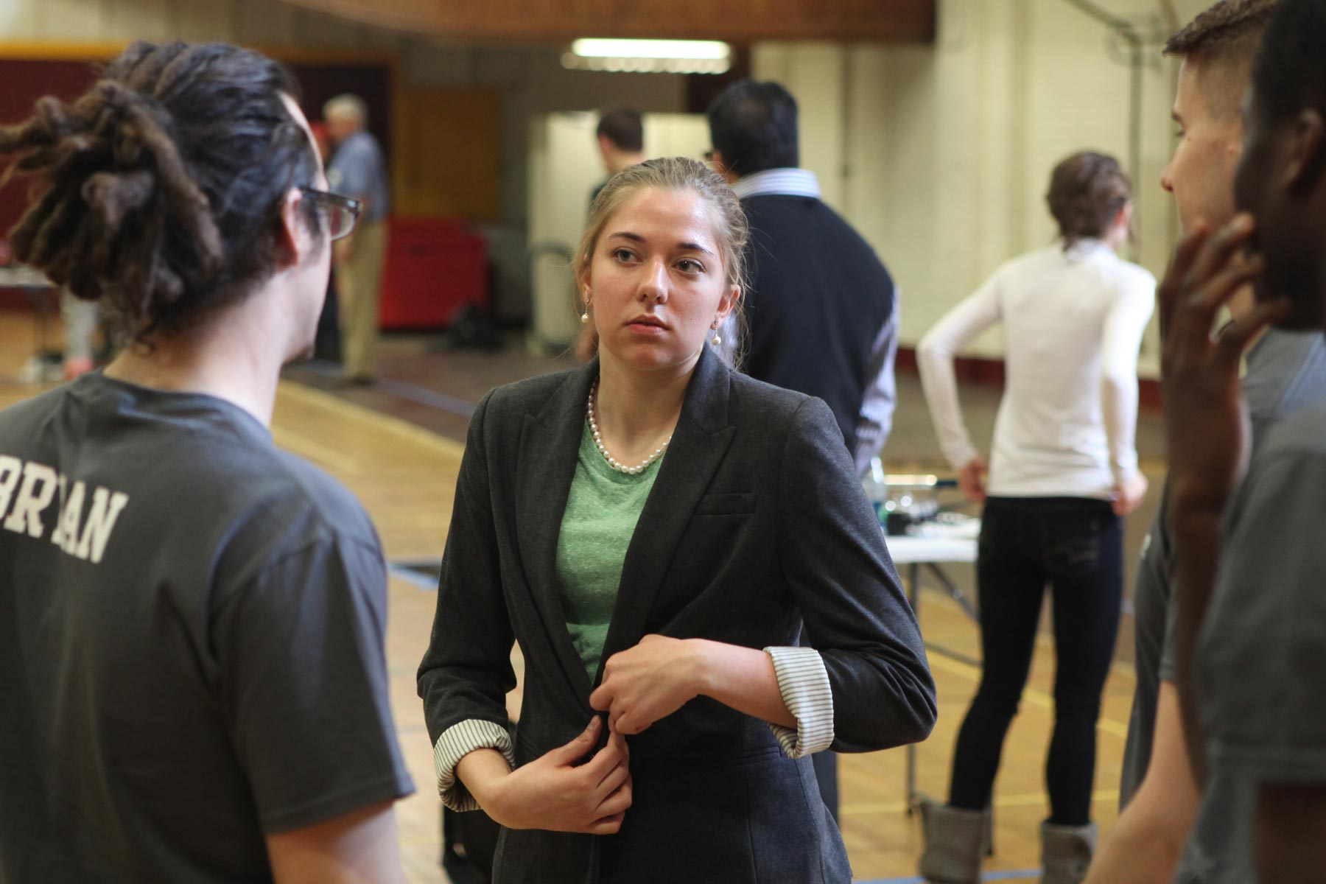
Team consult with TA Stephanie Wegner, U of MN aerospace student.

