Slide 1
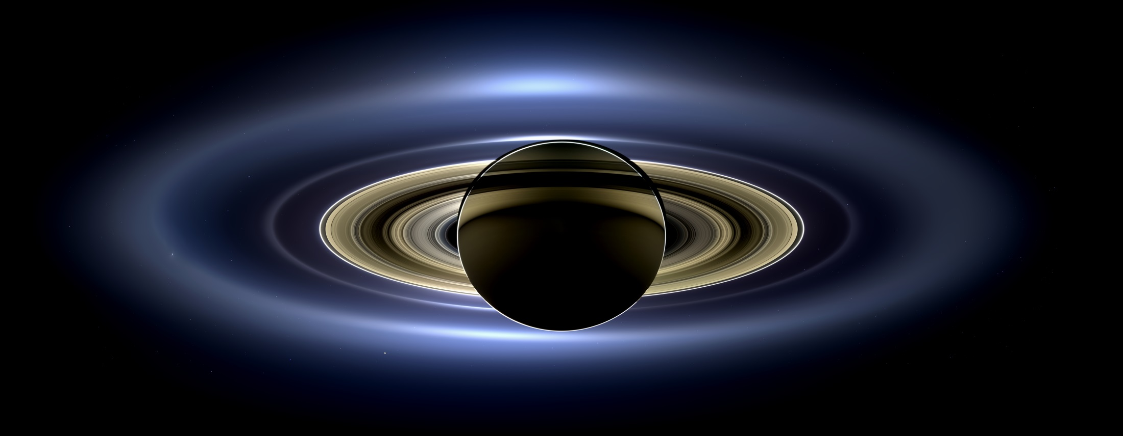
Holden Evening Prayer (Plus)
Notes:
Saturn (from within its shadow) taken by Cassini
https://saturn.jpl.nasa.gov/resources/23/?category=hall_of_fame

Slide 2
May these images and music
bring you comfort and joy
as we “prepare him room”
this Advent season.

Slide 4
The heavens declare
the glory of God,
and the sky proclaims
its maker’s handiwork.
– Psalm 19:1

Slide 5
Notes:
Zoom in on previous photo

Slide 6
The Earth,
as viewed
from Saturn.

Slide 7
The beauty of the firmament
exceeds even that
envisioned by the psalmist…

Slide 8
Holden Evening Prayer (Plus)

Slide 9
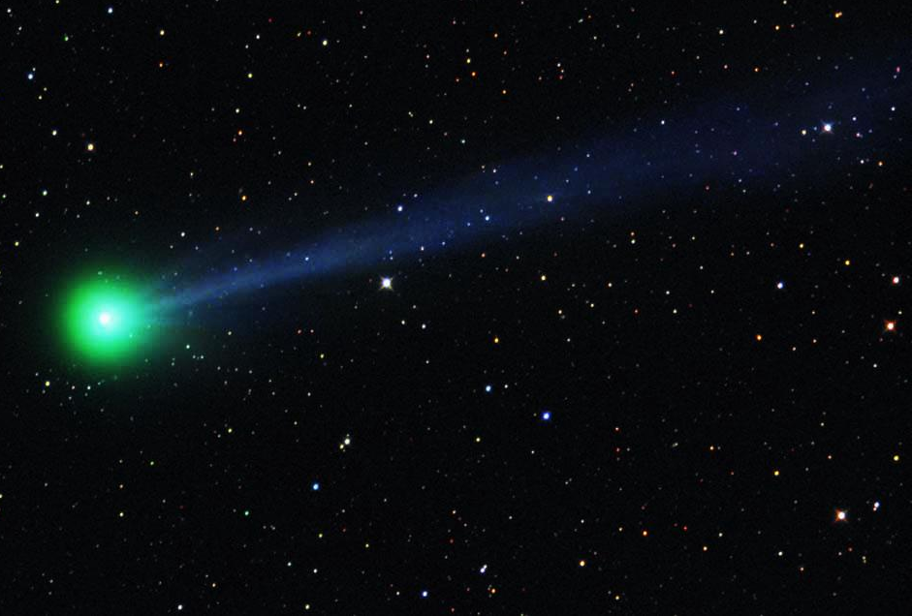
Opening Hymn
O come, O come, Emmanuel,
and ransom captive Israel,
that mourns in lonely exile here
until the Son of God appear.
Rejoice! Rejoice! Emmanuel
shall come to you, O Israel.
Notes:
Comet McNaught (2009)
http://stardustnext.jpl.nasa.gov/mission/images/cometMcNaught_hi.jpg

Slide 10
Opening Hymn
O come, O Wisdom from on high,
embracing all things far and nigh,
in strength and beauty come and stay;
teach us your will and guide our way.
Rejoice! Rejoice! Emmanuel
shall come to you, O Israel.

Slide 11
Opening Hymn
O come, O Dayspring, come and cheer;
O Sun of justice, now draw near
Disperse the gloomy clouds of night,
and death’s dark shadow put to flight.
Rejoice! Rejoice! Emmanuel
shall come to you, O Israel.

Slide 12
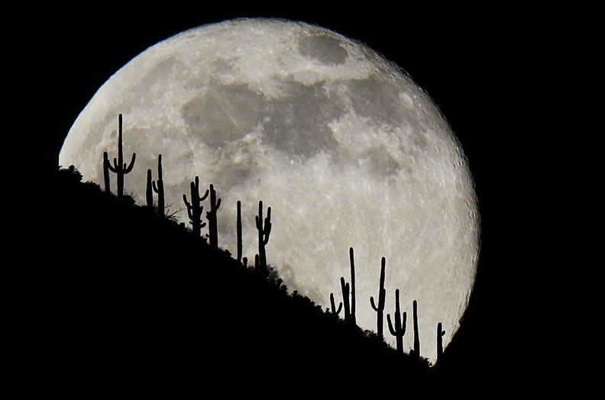
Procession Holden Evening Prayer
Jesus Christ, you are the light of the world;
the light no darkness can overcome;
Notes:
http://archive.azcentral.com/members/Blog/BehindtheLens/70508

Slide 13
Procession Holden Evening Prayer
Stay with us now, for it is evening,
and the day is almost over.

Slide 14
Procession Holden Evening Prayer
Let your light scatter the darkness,
and shine within your people here.

Slide 15
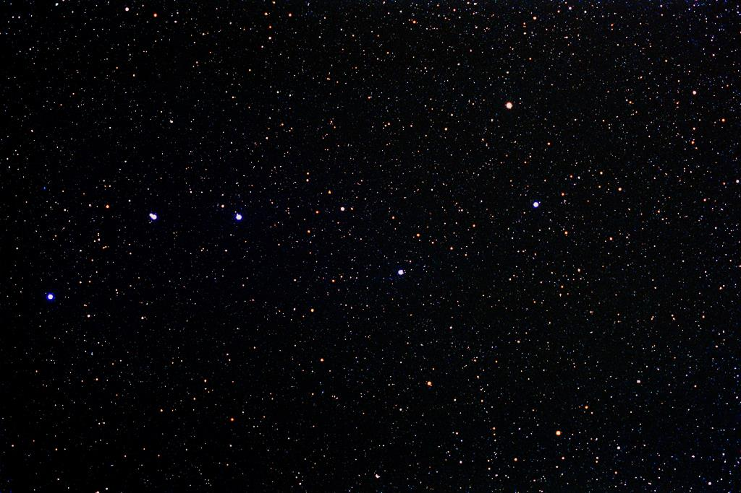
Evening Hymn Holden Evening Prayer
VERSE 1
Joyous light of heav’nly glory,
loving glow of God’s own face,
you who sing creation’s story,
shine on ev’ry land and race.
Notes:
Big Dipper (asterism)
http://www.allthesky.com/constellations/ursamajor/

Slide 16
Evening Hymn Holden Evening Prayer
VERSE 1 contd.
Now as evening falls around us,
we shall raise our songs to you,
God of daybreak, God of shadows,
come and light our hearts anew.

Slide 17
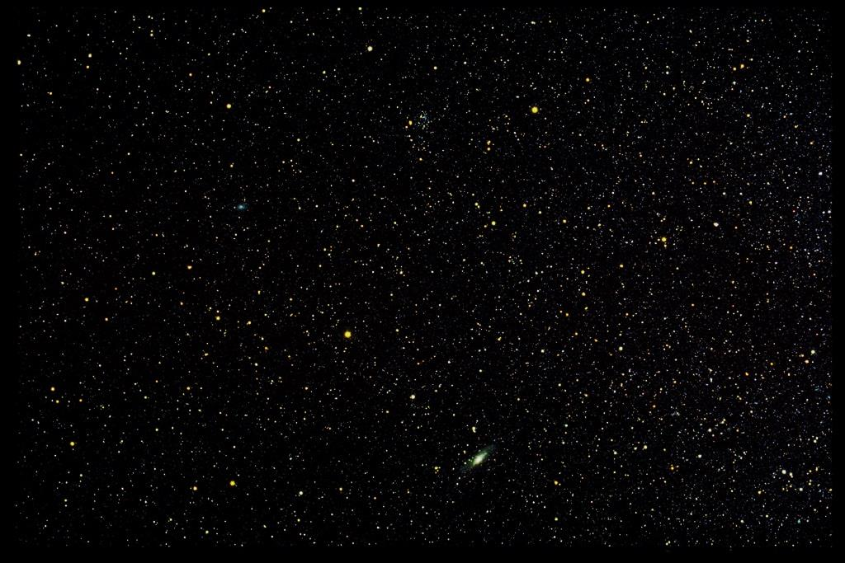
Evening Hymn Holden Evening Prayer
VERSE 2
In the stars that grace the darkness,
in the blazing sun of dawn,
in the light of peace and wisdom,
we can hear your quiet song.
Notes:
Andromeda (constellation and galaxy)
http://www.allthesky.com/constellations/andromeda/

Slide 18
Evening Hymn Holden Evening Prayer
VERSE 2 contd.
Love that fills the night with wonder,
love that warms the weary soul,
love that bursts all chains asunder,
set us free and make us whole.

Slide 19
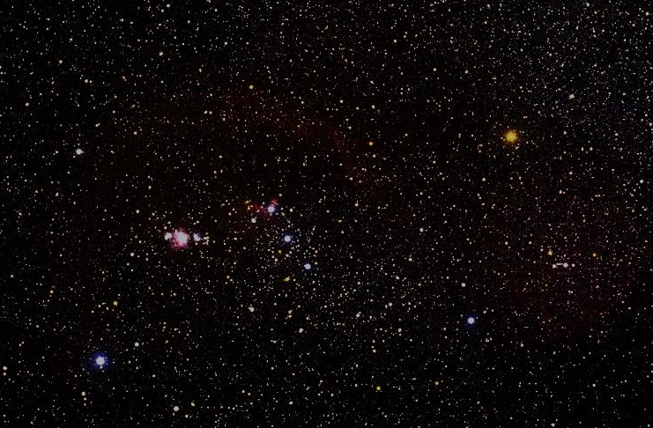
Evening Hymn Holden Evening Prayer
VERSE 3
You who made the heaven’s splendor,
ev’ry dancing star of night,
make us shine with gentle justice,
let us each reflect your light.
Notes:
Orion (constellation)
http://www.allthesky.com/constellations/orion/

Slide 20
Evening Hymn Holden Evening Prayer
VERSE 3 contd.
Mighty God of all creation,
gentle Christ who lights our way,
Loving Spirit of salvation,
lead us on to endless day.

Slide 21
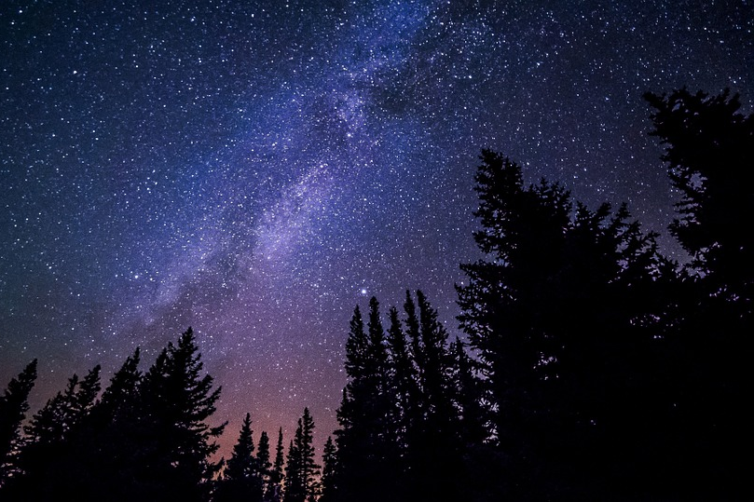
Evening Thanksgiving Holden Evening Prayer
May God be with you all,
and also with you;
Notes:
Milky Way Galaxy
https://pixabay.com/en/milky-way-galaxy-night-sky-stars-984050/

Slide 22
Evening Thanksgiving Holden Evening Prayer
Let us sing our thanks to God.
It is right to give God thanks and praise.

Slide 23
Evening Thanksgiving Holden Evening Prayer
Blessed are you, Creator of the Universe …
…you are the light and life of all creation.
Amen.

Slide 24
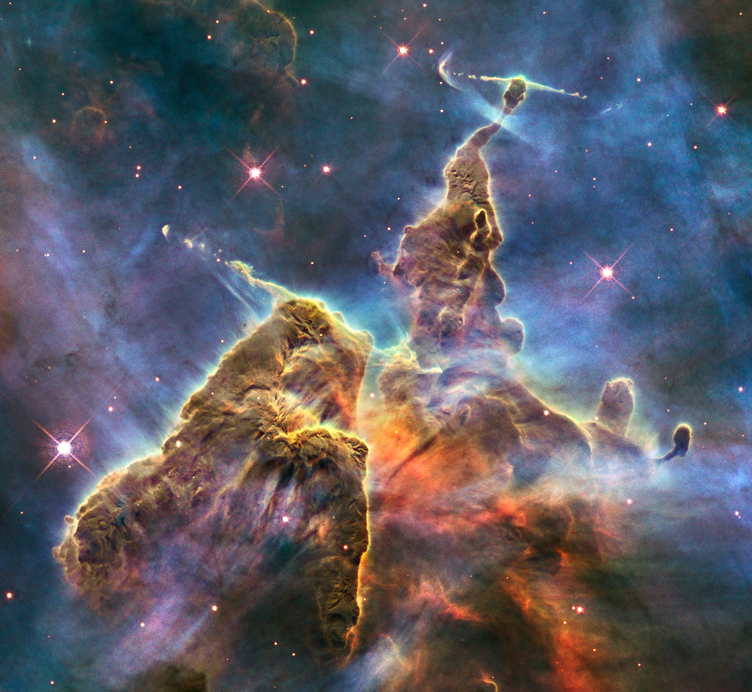
Notes:
Carina nebula (“Mystic Mountain”) taken by Hubble
https://www.spacetelescope.org/images/heic1007a/

Slide 25
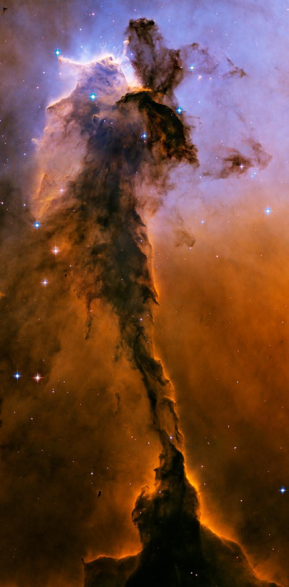
Psalm 141 Holden Evening Prayer
Sing in unison
Let my prayer rise up
like incense before you,
the lifting up of my hands
as an offering to you.
Notes:
Eagle Nebula (dust pillar) taken by Hubble
https://www.nasa.gov/mission_pages/hubble/hubble_anniversary/STScI-2005-12b.html

Slide 26
Psalm 141 Holden Evening Prayer
Sing as a canon
O God, I call to you,
come to me now;
O hear my voice
when I cry to you.

Slide 27
Psalm 141 Holden Evening Prayer
Sing as a canon
Let my prayer rise up
like incense before you,
the lifting up of my hands
as an offering to you.

Slide 28
Psalm 141 Holden Evening Prayer
Sing as a canon
Keep watch within me God;
deep in my heart
may the light of your love
be burning bright.

Slide 29
Psalm 141 Holden Evening Prayer
Sing as a canon
Let my prayer rise up
like incense before you,
the lifting up of my hands
as an offering to you.

Slide 30
Psalm 141 Holden Evening Prayer
Sing as a canon
All praise to the God of all –
Creator of life;
all praise be to Christ
and the spirit of love.

Slide 31
Psalm 141 Holden Evening Prayer
Sing as a canon
Let my prayer rise up
like incense before you,
the lifting up of my hands
as an offering to you.

Slide 32
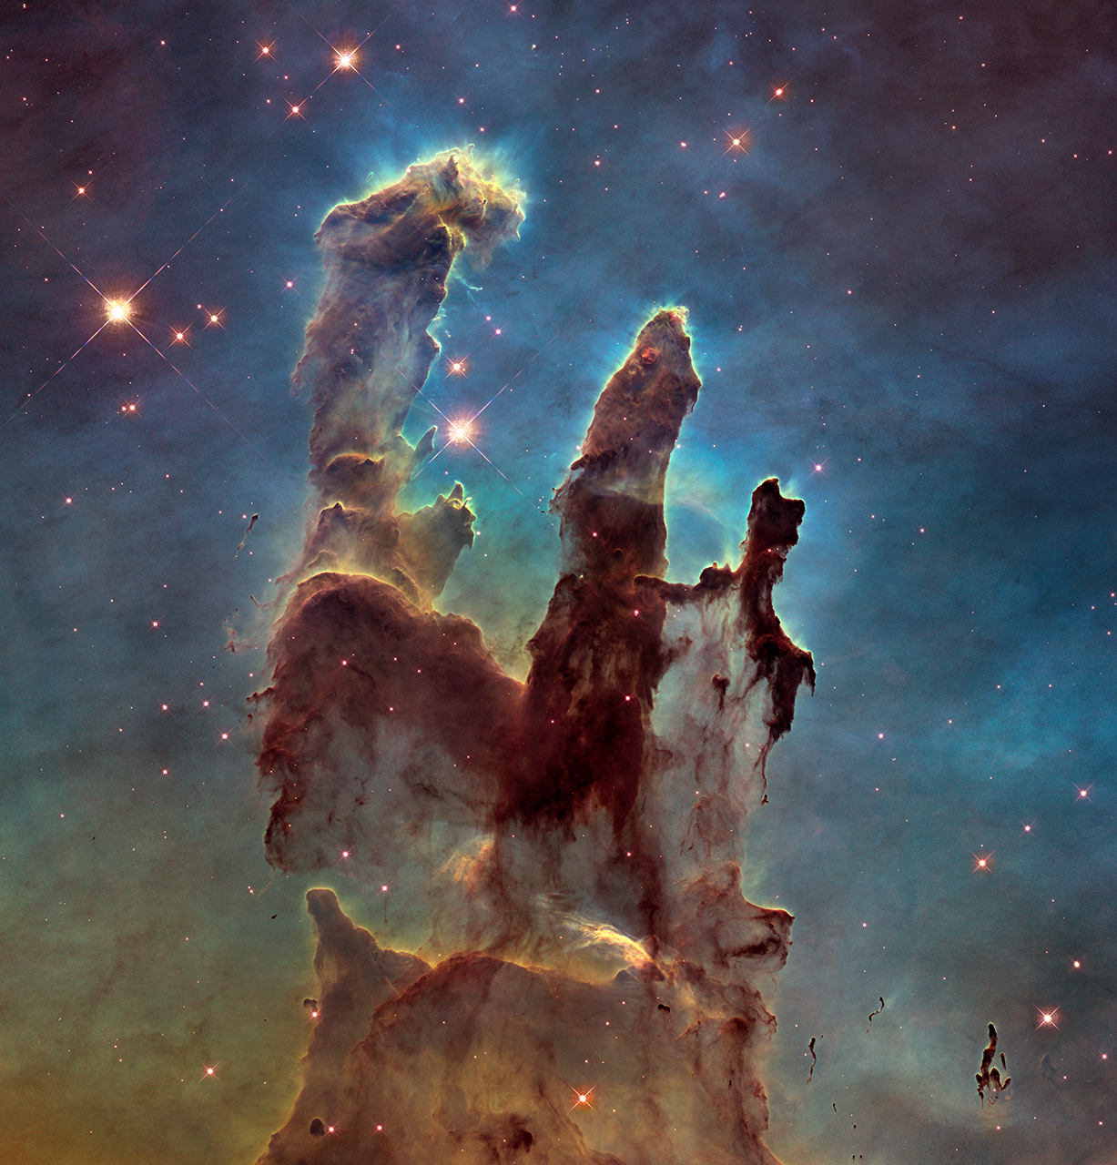
Meditation Holden Evening Prayer
Notes:
“Pillars of Creation” taken by Hubble
https://apod.nasa.gov/apod/image/1501/hs-2015-01m16pillarsHST.jpg

Slide 33
Meditation Holden Evening Prayer
May our prayers come before you, O God, as incense… and your love in our lives.
Amen.

Slide 34
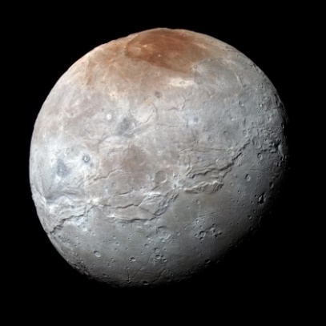
Readings and Canticles Holden Evening Prayer
Notes:
Pluto and largest moon Charon (montage), taken by New Horizons (2015)
https://www.nasa.gov/feature/new-horizons-top-10-pluto-pics
Matthew 1:18-25
Now the birth of Jesus the Messiah took place in this way. When his mother Mary had been engaged to Joseph, but before they lived together, she was found to be with child from the Holy Spirit. Her husband Joseph, being a righteous man and unwilling to expose her to public disgrace, planned to dismiss her quietly. But just when he had resolved to do this, an angel of the Lord appeared to him in a dream and said, "Joseph, son of David, do not be afraid to take Mary as your wife, for the child conceived in her is from the Holy Spirit. She will bear a son, and you are to name him Jesus, for he will save his people from their sins." All this took place to fulfill what had been spoken by the Lord through the prophet: "Look, the virgin shall conceive and bear a son, and they shall name him Emmanuel," which means, "God is with us." When Joseph awoke from sleep, he did as the angel of the Lord commanded him; he took her as his wife, but had no marital relations with her until she had borne a son; and he named him Jesus.

Slide 35
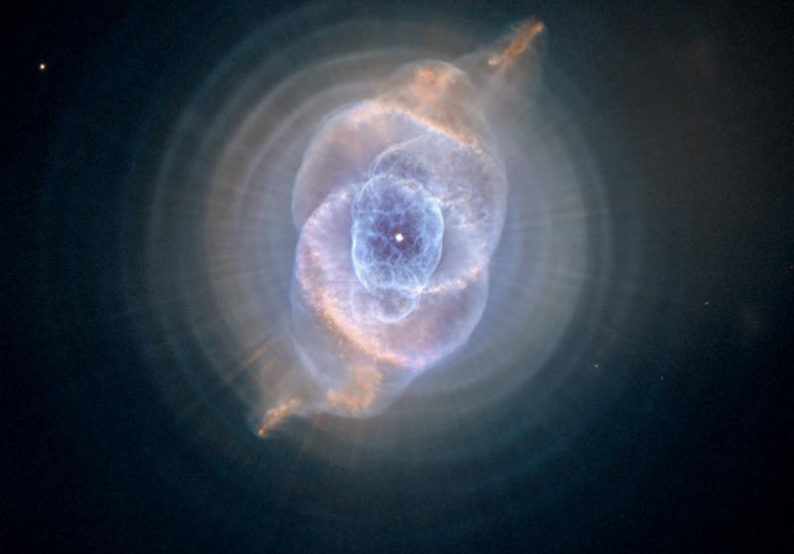
Readings and Canticles Holden Evening Prayer
Notes:
Cat’s Eye (planetary) Nebula taken by Hubble
http://hubblesite.org/newscenter/archive/releases/nebula/planetary/2004/27/image/a/
Blog/comments

Slide 36
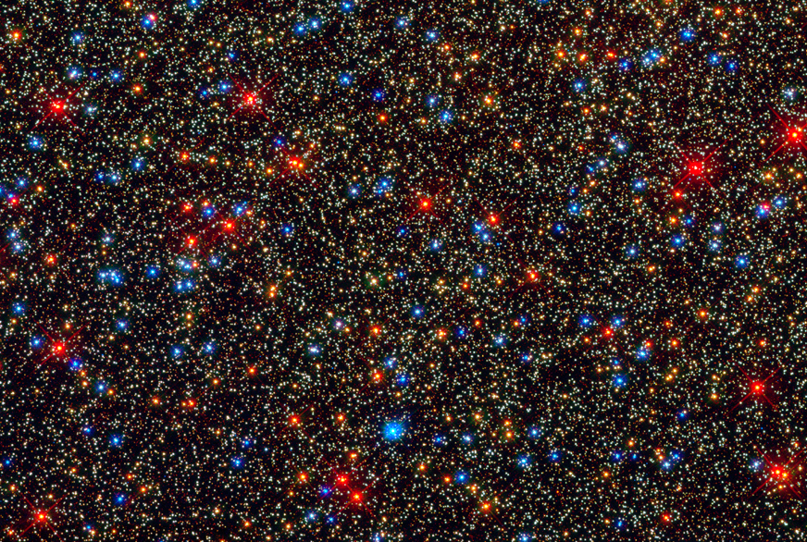
Readings and Canticles Holden Evening Prayer
Notes:
Stars in globular cluster Omega Centauri taken by Hubble
http://hubblesite.org/newscenter/archive/releases/2009/25/image/q/
Creator of the Stars of Night (5 verses – one slide each)

Slide 37
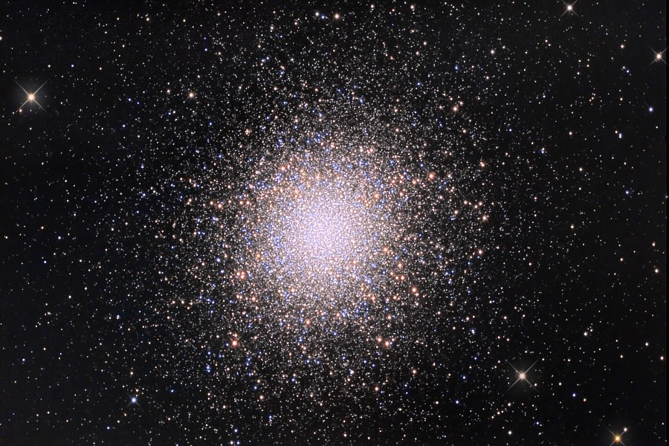
Readings and Canticles Holden Evening Prayer
Notes:
Globular cluster in Hercules (M13)
https://apod.nasa.gov/apod/ap100527.html

Slide 38
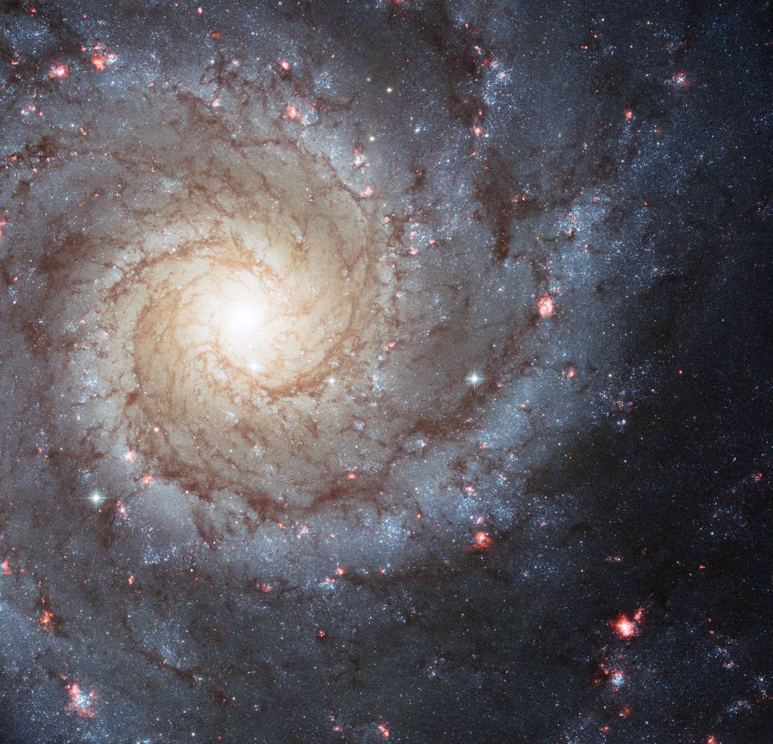
Readings and Canticles Holden Evening Prayer
Notes:
Spiral galaxy (M74)
https://www.nasa.gov/multimedia/imagegallery/image_feature_2132.html

Slide 39
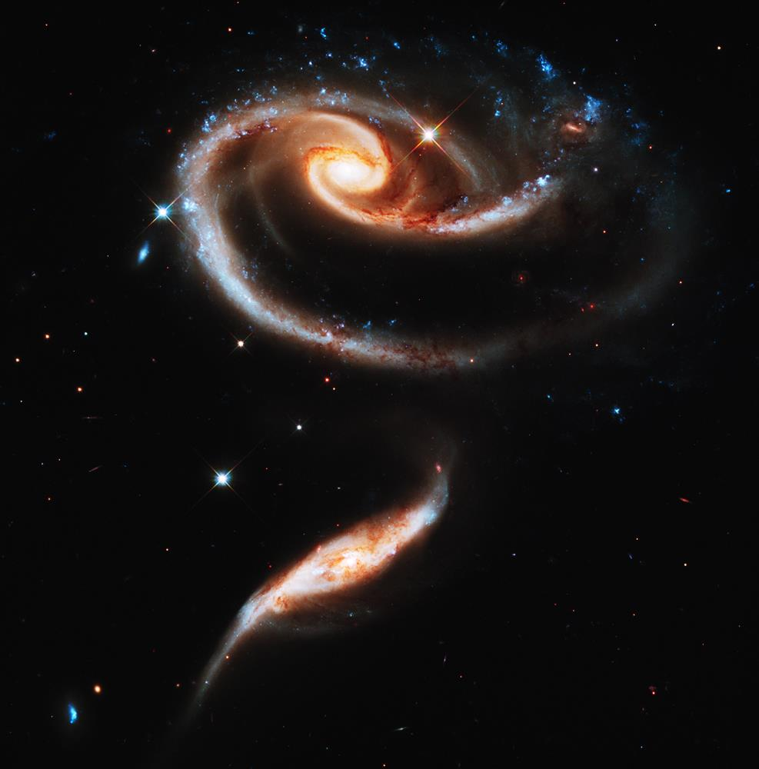
Readings and Canticles Holden Evening Prayer
Notes:
Interacting galaxies (UGC 1810 – UGC 1813; Arp 273) taken by Hubble
http://hubblesite.org/newscenter/archive/releases/2011/11/image/a/

Slide 40
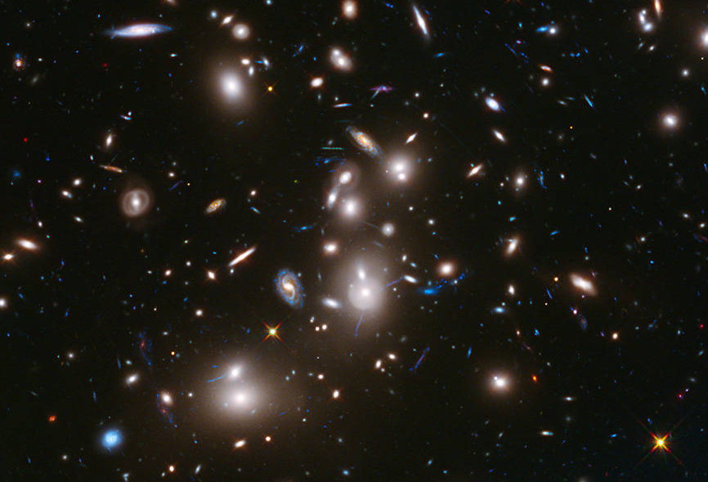
Readings and Canticles Holden Evening Prayer
Notes:
Gravitational lensing of galaxies (Abel 2744) taken by Hubble
https://www.nasa.gov/content/hubble-frontier-field-abell-2744

Slide 41
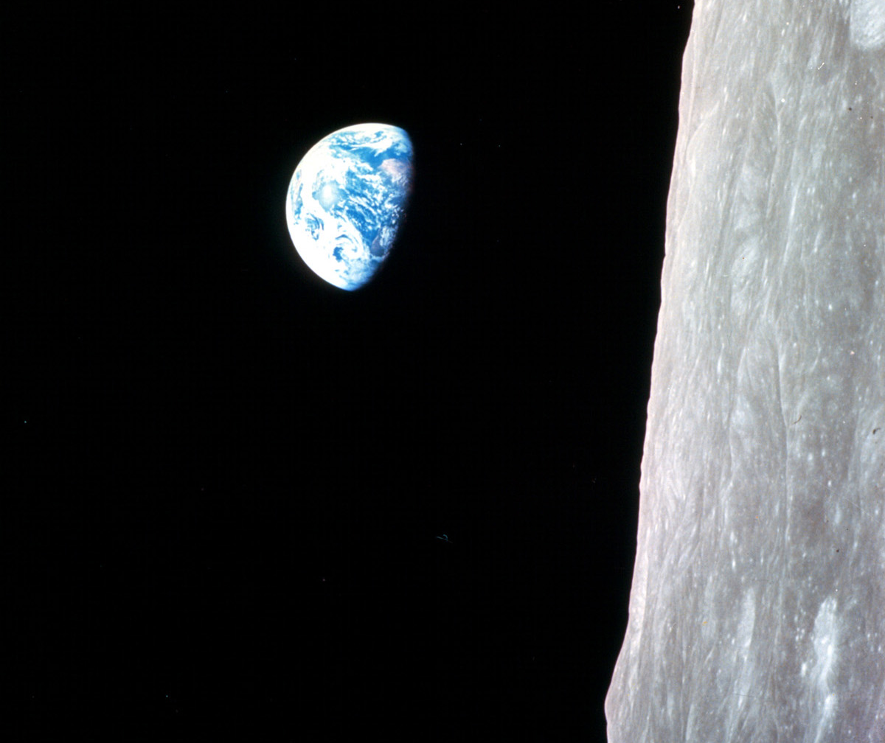
Readings and Canticles Holden Evening Prayer
The Light shines in the darkness
and the darkness has
not overcome it.
Notes:
Earthrise (over lunar horizon) taken by Apollo 8 (Christmas eve, 1968)
http://history.nasa.gov/ap08fj/photos/b/as08-14-2383.jpg

Slide 42
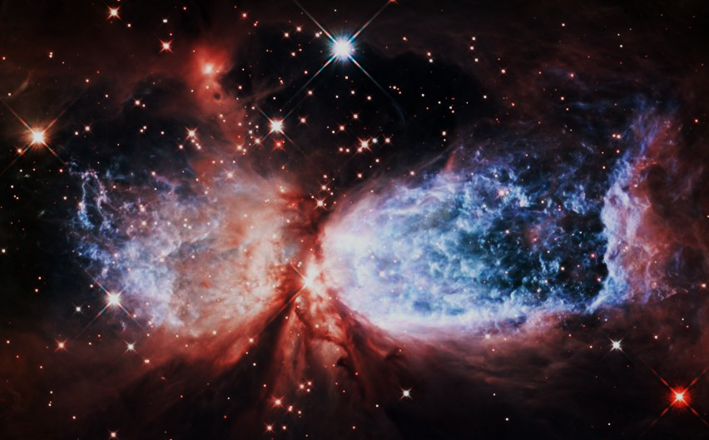
The Annunciation Holden Evening Prayer
An angel went from God… whose name was Mary… And Mary said… “I live to do your will.”
Notes:
Snow-angel nebula (Sharpless 2-106) taken by Hubble
https://www.nasa.gov/mission_pages/hubble/science/snow-angel.html

Slide 43
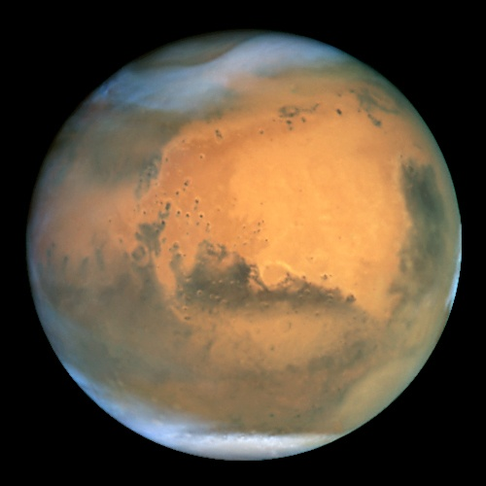
The Magnificat Holden Evening Prayer
VERSE 1
My soul proclaims your greatness, O God,
and my spirit rejoices in you.
You have looked with love on your servant here,
and blessed me all my life through.
Notes:
Venus, taken by Hubble
http://pics-about-space.com/venus-nasa#img2995815271285808521
Mars, taken by Hubble
https://www.spacetelescope.org/images/opo0124a/

Slide 44
The Magnificat Holden Evening Prayer
V1 contd
Great and mighty are you, O Holy One,
strong is your kindness evermore.
How you favor the weak and lowly one,
humbling the proud of heart.

Slide 45
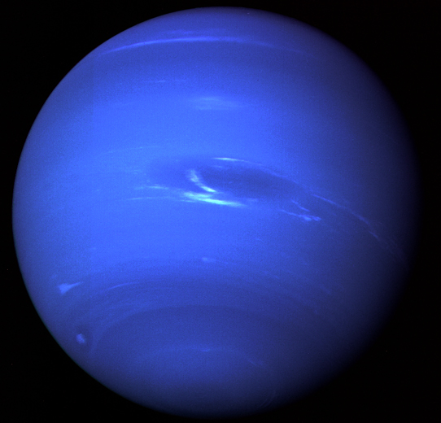
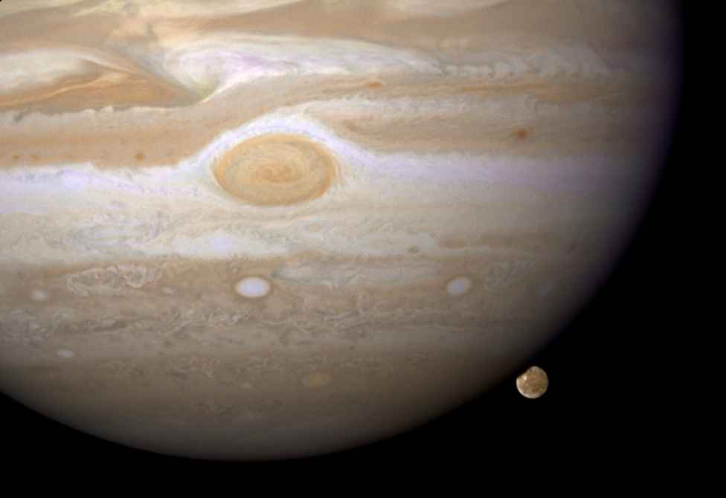
The Magnificat Holden Evening Prayer
VERSE 2
You have cast the mighty down from their thrones,
and uplifted the humble of heart,
You have filled the hungry with wondrous things,
and left the wealthy no part.
Notes:
Jupiter (and moon Ganymede), taken by Hubble
https://www.nasa.gov/sites/default/files/images/297731main_hst_img_20081218_HI_full.jpg
Neptune, taken by Voyager 2 in 1989
http://solarsystem.nasa.gov/planets/neptune/galleries

Slide 46
The Magnificat Holden Evening Prayer
V2 contd
Great and mighty are you, O Faithful One,
strong is your justice, strong your love.
As you promised to Sarah and Abraham,
kindness forevermore.

Slide 47
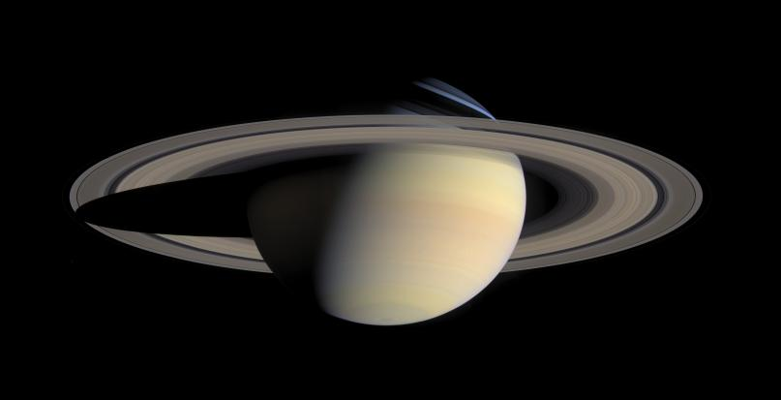
The Magnificat Holden Evening Prayer
VERSE 3
My soul proclaims your greatness, O God,
and my spirit rejoices in you.
You have looked with love on your servant here,
and blessed me all my life through.
Notes:
Saturn, taken by Cassini
http://photojournal.jpl.nasa.gov/jpegMod/PIA06193_modest.jpg

Slide 48
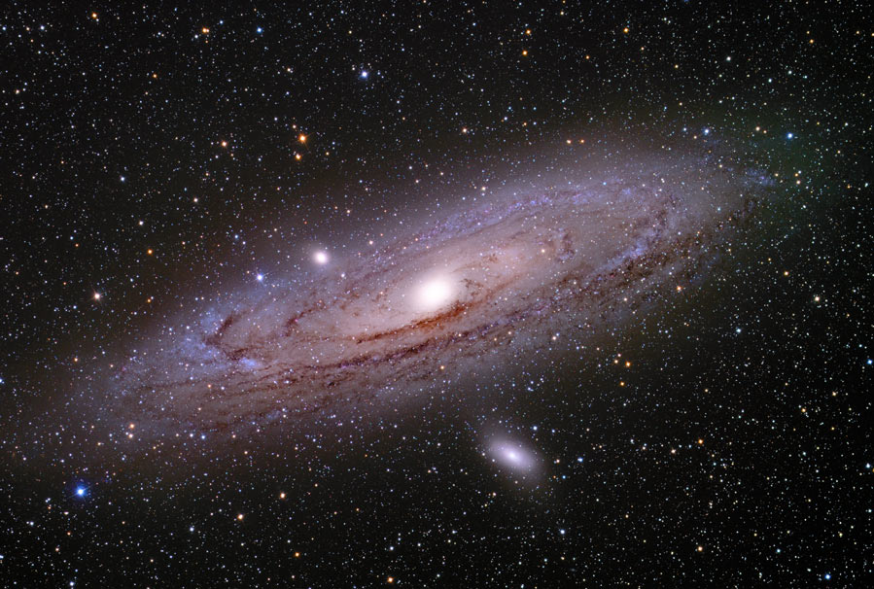
Litany and Prayers Holden Evening Prayer
Hum during verses, sing as refrain
In peace, in peace, we pray to you: …
Notes:
Andromeda galaxy (M31)
http://christensenastroimages.com/galaxies/m31_2.html

Slide 49
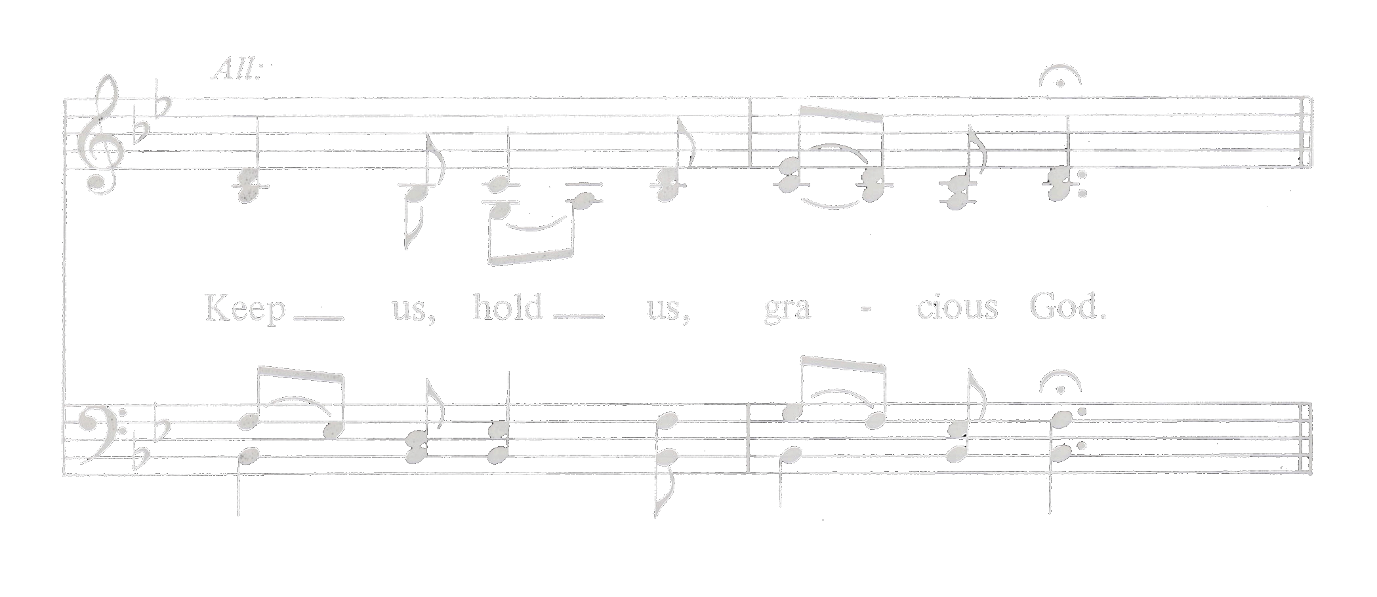
Litany and Prayers Holden Evening Prayer
Final verse and final refrain
Help us, comfort us, all of our days:

Slide 50
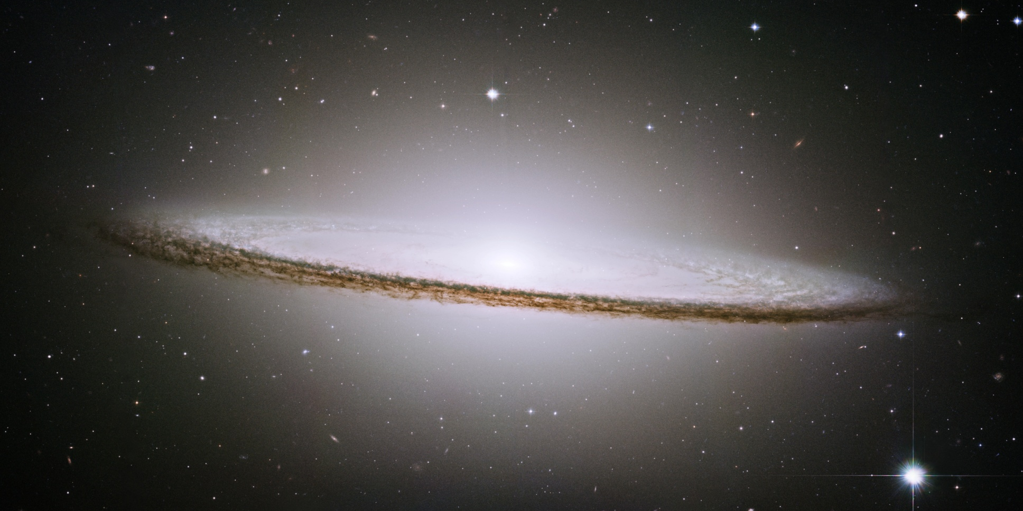
Closing Prayer Holden Evening Prayer
Notes:
Sombrero galaxy (M104) taken by Hubble
http://hubblesite.org/newscenter/archive/releases/2003/28/

Slide 51
Closing Prayer Holden Evening Prayer
Great and merciful God, Source and Ground of all goodness and life…
…through Jesus Christ our Lord.
Amen.

Slide 52
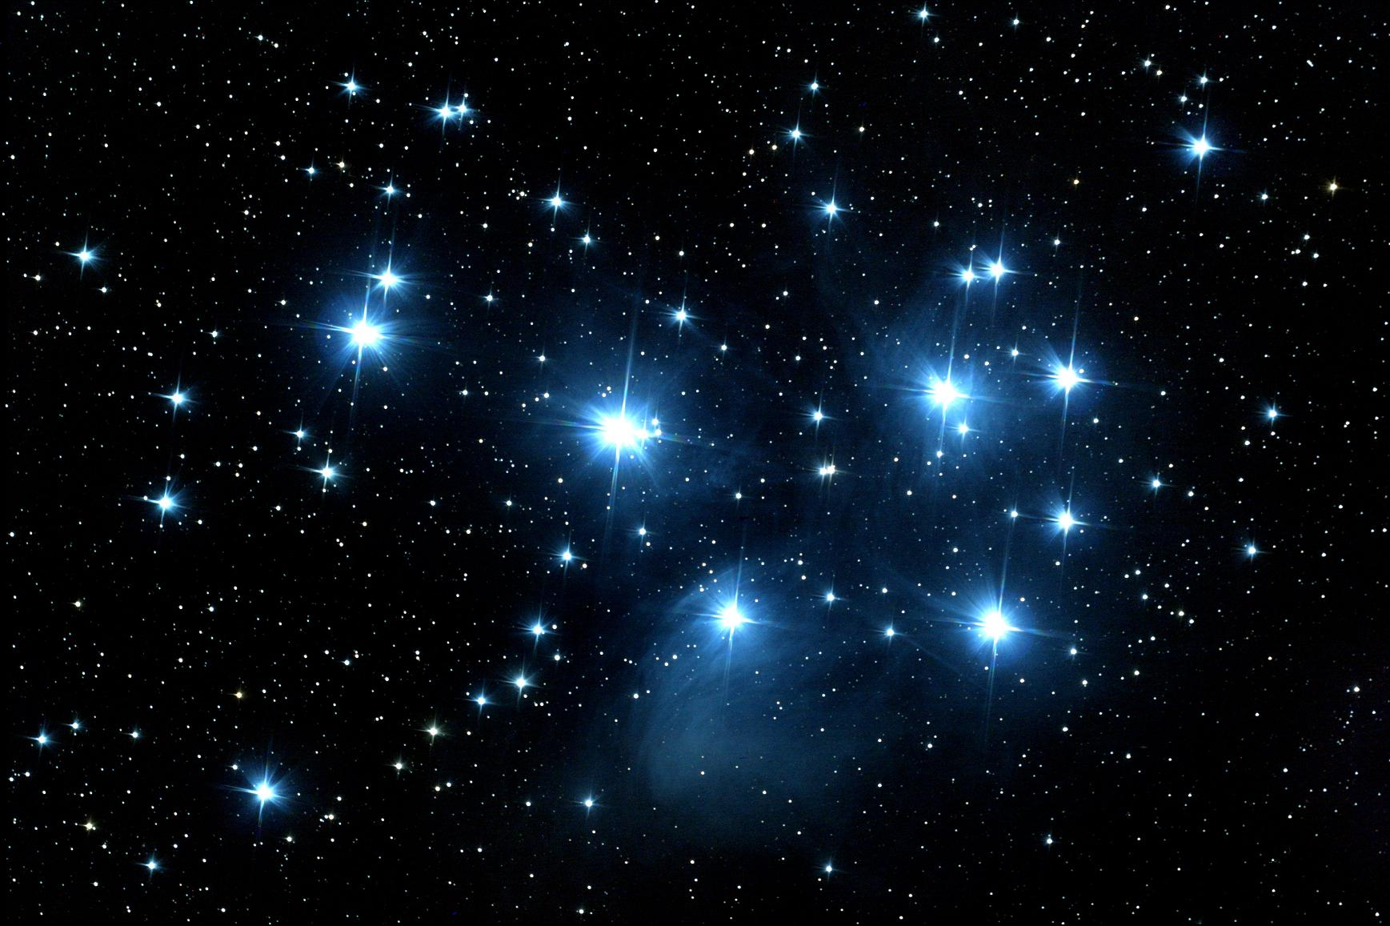
The Lord’s Prayer Holden Evening Prayer
God, remember us in your love, and teach us to pray:
Our Father in heaven, hallowed be your name.
Your Kingdom come: your will be done on earth as in heaven. Give us today our daily bread. Forgive us our sins as we forgive those who sin against us. Save us from the time of trial, and deliver us from evil. For the King-dom, the power, and the glory are yours, now and forever. Amen.
Notes:
Pleiades (7 Sisters) constellation
https://issachar5.files.wordpress.com/2010/03/pleiades.jpeg

Slide 53
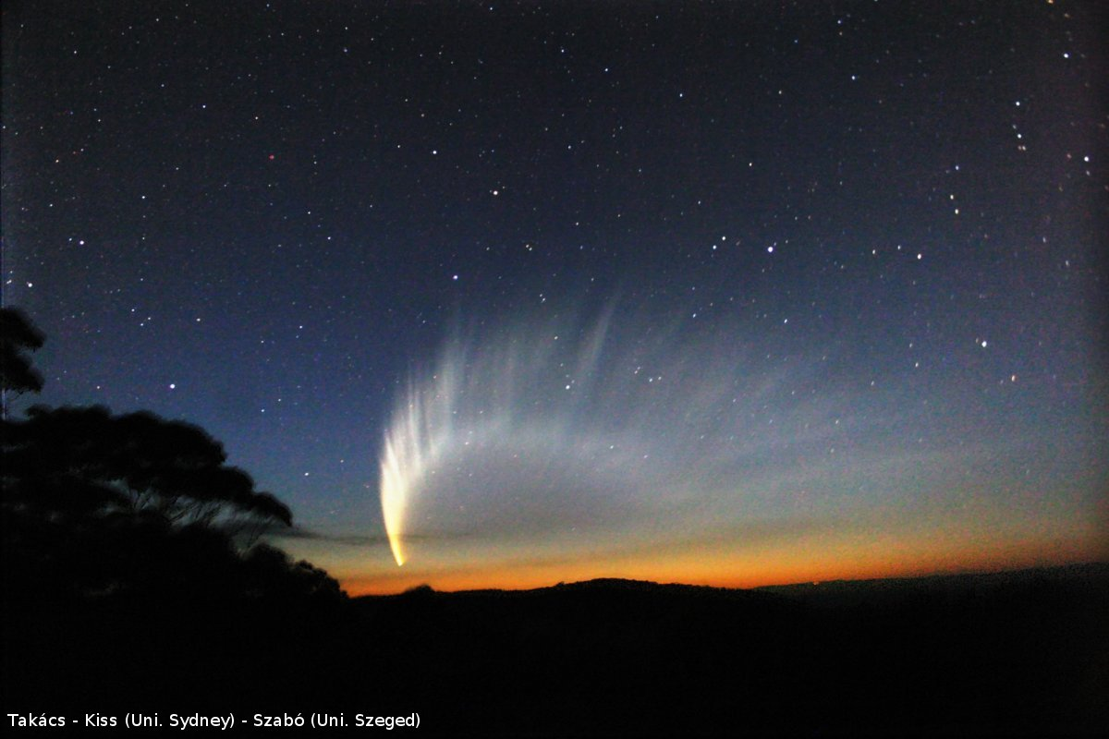
Final Blessing Holden Evening Prayer
Let us bless our God:
praise and thanks to you.
Notes:
Comet McNaught (December 2008)
https://cumbriansky.files.wordpress.com/2008/12/image_comet.jpg

Slide 54
Final Blessing Holden Evening Prayer
May God, Creator bless us and keep us,
may Christ be ever light for our lives,
may the Spirit of Love be our guide and path,
for all of our days.
Amen.

Slide 55
Holden Evening Prayer (Plus)

Slide 56
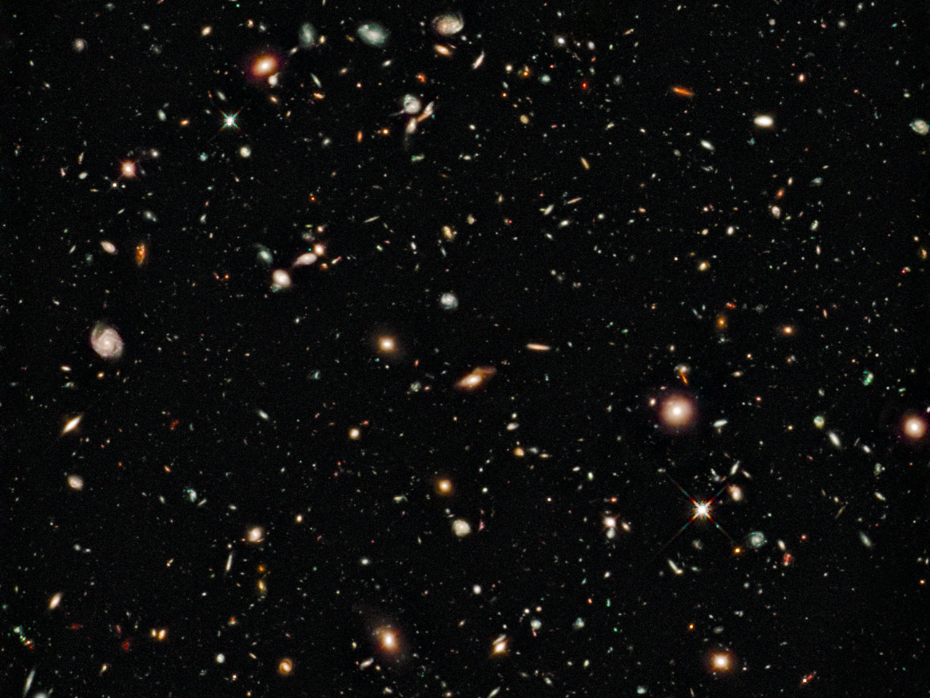
Photograph selection compliments of
James Flaten, MN Space Grant, U of MN
Notes:
Hubble Ultra Deep Field
http://hubblesite.org/gallery/album/the_universe/hubble_ultra_deep_field/pr2004007a/hires/true/

