Slide 1
Final Team Presentation
Anthony Knutson, Alex Knutson-Smisek, Henry Kunerth, Chad Larkin, & Eric Ly
Team Hindenburg
AEM 1905: Spaceflight with Ballooning 11/23/10

Slide 2
Mission Objectives
Measure temperature, relative humidity and pressure changes at altitude
View and record changes in balloon size
Measure radiation exposure with altitude
Determine viability of shielded and unshielded bacteria after radiation exposure
Recover payload after landing
Transmit data to the ground throughout flight

Slide 3
Expectations
Prove that temperature varies with altitude
Prove that pressure decreases with altitude
Prove that relative humidity varies with altitude
Show that UV radiation increases with altitude
Show that balloon expansion occurs with an increase in altitude
Prove radiation affects bacteria

Slide 4
Management

Slide 8
Budget

Slide 9
Original Design Layout

Slide 10
Final Design Layout
Flight Computer
Battery Pack
Weather Station
Heater
Bacteria
Geiger Counter
HOBO
Zigbee

Slide 11
Top Design Layout
Flip Video Camera

Slide 12
Purpose of Each Component
Flight Computer
Store weather station data
Weather Station
Relative Humidity
Pressure
External Temperature
HOBO
Internal Temperature
External Temperature

Slide 13
Purpose of Each Component
Geiger Counter
Measures cosmic radiation level
Zigbee
Transmit information (data gathered from the Geiger counter) to the ground
Flip Video Camera
Observes the growth of the balloon during ascent
Heater
Keeps the payload at an operational temperature level

Slide 14
Tests Performed
Cold soak
Used to confirm equipment viability at cold temperatures
Used to confirm effectiveness of systems when working together

Slide 15
Tests Performed (Con’t)
During Cold Soak:
Data recorded from weather station and HOBO
Camera used to record video during test
Effectiveness of heater measured
Flight computer tested

Slide 16
HOBO Data

Slide 17
BSE Data Graph

Slide 18
Tests Performed (Con’t)
Structural Integrity of Payload Shell- Completed shell was weighted and tossed down one flight of stairs

Slide 19
Tests Performed (Con’t)
In all cases, tests were completed successfully
All necessary tests have been completed. Team Hindenburg is not planning on performing any further tests
We have not tested the Geiger counter and Zigbee radio interface
Because of many past flights, we are reasonably assured they will work as planned

Slide 20
Flip Video Camera

Slide 21
Thermal Testing Video

Slide 22
Expected Science Results Overview
Temperature
Pressure
Relative humidity
Radiation
Bacterial results

Slide 23
Temperature Expectations
In the Troposphere, the atmospheric layer closest to Earth, temperature decreases at about -3.6°F/1,000 ft. This layer goes up to about 45,000 ft.
The balloon will then enter the Stratosphere, which goes up to 160,000 ft. In this layer temperature increases at 1.6°F/1,000 ft.
This will give us a graph with decreasing, and then increasing temperature.

Slide 24
Temperature Expectations (cont.)

Slide 25
Temperature Expections (cont.)

Slide 26
Actual Temperature Results

Slide 27
Actual Temperature Results (Cont.)

Slide 28
Actual Temperature Results (Cont.)

Slide 29
Actual Temperature Results (Cont.)

Slide 30
Actual Temperature Results (Cont.)

Slide 31
Actual Temperature Results (Cont.)

Slide 32
Pressure Expectations
Pressure decreases exponentially as altitude increases.
This is because the Earth's gravity is strongest near the surface, holding air molecules more tightly together.
As altitude increases the number of air molecules decreases because the greatest number are near the Earth's surface.

Slide 33
Pressure Expectations (cont.)

Slide 34
Pressure Actual Results

Slide 35
Relative Humidity
Relative humidity is a calculation of the amount of water vapor in the air. It is calculated by taking the partial pressure of water vapor over the saturated water vapor pressure.
Relative humidity is affected by:
Temperature
Pressure

Slide 36
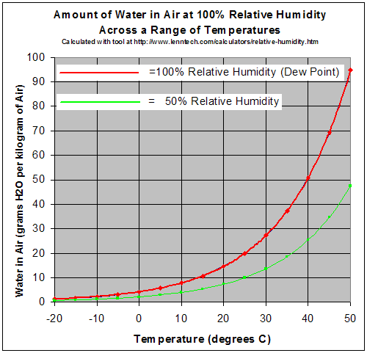
Expected RH and Temperature

Slide 37
Expected RH and Pressure

Slide 39
Relative Humidity Actual Results

Slide 40
Relative Humidity Actual Results (Cont.)

Slide 41
Relative Humidity Actual Results (Cont.)

Slide 42
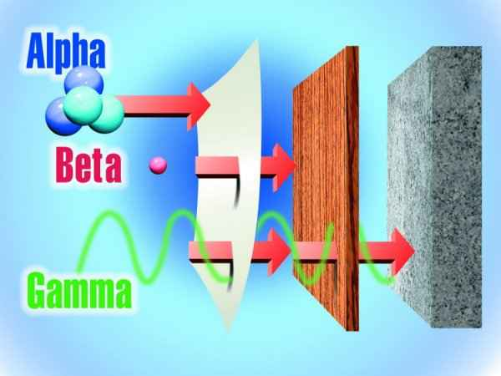
Radiation Expected Results
Radiation levels in the atmosphere are primarily generated by cosmic rays from the sun.
90% of this radiation is energetic protons, 9% are alpha particles, 1-2% heavy nuclei.

Slide 43
Radiation Expected Results (cont.)
This radiation can effect both people and electronics.
Many commercial airlines don't allow pregnant crew-members to fly for the duration of their pregnancy.
Electronics effected on airplanes (Qantas Airlines), as well as recent effects on Voyager 2.

Slide 44
Radiation Expected Results (Cont.)

Slide 45
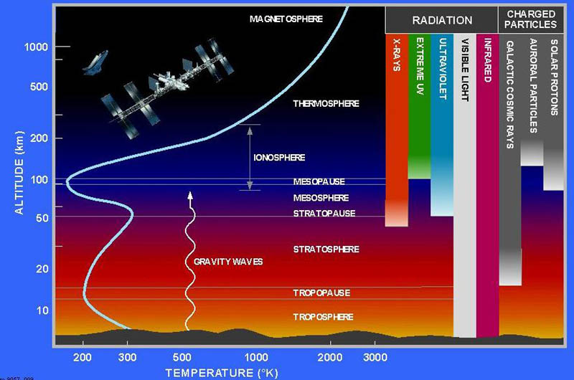
Radiation Expected Results (Cont.)

Slide 46
Radiation Expected Results (cont.)
Our box will be using a Geiger counter to detect this radiation.
Geiger counters mainly detect alpha and gamma radiation.
Because it will be inside of our box our Geiger counter will mainly be detecting gamma radiation.

Slide 47
Actual Radiation Results

Slide 48
Balloon Expansion Expected Results
Since pressure decreases with altitude, we expect the balloon to expand with altitude

Slide 49
Balloon Expansion Actual Results

Slide 50
Balloon Expansion Actual Results (Cont.)

Slide 51
Balloon Expansion Actual Results (Cont.)

Slide 52
Balloon Expansion Actual Results (Cont.)

Slide 53
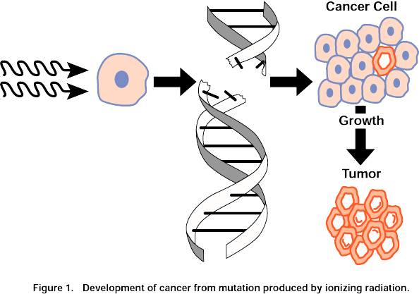
Bacteria Experiment
The purpose of including bacteria in our box is to detect the effects of cosmic radiation on biological material

Slide 54
Bacteria type
Our box will have three agar plates inoculated with Serratia marcescens.
The agar on the plates will be BHI (Brain-Heart Infusion).
Serratia naturally grows with a red-pink color produced by the pigment Prodigiosin.
When exposed to radiation mutant colonies will grow without the pigment (white).

Slide 55
Method
Black dots indicate spots inoculated with bacteria.
Black dots in
Yellow is the BHI agar contained in a petri dish.

Slide 56
Expected Control Results
All colonies show normal growth. No white colonies.
Colonies grow from a single bacteria, outwards in a circle from point of inoculation.

Slide 57
Expected Mutant Results
White-gray colonies are mutants. No longer produce pigment because of radiation effects.
Exposure to the radiation is highly variable. Some colonies will not be effected.

Slide 58
Bacterial Results
The bacteria Serratia marcescens were exposed to radiation in near space
Three petri dishes on each flight
Outside box
Inside box
Inside box, covered in aluminum foil
Also had three controls stored at room temp for each flight

Slide 59
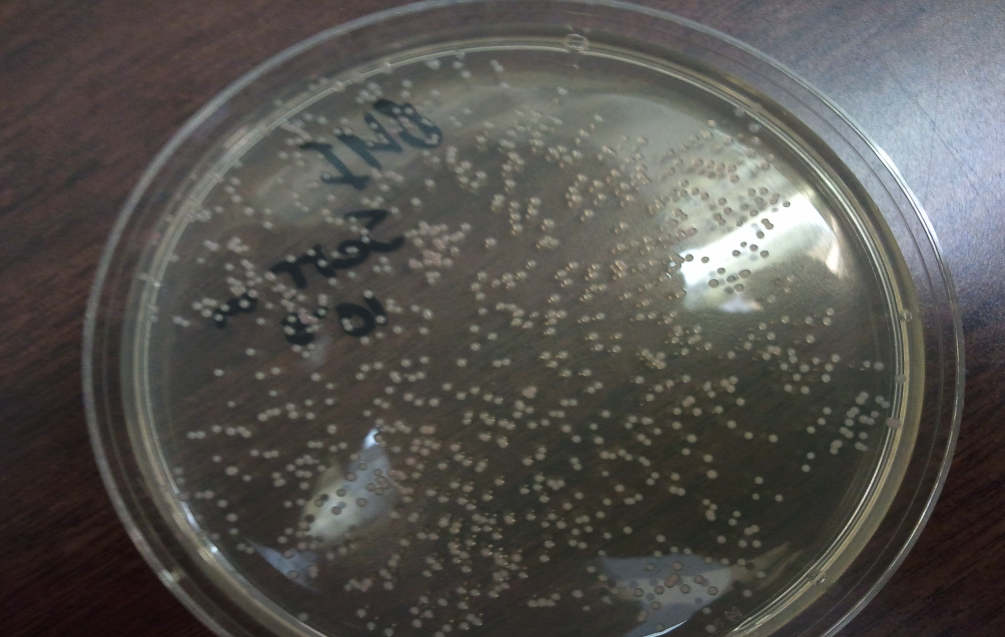
Before Flight

Slide 60
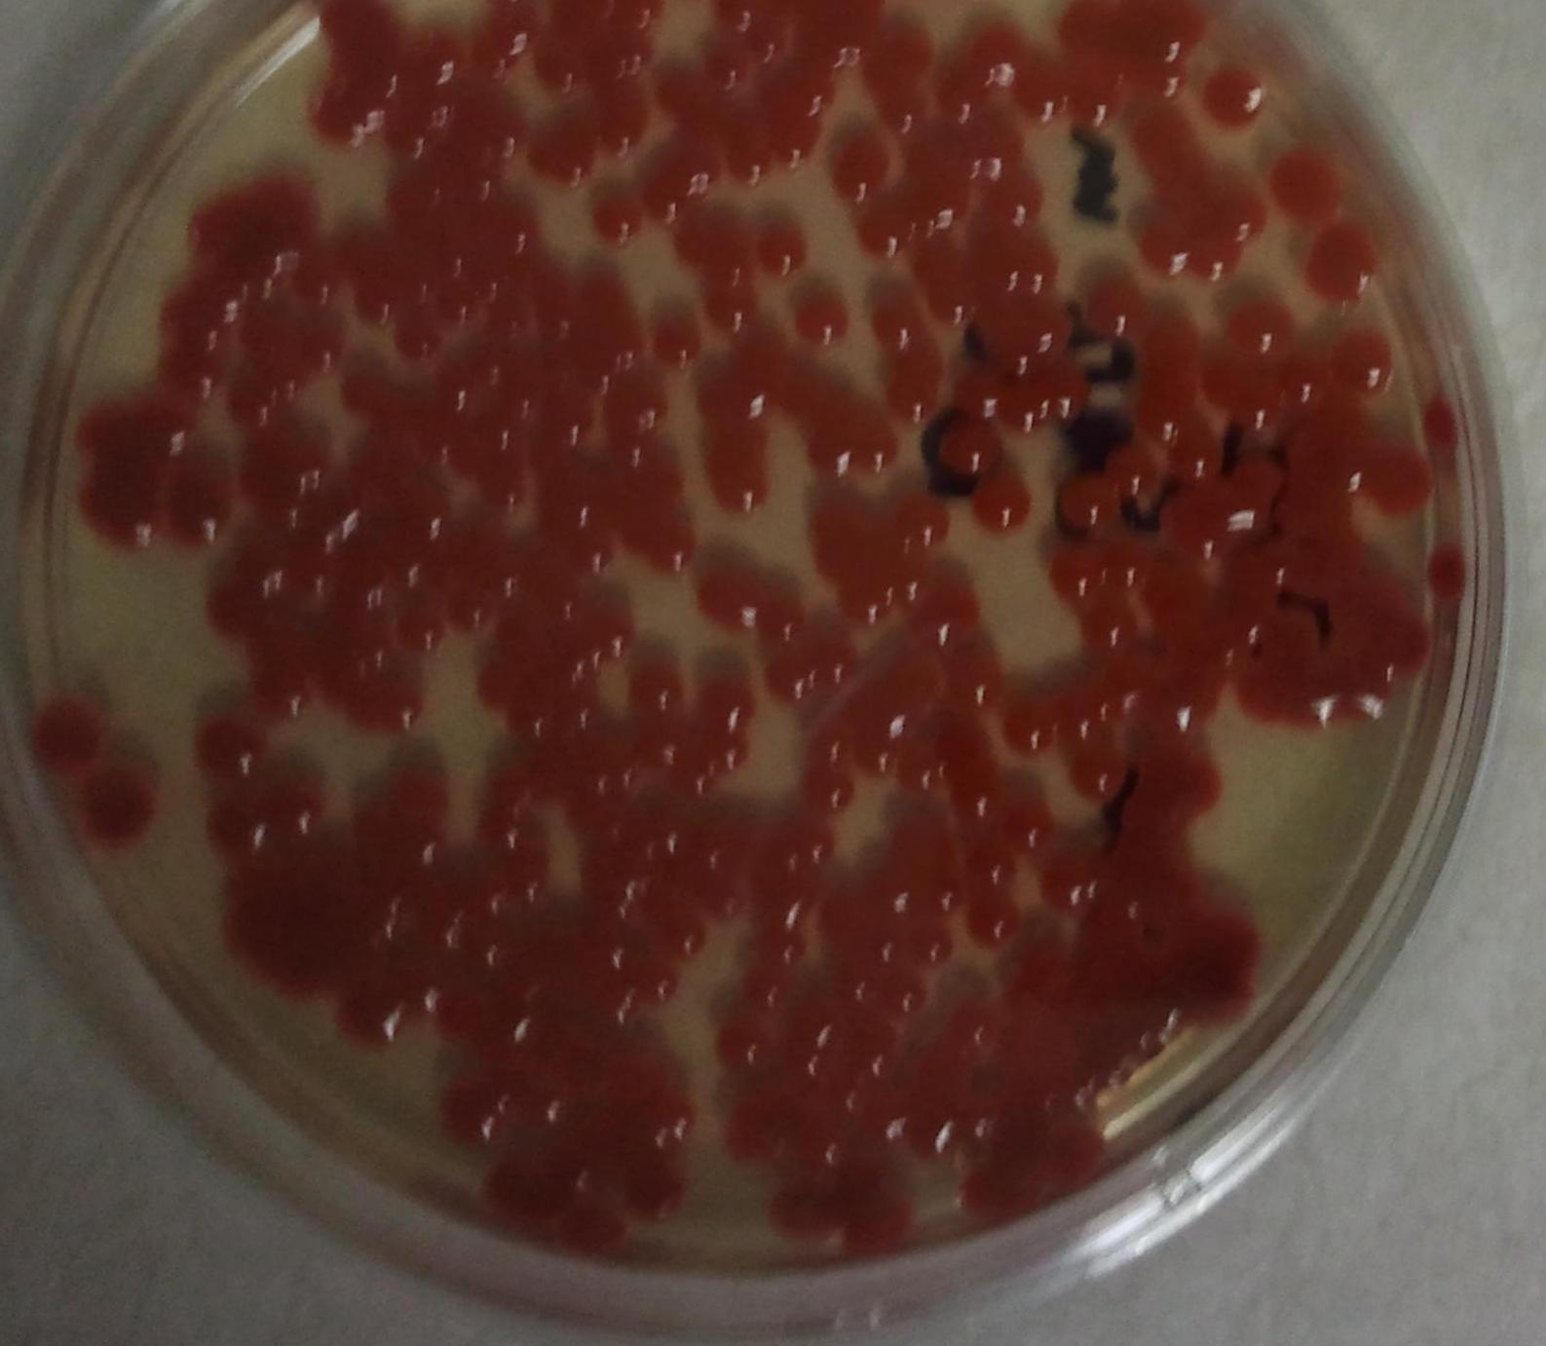
Before Flight

Slide 61
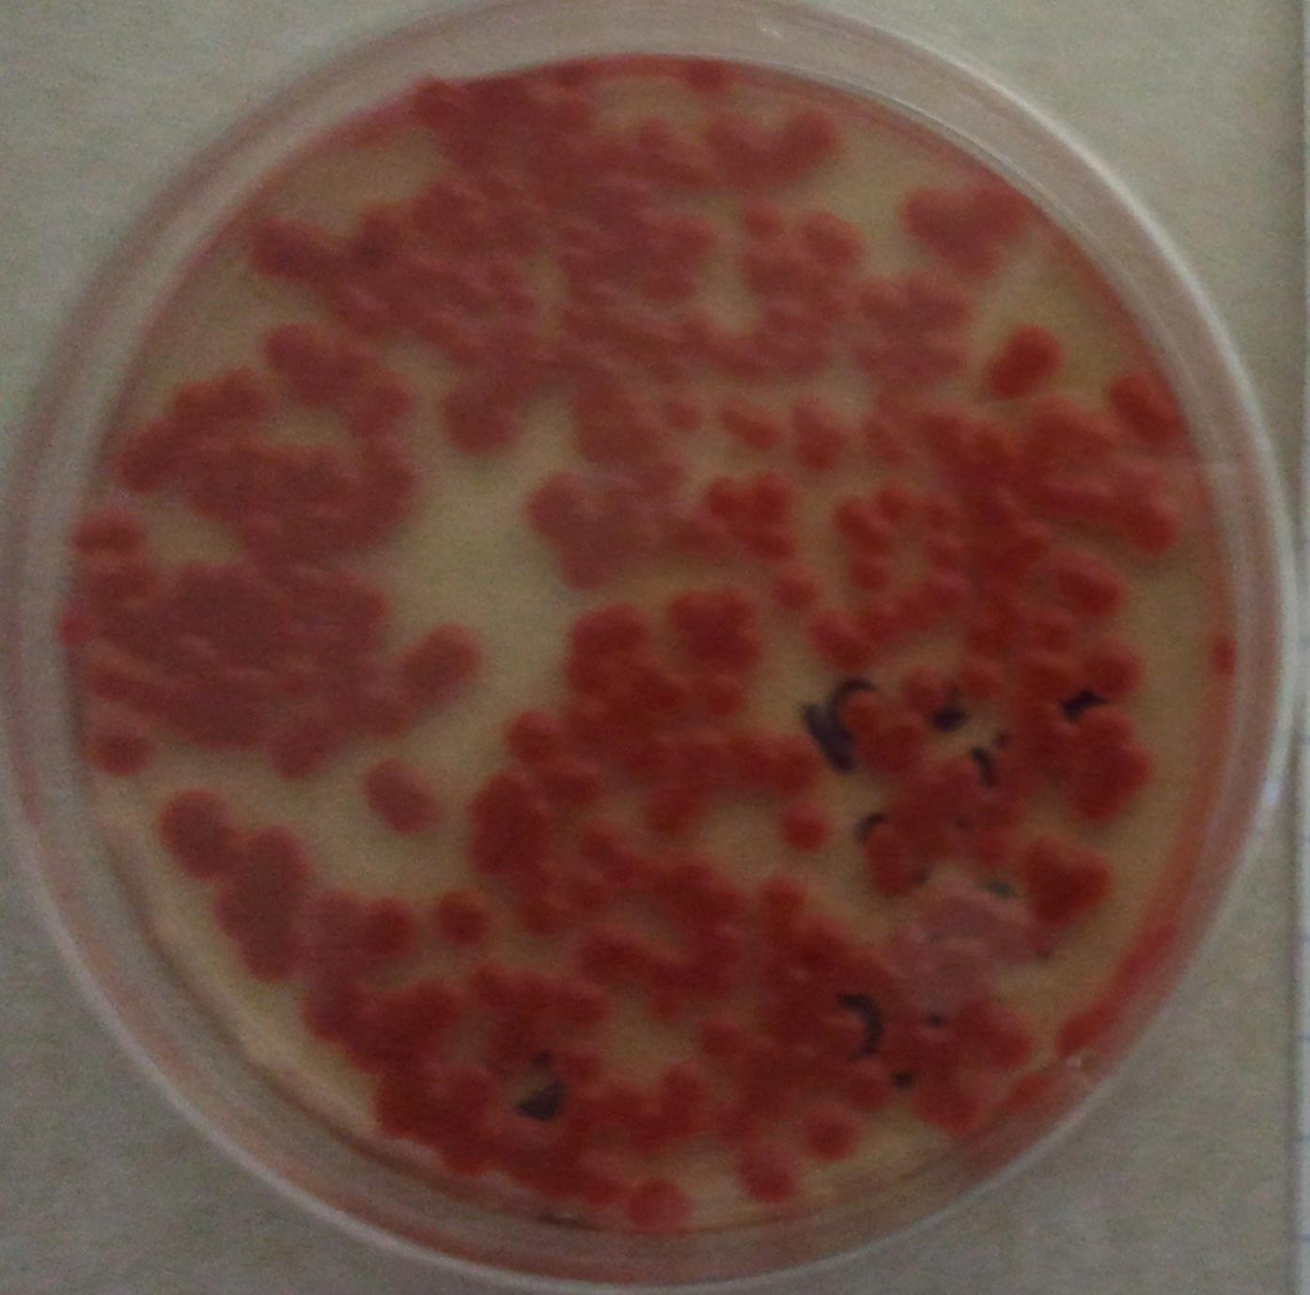
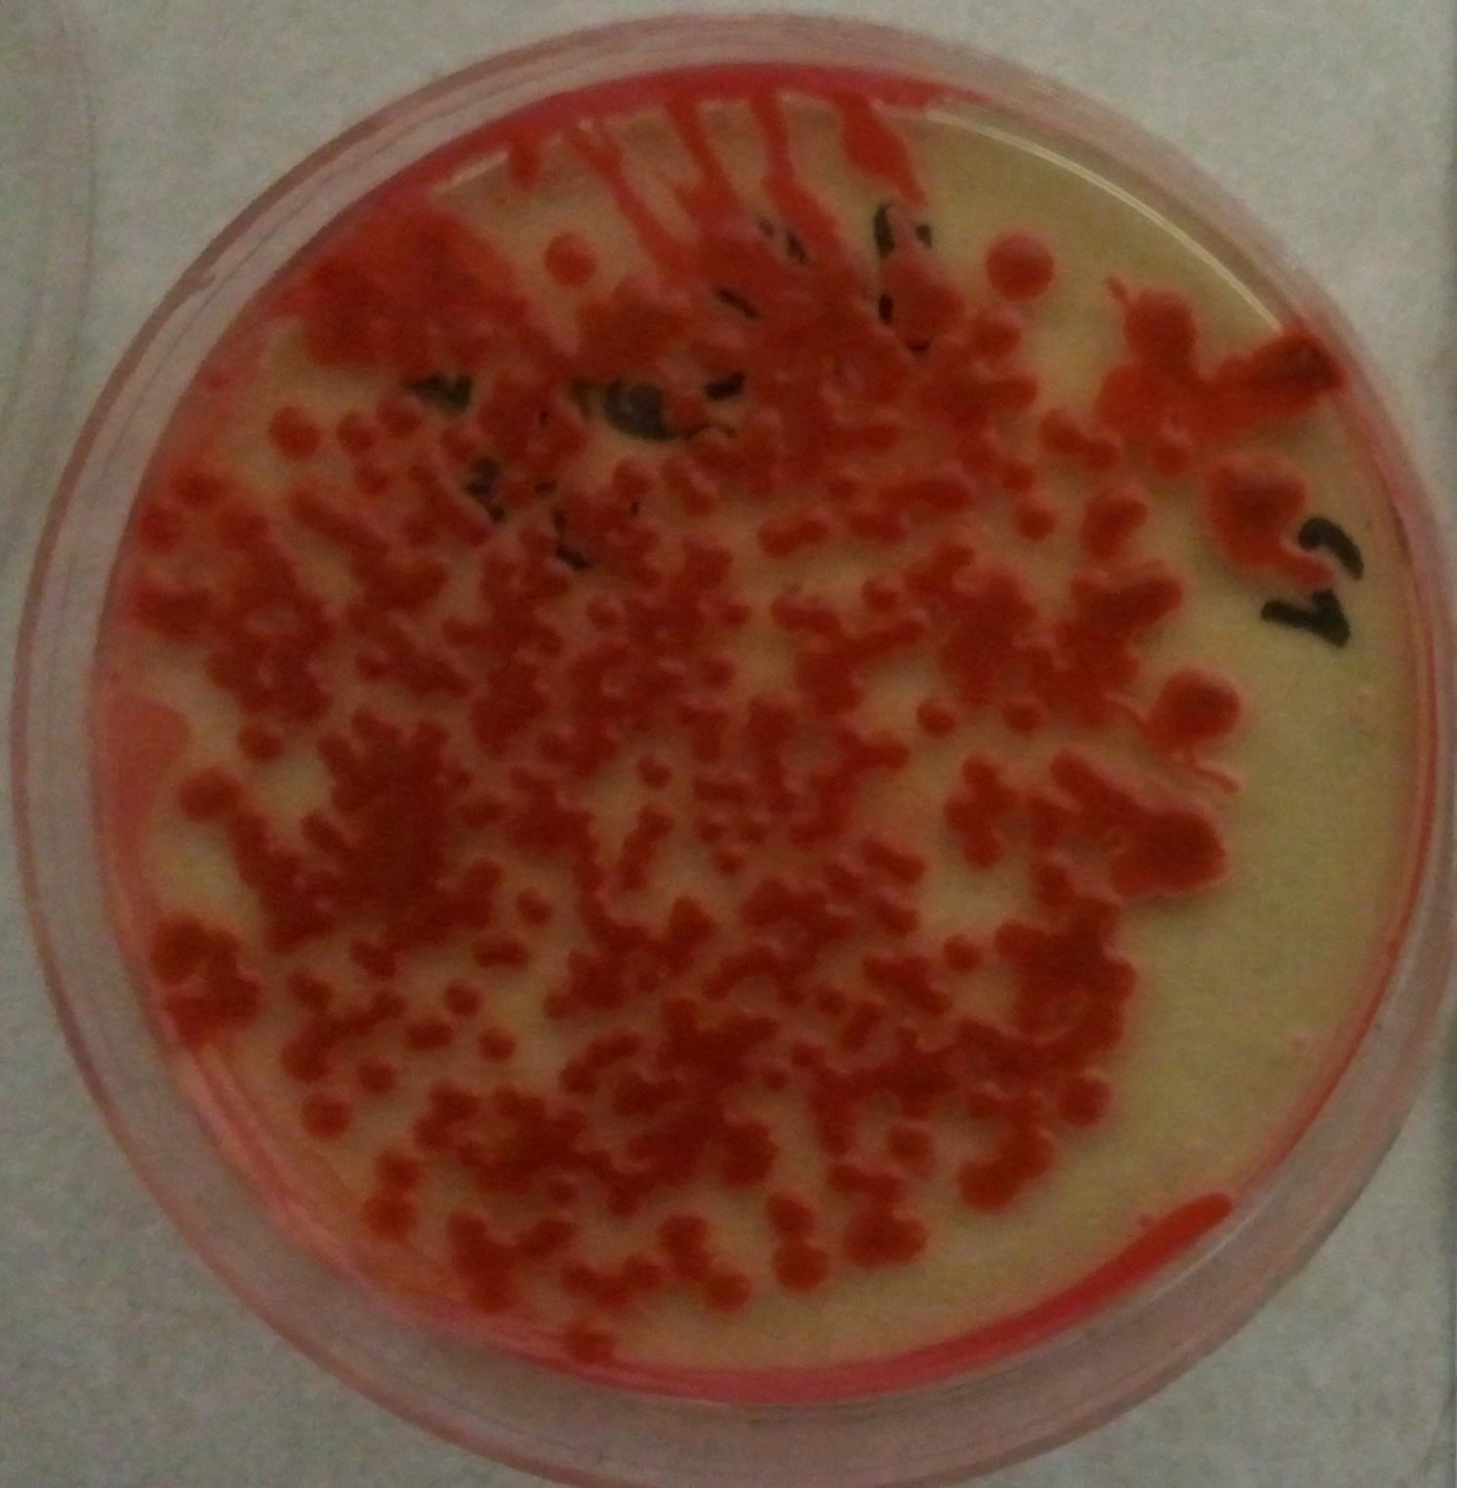
Flight One
Tin Foil
Inside

Slide 62
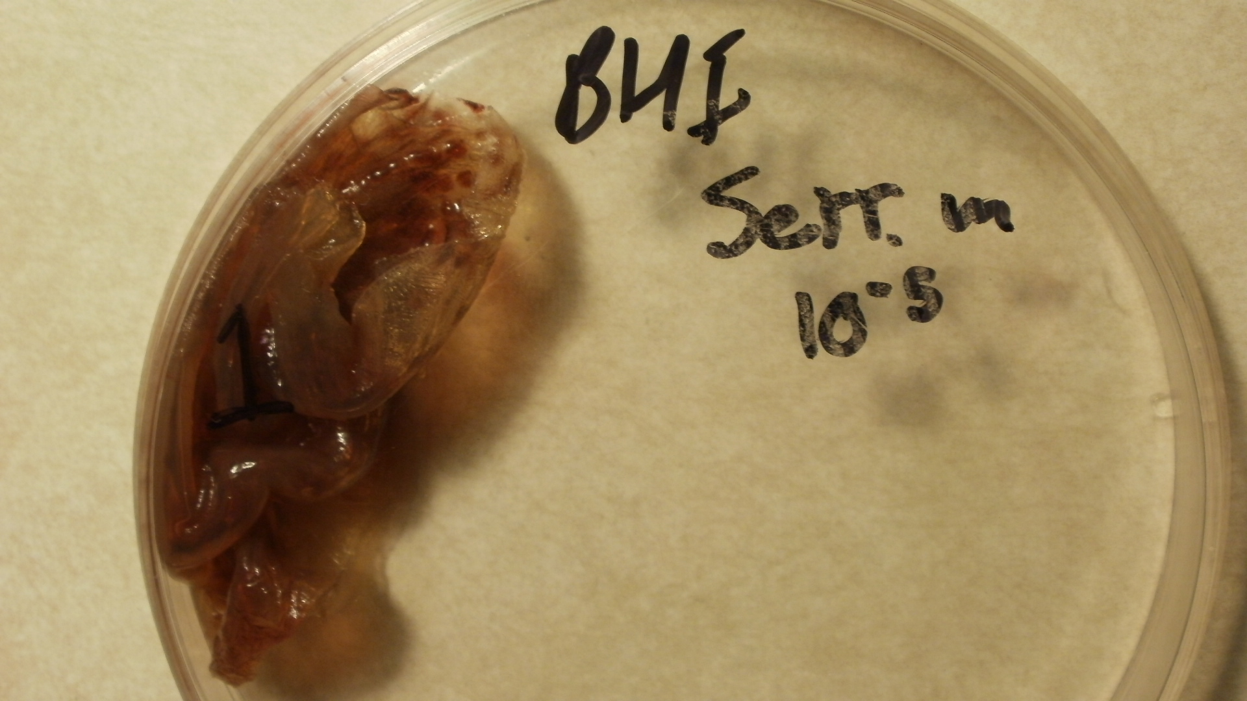
Flight One
Outside

Slide 63
White Colonies
The plates were kept at room temp after the flight, allowing the bacteria time to grow
After approximately two more days of growth white colonies were noticed on the plates
The colonies were allowed to grow for two more days and then these photos were taken:

Slide 64
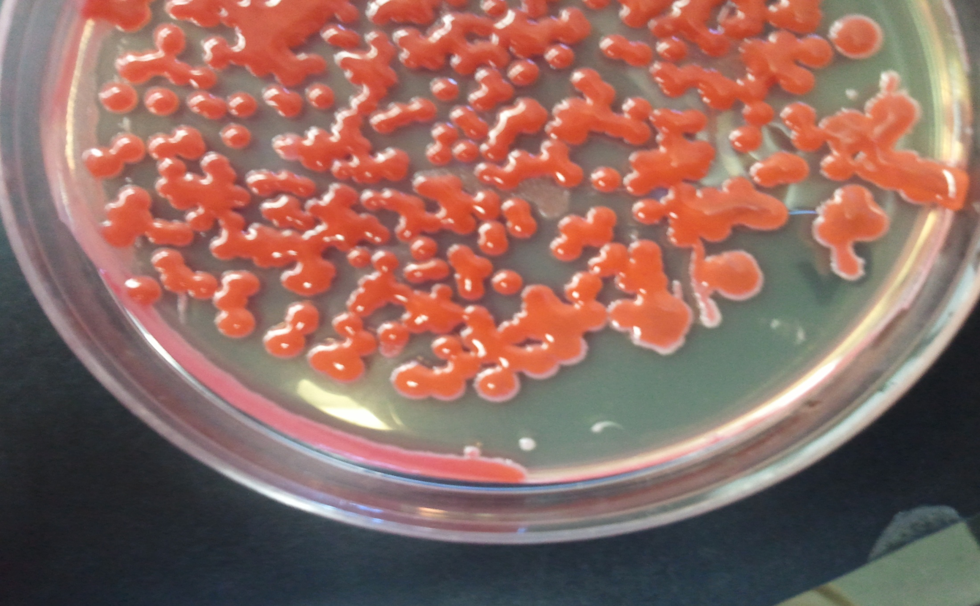
White Colonies

Slide 65
White Colonies

Slide 66
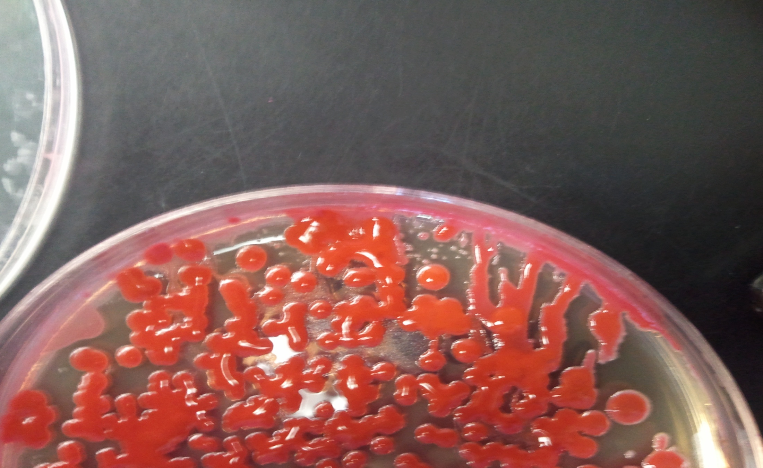
White Colonies

Slide 67
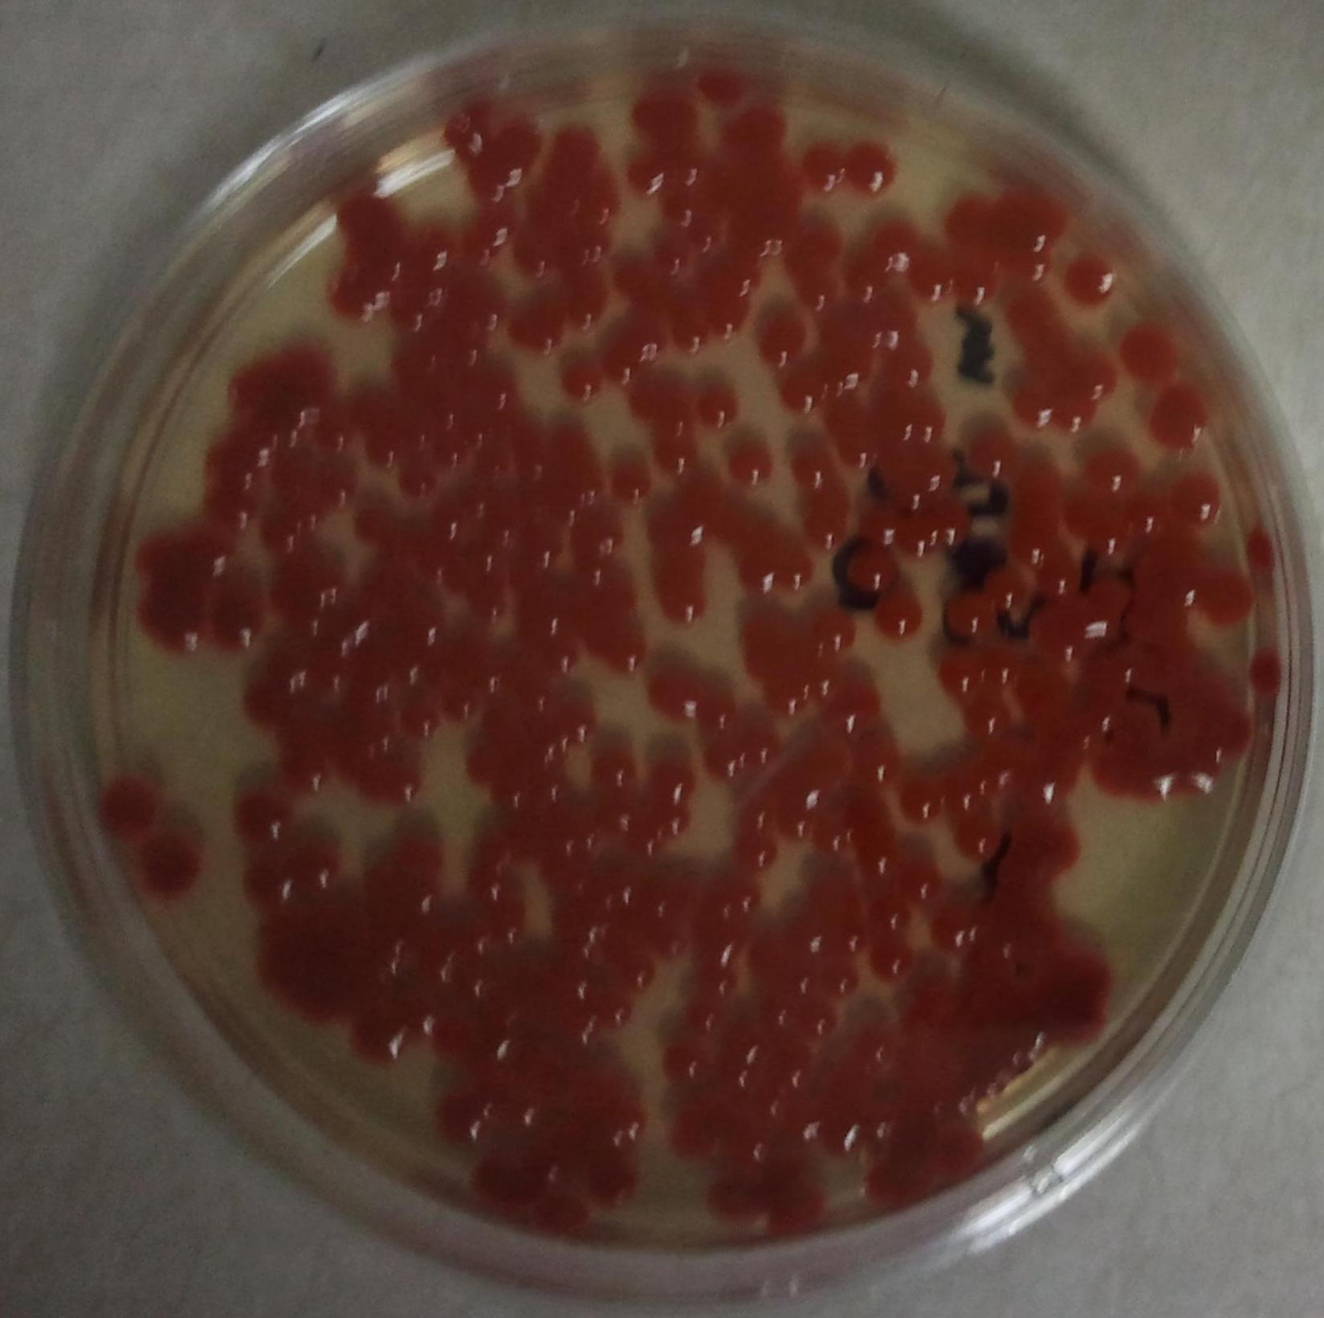
Control

Slide 68
White Colonies
The white colonies were taken individually off the plates and restreaked on new petri dishes
This was in the hopes that the colonies would grow white on the new plate, showing that a mutation had occurred

Slide 69
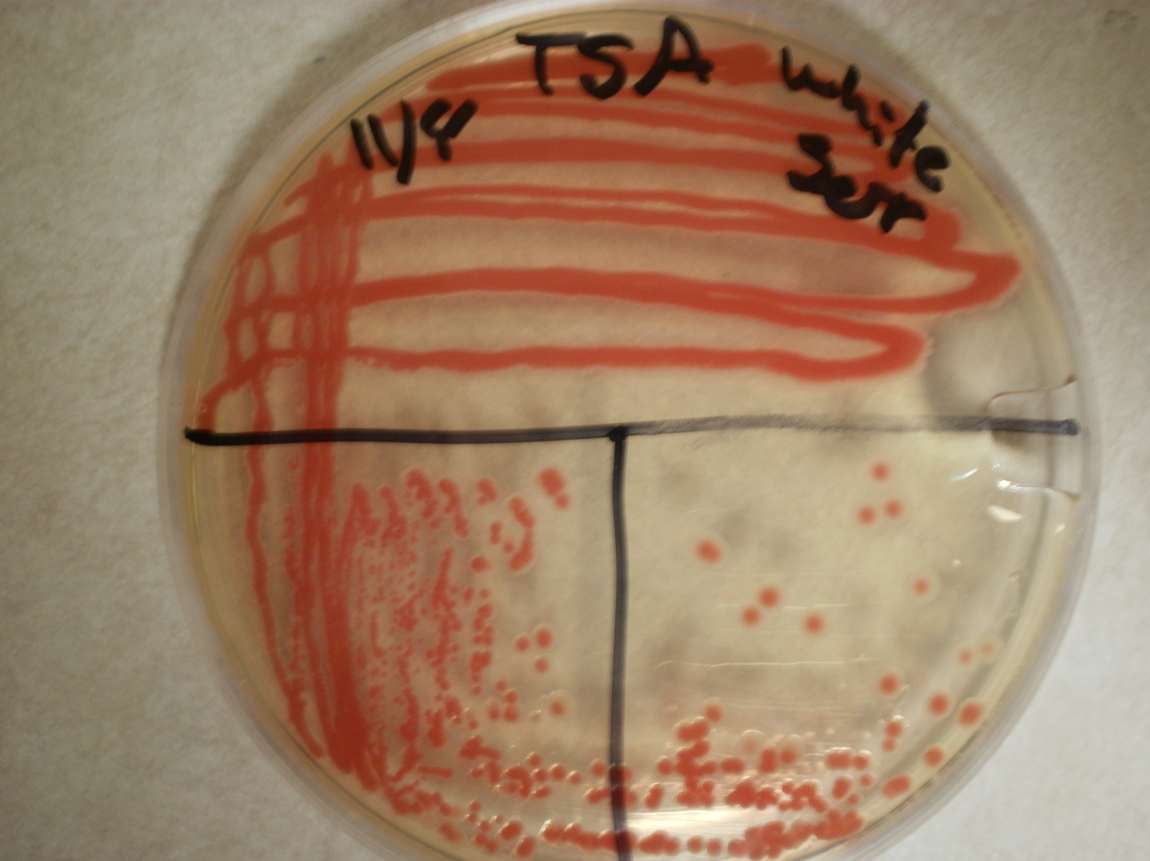

Slide 70
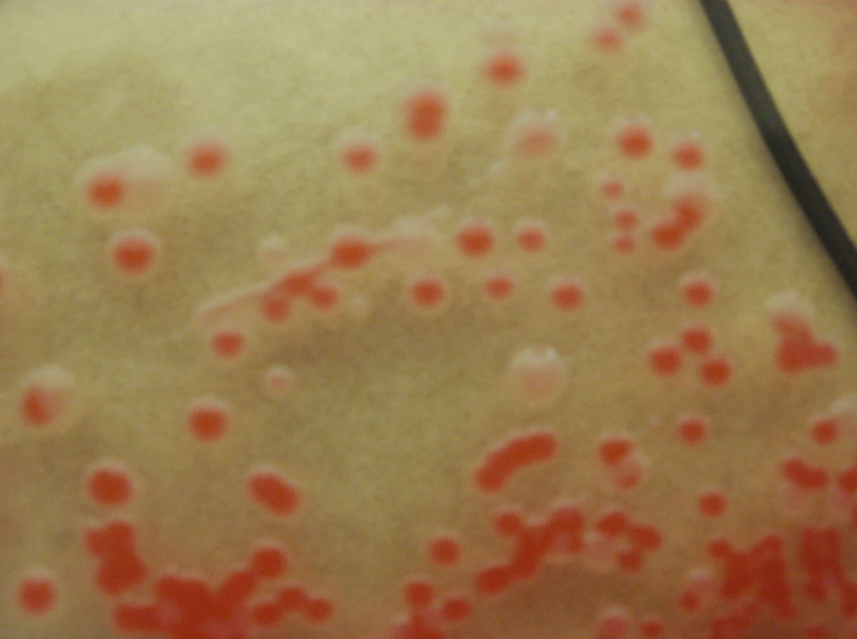

Slide 71
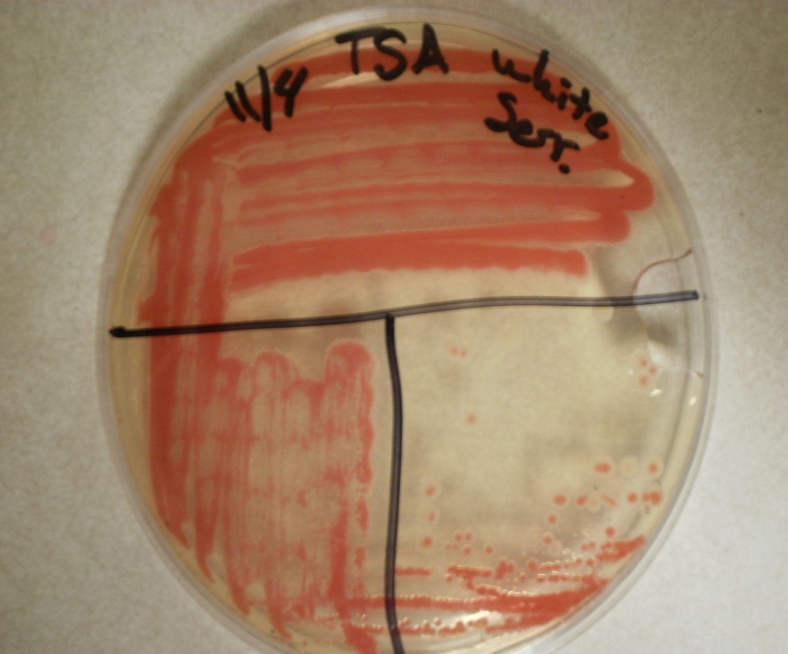
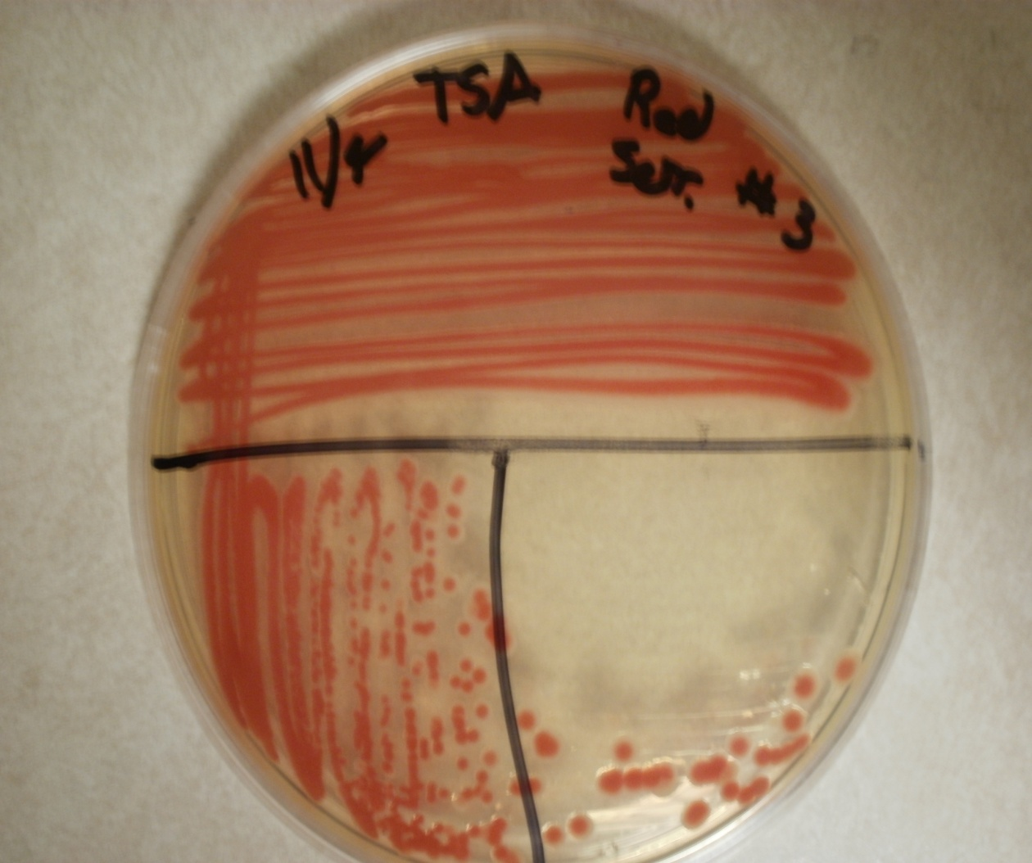

Slide 72
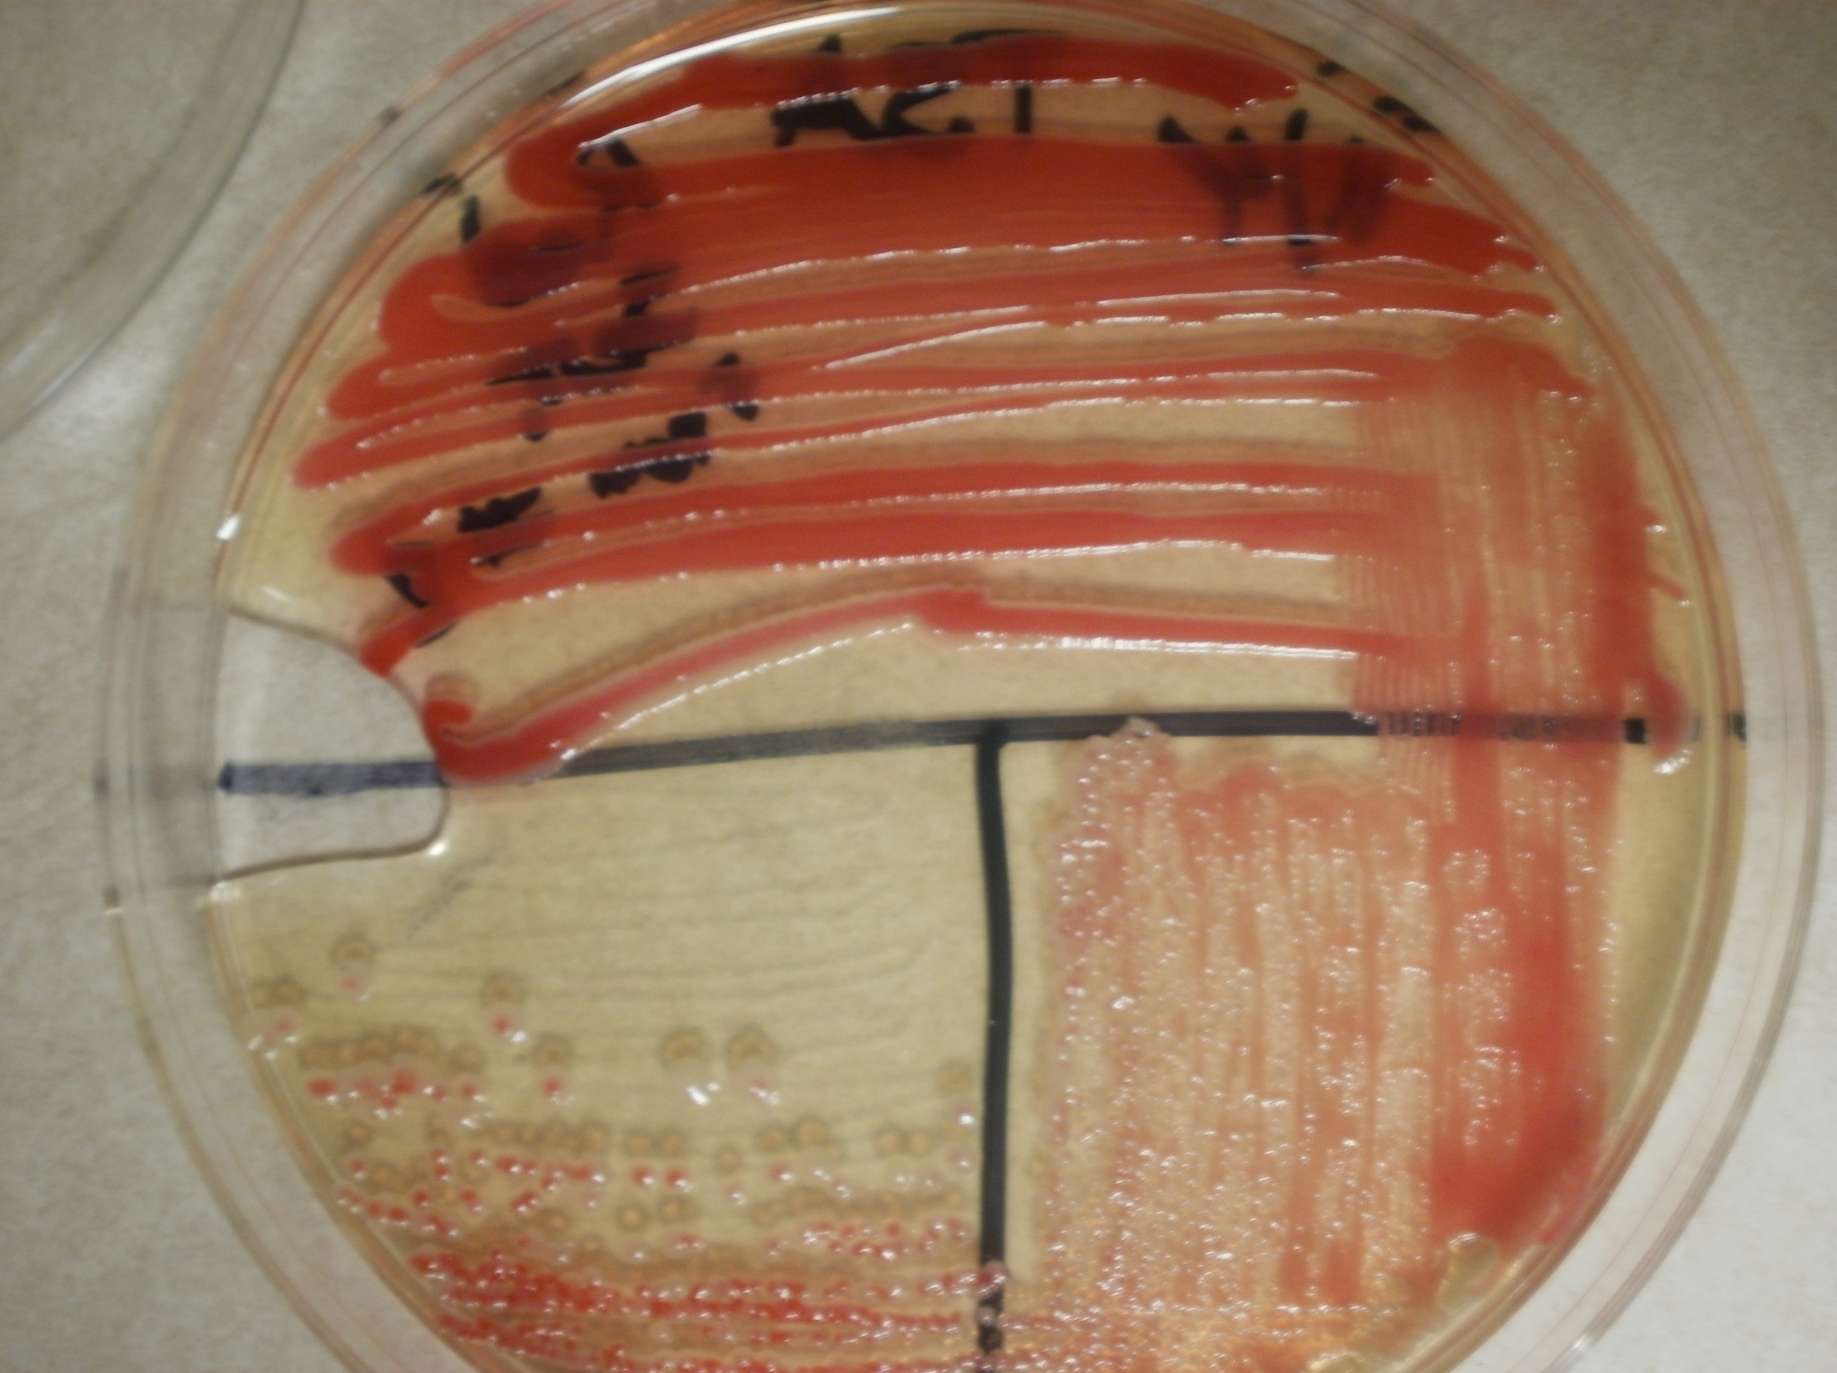

Slide 73
Flight One Conclusions
Our results were not as conclusive as we were expecting
We did have white colonies appear on the bacteria on the flight
The control plates did not have these white colonies form

Slide 74
Flight One Conclusions
We weren't able to isolate any white colonies after restreaking the bacteria
This could be due to an enzyme in many bacteria that can help promote repair of the DNA
This enzyme can be activated from exposure to less harsh UV light

Slide 75
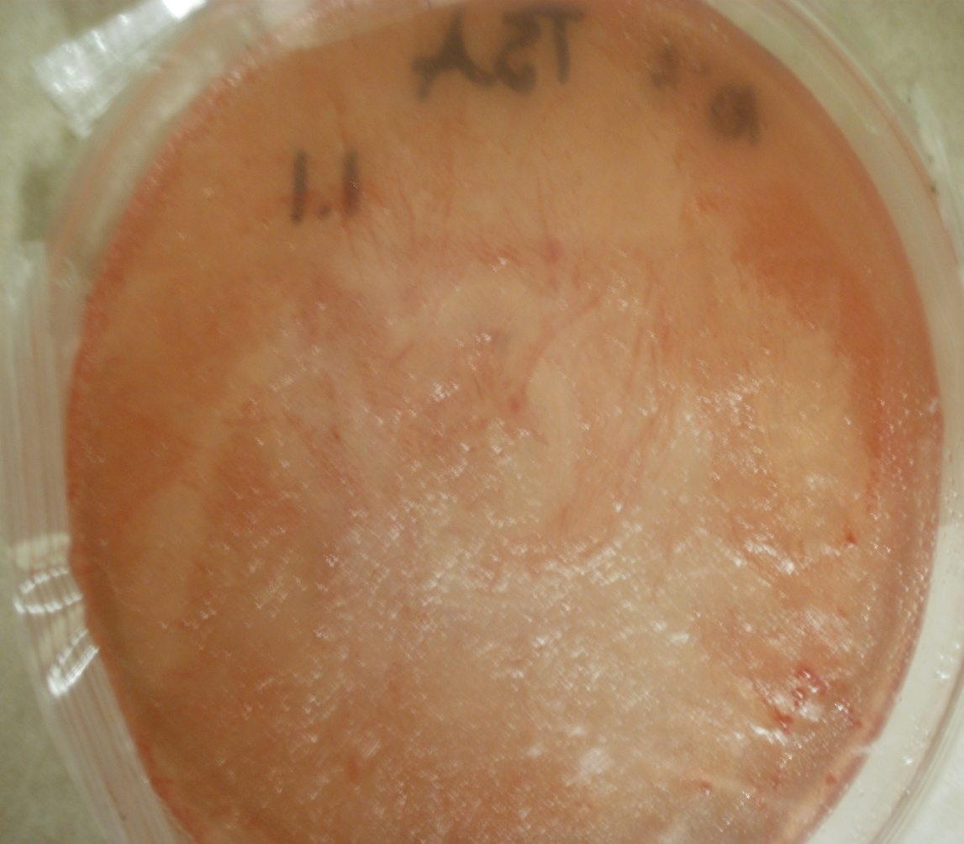
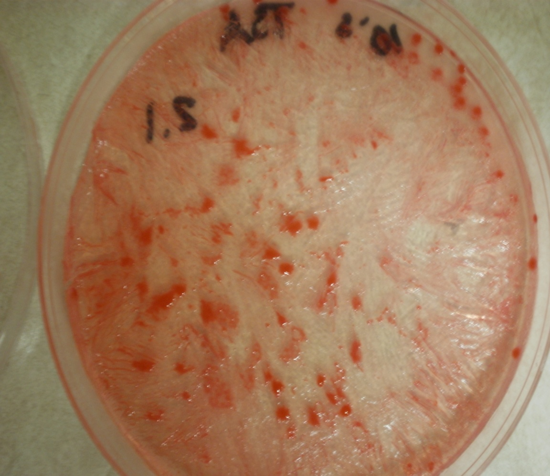
Flight Two
Outside
Inside

Slide 76
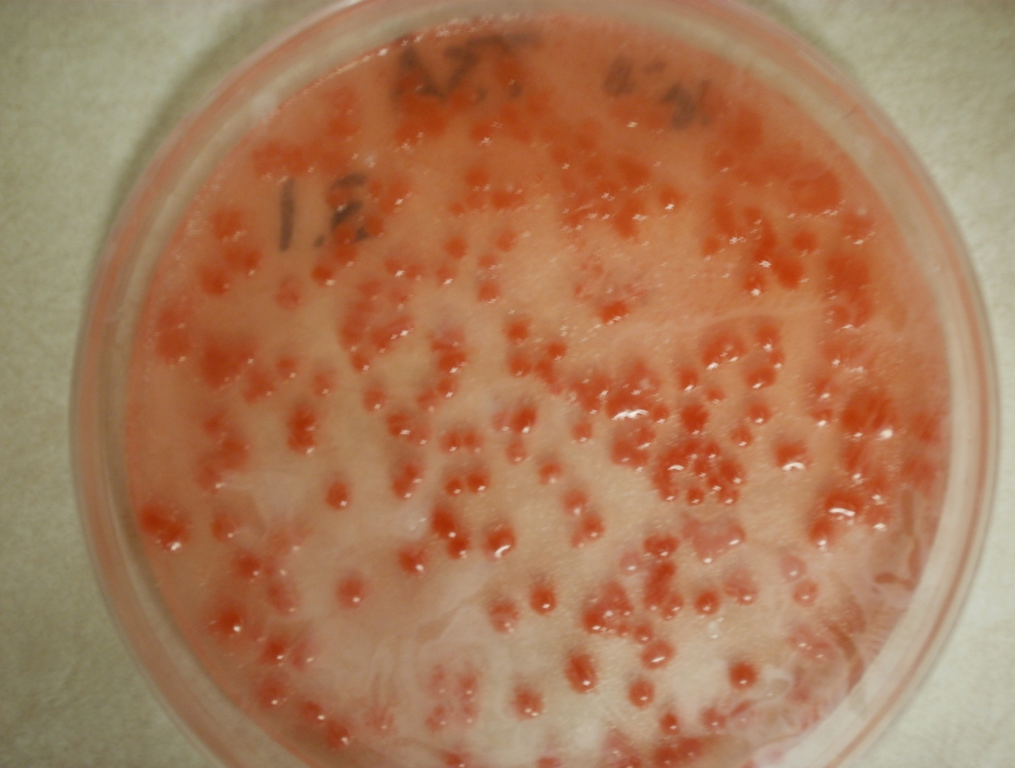
Flight Two
Tin Foil

Slide 77
Flight Two Conclusions
The agar plates on the outside and inside of the box dried up during the flight, so the bacteria weren't able to successfully grow
We suspect that they dried because the relative humidity on the second flight was much lower than the first
The tin foil plate did not dry as much because the tin foil helped to hold in the moisture
We will not be taking bacterial results from the second flight

Slide 78
Flight One Summary
Clear and cool day with temperatures around the lower 40s, little to no wind
Location was Pierz, MN at a school field
Overall it was a smooth launch
The stack overflew Barron, WI so we did not get to recover the payloads
Landed in a tree at the edge of some woods
Condition of the box was similar to preflight
Zigbee broke lose and bacteria on outside was messed up

Slide 79
Flight Two Summary
This was a rougher launch compared to the first launch
Temperatures were roughly the same, but wind speeds were higher
Launch location at public park in Danbury, MN
Fewer people to prepare stack at the launch site lead to some rushing
It also landed, but much higher this time, in a tree
It took over 3 hours to get the stack down
Heater most likely failed, but final condition of box and instruments was fine

Slide 80
Conclusions and Lessons Learned
First flight
Zigbee failure
Inability to see Galactic Gopher’s balloon
Bacteria experiment worked farily well
Payload shell and instruments survived flight and landing
Second flight
Exposed bacteria unusable
Heater failure
Camera failure
Geiger data successfully transmitted

Slide 81
Conclusions and Lessons Learned (Cont.)
Minor technical failures
Prevented us from acquiring all the data we had hoped for
From this we learned to check equipment before flight and to take charge of preflight preparation of the payload

Slide 82
Conclusions and Lessons Learned (Cont.)
From our bacterial results we learned that near space conditions include large amounts of both UV, and cosmic radiation. And that this radiation can cause mutations in DNA.
If we were to repeat the bacteria experiment over again we would try to grow the bacteria in only a dark environment after the flight to prevent activity of the repair enzyme.

Slide 83
Conclusions and Lessons Learned (Cont.)
Measure of main balloon’s expansion with altitude shows linear fit between balloon size and altitude
Experiment backed up hypotheses that “balloon expansion occurs with an increase in altitude”

Slide 84
Words of Wisdom
Communication is key to ensuring effective and efficient teamwork
Don't be afraid to think outside the box and pursue areas you are interested in, don't just do what everyone else is doing
Just because a piece of equipment has worked well in the past, always double check to make sure it is in working condition before flight

Slide 85
People to Thank
Rebecca Merica, Kathy Fryxell, Marty Wolf, Pat Goodman (Microbiology Lab Professors)
Seth Frick
Cait Mantych
Professor Flaten

Slide 86
References
http://www.weather.uwyo.edu/upperair/sounding.html
“The Effect of Altitude on Relative Humidity”
Cassidy Brooks and Isabel Huff
http://iopscience.iop.org/0952-4746/21/1/003
http://emedicine.medscape.com/article/228495-overview
Near Space: The History of Cosmic Rays
Paul Verhage

