Slide 1
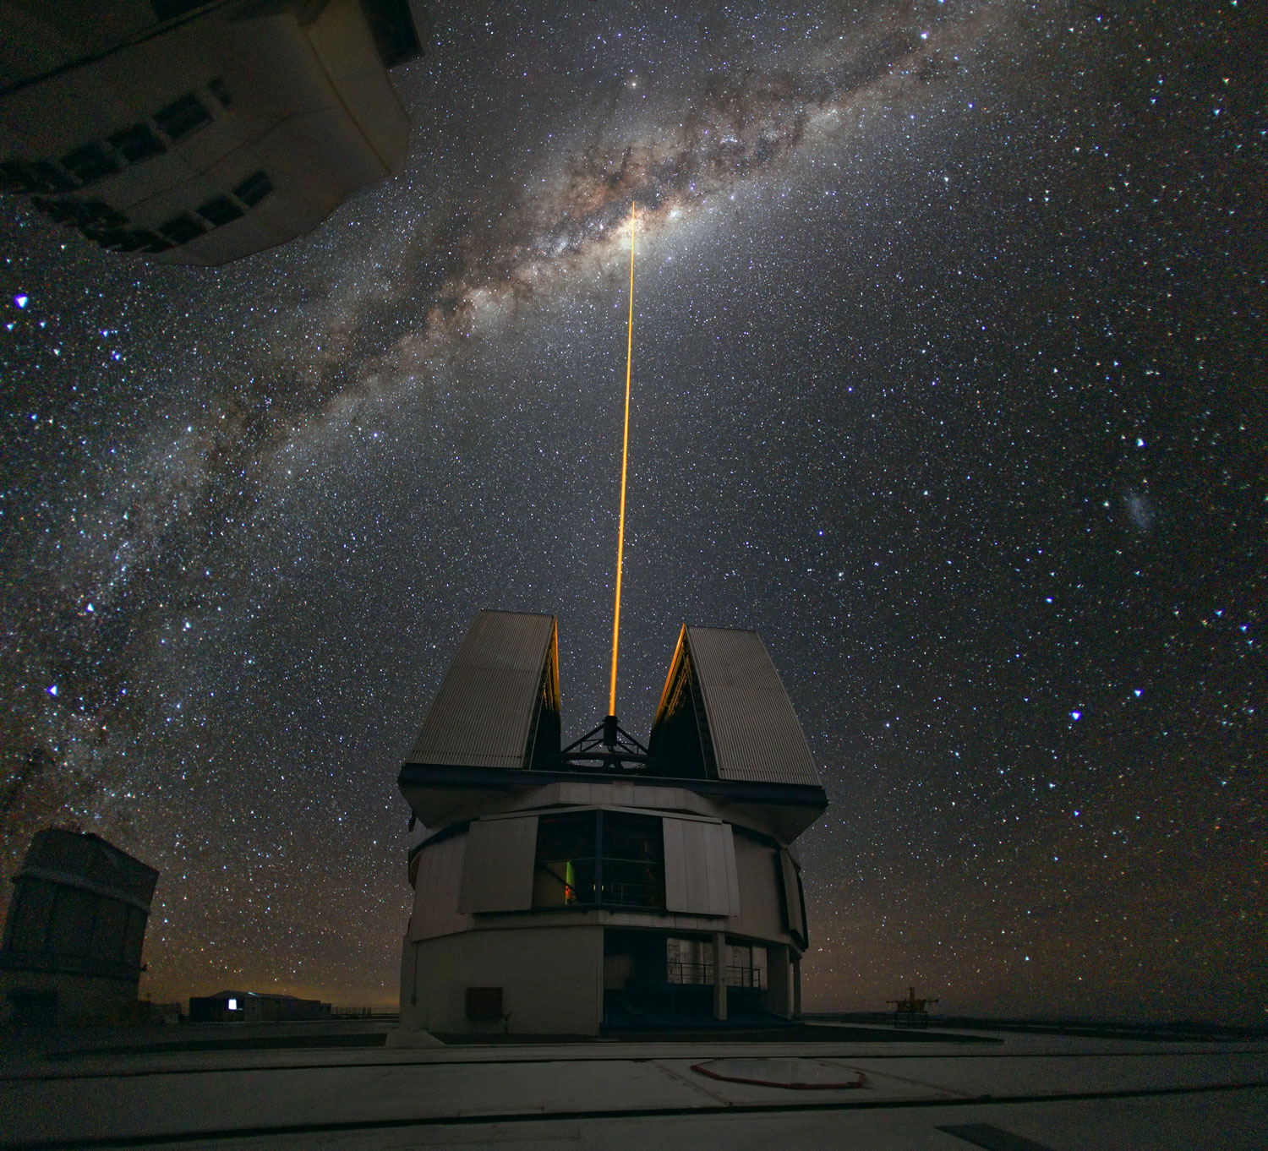
Team Icarus
Flight Readiness Review
Nick Barnes, Ethan Kapler, Henry McCabe, and Sean Grogan
AEM 1905 11-21-11
http://cache.gawkerassets.com/assets/images/4/2010/09/space-lasers.jpg

Slide 2
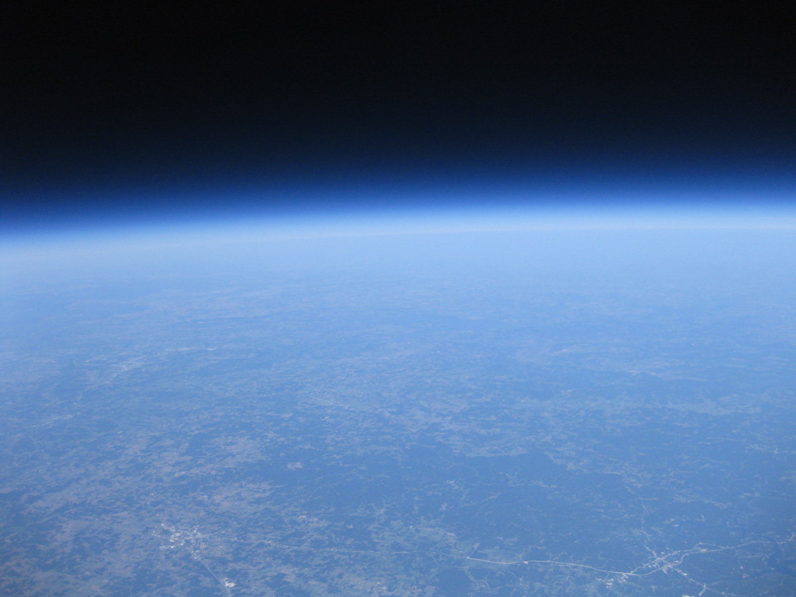
Mission Overview
Weather station
Logged pressure, humidity, and inside/outside temperature.
Compared data to time, as well as altitude
Will compare this to expected results and see how they differ
http://www.batee.com/projects/balloon/balloon_3/pics/IMG_4884.JPG

Slide 3
Mission Overview
To take pictures of the sun’s corona.
Procedure: used a camera mounted on a turntable with photo sensors, use servos to keep the camera pointed at the sun.
We used a strip instead of a dot to block out the sun so that the stabilizing was in only one direction.

Slide 4
Mission Overview
A secondary experiment to the mounted camera
Used a mounted video camera at an angle of 30 degrees to attempt to catch the sun’s corona in a single frame of video
We blocked half of the lens so as to create a greater chance of (partial) coronal view.

Slide 5
Management/Org Chart
Team Leader: Nick
Ethan
Henry
Sean
Project Budgets
Mission Overview
Introduction
Payload Design
Payload Photographs
Project Manage-ment
Conclusion
Test Plan and Results
Results and Analysis
Expected Science Results
Photographer
Launch and Recovery
FRR
Weather Station
Camera and Camera Experiment
CDR
Payload Box Build

Slide 6
Org Chart cont.
(Ethan)
(Kieran)
(Sean)
(Nick)
HOBO
Prediction
Flight Computer
Photographer
Other
Programmer
Recovery
Payload Handling
Balloon filling

Slide 7
Schedule (In-Class)
Sept 27: CDR proposal Due
Oct 4: Build Session
Oct 5: Essay A1 due
Oct 6: Essay A1 peer review due
Oct 11: Check out of various systems
Oct 12: A1 final draft due
Oct 14: Rev A due
Oct 18: Flight Readiness review
Oct 25: Flight Predictions
Oct 27: Payload due
Oct 29: Payload Launch Day
Nov 1- Dec 13: Analysis of data and continue on essay and revisions

Slide 8
Schedule (Out-of-Class)
Oct 4: Build session
Weeks of Oct 3- Oct 17: build sessions according to individual availability.
Weeks of Oct 3- Oct 17: weekly group check-ins to discuss progress, difficulties and what needs to be done/ improved on.

Slide 9
Cost Budgeting
Ball Joint Rod End- $8
Washers/Nuts- $4
Heater- $5
Heater Battery- $6
Weather Station- $50
BalloonSat Easy Flight Computer- $50
BSE Battery- $2
FLIP Camera- $140
HOBO Data Logger-$130
Geiger Counter- $150
Zigbee- $300
Hobo Accelerometer- $75
Total-- $920

Slide 10
Cost Budgeting (revised)
Heater- $5
Heater Battery- $6
BalloonSat Easy Flight Computer- $50
BSE Battery- $2
FLIP Camera- $140
HOBO Data Logger-$130
Servo-$18
Acrylic Dome-$12
Turntable-$4
Vivatar camera-$50
Total:$420
Difference between both prices: $500

Slide 11
Mass Budgeting
Ball Joint Rod End: .25lb
Servos: .04lb
Adapter: >.04lb
Camera: .386lb
Nuts/Washers: > .06lb
Hobo Logger: .11lb
Heater: .05lb
Heater Battery: .33lb
Accelerometer: .037lb
BSE Flight Computer: .072lb
BSE Battery: .10lb
Zigbee: .28lb
Geiger counter: .41lb
Structure: >.32
Total:2.485

Slide 12
Mass Budgeting (revised)
Heater: .05lb
Heater Battery: .33lb
BSE Flight Computer: .072lb
BSE Battery: .10lb
Structure: >.32
Servos: .04lb
Flip Camera: .386lb
Hobo Logger: .11lb
Servos: .04lb
Acrylic Dome:.38lbs
Turntable:.28lbs
Vivatar camera:.61lbs
Total:2.718 lbs
Difference between both prices: Heavier by .233 lbs

Slide 13
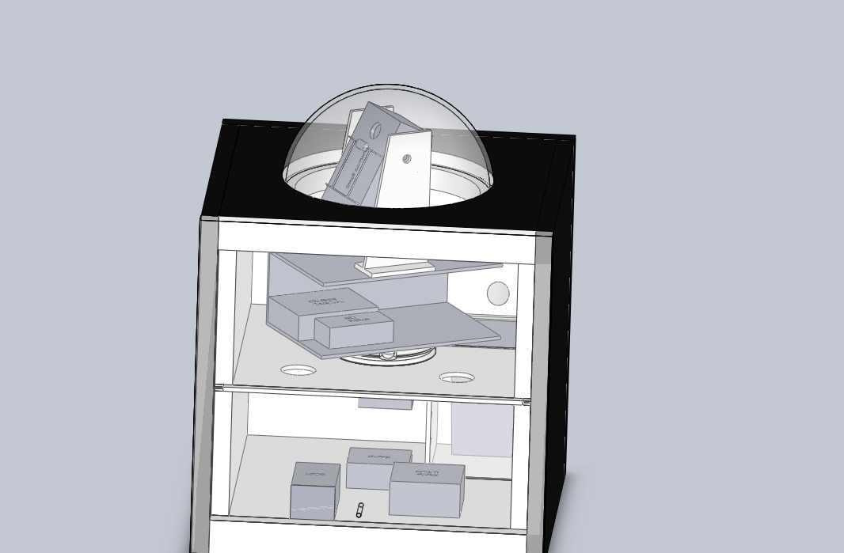
Design

Slide 14
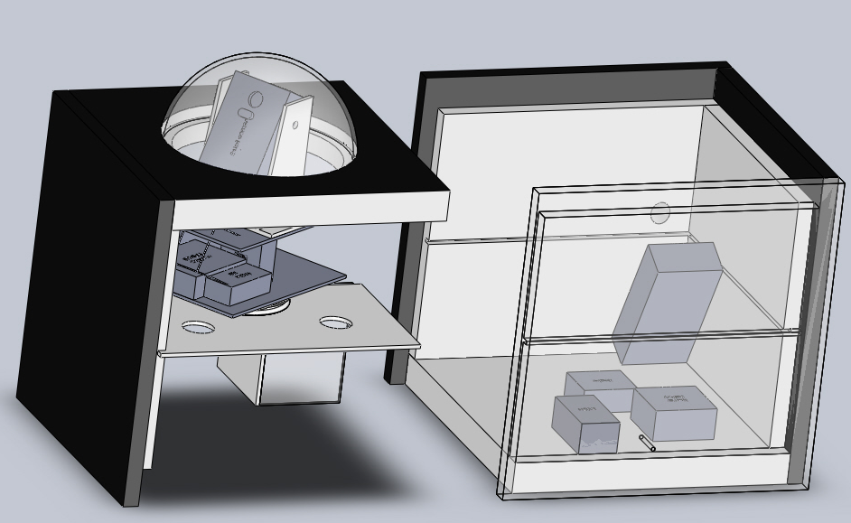
Design

Slide 15
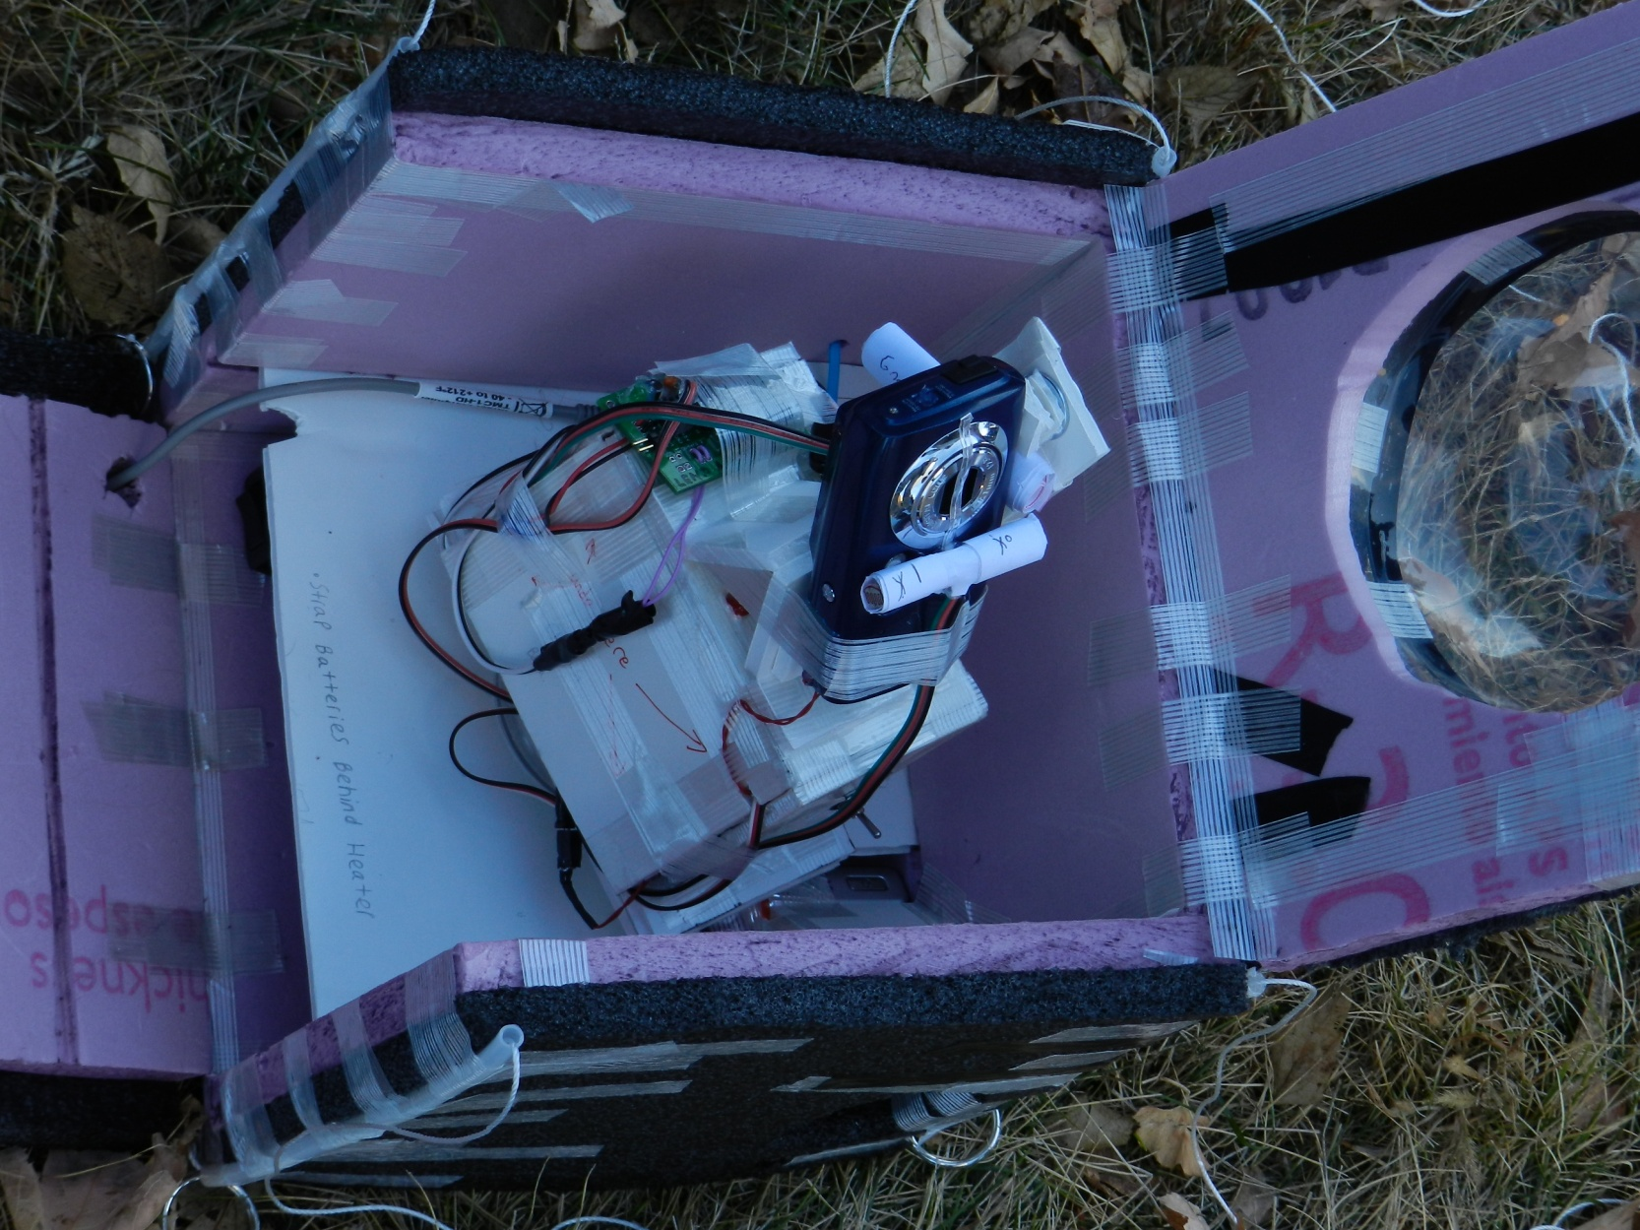
Design (Final)

Slide 16
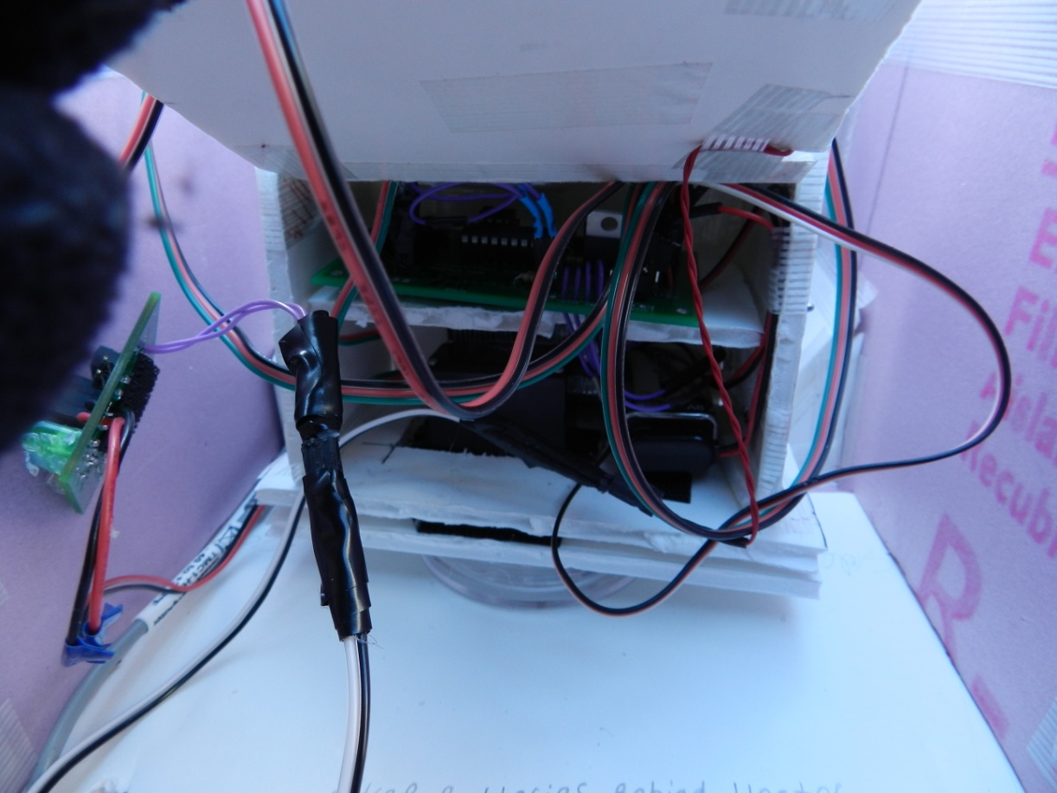
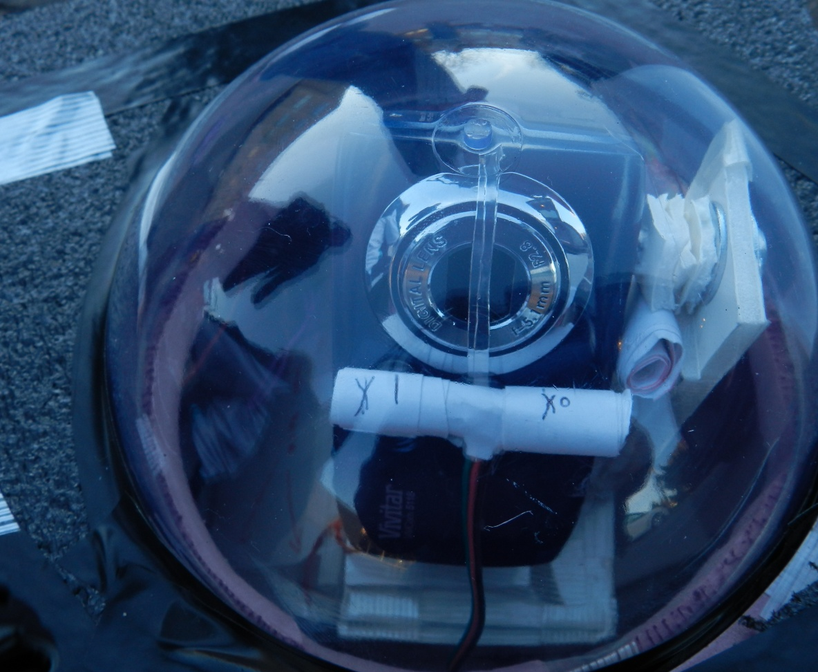
Design (Final)

Slide 17
Test Results
Our BSE Flight computer was tested and hooked up to a camera, weather station, and servo.
The BSE was also connected to a pc and a diagnostic test was ran on the computer and all systems were nominal.
The Weather station was able to collect data,
The servo went through a diagnostic test•
Our structure was tested in a cold chamber

Slide 18
Test Results
Payload changed so a second drop may be necessary
The only thing(s) remaining to be tested:
the whole assembly works with all its components when everything is put together and put in the box.
This is our final test to do once everything has been assembled. This will hopefully be tested sometime late Tuesday, or on Thursday.

Slide 19
Test Results
Drop test- passed
Heater has been difficult to get to run consistently, but it passed the cold test
We may want to run another cold test or do more testing of the heater
Concerns are in the camera mounting and motion system, would be optimal to do a flight test, but we can’t do one, and have to rely on mentor input.

Slide 20
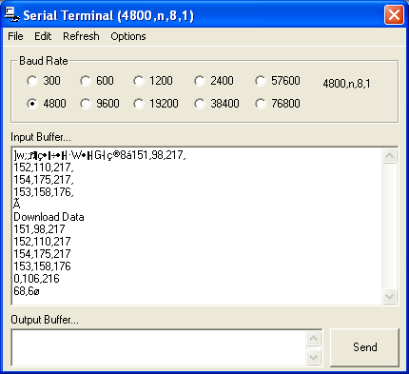
BSE Test

Slide 21
HOBO/Heater Test

Slide 22
Expected Science Results
Corona experiment
Expected results: We hope to see more clarity of pictures as we get higher in the atmosphere. Very difficult experiment, but interesting results.

Slide 23
Expected results
Geiger counter
We expect to see the radiation levels increase significantly with altitude. We will compare with other group to see the difference made by tin foil shielding .

Slide 24
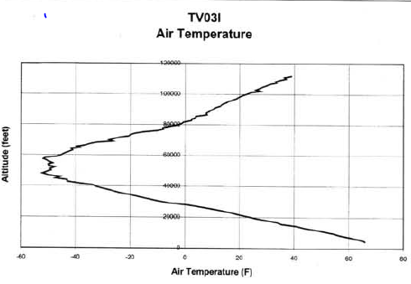
Expected science results
Ref. Paul Verhage Feb 2004
We expect to see temperature drop until around 50,000 feet of altitude (stratosphere), then level off for around 5,000-10,000 feet, and then steadily increase with altitude.

Slide 25
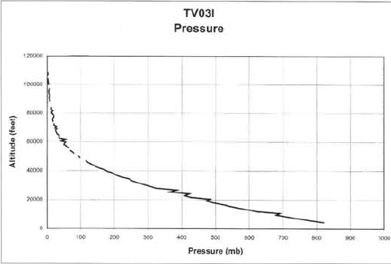
Expected Science Results
We expect the pressure to steadily and linearly decrease until around 45,000 feet, and then asymptotically approach 0 millibars after that.

Slide 26
Flight day.
The launch occurred on October 29, it was launched out of Gustavus Adolphus College in St. Peter Minnesota, and was recovered two miles south of Hollandale Minnesota. The Icarus Payload was flown twice because of camera problems. The second flight was launched out of Northfield Minnesota and recovered south east of Menomonie Wisconsin.
Both launches went relatively smoothly, hardly any problems arose during the launches. Tracking of the second launch was quite smooth as well, a strong signal was maintained during the entire chase, the first launch however lost communication during flight, and tracking was made much harder.

Slide 27
Flight Day
The payload for both launches was nearly pristine in each case. The payload was unharmed in both cases (pictures of before and after are in the proceeding slides).
On both flights the cameras and in particular the servos were running, this is known because the servos make a distinct sound when they are rotating. Unfortunately, just before the first flight, the Vivatar camera ceased to take any pictures, but during the second flight of the payload, the camera captured over 5 thousand pictures. We believe that something may have been bumped before the first flight, the problem was resolved though.

Slide 28
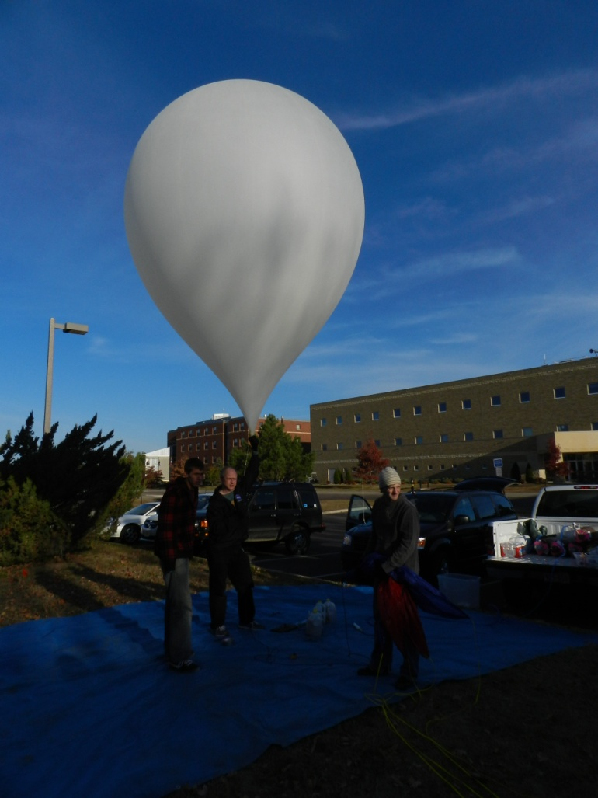
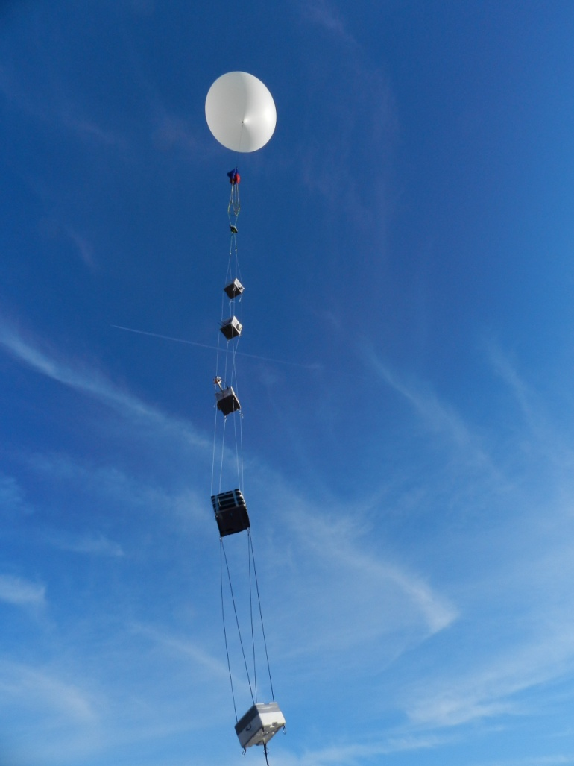
Flight Day Pictures
Below: Balloon inflated and ready for the payloads to be attached
Right: Balloon being launched with all of its payloads, and tracking devices.

Slide 29
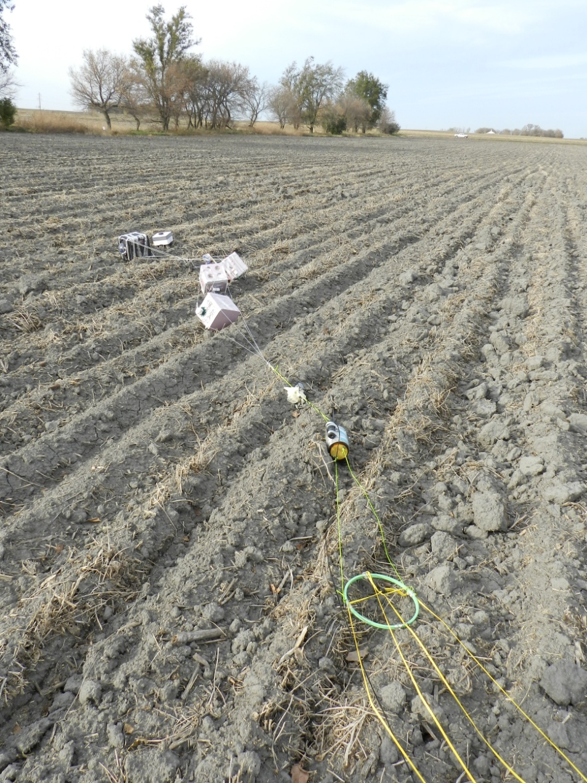
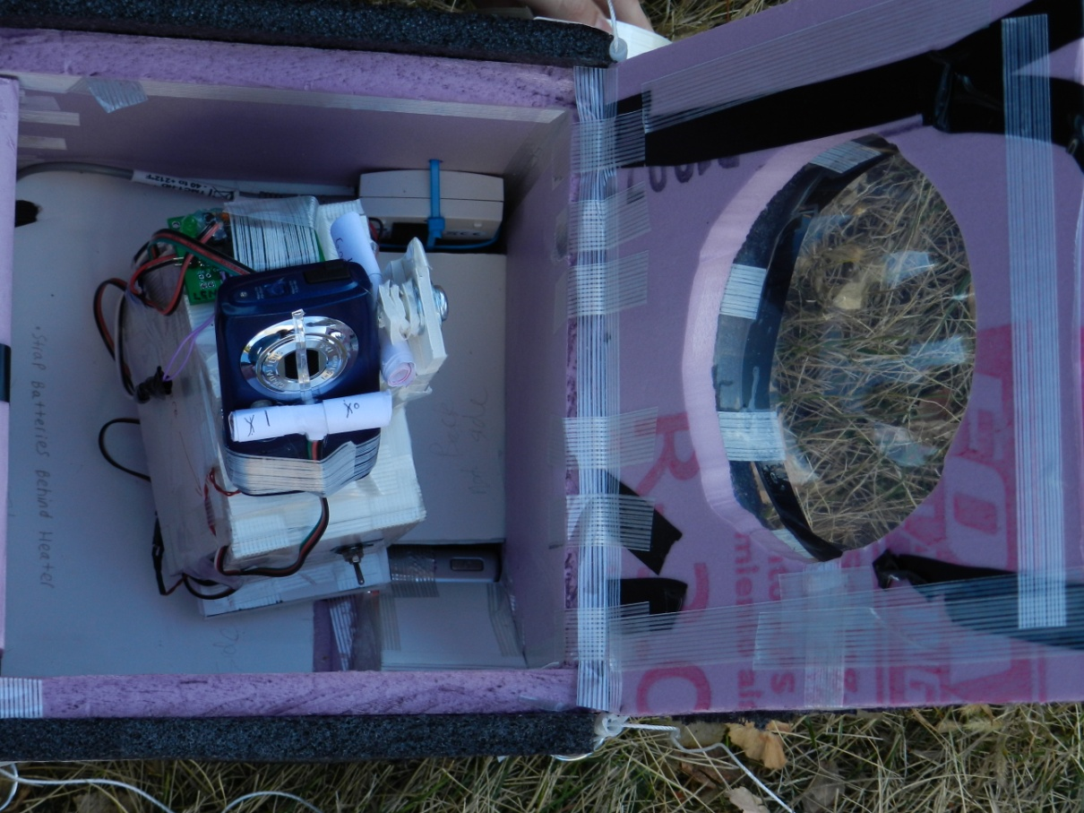
Flight Day Pictures
Right: the order in which the payload landed, and the untouched state of the payloads
Below: Icarus payload, all ready to be taped up, this is just before launch.

Slide 30
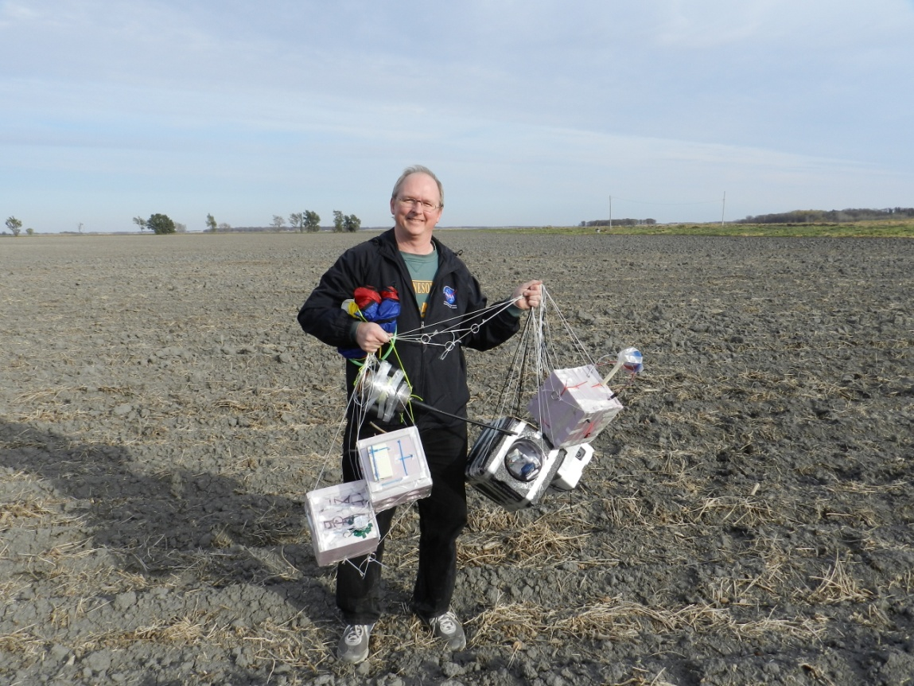
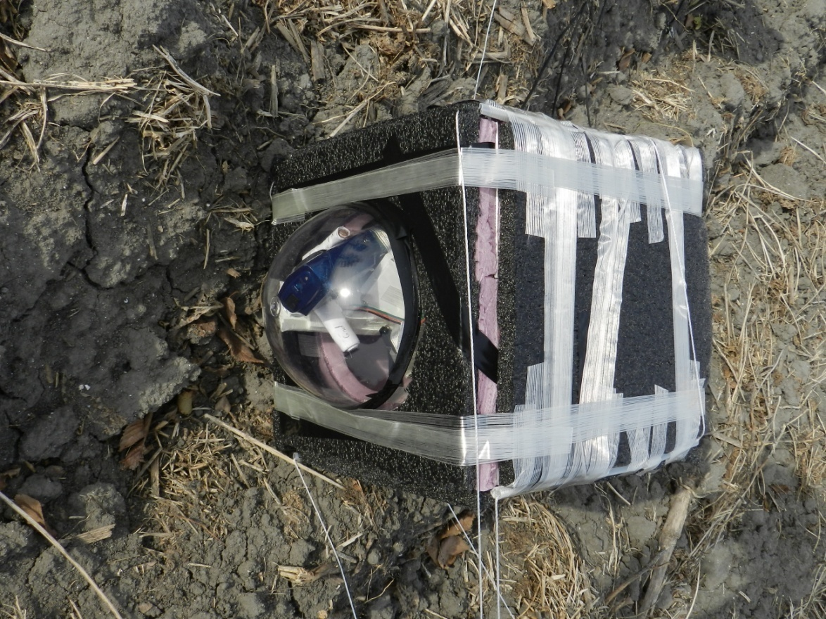
Flight Day Pictures
Below: Team Icarus’s payload before being retrieved to be turned off.
Above: Dr. Flaten with the recovered payloads.

Slide 31
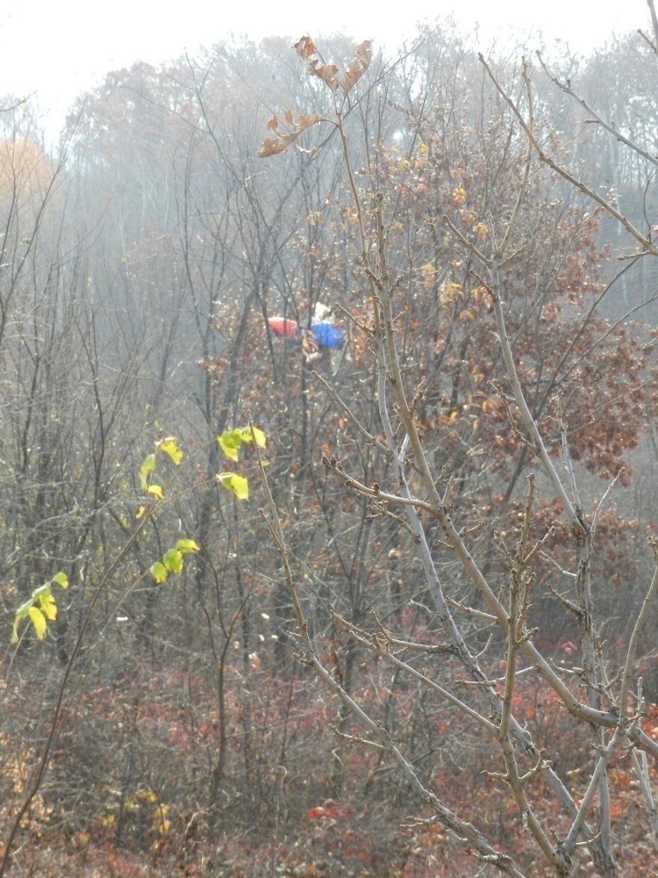
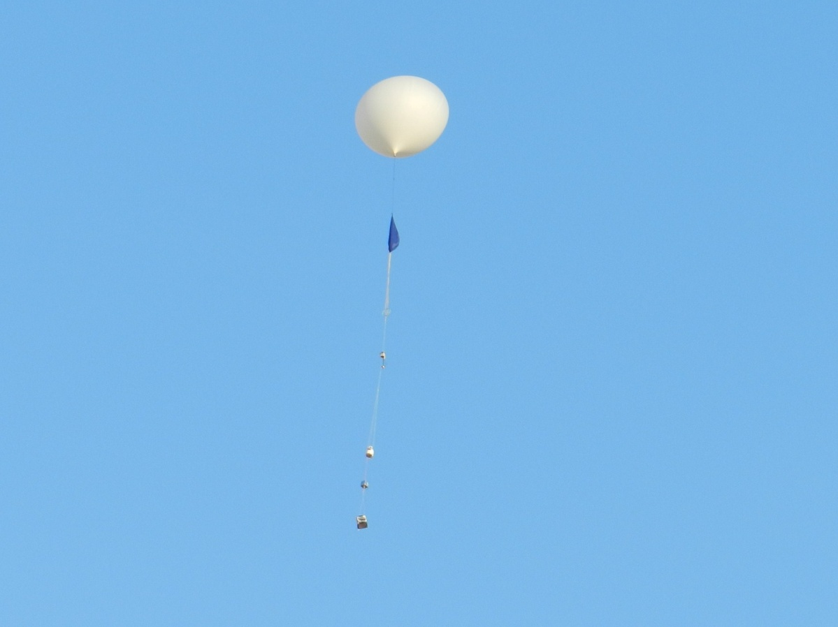
Flight Day Pictures
(from Launch 2)
Right: Location of second balloon upon arriving at the retrieval site.
Below: Day 2 payload launch.

Slide 32
Science Results (HOBO Data)
The internal temperature decreases until the balloon reaches chaos(besides the dip in the graph showing where the stratosphere began.) Once the balloon pops, the internal temperature increases until it reaches the ground and then settle around 70°F. The lowest temp. that the inside of our payload got to was about -8°F. Our heater worked but not the best it could have.
The relative humidity seemed to people kind of sporadic. From T=0, the humidity decreased to about 5% but then jumped up to 22% and back down to 0%. This is when the balloon popped. Once the balloon popped, the humidity started to increase until almost 100%. After the peak, the humidity decreased drastically and settled at around 10%.

Slide 33
HOBO Data cont.
The external temperature followed the same trend as the internal temperature just more colder. The external temperature decreased until it reached the stratosphere, and reached about -70°F. Once the stratosphere was reached, the temperature began to increase and then decrease to -70°F again. During descent, the temperature rose until it settled at 50°F. The reason this is lower than the internal temperature even though it was on the ground is because the heater was on. This shows that our heater did work.

Slide 34
Flight Analysis
Launch was approximated at 7.25 minutes into data.
We can estimate that landing was around 92 minutes into flight from data.

Slide 35
Flight Analysis Cont.
(On the left): Another graph showing temperature. Similar to graphs previously shown.
(On the right): This graph shows that as the balloon traveled through the troposphere the temperature decreased steadily. As the balloon reached the stratosphere and got closer and closer to chaos, the temperature began to rise again.

Slide 36
Flight Analysis Cont.
(On the left): This graph is very similar to the graph shown earlier. The humidity increased and then decreased during the ascent. Right before the balloon popped, humidity was increased to a peak. After chaos the humidity continuously decreased until it reached the ground.
(On the right): As seen, the humidity decreased until the balloon was about 20000ft above sea level. The humidity then increased until about 40000ft and then started to decrease until the balloon reached its maximum altitude.

Slide 37
Flight Analysis Cont.
(On the left): The pressure decreased until chaos and then increased until the balloon reached the ground.
(On the right) This is the most simple graph collected. As the altitude increases, the pressure decreases.

Slide 38
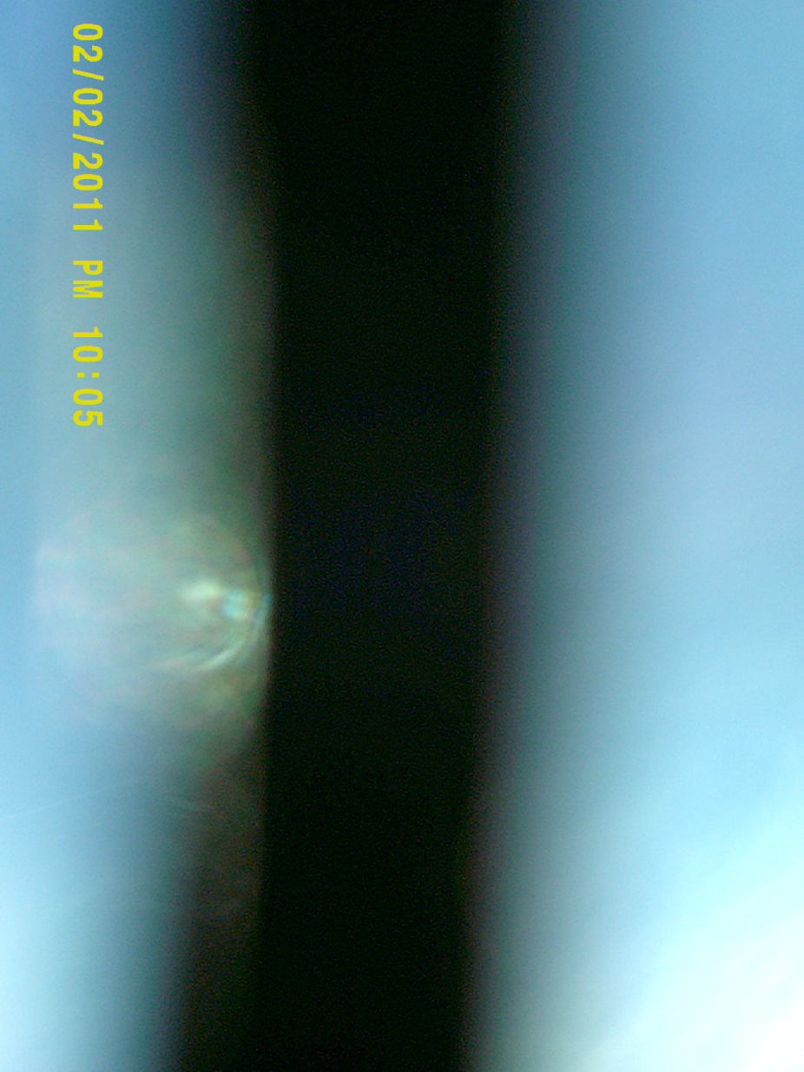
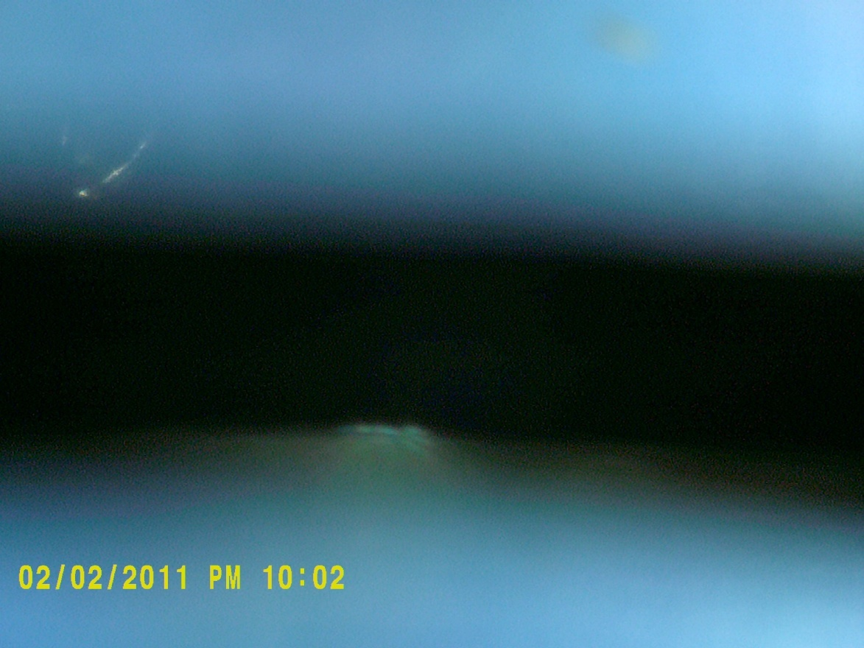
Possibly Successful Photo’s
These are possibly successful photos catching the edges of the suns corona, they could be glitches or misinterpretations.

Slide 39
Conclusion
Sun’s Corona Experiment: This one failed our first flight since the camera got disconnected and stopped taking pictures before it left the ground. We then re-flew the same setup on the second flight and it took numerous promising pictures.
Sun Tracking System: This experiment worked on both flights and, as far as we could tell, correctly pointed the camera towards the sun. However, the servo we used could not quite keep up with the rotation of the payload, and so it was not perfect. If we could fly it again we would get a faster motor that continuously ran to correct for rotation in the stack.
Flip Video Camera: This was a backup for the still camera in case it did not work. The first flight it took video from launch until after landing and did have some good pictures of the sun, but it was not needed after our primary experiment worked on the second flight.
Hobo Data: The Hobo correctly logged data throughout the entire flight. The data also matched up with the expected results.

Slide 40
Words of Wisdom
Pick an experiment that you will enjoy.
Do not go too complex. Try to keep it simple yet interesting and meaningful.
Even out the workload. Don’t cram the week before the flight.

Slide 41
Special Thanks
Philip Hansen
Vishnu Mallik
Joey Senykr
Alex Ngure
Dr. Flaten

Slide 42
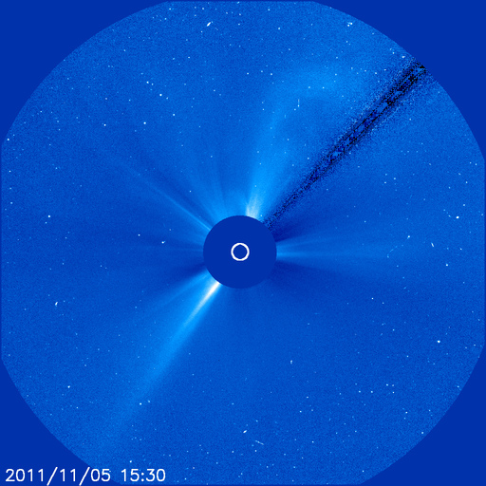
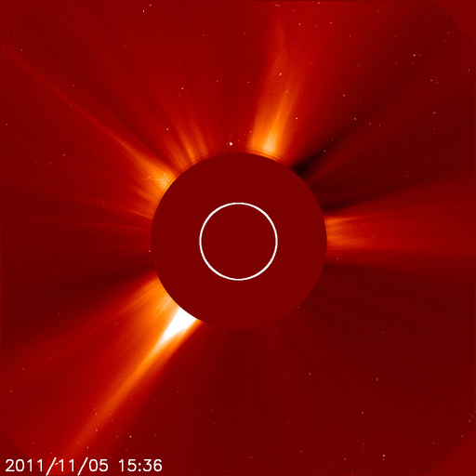
Post Script: What SOHO saw.

