Slide 1

Team NASA
Final Team Presentation
Zach Fadness, Travis Bridell,
Dan Bakke, Nate Randall
AEM 1905 Spaceflight with ballooning
11/22/11

Slide 2
Mission Overview
Diagnose light patterns with changes in altitude
  By using a Diffraction Grating, we will separate the light from the sun into the color spectrum. This will be captured by our camera inside of our box. We hypothesize that the color spectrum will become more clear with less missing colors as the altitude increases.

Slide 3
Mission Overview
Determine magnetic field strength
  By using an Arduino with a Micromag, we plan to record magnetic orientation throughout the flight. Our hope and hypothesis is that the magnetic field will lessen with distance from the core

Slide 4
Mission Overview
Document internal temperature
  This will be accomplished with a HOBO. We expect the internal temperature to get a little colder, but not to get as cold as the external temperature, due to our internal heater.

Slide 5
Mission Overview
Characterize external temperature, pressure, and humidity using onboard weather station
  Temperature: it will decrease as it rises through the troposphere, but then increase as we enter the stratosphere as we get closer to the ozone layer which captures UV heat from the sun
  Pressure: it will constantly decrease down, closer and closer to 0. Theorists say that pressure can be viewed as how much “is above you.” As we get higher into the atmosphere, there is less and less air above our object pushing us down
  Humidity: we expect it to decrease as we get into higher areas in the troposphere because the temperature drops so low that the air can’t hold as much water as before. After that, it gets too cold for water to rise any farther, so humidity should drop down to near nothing

Slide 6
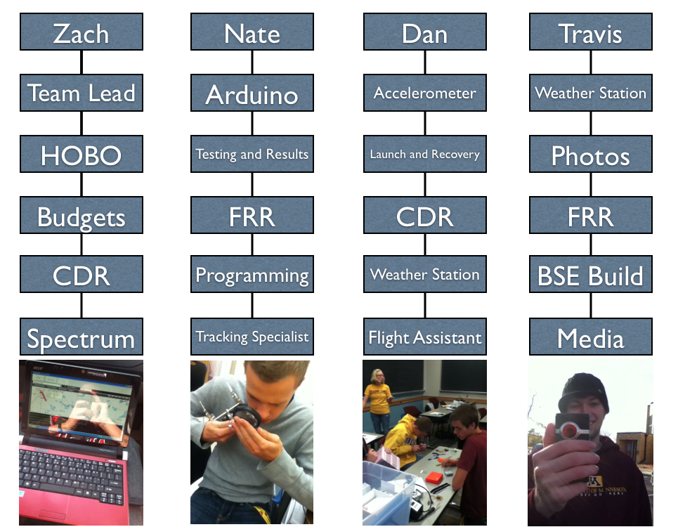
Org Chart

Slide 7
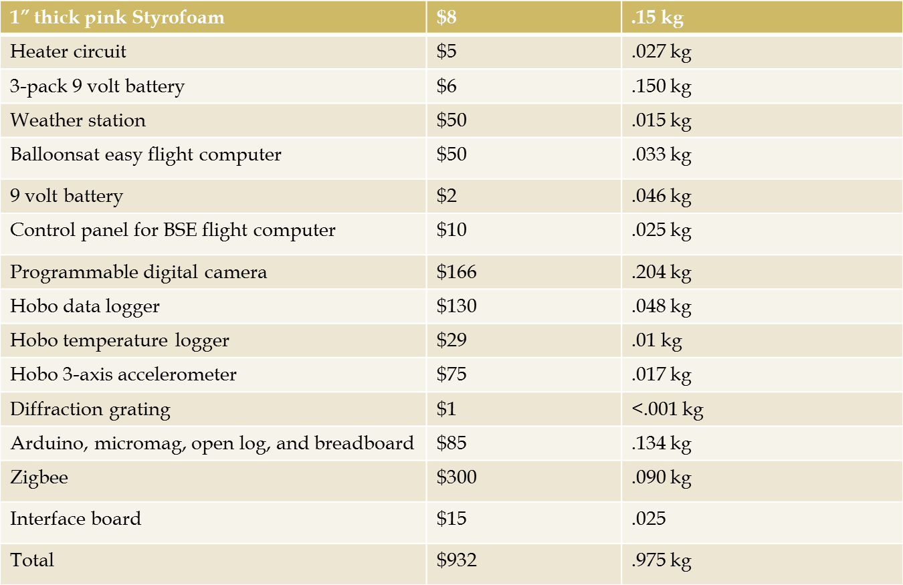
Budget and Mass

Slide 8
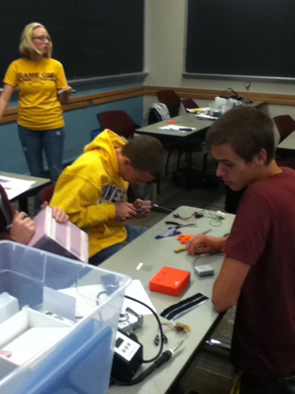
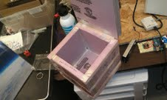
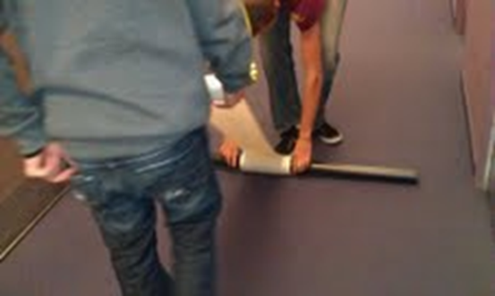
Construction
Our empty box
Wiring of the BSE Flight computer
Unraveling of the paper towel to reach our spectrum tube

Slide 9
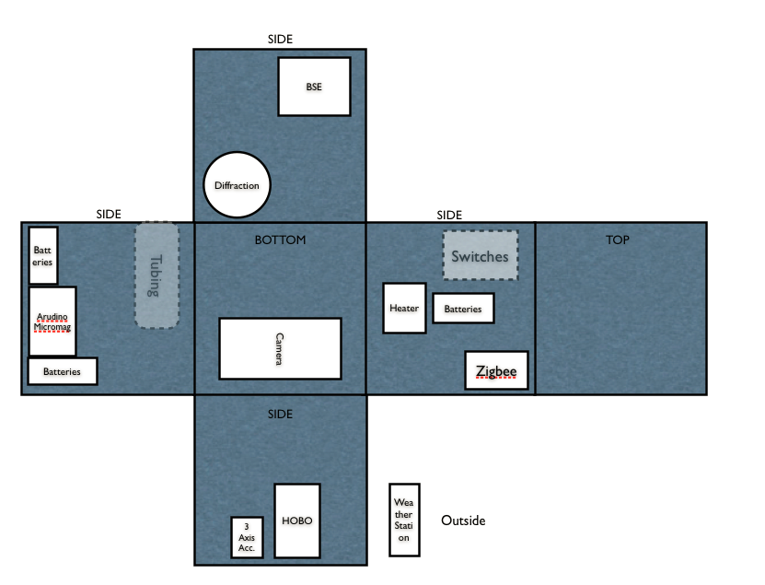
Payload Layout

Slide 10
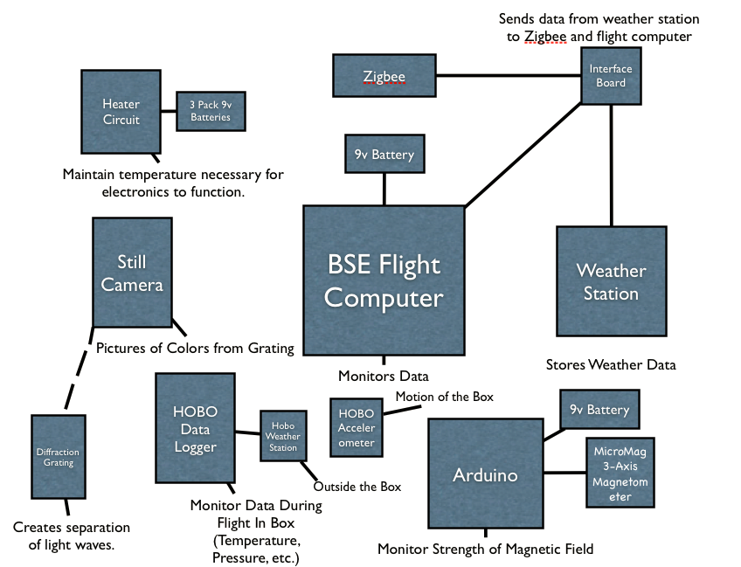
Functional diagram

Slide 11
Programming
BSE
  Our BSE is programmed to accept data from our weather station in the forms of temperature, pressure, and humidity. It will store this information, but also transmit it to the Zigbee radio
HOBO
  The hobo will be programmed to take internal and external temperature readings every three seconds. It will continue to run until it has no memory left or until it is plugged into the computer. Also, it will track humidity inside the payload

Slide 12
The Cold Soak
  From our experiment, we saw that our internal heater was strong enough to keep our payload insides at or above room temperature for most of the experiment even when the outer temperature reached -15
We did not have to make any changes to our heater

Slide 13
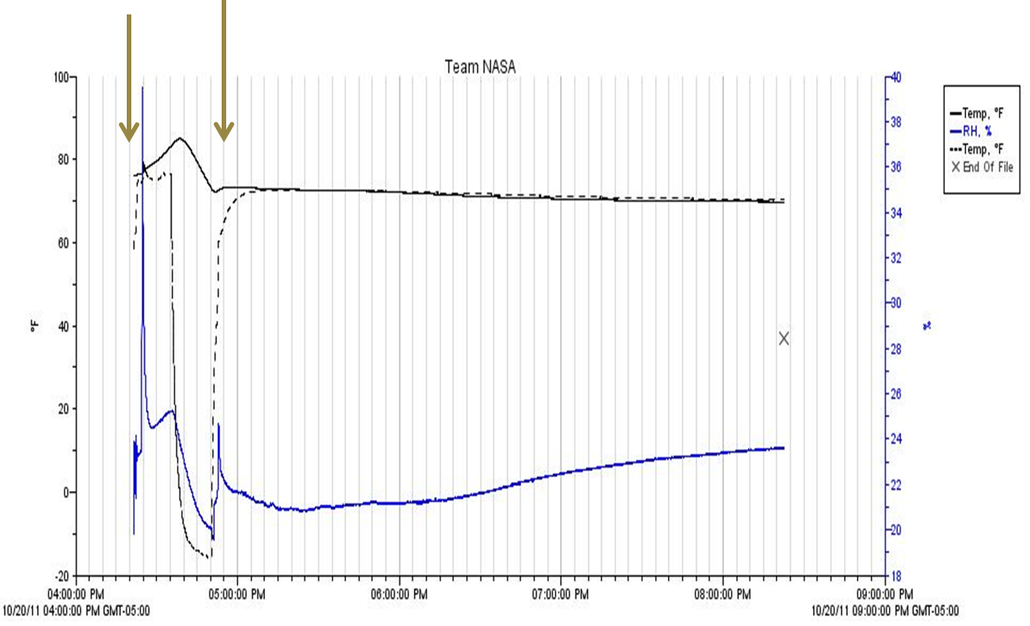
The Cold Soak Graph
This is the interval when our test took place
This shows that internal temperature raised until the cold soak began, at which point internal temperature only dropped back roughly to the original temperature

Slide 14
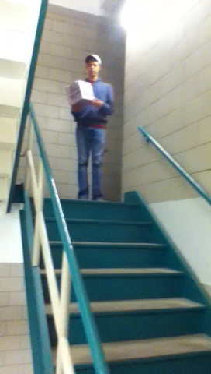
Drop Test
  Our payload was successfully dropped the first time. It did not take any serious damage, and it should be able to survive the flight

Slide 15
Diffraction Grating
  We figured out that it would be best to actually have the grating on the lens, then position the entire thing at an angle against the slit, so now we have repositioned it to get the best picture. Instead of sitting flat on the bottom, it is angled against the side.
  We are also running a cardboard tube into another cardboard to decrease the glare and see less of the actual slit we made of tape

Slide 16
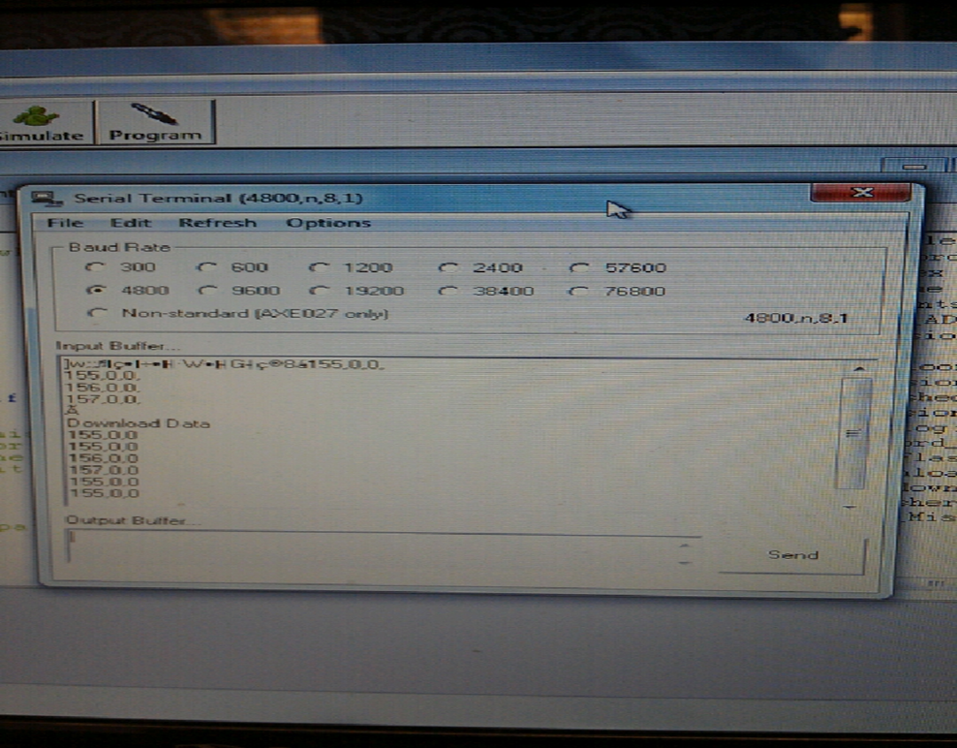
Weather Station
  After one piece malfunctioned, so did another so all we had left is temperature. So we may have to use another weather station.
Note: it was still able to
take down temperature
and download it afterwards

Slide 17
Arduino board
At the beginning of using the Arduino, it was not working at all. Then we reprogrammed the coding, and that seemed to do the trick. Unfortunately, this wasn’t until two days before flight, so we did not have time to figure out what any of the data would really mean.

Slide 18
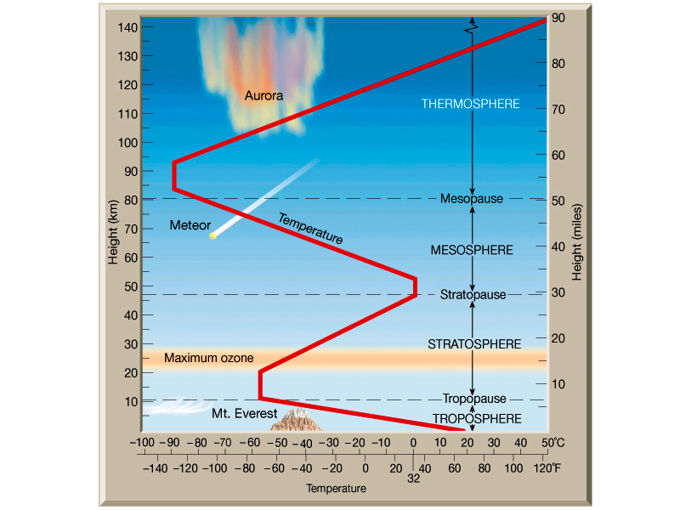
Expected Science Results
Temperature
As you can see by the
Graph, the temperature
Decreases until it hits
The Stratosphere
Where temperature will
Begin to rise again. This
Is because it begins to
pass through the Ozone
Layer which absorbs all
types of radiation and
heat energy. Source is
Julie Malmberg, a
Professor from Colorado

Slide 19
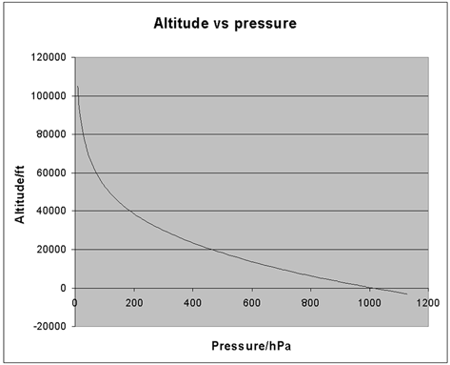
Expected Science Results
Pressure
As we increase in altitude, we expect to see exponential decay of the pressure, according to the graph presented by NPL, a leader in a scientific and technological excellence

Slide 20
Expected Science Results
Relative Humidity
  We expect it to decrease until we get to the stratosphere, where it will begin to rise again.

Slide 21
Internal temperature
We expect the internal temperature to decrease a little bit, but not nearly to the low temperatures reached outside of our payload, due to our internal heater.

Slide 22
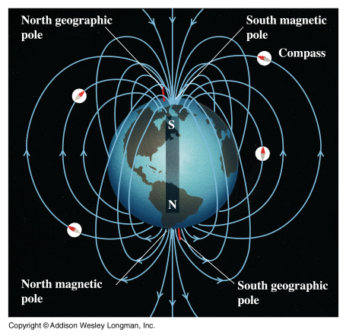
Expected Science Results
The Magnetic Field
This is a representation of the magnetic fields throughout the Earths atmospheres. However, for our expectations, we expect it to be pointing more towards the north pole than this graph represents. This goes against previously assumed ideas of Merrill, Mcelhinny, and McFadden

Slide 23
Expected Science Results
The Light Patterns
  We are using the idea from the philosopher Seneca that claims rainbows are made up of different wavelengths of light refracting differently from raindrops. We assume that after we get into the stratosphere, where water won’t be, that less light will have been refracted, and our images will be more pure and full.

Slide 24
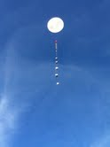
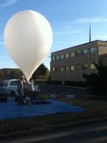
Launch Day
The first balloon before release
The first balloon after release

Slide 25
Launch Day
After our payload was recovered, we saw that it didn’t appear to have suffered any damage externally
However, our data from our Arduino seems to have been corrupted somehow. It took data for seven hours. Yet, it claims that our flight was only about 77 minutes. We are not exactly sure why yet.

Slide 26
Common science results

Slide 27
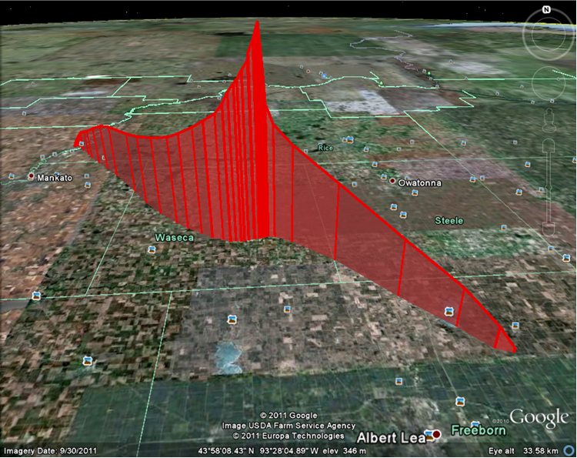
Common science results
Estimated path of balloon and payloads

Slide 28
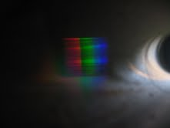
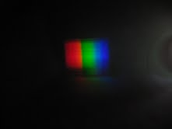
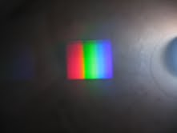
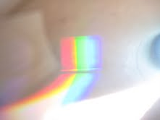
Optics experiment
Picture taken at ground level
Picture taken a few minutes after take off. Note the three colors easily identified: red, green and blue
Picture taken high in flight. Note: it is easy to see purple, blue, green, yellow, and red
This is an interesting picture taken just seconds before the one to the left, just a fun picture

Slide 29
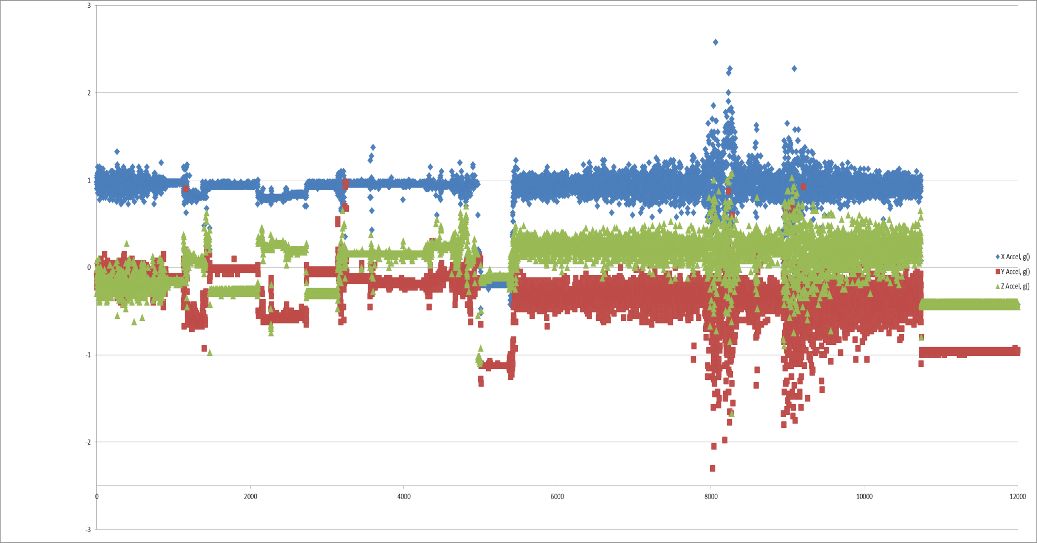
Accelerometer data (part one)
Launch
Landing
Burst

Slide 30
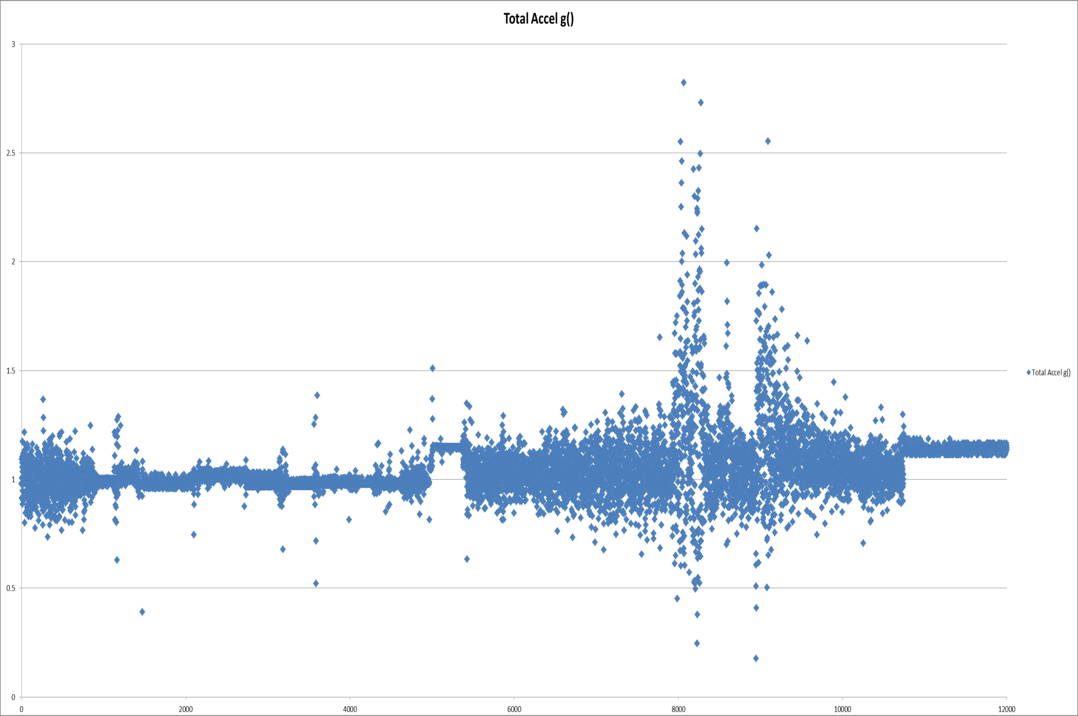
Accelerometer data (part two)
Launch
Burst
Landing

Slide 31
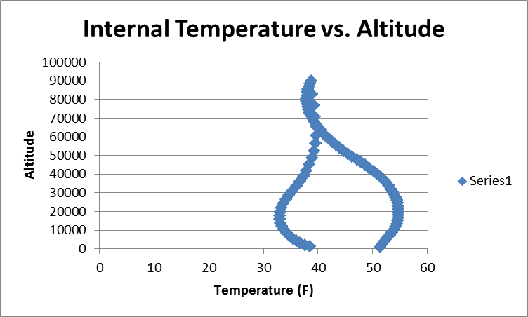
Weather station Data

Slide 32
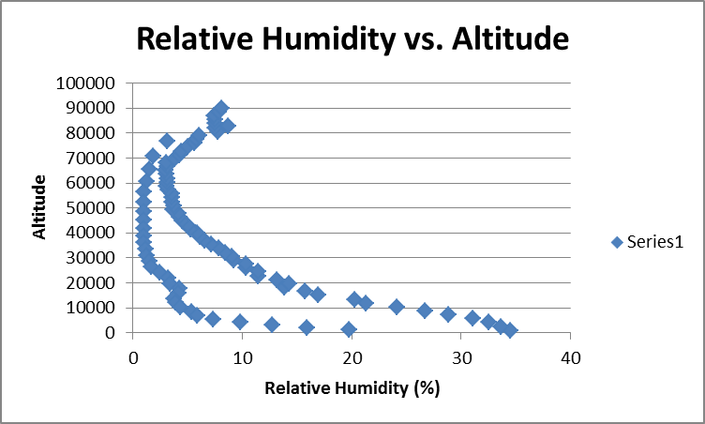
Weather station data

Slide 33
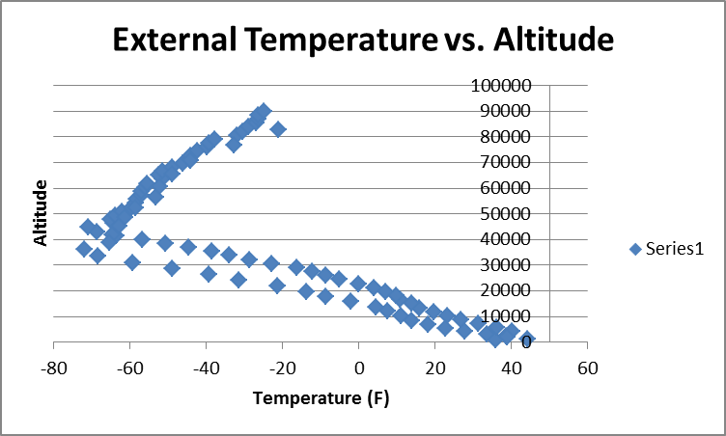
Weather station data

Slide 34
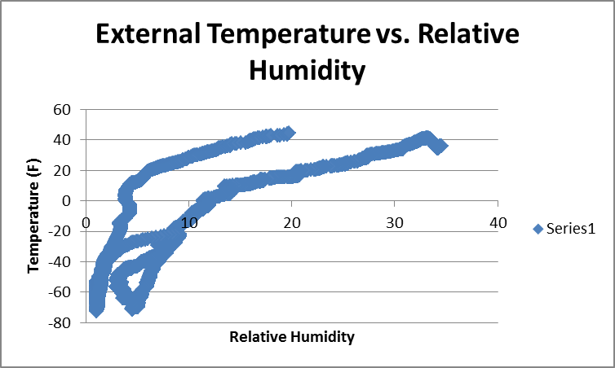
Weather station data

Slide 35
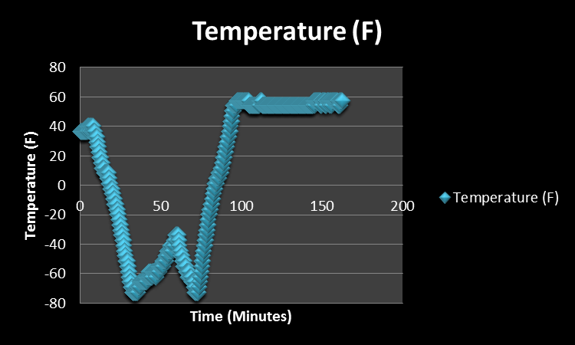
Battle Creek BSE

Slide 36
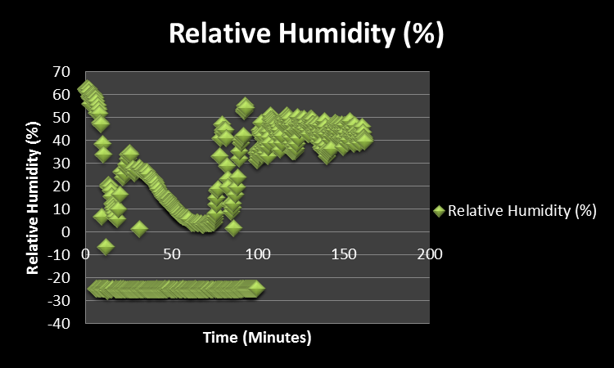
Battle Creek BSE

Slide 37
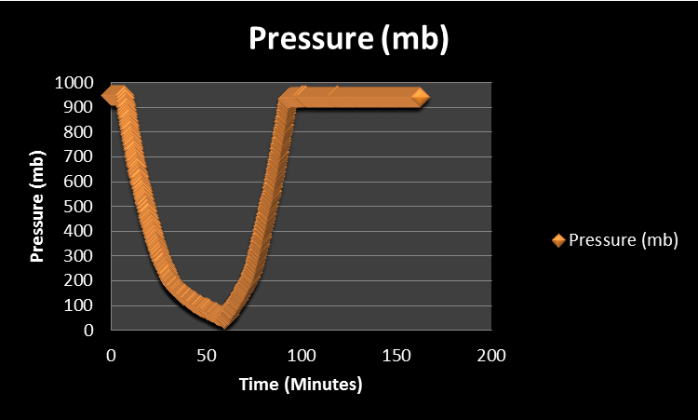
Battle Creek BSE

Slide 38
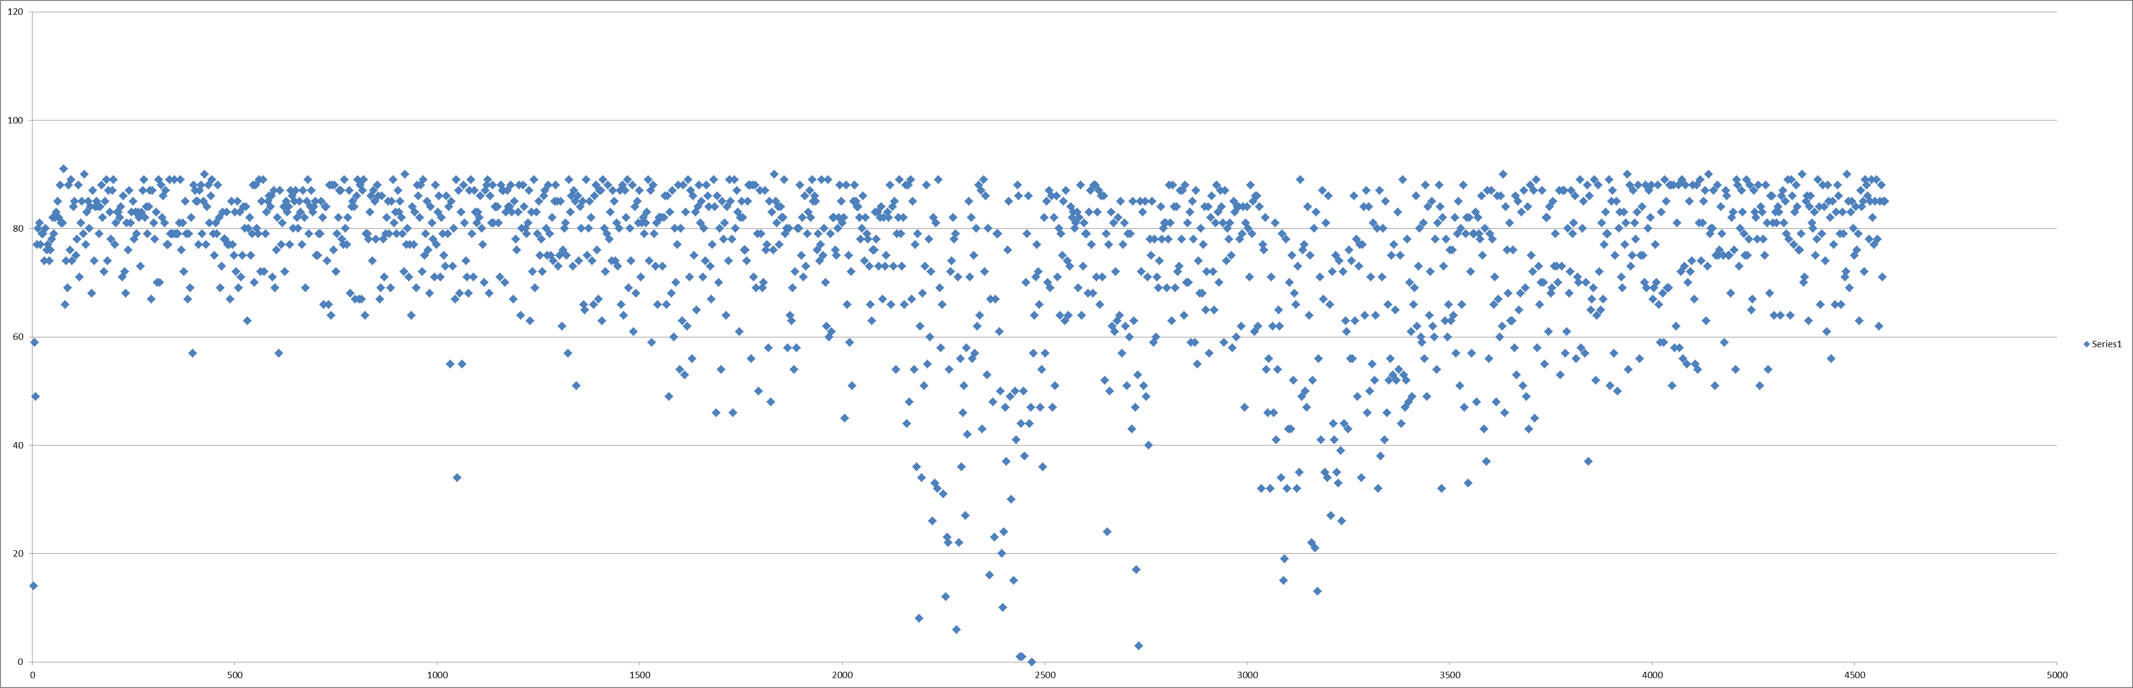
Micromag Data
Y-axis
Launch
Burst
Apparent landing

Slide 39
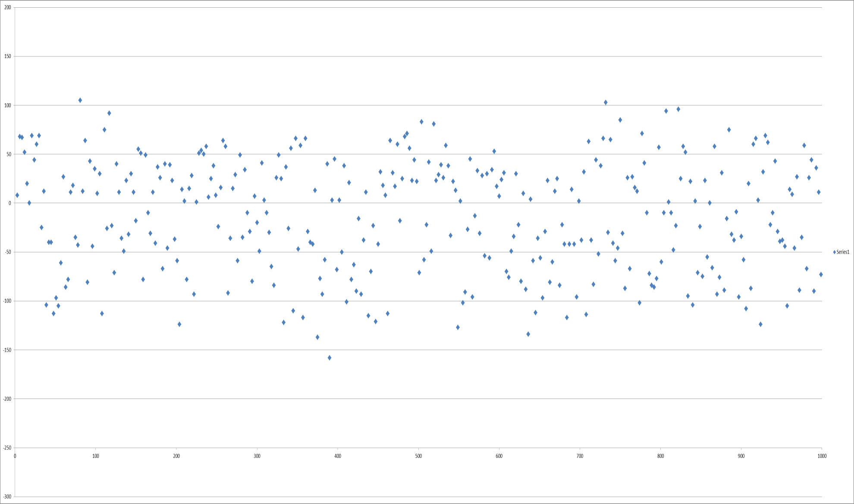
Micromag Data
X Axis

Slide 40
Micromag Data
X Axis

Slide 41
Conclusions
Accelerometer
  We observe from our data that there seems to have more overall acceleration as we reach higher levels in the atmosphere
The Temperature gradually decreases, then increases as we enter the stratosphere
Relative humidity will increase as we get to higher levels in the troposphere.
Pressure will decrease exponentially as we get higher in the atmosphere
No conclusions have yet been formed from the Micromag

Slide 42
What might we change next time?
We would put the camera at even more of an angle so as not to be able to see so much light on the right, and we would have painted the insides of the tube black to eliminate more glare.

Slide 43
Words of Wisdom
Don’t think of this so much as a ‘class’. You don’t have opportunities to do things like this very often.
Put the time in, it’s worth it in the end.
Add extra trackers.
More weight seems to find its way into the payload, so aim low.
Aim high with your experiments, otherwise they could be performed on the ground

Slide 44
Special thanks
Thank you Professor Flaten,
Thank you to our TAs Joey and Alex, and Seth
Thank you Vishnu for helping us with our optics experiment
Thank you Kyle Marek-Sparts and Chris Woehrle from Augsburg for helping us with our Micromag

