Slide 1
Up, Up, and Away
Final Team Presentation
Alex Cohen, Yunus Agamawi,
Charles Thao, Joel Knighton,
Timothy Goodfellow
AEM 1905 11-22-2011

Slide 2
Mission Overview
Bacteria - what sort of radiation causes them to mutate?
  Determine what kind(s) of radiation cause mutation
  Using controls and aluminum foil shielding
  Control exposed to all radiation, aluminum-shielded exposed to gamma, cosmic, and neutron radiation
Geiger counters
  Show the presence of radiation as a way to make sense of the results from bacteria experiment
  Flying both shielded and unshielded Geiger counters
Measure internal health of box
  Show that temperature and relative humidity are maintained for bacteria survival and continued operation
Measure external characteristics (temperature, pressure, relative humidity)
  Verification of expected changes in atmospheric traits
Use a camera to verify relationships during the flight
  Look at altitude, position, angle, and position of a known landmark
  We won’t be flying a camera – use imagery from other cameras

Slide 3
Schedule
Week of Tuesday, September 27, 2011
  Finish heater circuit
  Make contact with biology department
Week of Tuesday, October 4, 2011
  Weather station and BalloonSat Easy built
  Main payload box constructed
Week of Tuesday, October 11, 2011
  Obtain shielding for petri dishes
  Make definite contact with an advisor within the biology department
Friday, October 14, 2011
  Turn in Revision A of documentation
Week of Tuesday, October 18, 2011
  Structural integrity of payload box tested
  All soldering projects finished
  Complete programming of flight computers
Week of Tuesday, October 25, 2011
  All electronics and bacterial testing completed
  Payload/rigging fully integrated
Friday, October 28, 2011
  Prepare petri dishes with bacteria samples for flight day
Saturday, October 29, 2011
  Attend launch
  Isolate and preserve bacteria samples as soon as possible after flight
Week of Tuesday, November 1, 2011
  Retrieve data from payload
  Begin data analysis
Friday, November 4, 2011
  Turn in Revision B of documentation
Week of Tuesday, November 8, 2011
  Continue work on data analysis
  Create visualizations of data
Week of Tuesday, November 15, 2011
  Prepare final team presentation
  Revise data visualizations
Week of Tuesday, November 22, 2011
  Give Final Team Presentation
  Continue data analysis
Week of Tuesday, November 29, 2011
  Finish final data analysis
Friday, December 2, 2011
  Turn in Revision C of documentation
Week of Tuesday, December 6, 2011
  Prepare display for public viewing
Tuesday, December 13, 2011
  Give final poster presentation to public

Slide 4
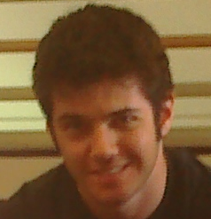
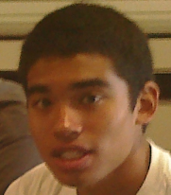

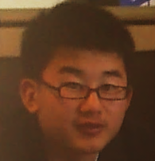
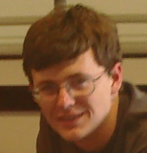
Team Leader: Joel Knighton
(Prediction/ Tracking Assistant, FRR ppt, Payload Design, Test Plan and Results)
Alex Cohen
(Photographer, CDR ppt, HOBO Health, Recovery Specialist, Project Management, Launch and Recovery)
Yunus Agamawi
(Build Payload Box, CDR ppt, Bacteria Experiment, Balloon Filling and Release Assistant, Mission Overview, Project Budgets)
Tim Goodfellow
(Build Weather Station, Program Flight Computers, Payload Handling Specialist, FRR ppt, Payload Photographs, Expected Science Results)
Charles Thao
(Build Flight Computer, Camera and Camera Experiment, Photographer, Introduction, Conclusion)

Slide 5
Budgets
Component Name | Cost | Mass
HOBO Data Logger | $130.00 | 0.048 kilograms
HOBO Temperature Probe | $29.00 | 0.010 kilograms
Heater Circuit | $5.00 | 0.027 kilograms
Battery Pack for Heater | $6.00 | 0.150 kilograms
Weather Station | $50.00 | 0.015 kilograms
BSE Flight Computer | $50.00 | 0.033 kilograms
Battery for BSE Computer | $2.00 | 0.046 kilograms
1”-thick Pink Styrofoam | $8.00 | 0.150 kilograms
Rigging/Tubing/etc. | $5.00 | 0.050 kilograms
Geiger Counter | $150.00 | 0.185 kilograms
Geiger Counter | $150.00 | 0.185 kilograms
Zigbee Radio | $300.00 | 0.126 kilograms
Petri Dishes with Agar | $9.50 | 0.091 kilograms
Aluminum Foil Shielding | $0.34 | 0.004 kilograms
Total | $894.84 | 1.120 kilograms

Slide 6
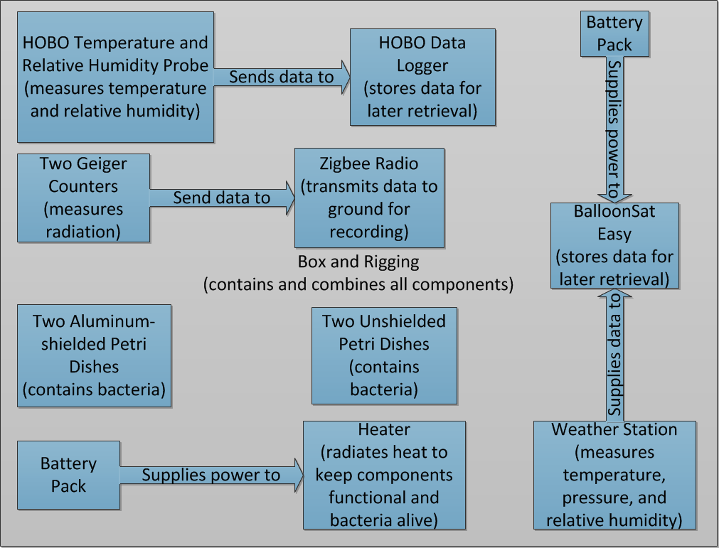
Functional Diagram

Slide 7
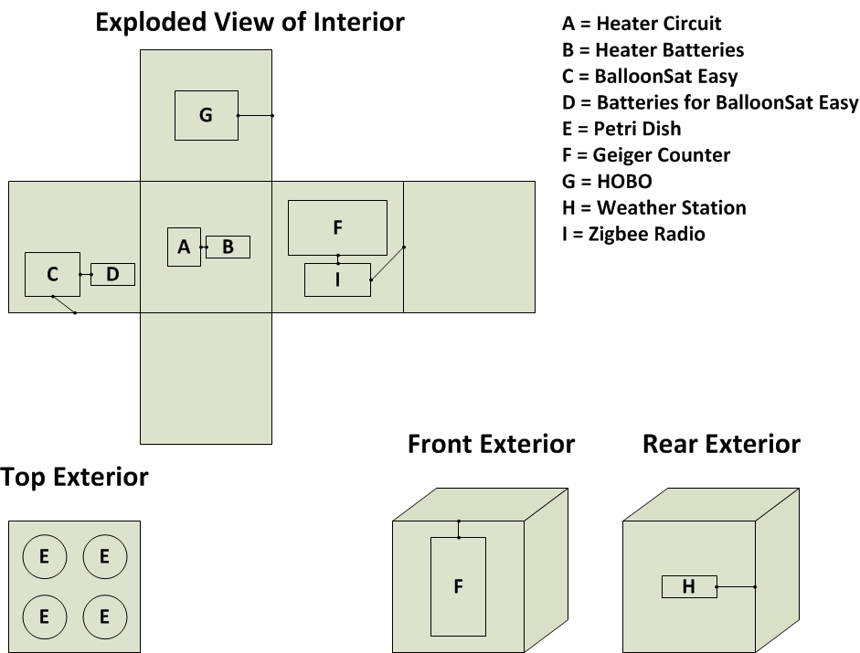
Mockups of Box

Slide 8
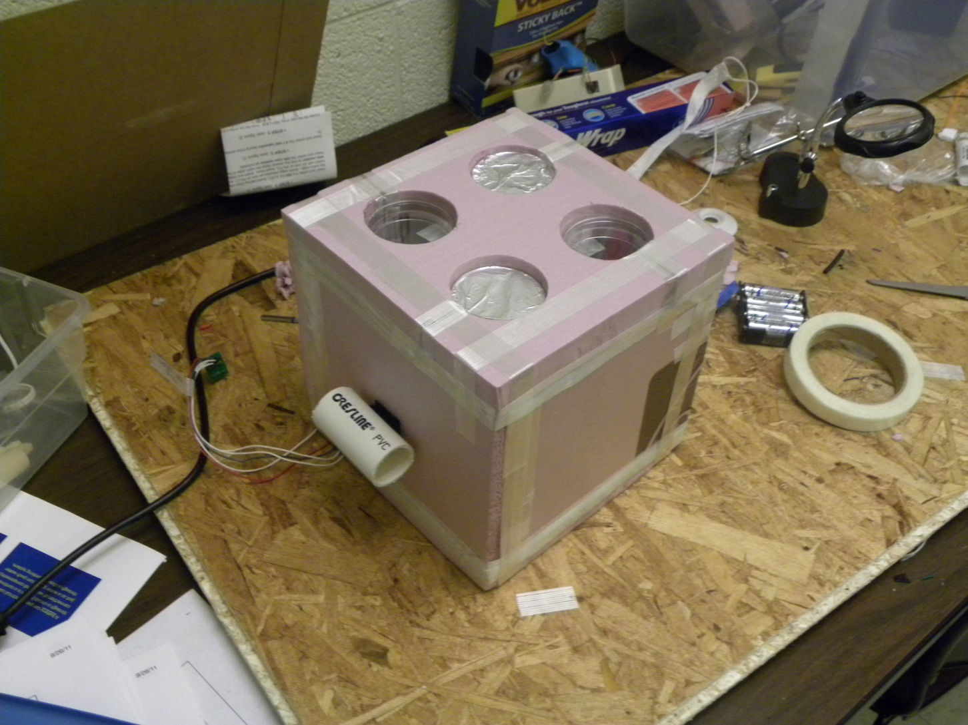
Box Construction
Completed Payload Shell in Preparation for Cold Soak

Slide 9
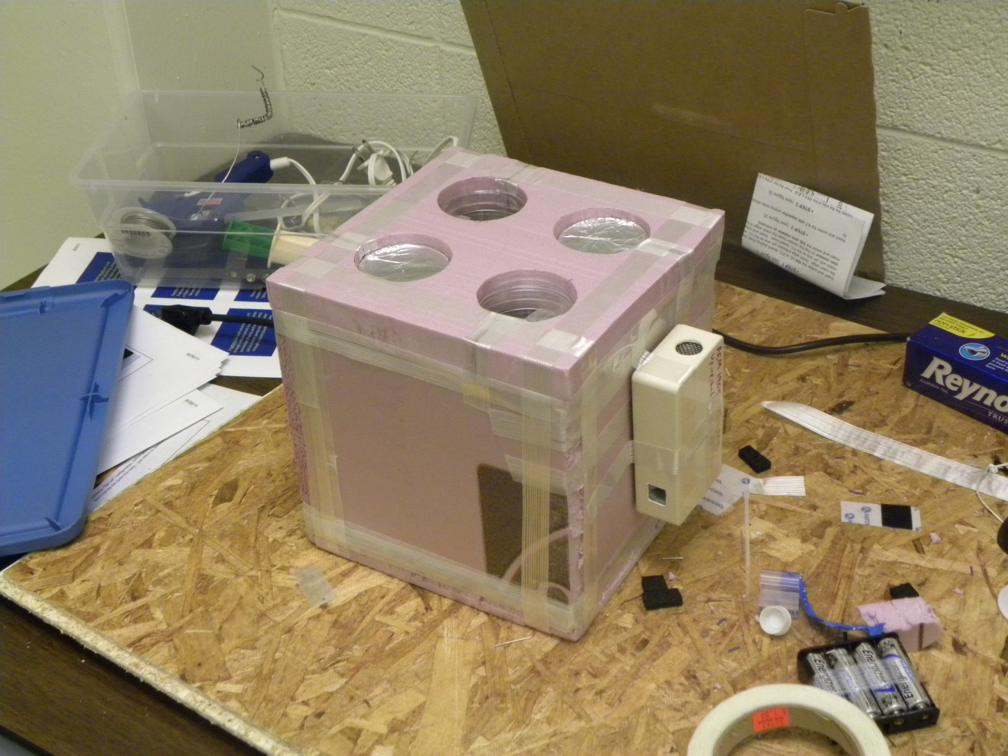
Box Construction
Completed Payload Shell in Preparation for Cold Soak (Opposite Side)

Slide 10
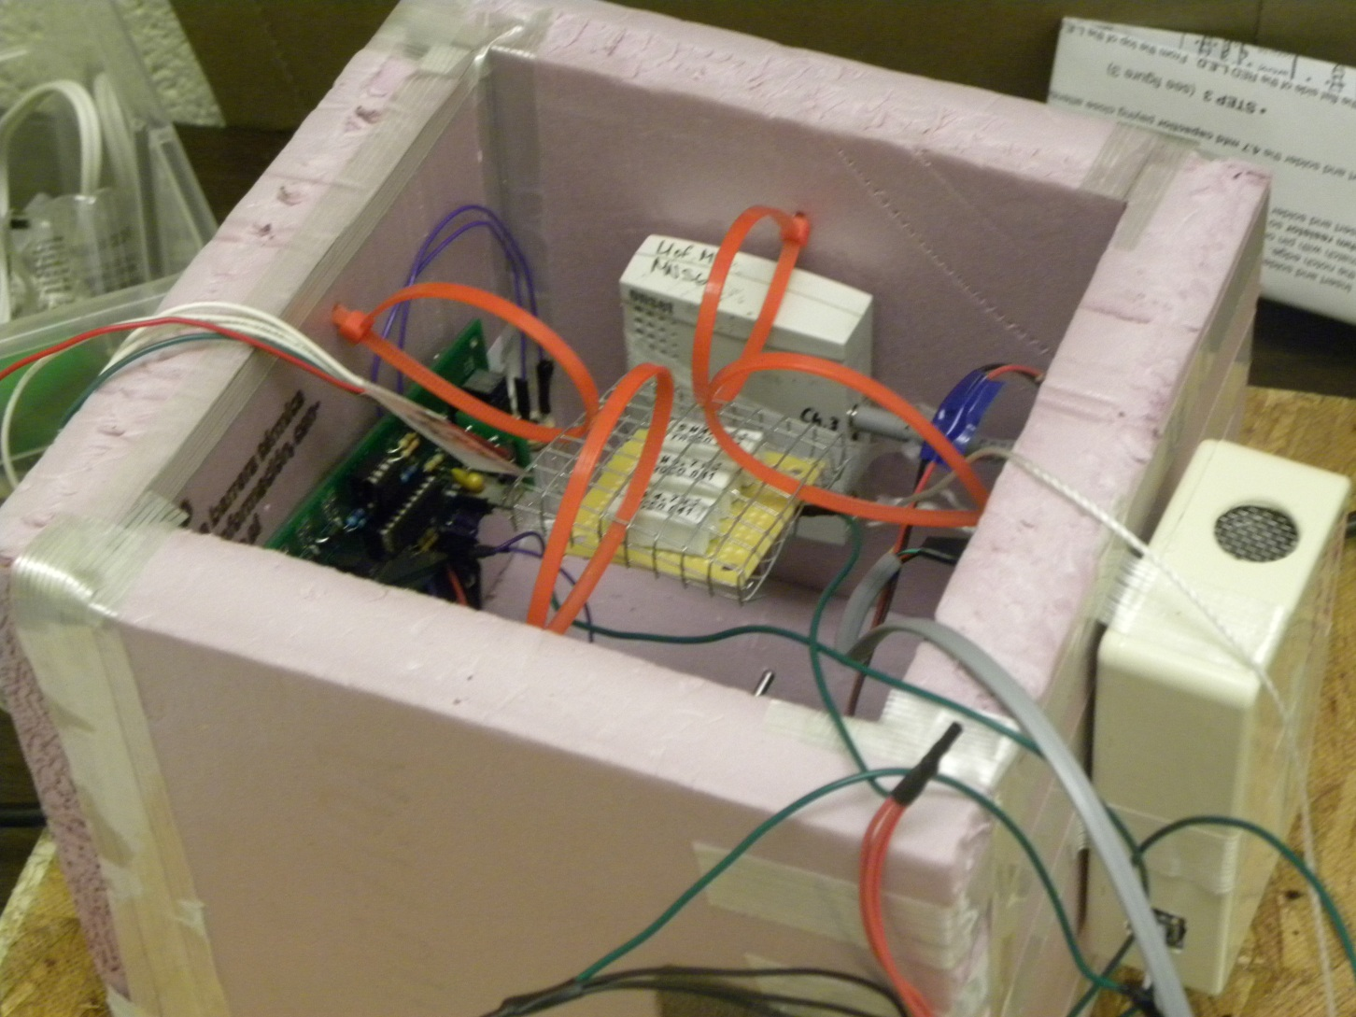
Box Construction
Internals of Payload Shell Before Addition of Zigbee and Second Geiger Counter

Slide 11
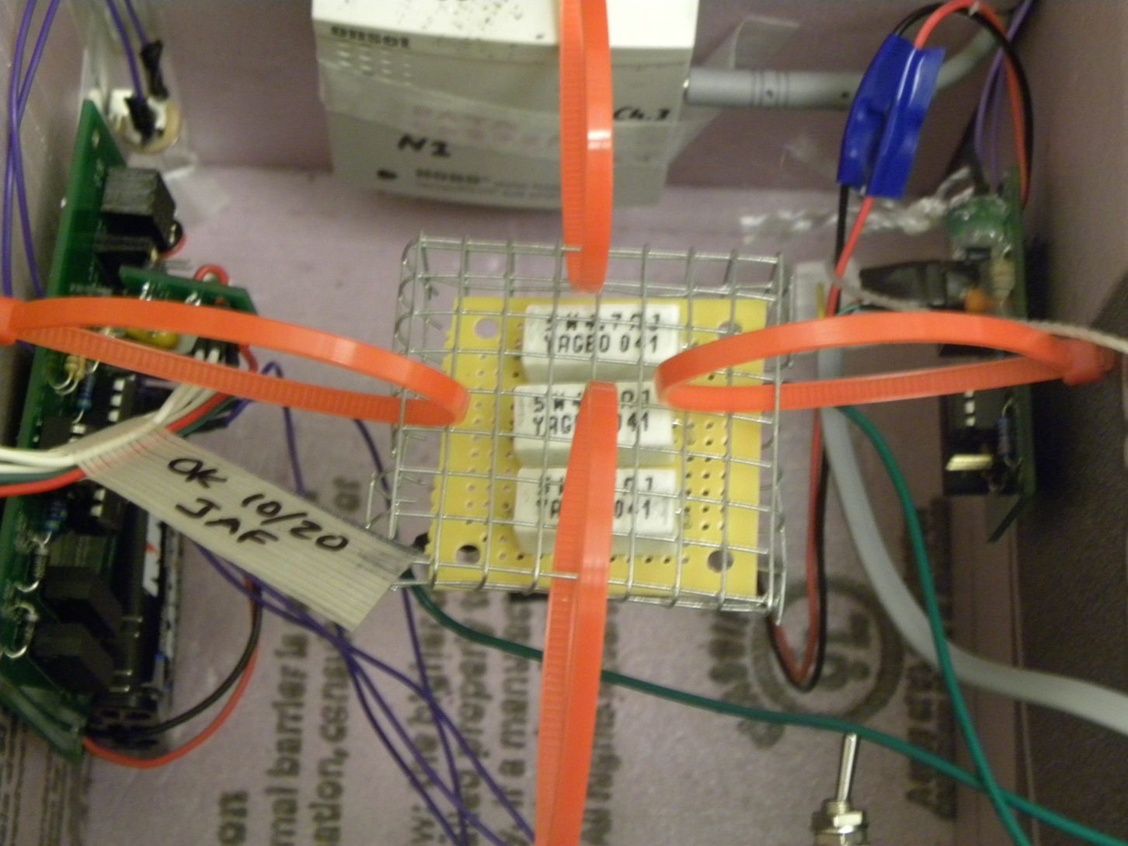
Box Construction
Internal Payload Shell in Preparation for Cold Soak

Slide 12
Box Programming/Communication
BalloonSat Easy/Weather Station Pair
  Senses temperature, relative humidity, and pressure
  Records every fifteen seconds
HOBO
  Senses internal temperature, relative humidity, and external temperature using a temperature probe
  Records every second
Zigbee Radio
  Transmits data from two Geiger counters to the ground during flight

Slide 13
Payload Testing
Completed Tests
Drop/Agitation tests
Weather Station/BSE operation
Geiger counter operation
Cold soak
Yank test
Uncompleted Tests
Bacteria reaction to radiation
Bacteria cold survival

Slide 14
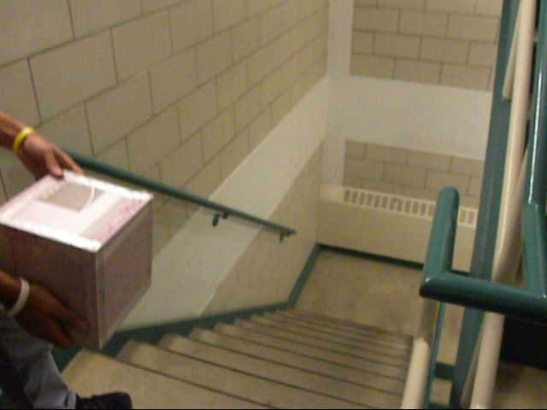
Drop/Agitation Testing
Tests components and payload’s abilities to withstand the expected rough conditions of the flight
Passed successfully, no modifications to design

Slide 15
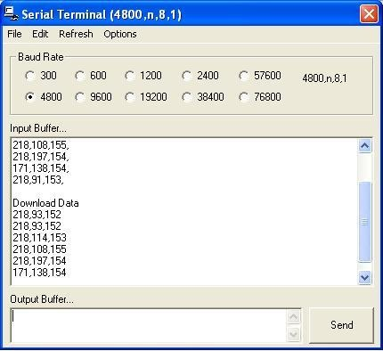
Weather Station/BSE Operation
Determines whether weather station can measure temperature/relative humidity/pressure, as well as whether this data can be written/read
Passed successfully, no fixes necessary

Slide 16
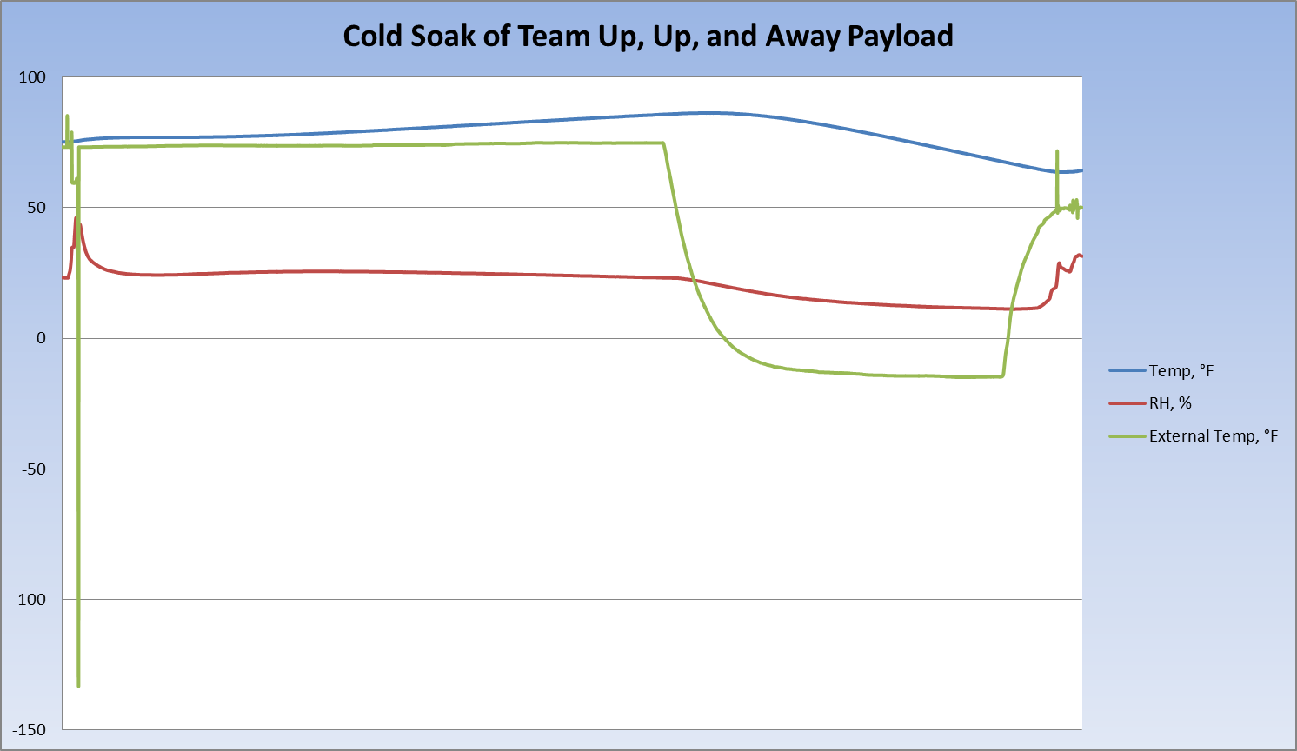
Cold Soak Testing
Measures internal/external characteristics of the payload during a prolonged period in a cold box
Shows that heater is functional
Passed successfully, no modifications to design
http://www.space.com/12945-future-exploration-destinations.html

Slide 17
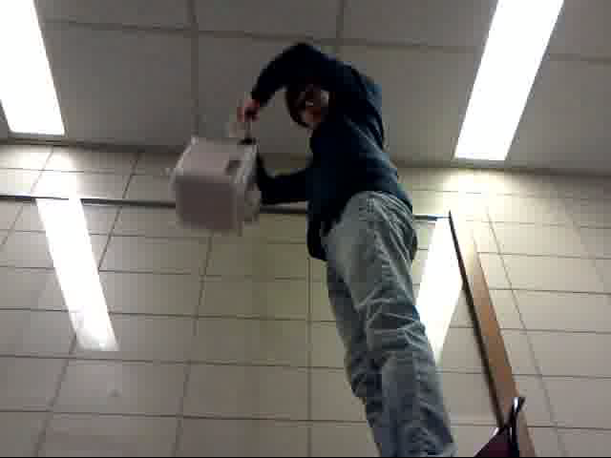
Yank Test
Multiple drops performed from a chair to test the strength of rigging
Passed test successfully
No modifications made

Slide 18
Bacteria’s Reaction to Radiation
Due to a lack of access to sources of radiation as well as bacteria samples, we were unable to establish a baseline level of mutation
We are not overly concerned about this because:
  We are dealing with mutation on a more qualitative level
  We know our bacteria will mutate when exposed to alpha/beta/gamma/cosmic/ultraviolet radiation
  Multiple sources indicate that several millimeters of aluminum foil will block alpha/beta/UV radiation
Ideally, this would be tested using a directional and known radiation source with varying levels of radiation

Slide 19
Bacteria’s Cold Survival
Due to inability to obtain early samples of our bacteria, we could not have them involved in our cold soak
Ideally, this would be tested
We are not concerned because:
  We know the optimum range of our bacteria ranges from 5 to 40 Degrees Celsius
  Others have flown this type of bacteria before
From the cold soak, we know being too warm will not be a problem – thus, keep things as warm as possible

Slide 20
Main Flight Concerns
Continued viability of bacteria after exposure to extremes
  Temperature drop
  Post-burst chaos
  Changes in humidity
Performance of Geiger counters in cold environment
  No reason to believe it won’t work, but it hasn’t been done before

Slide 21
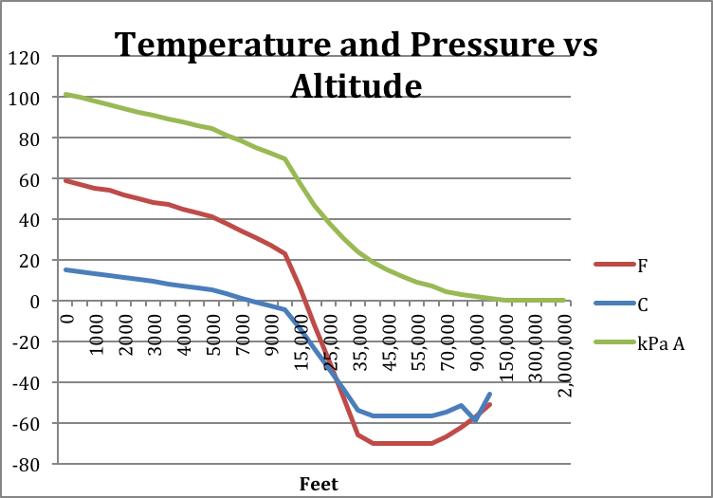
Expected Science Results
Atmospheric conditions:
  Temperature will decrease until reaching approximately -60 degrees Fahrenheit before beginning to increase again between 40 and 60 thousand feet
  Pressure will decrease as a function of exponential decay approaching zero. It will start at around 95 kilopascals and decrease to approximately 1 or 2 kilopascals.
  Relative Humidity will generally decrease with altitude, but this is unpredictable because of cloud layers and weather fluctuations.
  Data from http://www2.avs.org/chapters/nccavs/pdf/AtmPres_at_Diff_Altitudes.pdf

Slide 22
Expected Science Results
HOBO data:
  The internal temperature of the box should remain substantially elevated from external temperatures but will decrease and increase with external temperature
  The temperature sensor on the bottom of the petri dish should be comparable to the internal temperature due to its proximity to the heater but slightly lower because it is nearer to the outside of the container
  The external temperature sensor should read approximately the same as the weather station temperature sensor because it is protected only by aluminum foil that should have little insulating effect

Slide 23
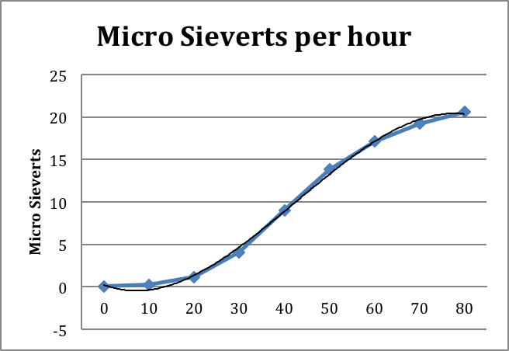
Expected Science Results
Geiger counter readings:
  Radiation readings should increase during the ascent
  The rate of increase should be greatest from 30,000 to 60,000 feet and level off soon after
  There should not be a substantive difference between the readings from the shielded and unshielded Geiger counters because the aluminum foil will not block the high levels of gamma radiation

Slide 24
Expected Science Results
Qualititative results:
  If all the tracking equipment and cameras operate throughout the flight, we should be able to perform image analysis that allows us to correlate height to camera angle for a given image with known landmarks
  If the internal temperature of our box is maintained and the heater conducts adequate heat to the bottom of the petri dishes, the bacteria should survive the flight
  The unshielded bacteria should show slightly less mutation due to the effects of radiation, resulting in fewer white colonies

Slide 25
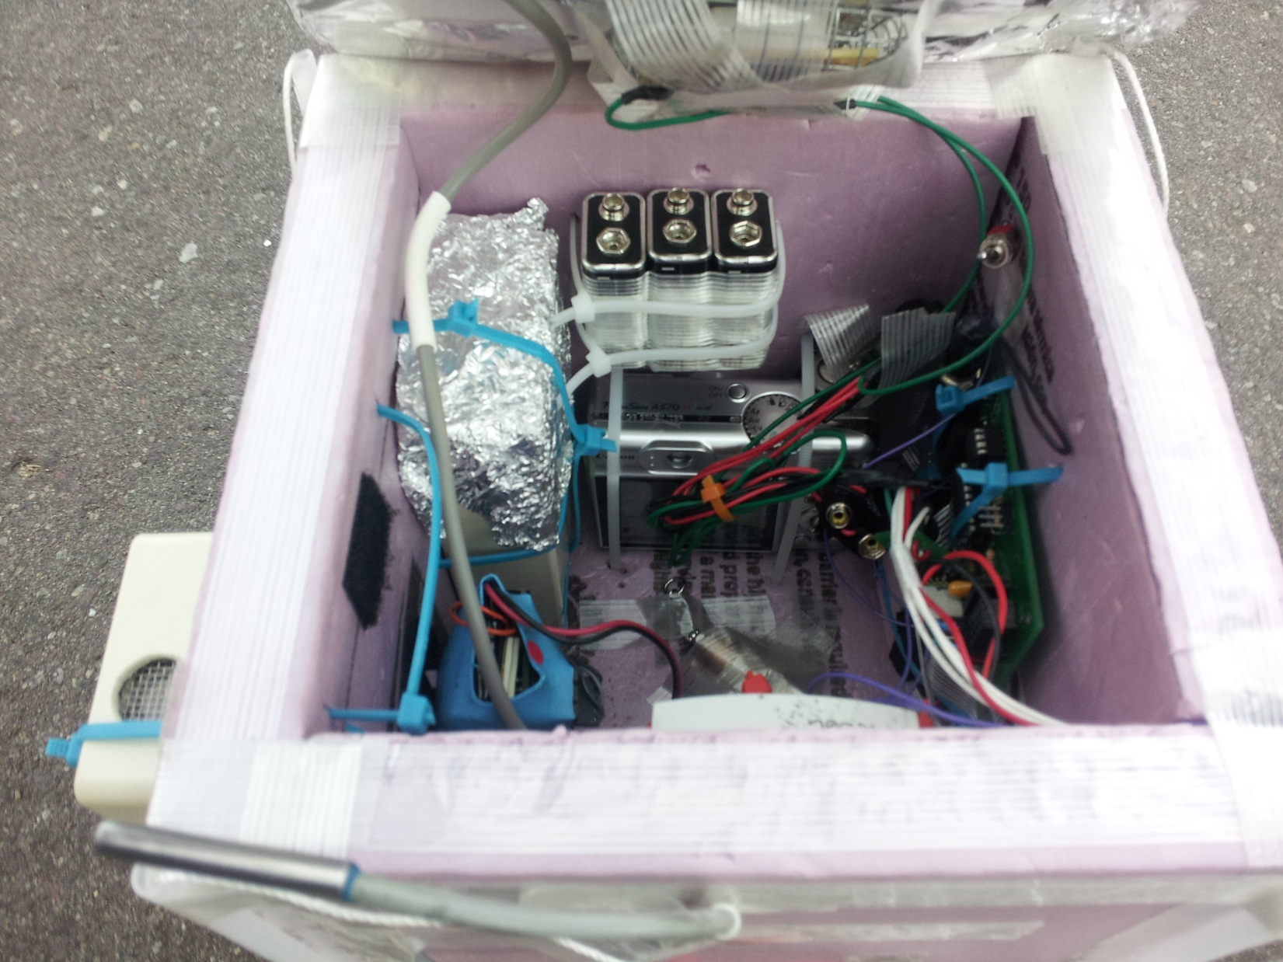
Flight Day
Internals of Payload Shell Before Flight

Slide 26
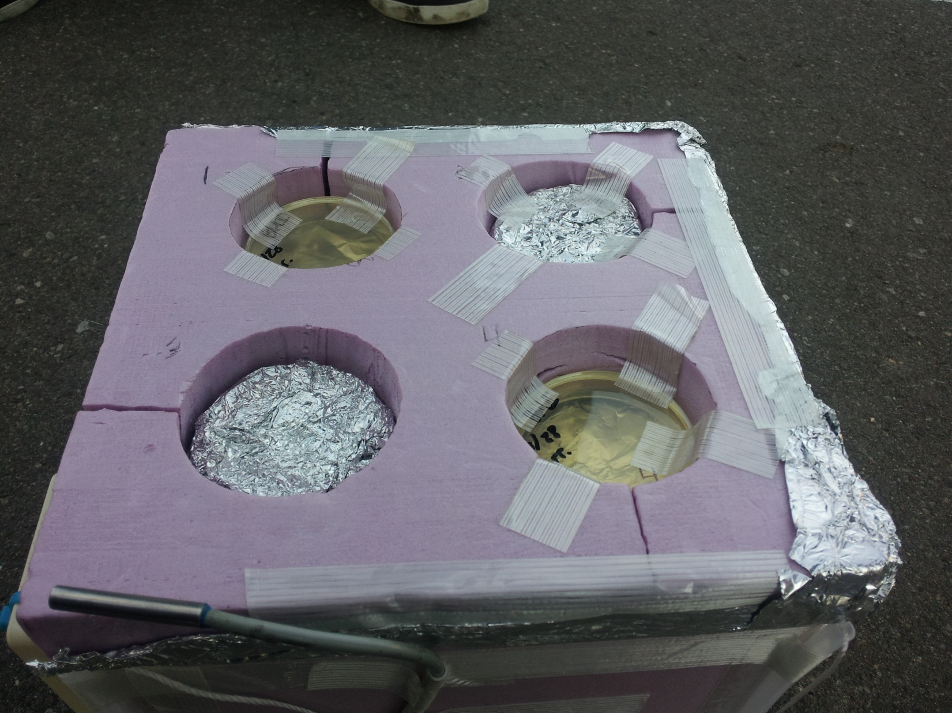
Flight Day
External View of Payload Shell Before Flight

Slide 27
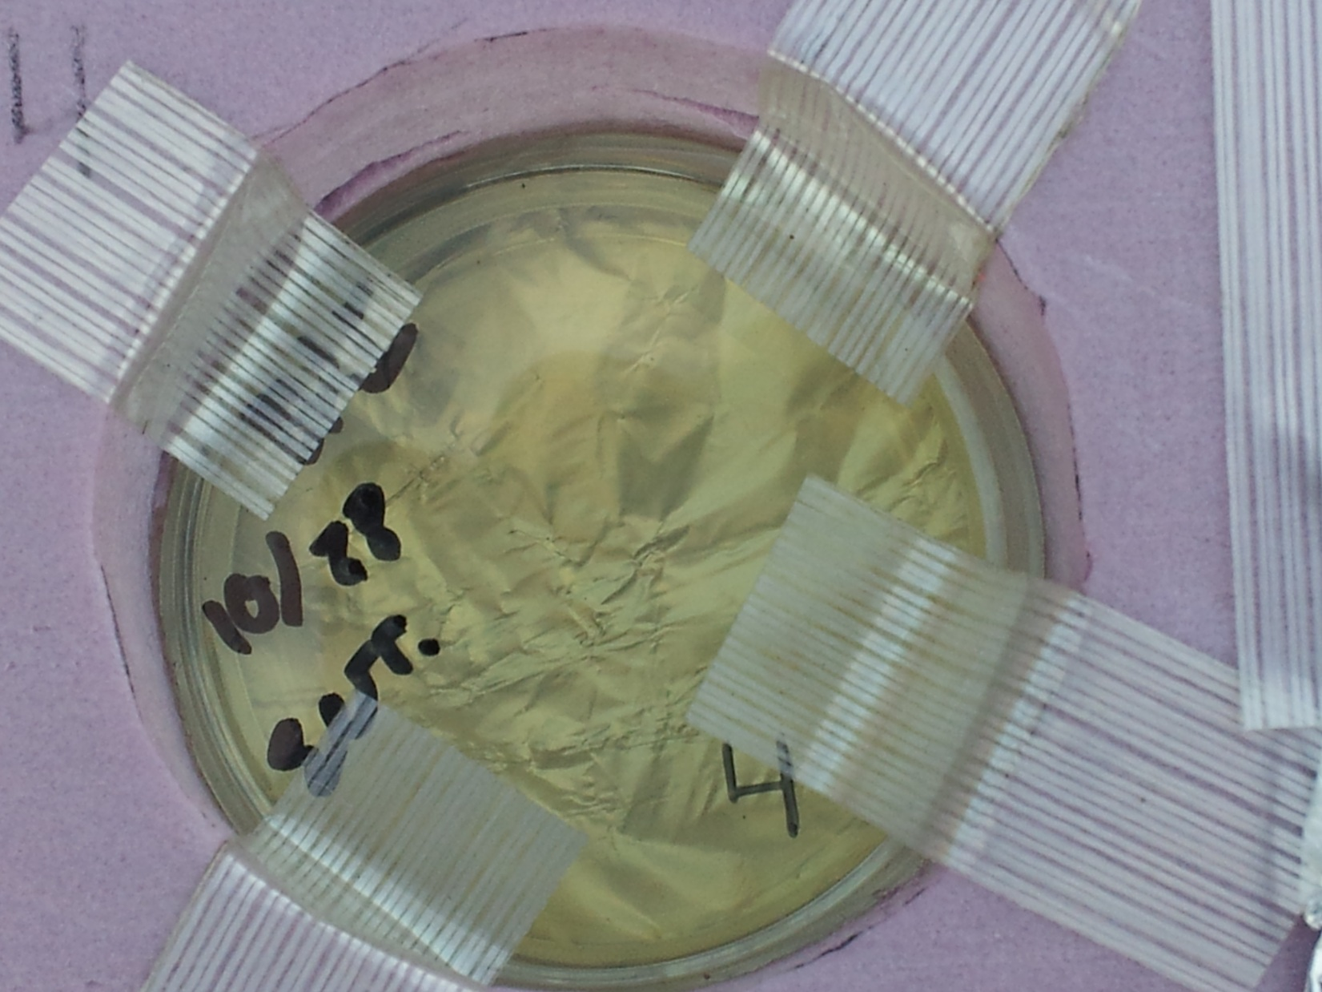
Flight Day
Close-up View of Petri Dish in Payload Shell

Slide 28
Flight Day
External View of Payload Shell Before Flight

Slide 29
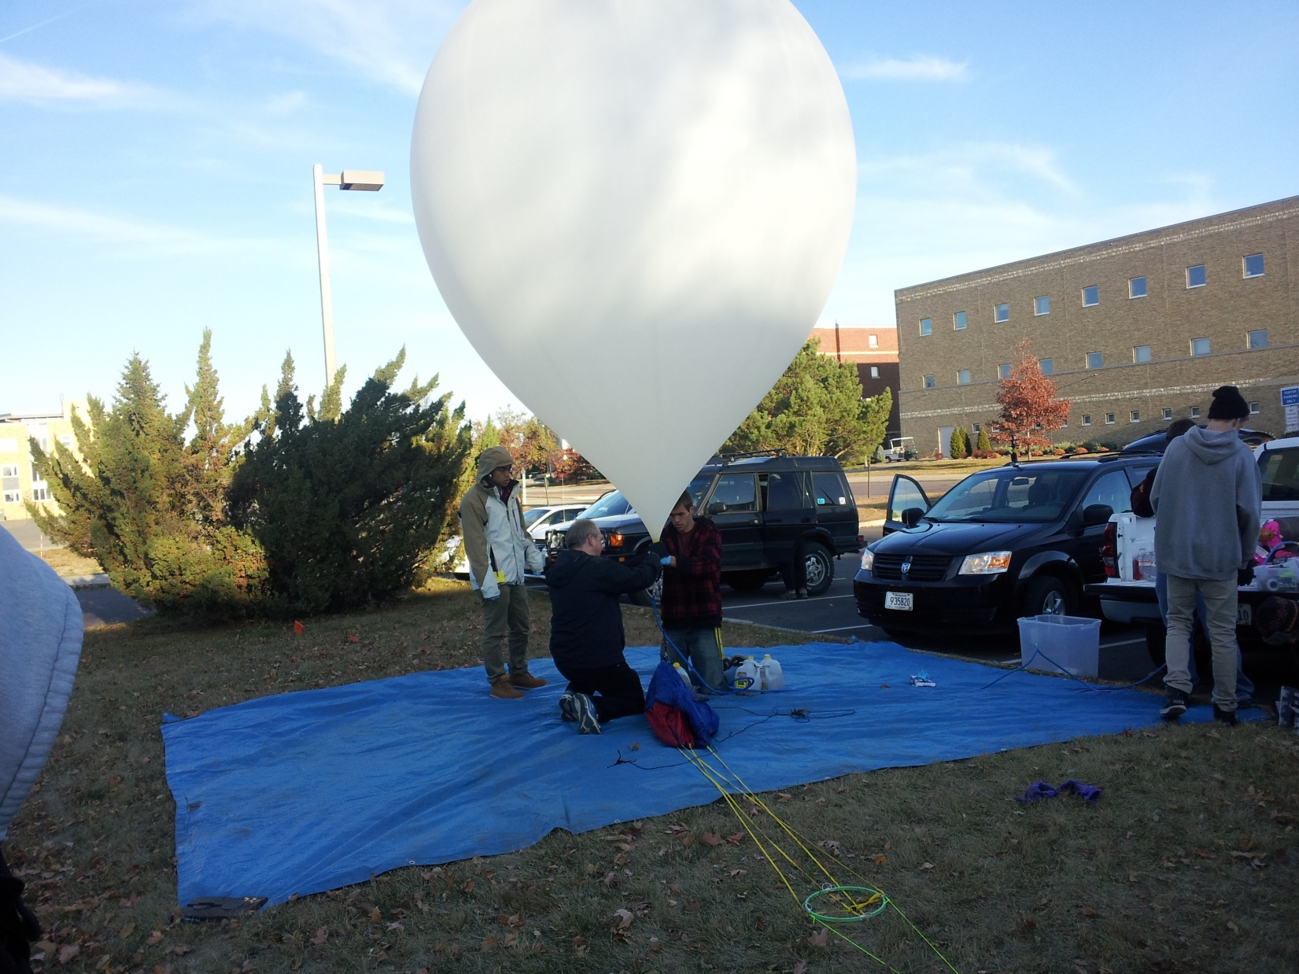
Flight Day
Inflation of the Balloon for Flight

Slide 30
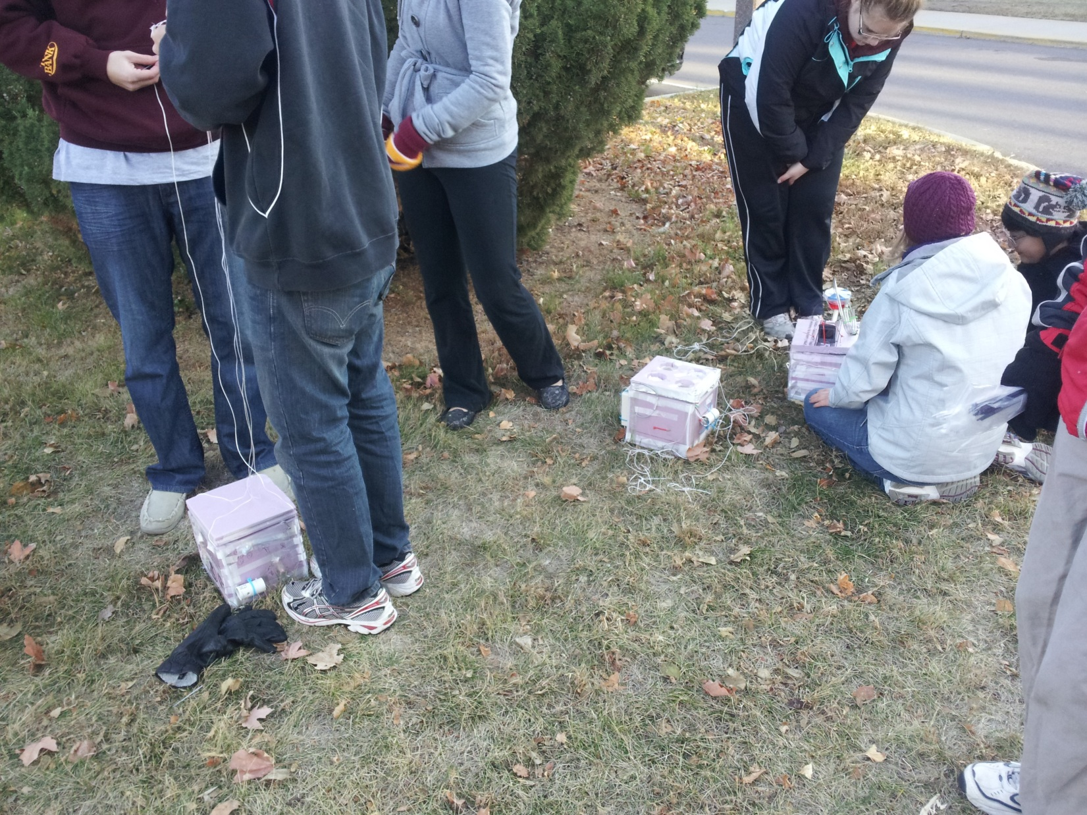
Flight Day
Beginning Assembly of Payload Stack

Slide 31
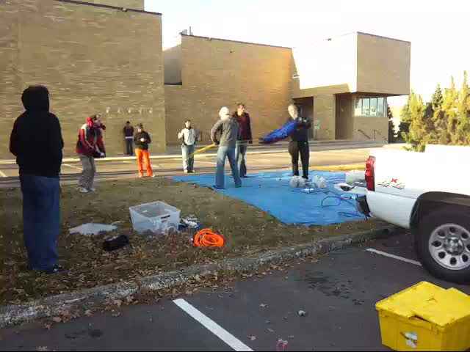
Flight Day
Release of the Balloon

Slide 32
Flight Day
  Launch was successful
  Lost contact with our balloon during the chase
  Located second balloon
  Spent afternoon searching for the first balloon
  First balloon was retrieved once radio contact could once again be made
  Loss of contact was due to an unusually rough patch in ascent
  Box was still operating when recovered
  Shell was pierced by stick, but no visible damage to internals
  Weather station disconnected from the BalloonSat Easy at some point during the flight

Slide 33
Science Results

Slide 34
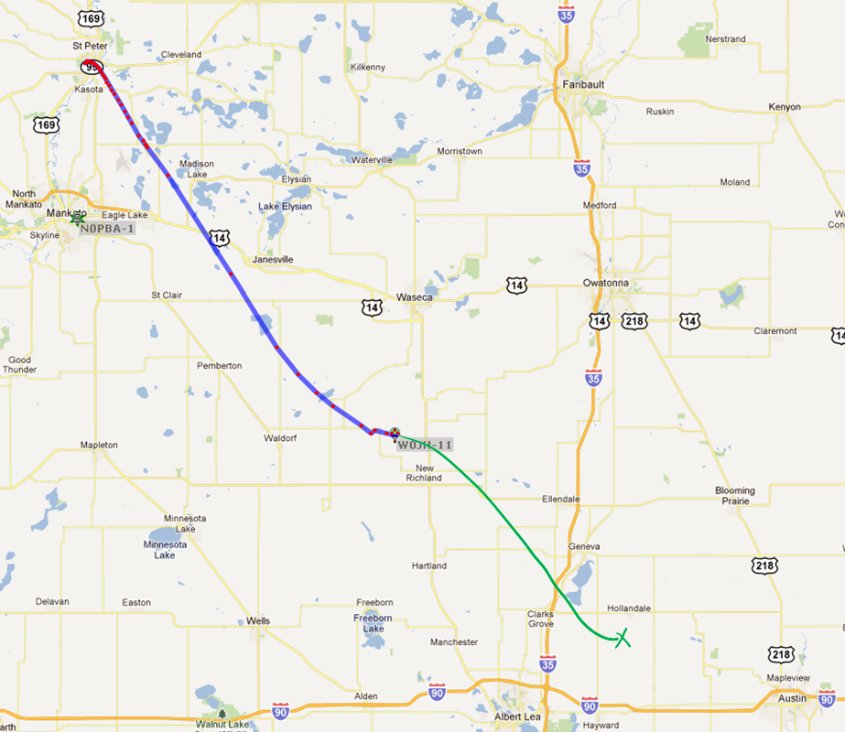
Path of Flight

Slide 35
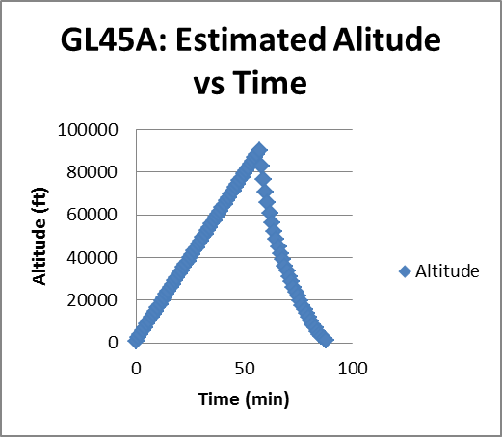
Altitude of Flight

Slide 36
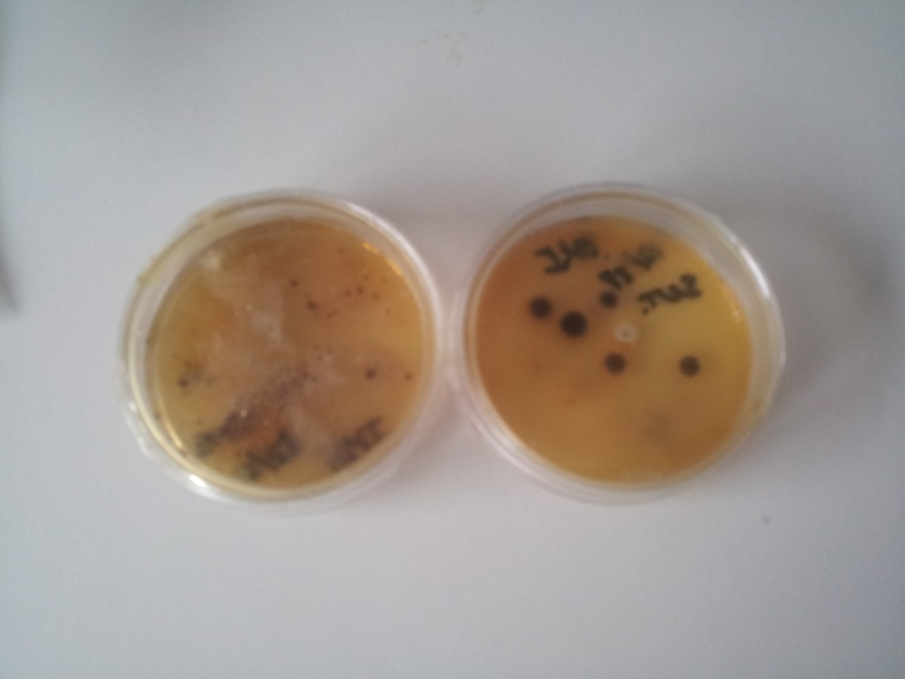
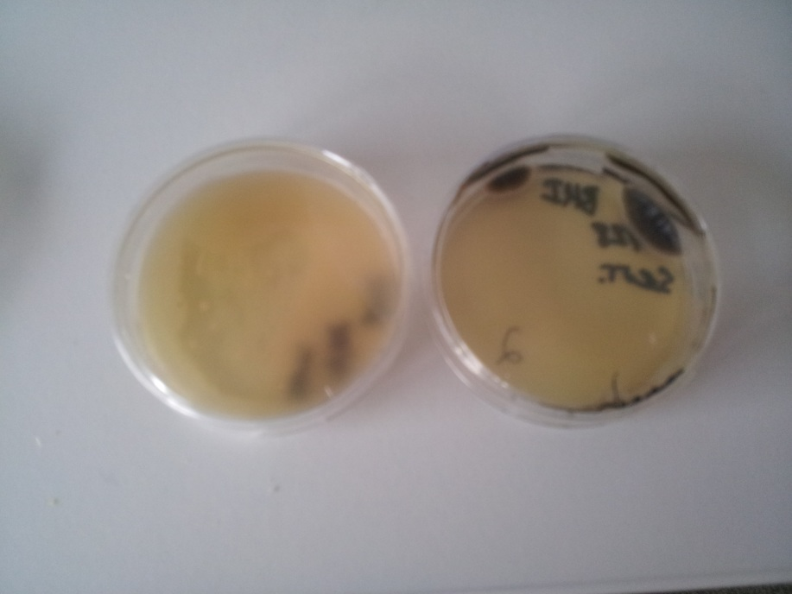
Flight Petri Dishes
Unshielded
Shielded

Slide 37
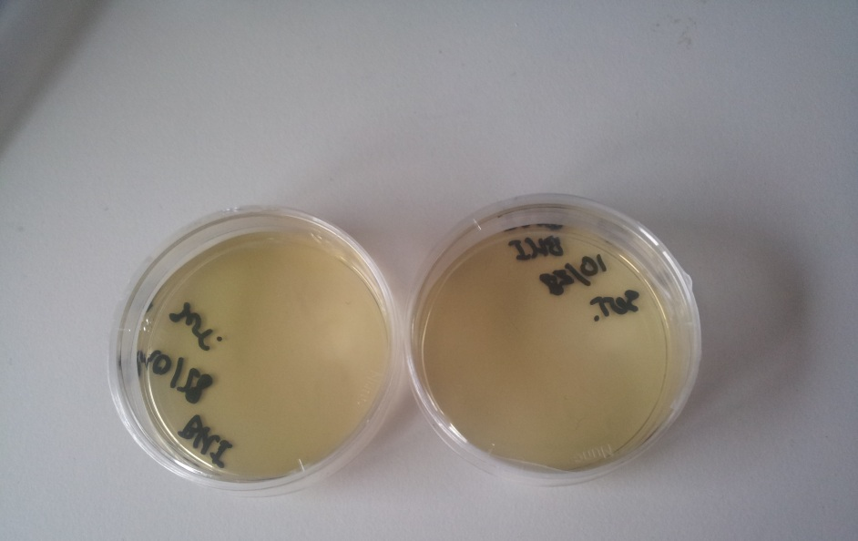
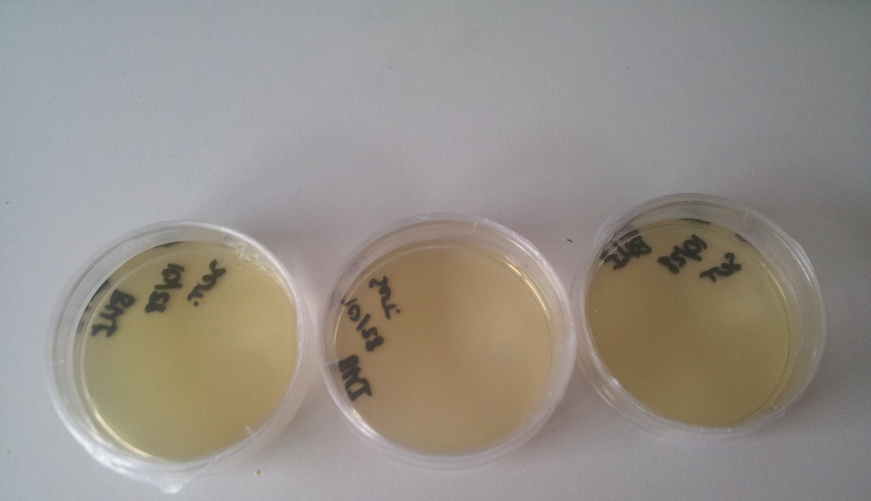
Control Petri Dishes
Unshielded
Shielded

Slide 38
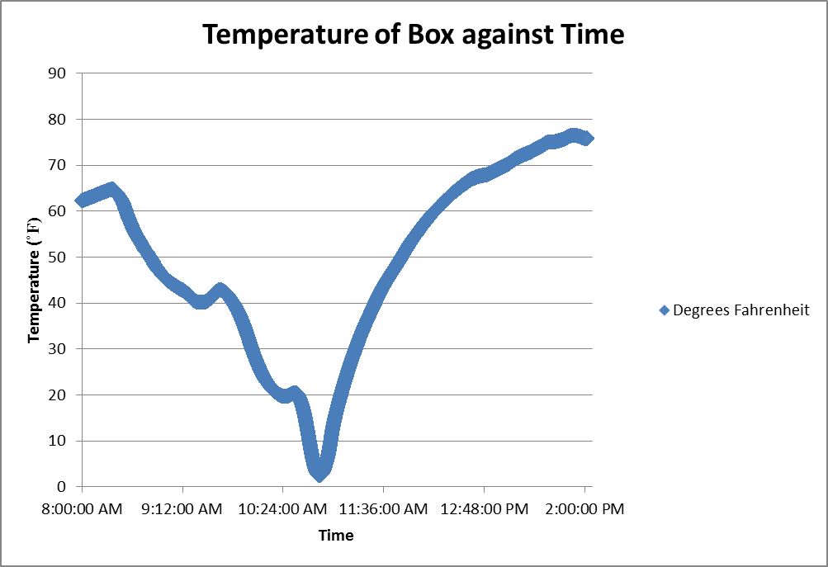
HOBO Results

Slide 39
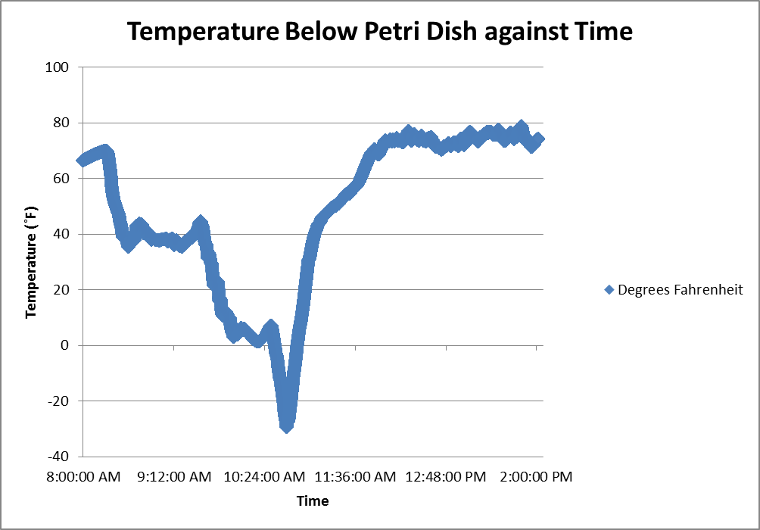
HOBO Results

Slide 40
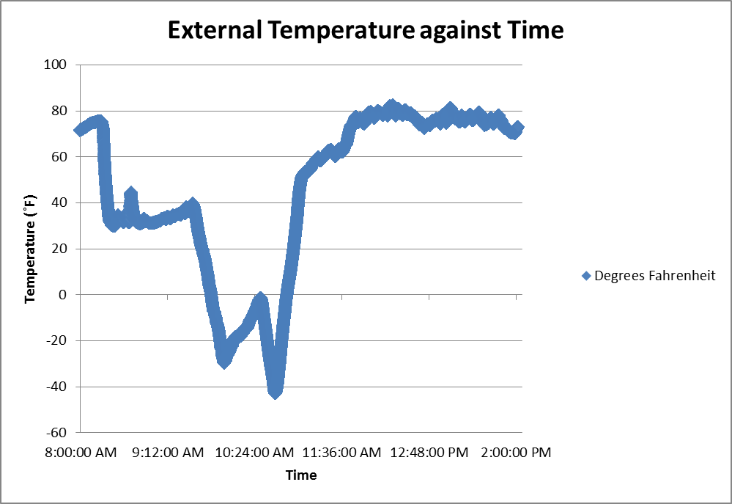
HOBO Results

Slide 41
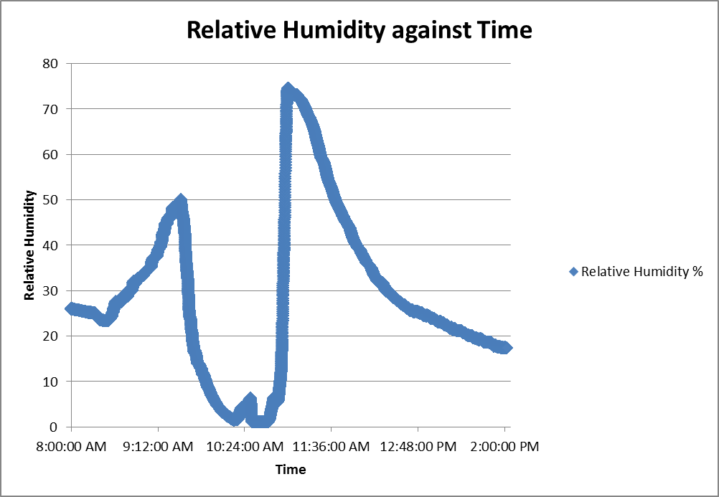
HOBO Results

Slide 42
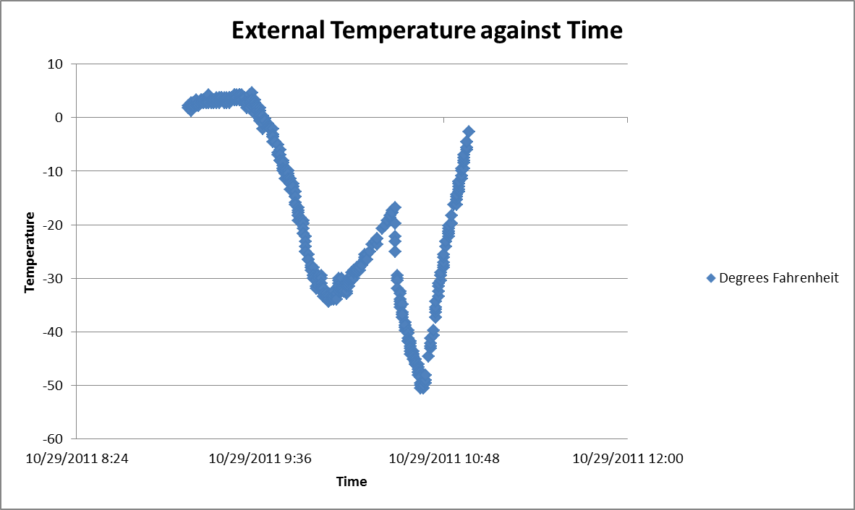
StratoStar Results

Slide 43
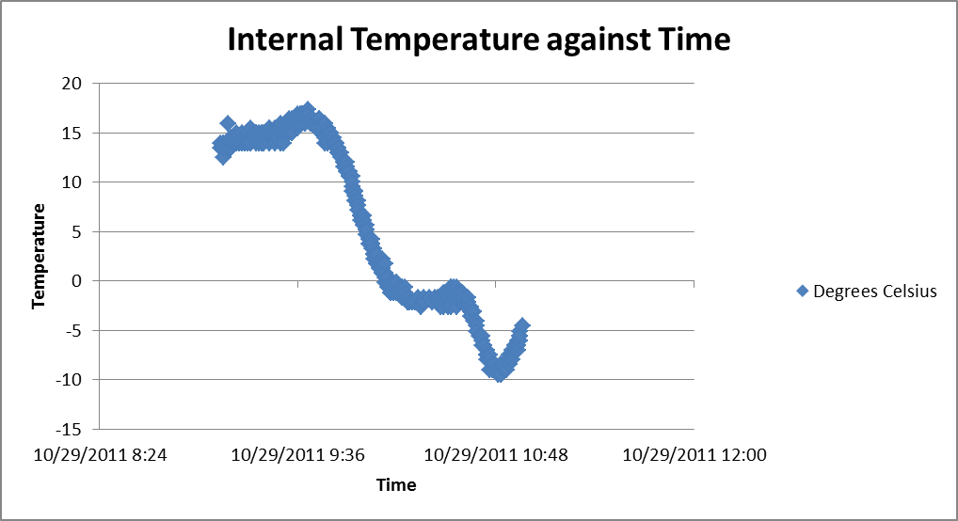
StratoStar Results

Slide 44
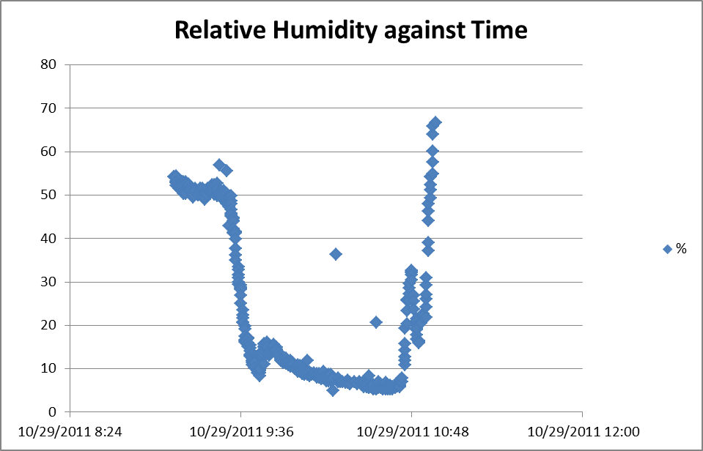
StratoStar Results

Slide 45
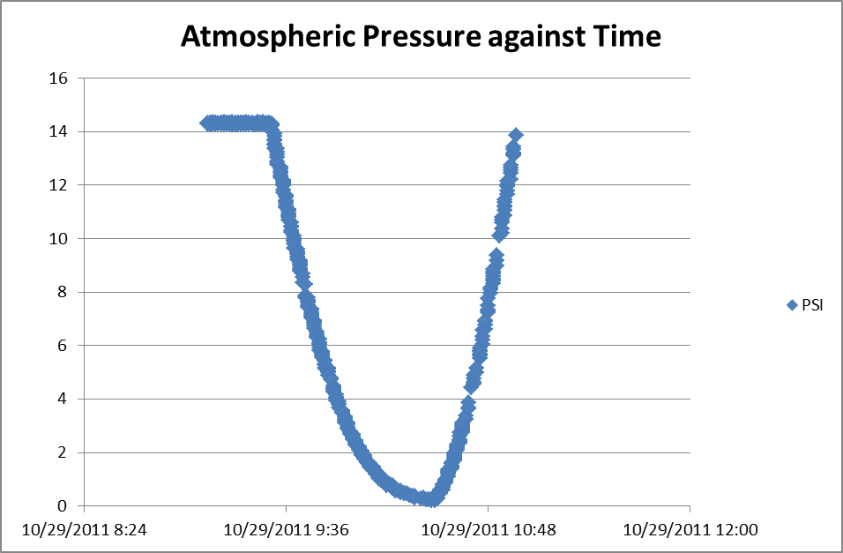
StratoStar Results

Slide 46
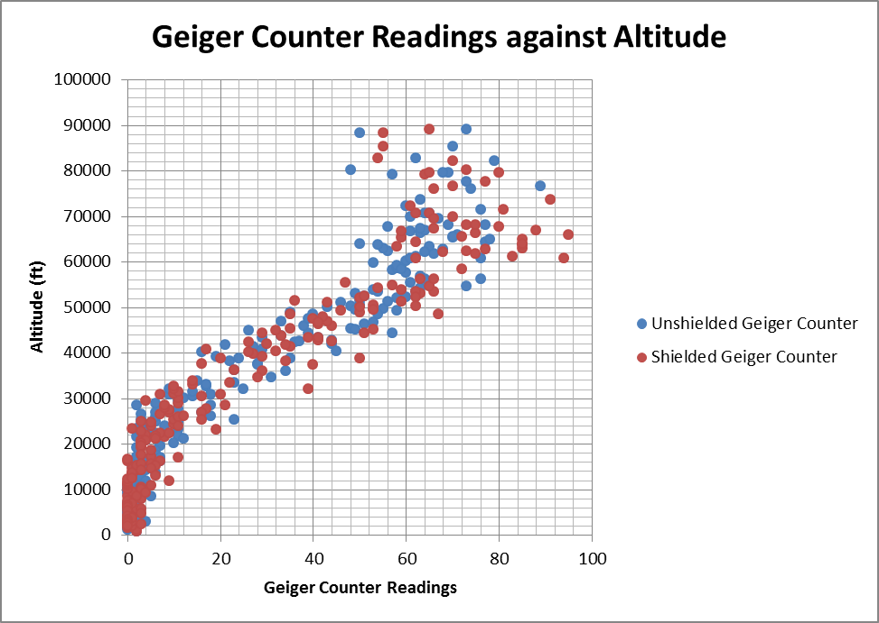
Geiger Counter Results

Slide 47
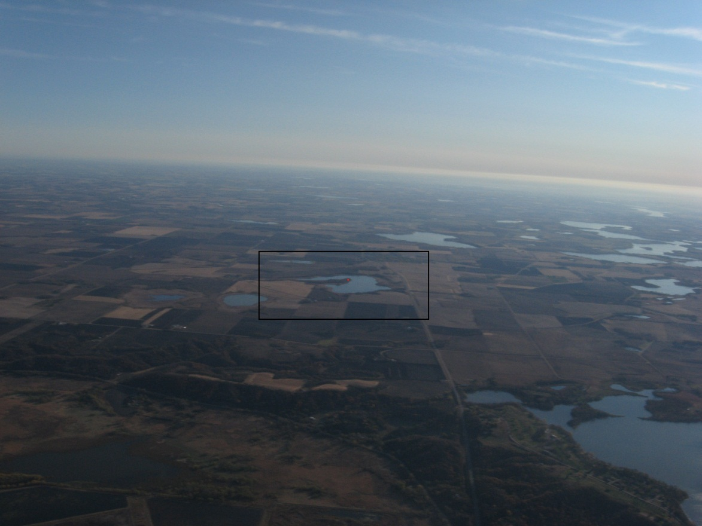
Picture Analysis
Find a picture
Find the time
Find the balloon position
Choose a reference
Find reference coordinates
Use http://www.movable-type.co.uk/scripts/latlong.html to get the distance
Find the altitude
Calculate angle
Photo 1345

Slide 48
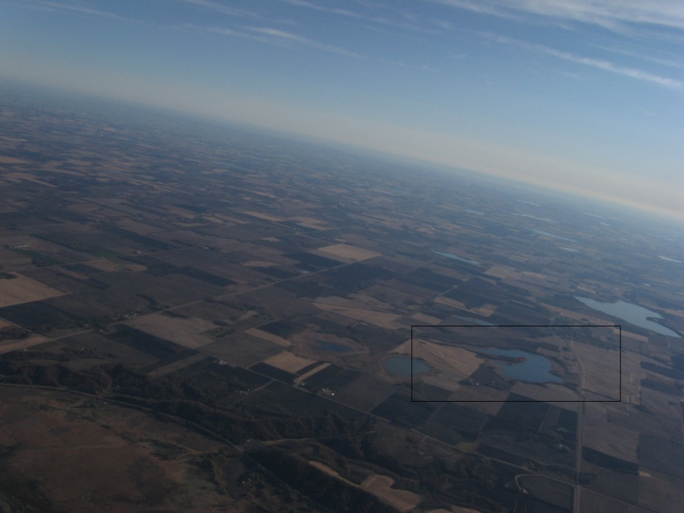
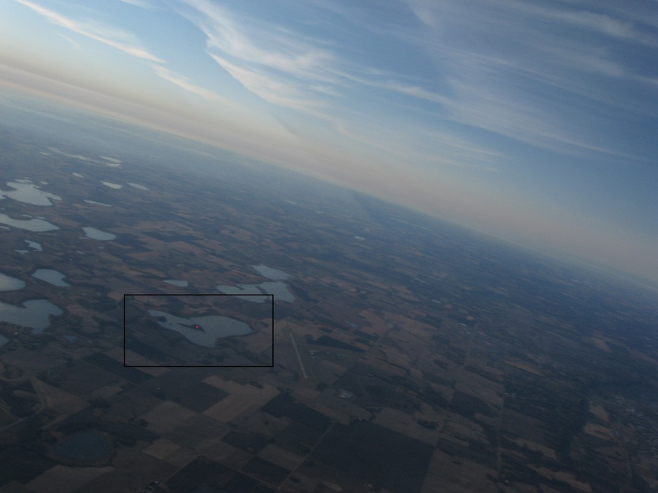
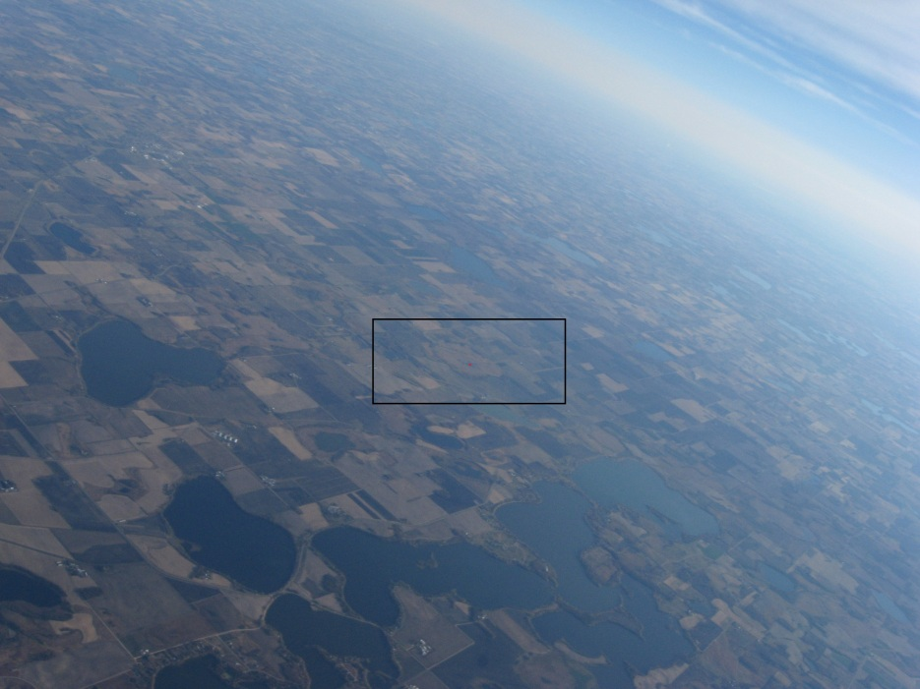
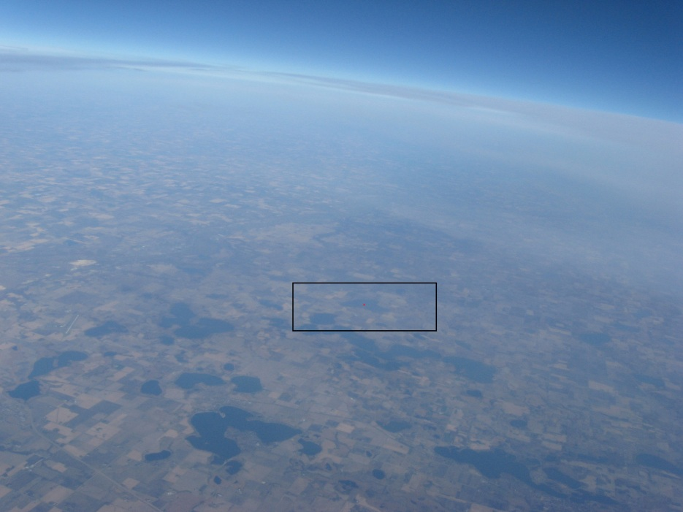
Picture Analysis

Slide 49
Picture Analysis
Starting photo | Time in seconds | Time in Hours | Time Normal | Lat, Lon | Reference Lat, Lon | Distance | Altitude | Angle to landmark | Angle from Ground
1345 | 34260 | 9.516666667 |  | 44 19.3225, -93 58.4054
Current Photo
1349 | 34396 | 9.554444444
1351 | 34464 | 9.573333333 | 9:34 | 44 19.4109 ,-93 58.0819 | 44.327102,-93.863754 | 8.305 | 1.275 | 255.3235 | 27.4199
1354 | 34566 | 9.601666667 |  | 44 19.3397, -93 57.7605 | 44.327041,-93.863612 | 7.898 | 1.924 | 239.7320 | 43.0113
1358 | 34702 | 9.639444444 | 9:38 | 44 19.0533, -93 57.2774 | 44.230441,-93.900833 | 10.59 | 2.693 | 237.9200 | 44.8233
1369 | 35076 | 9.743333333 | 9:44 | 44 16.0845, -93 54.7781 | 44.308741,-93.725395 | 15.6 | 5.258 | 224.2266 | 58.5167
1390 | 35790 | 9.941666667 | 9:56 | 44 04.9372, -93 44.8757 | 44.317216,-93.802986 | 26.49 | 10.42 | 215.2855 | 67.4578

Slide 50
Conclusions - Bacteria
  Bacteria, even resilient ones, need a controlled environment
  In the near future, better to build containers/environments and measure their performance with sensors
  Problem is that bacteria don’t have a spectrum of success – either survive or don’t
  Recommend against flying bacteria until survival is more under control

Slide 51
Conclusions - HOBO
  HOBO data showed that the temperature inside the box stayed above zero degrees Fahrenheit during the flight
  Temperature below the petri dish dropped as low as approximately negative thirty degrees Fahrenheit
  External temperature dropped as low as negative forty degrees Fahrenheit
  Basically, the temperatures around the petri dish were too low for the bacteria to survive
  Relative humidity generally declined in flight

Slide 52
Conclusions – StratoStar/Weather Station
  StratoStar data matched expectations for relative humidity, pressure, and temperature
  Took place of failed BalloonSat Easy and Weather Station
  Don’t just stress test components, stress test connectors
  Ensure that connectors give as solid of a connection as possible

Slide 53
Conclusions – Geiger Counter
  Aluminum foil provided no protection from gamma rays
  Unless heavier, more effective shielding (like lead) can be flown, don’t expect a reduction in measured radiation
  Likely would have done little to protect the bacteria from mutation

Slide 54
Conclusions – Picture Experiment
  Picture data from still camera is sufficiently high resolution to make out identifiable landmarks
  Pictures are also easily correlated with characteristics of a flight
  In a pinch, photo data could be used to reconstruct time/altitude/position/angle, if the others were known

Slide 55
Future Ideas
  Construct an alternative heating grid and measure its thermal performance using a HOBO
  Create insulated containers for the petri dishes that still allow penetration by certain types of radiation
  Build a payload shell from an alternate material with desired thermal/strength characteristics that still allows substantial radiation penetration

Slide 56
Words of Wisdom
  Pick an experiment that is both ambitious and realistic
  Make sure you can maintain a relationship with any external advisors – they’re busy too!
  Try to design your experiment so that you gain useful information even if it “fails”
  Don’t be too easy with your testing – the flight won’t be nice to your payload
  Take questions raised during your first two presentations into serious consideration

Slide 57
Acknowledgements
  Alex Knutson-Smisek
  Professor Goodman
  Professor Flaten
  Alex Ngure
  Joey Senkyr

