Slide 1
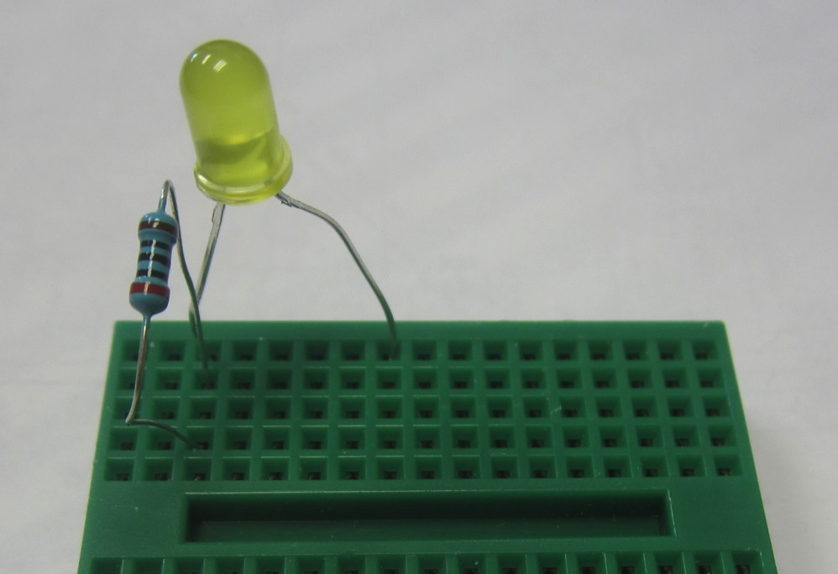
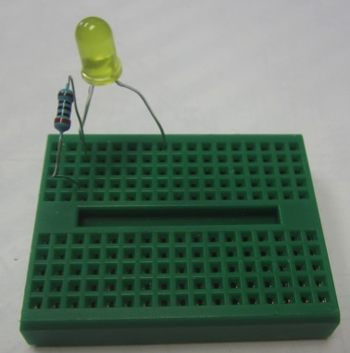
Arduino Overview:
- Remove LED from 13 and GND
- Bring out your breadboard from HW#4

Slide 2
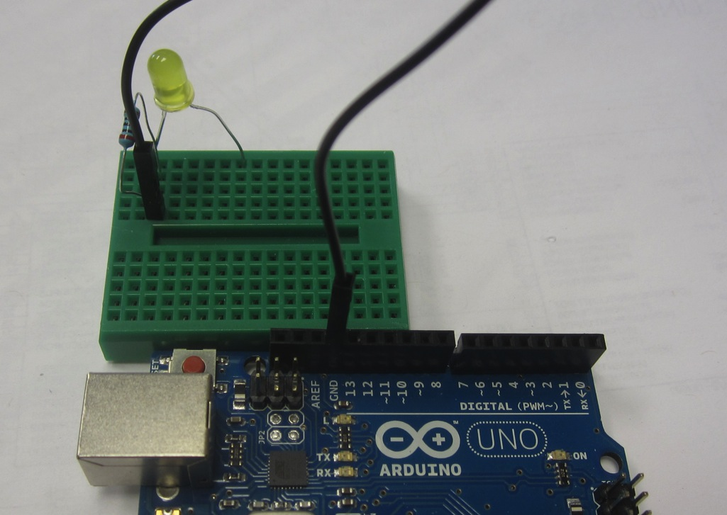
Arduino Overview:
- Connect resistor row to GND on your Arduino

Slide 3
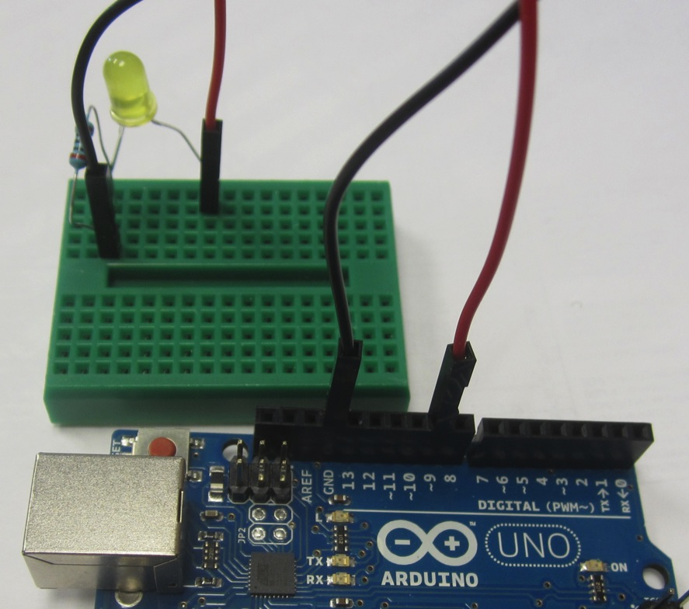
Arduino Overview:
- Connect + lead of LED to Arduino pin 9

Slide 4
Arduino Overview:
- Modify sketch to have LED blink on pin 9 through your breadboard
- Compile and Upload the code
- Do the LEDs blink?
- Switch pin number in sketch and hardware
- Tinker until all teams here

Slide 5
Arduino Overview:
- Understanding what is happening on pin 9
- High ( = 1 ) and Low ( = 0 ) state
- Let’s use the Arduino Serial Monitor to verify
- Change delay to 3 seconds

Slide 6
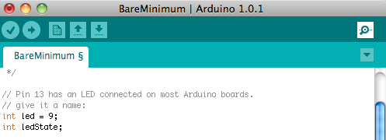
Arduino Overview:
- Modify the sketch to add the following variable

Slide 7
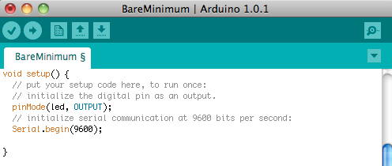
Arduino Overview:
- Modify the sketch to add the following to the setup

Slide 8
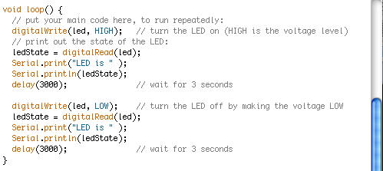
Arduino Overview:
- Modify the sketch to add the following to the loop

Slide 9
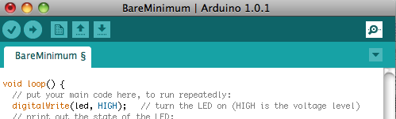
Arduino Overview:
- Compile and Upload your code
- Verify blink is every 3 seconds then…
- Click Serial Monitor icon

Slide 10
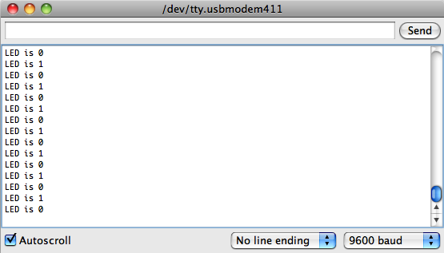
Arduino Overview:
- “LED is 1 or 0” correspond with on or off of LED?

Slide 11
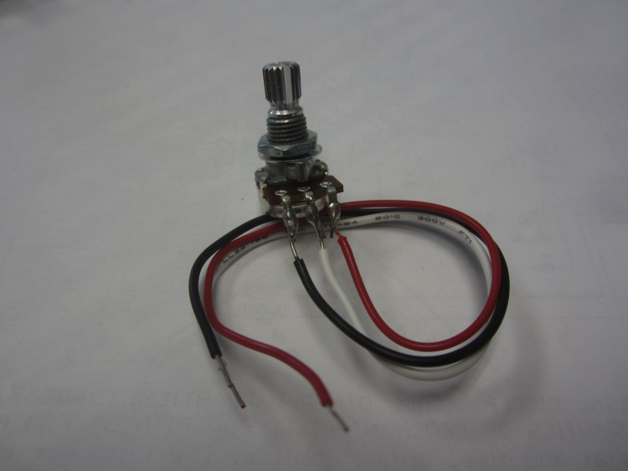
Arduino Overview:
- Now let’s modify our sketch to add an analog input
- Let’s use the potentiometer from HW #4

Slide 12
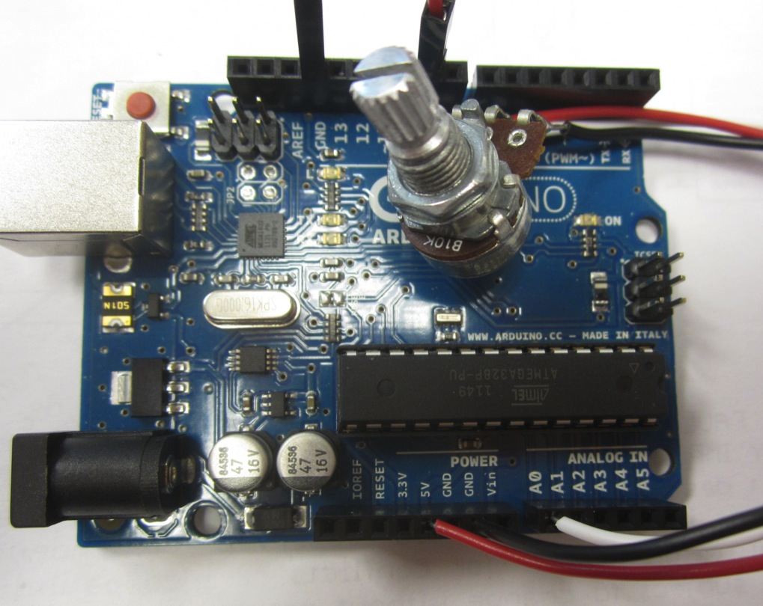
Arduino Overview:
- Connect the Red wire to +5V, Black to GND, and White to A0

Slide 13
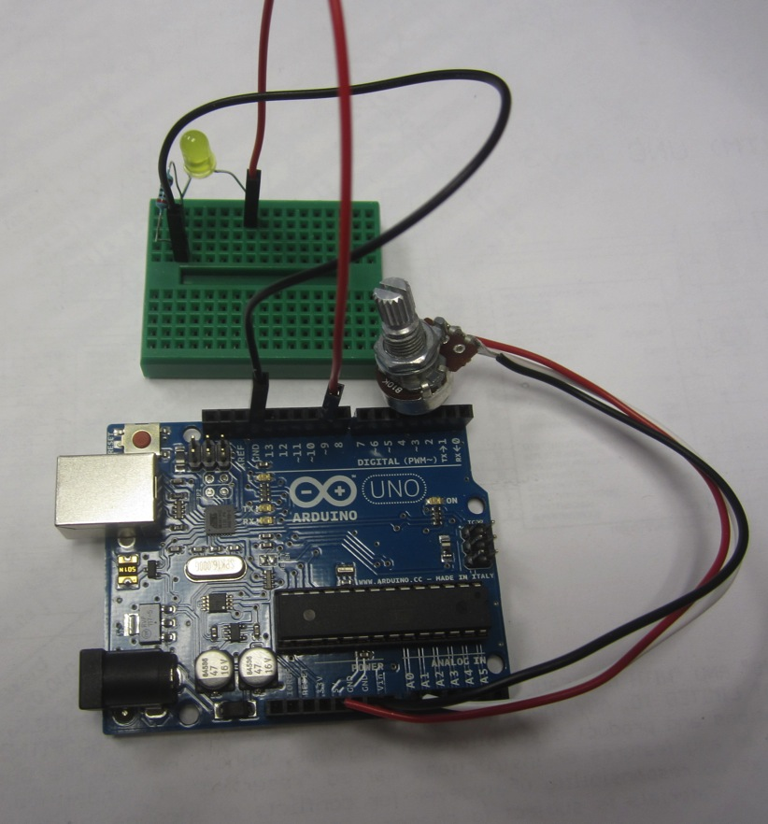
Arduino Overview:
- Leave the LED connected to pin 9 but it won’t blink

Slide 14
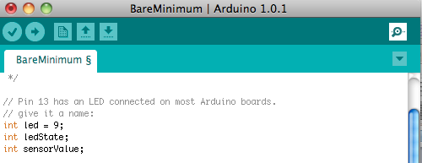
Arduino Overview:
- Modify your sketch to add the following variable

Slide 15
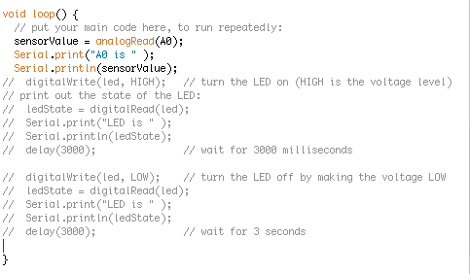
Arduino Overview:
- Modify your sketch to add the following to your loop
- Comment out all LED blink and Serial Print for LED

Slide 16
Arduino Overview:
- Compile and Upload your code
- Click Serial Monitor icon

Slide 17
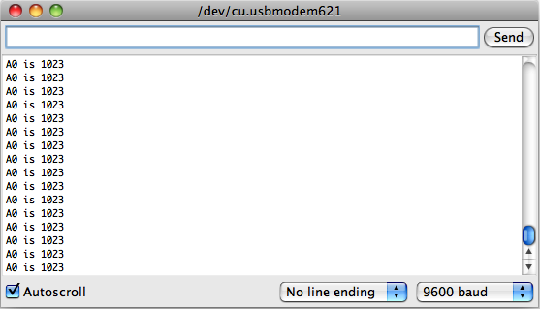
Arduino Overview:
- “A0 is ” should change as you turn the potentiometer

Slide 18
Arduino Overview:
- What does this number mean?
- What resolution is it? 8 bit, 10 bit, 16 bit?
- Modify sketch to Serial Print both 10 bit value and corresponding voltage value
- Recompile and upload
- Tinker until everyone is at this point

Slide 19
Arduino Overview:
- Let’s connect the A0 to the LED with software
- Turn your potentiometer fully counterclockwise
- What do you think will happen?

Slide 20
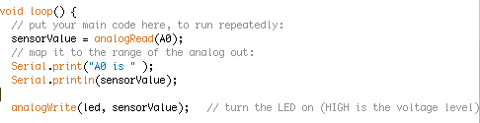
Arduino Overview:
- Modify sketch to add the following line:

Slide 21
Arduino Overview:
- Compile and Upload
- Activate Serial Monitor
- Begin turning potentiometer clockwise
- What happens?
- Why?
- 10 bit vs. 8 bit? 255 vs 1023? Look at the monitor…

Slide 22
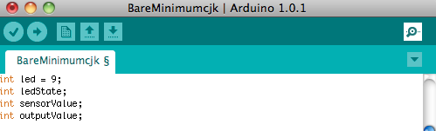
Arduino Overview:
- When 255 is hit, resets
- Let’s map our 10 bit analog to a 8 bit digital
- Add the following variable to your sketch

Slide 23
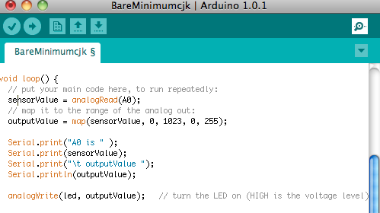
Arduino Overview:
- Add the following lines to your loop

Slide 24
Arduino Overview:
- Compile and Upload
- Activate Serial Monitor
- Begin turning potentiometer clockwise
- What happens?
- 255 = 1023?

Slide 25
Arduino Overview:
- Potentiometer is acting like an analog sensor
- We can now hook up any analog sensor and see its value (at least through serial)
- What other sensors can we hook up?
- Let’s add some…
- But first let’s add the Protoshield

