Slide 1
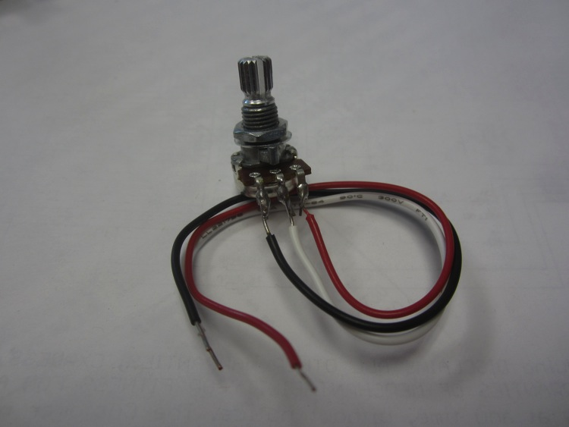
Arduino Overview:
- Now let’s modify our sketch to add an analog input
- Let’s use the potentiometer from HW #4

Slide 2
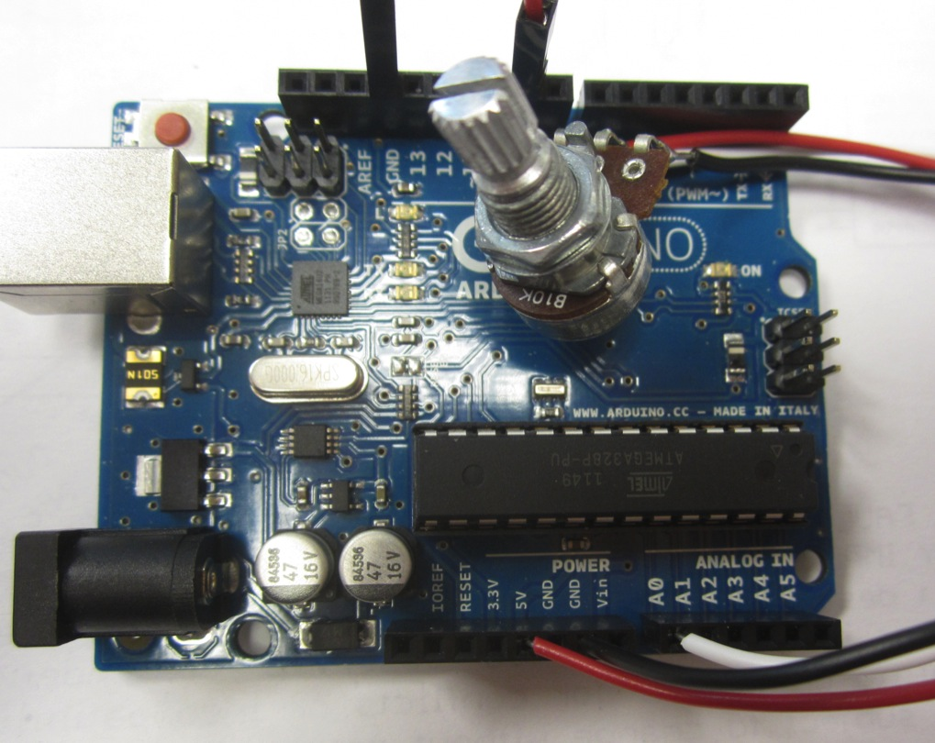
Arduino Overview:
- Connect the Red wire to +5V, Black to GND, and White to A0

Slide 3
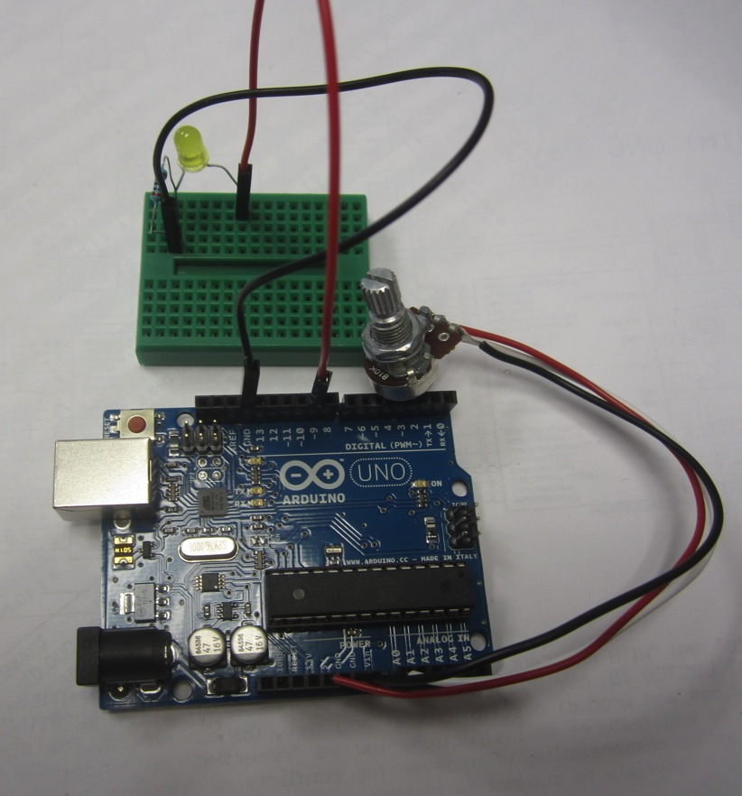
Arduino Overview:
- Leave the LED connected to pin 9 but it won’t blink

Slide 4
Arduino Overview:
- Potentiometer is acting like an analog sensor
- We can now hook up any analog sensor and see its value (at least through serial)
- What other sensors can we hook up?
- Let’s add some…
- But first let’s add the Protoshield

Slide 5
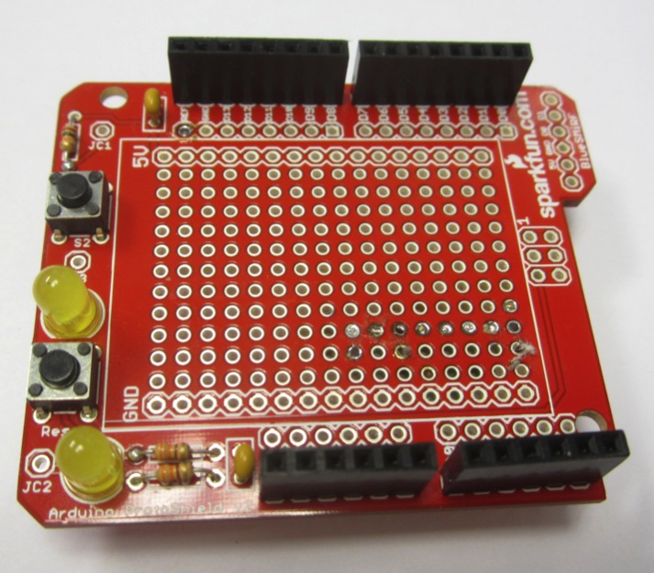
Arduino Overview:
- Take out the Protoshield your team built in HW#4

Slide 6
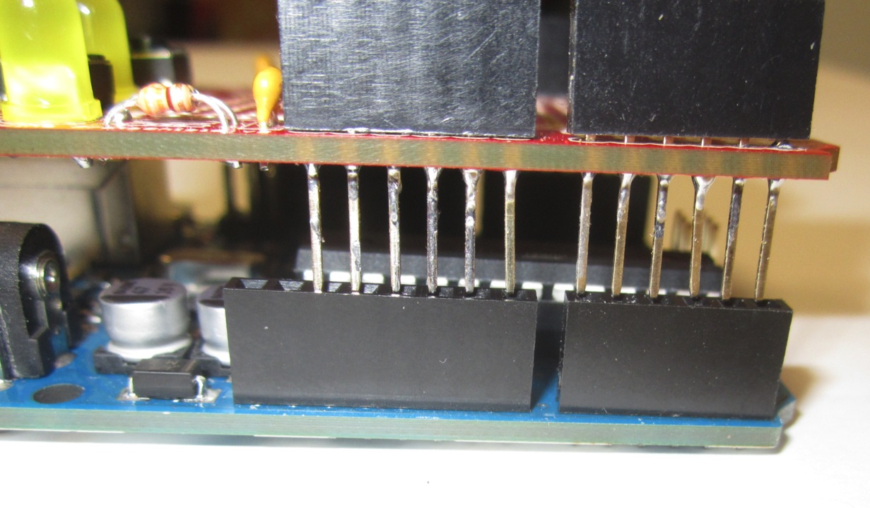
Arduino Overview:
- Carefully connect it with your unpowered Uno

Slide 7
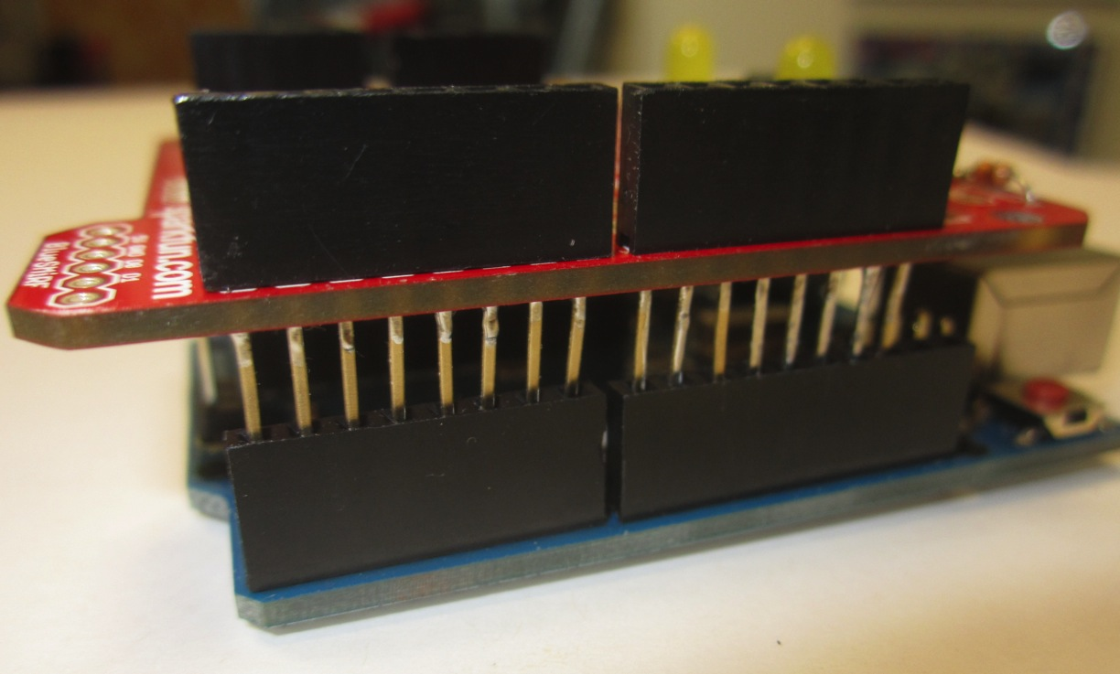
Arduino Overview:
- Carefully connect it with your unpowered Uno

Slide 8
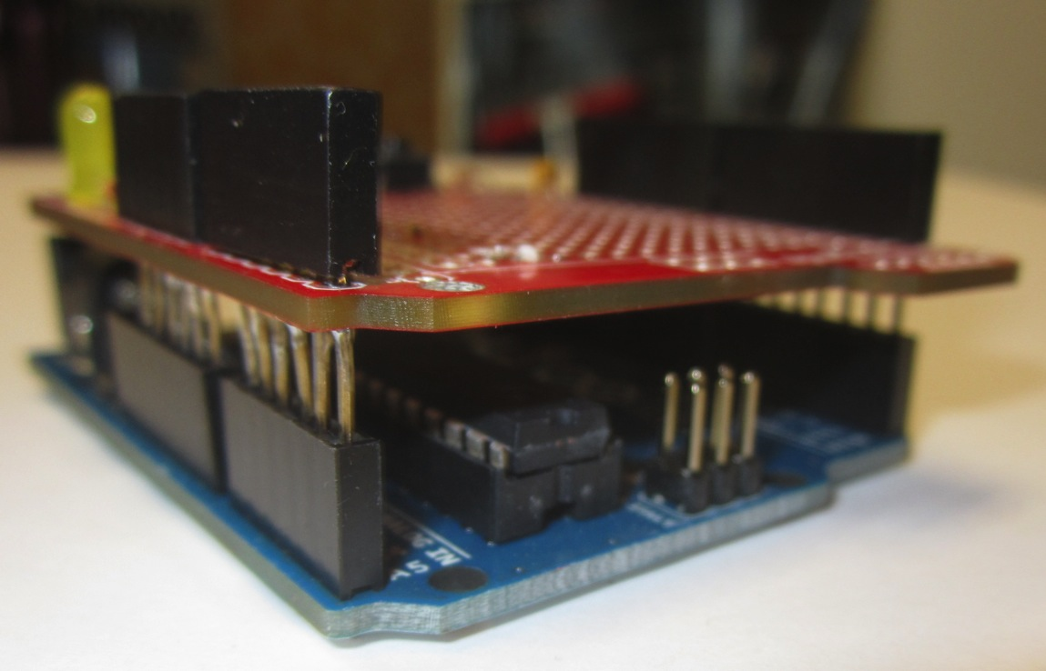
Arduino Overview:
- Carefully connect it with your unpowered Uno

Slide 9
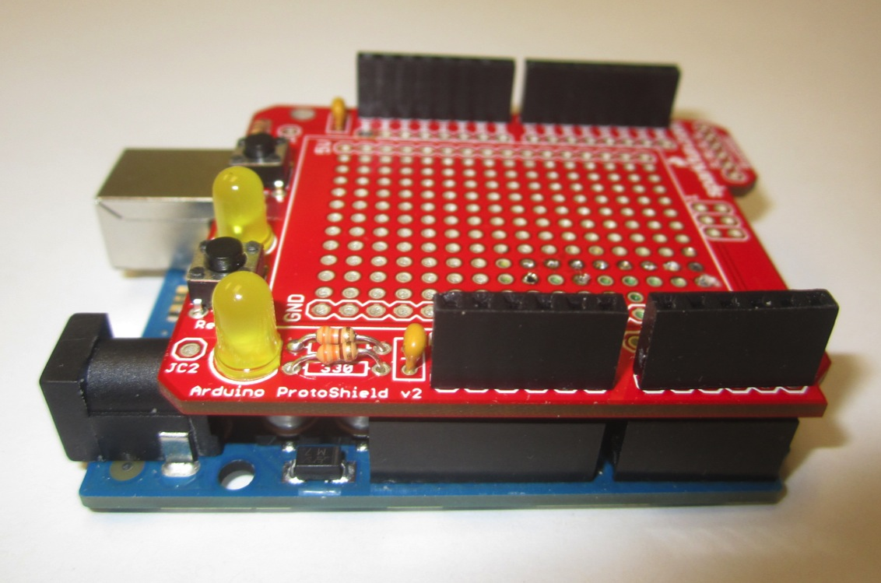
Arduino Overview:
- Carefully connect it with your unpowered Uno

Slide 10
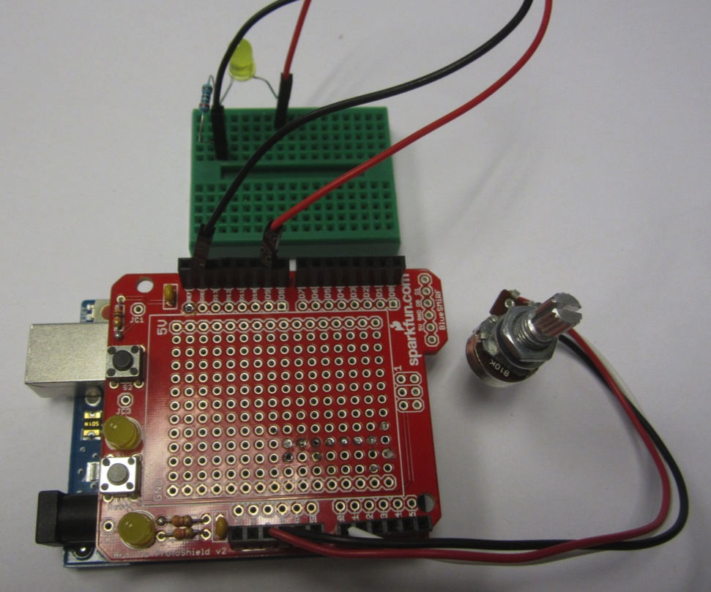
Arduino Overview:
- Reconnect Uno to laptop and verify all is working
- Activate Serial Monitor

Slide 11
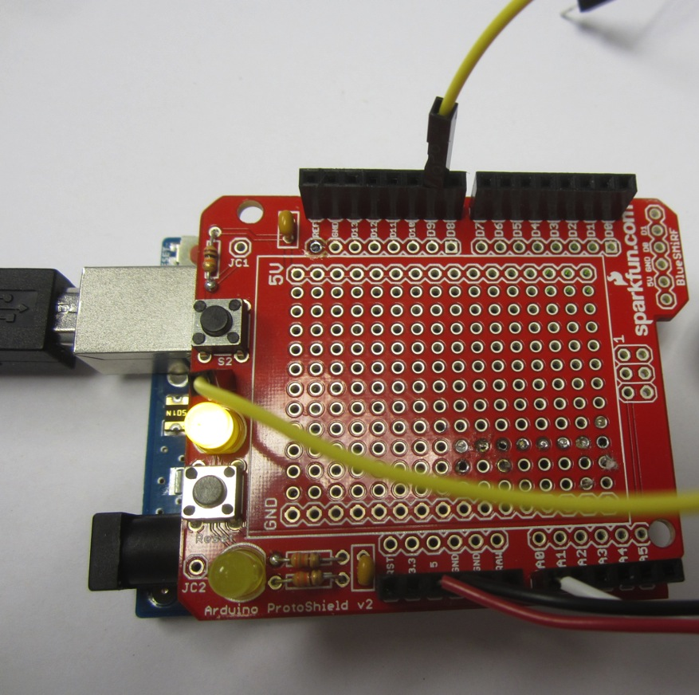
Arduino Overview:
- Disconnect LED Breadboard and connect wire from pin 9 to JC3 on ProtoShield
- Activate Serial Monitor

Slide 12
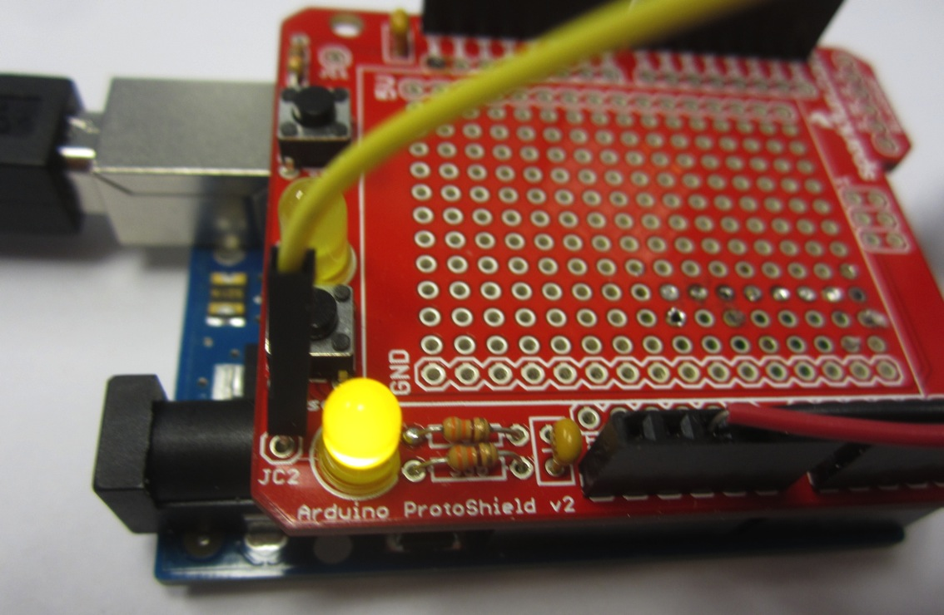
Arduino Overview:
- Carefully move wire to JC3 to JC2…

Slide 13
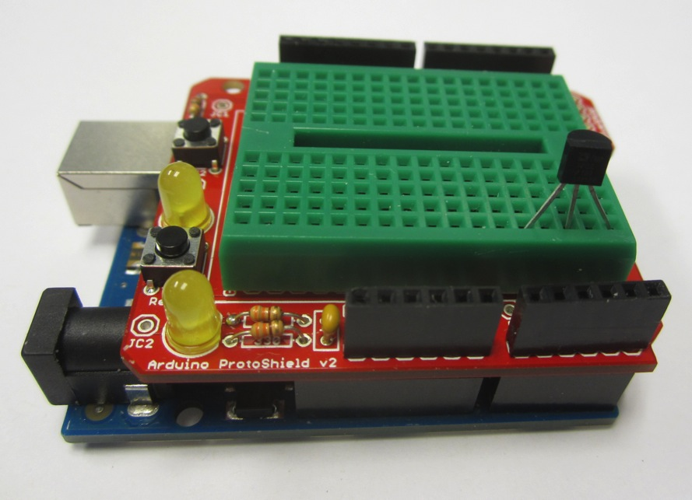
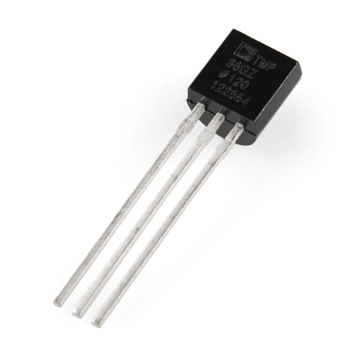
Arduino Overview:
- Add the Temperature Sensor to the Breadboard

Slide 14
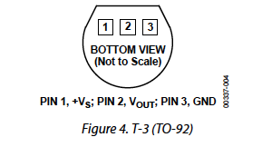
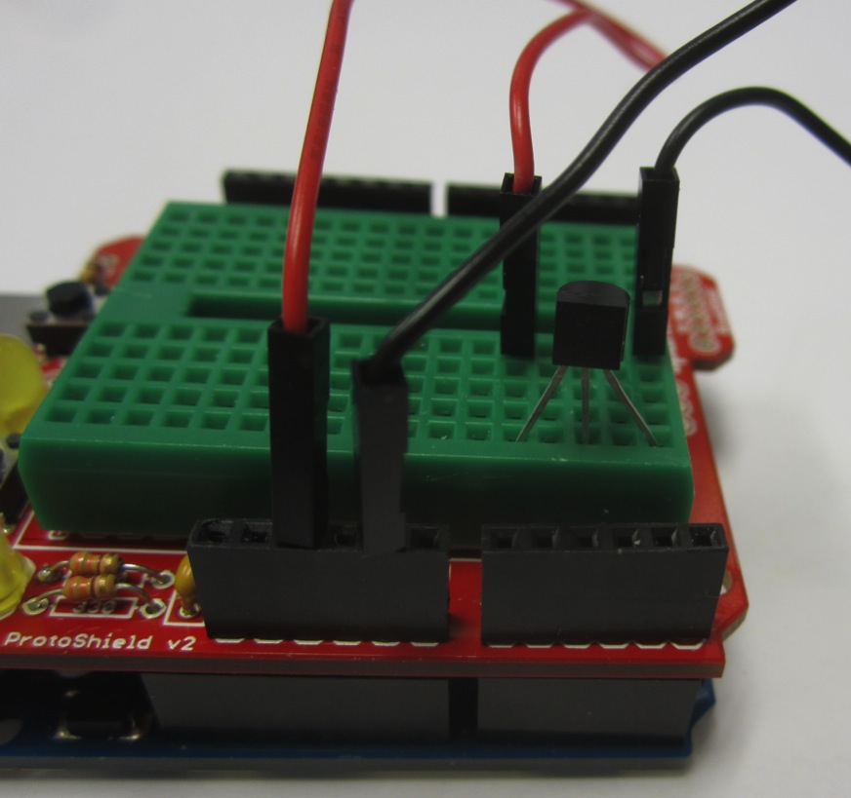
Arduino Overview:
- Connect Pin 1 to 5V

Slide 15
Arduino Overview:
- Connect Pin 3 to GND

Slide 16
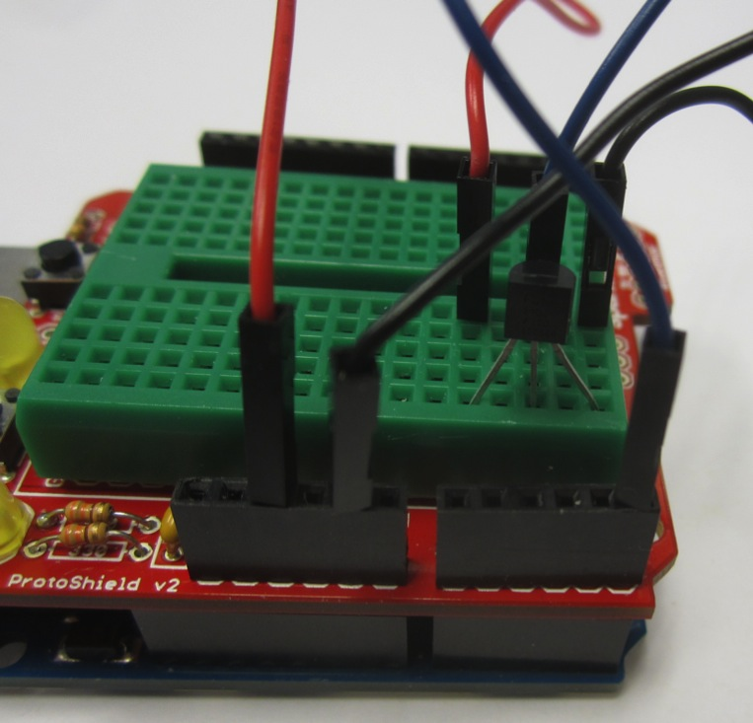
Arduino Overview:
- Connect Pin 2 to A5

Slide 17
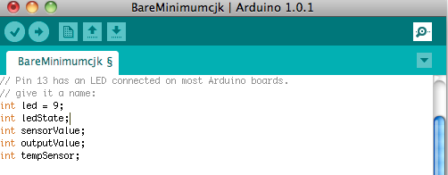
Arduino Overview:
- Modify your sketch to add the following variable

Slide 18
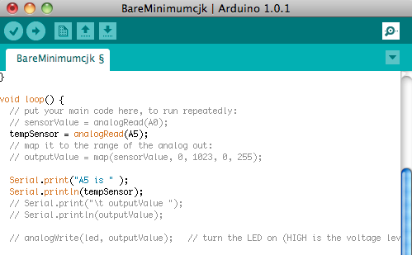
Arduino Overview:
- Modify your sketch to add the following lines in loop

Slide 19
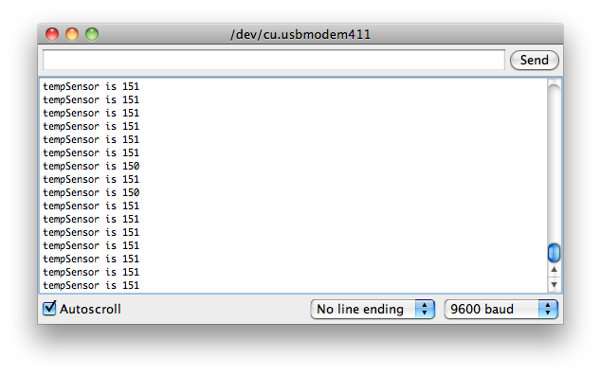
Arduino Overview:
- Compile and Upload
- Activate Serial Monitor
- Test by putting your finger on the sensor
- Do you see a change?

Slide 20
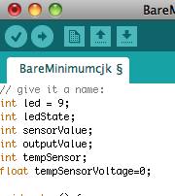
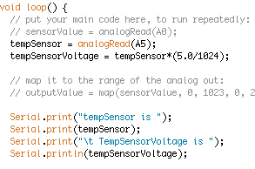
Arduino Overview:
- Convert to Voltage and display on Serial Monitor

Slide 21
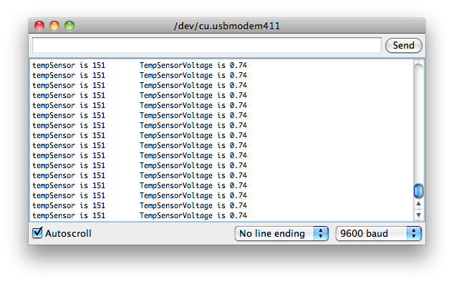
Arduino Overview:
- Should see this…

Slide 22
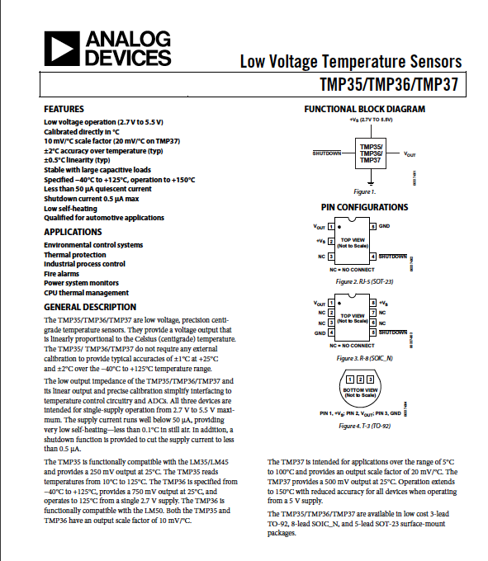
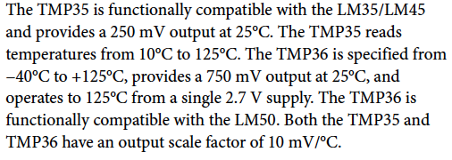
Arduino Overview:
- Use spec sheet to convert to degrees C
- 10 mV/C
- Look for offset

Slide 23
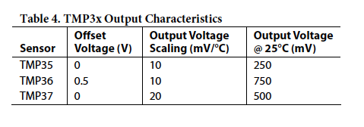
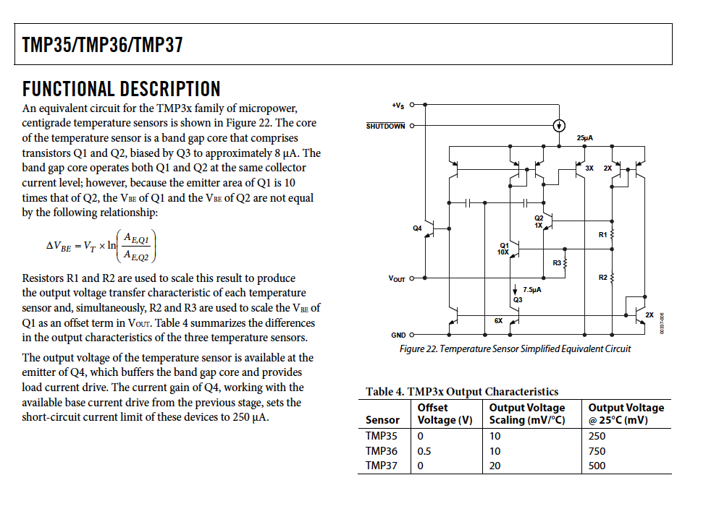
Arduino Overview:
- 0.5 V offset

Slide 24
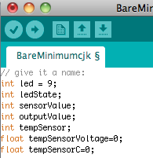
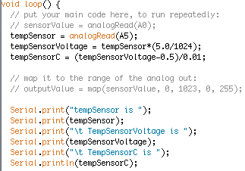
Arduino Overview:
- Modify your sketch

Slide 25
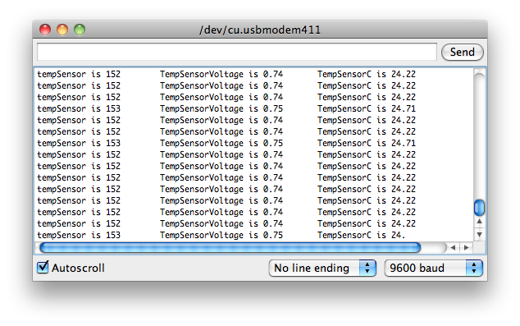
Arduino Overview:
- Should see this…

Slide 26
Arduino Overview:
- Data make sense?
- How would you calibrate this sensor?

Slide 27
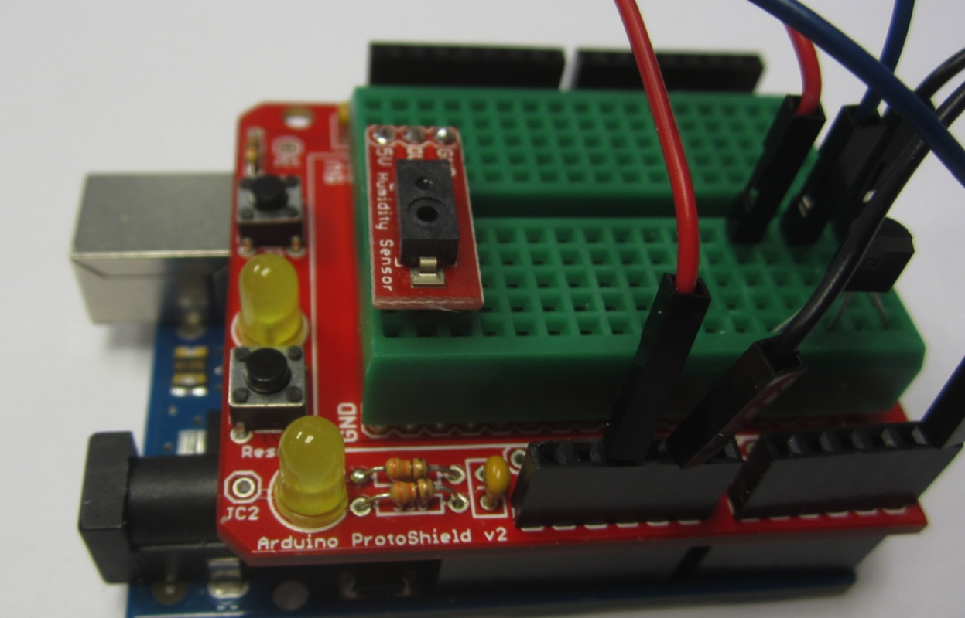
Arduino Overview:
- Add the Humidity Sensor to the Breadboard

Slide 28
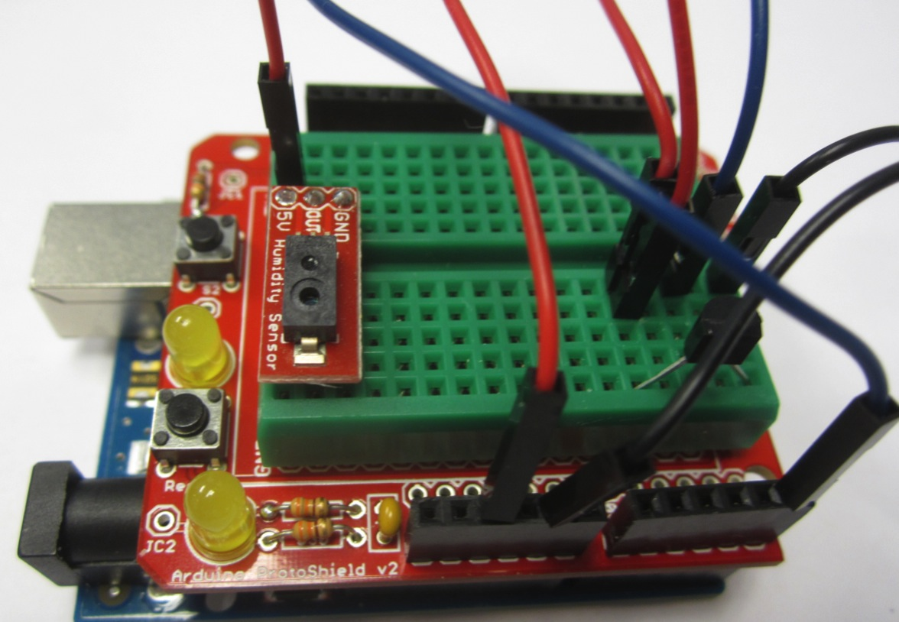
Arduino Overview:
- Connect 5 V from Temp Sensor

Slide 29
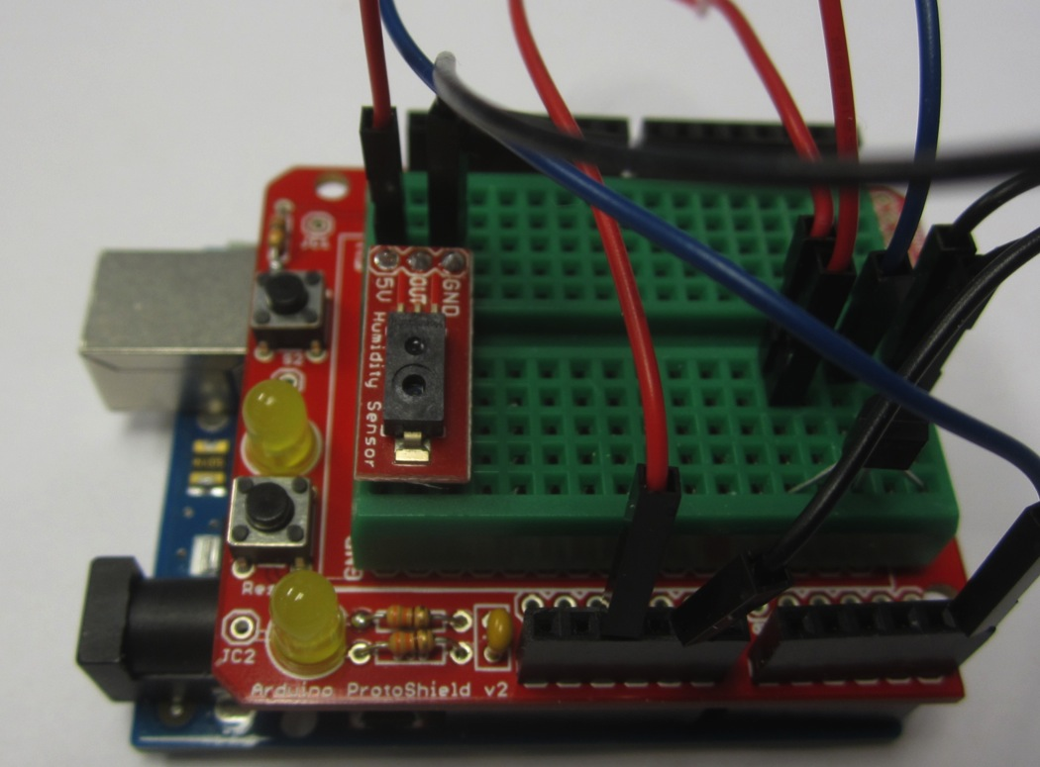
Arduino Overview:
- Connect GND from Temp Sensor

Slide 30
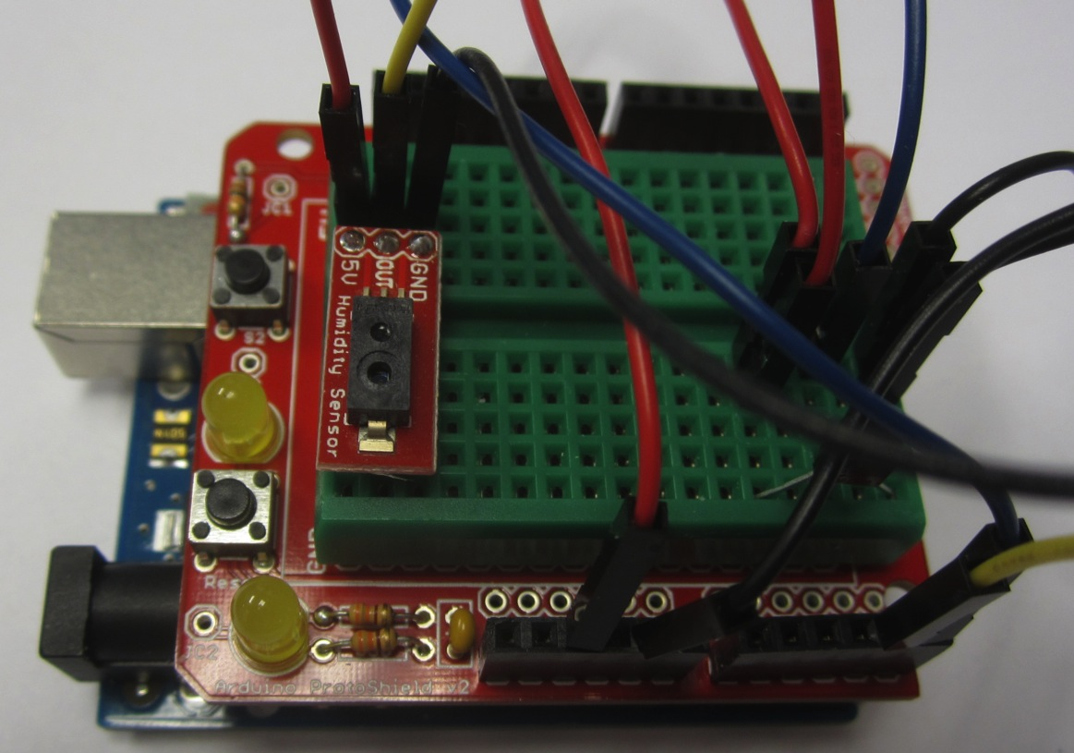
Arduino Overview:
- Connect Out to A4

Slide 31
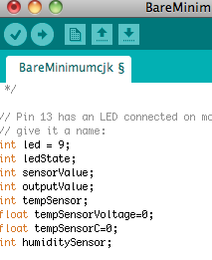
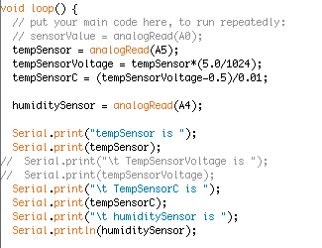
Arduino Overview:
- Modify Sketch

Slide 32
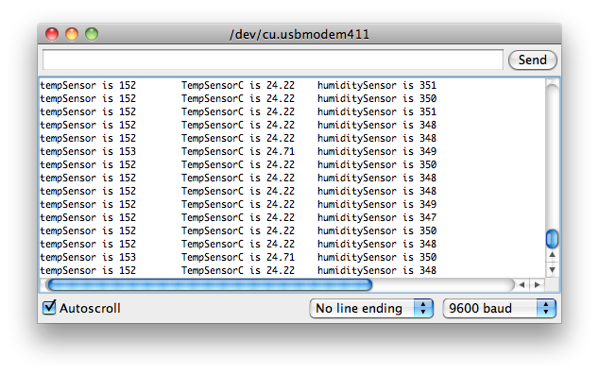
Arduino Overview:
- Should get…

Slide 33
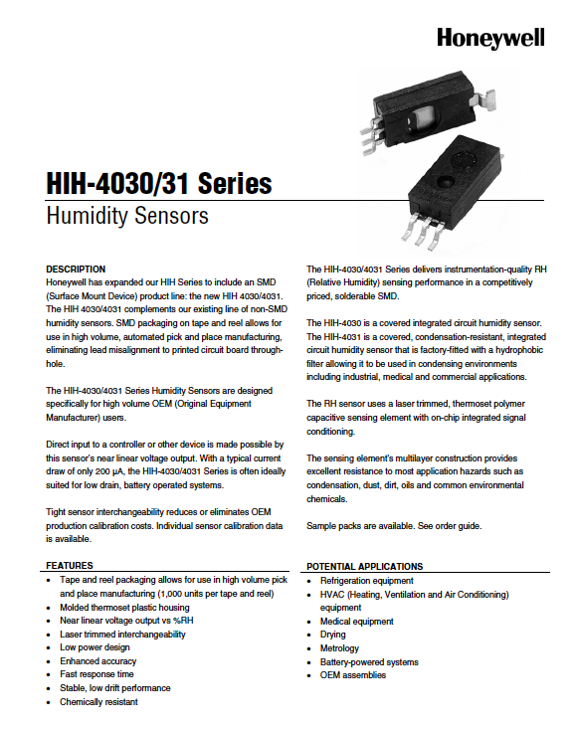
Arduino Overview:
- Convert to voltage and understandable units from data sheet
- Algebra

Slide 34
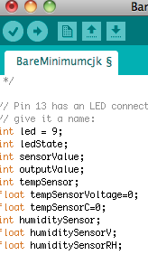
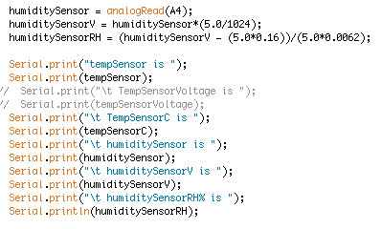
Arduino Overview:
- Modify Sketch

Slide 35
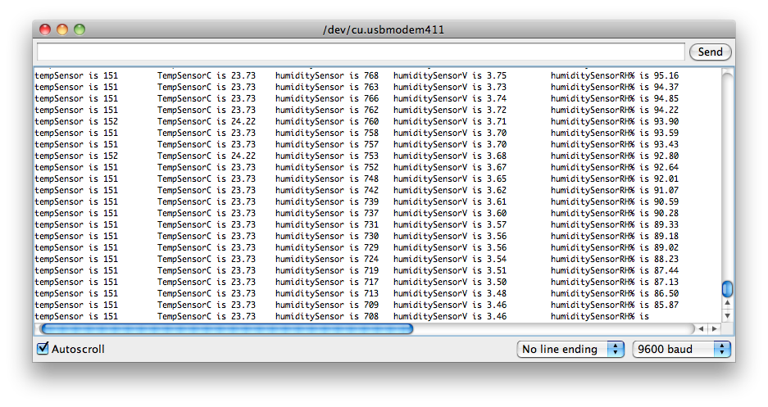
Arduino Overview:
- Should get…

Slide 36
Arduino Overview:
- Data make sense?
- How would you calibrate this sensor?

Slide 37
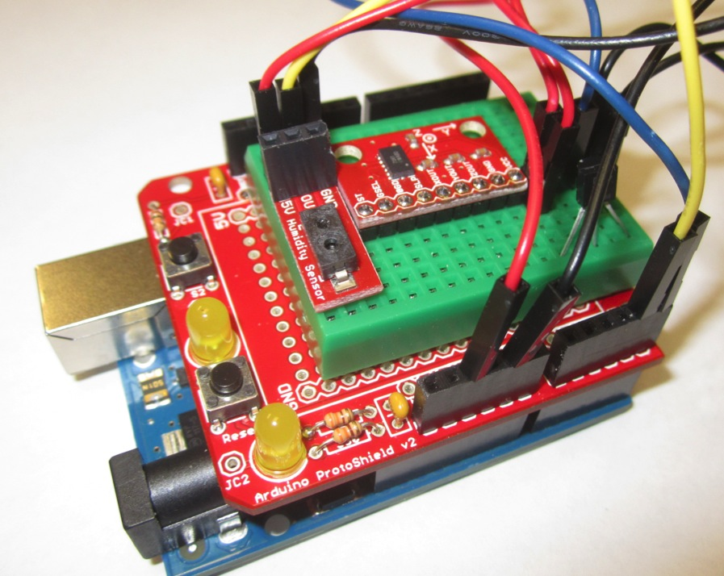
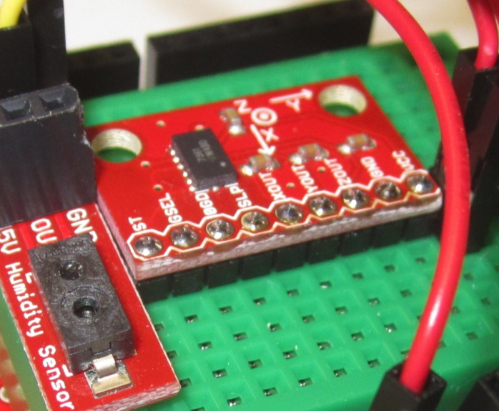
Arduino Overview:
- Add the Accelerometer to the Breadboard

Slide 38
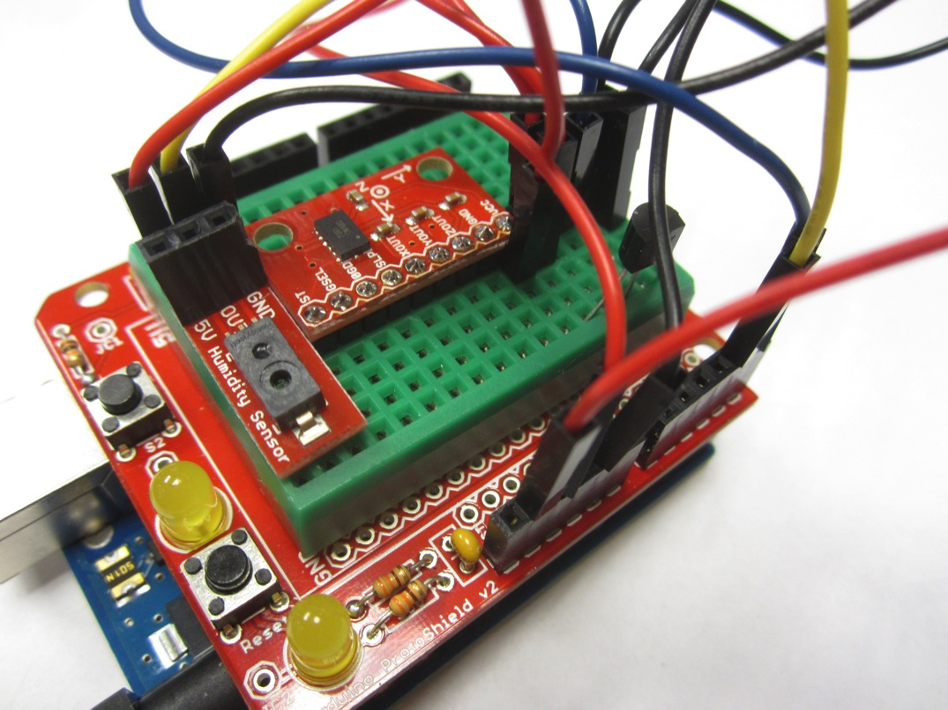
Arduino Overview:
- Connect 3.3V to Vcc from UNO

Slide 39
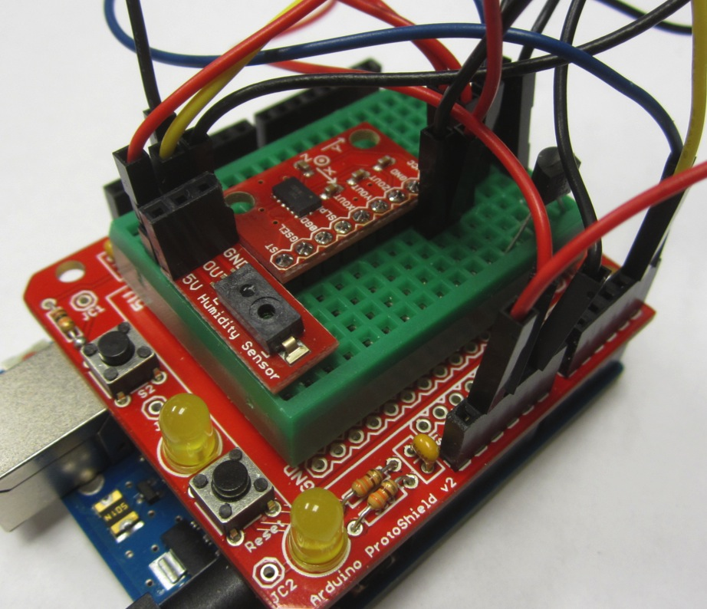
Arduino Overview:
- Connect GND to GND from Humidity Sensor

Slide 40
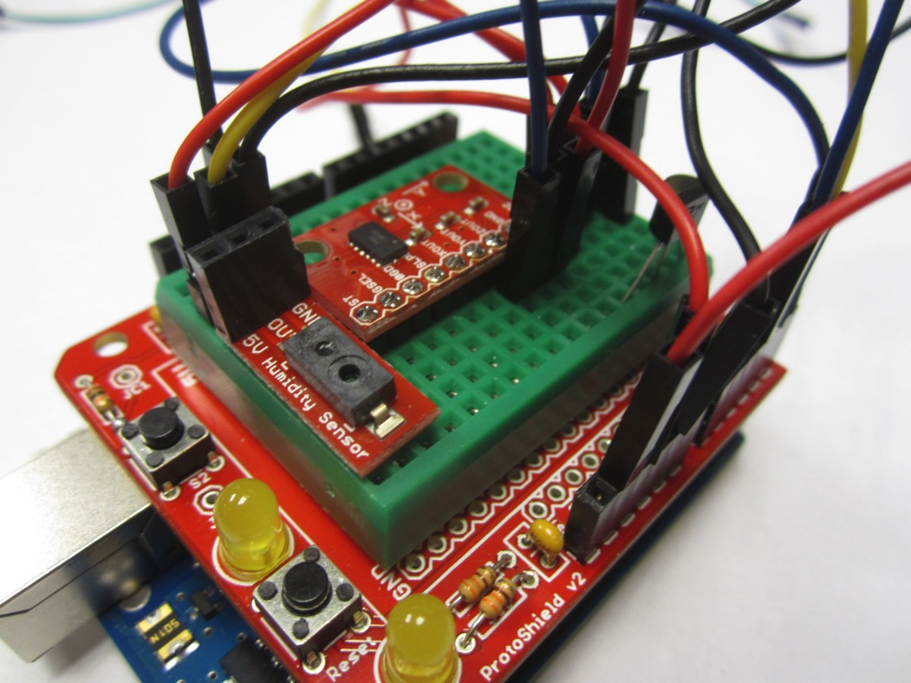
Arduino Overview:
- Connect ZOUT to A3 on UNO

Slide 41
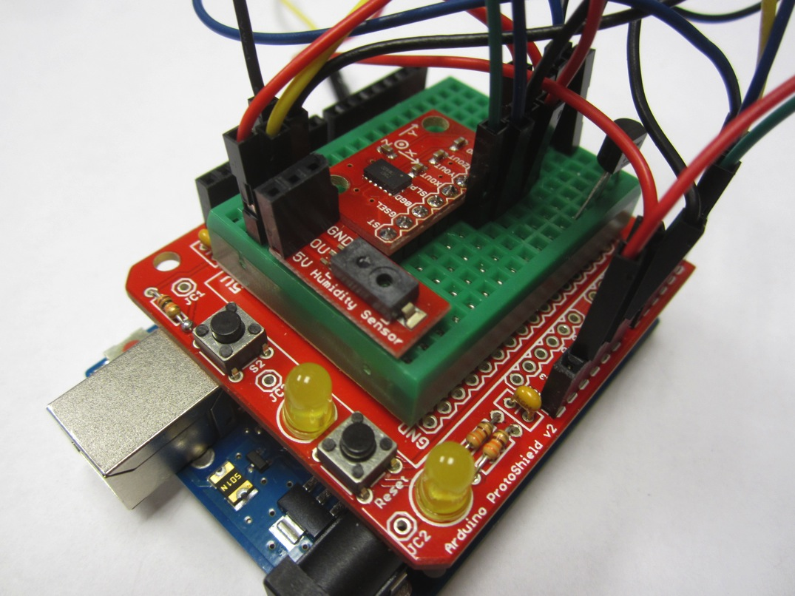
Arduino Overview:
- Connect YOUT to A2 on UNO

Slide 42
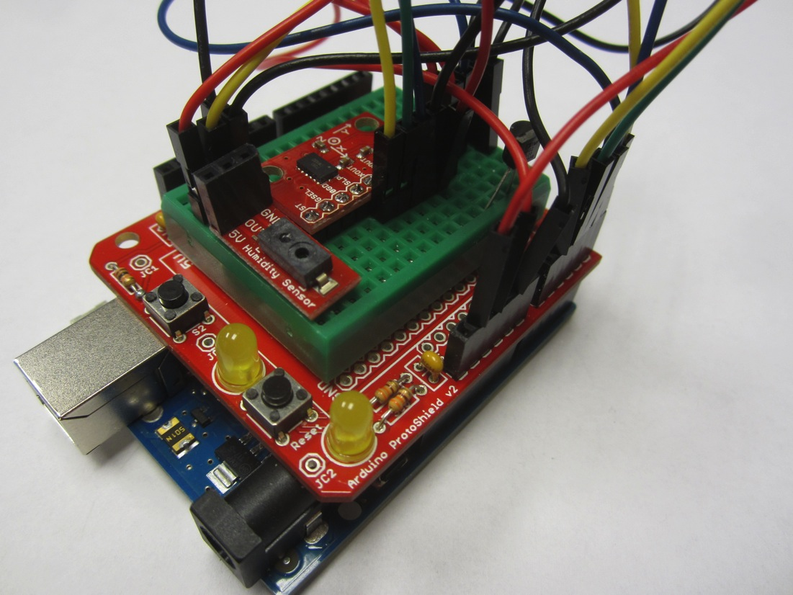
Arduino Overview:
- Connect XOUT to A1 on UNO

Slide 43
Arduino Overview:
- Accelerometer has a few other settings we need address from the Data Sheet

Slide 44
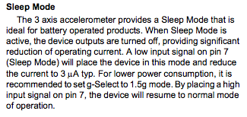
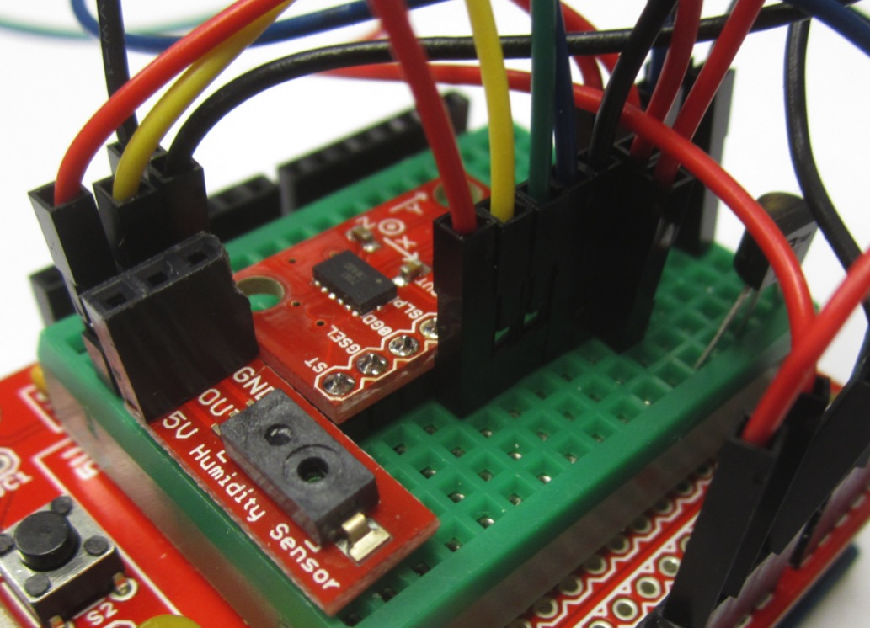
Arduino Overview:
- Sleep…Connect 3.3V from Accel Vcc to SLP

Slide 45
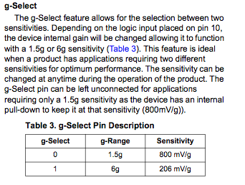
Arduino Overview:
- Range…Connect 3.3V from Accel Vcc to GSEL

Slide 46
Arduino Overview:
- Modify Sketch as follows

Slide 47
Arduino Overview:
- Modify Sketch as follows

Slide 48
Arduino Overview:
- Should get…

Slide 49
Arduino Overview:
- Convert to voltage and understandable units from data sheet
- Algebra

Slide 50
Arduino Overview:
- Convert to Voltage = accelX * (5.0/1024)
- Subtract offset and convert to Gs
Gs = (voltage – 1.65) / (0.206)

Slide 51
Arduino Overview:
- Modify Sketch as follows

Slide 52
Arduino Overview:
- Modify Sketch as follows

Slide 53
Arduino Overview:
- Should get…

Slide 54
Arduino Overview:
- Hold X flat, should see 0 G

Slide 55
Arduino Overview:
- Hold X arrow pointing up, should see 1.0 G

Slide 56
Arduino Overview:
- Hold X arrow pointing down, should see - 1.0 G

Slide 57
Arduino Overview:
- Repeat with Y and Z axes
- May need to tape breadboard down
- Do you need to Calibrate?
- How would you do it?

Slide 58
Arduino Overview:
- Add the Pressure Sensor to the Breadboard
- Notice orientation

Slide 59
Arduino Overview:
- Add the Pressure Sensor to the Breadboard
- Notice orientation

Slide 60
Arduino Overview:
- Connect Pin 2 to 5.0 Volts from your Humidity Sensor

Slide 61
Arduino Overview:
- Connect Pin 4 to GND from your Humidity Sensor

Slide 62
Arduino Overview:
- Connect Pin 3 to A0 on your UNO

Slide 63
Arduino Overview:
- Modify your sketch…

Slide 64
Arduino Overview:
- Modify your sketch…

Slide 65
Arduino Overview:
- Compile and upload. Should see…

Slide 66
Arduino Overview:
- Use ¼ sprinkler tubing to suck on pressure sensor
- Do not blow as limit of this sensor is 15 psi

Slide 67
Arduino Overview:
- Convert to voltage
pV=A0*(5.0/1024)
- Use spec sheet to solve for psi (Algebra)
Pmax = 15 psi
Pmin = 0
Vsupply = 5.0 V
Output(V) = pV

Slide 68
Arduino Overview:
- Solve for Pressure(applied) = Pa
Pa = psi = (pV – (.1 * 5.0)) / (.8*5.0) / (15-0)
psi = (pV – .5) / (.4 / 15)

Slide 69
Arduino Overview:
- Modify your sketch…

Slide 70
Arduino Overview:
- Modify your sketch…Suggest commenting out your accel and other sensor Serial.print statements

Slide 71
Arduino Overview:
- Should see this…
- Suck to zero?

