Slide 1
Arduino Overview:
- Navigate to your Arduino Libraries
- Should be where your Sketch is being saved
- Copy the following folders into your libraries
- SdFat
- OneWire
- DallasTemperature

Slide 2
Arduino Overview:
- Let’s make sure everyone’s sensors and code is working and outputting all 6 sensors correctly
- Compile and upload your code
- Verify that all your data is correct
- Wait here until every is checked out

Slide 3
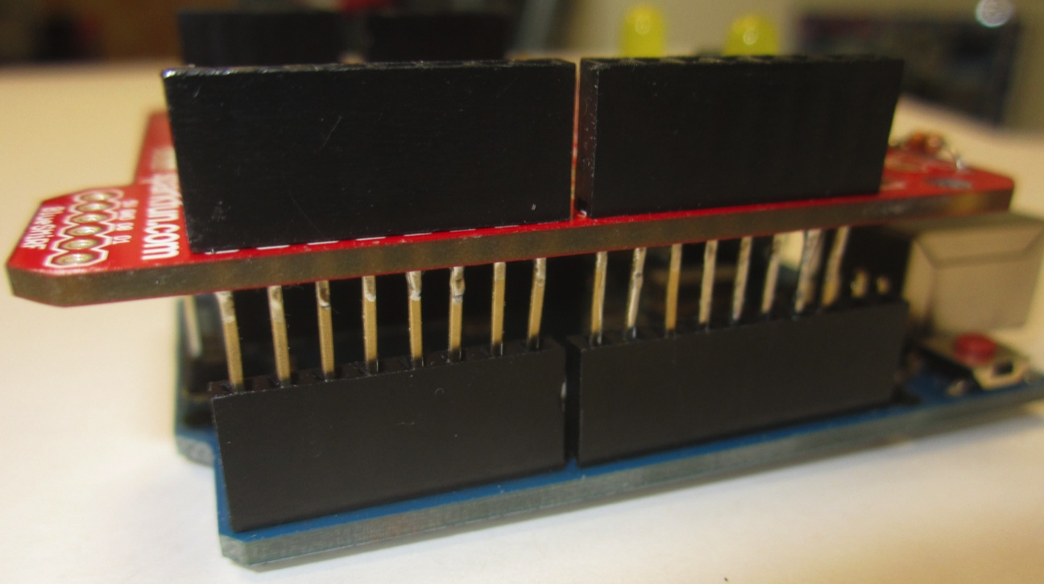
Arduino Overview:
- Let’s make room for the sd card by carefully removing your protoshield

Slide 4
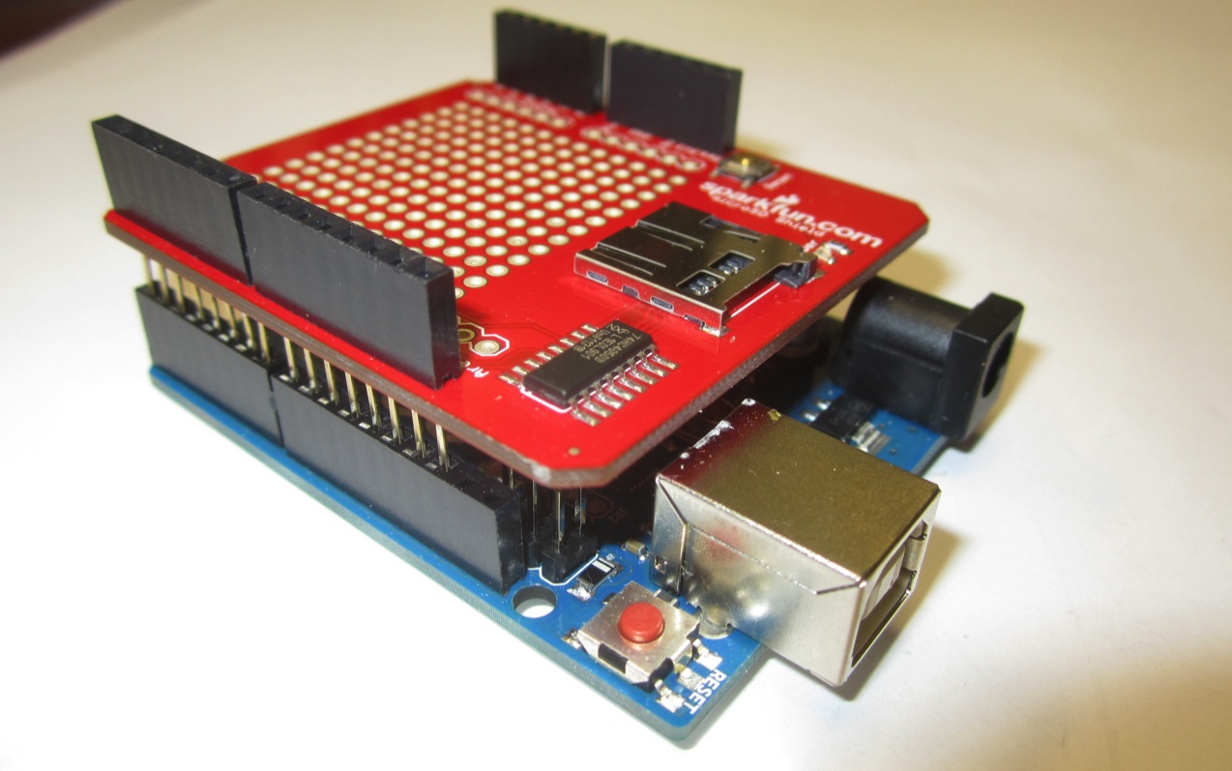
Arduino Overview:
- Carefully add your microSD Shield

Slide 5
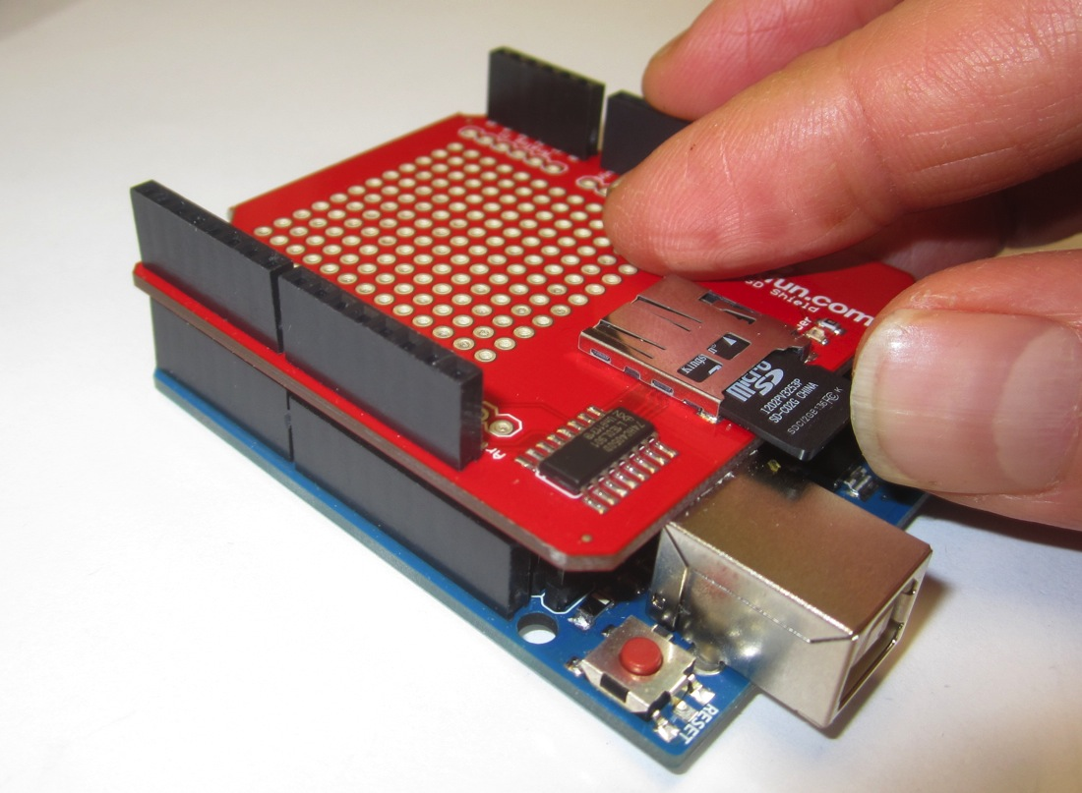
Arduino Overview:
- Insert your microSD card

Slide 6
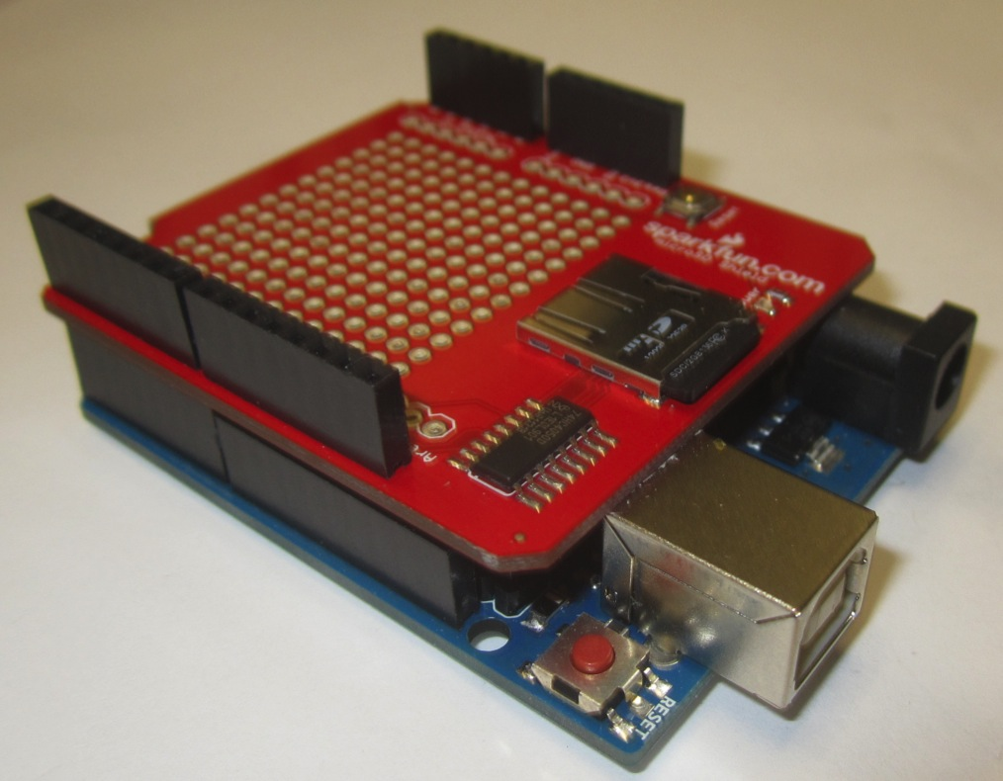
Arduino Overview:
- Insert your microSD card

Slide 7
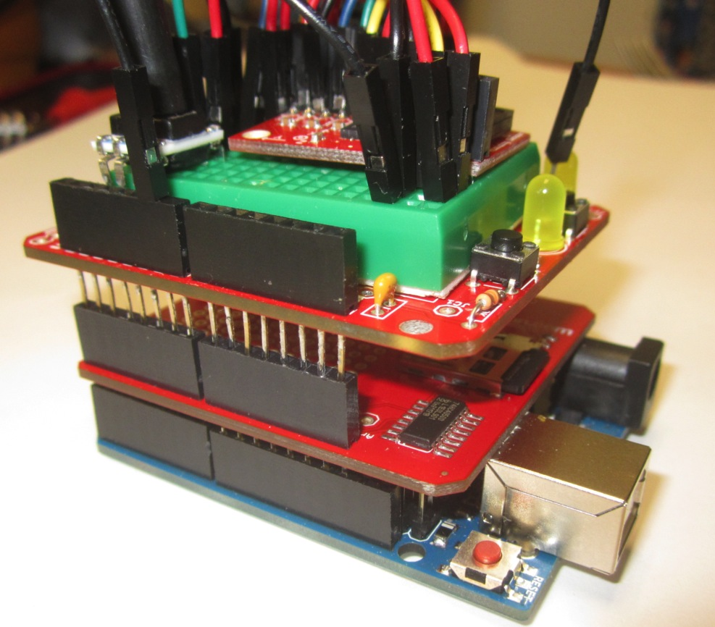
Arduino Overview:
- Carefully re-attach your protoshield

Slide 8
Arduino Overview:
- Compile and upload your code and verify that it still runs as it did before
- Wait here until everyone is at this point

Slide 9
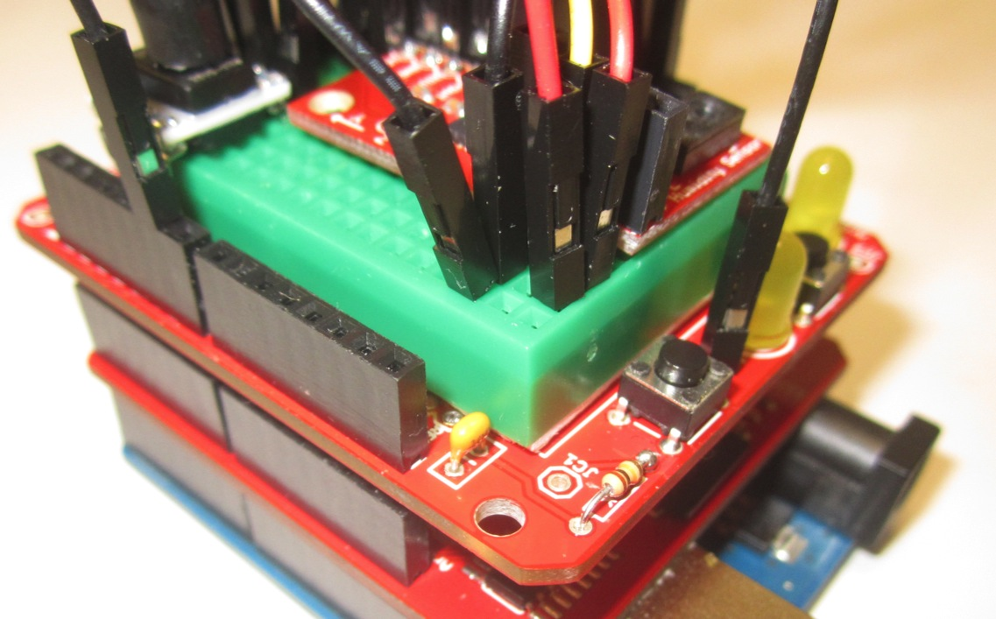
Arduino Overview:
- Connect an LED to pin 6 or use your development board LED JC2 or JC3 (Used to verify write to sd)

Slide 10
Arduino Overview:
- Reopen your previous Sketch

Slide 11
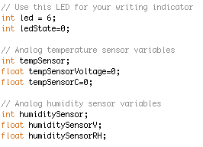
Arduino Overview:
- Let’s clean up our Sketch

Slide 12
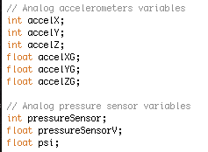
Arduino Overview:
- Let’s clean up our Sketch

Slide 13
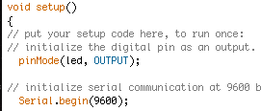
Arduino Overview:
- Let’s clean up our Sketch

Slide 14
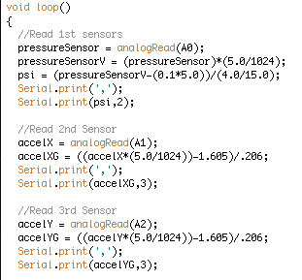
Arduino Overview:
- Let’s clean up our Sketch

Slide 15
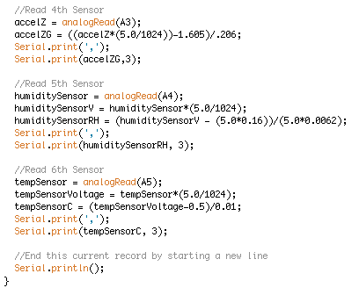
Arduino Overview:
- Let’s clean up our Sketch

Slide 16
Arduino Overview:
- Compile and Build your code
- Verify it still works
- Everyone wait here until we are all at the same place

Slide 17
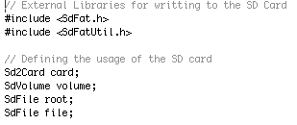
Arduino Overview:
- Add the following to your Sketch
- Includes library SdFat + magic

Slide 18

Arduino Overview:
- Add the following to your Sketch
- uint32_t is basically a big number declaration

Slide 19
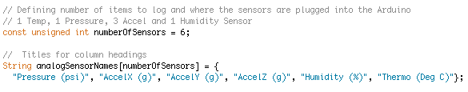
Arduino Overview:
- Add the following to your Sketch
numberOfSensors is a just a variable
analogSensorNames is just a string of text

Slide 20
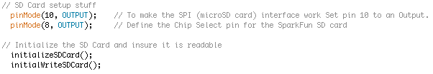
Arduino Overview:
- Add the following to your Sketch
pinMode is just like pinMode for LED
initializeSDCard and initialWriteSDCard are function calls

Slide 21
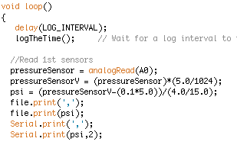
Arduino Overview:
- Add the following to your Sketch
- delay(LOG_INTERVAL) is how often you will sample your sensors
- logTheTime is another function call
- file.print writes ( ) to the buffer

Slide 22
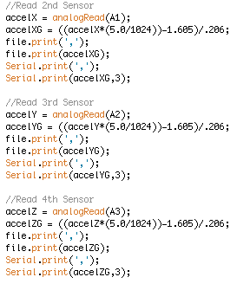
Arduino Overview:
- Add the following to your Sketch

Slide 23
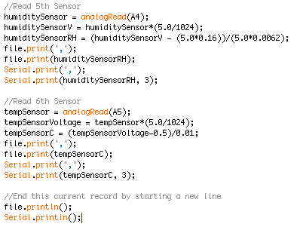
Arduino Overview:
- Add the following to your Sketch

Slide 24
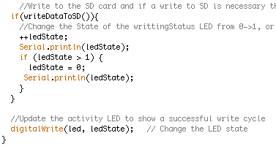
Arduino Overview:
- Add the following to your Sketch

Slide 25
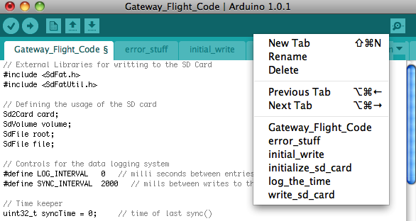
Arduino Overview:
- Create a new Tab called “initialize sd card”

Slide 26
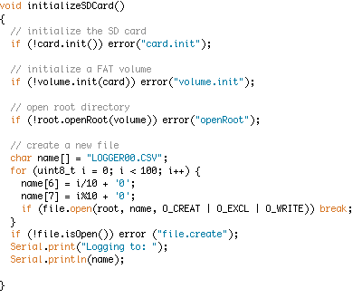
Arduino Overview:
- Add to the following to initialize sd card tab…

Slide 27
Arduino Overview:
- Create a new Tab called “error stuff”

Slide 28
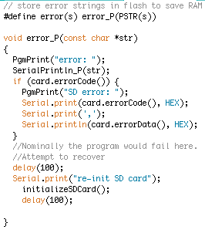
Arduino Overview:
- Add to the following to error stuff tab…

Slide 29
Arduino Overview:
- Create a new Tab called “initial write”

Slide 30
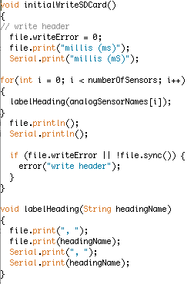
Arduino Overview:
- Add to the following to initial write tab…

Slide 31
Arduino Overview:
- Create a new Tab called “log the time”

Slide 32
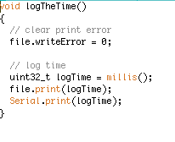
Arduino Overview:
- Add to the following to log the time tab…

Slide 33
Arduino Overview:
- Create a new Tab called “write sd card”

Slide 34
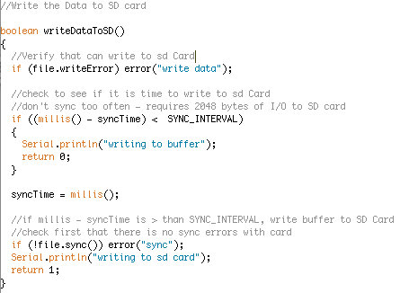
Arduino Overview:
- Add to the following to write sd card tab…

Slide 35
Arduino Overview:
- file.print prints to buffer
- write to sd writes to sd card if all conditions are true
- Sync time is reset

Slide 36
Arduino Overview:
- Compile your Sketch
- Do not upload your Sketch until we are all error free

Slide 37
Arduino Overview:
- Upload your code and launch your serial monitor
Verify the following:
- LED is blinking at the right interval you set in your code
- Difference between time stamp on serial monitor makes sense
- Tinker with the sample and write times
- Wait for all clear to proceed

Slide 38
Arduino Overview:
- Set your Log intervals to 100 ms
- Set your Sync interval to 2000 ms
- Compile and Upload your code
- Start Serial Monitor
- Give it following data in the following order

Slide 39
Arduino Overview:
- Suck on your pressure sensor for about a 2 seconds
- Breathe on your humidity sensor
- Touch your temp sensor for 5 seconds

Slide 40
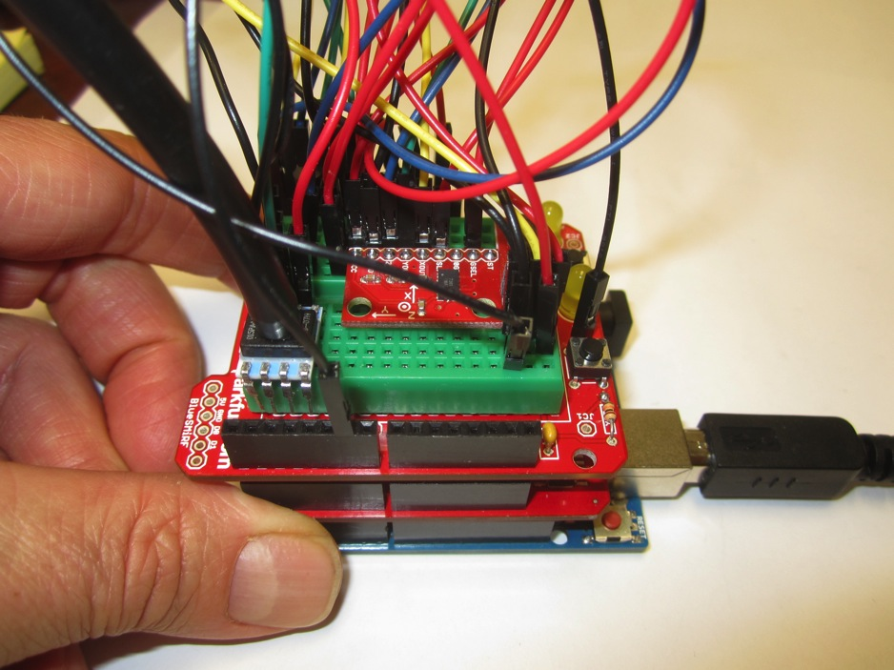
Arduino Overview:
- Hold your accels completely flat and still for 10 seconds

Slide 41
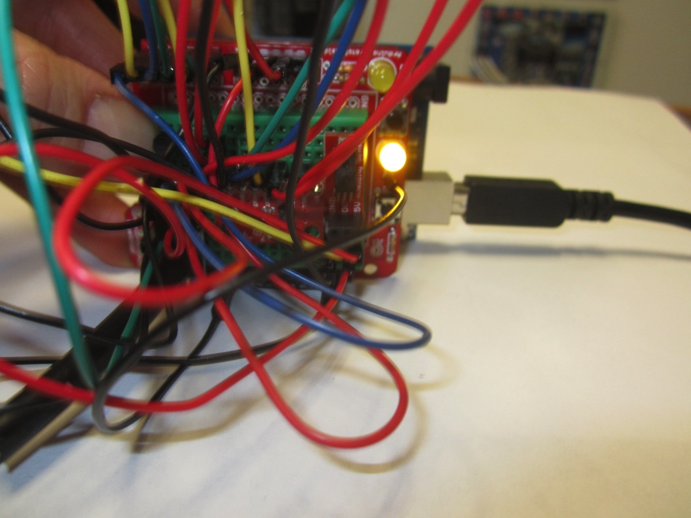
Arduino Overview:
- Hold accels with X up and still for 10 seconds

Slide 42
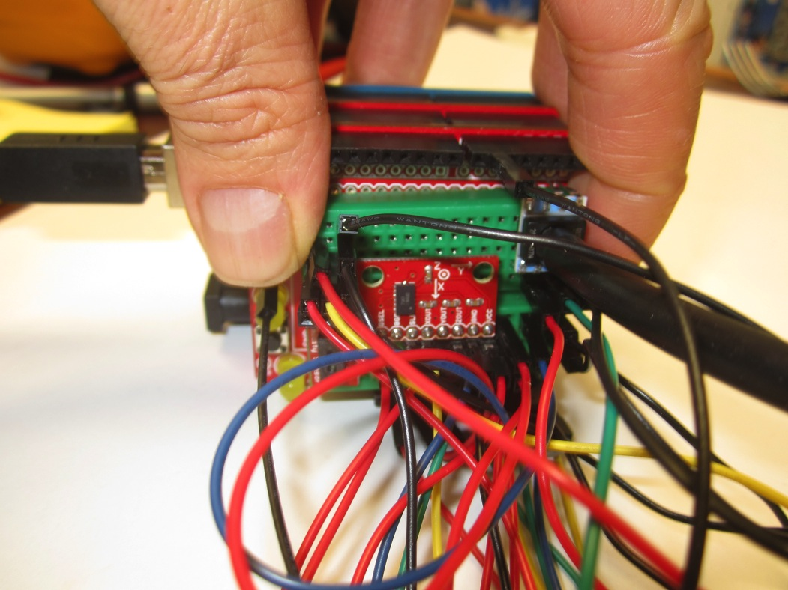
Arduino Overview:
- Hold accels with X down and still for 10 seconds

Slide 43
Arduino Overview:
- Hold accels completely flat and still for 10 seconds

Slide 44
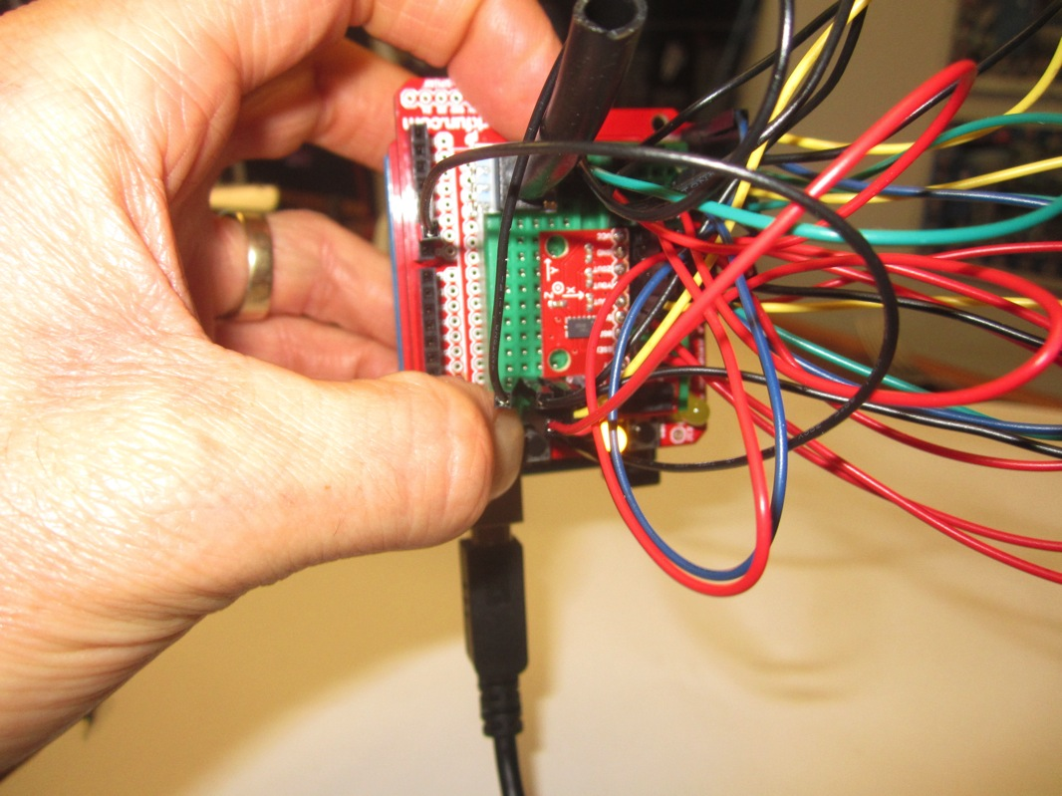
Arduino Overview:
- Hold accels with Y up and still for 10 seconds

Slide 45
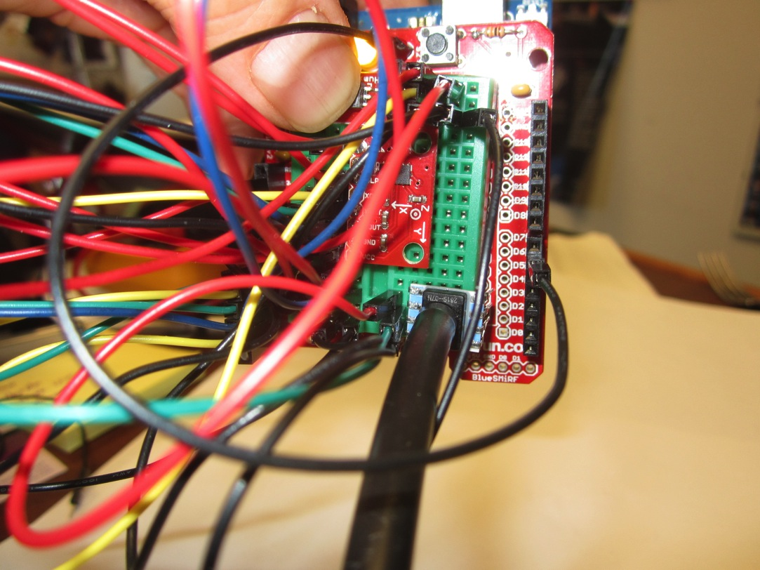
Arduino Overview:
- Hold accels with Y down and still for 10 seconds

Slide 46
Arduino Overview:
- Hold accels completely flat and still for 10 seconds

Slide 47
Arduino Overview:
- Hold accels with Z up and still for 10 seconds

Slide 48
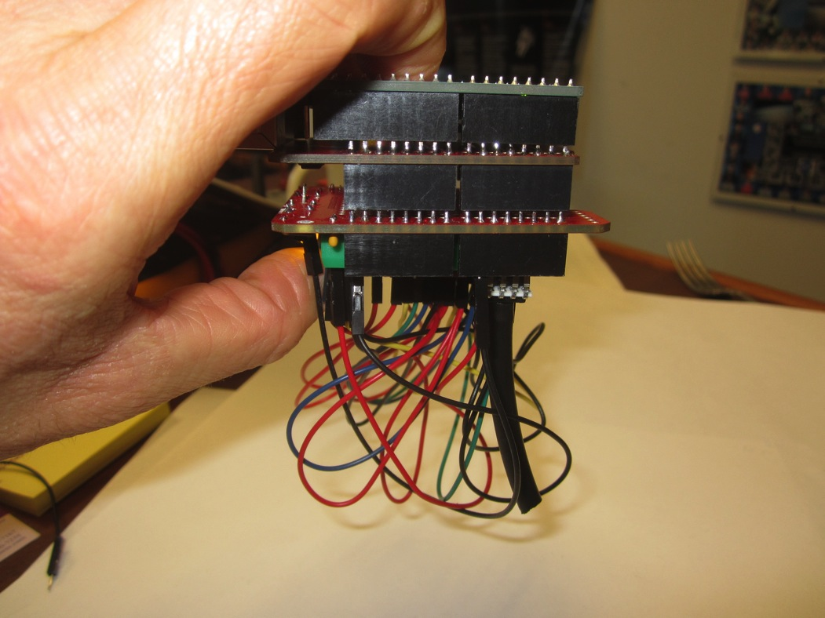
Arduino Overview:
- Hold accels with Z down and still for 10 seconds

Slide 49
Arduino Overview:
- Hold accels completely flat and still for 10 seconds

Slide 50
Arduino Overview:
Record end of file markers
- Touch your temp sensor for 5 seconds
- Breathe on your humidity sensor
- Suck on your pressure sensor for about a 2 seconds
- Pull USB from Uno

Slide 51
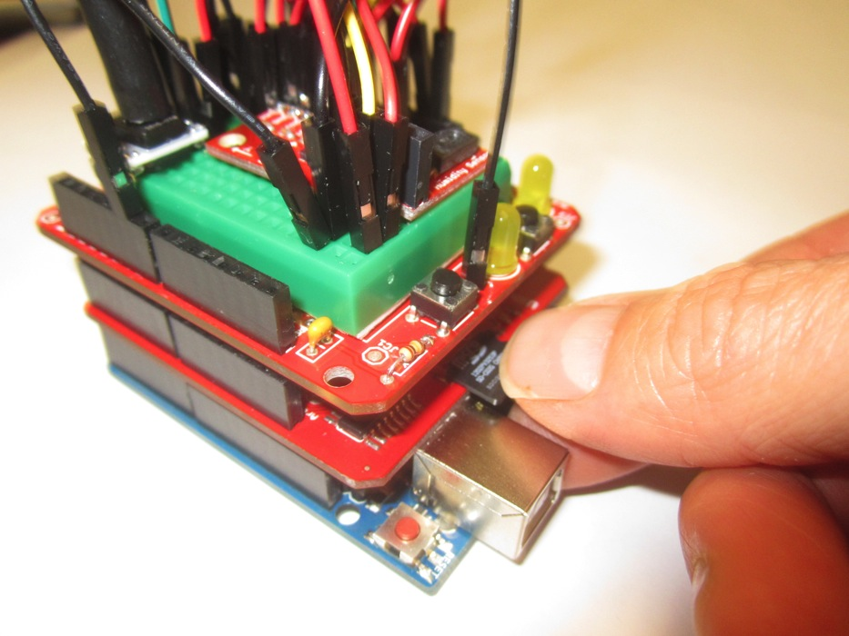
Arduino Overview:
- Remove microSD card from Uno and insert into SD card adapter

Slide 52
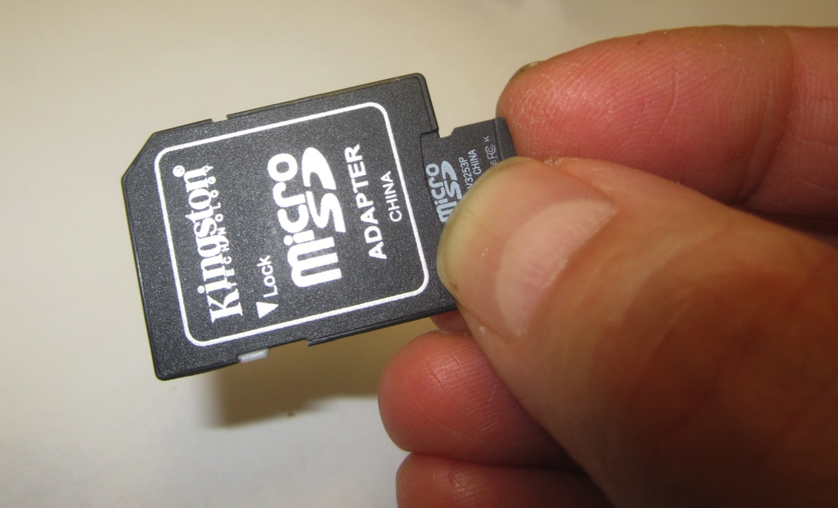
Arduino Overview:
- Remove microSD card from Uno and insert into SD card adapter

Slide 53
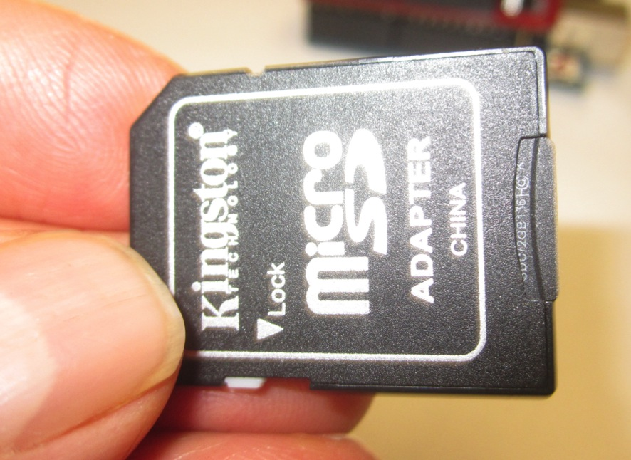
Arduino Overview:
- Remove microSD card from Uno and insert into SD card adapter

Slide 54
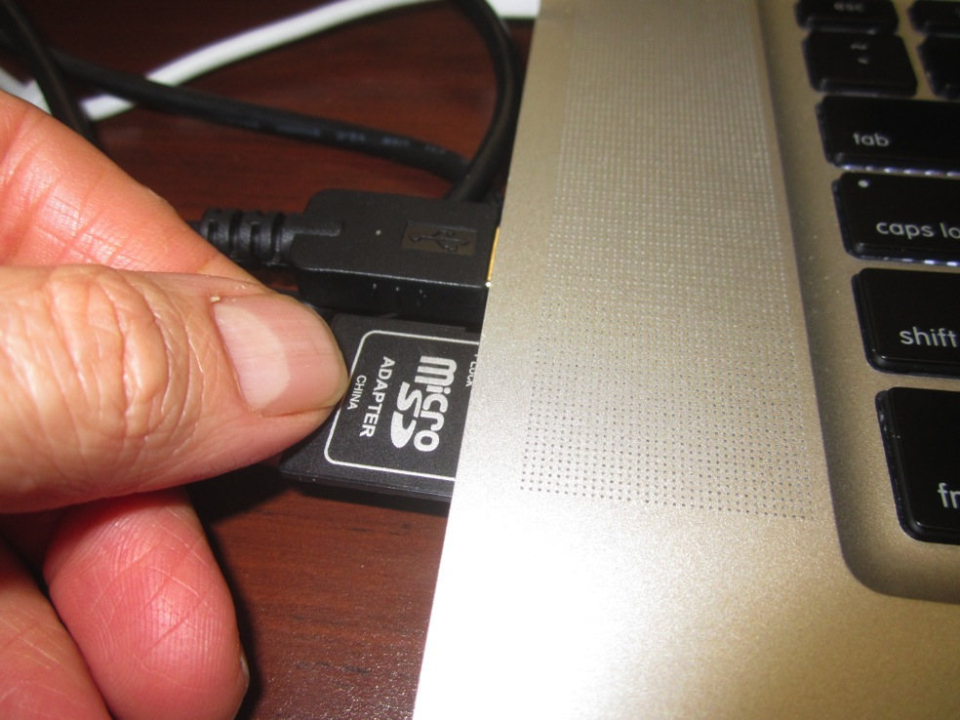
Arduino Overview:
- Insert SD card adapter into your laptop

Slide 55
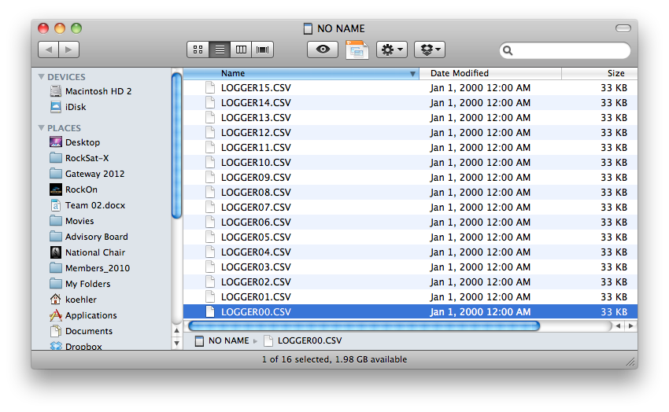
Arduino Overview:
- Navigate to card and copy last LOGGER file written
- Open this file with Excel

Slide 56
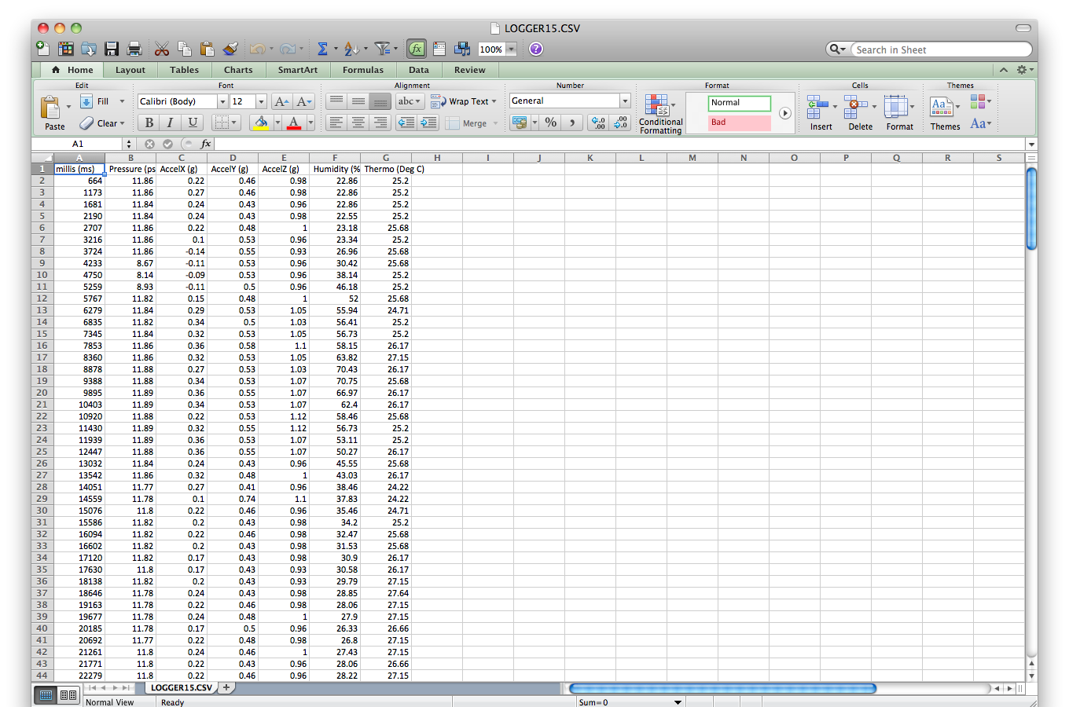
Arduino Overview:
- Graph all data minus the time stamp

Slide 57
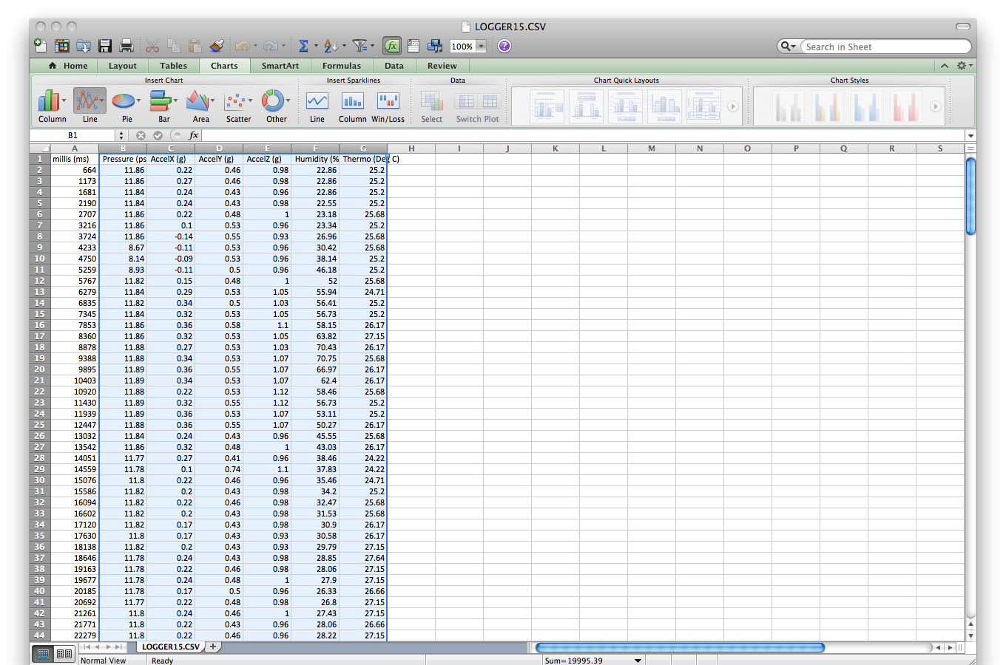
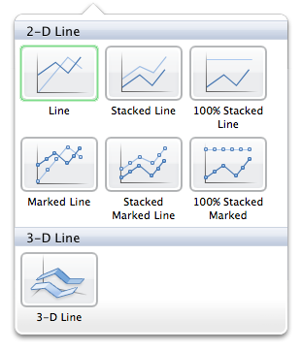
Arduino Overview:
- Graph all data minus the time stamp

Slide 58
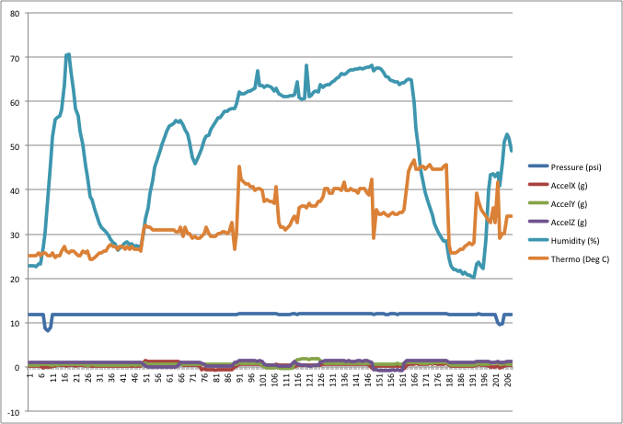
Arduino Overview:
- Do you see your data markers?

Slide 59
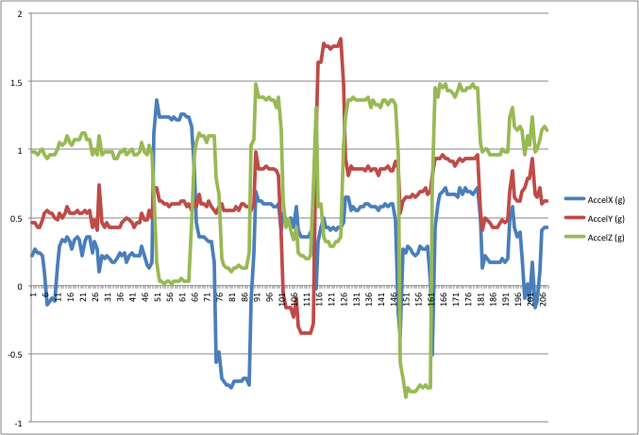
Arduino Overview:
- Re-plot just your accel data

Slide 60
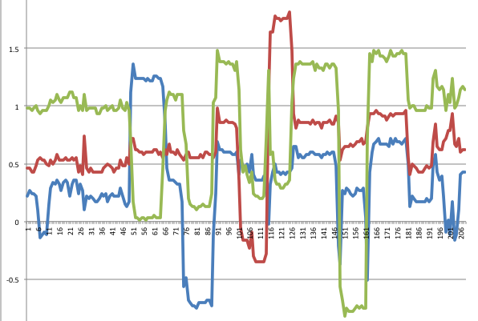
Arduino Overview:
- How can you use this data?

Slide 61
Arduino Overview:
- So that’s the SD card stuff
- Questions?

Slide 62
Arduino Overview:
Digital Sensors
- Like analog sensors but smarter and more capable
- Analog sensors are one way communicators
- Digital sensors are two way communicators
- “Onewire” can communicate with multiple sensors with one wire

Slide 63
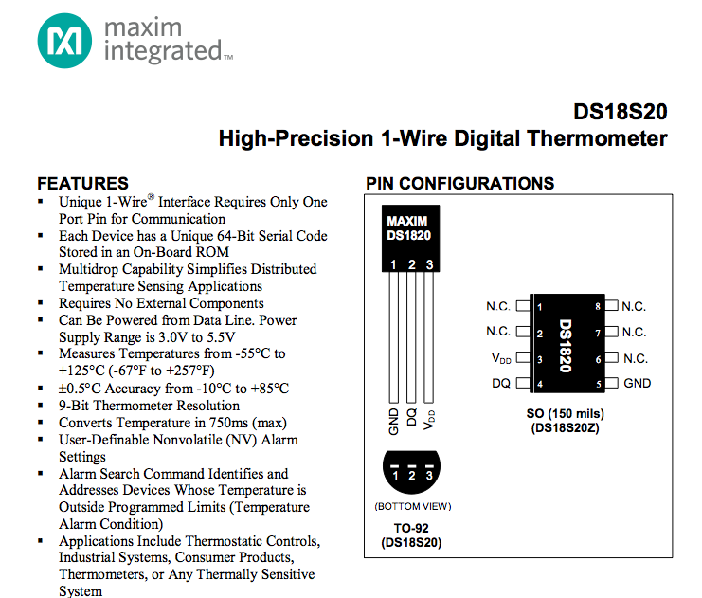
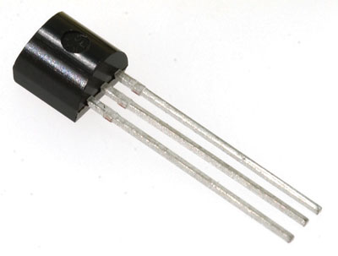
Arduino Overview:
- Looks similar to other sensor but on the inside…

Slide 64
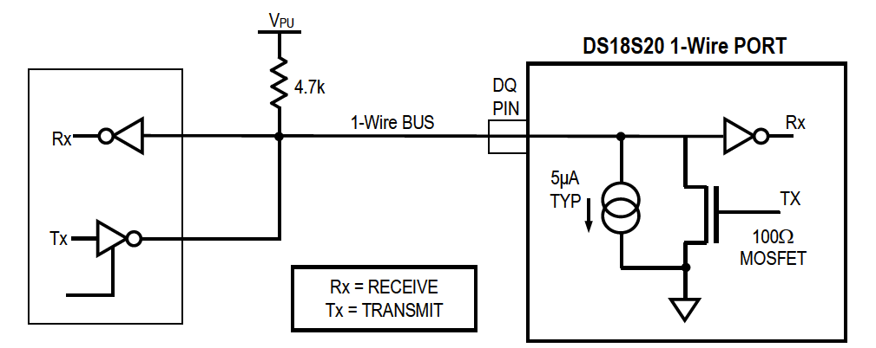
Arduino Overview:
- Looks similar to other sensor but on the inside…

Slide 65
Arduino Overview:
- More capable means more magic in the code
- Most digital sensors require much more additional code and libraries
- Most vendors, like Spark Fun, provide those on their website
- OneWire
- Dallas Temperature
- I can’t help much with these type of sensors
- See Tim May or Jared Wampler

Slide 66
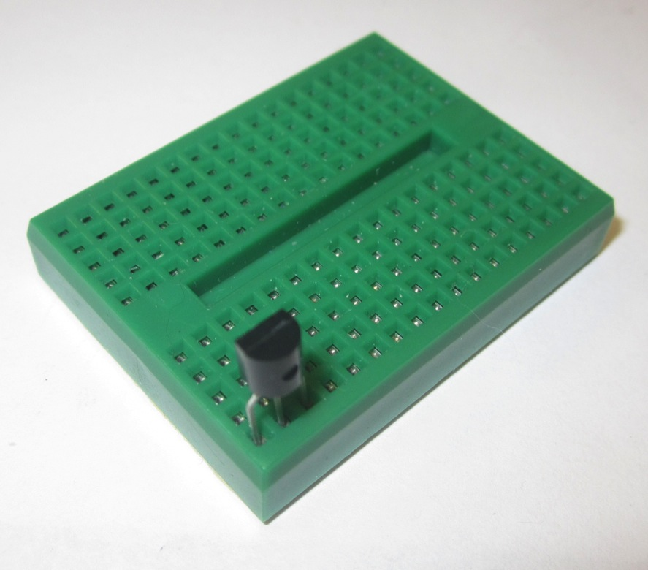
Arduino Overview:
- Let’s hook up the sensor

Slide 67
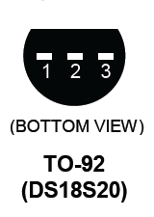
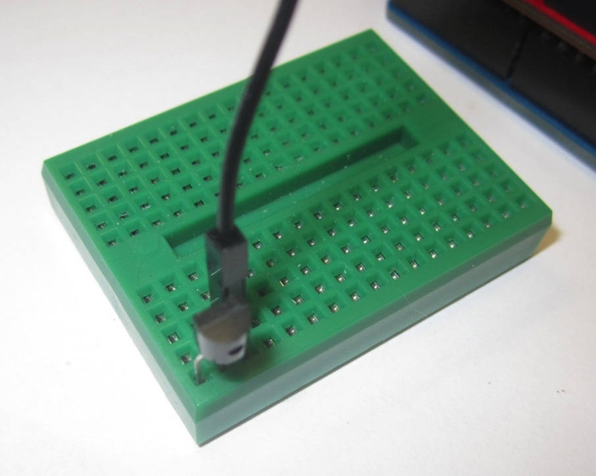
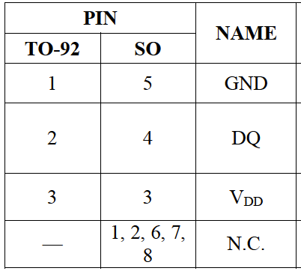
Arduino Overview:
- Pin 1 to GND to GND of Uno

Slide 68
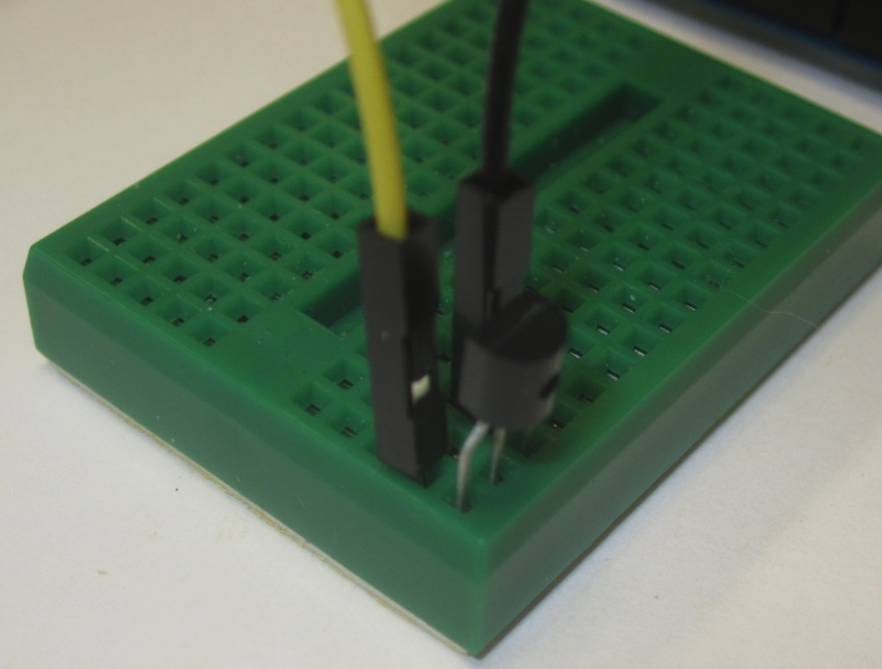
Arduino Overview:
- Pin 3 to 5V from Humidity Sensor

Slide 69
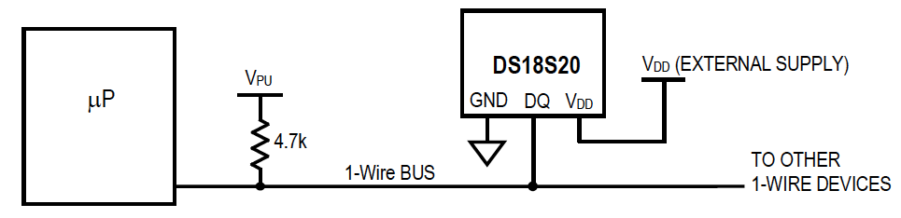
Arduino Overview:
- We need a Pull Up resistor between Pin 2 and digital pin 3 on the Uno with 5 V

Slide 70

Arduino Overview:
- We need a Pull Up resistor between Pin 2 and digital pin 3 on the Uno with 5 V

Slide 71

Arduino Overview:
- We need a Pull Up resistor between Pin 2 and digital pin 3 on the Uno with 5 V

Slide 72

Arduino Overview:
- We need a Pull Up resistor between Pin 2 and digital pin 3 on the Uno with 5 V

Slide 73

Arduino Overview:
- Now for the Sketch…

Slide 74


Arduino Overview:
- Now for the Sketch…

Slide 75

Arduino Overview:
- Now for the Sketch…

Slide 76

Arduino Overview:
- Now for the Sketch…

Slide 77

Arduino Overview:
- Now for the Sketch…

Slide 78

Arduino Overview:
- Now for the Sketch…

Slide 79
Arduino Overview:
- Set your Log intervals to 100 ms
- Set your Sync interval to 2000 ms
- Compile and Upload your code
- Start Serial Monitor
- Verify that the one wire is there and changes when touched
- Give it following data in the following order

Slide 80
Arduino Overview:
- Suck on your pressure sensor for about a 2 seconds
- Breathe on your humidity sensor
- Touch your temp sensor for 5 seconds
- Touch your new One Wire sensor
- Do the first three above and then pull USB

Slide 81
Arduino Overview:
- Now for the Sketch…

Slide 82
Arduino Overview:
- Now for the Sketch…

Slide 83
Arduino Overview:
- Now for the Sketch…

