Slide 1
Introduction to Arduino
(programming, wiring, and more!)
James Flaten, MN Space Grant Consortium
with Christopher Gosch, Alex Pratt, et al.
University of MN – Twin Cities
Aerospace Engineering and Mechanics Department
Some references we used (there are many):
1. Beginning Arduino by Michael McRoberts, 2nd edition
2. http://www.arduinoclassroom.com/index.php/arduino-101
3. http://www.oomlout.com/a/products/ardx/

Slide 2
Goals of this workshop
Learn what microcontrollers are and things they can do.
Learn how to use a (solderless) breadboard to wire up sensors and other hardware to an Arduino Uno.
Learn to open, understand, comment, upload/run, and edit Arduino programs (AKA sketches).
Learn the difference between input, output, and power pins and also between analog and digital pins.
Learn to control things like LEDs and write information to the serial monitor (a text window on the computer).
Learn to read sensor values and log data to an SD card for later retrieval and analysis.
Learn the basics of controlling motors with a microcontroller
Learn to expand Arduino functionality with “shields.”
Put you in a position to implement an Arduino-based computer system for your own projects.

Slide 3
What is a Microcontroller?
“A microcontroller is a very small computer that has digital electronic devices (peripherals) built into it that help it control things. These peripherals allow it to sense the world around it and drive the actions of external devices.” (Ref. 2)
It is an “embedded computer system” that continuously repeats software (programming) commands
Examples: Arduino Uno, Raspberry Pi, etc.

Slide 4
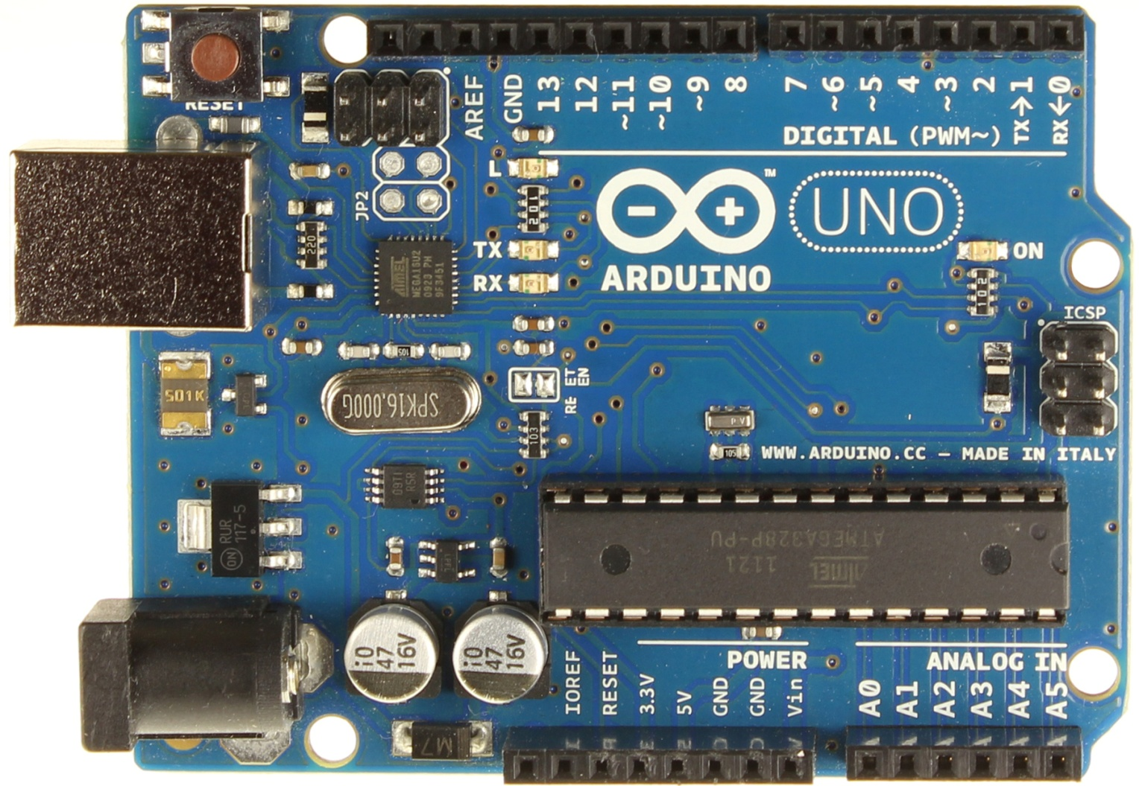
Arduino Uno
Digital
(Input/Output) Pins
USB Connector
Battery Connector
Analog
(Input) Pins
Power Pins

Slide 5
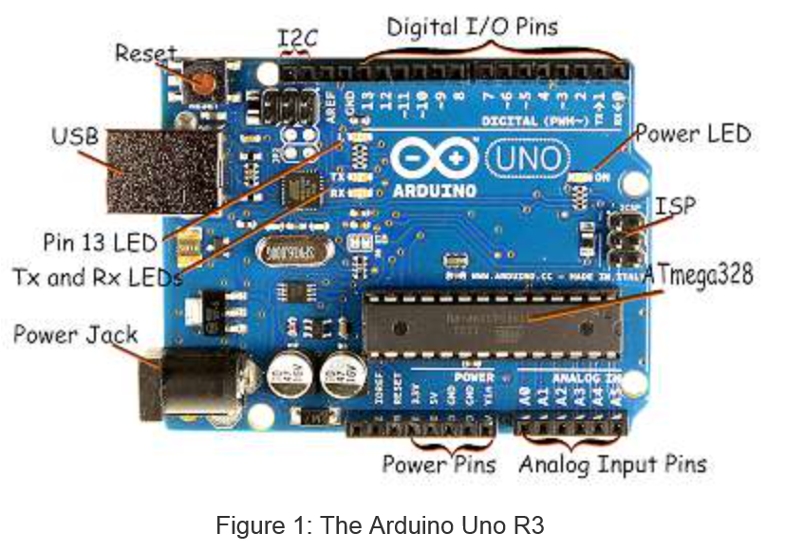
Arduino Uno – more details (Ref. 2)

Slide 6
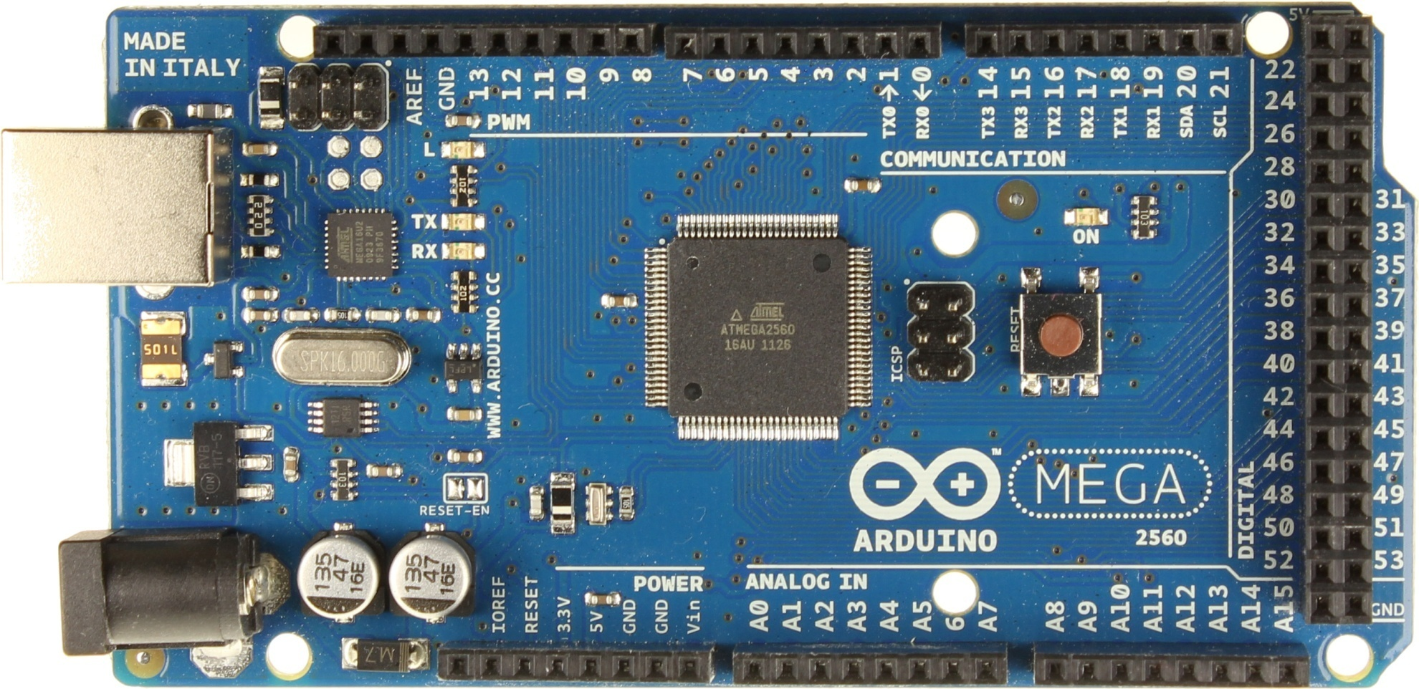
Arduino Mega – Larger (we won’t be using one in this workshop)
USB Connector
Serial Pins
Digital Pins
Battery Connector
Power Pins
Analog Pins

Slide 7
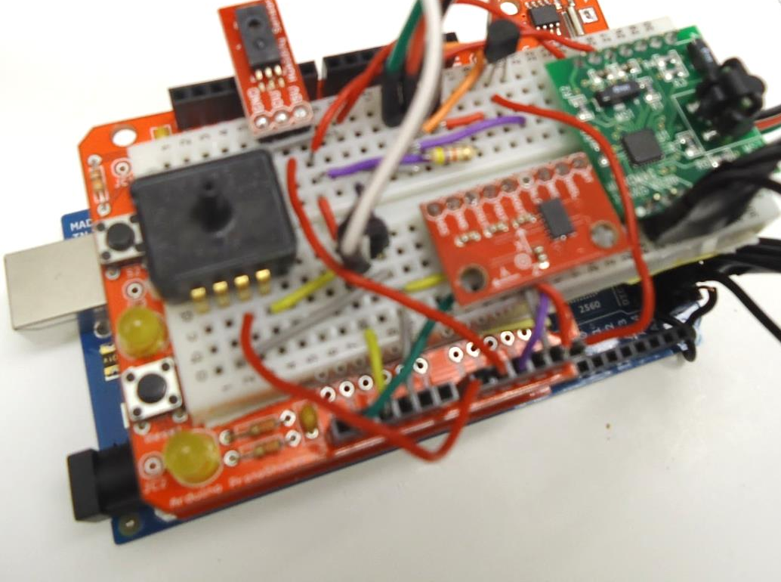
Example Project: Mega data logger
GPS
Magnetometer
Pressure
Humidity
RTC
Accelerometer
2 Digital Temp Sensors
Analog Temp Sensor
SD Card Logging

Slide 8
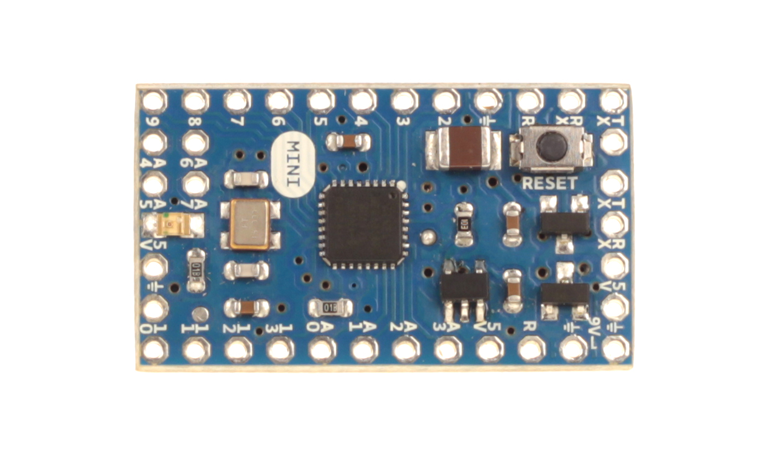
Arduino Mini
Digital Pins
Serial Connectors
Analog Pins
Power Pins

Slide 9
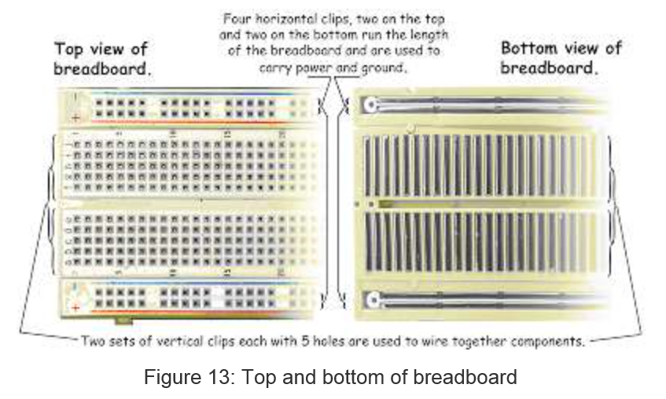
(Solderless) Breadboard (Ref. 2)

Slide 10
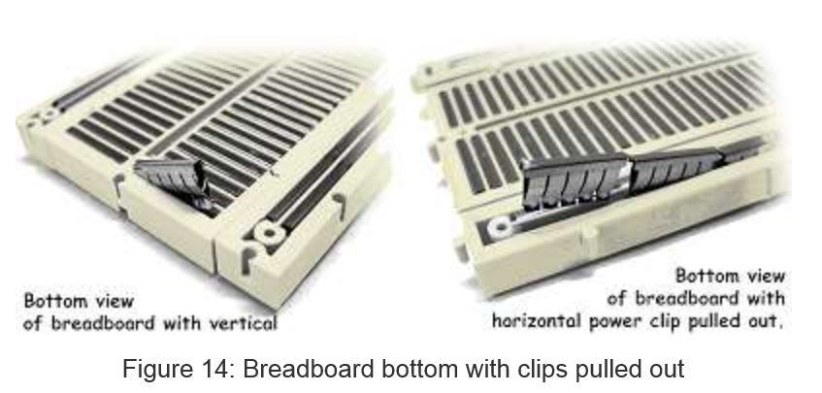
Breadboard Innards (Ref. 2)
Insert 22-gauge solid wire jumpers and component leads into breadboard clips to make
electrical connections without soldering. Use the edge “rails” for power (5V) and ground.

Slide 11
Introduction to Software
Arduino microcontrollers are programmed using the Arduino IDE (Integrated Development Environment)
  Can be downloaded for free from http://arduino.cc/en/Main/Software
Arduino programs, called “sketches,” are written in a programming language similar to C and C++
Every sketch must have a setup() function (executed just once) followed by a loop() function (potentially executed many times); add “comments” to code to make it easier to read (technically optional, but highly recommended)
Many sensors and other hardware devices come with prewritten software – look on-line for sample code, libraries (of functions), and tutorials

Slide 12
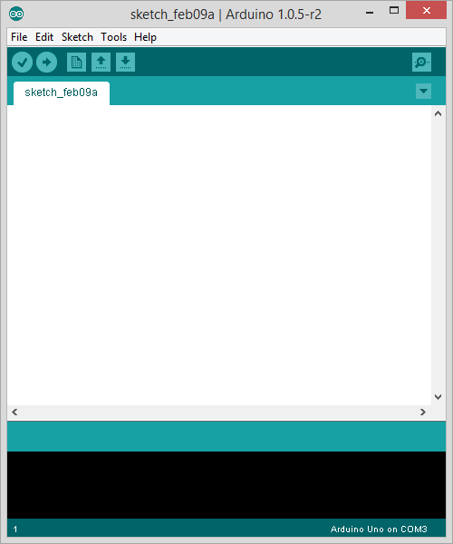
Parts of the IDE main screen
Name of current sketch
Main menus
Action buttons/icons
Verify (AKA compile)
Upload (send to Arduino)
Start a new sketch
Open a sketch (from a file)
Save current sketch (to a file)
Open Serial Monitor window
Text area for
writing/editing
sketches.
Error messages and other
feedback show up here.

Slide 13
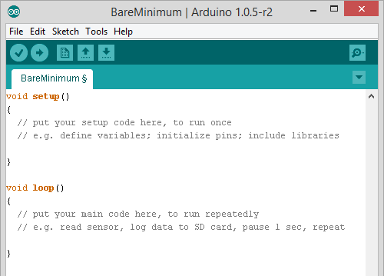
BareMinimum – shows sketch organization

Slide 14

Activity 1 – making an on-board LED blink
After installing the Arduino IDE (programming software)…
Run the Arduino IDE
Plug in the Arduino Uno using the USB cable – its power LED should come on and stay on
Under Tools:Board make sure Arduino Uno is selected
Under Tools:Serial Port select the correct COM port (e.g. COM3)
Under File:Examples:01Basics select the Blink sketch
Look at the code. Note delay(1000) waits 1000 millisec = 1 second
Verify (AKA Compile) the code , then Upload it to the Uno – notice that it runs immediately (and will re-run if you power cycle by pressing the Reset button or by pulling the reconnecting power) – the sketch stays in the Uno memory until overwritten or erased
Discuss how the sketch works (in general terms: setup(), loop(), liberal use of comments); digital HIGH is 5V and LOW is 0V (ground)
This is an example of “control (output) using digital pin 13”

Slide 15
Activity 2 – making an external LED blink
Power down the Arduino (i.e. disconnect the USB cable)
Use jumper wires to run power (5V) and ground (GND) from the power pins on the Arduino to the + and – rails of the breadboard respectively (when you can, use red for power and black for ground)
Place an LED in the breadboard (somewhere other than on the power rails)
Wire the LED’s negative (shorter) lead to a 560 Ohm “safety resistor” then wire the other end of the resistor to ground
Wire the LED’s positive (longer) lead to Pin 13 on the Arduino
Plug the Arduino back into the USB cable to power it up – the Blink sketch is still in its memory and will begin to run
Discuss what you see
Which of the instructions above wasn’t actually necessary (but will be useful for future wiring projects)?

Slide 16
Activity 3 – write to the “Serial Monitor”
Add the following lines of code to your Blink sketch, save it as Blink_and_Count, then verify and upload it again
Before setup, right under int led = 13; type (all on one line)
int count = 1; // establish a count variable, start it at one
In setup, right under pinMode(led, OUTPUT); type (all on one line)
Serial.begin(9600); // start serial communications at 9600 baud (char per second)
At the end of the loop type
Serial.print("Count is ");
Serial.println(count); //print count value to screen
count++; //increment count by one
Upload the sketch (it will start to run immediately) then open the serial monitor (window) (doing so will restart the sketch)
Verify/change the baud rate to 9600 at the bottom of the serial window
Discuss what you see and how the sketch accomplishes it

Slide 17
Activity 4 – controlling brightness of an LED
Under File:Examples:01Basics select the Fade sketch
This code controls the brightness of an LED using a “pwm” (pulse-width modulation) digital pin (you’ll need to look at the code to figure out which pin it is and rewire your circuit to use that pin) – only some of the digital pins support pwm in which you use the command analogWrite(pin, brightness) where brightness can range from 0 (means go HIGH 0% of the time) to 255 (means go HIGH 100% of the time) or any value in between
Run the code and watch the intensity of the LED vary as time goes by – this gives you more control than just the pure HIGH or pure LOW available using the digitalWrite command in the Blink sketch

Slide 18
Notes
Flashing LEDs and/or writing information to the serial monitor (window) lets the sketch tell observers what it is up to – the latter only works when you are attached to a computer with a screen, so the former method is more likely for a balloon or rocket implementation
Digital pins can be set to OUTPUT mode, after which you can send them digital values (just HIGH or LOW) with digitalWrite or else more-continuous analog values (from 0 to 255) with analogWrite – the latter still sets them just HIGH or LOW, but does so only some fraction of the time, which makes some devices think the output voltage is somewhere between HIGH (5 Volts) and LOW (0 Volts)
NOTE: All of the analog sensor exercises can have an indicator LED wired up to digital pin 13
Up next: Fritzing software (a free download): breadboard view (fairly realistic) vs circuit diagram (AKA schematic)

Slide 19
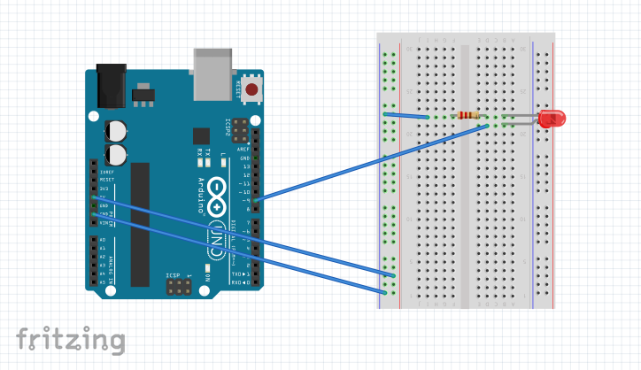
A “breadboard view” looks fairly realistic

Slide 20
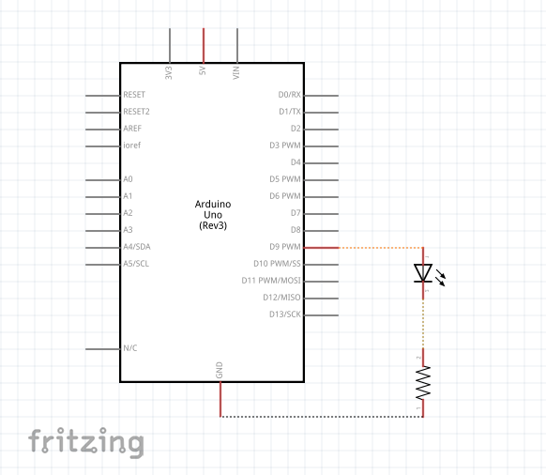
A circuit diagram (AKA schematic)

Slide 21
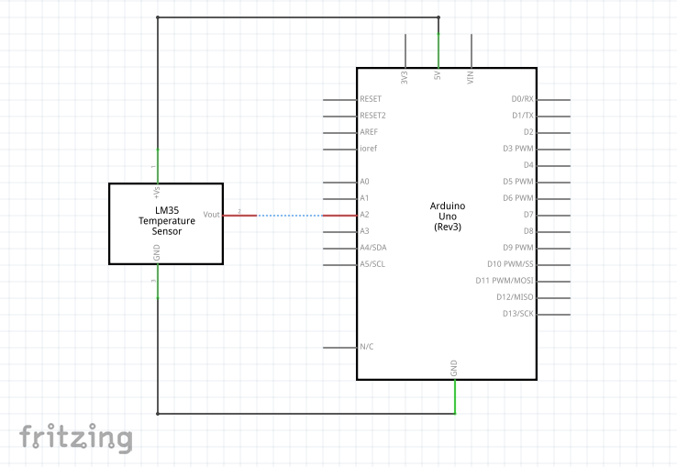
Typical wiring of a powered analog sensor

Slide 22
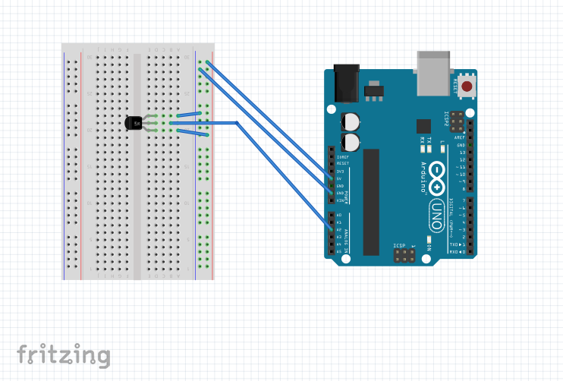
Note the utility of having both 0 and 5V rails

Slide 23
A few words about sensors
For most of the rest of this workshop we will focus on how to use various sensors. (We will discuss servos and shields too.)
Sensors can be classified into two major categories:
Analog sensors:
  Measurement is based on changing the voltage of the sensor output pin
  Can only use analog inputs (A0, A1, etc) to read analog sensor values
  Generally easier to program and use than digital sensors (below)
  But not as accurate and can be interfered with by other electronics (“noise” in the sensor voltage output)
Digital Sensors:
  Usually use digital pins.
  Can use more advanced forms of communication to put multiple sensors on the same pins (sometimes using analog pins)
  Generally more difficult to program and wire up - often need libraries and significantly more code for each type of sensor used
  Most advanced sensors (GPS, IMU, etc) are digital – usually the best way to pass more data between the sensor and microcontroller quickly & cleanly

Slide 24
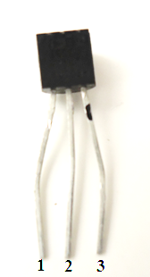
Activity 5 – analog temperature sensor
With the Arduino Uno unpowered, wire the TMP 36 sensor using the table below
Load the sketch Analog_Temperature; study the code; run it; test it; discuss
Important note! The serial monitor normally operates at 9600 baud but this sketch runs it at 115200 baud so in addition to the Serial.begin call in the sketch you will need to open the serial monitor and change the baud rate using the drop-down menu at the bottom right hand corner.
Pin | Function | Attached To
1 | 5V (Power) | 5V pin
2 | Analog Output | Pin A2
3 | Ground | GND pin
Note: Diagram shows flat end facing you
This 3-pin sensor has TMP written on it. This is called a T0-92 package.
Check the orientation!

Slide 25
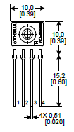
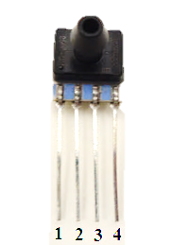
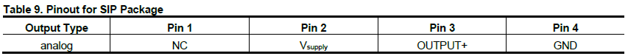
Activity 6 – analog (air-)pressure sensor
With the Arduino Uno unpowered, wire the 0-15 psi pressure sensor using the table below (you can leave the TMP 36 sensor in place)
Load the sketch Analog_Pressure; study code; run; test; discuss
Pin | Function | Attached To
1 | Nothing | Not connected
2 | 5V (Power) | 5V pin
3 | Analog Output | Pin A0
4 | Ground | GND pin
This 4-pin pressure sensor is the Honeywell SSCSANN015PAAA5 and is called a SIP-AN package.
Notes:
Note-Test by sucking on it- cannot have pressure above 15psi (We are about 14.2 psi here, so blowing on it would blow it out)

Slide 26
Example Project: Rocket Flight Computer

Slide 27
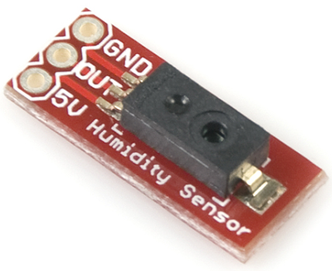
Activity 7 – analog relative humidity sensor
With the Arduino Uno unpowered, wire the HIH4030 relative humidity sensor using the table below (leave other sensors in place)
Load the sketch Analog_Humidity; study code; run; test; discuss
Pin | Function | Attached To
GND | Ground | GND pin
OUT | Analog Data Output | Pin A1
5V | 5V (Power) | 5V pin
This 3-pin relative humidity sensor is pre-mounted on a “breakout board”
Notice that we soldered on a 3-pin male header so the breakout board can plug into a (solderless) breadboard

Slide 28
Notes:
We are almost out of analog pins on the Uno so next we will learn how to read multiple digital sensors using just one digital pin (in INPUT mode).
  Note: Other boards (like a Mega) have more analog pins. Still, it is easy to run out of them if you are using many sensors, so it is best to use digital sensors if you want to monitor many different sensor readings.
We will also discuss how to log data to an SD card and how to stack “shields” on top of an Arduino Uno to make our wiring more compact.

Slide 29
Note about Libraries:
This next sketch uses a library to interface with the SD/RTC shield
Libraries take large amounts of code and refine it into a few simple commands we can use. Ex: datalog.print will print something to a file.
This actually takes a lot of code, but by putting it in a library we can ignore the code details and focus on using the commands and functions
Usually a library name ends in a .h (called a header file)
Call a library in our programs using the #include command such as: #include "SD.h"
Almost everything that is not analog (digital sensors, servos, etc) use a library of some sort (many use the same library – i.e. Wire.h)
You can install additionally libraries into your IDE. Look under Sketch:Import Library to see which ones you have installed.
We will give you some more you’ll have to restart the IDE to load them
Ex: SD.h, SoftwareSerial.h, Wire.h, OneWire.h, RTClib.h

Slide 30
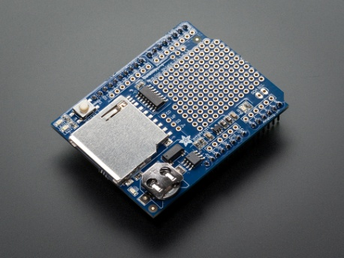
Activity 8 – RTC/SD Card Shield
With the Arduino Uno unplugged, disconnect all of the sensors from the board and attach the RTC/SD card shield (it is the blue shield)
The RTC (real-time clock) makes use of the I²C (I-squared C) “bus” to send time stamps to the Arduino. This stands for “Inter-Integrated Circuit” and was invented by Phillips. Pins A4 and A5 are used as SDA (Serial Data Line) and SCL (Serial Clock Line) for the I²C bus on an Arduino Uno.
The SD Card interfaces with the Uno using digital pins 10-13. Thus you cannot use these pins for other sensors/shields.
Load the sketch Datalog_Real_Time_Clock; study the code; run; test, discuss. Note that we made the file a .csv file so we can open (and analyze) the data with Microsoft Excel.
After you have run the sketch for a bit, unplug the Uno, extract the SD card, and read the SD card on your computer. How does the data look?
Discuss the utility of saving data this way; We will do some more advanced datalogging shortly.
Sparkfun also makes a RTC-only breakout board, if you don’t use this combination RTC/SD card shield. Other companies sell SD card and microSD card shields as well.
Notes:
Note: RTC must have battery to run
Make sure to unplug the arduino, otherwise files wont save properly

Slide 31
Datalogging (to an SD card)
As you can see in the setup, datalogging can be a bit complex.
  Most of the time you can directly copy the code from the setup loop used for the SD card
A few details to keep in mind:
  Sketch must do all reading/writing of data from the main loop.
  We included a special piece of code to write a new file each time the Arduino is powered up. Without this, it would overwrite the old data
  Pins can change depending on the SD card reader you use. Sparkfun’s microSD car shield also uses D8, in addition to D10-13. You must adjust one line of code (Chipselect) too.

Slide 32
About Digital Sensors:
Digital Sensors typically use one of two voltages: 3.3V or 5V
Always check to be sure you are providing the correct voltage. If you send a 3.3V sensor 5V, it may blow it out.
Watching out for pin conflicts and voltage discrepancies is par for the course when using microcontrollers. If you aren’t careful you can get bad data, fry components, or possibly even damage the microcontroller itself. Also watch out for components that look alike (e.g. the analog temp sensor (Activity 5) and the digital temp sensor). Also remember that most components require specific orientations; almost all do except resistors.
NOTE: For all of the remaining exercises, an indicator LED can be wired into digital pin 4.

Slide 33
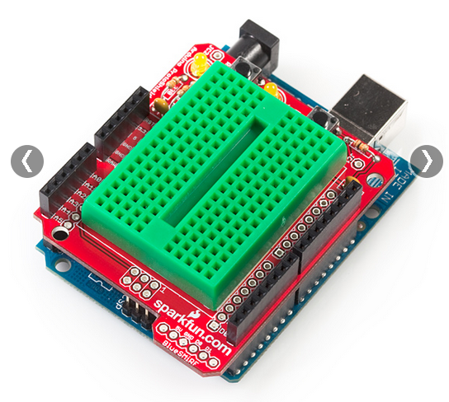
Proto shield & “tiny” breadboard
Notice that this “tiny” solderless breadboard (ours are white)
has no power rails and very limited real-estate. Use it wisely!

Slide 34
Example Project: SuperUno

Slide 35
About Motors
There are several different types
  Motors – Regular DC motors – input current for full rotation. No special pins/wiring needed.
  Standard Servos – Motor capable of limited rotation (often 180°) in precise degree increments. Uses Servo library in Arduino. Has 3+ pins.
  Continuous Rotation Servos – Can go all the way around, as the name implies.
  Stepper Motors – Servo capable of full rotation. Uses Stepper library in Arduino. Has 3+ pins.
  We have DC motors, standard servos, and continuous rotation servos available for this workshop.

Slide 36
Activity 9: Using a Standard Servo
With the Uno unplugged, wire up the standard servo according to the chart on the next slide.
Load the sketch Sweep from the IDE. It will be under File:Examples:Servo
Take a look at the code and note the commands used to drive the servo. The comments should help you understand what each does.
Be careful – Servos use a lot of power. In some applications you may need to provide them with extra power from an external source.
Notes:
Servos use the library Servo.h
Only a few simple commands: attach, read, write
Our servos only go 180°
Can modify to spin 360°(Have to disassemble the motor and modify gears, not that easy)
Often better to use a stepper motor for full rotation
Can have it go specific degree increments
Disables analogWrite() on pins 9 and 10

Slide 37
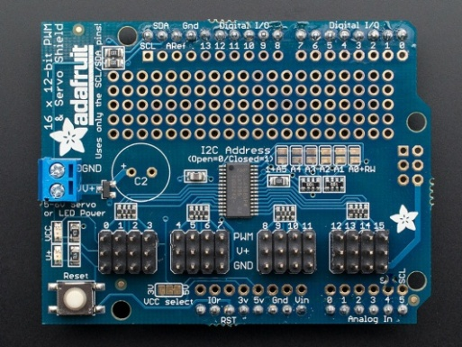
Standard Servo
Pin | Description | Attached To
Black | Ground | GND
Red | Power (5V) | 5V
Yellow | Control Lead | D9
Note that the standard servo has a plug attached to its ribbon cable. This is so that we can more easily extend the cable using plugs and more ribbon cable. It also allows it to plug into specific plugs built into some shields. Several companies make Motor Shields which are shields specifically designed to drive servomotors and stepper motors. These often support 2 to 4 motors, though Adafruit has one shield that will control 16! Motor shields generally have plugs built into the shield for the motors and often drive them through some sort of a serial connection (I2C or SPI is common).
Right: Adafruit Motor Shield
http://www.adafruit.com/products/1411

Slide 38
Project Example: Life Support Payload

Slide 39
Activity 10 – using a 3-axis accelerometer
Unplug the Arduino Uno, the servomotor, and all the wires used for the motor. We won’t be using them anymore (but feel free to play with it more on your own).
The digital 3-axis accelerometer (breakout board ADXL345) is powered with 3.3 volts, not 5 volts, and makes use of analog pins A4 and A5 for communication on the I²C bus, just like the RTC. All 3 outputs (the x, y, and z values) are sent through the single serial data line, A4, clocked (i.e. timed) by line A5.
The digital accelerometer makes use of the Wire library which should already be in your Arduino program.
Plug in the Arduino Uno and load Digital_Accelerometer
Study the code (it might be long!); run it (open serial monitor); test all 3 axes, discuss

Slide 40
Digital 3-Axis Accelerometer (breakout board ADXL345)
Pin | Description | Attached To
GND | Ground | GND
VCC | Power input (3.3V) | 3.3V
CS | Chip Select | 3.3V
INT 1 | Interrupt 1 Output | N/A
INT 2 | Interrupt 2 Output | N/A
SDO | Serial Data Output | N/A
SDA | Serial Data | A4
SCL | Serial Communications (Clock) | A5

Slide 41
Activity 11 – digital pressure/temp sensor
With the Arduino Uno unplugged, leaving your accelerometer in place, add the pressure(altitude) / temperature (MPL3115A2) breakout board to your tiny breadboard and wire it as follows. This is a 3.3 volt I²C device.
Look for pin conflicts. Hopefully there won’t be any, but always look.
Plug in the Arduino Uno and load Altitude_Pressure_plusTemp_Sensor
Study the code (it might be long!); run it (open serial monitor); test, discuss
Pin | Description | Attached To
INT2 | Pressure interrupt 2 | Not connected
INT1 | Pressure interrupt 1 | Not connected
SDA | Serial Data | A4
SCL | Serial Communications (Clock) | A5
VCC | Power input (3.3V) | 3.3V
GND | Ground | GND

Slide 42
Activity 12 – 2 digital temp sensors, SD card
With the Arduino Uno unplugged, take all sensors off your breadboard.
Add one “Dallas one-wire” digital temperature sensor on the breadboard and a second one at the end of a 3-wire cable (provided), as shown on the following slide. Notice that both sensors need ground and power (5 volts) and that they are polled through a single digital pin (D2). Also notice that a 4.7 kΩ “pull-up” resistor is required between pin D2 and the 5 volt line so that it stays HIGH when not in use.
Place OneWire and DallasTemperature into your Arduino library. This activity also uses Wire and SD (already in your library).
Put a SD card into your SD card shield.
Plug in the Arduino Uno and load the sketch SD_RTC_2_Digital_Temp which will determine the sensor names, poll them, write the results to both the screen and to the SD card (after opening a file), then repeat.
Study the code (it might be long!); run it (open serial monitor); test (including removing the SD card and reading the data directly on your computer). Discuss the utility of saving data this way; discuss the utility of having “off-board” sensors. Note: cable length can impact analog sensor data readings so always minimize cable lengths and use digital sensors when off-board (if possible).

Slide 43
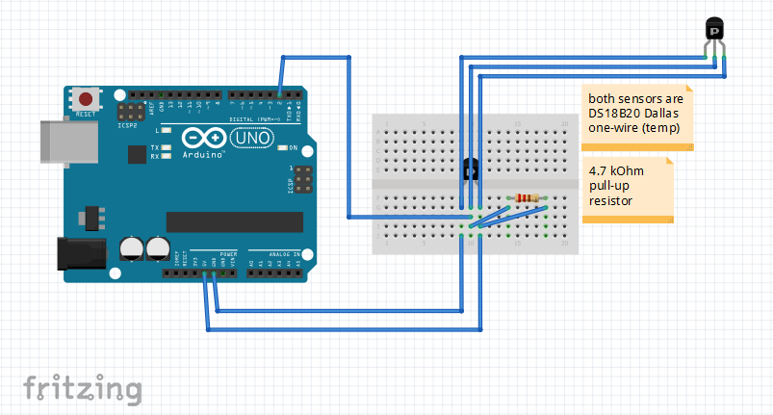
Wiring for two digital temperature sensors
(Not shown – the tiny breadboard is actually mounted on a protoshield on top of the Arduino Uno; also has an RTC (perhaps put that on the upper left side of the breadboard). Abide by this color convention: red is power, black is ground, green is data.

Slide 44
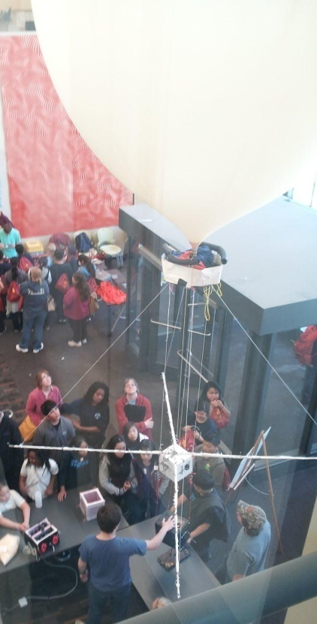
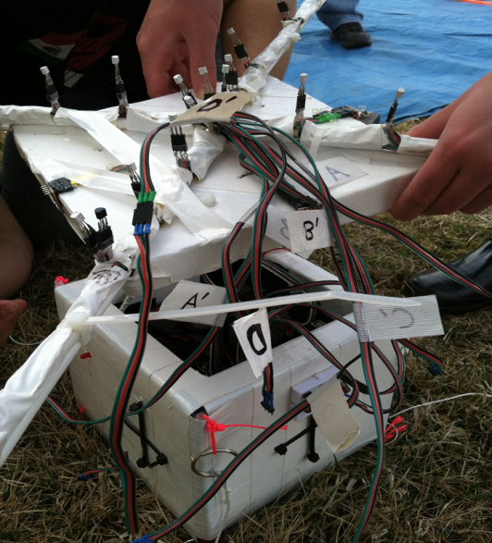
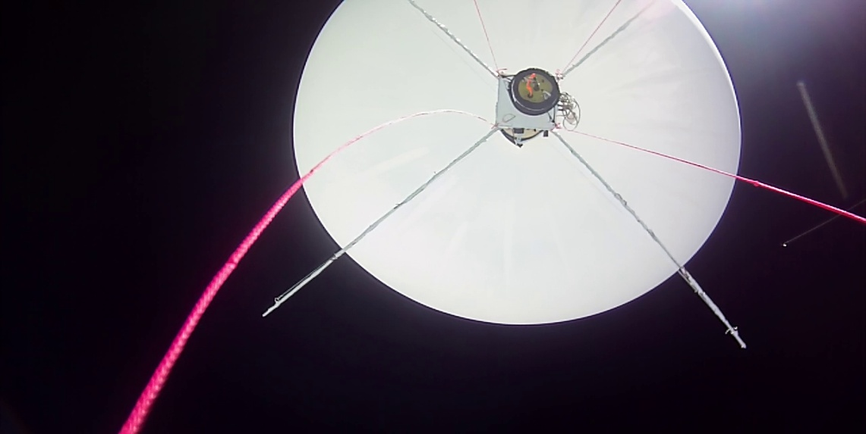
Project Example:
X-Boom
Measures thermal wake of balloon
Digital temperature sensors along 4 arms
2 Arduino Unos log data from more than 40 digital temperature sensors!

Slide 45
Activity 13 – GPS, external power
With the Arduino unplugged, add the GPS module (to the upper right hand corner of your breadboard) using the table on the next slide.
Place TinyGPS into your Arduino library. This activity also uses SD, SPI, and SoftwareSerial (already in your library).
Plug in the USB cable and load the sketch GPS_on_SD. Upload the sketch to the Arduino Uno. Open the serial monitor and watch it run. The GPS probably won’t get a lock indoors so the data might be uninteresting.
Unplug the USB cable (AKA the programming cable). Power the Arduino Uno using a 9-volt battery through the power jack instead. You can now run sketches independently from the laptop (but no more serial monitoring!). This mode of operating is critical for applications like ballooning and rocketry.
The LED on the GPS gives its lock status. Fast blink means “not locked”; slow blink means locked. You are unlikely to get it to lock indoors so take the package outside until it gets a lock then walk around a bit to collect some position data. Come back in and look at the GPS data that was logged to the micro-SD card (raw and also on Goggle Earth).

Slide 46
Adafruit Ultimate GPS Breakout
Pin | Function | Attached To
3.3V | Provides a 3.3V Output | Not connected
EN | Enables Sleep Mode | Not connected
VBAT | Allows battery input for RTC | Not connected
FIX | Output at same time as fix LED | Not connected (May want to connect depending on your project)
TX | Transmit | D5
RX | Receive | D6
GND | Ground | GND
VIN | 5V Power | 5V
PPS | Pulse per second output | Not connected

Slide 47
Activity 14: Digital 3 Axis Magnetometer
With the Arduino unplugged, add the Digital 3 Axis Magnetometer to your breadboard using the table on the next slide.
Upload the sketch DigitalMAG to the Arduino.
  Note that this uses the Wire library (this is included when you downloaded the Arduino IDE)
Look at the code, discuss, run, check SD card
The magnetometer can be combined with an accelerometer (and maybe gyros) to make an IMU
  Not perfect – a magnetometer can be interfered with by magnets, metals, and any electronic device (good IMUs can sometimes account for this).

Slide 48
Sparkfun MAG 3110 Digital 3 Axis Magnetometer
Pin | Function | Attached To
VCC | Power Input (3.3V) | 3.3V
GND | Ground | GND
SDA | Serial Data Line (I2C Bus) | A4
SCL | Serial Clock Line (I2C Bus) | A5
INT | Interrupt Pin | Not Connected

Slide 49
Project Example: Xbee Radios

Slide 50
Next Steps
This has only been a brief intro, things can get a lot more complicated!
Look online for help with advanced projects, weird things (pin conflicts, voltage issues, software bugs, etc) can happen pretty easily.
Also keep in mind how much power you are drawing – you can drain individual 9V batteries quickly – use more batteries in parallel to provide enough current for a long run time.
Research and think through projects before building. A good plan can solve many problems before they occur.

Slide 51
Good further resources
https://learn.adafruit.com
  Adafruit makes many shields and sensors, and they have tutorials for almost everything they carry
http://www.arduinoclassroom.com/index.php/arduino-101
  Arduino Classroom is currently doing an intro series on Arduinos. Check it for updates and more topics in the future
http://playground.arduino.cc/
  Arduino playground is the wiki run by the Arduino company for its products. There is a lot of helpful information on many, many topics here.

