Slide 1
Some thoughts about
Global Warming and
Global Climate Change
James Flaten
NASA’s MN Space Grant Consortium
U of MN – Twin Cities

Slide 2
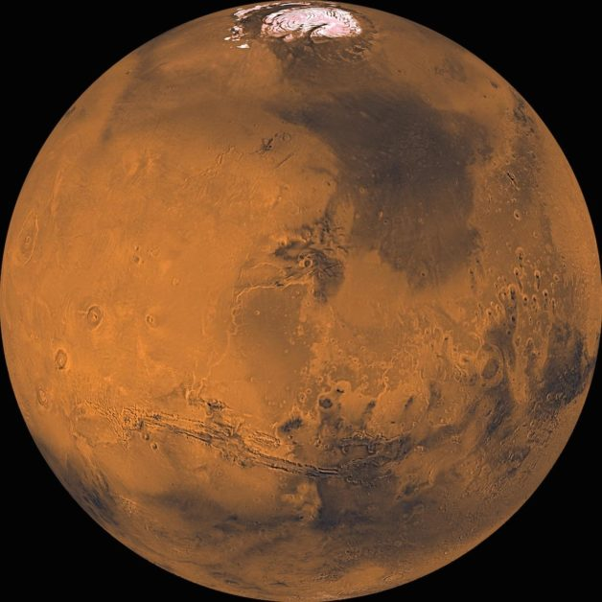

Cautionary Tales
Mars
Venus

Slide 3
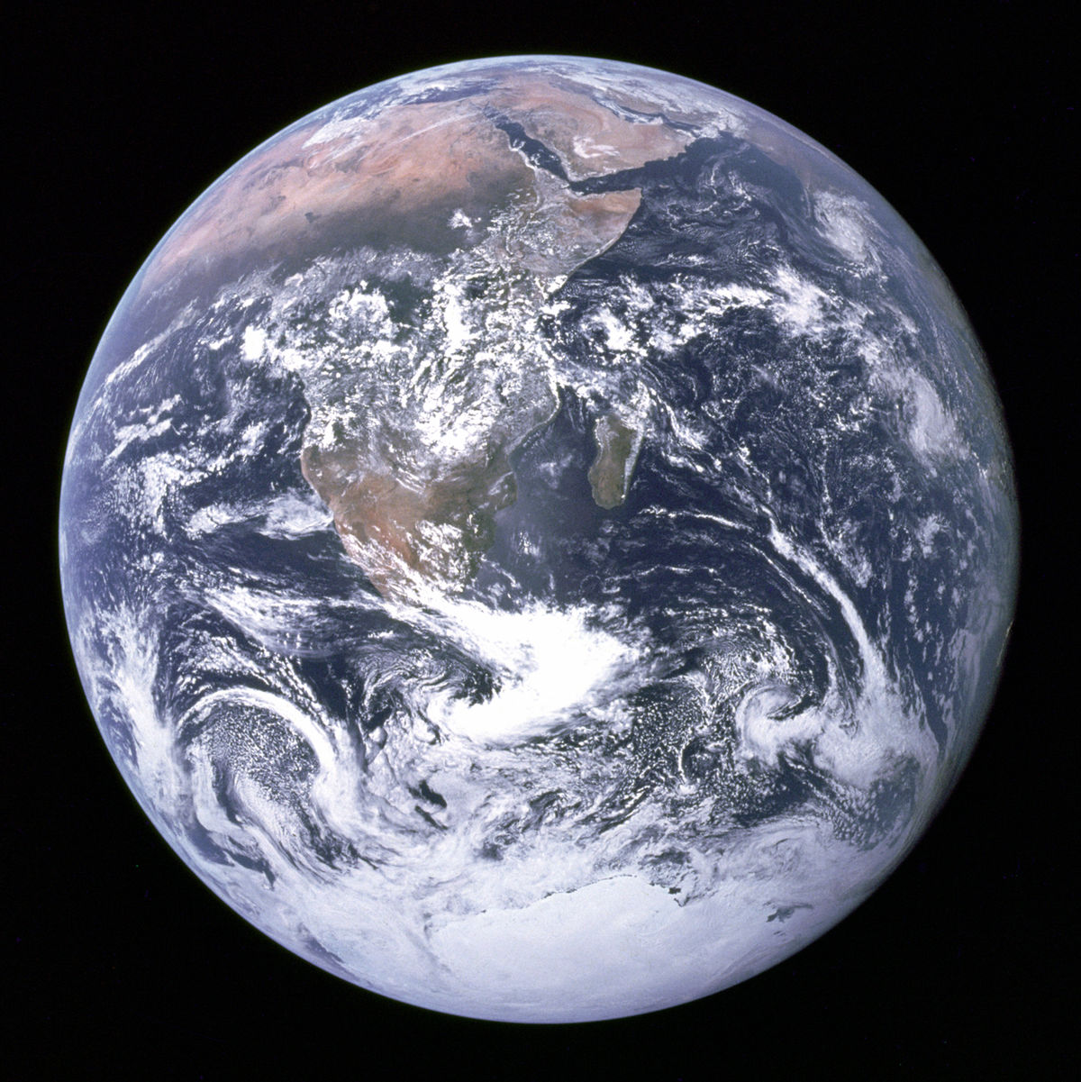
So what is in store for the Earth?

Slide 4
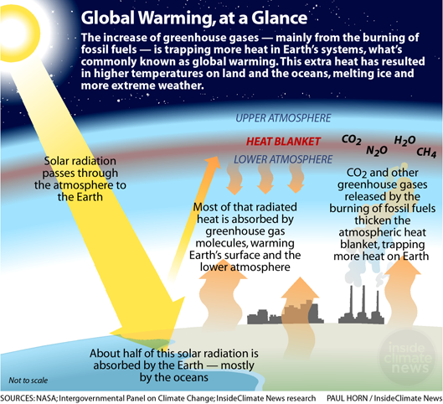
Global Warming: Upsetting the balance

Slide 5
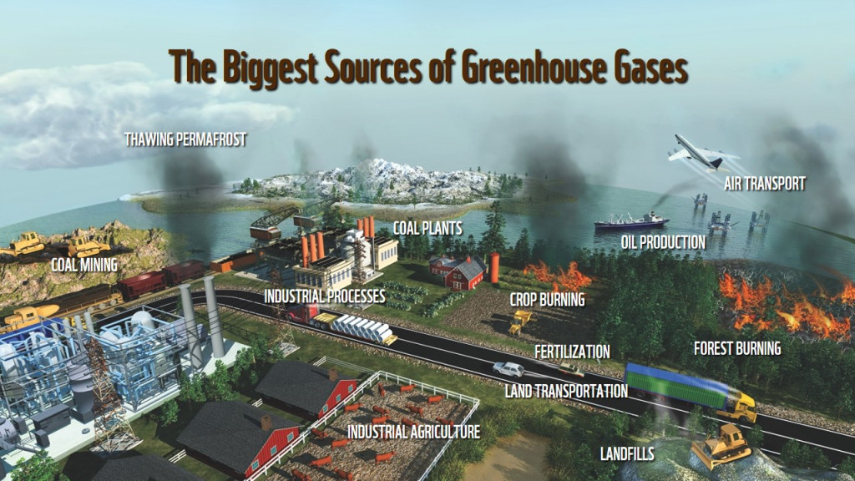
Humans and greenhouse gases

Slide 6
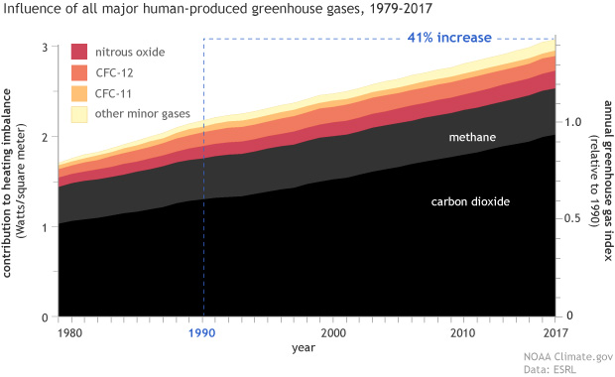
Greenhouse gas levels in the last 40 years

Slide 7
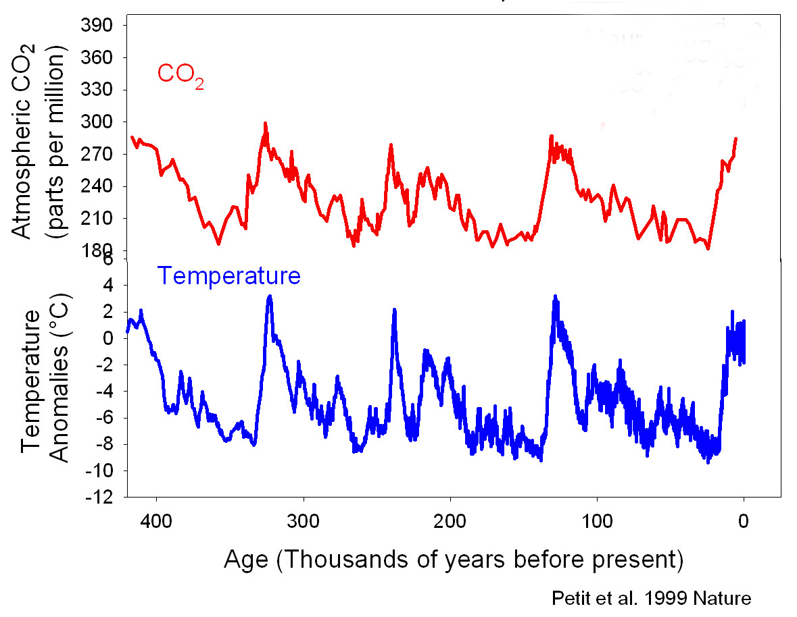
Temperature and CO₂ correlation

Slide 8
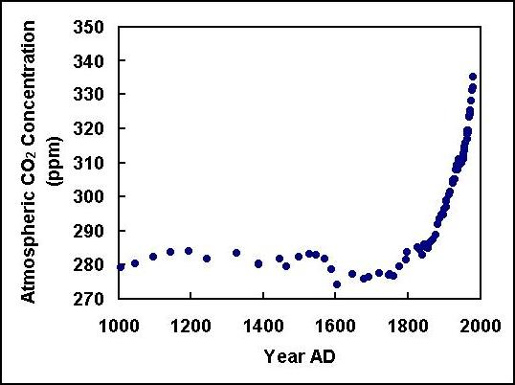
CO₂ levels for the last 1000 years

Slide 9
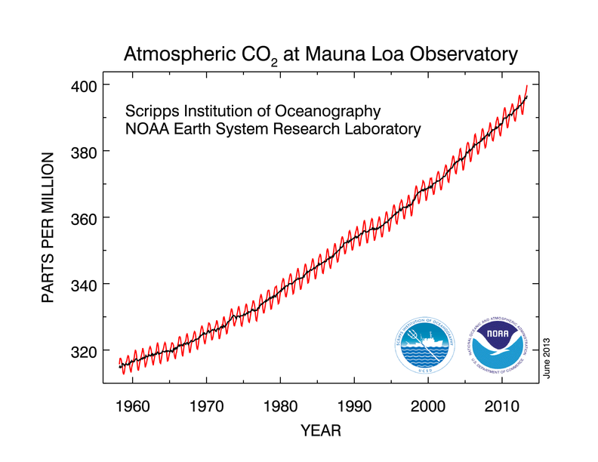
CO₂ levels for the last 60 years

Slide 10
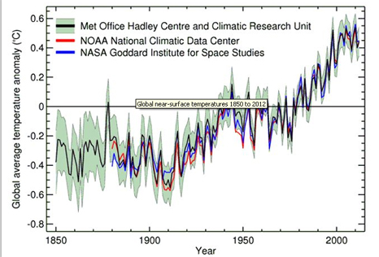
Average global T increase since 1850

Slide 11
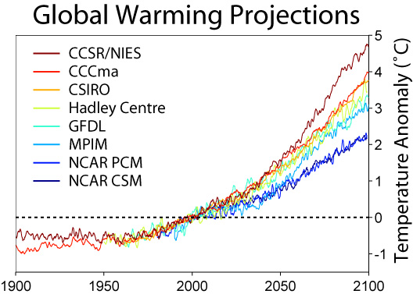
Predicted T increase through 2100

Slide 12
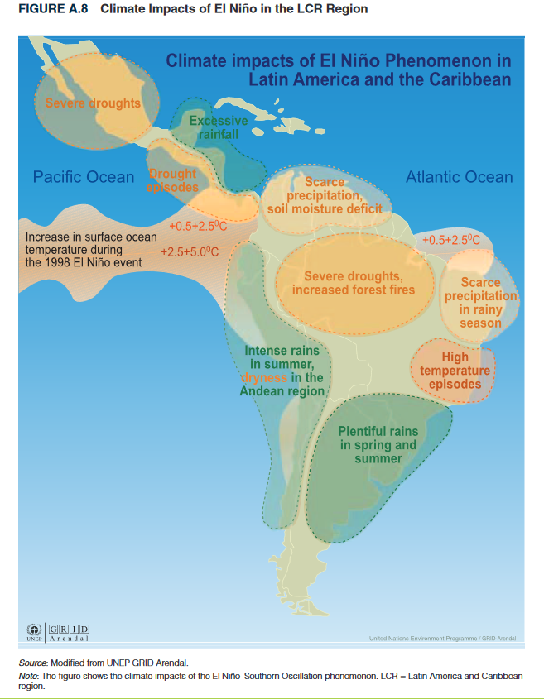
Some consequences of Global Warming
Polar ice melting
Sea level rise
Extreme weather
(more strong storms,
wild fires, floods, and
severe droughts)
Agricultural issues
Spread of diseases
Loss of biodiversity
Global
Climate
Change

Slide 13
More consequences – “threat multiplier”
Access to clean water reduced
Ability to reliably grow food reduced
Increasing numbers of climate migrants
Economic impacts, especially to the poor
Increasing rates of poverty
Induced social/political instability
Negative impacts on human health
Wide disparities in vulnerability & culpability

Slide 14
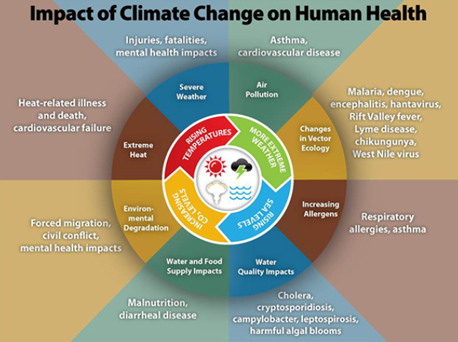

Slide 15
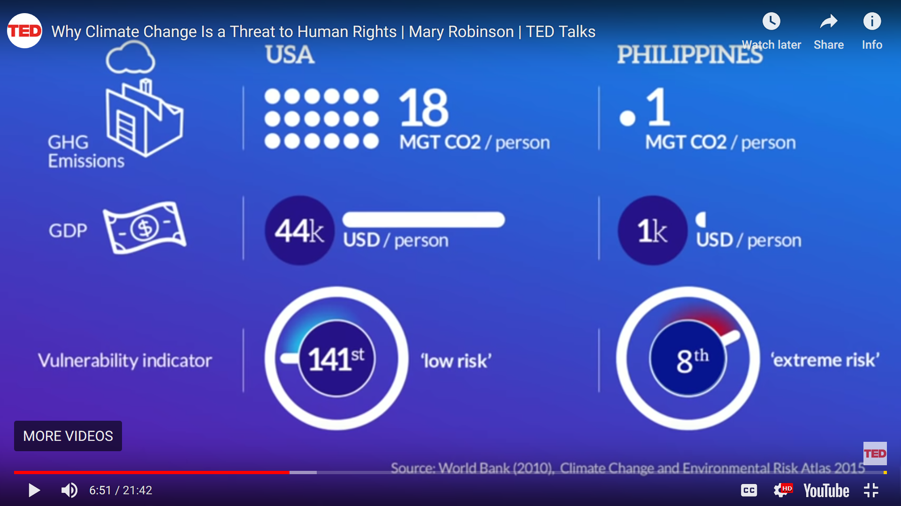
All are impacted; vulnerability varies

Slide 16
What can be done (globally)?
Reduce emissions of greenhouse gases
  Use less energy; increase energy efficiency
  Renewable energy sources (wind, solar, waves)
  Reduce burning of fossil fuels (esp. coal & oil)
Carbon capture & sequestration
Educate people (especially women/girls)
  Family planning, better farming practices, etc.
Changes to land management & the food system
  Eat local & lower on the food chain; waste less

Slide 17
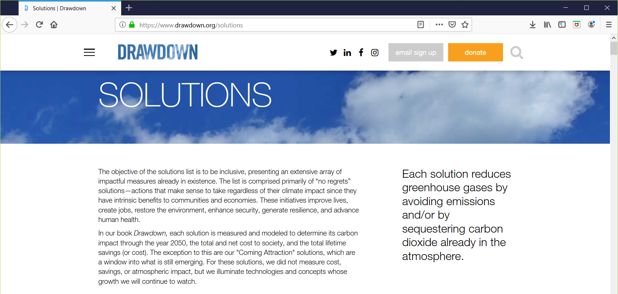
Project Drawdown
www.drawdown.org

Slide 18
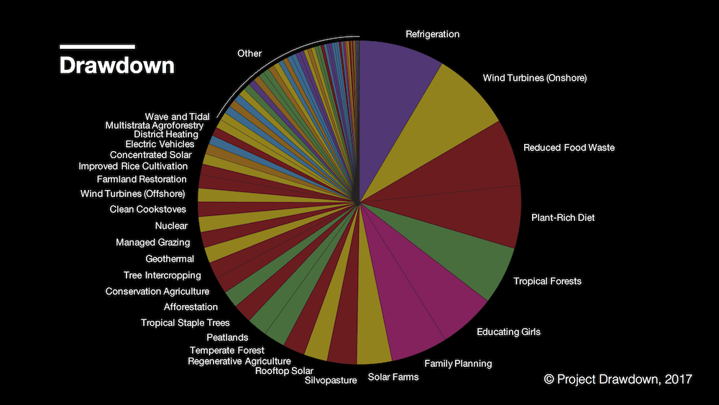

Slide 19
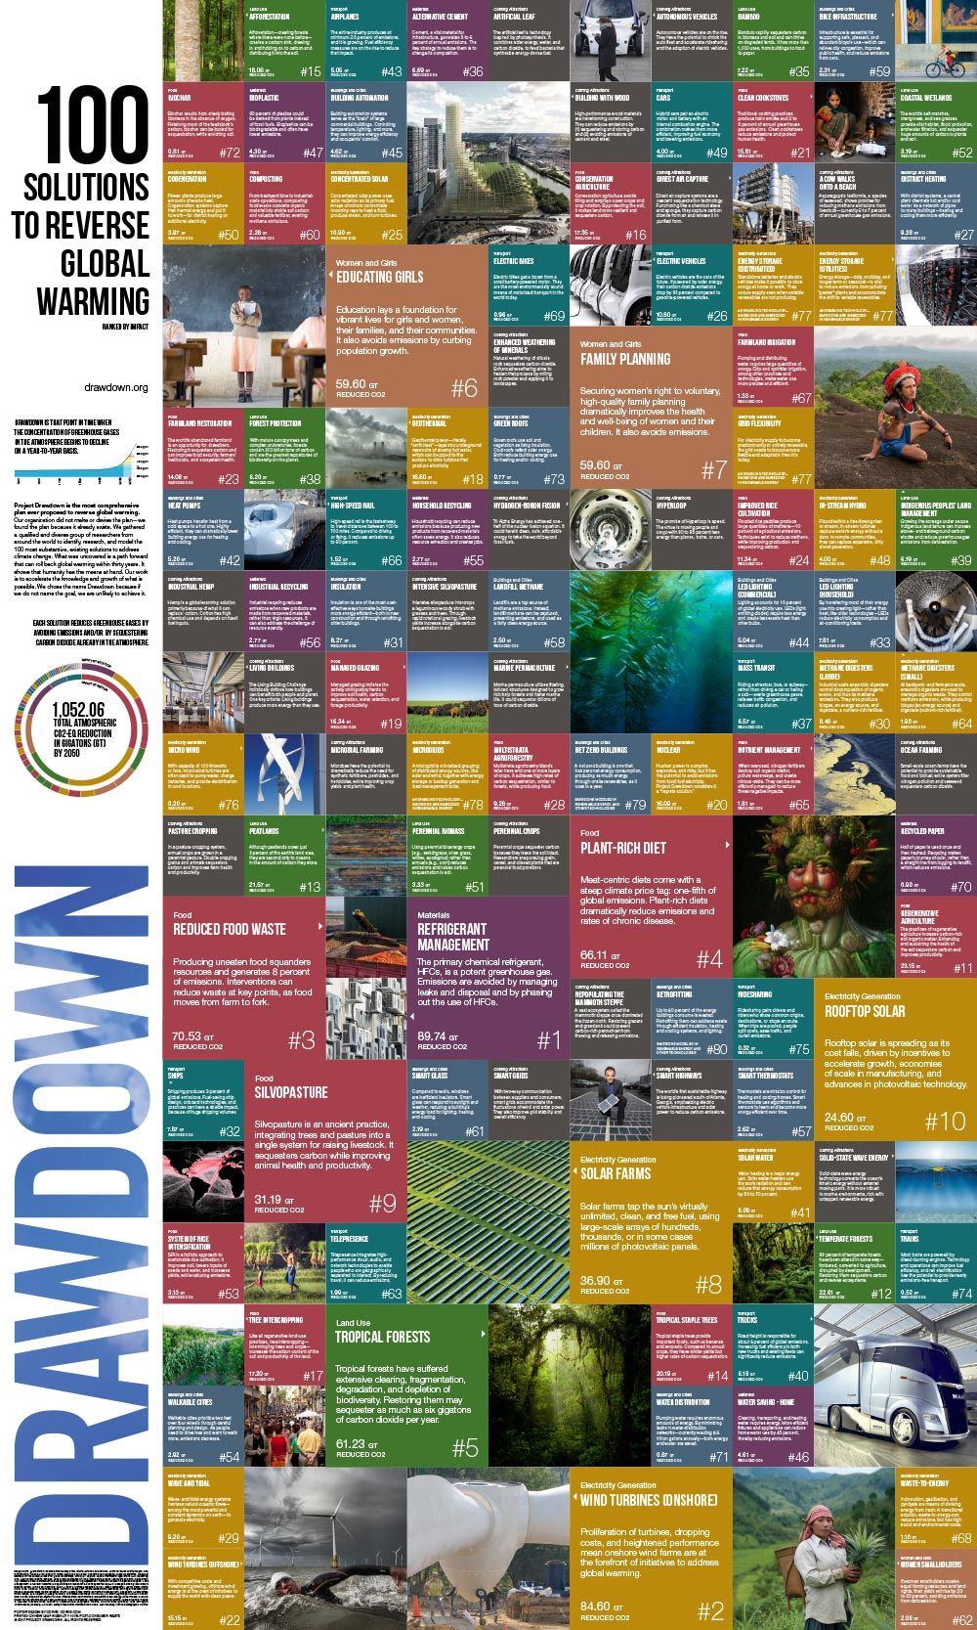

Slide 22
What can be done (personally)?
Learn even more – e.g. watch some TED talks!
Talk about Global Warming and Climate Change
Consider both when making personal decisions
  What to eat, How to get around, How to vote
Act to enable “global” solutions when you can
  Energy: efficiency, renewables, etc.
  Farming and food: less waste, less meat, etc.

Slide 23
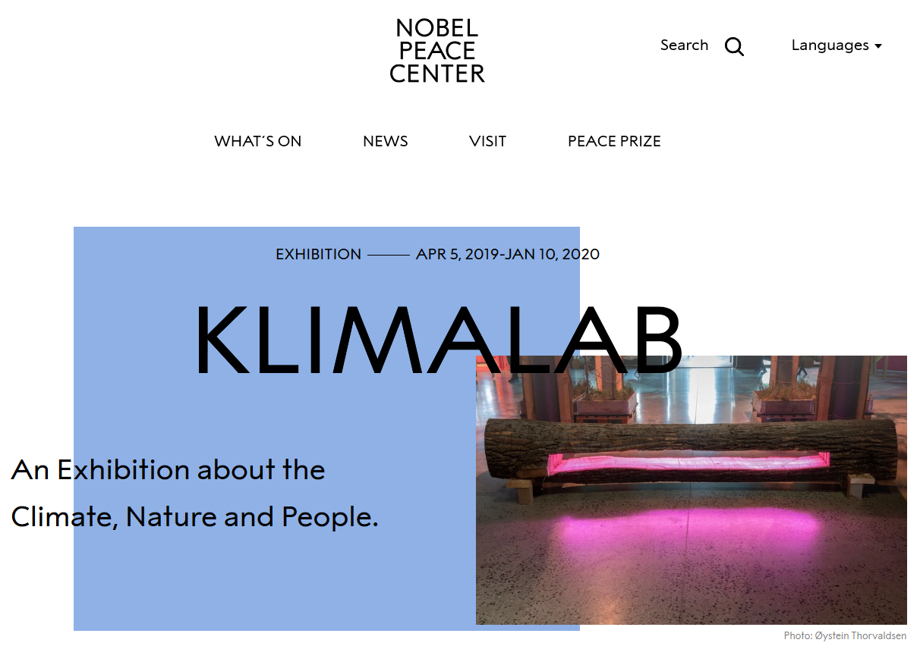
www.nobelpeacecenter.org/en/

Slide 24
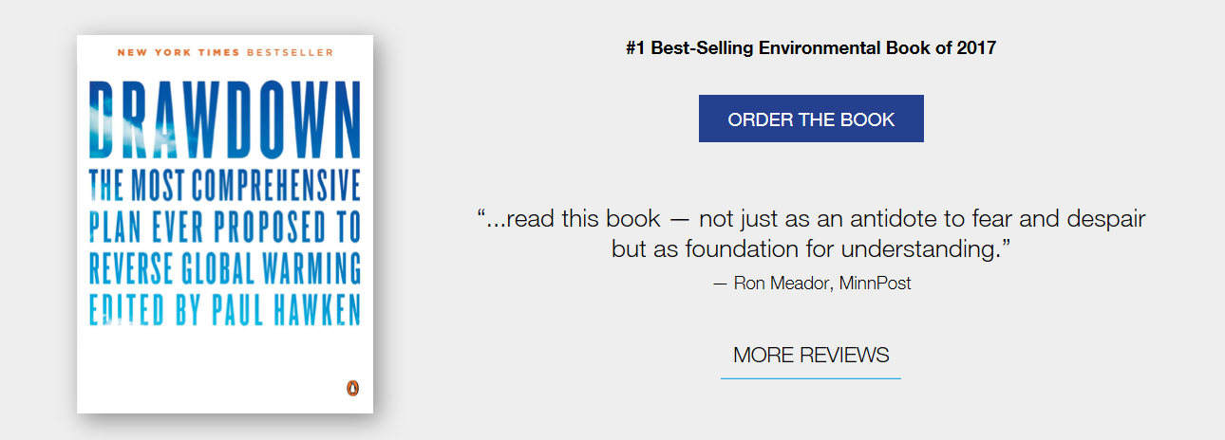
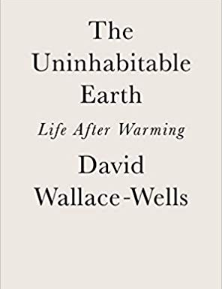
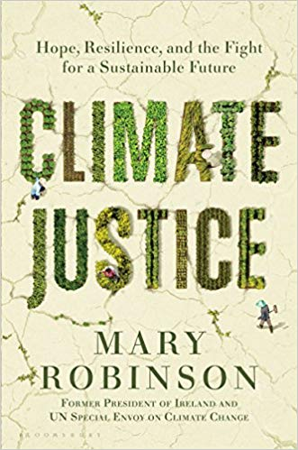
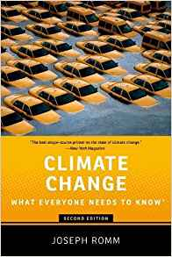
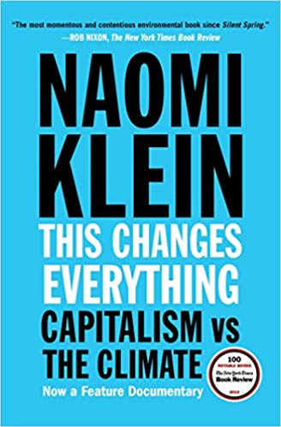
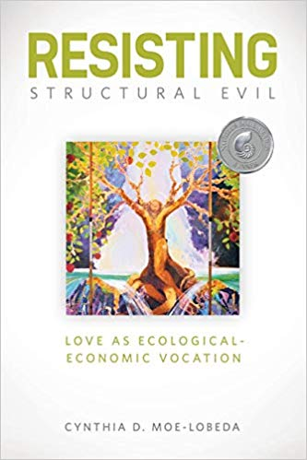

Slide 25
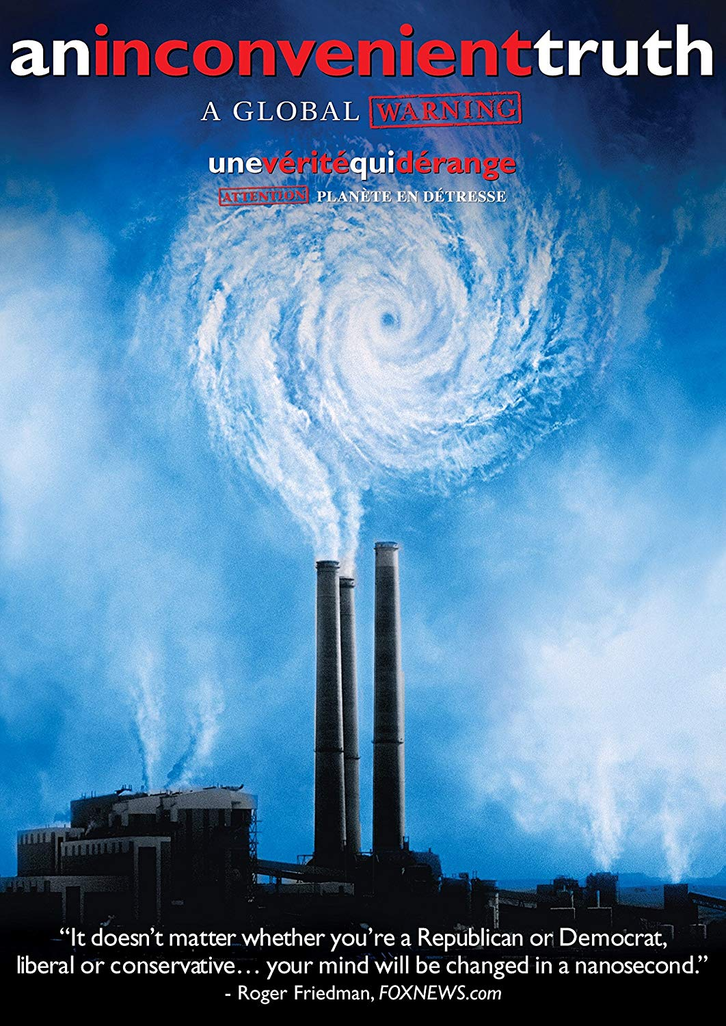
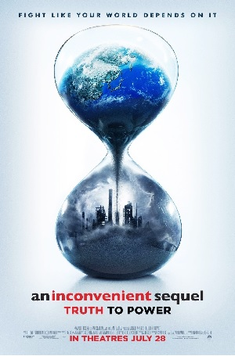
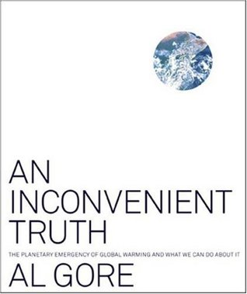
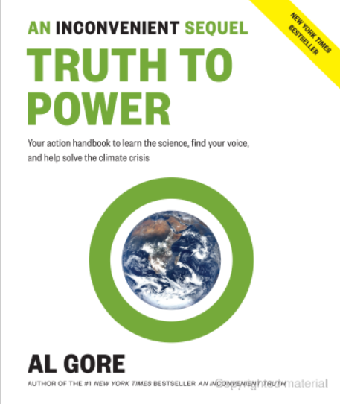
2006
Academy Award for
Best Documentary Feature
2017
Nominated for
Best Documentary
British Academy Films Awards

Slide 26
Don’t get discouraged; be hopeful, but persistent
Do what you can,
when you can,
as often as you can.

