Slide 1
Some thoughts about
Global Warming and
Global Climate Change
(Part 2)
James Flaten
NASA’s MN Space Grant Consortium
U of MN – Twin Cities

Slide 2
Some take-aways
Climate always changes, but usually does so “slowly”
On-going climate change is happening much faster
than “nature” can explain (but we know why)
Climate change can lead to “mass extinctions” of
entire species (and other things, including cultures)
People are paying attention and starting to try to
correct/limit the damage we are responsible for
Human effort is currently falling far short of what is
needed to stop, much less reverse, climate change

Slide 3
More take-aways
By the end of this century large swaths of the earth
will be uninhabitable (by today’s standards) due to
overheating, lack of water, fires (in some areas)
sea level rise, flooding (in other areas)
The problem doesn’t go away by the year 2100 – that
Is just the year beyond which most models don’t go
Despite people’s best efforts, dramatic (negative)
social and economic changes are probably unavoidable
The Earth will survive; people will too (probably)

Slide 4
Some thoughts about
Global Warming and
Global Climate Change
(Part 2)
James Flaten
NASA’s MN Space Grant Consortium
U of MN – Twin Cities

Slide 5
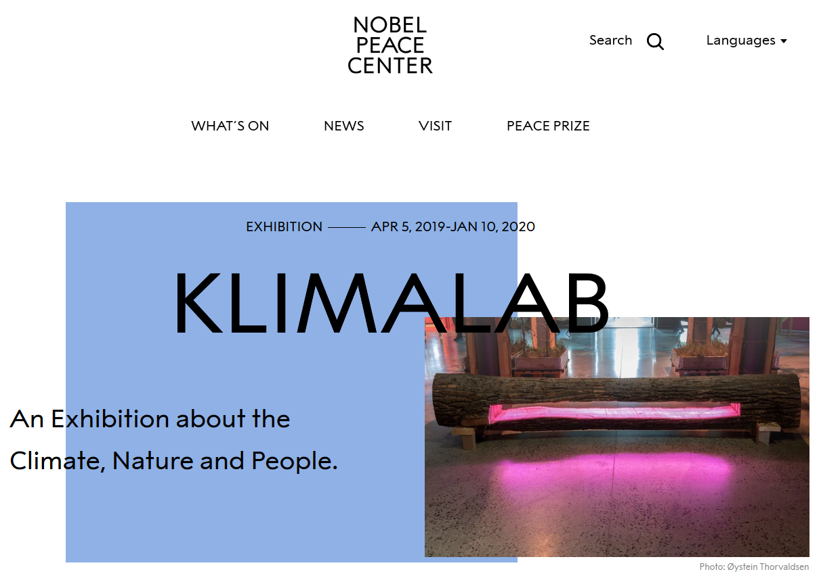
www.nobelpeacecenter.org/en/

Slide 6
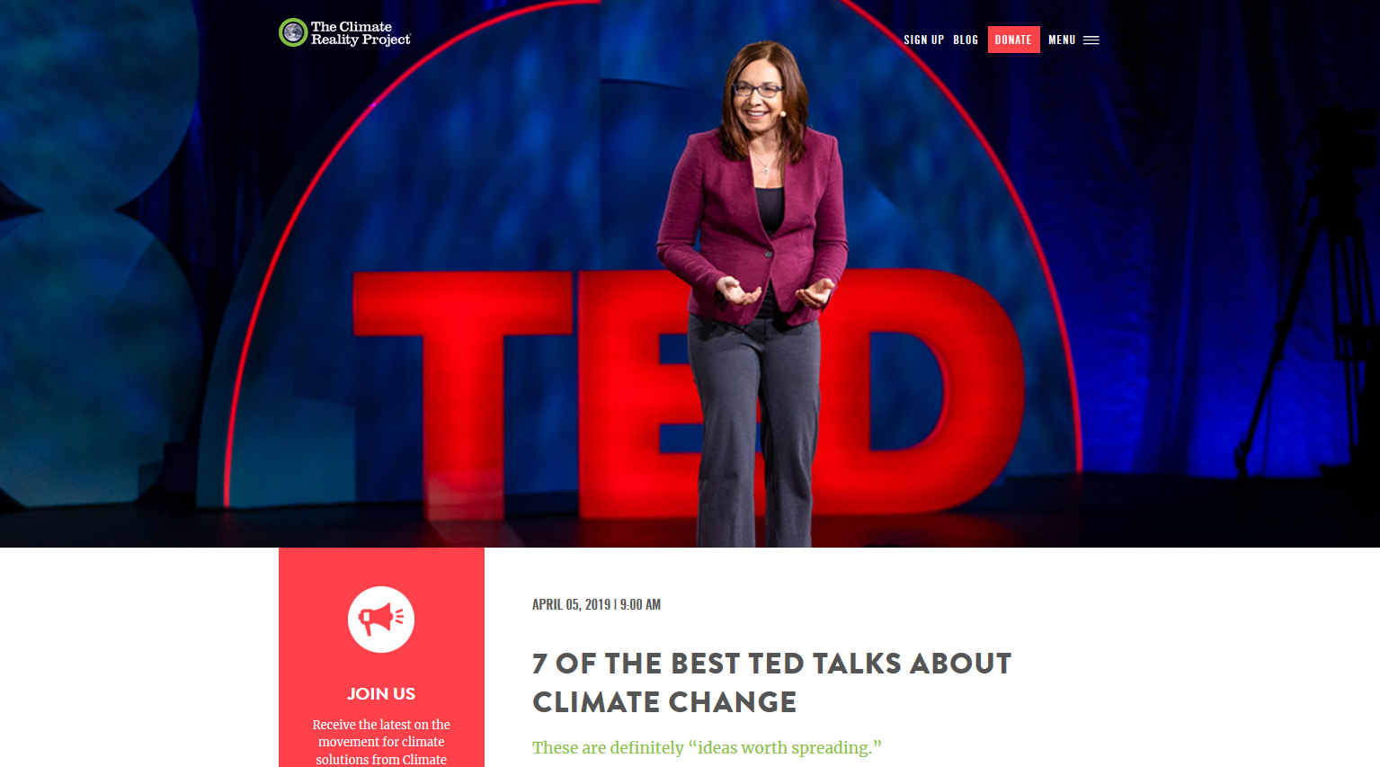
https://www.climaterealityproject.org/blog/7-best-ted-talks-about-climate-change

Slide 7

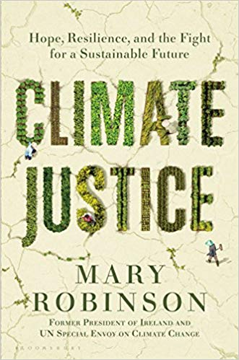


Slide 8
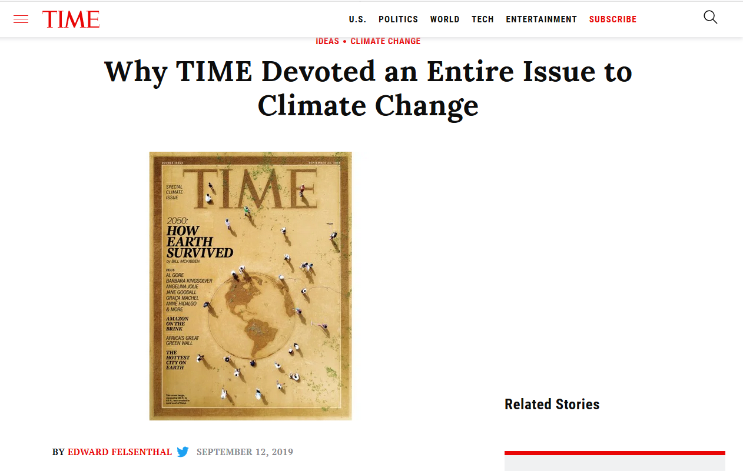
Some article titles:
2050: How Earth Survived
Why I Have Hope for the Climate-Change
Battles to Come (by Al Gore)
The Hottest City on Earth
The Tipping Point: Amazon on the Brink
The Great Green Wall (Project) of Africa
Take a Walk on the Rewilding Side
The Climate Caucuses
No Person is an Island
Can We Innovate Our Way Out Of This Mess?
https://time.com/5669069/time-climate-change-issue/

Slide 9
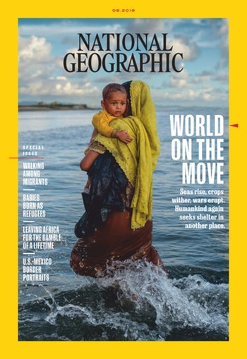
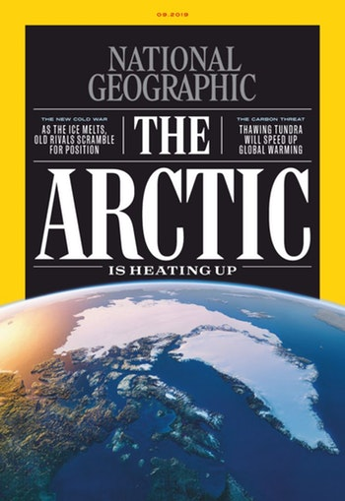
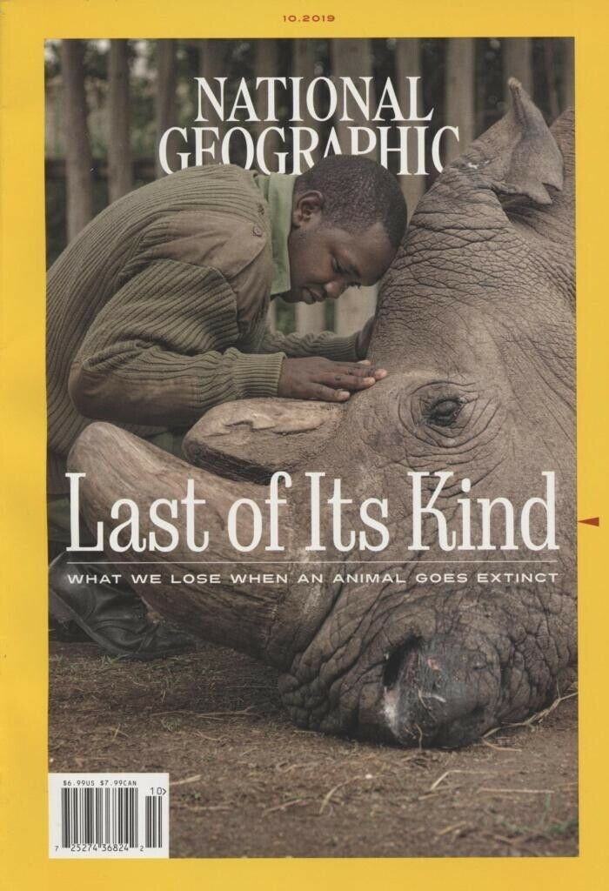
https://www.nationalgeographic.com/magazine/

Slide 10
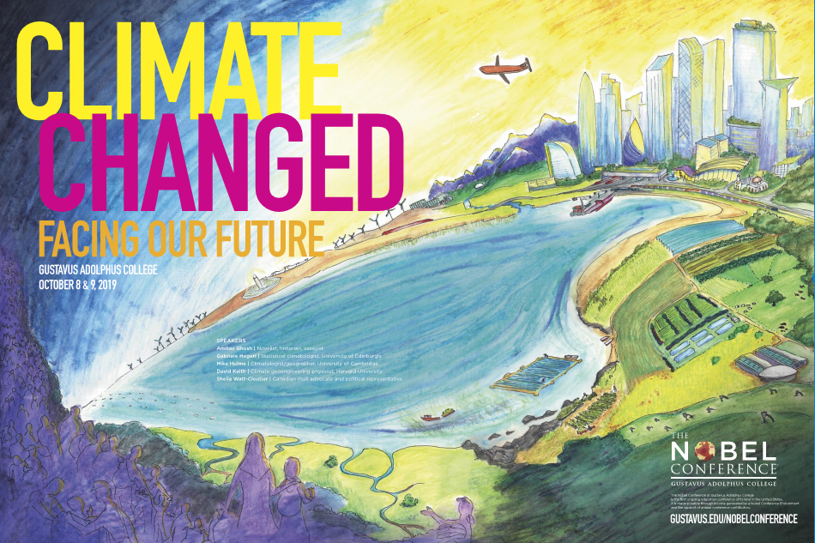
Gustavus Adolphus College
Nobel Conference 55 (2019):
Climate Changed: Facing Our Future
September 24 - 25, 2019
Speakers
  Amitav Ghosh, novelist, historian, essayist
  Richard Alley, glaciologist, Penn State University
  Diana Liverman, geographer, University of Arizona
  Sheila Watt-Cloutier, Canadian Inuit advocate and political representative
  Gabriele Hegerl, statistical climatologist, University of Edinburgh
  Mike Hulme, climatologist/geographer, University of Cambridge
  David Keith, climate geoengineering physicist, Harvard University
https://gustavus.edu/events/nobelconference/2019/

Slide 11
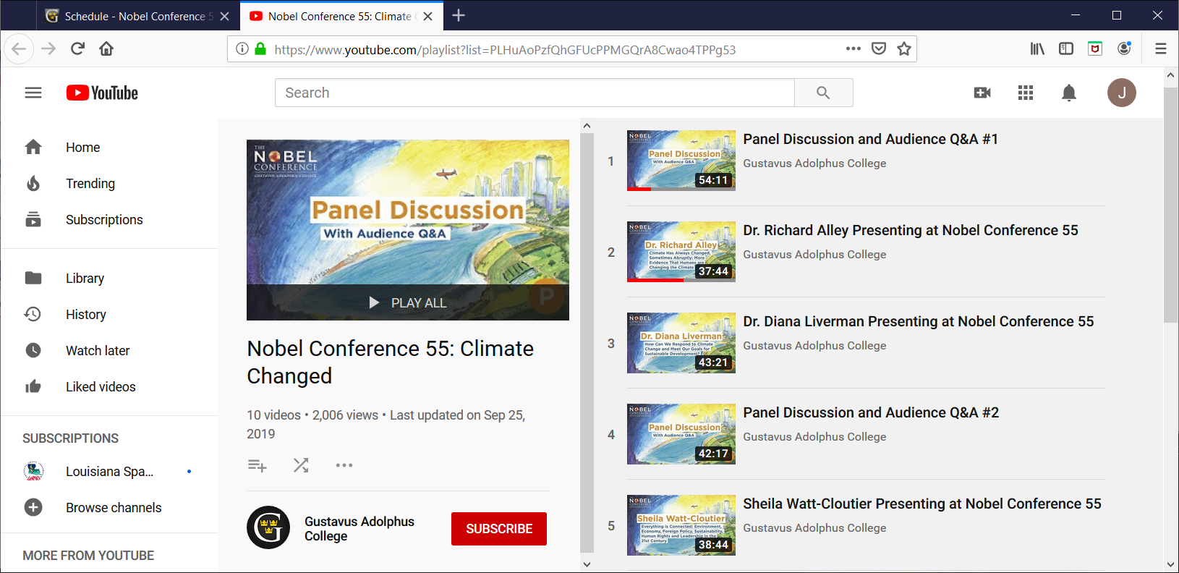
https://www.youtube.com/playlist?list=PLHuAoPzfQhGFUcPPMGQrA8Cwao4TPPg53

Slide 12
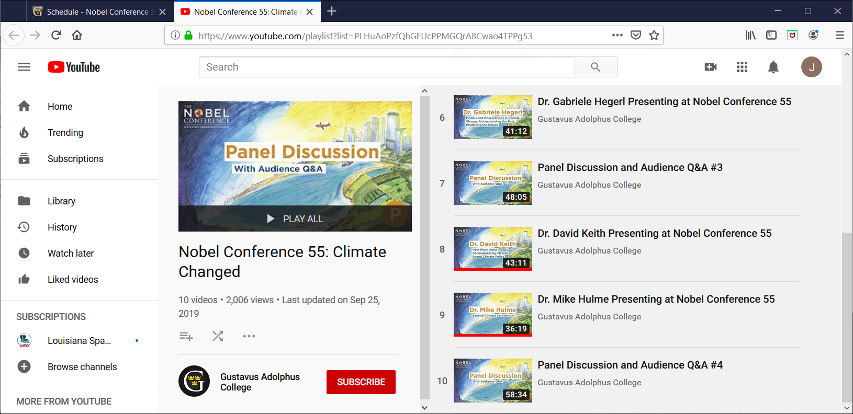
https://www.youtube.com/playlist?list=PLHuAoPzfQhGFUcPPMGQrA8Cwao4TPPg53

Slide 13
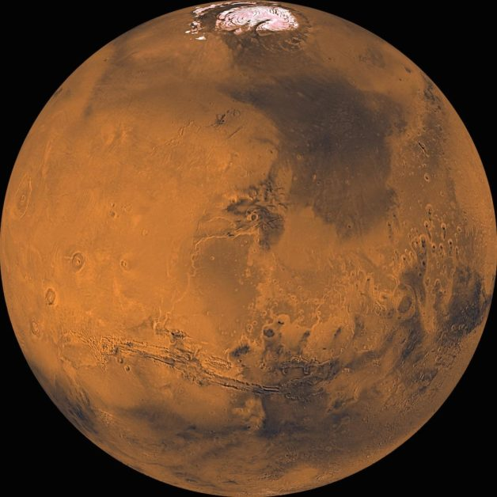
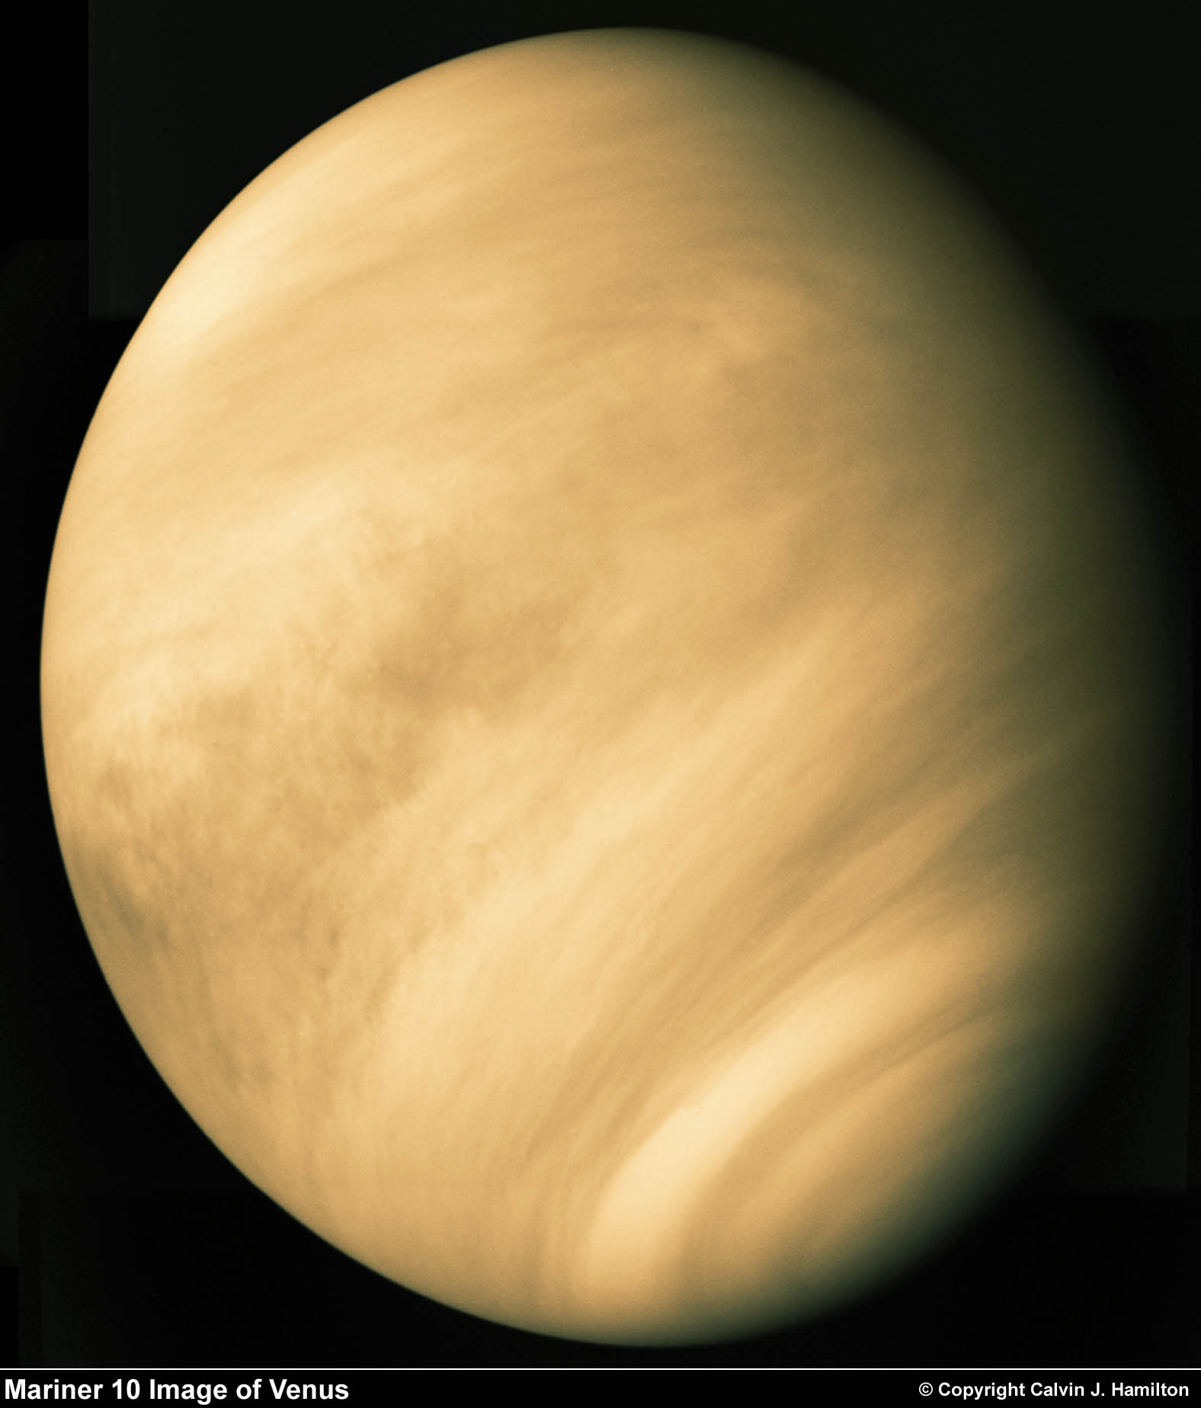
Cautionary Tales
Mars
Venus

Slide 14
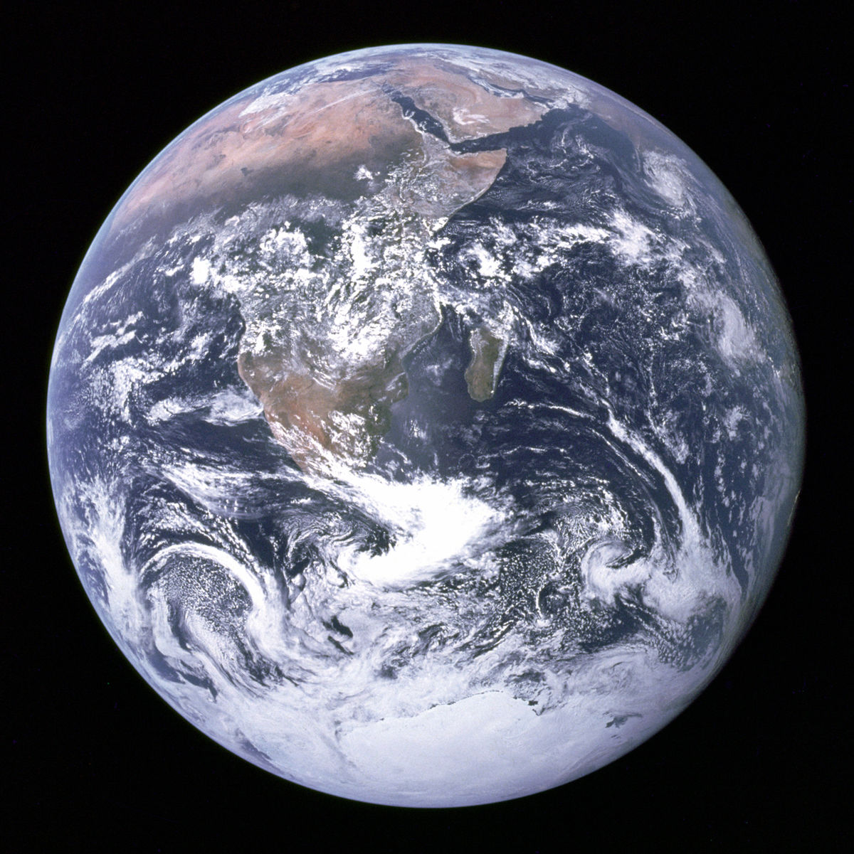
What about the Earth?

Slide 15
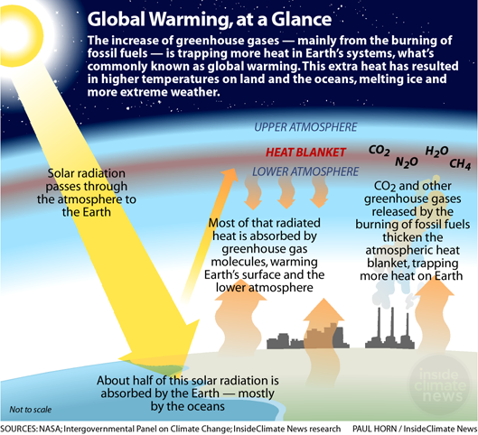

Slide 16
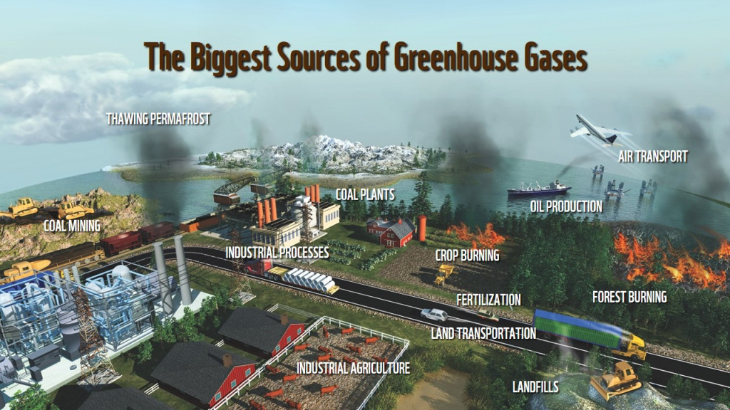

Slide 17
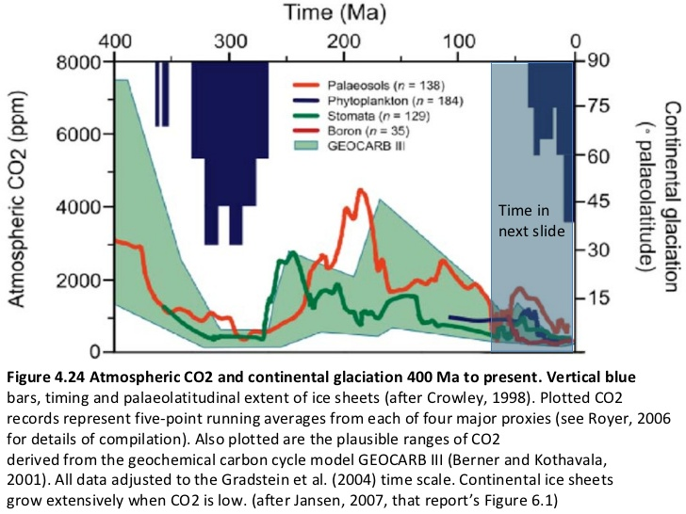
Prof. Richard B. Alley, Penn State
https://www.slideshare.net/sercuser/still-the-biggest-control-knob-carbon-dioxide-in-earthrsquos-climate-quothistoryquot

Slide 18
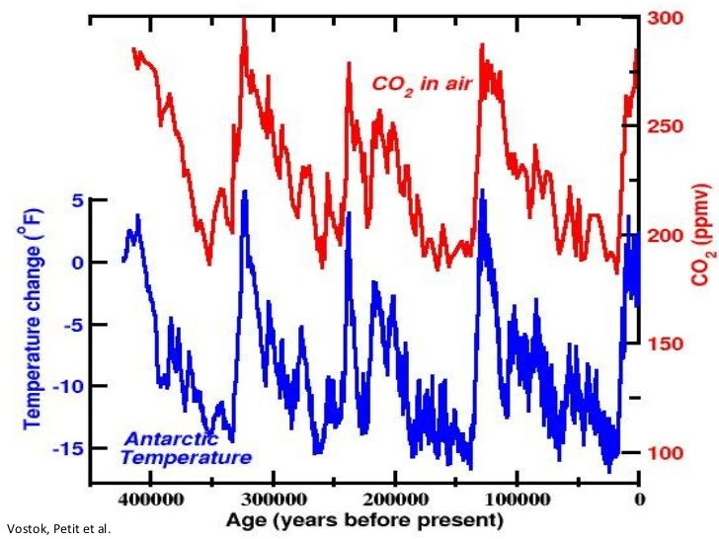
Prof. Richard B. Alley, Penn State
https://www.slideshare.net/sercuser/still-the-biggest-control-knob-carbon-dioxide-in-earthrsquos-climate-quothistoryquot

Slide 19
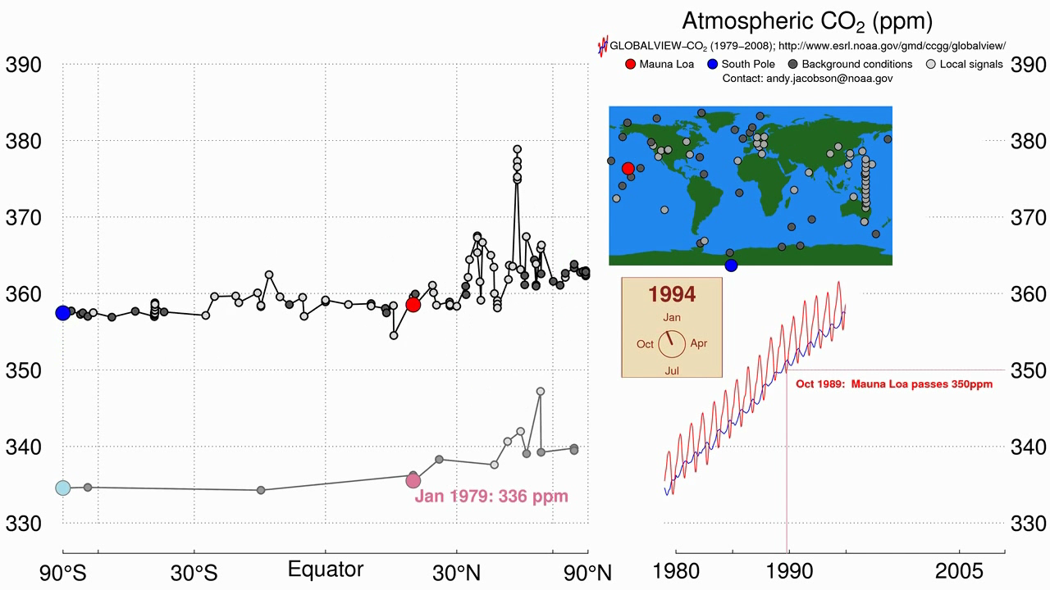

Slide 20
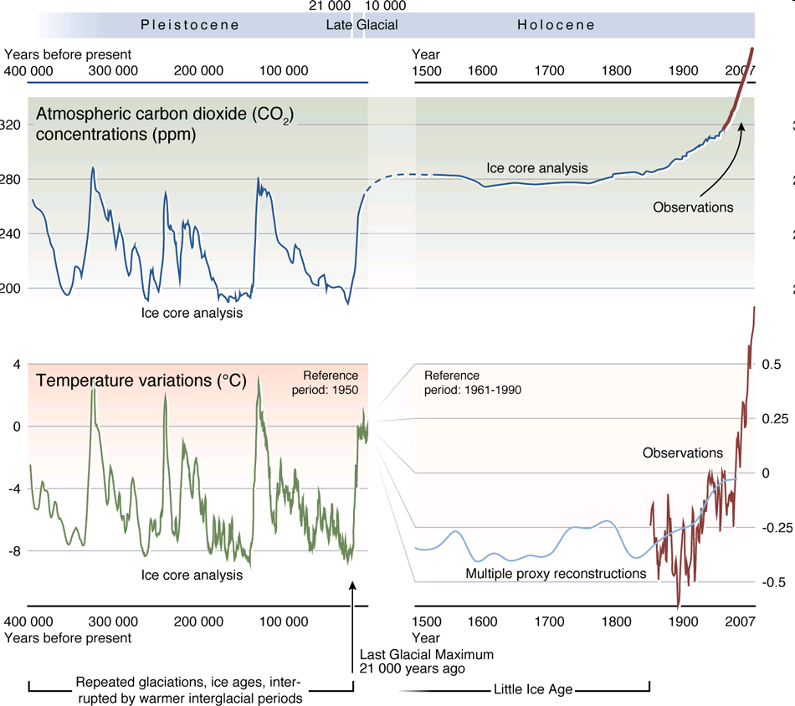

Slide 21
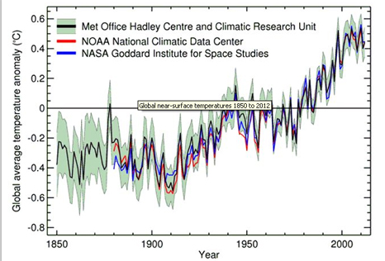
Average global T increase since 1850

Slide 22
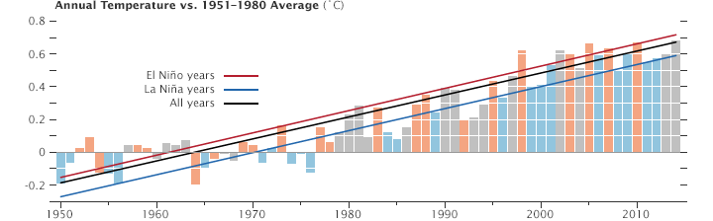
https://earthobservatory.nasa.gov/world-of-change/DecadalTemp

Slide 23
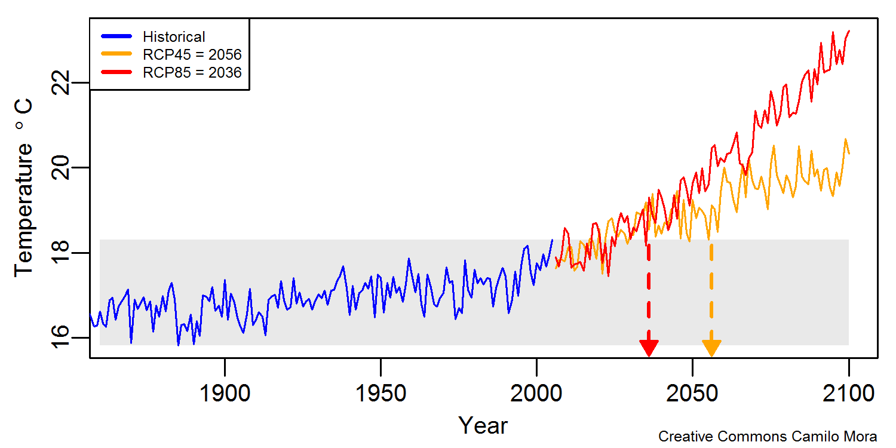
RCP85
  Business as Usual
  Emission of CO₂
RCP45
  Aggressive Reduction
  in Emission of CO₂
Marked: “climate departure” … when the lowest temperature for a given month will be higher than any temperatures … experienced over the last 150 years.
https://greattransition.net/blog/38-a-new-spur-to-passionate-climate-action

Slide 24
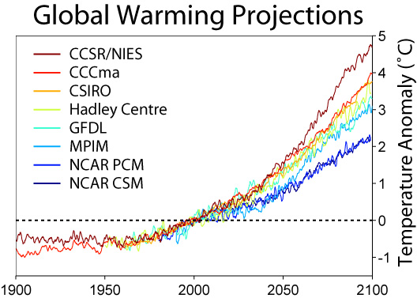
Notice the upwards slope of every model by the year 2100.

Slide 25
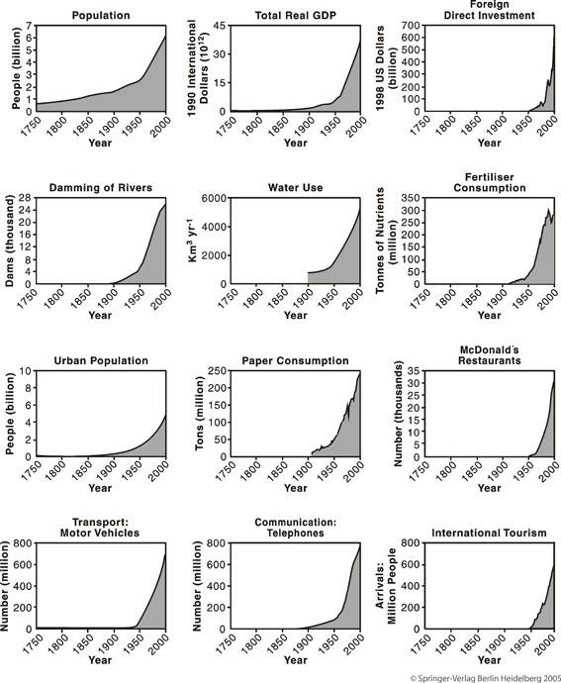
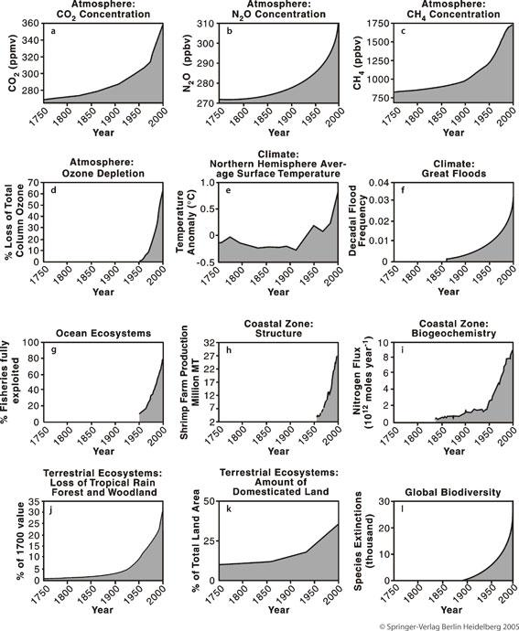
Why so much growth? Population & “Development”

Slide 26
United Nation’s Intergovernmental Panel on Climate ChangeI (IPCC) Reports
(Consensus of Thousands of Experts)
“Anthropogenic (Human Caused) greenhouse gas emissions have increased since the pre-industrial era, driven largely by economic and population growth, and are now higher than ever. This has led to atmospheric concentrations of carbon dioxide, methane and nitrous oxide that are unprecedented in at least the last 800,000 years. Their effects, together with those of other anthropogenic drivers (Human factors), have been detected throughout the climate system and are extremely likely (95% confidence) to have been the dominant cause of the observed warming since the mid-20th century.”
“Continued emission of greenhouse gases will cause further warming and long-lasting changes in all components of the climate system, increasing the likelihood of severe, pervasive and irreversible impacts for people and ecosystems. Limiting climate change would require substantial and sustained reductions in greenhouse gas emissions which, together with adaptation, can limit climate change risks.”
(IPCC, Climate Change 2014 Synthesis Report)
https://www.ipcc.ch/

Slide 27
(United States) FOURTH NATIONAL CLIMATE ASSESSMENT (2017-2018)
The impacts of climate change are already being felt in communities across the country. More frequent and intense extreme weather and climate-related events, as well as changes in average climate conditions, are expected to continue to damage infrastructure, ecosystems, and social systems that provide essential benefits to communities. Future climate change is expected to further disrupt many areas of life, exacerbating existing challenges to prosperity posed by aging and deteriorating infrastructure, stressed ecosystems, and economic inequality. Impacts within and across regions will not be distributed equally. People who are already vulnerable, including lower-income and other marginalized communities, have lower capacity to prepare for and cope with extreme weather and climate-related events and are expected to experience greater impacts. Prioritizing adaptation actions for the most vulnerable populations would contribute to a more equitable future within and across communities. Global action to significantly cut greenhouse gas emissions can substantially reduce climate-related risks and increase opportunities for these populations in the longer term.
https://nca2018.globalchange.gov/chapter/front-matter-about/

Slide 28
Some reasons to be optimistic
Human societies, especially with advance notice, can be quite adaptable (though wild plants and animals not so much)
People are creative and have managed to deal with some global problems in the past (e.g. DDT, CFC’s -> ozone hole, etc.)
Enough technology already exists to address this problem
(but the will to act aggressively enough is not yet sufficient)
The price of solar installations has fallen faster than
expected and efficiency of solar panels is improving quickly
New technologies are being developed that will be brought
to bear in coming years (but when & actual effectiveness TBD)

Slide 29
Some reasons to be pessimistic
This problem is much more pernicious than previous ones
The countries most responsible for the problem, and most able to help address it, are often the countries least impacted (and hence, sometimes, the least motivated to act)
Conventional “nation development” increases emissions
Many “solutions” just defer (and complicate) matters
It might not be possible to act quickly enough to get ahead of this problem -> there are many positive feedback loops
Solutions are expensive (but people are realizing that not solving this problem is even more expensive)

Slide 30
Some pathways and feedback loops
VOLCANIC ERUPTIONS
EXTREME WEATHER: DROUGHT, FLOODS, ETC.
ICE MELTING

Slide 31
Why the “pause” in global warming?

Slide 32
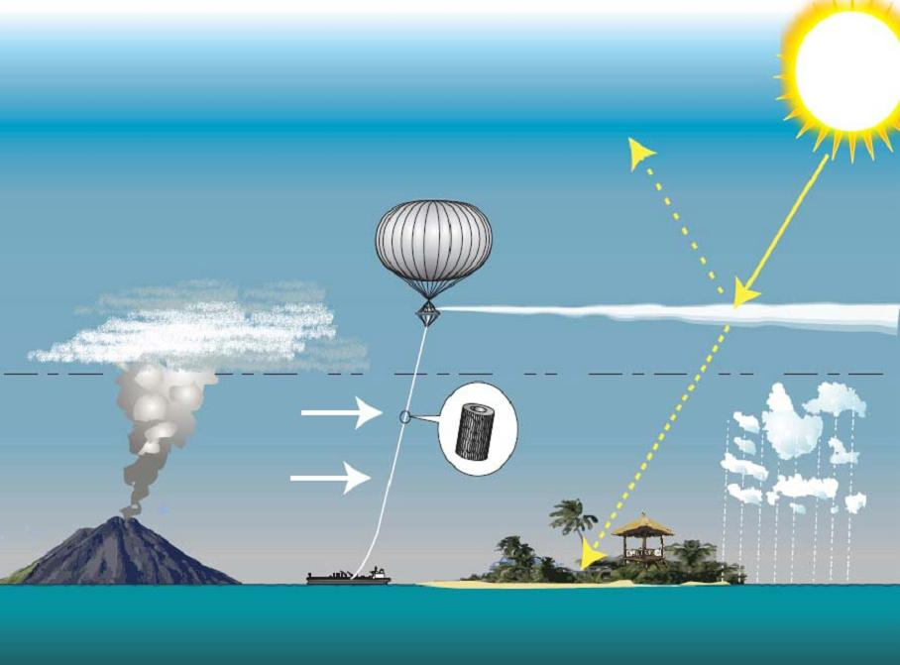
Solar Geo-Engineering (AKA Solar radiation management)
https://en.wikipedia.org/wiki/Solar_radiation_management

Slide 33
More take-aways
Every realistic/comprehensive plan to mitigate
global warming requires steep cuts (starting now!)
in emissions of greenhouse gases (esp. CO₂)
Reducing greenhouse gas emissions may be hard,
but actively getting CO₂ out of the atmosphere
is harder still so don’t count on that (much).
Beware also of betting on untested technologies;
expect failures & unintended consequences.
No silver bullet, but lots of silver buckshot.

Slide 34
Good news / Bad news
Despite its complexity,
we now have a good understanding
of the Earth’s climate system
Understanding the system
has not resulted in adequate
will to fix this problem (yet).

Slide 35
Good news / Bad news
Some places on Earth
might appear to gain some benefits
from global warming.
Global climate change (including
more extreme weather events)
is having a net-negative effect on
essentially all places on Earth.

Slide 36
Good news / Bad news
Some progress has been made
at the international level to
reduce greenhouse gas emissions.
Countries aren’t living up to the
promises they made in the Paris
Agreement (and that was not sufficient
to limit warming to <2° C anyway).

Slide 37
Good news / Bad news
There are many options for
energy production without
greenhouse gas emissions.
Fossil fuels are inexpensive,
convenient, and their proponents
have a strong lobby – they aren’t
going away any time soon.

Slide 38
Good news / Bad news
Plants naturally take CO₂
out of the atmosphere and
sequester the carbon.
Burning plants (fossil fuels are
made from plants), or just letting
them decay naturally, allows the
carbon to re-enter the atmosphere.

Slide 39
Good news / Bad news
Climate change takes time and
things aren’t intolerable yet (here),
so we have time to continue to act.
The impact of CO₂ is cumulative –
the Earth will continue to warm
(and will stay warm) even if C02
emissions were to be halted now.

Slide 40
Actual news (i.e. Current Events)

Slide 41
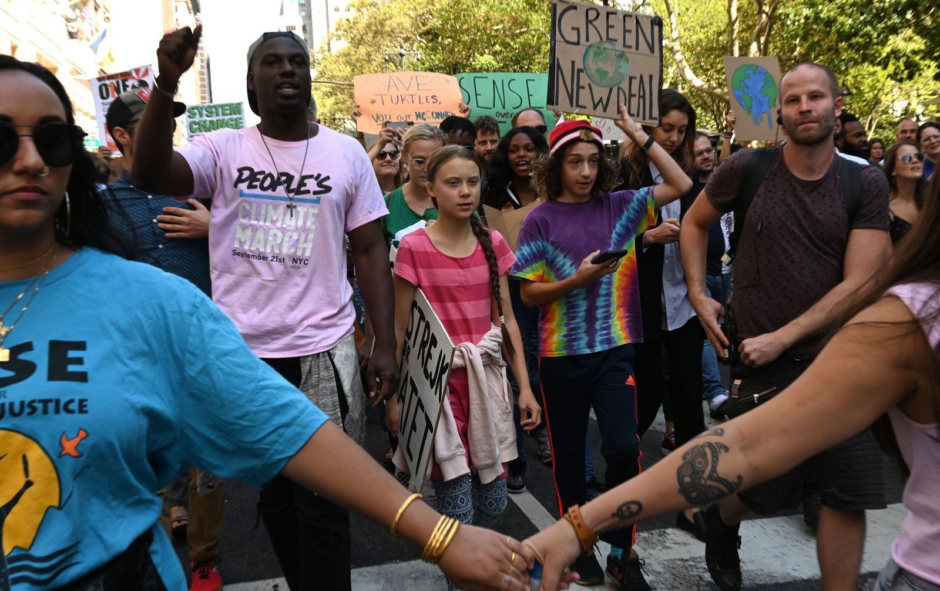
Greta Thunberg in New York City
Youth hold climate strikes worldwide on Sept. 20, 2019
https://www.cnn.com/2019/09/20/world/gallery/climate-strike-2019/index.html

Slide 42
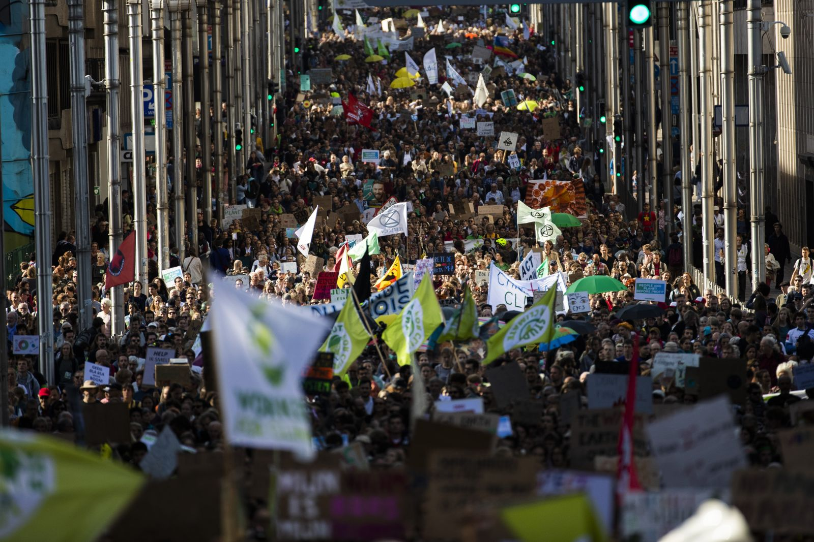
Brussels, Belgium
Youth hold climate strikes worldwide on Sept. 20, 2019
https://www.cnn.com/2019/09/20/world/gallery/climate-strike-2019/index.html

Slide 43
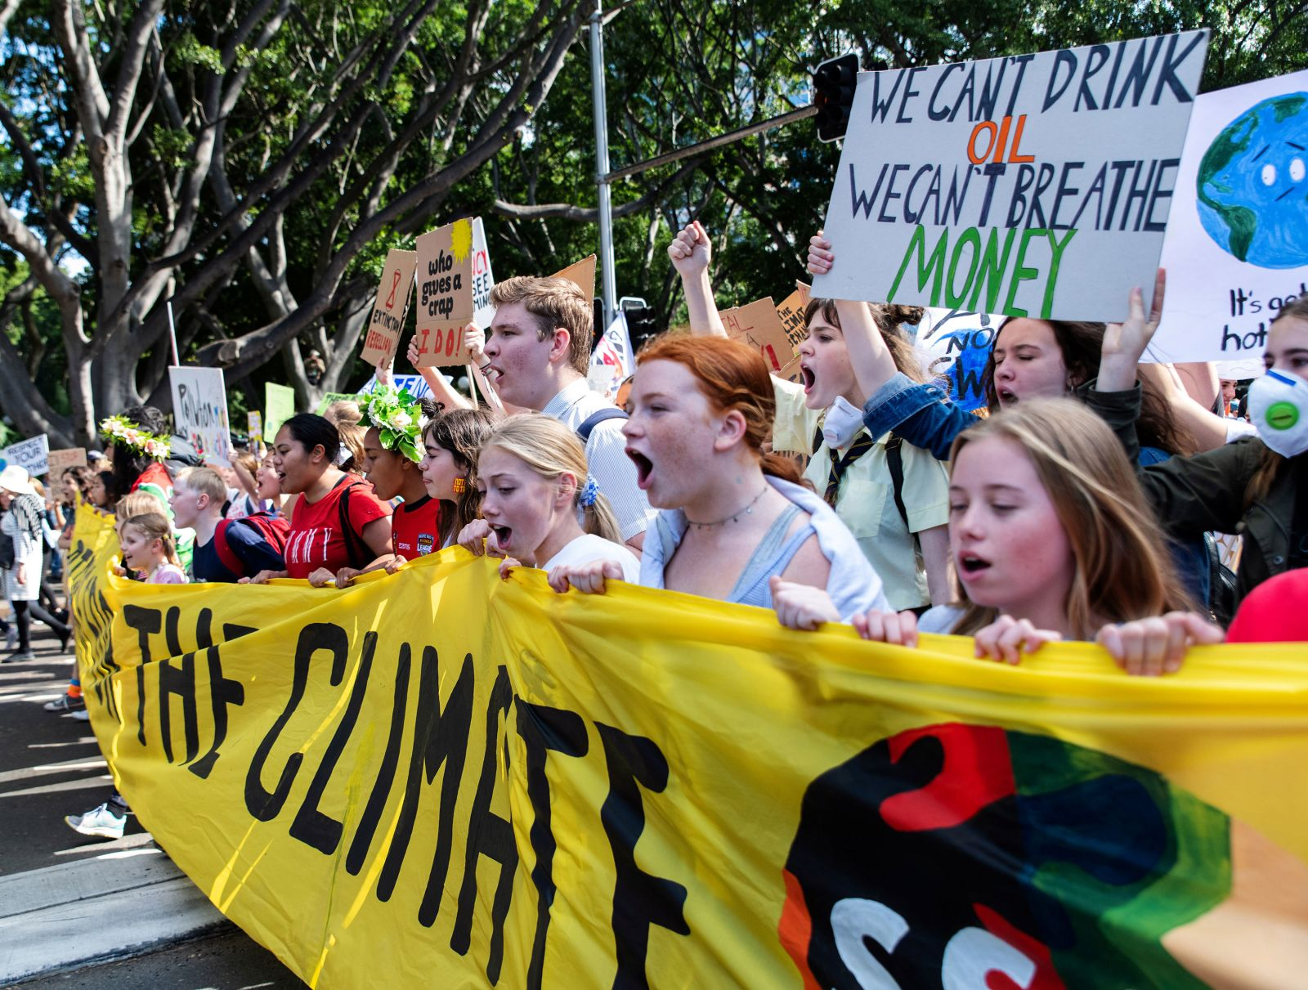
Sydney, Australia
Youth hold climate strikes worldwide on Sept. 20, 2019
https://www.cnn.com/2019/09/20/world/gallery/climate-strike-2019/index.html

Slide 44
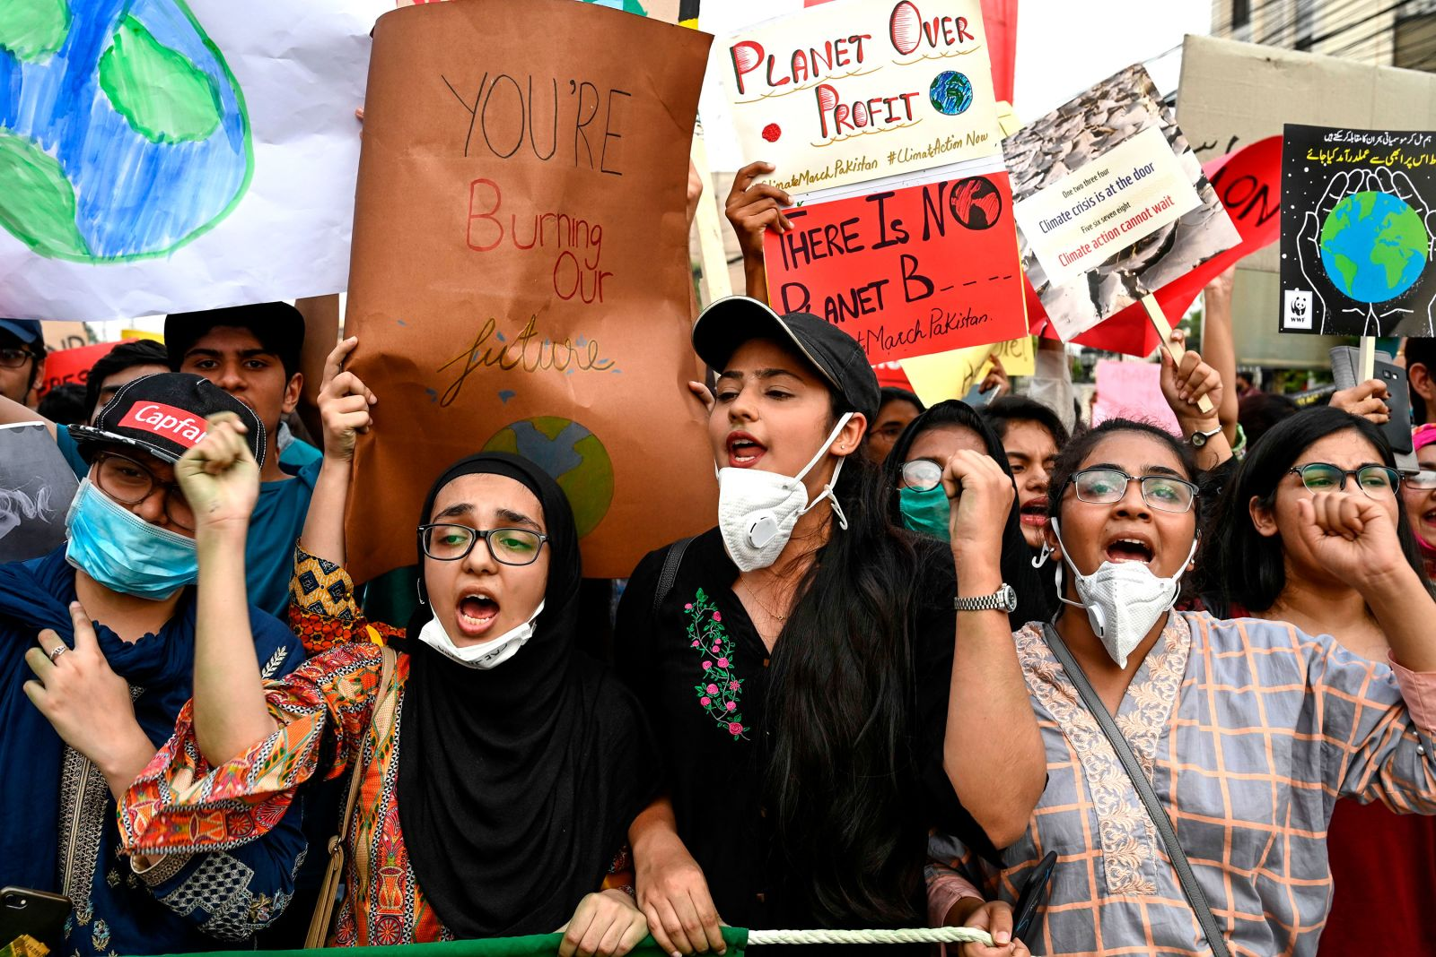
Lahore, Pakistan
Youth hold climate strikes worldwide on Sept. 20, 2019
https://www.cnn.com/2019/09/20/world/gallery/climate-strike-2019/index.html

Slide 45
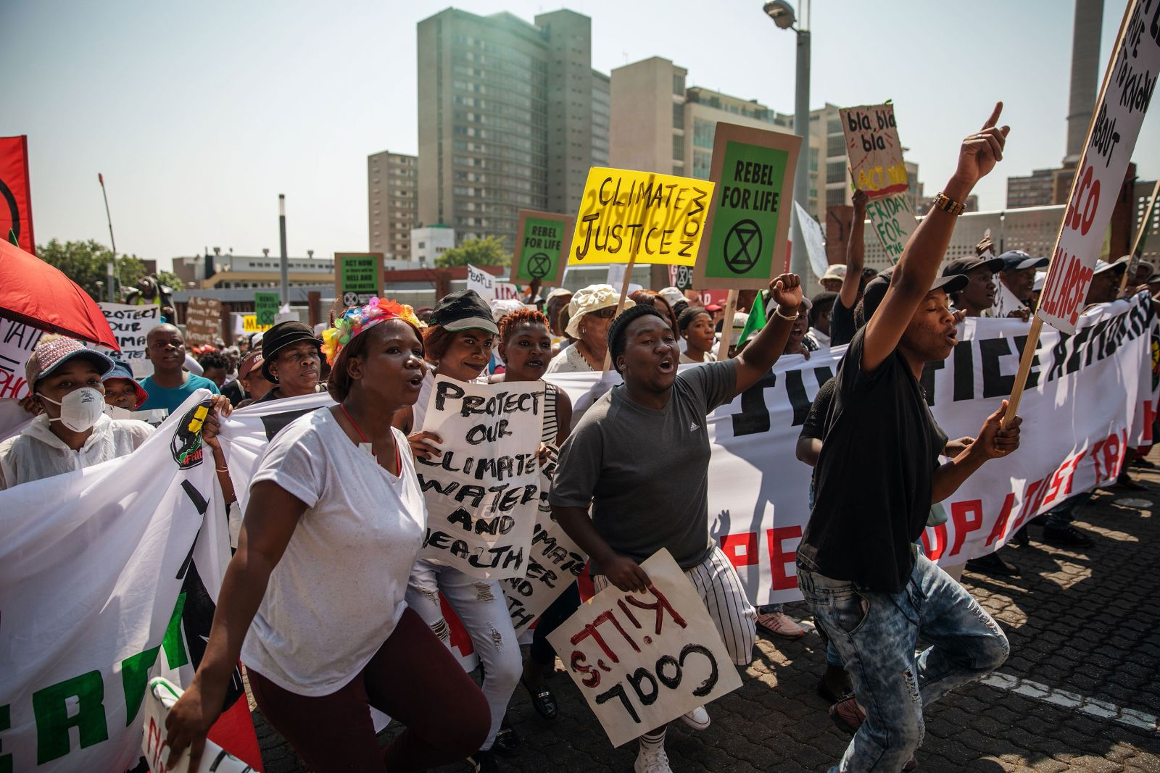
Johannesburg, South Africa
Youth hold climate strikes worldwide on Sept. 20, 2019
https://www.cnn.com/2019/09/20/world/gallery/climate-strike-2019/index.html

Slide 46
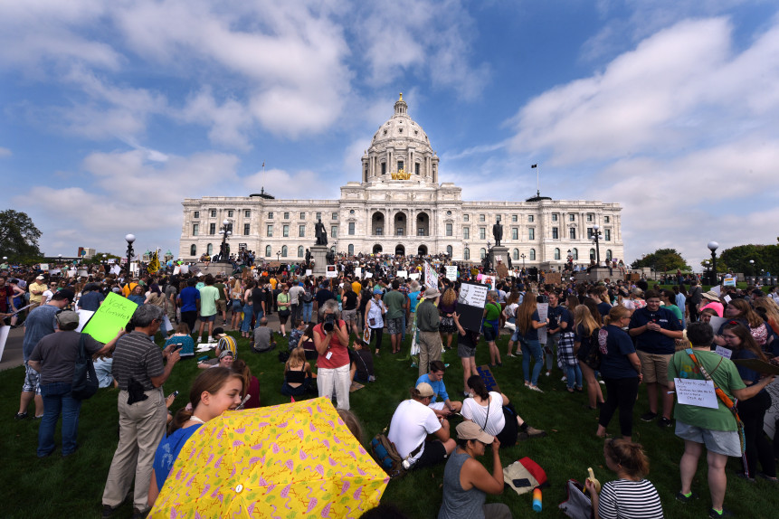
St. Paul, MN
Youth hold climate strikes worldwide on Sept. 20, 2019
https://www.twincities.com/2019/09/20/youth-climate-strike-draws-thousands-across-minnesota/

Slide 47
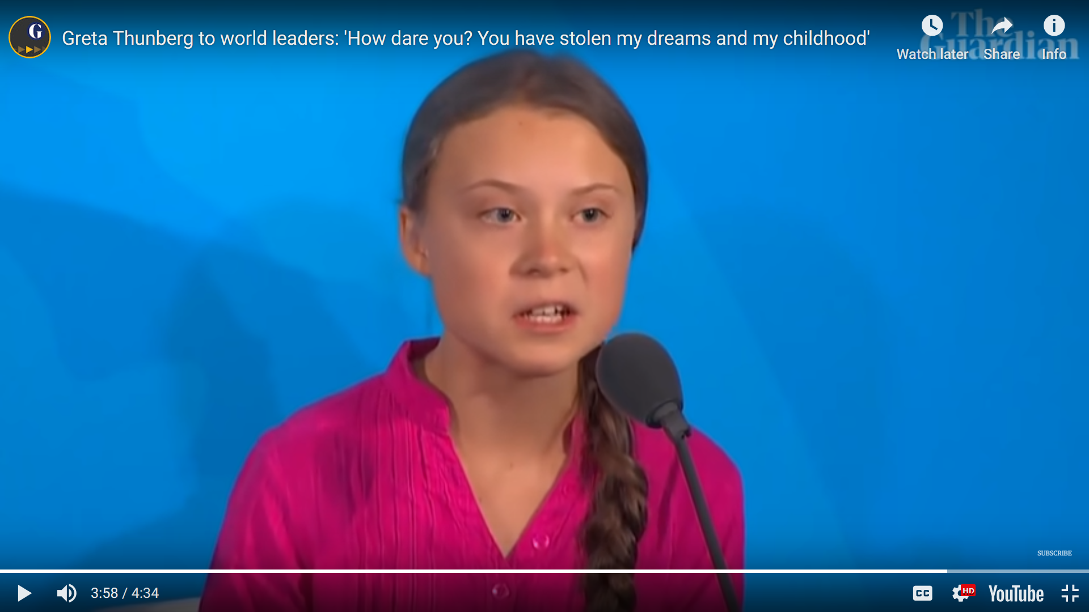
Greta Thunberg, age 16, climate activist
at Climate Action Summit, Sept. 23, 2019
https://www.theguardian.com/environment/video/2019/sep/23/greta-thunberg-to-world-leaders-how-dare-you-you-have-stolen-my-dreams-and-my-childhood-video

Slide 48
Minnesota news

Slide 49
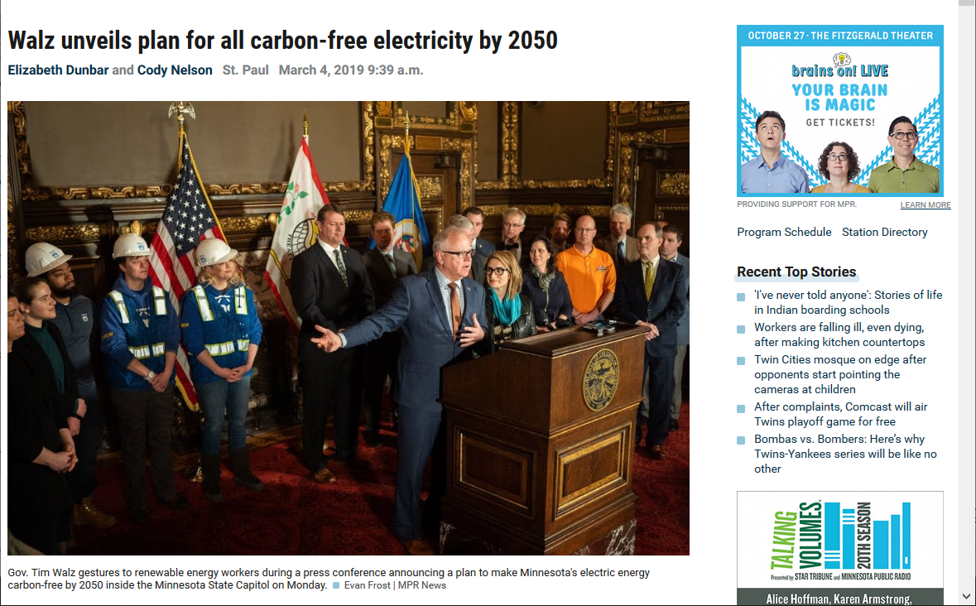
MN state government plans
https://www.mprnews.org/story/2019/03/04/walz-carbon-free-electricity-2050

Slide 50
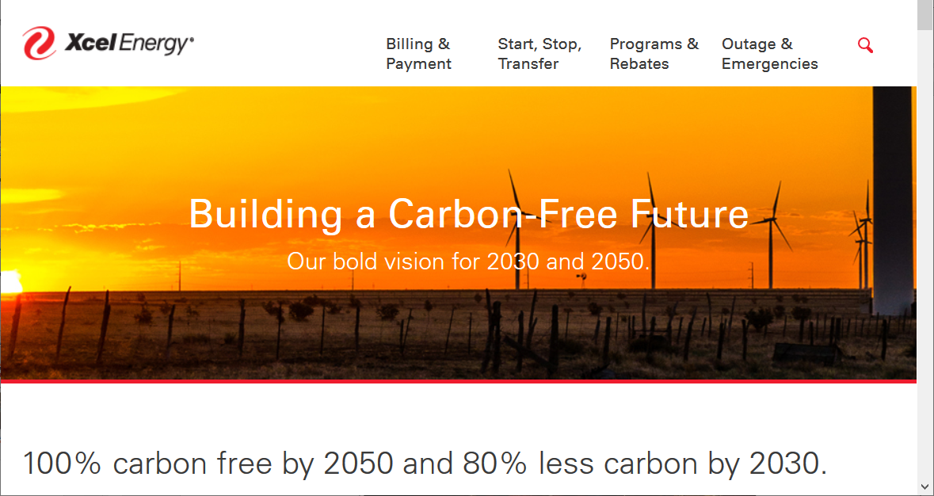
Xcel Energy plans
https://www.xcelenergy.com/environment/carbon_reduction_plan

Slide 51
What to do

Slide 52
What can be done (globally)?
Reduce emissions of greenhouse gases
  Use less energy; increase energy efficiency
  Renewable energy sources (wind, solar, waves)
  Reduce burning of fossil fuels (esp. coal & oil)
Carbon capture & sequestration
Educate people (especially women/girls)
  Family planning, better farming practices, etc.
Changes to land management & the food system
  Eat local & lower on the food chain; waste less

Slide 53
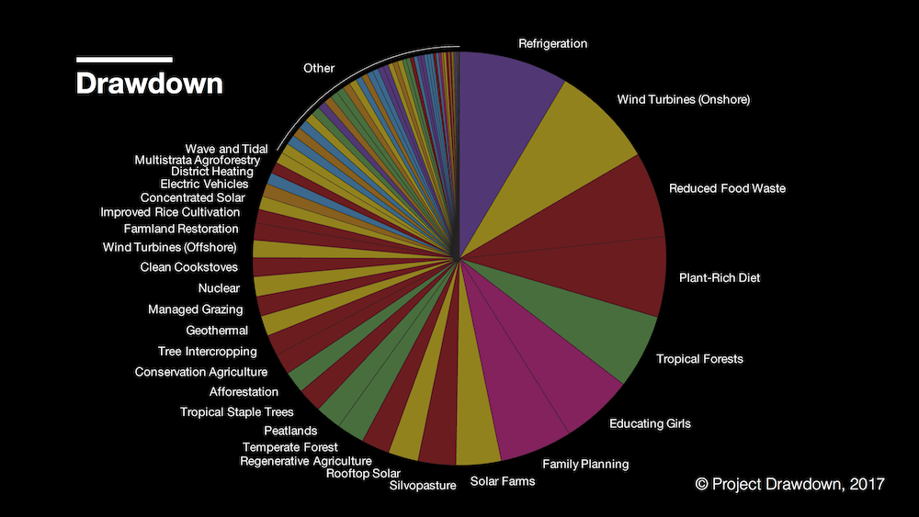
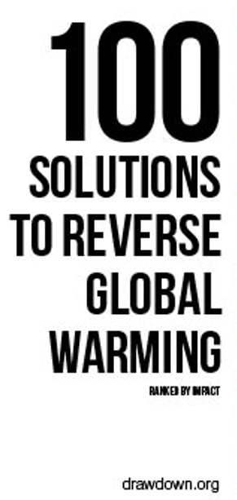

Slide 54
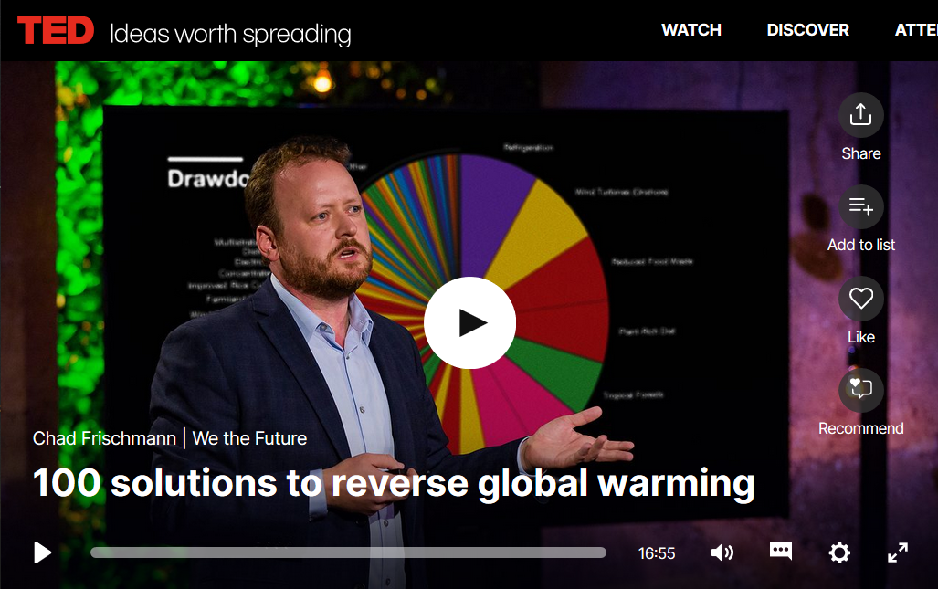
https://www.ted.com/talks/chad_frischmann_100_solutions_to_climate_change

Slide 55
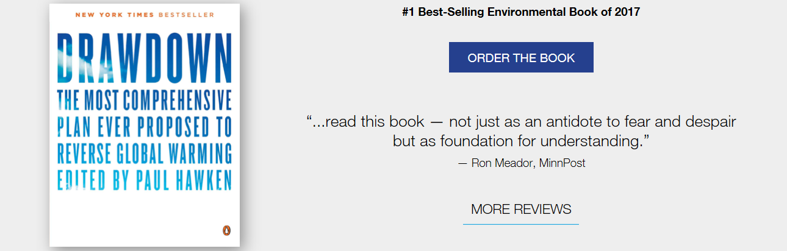
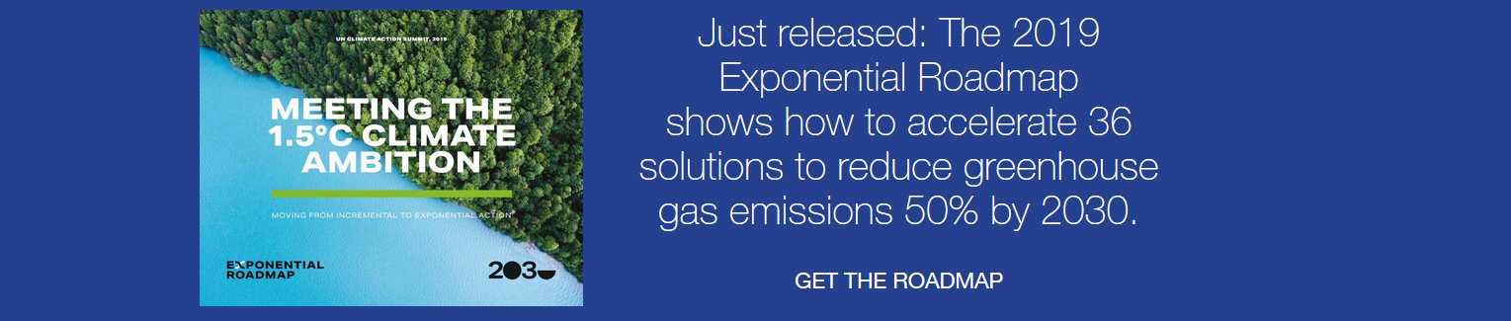
https://www.drawdown.org/

Slide 56
What can be done (personally)?
Learn even more – e.g. books, TED talks, lectures
Talk about Global Warming and Climate Change
Consider both when making personal decisions
  What to buy, how to get around
  What people & causes to support / vote for
Act to enable “global” solutions when you can
  Energy: increase efficiency, use renewables
  Farming & food: waste less, eat less meat

Slide 57
Don’t get discouraged; be hopeful, but persistent
Do what you can,
when you can,
as often as you can.

Slide 59

Broadcast in May 2014

Slide 61
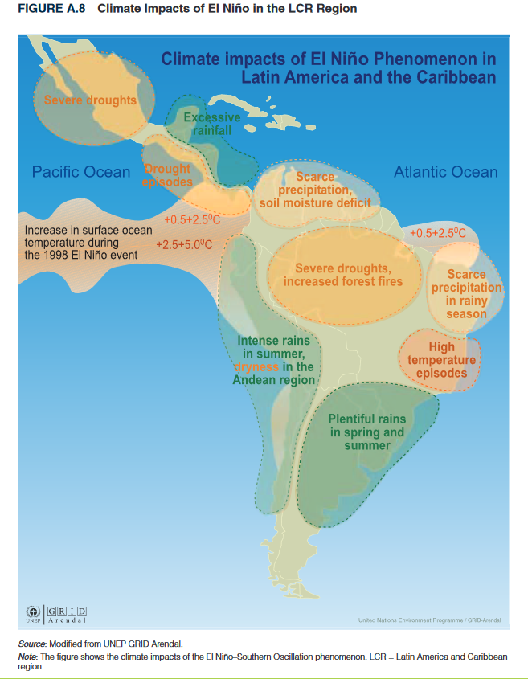
Some consequences of Global Warming
Polar ice melting
Sea level rise
Extreme weather
(more strong storms,
wild fires, floods, and
severe droughts)
Agricultural issues
Spread of diseases
Loss of biodiversity
Global
Climate
Change

Slide 62
Consequences contd: “a threat multiplier”
Access to clean water reduced
Ability to reliably grow food reduced
Increasing numbers of climate migrants
Economic impacts, especially to the poor
Increasing rates of poverty
Induced social/political instability
Negative impacts on human health
Wide disparities in vulnerability (& culpability)

