Slide 1
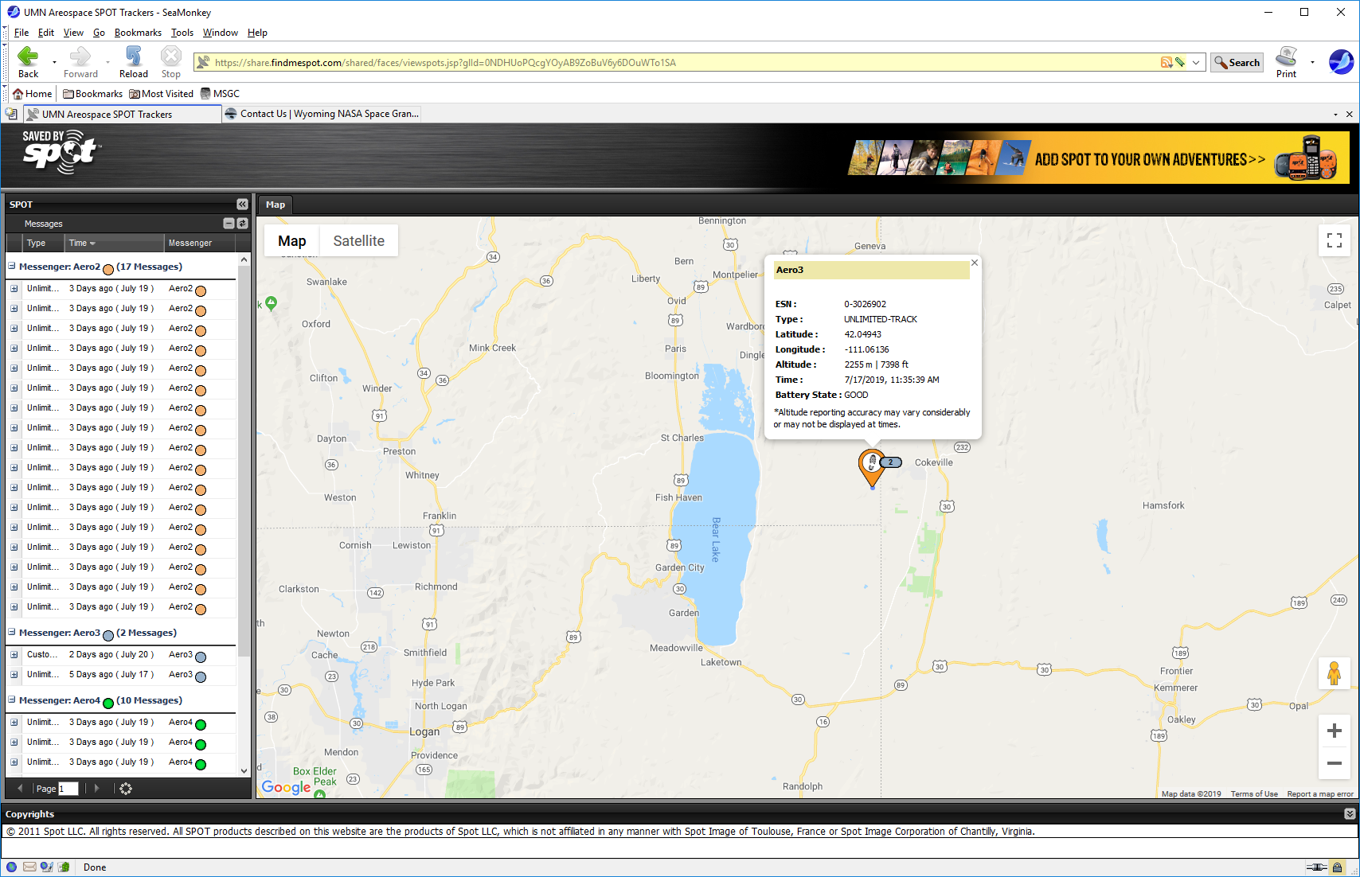
Location of lost U of MN balloon payload James Flaten, MN Space Grant, flate001@umn.edu, 651-399-2423

