Slide 1
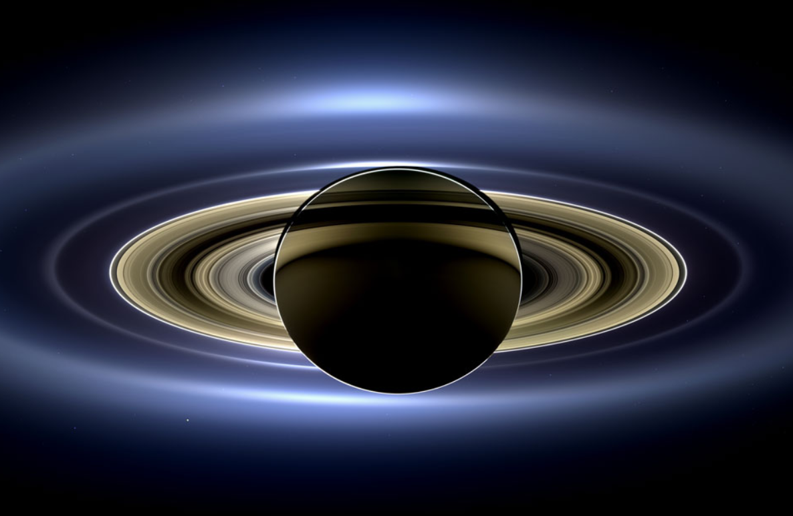
Holden Evening Prayer (Plus Astronomical Images)
Image: Cassini, NASA, ESA apod.nasa.gov/apod/ap131113.html
Notes:
Saturn (from within its shadow), taken by Cassini
NASA Astronomy Photo of the Day - https://apod.nasa.gov/apod/ap131113.html
Image Credit: Cassini Imaging Team, SSI, JPL, ESA, NASA
Vespers ‘86 (AKA Holden Evening Prayer) by Marty Haugen. Music available from GIA Publications, Inc. www.giamusic.com.
Images selected by James Flaten <flate001@umn.edu>, MN Space Grant Consortium, University of Minnesota – Twin Cities.

Slide 2
Notes about doing Holden Evening Prayer (Plus Astronomical Images) by J. Flaten:
Using astronomical projections to accompany Marty Haugen’s “Vespers ‘86” (AKA “Holden Evening Prayer”) (music available from GIA Publications, Inc. www.giamusic.com) was inspired by “Night Songs” choir + poetry reading events at University Lutheran Church of Hope (ULCH) www.ulch.org in Minneapolis, MN. These astronomical slides were organized by James Flaten flate001@umn.edu, ULCH choir member, Associate Director of the MN Space Grant Consortium, and Aerospace Engineering contract faculty at the U of MN – Twin Cities.
We encourage doing Holden Evening Prayer this way in as complete-darkness as is practical, such as after dark or else in a fully-darkenable space. Since all lyrics are shown on the screen, there is no need to distribute sheet music (except to musicians, who may need to use book lights). Of course this works best if the congregation knows the music and can sing along with just projected lyrics. This allows them to take in the images better as well. We also encourage using a projection screen that is as large as is practical for the space – we use an oversize screen that is much larger than our sanctuary would typically “merit” – since the images are of fundamentally-large, awe-inspiring objects.
Slides 3-10 are for use during a prelude, if any. Slide 4, in particular, can be customized to suit the occasion. Slide 23 is for a transition into the psalmody – the division of the congregation for the round can be announced then, or else before the service begins. Slides 33-37 are for five short readings (see text in Powerpoint notes) and may need to be adjusted, especially if other (fewer) readings are selected. Slide 47 is another transition slide, and can be omitted if desired. Slide 51 should be edited if you have just the cantor sing the Final Blessing, rather than the entire congregation. The service can end on slide 52 or slide 53, but please leave slide 53 in place (for completeness).
These slides use a “Standard (4:3)” aspect ratio and may require modification to be shown in “Widescreen (16:9)” mode. Font size may require adjustment, depending on the relative size of the projection screen and the worship space. Too large is better than too small.
Requests:
If you use these slides, please send a note indicating when and where to James Flaten flate001@umn.edu. Consultation welcome as well.
If you add or modify the astronomical images used, please stick to images allowed for public use and include links to image sources. NASA images generally may be used for non-commercial purposes (with credit) – see https://www.nasa.gov/multimedia/guidelines/index.html.
Please leave this notes page in place, as well the last slide, if you re-post or distribute these slides. Powerpoint format is encouraged, rather than pdf format, since the slides are easier to customize and to project, and also the notes on individual slides can then be included.
Notes:
Please leave this notes page in place, as well the last slide, if you re-post or distribute these slides. Distribution in Powerpoint format is better than in pdf format since the slides are then easier to customize and project and the notes on individual slides are also included.

Slide 3
Holden Evening Prayer (Plus Astronomical Images)
Image: Cassini, NASA, ESA apod.nasa.gov/apod/ap131113.html
Notes:
Saturn (from within its shadow), taken by Cassini
NASA Astronomy Photo of the Day - https://apod.nasa.gov/apod/ap131113.html
Image Credit: Cassini Imaging Team, SSI, JPL, ESA, NASA
First slide of prelude, if any.

Slide 4
May these awe-inspiring images
enhance your appreciation
of the beauty of the universe
as we sing this vespers service.
Notes:
Optional – customize text as desired.

Slide 5
Image: Cassini, NASA, ESA apod.nasa.gov/apod/ap131113.html
Notes:
Saturn (from within its shadow), taken by Cassini
NASA Astronomy Photo of the Day - https://apod.nasa.gov/apod/ap131113.html
Image Credit: Cassini Imaging Team, SSI, JPL, ESA, NASA

Slide 6
The heavens declare
the glory of God,
and the sky proclaims
its maker’s handiwork.
– Psalm 19:1

Slide 7
Image: Cassini, NASA, ESA zoom in on apod.nasa.gov/apod/ap131113.html
Notes:
Saturn (from within its shadow), taken by Cassini
NASA Astronomy Photo of the Day - https://apod.nasa.gov/apod/ap131113.html (zoom in)
Image Credit: Cassini Imaging Team, SSI, JPL, ESA, NASA

Slide 8
The Earth,
as viewed
from Saturn.
Image: Cassini, NASA, ESA zoom in on apod.nasa.gov/apod/ap131113.html
Notes:
Saturn (from within its shadow), taken by Cassini
NASA Astronomy Photo of the Day - https://apod.nasa.gov/apod/ap131113.html (zoom in)
Image Credit: Cassini Imaging Team, SSI, JPL, ESA, NASA

Slide 9
The beauty of the firmament
exceeds even that
envisioned by the psalmist…

Slide 10
Holden Evening Prayer (Plus Astronomical Images)
Image: Cassini, NASA, ESA apod.nasa.gov/apod/ap131113.html
Notes:
Saturn (from within its shadow), taken by Cassini
NASA Astronomy Photo of the Day - https://apod.nasa.gov/apod/ap131113.html
Image Credit: Cassini Imaging Team, SSI, JPL, ESA, NASA
Last slide of prelude, if any.

Slide 11
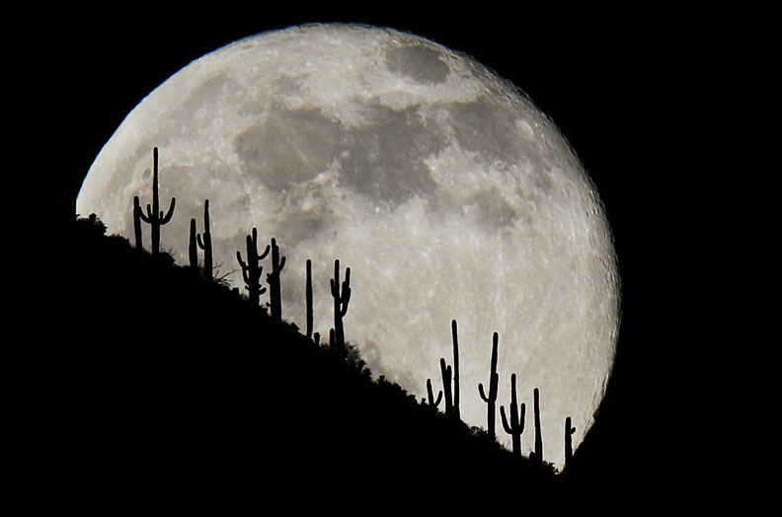
Procession Holden Evening Prayer
Jesus Christ, you are the light of the world;
the light no darkness can overcome;
Image: Rob Schumacher, The Republic www.azcentral.com/picture-gallery/news/local/phoenix/2014/06/13/13-stunning-full-moon-photos-from-republic-staff/10344765/
Notes:
Moon rising
https://www.azcentral.com/picture-gallery/news/local/phoenix/2014/06/13/13-stunning-full-moon-photos-from-republic-staff/10344765/
Image Credit & Copyright: Rob Schumacher, The Republic
First slide of actual service.

Slide 12
Procession Holden Evening Prayer
Stay with us now, for it is evening,
and the day is almost over.
Image: Rob Schumacher, The Republic www.azcentral.com/picture-gallery/news/local/phoenix/2014/06/13/13-stunning-full-moon-photos-from-republic-staff/10344765/
Notes:
Moon rising
https://www.azcentral.com/picture-gallery/news/local/phoenix/2014/06/13/13-stunning-full-moon-photos-from-republic-staff/10344765/
Image Credit & Copyright: Rob Schumacher, The Republic

Slide 13
Procession Holden Evening Prayer
Let your light scatter the darkness,
and shine within your people here.
Image: Rob Schumacher, The Republic www.azcentral.com/picture-gallery/news/local/phoenix/2014/06/13/13-stunning-full-moon-photos-from-republic-staff/10344765/
Notes:
Moon rising
https://www.azcentral.com/picture-gallery/news/local/phoenix/2014/06/13/13-stunning-full-moon-photos-from-republic-staff/10344765/
Image Credit & Copyright: Rob Schumacher, The Republic

Slide 14
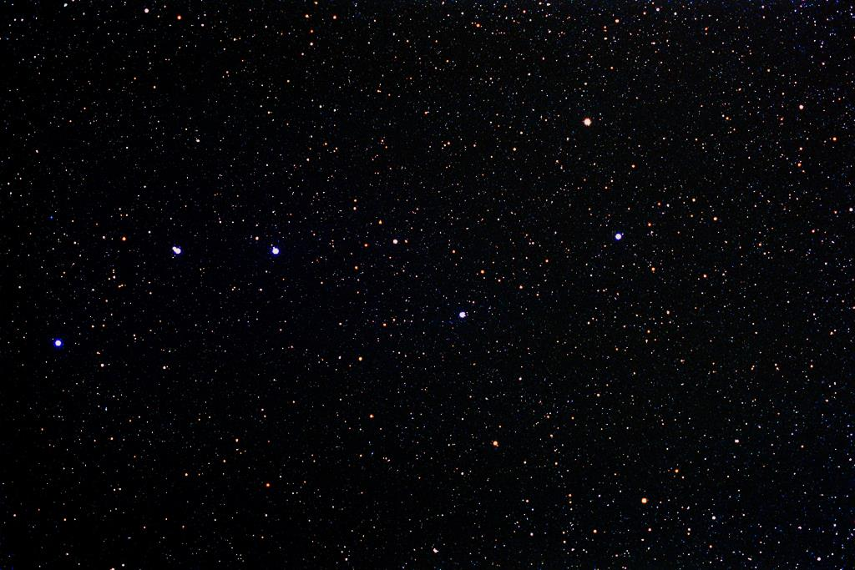
Evening Hymn Holden Evening Prayer
VERSE 1
Joyous light of heav’nly glory,
loving glow of God’s own face,
you who sing creation’s story,
shine on ev’ry land and race.
Image: T. Credner & S. Kohle www.allthesky.com/constellations/ursamajor/
Notes:
Big Dipper (asterism)
http://www.allthesky.com/constellations/ursamajor/
Image Credit & Copyright: T. Credner & S. Kohle, AlltheSky.com, http://wwww.allthesky.com/copyright.html
Till Credner <credner@allthesky.com>, Sven Kohle <kohle@allthesky.com>

Slide 15
Evening Hymn Holden Evening Prayer
VERSE 1 contd.
Now as evening falls around us,
we shall raise our songs to you,
God of daybreak, God of shadows,
come and light our hearts anew.
Image: T. Credner & S. Kohle www.allthesky.com/constellations/ursamajor/
Notes:
Big Dipper (asterism)
http://www.allthesky.com/constellations/ursamajor/
Image Credit & Copyright: T. Credner & S. Kohle, AlltheSky.com, http://wwww.allthesky.com/copyright.html
Till Credner <credner@allthesky.com>, Sven Kohle <kohle@allthesky.com>

Slide 16
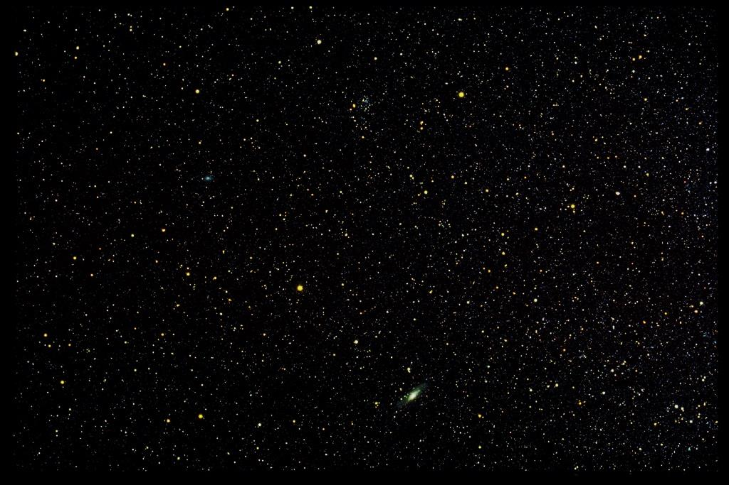
Evening Hymn Holden Evening Prayer
VERSE 2
In the stars that grace the darkness,
in the blazing sun of dawn,
in the light of peace and wisdom,
we can hear your quiet song.
Image: T. Credner & S. Kohle www.allthesky.com/constellations/andromeda/
Notes:
Andromeda (constellation and galaxy)
http://www.allthesky.com/constellations/andromeda/
Image Credit & Copyright: T. Credner & S. Kohle, AlltheSky.com, http://wwww.allthesky.com/copyright.html
Till Credner <credner@allthesky.com>, Sven Kohle <kohle@allthesky.com>

Slide 17
Evening Hymn Holden Evening Prayer
VERSE 2 contd.
Love that fills the night with wonder,
love that warms the weary soul,
love that bursts all chains asunder,
set us free and make us whole.
Image: T. Credner & S. Kohle www.allthesky.com/constellations/andromeda/
Notes:
Andromeda (constellation and galaxy)
http://www.allthesky.com/constellations/andromeda/
Image Credit & Copyright: T. Credner & S. Kohle, AlltheSky.com, http://wwww.allthesky.com/copyright.html
Till Credner <credner@allthesky.com>, Sven Kohle <kohle@allthesky.com>

Slide 18
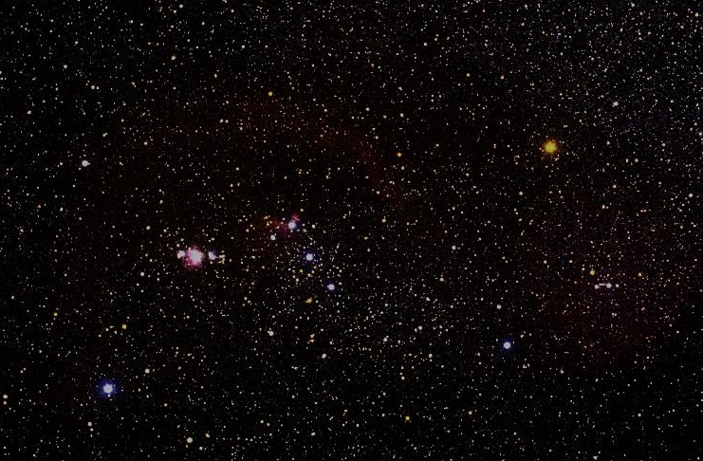
Evening Hymn Holden Evening Prayer
VERSE 3
You who made the heaven’s splendor,
ev’ry dancing star of night,
make us shine with gentle justice,
let us each reflect your light.
Image: T. Credner & S. Kohle www.allthesky.com/constellations/orion/
Notes:
Orion (constellation)
http://www.allthesky.com/constellations/orion/
Image Credit & Copyright: T. Credner & S. Kohle, AlltheSky.com, http://wwww.allthesky.com/copyright.html
Till Credner <credner@allthesky.com>, Sven Kohle <kohle@allthesky.com>

Slide 19
Evening Hymn Holden Evening Prayer
VERSE 3 contd.
Mighty God of all creation,
gentle Christ who lights our way,
Loving Spirit of salvation,
lead us on to endless day.
Image: T. Credner & S. Kohle www.allthesky.com/constellations/orion/
Notes:
Orion (constellation)
http://www.allthesky.com/constellations/orion/
Image Credit & Copyright: T. Credner & S. Kohle, AlltheSky.com, http://wwww.allthesky.com/copyright.html
Till Credner <credner@allthesky.com>, Sven Kohle <kohle@allthesky.com>

Slide 20
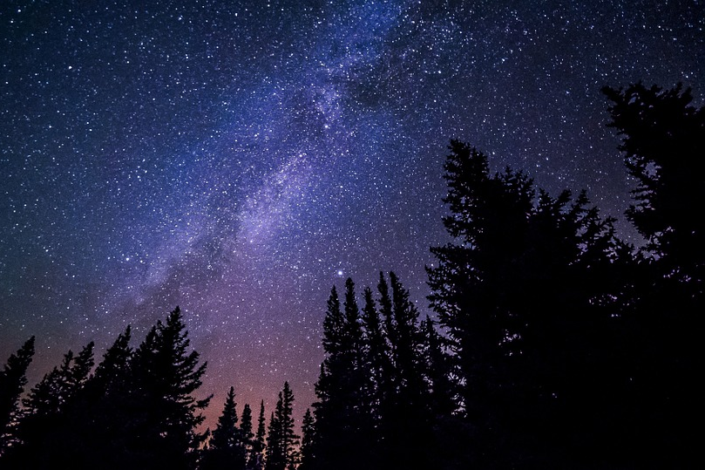
Evening Thanksgiving Holden Evening Prayer
May God be with you all,
and also with you;
Image: Pixabay pixabay.com/en/milky-way-galaxy-night-sky-stars-984050/
Notes:
Milky Way Galaxy
https://pixabay.com/en/milky-way-galaxy-night-sky-stars-984050/
Image Credit: released by Pixabay under Creative Commons CC0 (public domain)

Slide 21
Evening Thanksgiving Holden Evening Prayer
Let us sing our thanks to God.
It is right to give God thanks and praise.
Image: Pixabay pixabay.com/en/milky-way-galaxy-night-sky-stars-984050/
Notes:
Milky Way Galaxy
https://pixabay.com/en/milky-way-galaxy-night-sky-stars-984050/
Image Credit: released by Pixabay under Creative Commons CC0 (public domain)

Slide 22
Evening Thanksgiving Holden Evening Prayer
Blessed are you, Creator of the Universe …
…you are the light and life of all creation.
Amen.
Image: Pixabay pixabay.com/en/milky-way-galaxy-night-sky-stars-984050/
Notes:
Milky Way Galaxy
https://pixabay.com/en/milky-way-galaxy-night-sky-stars-984050/
Image Credit: released by Pixabay under Creative Commons CC0 (public domain)

Slide 23
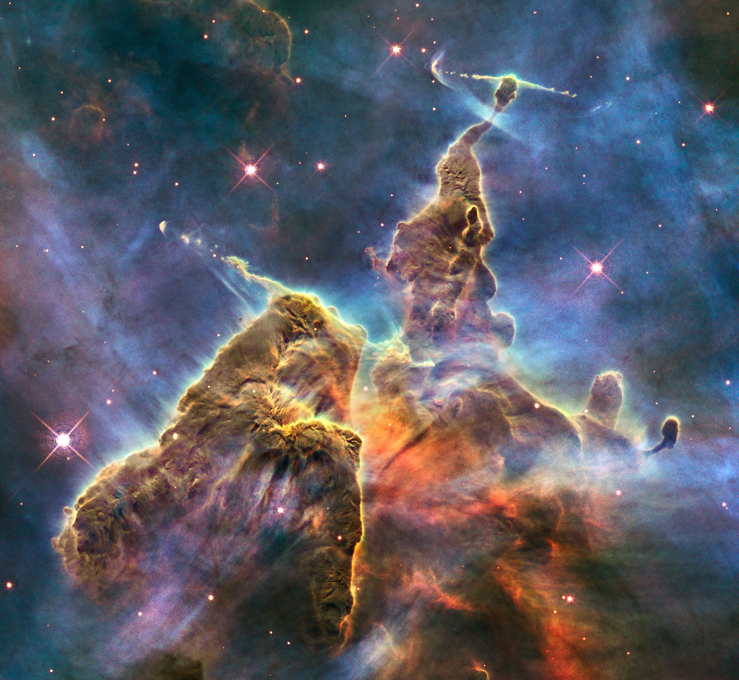
Image: Hubble, NASA, ESA apod.nasa.gov/apod/ap170702.html
Notes:
Carina Nebula (AKA “Mystic Mountain”) (NGC 3372), taken by Hubble
NASA Astronomy Photo of the Day - https://apod.nasa.gov/apod/ap170702.html
Image Credit: NASA, ESA, and M. Livio (STScI)
Transition slide - announce who sings which part of the Psalm canon now, or before the service.

Slide 24
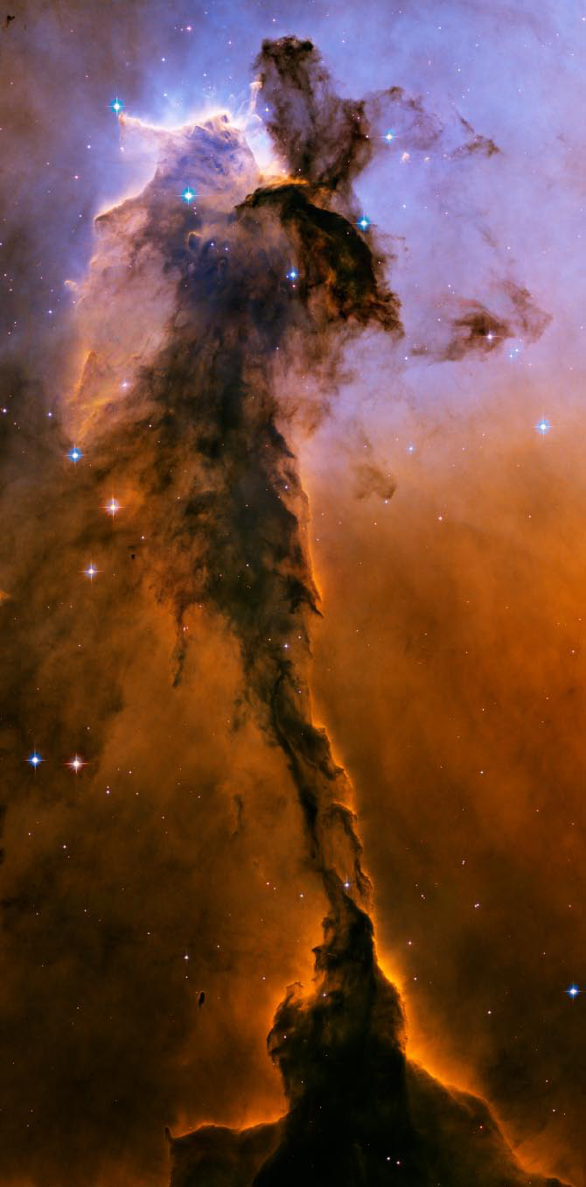
Psalm 141 Holden Evening Prayer
Sing in unison
Let my prayer rise up
like incense before you,
the lifting up of my hands
as an offering to you.
Image: Hubble, NASA, ESA apod.nasa.gov/apod/ap130929.html
Notes:
The Fairy (dust pillar) of the Eagle Nebula (M16), taken by Hubble
NASA Astronomy Photo of the Day - https://apod.nasa.gov/apod/ap130929.html
Image Credit: The Hubble Heritage Team, (STScI/AURA), ESA, NASA

Slide 25
Psalm 141 Holden Evening Prayer
Sing as a canon
O God, I call to you,
come to me now;
O hear my voice
when I cry to you.
Image: Hubble, NASA, ESA apod.nasa.gov/apod/ap130929.html
Notes:
The Fairy (dust pillar) of the Eagle Nebula (M16), taken by Hubble
NASA Astronomy Photo of the Day - https://apod.nasa.gov/apod/ap130929.html
Image Credit: The Hubble Heritage Team, (STScI/AURA), ESA, NASA

Slide 26
Psalm 141 Holden Evening Prayer
Sing as a canon
Let my prayer rise up
like incense before you,
the lifting up of my hands
as an offering to you.
Image: Hubble, NASA, ESA apod.nasa.gov/apod/ap130929.html
Notes:
The Fairy (dust pillar) of the Eagle Nebula (M16), taken by Hubble
NASA Astronomy Photo of the Day - https://apod.nasa.gov/apod/ap130929.html
Image Credit: The Hubble Heritage Team, (STScI/AURA), ESA, NASA

Slide 27
Psalm 141 Holden Evening Prayer
Sing as a canon
Keep watch within me God;
deep in my heart
may the light of your love
be burning bright.
Image: Hubble, NASA, ESA apod.nasa.gov/apod/ap130929.html
Notes:
The Fairy (dust pillar) of the Eagle Nebula (M16), taken by Hubble
NASA Astronomy Photo of the Day - https://apod.nasa.gov/apod/ap130929.html
Image Credit: The Hubble Heritage Team, (STScI/AURA), ESA, NASA

Slide 28
Psalm 141 Holden Evening Prayer
Sing as a canon
Let my prayer rise up
like incense before you,
the lifting up of my hands
as an offering to you.
Image: Hubble, NASA, ESA apod.nasa.gov/apod/ap130929.html
Notes:
The Fairy (dust pillar) of the Eagle Nebula (M16), taken by Hubble
NASA Astronomy Photo of the Day - https://apod.nasa.gov/apod/ap130929.html
Image Credit: The Hubble Heritage Team, (STScI/AURA), ESA, NASA

Slide 29
Psalm 141 Holden Evening Prayer
Sing as a canon
All praise to the God of all –
Creator of life;
all praise be to Christ
and the spirit of love.
Image: Hubble, NASA, ESA apod.nasa.gov/apod/ap130929.html
Notes:
The Fairy (dust pillar) of the Eagle Nebula (M16), taken by Hubble
NASA Astronomy Photo of the Day - https://apod.nasa.gov/apod/ap130929.html
Image Credit: The Hubble Heritage Team, (STScI/AURA), ESA, NASA

Slide 30
Psalm 141 Holden Evening Prayer
Sing as a canon
Let my prayer rise up
like incense before you,
the lifting up of my hands
as an offering to you.
Image: Hubble, NASA, ESA apod.nasa.gov/apod/ap130929.html
Notes:
The Fairy (dust pillar) of the Eagle Nebula (M16), taken by Hubble
NASA Astronomy Photo of the Day - https://apod.nasa.gov/apod/ap130929.html
Image Credit: The Hubble Heritage Team, (STScI/AURA), ESA, NASA

Slide 31
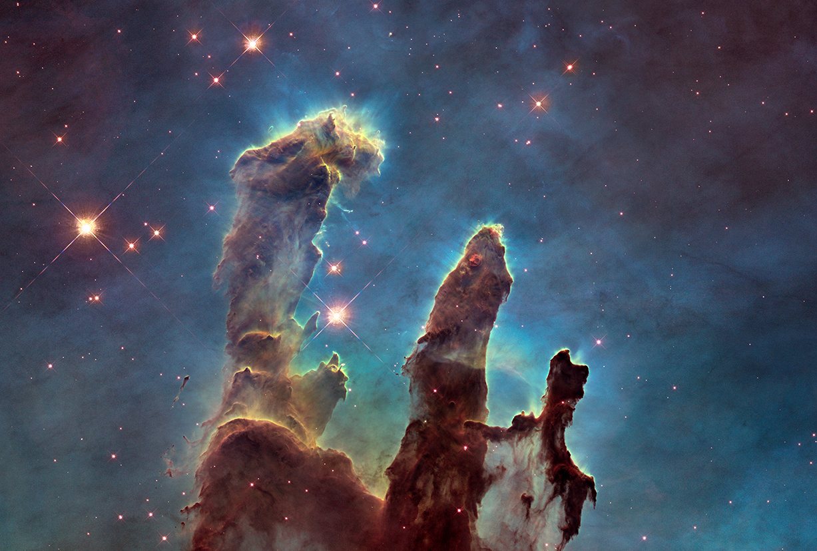
Meditation Holden Evening Prayer
Image: Hubble, NASA, ESA zoom in on apod.nasa.gov/apod/ap150107.html
Notes:
“Pillars of Creation” in the Eagle Nebula (M16), taken by Hubble
NASA Astronomy Photo of the Day - https://apod.nasa.gov/apod/ap150107.html (zoom in)
Image Credit: NASA, ESA, and The Hubble Heritage Team (STScI/AURA)
Transition before the Meditation (same image).

Slide 32
Meditation Holden Evening Prayer
May our prayers come before you, O God, as incense… and your love in our lives.
Amen.
Image: Hubble, NASA, ESA zoom in on apod.nasa.gov/apod/ap150107.html
Notes:
“Pillars of Creation” in the Eagle Nebula (M16), taken by Hubble
NASA Astronomy Photo of the Day - https://apod.nasa.gov/apod/ap150107.html (zoom in)
Image Credit: NASA, ESA, and The Hubble Heritage Team (STScI/AURA)

Slide 33
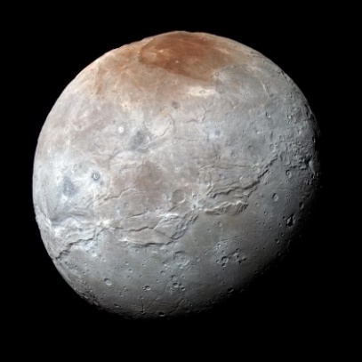
Readings and Canticles Holden Evening Prayer
Image: New Horizons, NASA www.nasa.gov/feature/new-horizons-top-10-pluto-pics
Notes:
Pluto and largest moon Charon (montage), taken by New Horizons in 2015
https://www.nasa.gov/feature/new-horizons-top-10-pluto-pics
Image Credit: New Horizons, NASA
Possible reading 1 (of 5):
A quote from Ecclesiastes
As you do not know the way the spirit comes to the bones in the womb of a woman with child, so you do not know the work of God who makes everything.

Slide 34
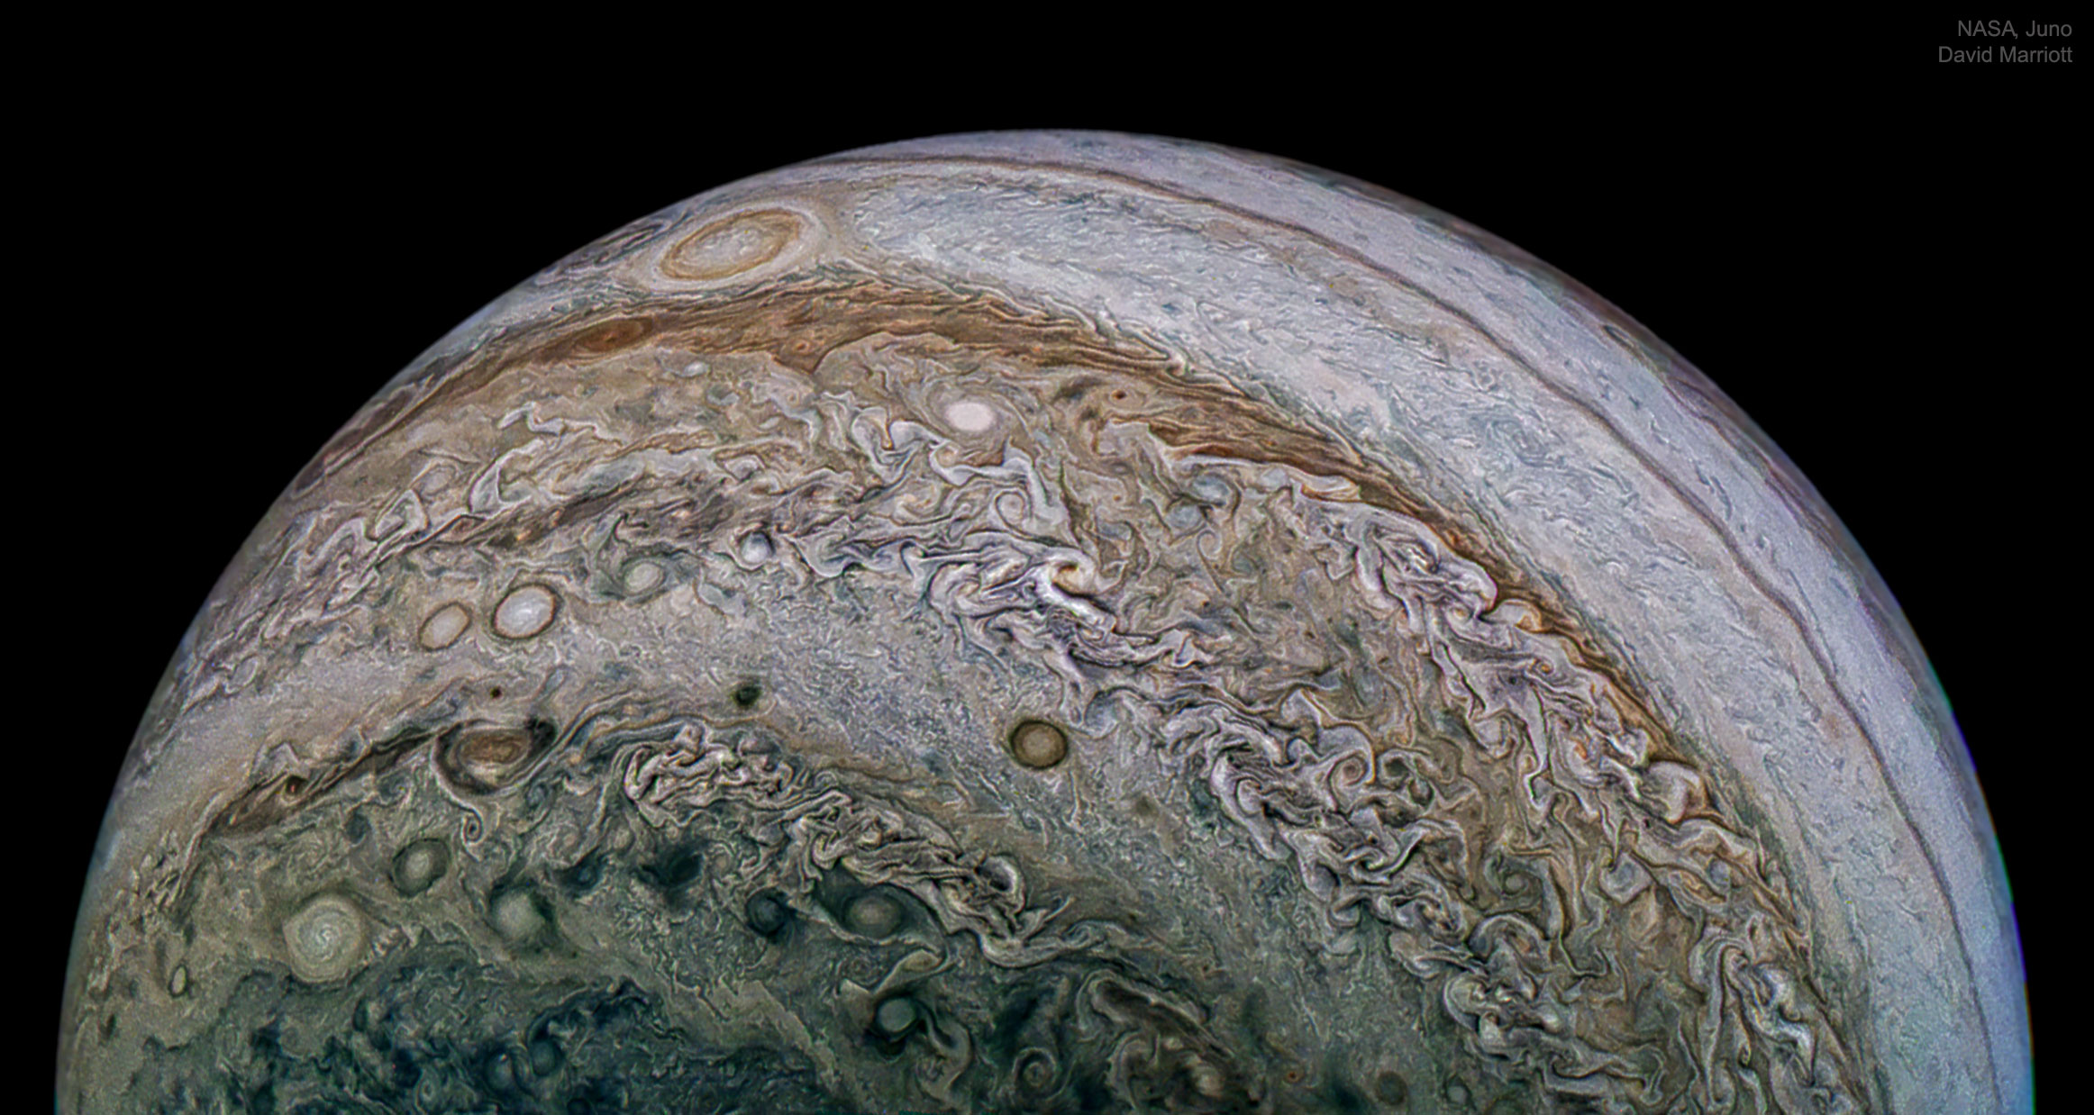
Readings and Canticles Holden Evening Prayer
Image: Juno, NASA apod.nasa.gov/apod/ap180605.html
Notes:
Jupiter (southern hemisphere complexity), taken by Juno
NASA Astronomy Photo of the Day - https://apod.nasa.gov/apod/ap180605.html
Image Credit: NASA, Juno, SwRI, MSSS; Composition: David Marriott
Possible reading 2 (of 5):
A quote from Chet Raymo, naturalist
Through our science we have created magnificent spacecraft and telescopes to explore the night and the light and the half light. We have made visible things that are invisible to the unaided eye. We have brought the dreamy heavens down to Earth, held them in the mind's eye. Our explorations have produced a vast archive of remarkable astronomical images... The riches are too many for choices, the revelations beautiful and dreadful. Who can look at these images and not be transformed? The heavens declare God's glory.

Slide 35
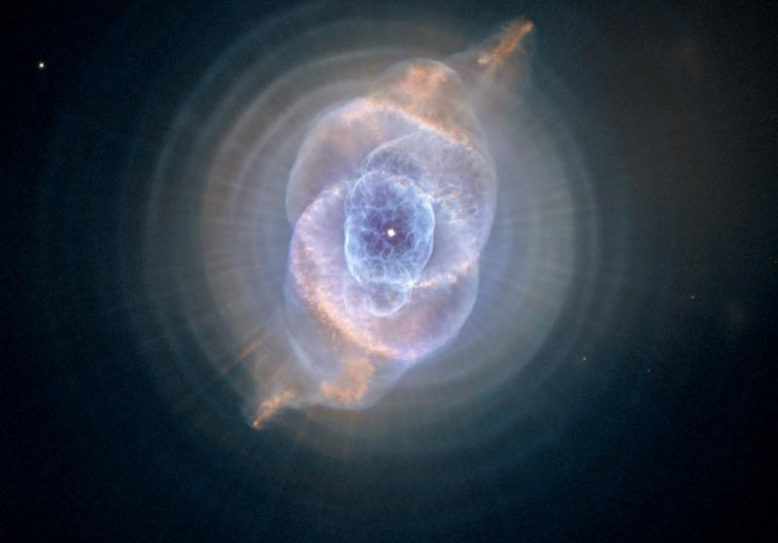
Readings and Canticles Holden Evening Prayer
Image: Hubble, NASA, ESA apod.nasa.gov/apod/ap180610.html
Notes:
Cat’s Eye (Planetary) Nebula, taken by Hubble
NASA Astronomy Photo of the Day - https://apod.nasa.gov/apod/ap180610.html
Image Credit: NASA, ESA, HEIC, and The Hubble Heritage Team (STScI/AURA)
Possible reading 3 (of 5):
A quote from Albert Einstein, scientist
The human mind is not capable of grasping the Universe. We are like a little child entering a huge library. The walls are covered to the ceilings with books in many different tongues. The child knows that someone must have written these books. It does not know who or how. It does not understand the languages in which they are written. But the child notes a definite plan in the arrangement of the books — a mysterious order which it does not comprehend, but only dimly suspects.

Slide 36
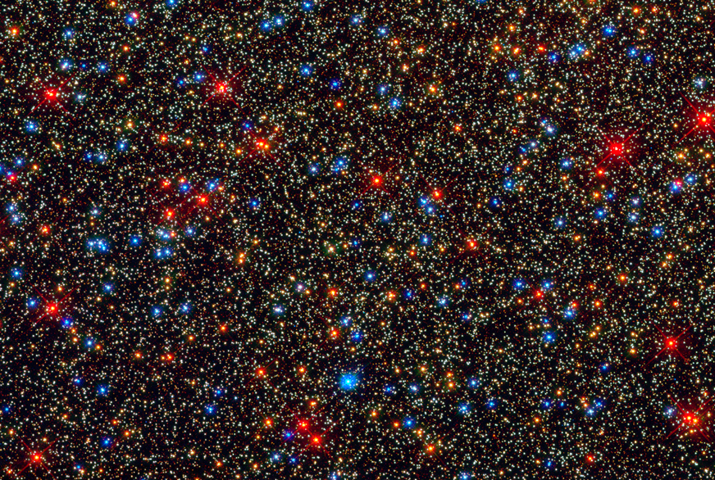
Readings and Canticles Holden Evening Prayer
Image: Hubble, NASA, ESA www.spacetelescope.org/images/heic0910g/
Notes:
Stars in globular cluster Omega Centauri, taken by Hubble
https://www.spacetelescope.org/images/heic0910g/
Image Credit: NASA, ESA and the Hubble SM4 ERO Team
Possible reading 4 (of 5):
A quote from Jane Goodall, primatologist
There are many windows through which we can look out into the world, searching for meaning … …Most of us, when we ponder on the meaning of our existence, peer through but one of these windows onto the world. And even that one is often misted over by the breath of our finite humanity. We clear a tiny peephole and stare through. No wonder we are confused by the tiny fraction of a whole that we see. It is, after all, like trying to comprehend the panorama of the desert or the sea through a rolled-up newspaper.

Slide 37
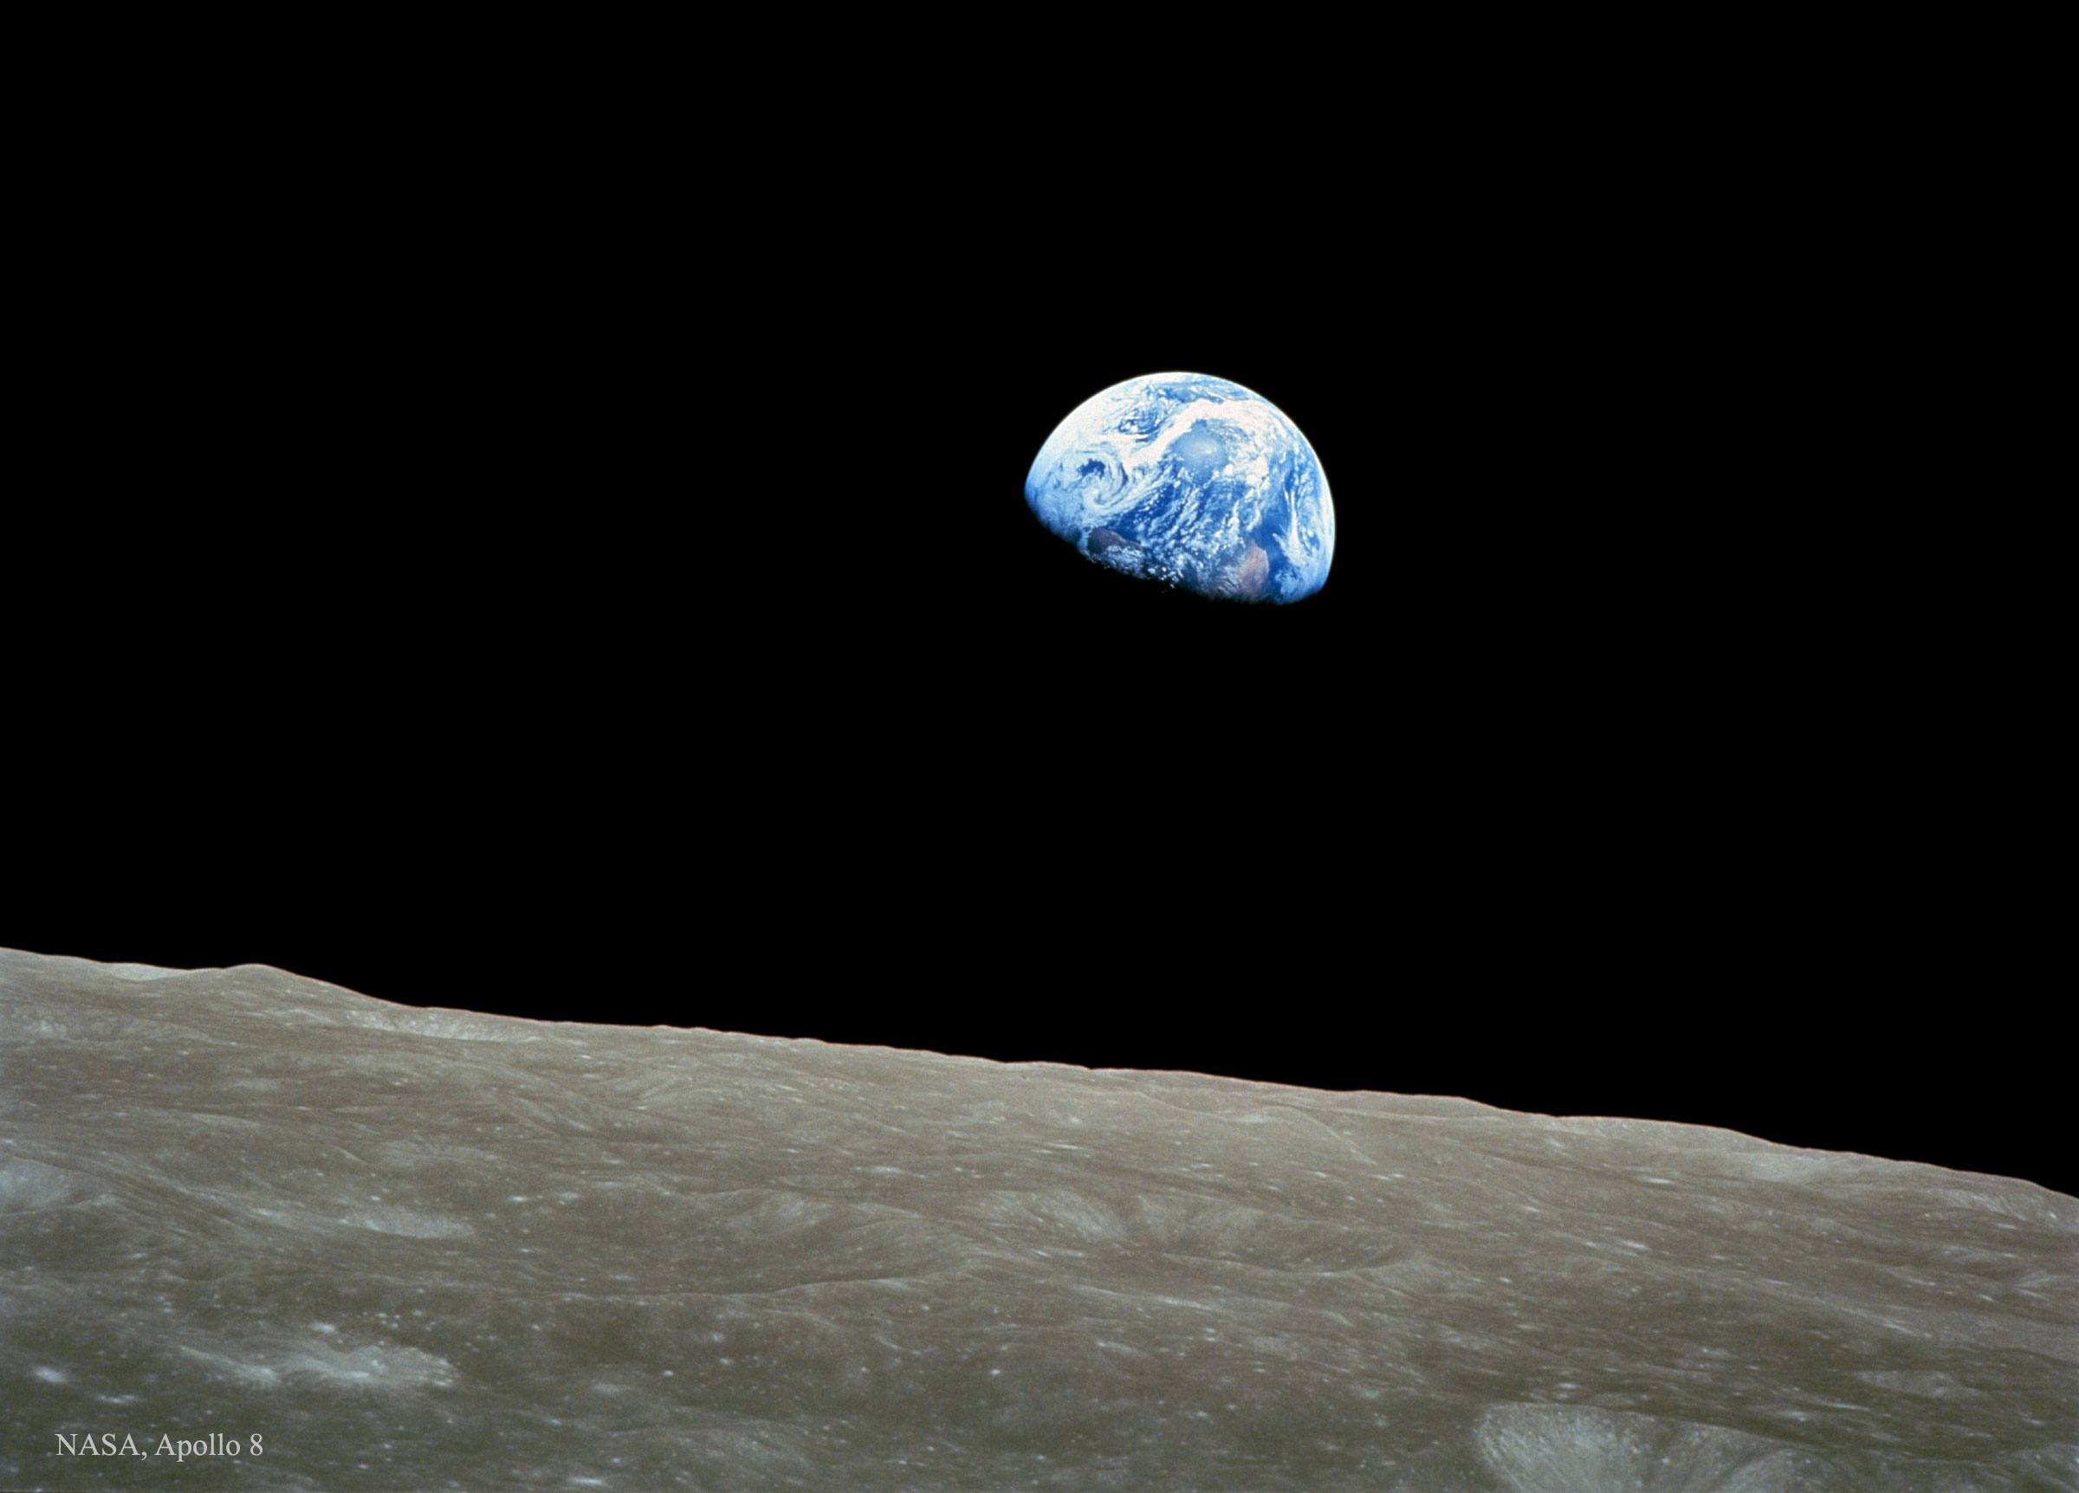
Readings and Canticles Holden Evening Prayer
Image: Apollo 8, NASA apod.nasa.gov/apod/ap150906.html
Notes:
Earthrise (over lunar horizon), taken by Apollo 8 on Christmas eve, 1968
NASA Astronomy Photo of the Day - https://apod.nasa.gov/apod/ap150906.html
Image Credit: Apollo 8, NASA
Possible reading 5 (of 5) – then proceed with service (same image):
A quote from James Irwin, Apollo 15 astronaut
The Earth reminded us of a Christmas tree ornament hanging in the blackness of space. As we got farther and farther away it diminished in size. Finally it shrank to the size of a marble, the most beautiful marble you can imagine. That beautiful, warm, living object looked so fragile, so delicate, that if you touched it with a finger it would crumble and fall apart. Seeing this has to change a man, has to make a man appreciate the creation of God and the love of God.

Slide 38
Readings and Canticles Holden Evening Prayer
The Light shines in the darkness
and the darkness has not overcome it.
Image: Apollo 8, NASA apod.nasa.gov/apod/ap150906.html
Notes:
Earthrise (over lunar horizon), taken by Apollo 8 on Christmas eve, 1968
NASA Astronomy Photo of the Day - https://apod.nasa.gov/apod/ap150906.html
Image Credit: Apollo 8, NASA

Slide 39
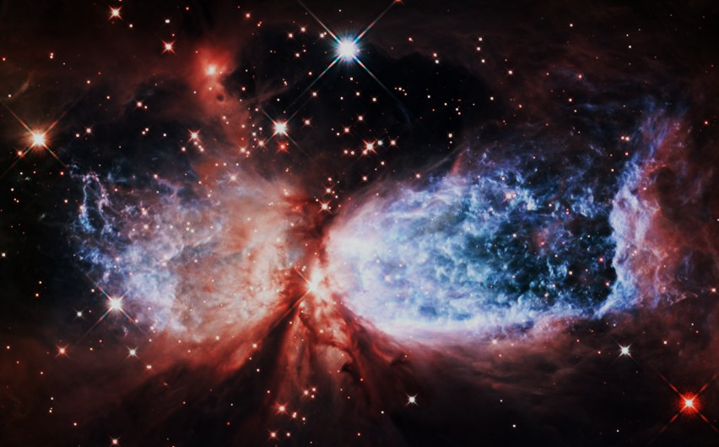
The Annunciation Holden Evening Prayer
An angel went from God… whose name was Mary… And Mary said… “I live to do your will.”
Image: Hubble, NASA, ESA www.nasa.gov/mission_pages/hubble/science/snow-angel.html
Notes:
Snow Angel Nebula (Star-Forming Region Sharpless 2-106), taken by Hubble
https://www.nasa.gov/mission_pages/hubble/science/snow-angel.html
Image Credit: NASA, ESA, and The Hubble Heritage Team (STScI/AURA)

Slide 40
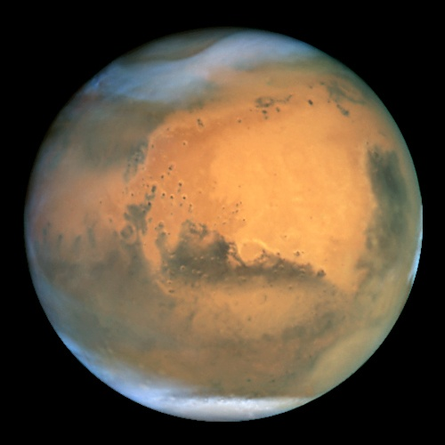
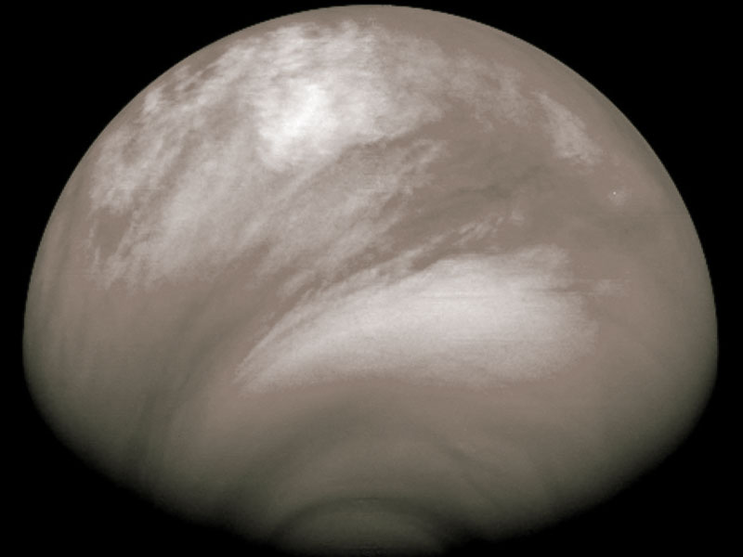
The Magnificat Holden Evening Prayer
VERSE 1
My soul proclaims your greatness, O God,
and my spirit rejoices in you.
You have looked with love on your servant here,
and blessed me all my life through.
Image: Venus Express, ESA apod.nasa.gov/apod/ap080226.html
Image: Hubble, NASA, ESA www.spacetelescope.org/images/opo0124a/
Notes:
Venus, taken by ESA’s Venus Express
NASA Astronomy Photo of the Day - https://apod.nasa.gov/apod/ap080226.html
Image Credit: ESA/MPS, Katlenburg-Lindau, Germany
Mars, taken by Hubble
https://www.spacetelescope.org/images/opo0124a/
Image Credit: NASA/ESA and The Hubble Heritage Team STScI/AURA

Slide 41
The Magnificat Holden Evening Prayer
V1 contd
Great and mighty are you, O Holy One,
strong is your kindness evermore.
How you favor the weak and lowly one,
humbling the proud of heart.
Image: Venus Express, ESA apod.nasa.gov/apod/ap080226.html
Image: Hubble, NASA, ESA www.spacetelescope.org/images/opo0124a/
Notes:
Venus, taken by ESA’s Venus Express
NASA Astronomy Photo of the Day - https://apod.nasa.gov/apod/ap080226.html
Image Credit: ESA/MPS, Katlenburg-Lindau, Germany
Mars, taken by Hubble
https://www.spacetelescope.org/images/opo0124a/
Image Credit: NASA/ESA and The Hubble Heritage Team STScI/AURA

Slide 42
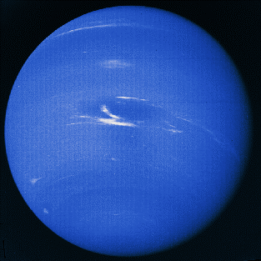
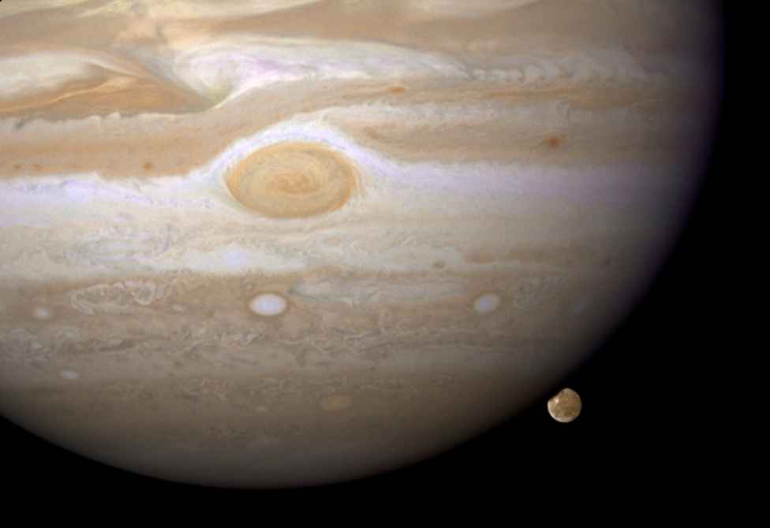
The Magnificat Holden Evening Prayer
VERSE 2
You have cast the mighty down from their thrones,
and uplifted the humble of heart,
You have filled the hungry with wondrous things,
and left the wealthy no part.
Image: Hubble, NASA, ESA apod.nasa.gov/apod/ap090106.html
Image: Voyager 2, NASA apod.nasa.gov/apod/ap980221.html
Notes:
Jupiter (and moon Ganymede), taken by Hubble
NASA Astronomy Photo of the Day - https://apod.nasa.gov/apod/ap090106.html
Image Credit: NASA, ESA, and E. Karkoschka (University of Arizona)
Neptune, taken by Voyager 2 in 1989
NASA Astronomy Photo of the Day - https://apod.nasa.gov/apod/ap980221.html
Image Credit: Voyager 2, NASA

Slide 43
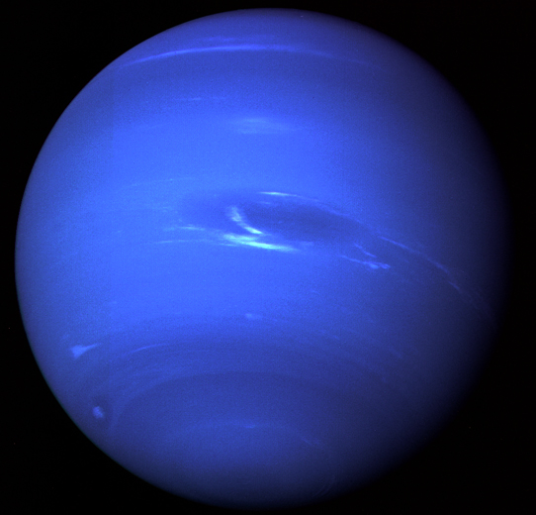
The Magnificat Holden Evening Prayer
V2 contd
Great and mighty are you, O Faithful One,
strong is your justice, strong your love.
As you promised to Sarah and Abraham,
kindness forevermore.
Image: Hubble, NASA, ESA apod.nasa.gov/apod/ap090106.html
Image: Voyager 2, NASA apod.nasa.gov/apod/ap980221.html
Notes:
Jupiter (and moon Ganymede), taken by Hubble
NASA Astronomy Photo of the Day - https://apod.nasa.gov/apod/ap090106.html
Image Credit: NASA, ESA, and E. Karkoschka (University of Arizona)
Neptune, taken by Voyager 2 in 1989
NASA Astronomy Photo of the Day - https://apod.nasa.gov/apod/ap980221.html
Image Credit: Voyager 2, NASA

Slide 44
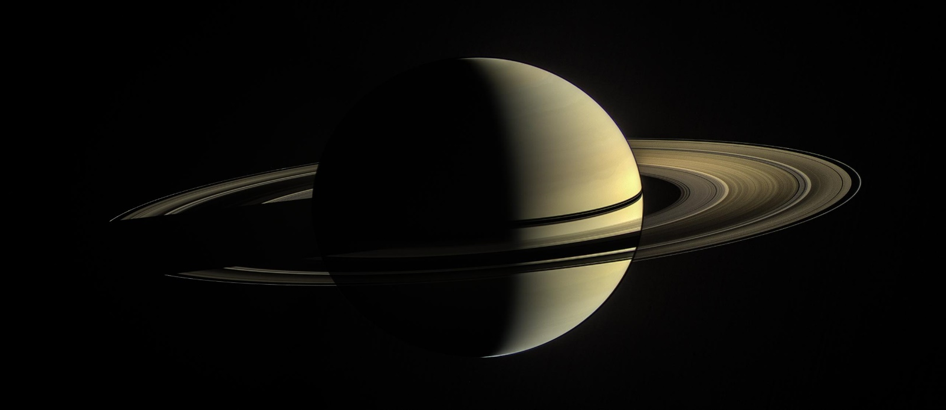
The Magnificat Holden Evening Prayer
VERSE 3
My soul proclaims your greatness, O God,
and my spirit rejoices in you.
You have looked with love on your servant here,
and blessed me all my life through.
Image: Cassini, NASA, ESA photojournal.jpl.nasa.gov/catalog/PIA12567
Notes:
Saturn, taken by Cassini
https://photojournal.jpl.nasa.gov/catalog/PIA12567
Image Credit: NASA/JPL-Caltech/Space Science Institute

Slide 45
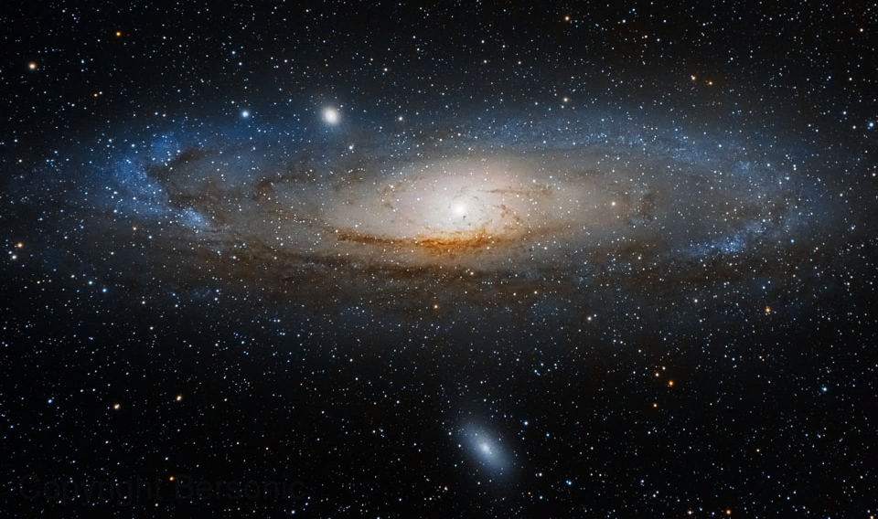
Litany and Prayers Holden Evening Prayer
Tune – then hum – then sing refrain
Hum during verses – then sing refrain
In peace, in peace, we pray to you: …
Image: Jacob Bers, Bersonic apod.nasa.gov/apod/ap140730.html
Notes:
Andromeda galaxy (M31)
NASA Astronomy Photo of the Day - https://apod.nasa.gov/apod/ap140730.html
Image Credit & Copyright: Jacob Bers (Bersonic)

Slide 46
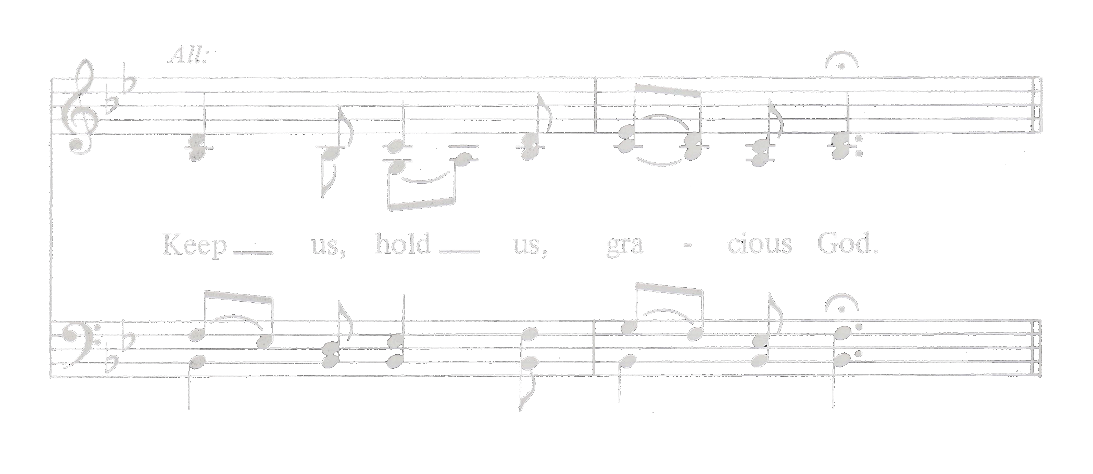
Litany and Prayers Holden Evening Prayer
Final verse and final refrain
Help us, comfort us, all of our days:
Image: Jacob Bers, Bersonic apod.nasa.gov/apod/ap140730.html
Notes:
Andromeda galaxy (M31)
NASA Astronomy Photo of the Day - https://apod.nasa.gov/apod/ap140730.html
Image Credit & Copyright: Jacob Bers (Bersonic)

Slide 47
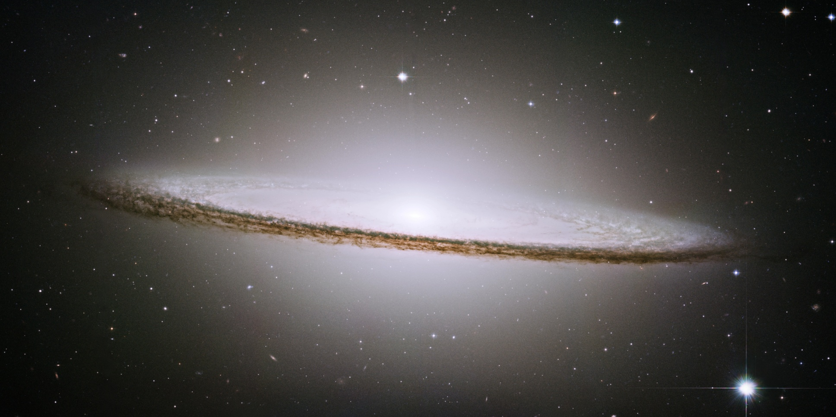
Closing Prayer Holden Evening Prayer
Image: Hubble, NASA, ESA apod.nasa.gov/apod/ap150726.html
Notes:
Sombrero galaxy (M104), taken by Hubble
NASA Astronomy Photo of the Day - https://apod.nasa.gov/apod/ap150726.html
Image Credit: Hubble Heritage Team (AURA/STScI/NASA)
Transition before the Closing Prayer (same image).

Slide 48
Closing Prayer Holden Evening Prayer
Great and merciful God, Source and Ground of all goodness and life…
…through Jesus Christ our Lord.
Amen.
Image: Hubble, NASA, ESA apod.nasa.gov/apod/ap150726.html
Notes:
Sombrero galaxy (M104), taken by Hubble
NASA Astronomy Photo of the Day - https://apod.nasa.gov/apod/ap150726.html
Image Credit: Hubble Heritage Team (AURA/STScI/NASA)

Slide 49
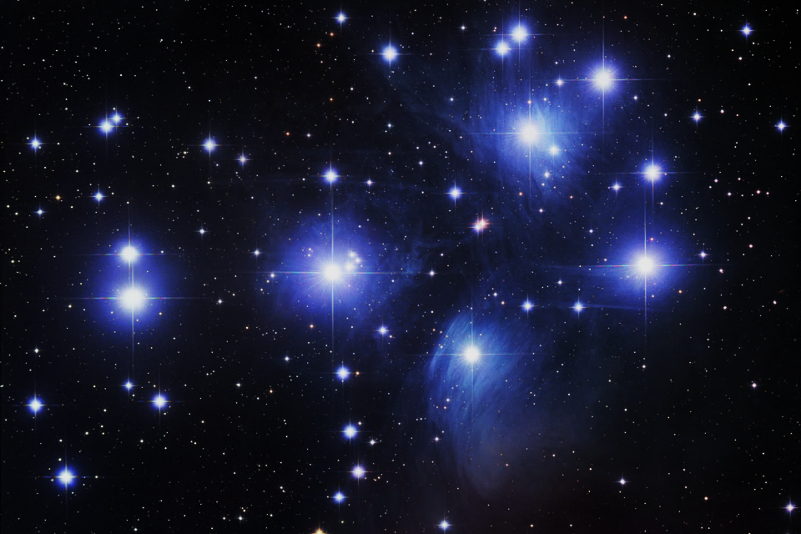
The Lord’s Prayer Holden Evening Prayer
God, remember us in your love, and teach us to pray:
Our Father in heaven, hallowed be your name.
Your Kingdom come: your will be done on earth as in heaven. Give us today our daily bread. Forgive us our sins as we forgive those who sin against us. Save us from the time of trial, and deliver us from evil. For the Kingdom, the power, and the glory are yours, now and forever. Amen.
Image: Robert Gendler apod.nasa.gov/apod/ap120903.html
Notes:
Pleiades M45 open star cluster (AKA the Seven Sisters)
NASA Astronomy Photo of the Day - https://apod.nasa.gov/apod/ap120903.html
Image Credit & Copyright: Robert Gendler

Slide 50
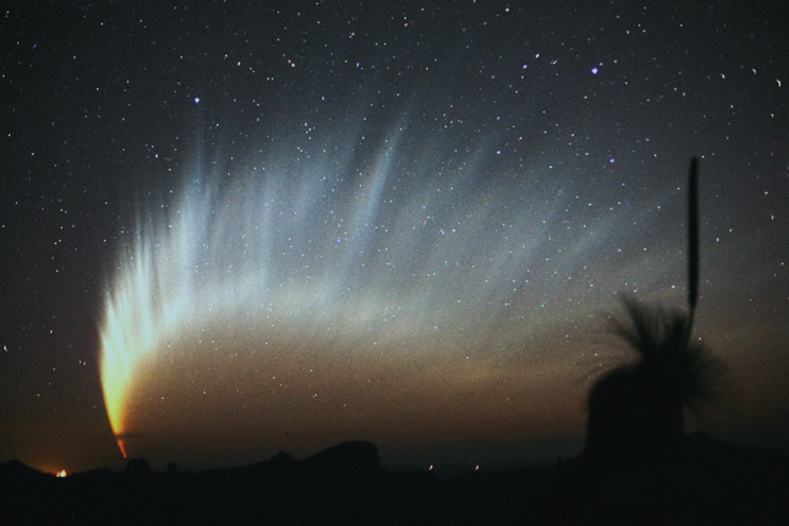
Final Blessing Holden Evening Prayer
Let us bless our God:
Praise and thanks to you.
Image: Robert H. McNaught apod.nasa.gov/apod/ap131117.html
Notes:
Comet McNaught (January 2007)
NASA Astronomy Photo of the Day - https://apod.nasa.gov/apod/ap131117.html
Image Credit & Copyright: Robert H. McNaught

Slide 51
Final Blessing Holden Evening Prayer
(ALL SING)
May God, Creator bless us and keep us,
may Christ be ever light for our lives,
may the Spirit of Love be our guide and path,
for all of our days.
Amen.
Image: Robert H. McNaught apod.nasa.gov/apod/ap131117.html
Notes:
Comet McNaught (January 2007)
NASA Astronomy Photo of the Day - https://apod.nasa.gov/apod/ap131117.html
Image Credit & Copyright: Robert H. McNaught
Modify text coloration (and perhaps shift to previous slide instead) if to by sung by cantor only.

Slide 52
Holden Evening Prayer (Plus Astronomical Images)
Image: Cassini, NASA, ESA apod.nasa.gov/apod/ap131113.html
Notes:
Saturn (from within its shadow), taken by Cassini
NASA Astronomy Photo of the Day - https://apod.nasa.gov/apod/ap131113.html
Image Credit: Cassini Imaging Team, SSI, JPL, ESA, NASA

Slide 53
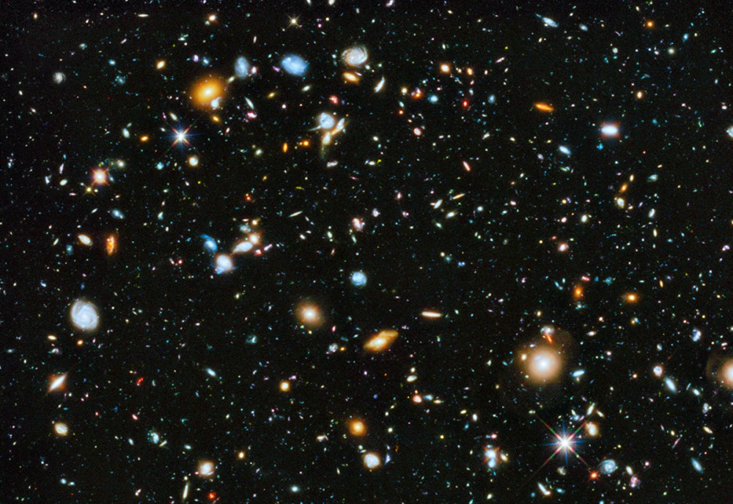
Vespers ‘86 (Holden Evening Prayer)
by Marty Haugen
Image selection by James Flaten
MN Space Grant, U of MN – Twin Cities
Image: Hubble, NASA, ESA apod.nasa.gov/apod/ap140605.html
Notes:
Hubble Ultra Deep Field 2014, taken by Hubble
NASA Astronomy Photo of the Day - https://apod.nasa.gov/apod/ap140605.html
Image Credit: NASA, ESA, H. Teplitz and M. Rafelski (IPAC/Caltch), A. Koekemoer (STScI), R. Windhorst (ASU), Z. Levay (STScI)

