Slide 1
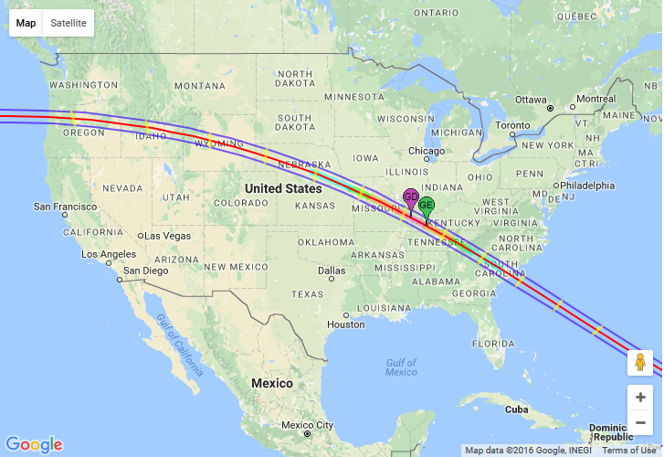
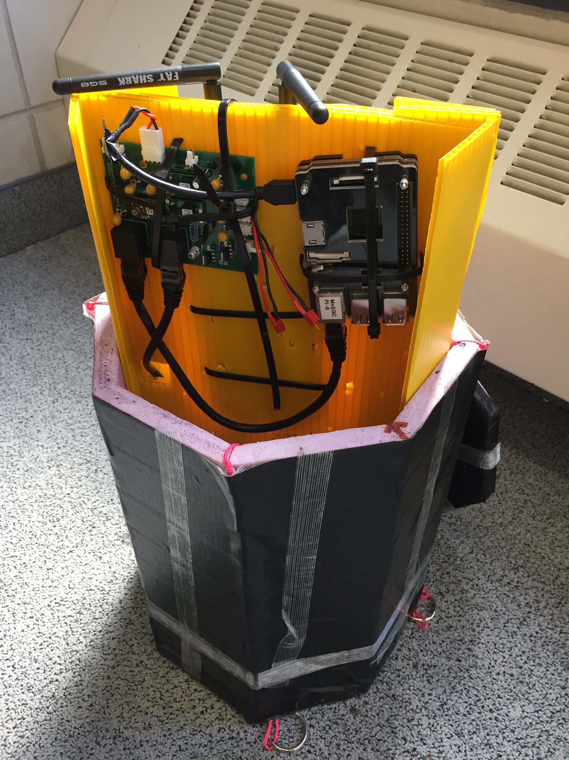
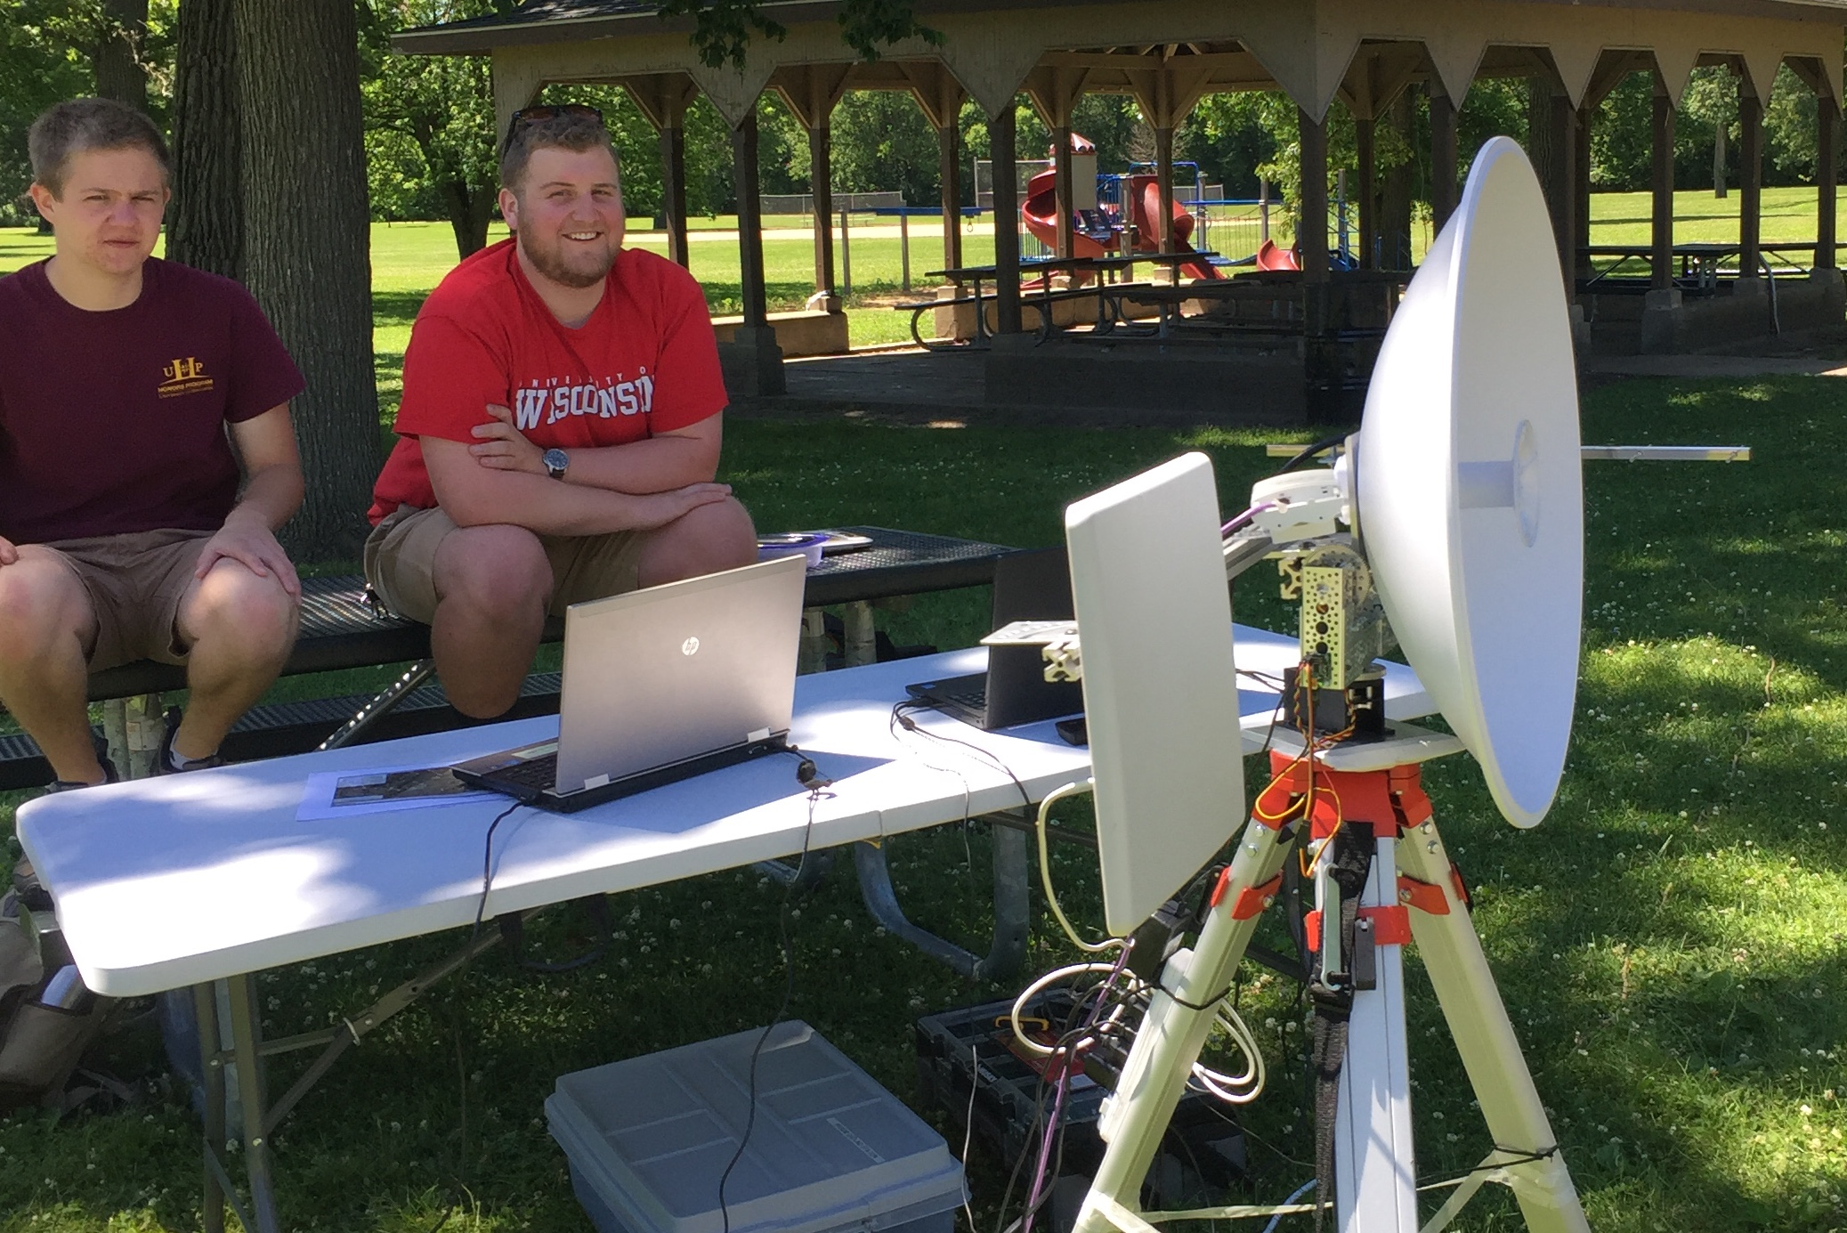
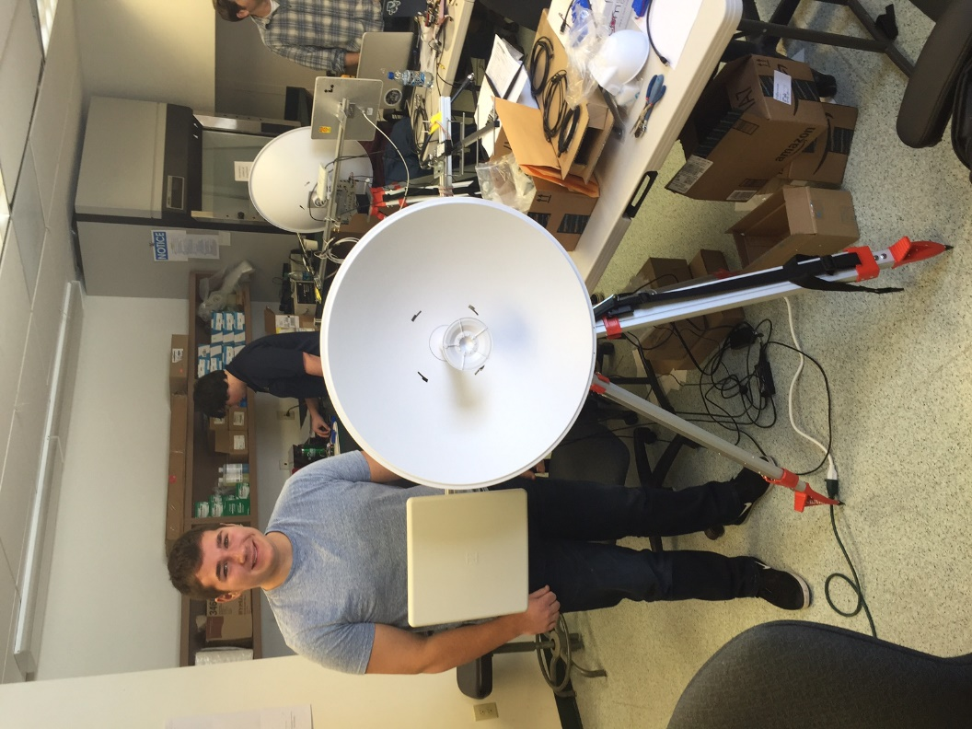
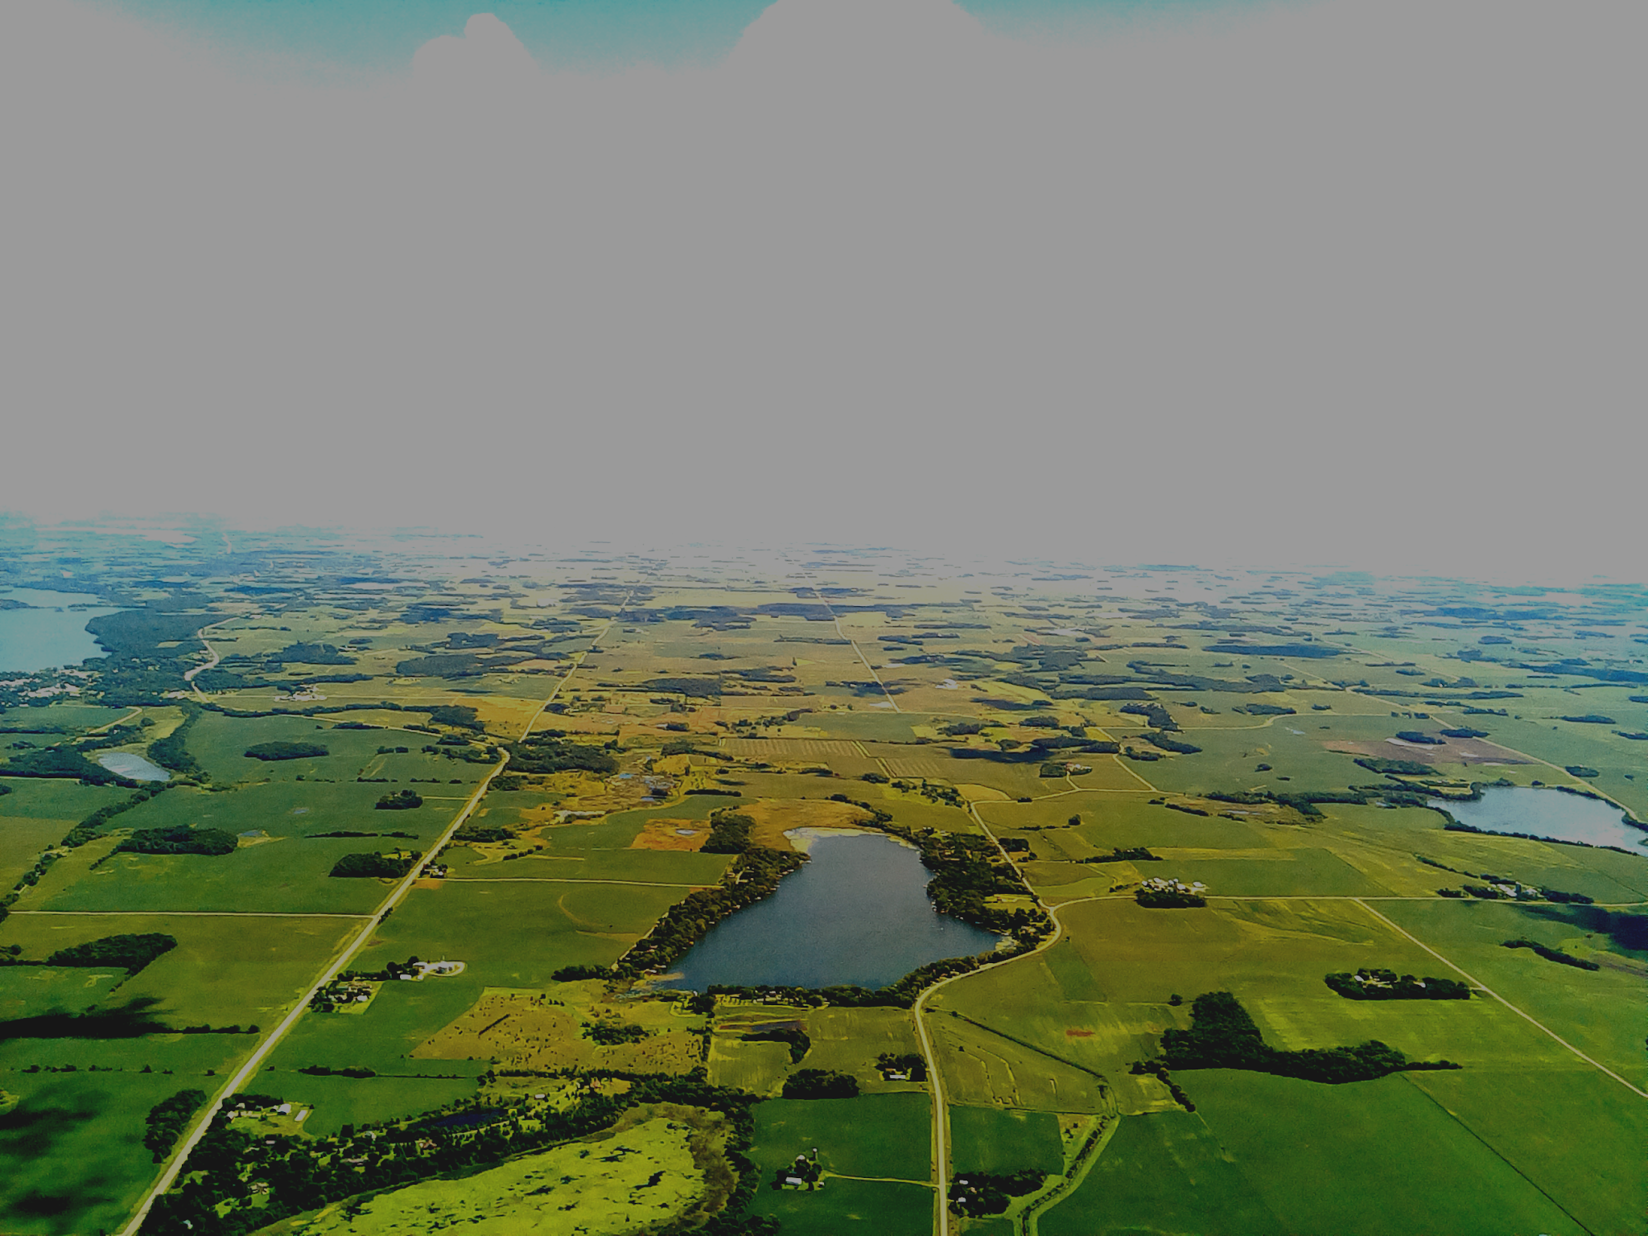
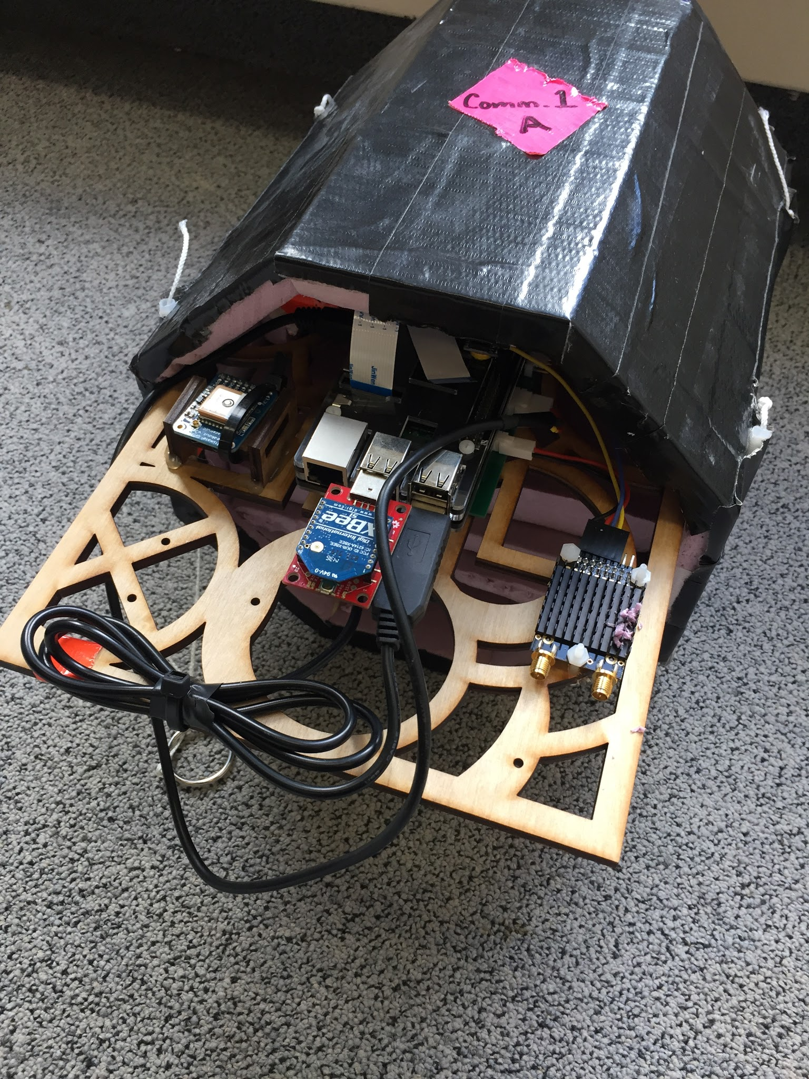
Preparing To Fly Stratospheric Balloons Into the
Total Solar Eclipse of August 21, 2017
Student Authors: Austin Langford, Ben Geadelmann, Christopher Gosch, Ryan Bowers,
Esther O’Connor, Sawyer Mitchell, Josh Nelson
University of Minnesota – Twin Cities, Department of Aerospace Engineering and Mechanics
Faculty Adviser: Dr. James Flaten, University of Minnesota – Twin Cities,
Minnesota Space Grant Consortium and Department of Aerospace Engineering and Mechanics
Eclipse path of totality
Abstract
Tracking Ground Station
Video Payload
On August 21, 2017, the path of totality of a solar eclipse will sweep across the continental United States from Oregon to South Carolina. The “NASA Space Grant Eclipse Ballooning Project” is an initiative to develop science payloads to fly on stratospheric sounding balloons (mostly latex weather balloons) during this eclipse. One core challenge of this project is to live-stream video from the stratosphere to the internet in real time from dozens of balloons spread out along the eclipse path. This initiative is being led by the Montana Space Grant and involves about 50 ballooning teams from 30 states, including the MN Space Grant Consortium (MnSGC) spon-sored “Gophernauts” Stratospheric Ballooning Team at the U of MN – Twin Cities.
As one of two states (the other is Louisiana) serving as “early adopters” of the Montana-developed video telemetry system, the U of MN ballooning team has been actively involved since January 2016 in testing and modifying/improving flight telemetry units and ground tracking antennas. During the summer of 2016 six team members helped instruct training workshops in Bozeman, MT, at which over 45 telemetry systems were built and ground-tested. One major contribution made by the MnSGC ballooning team was expanding the communication functionality of the 900 MHz telemetry flight unit, originally only used for taking and transmitting still images (in parallel with the video telemetry stream). This initiative significantly increased the gps downlink update rate, which improved robustness of ground station autonomous pointing. It also involved linking flight payloads together using a network of short-range XBEE radios so that more types of commands could be uplinked and more payload status information and experiment data could be downlinked during flight. The team also developed an application to pre-calculate antenna pointing angles and distances to target balloons following predicted (or historical) trajectories, as viewed from potential ground station sites. This application will assist teams in decision-making about where to locate their ground station(s) – not necessarily at their launch site. New procedures were developed to allow teams to monitor telemetry at the launch site even without a full ground tracking system and also to pass off telemetry from launch site (AKA uprange) to mid-flight (AKA downrange) tracking radios.
This poster summarizes hardware and software development to date, ground and flight test results, and plans for further system development work prior to the actual eclipse on August 21, 2017.
The ground station uses pan and tilt servos to point multiple antennas toward the target (i.e. the balloon), calculating the pointing angles from GPS coordinates of the target and those of the ground station itself. Target GPS coordinates can be fed into the pointing software automatically using several different methods. The original method is through the Iridium modem link (accessed via the internet). Another method the we developed involves using the RFD 900+ radio modems to communicate directly with the ground station. Using this connection we can relay GPS coordinates and commands, along with images from the balloon. This allows us to receive GPS data every three seconds, instead of every thirty seconds with the Iridium. It also gives us a backup tracking system if we cannot access the SQL server in Montana that holds iridium data. In addition to the steerable ground station, we can use a high-gain omnidirectional antenna to pick up RFD signals up to 50 km away.
This payload contains a 5.8 GHz Ubiquiti Rocket M5 modem connected to a custom power board and a Raspberry Pi. There is a Raspberry Pi camera, used in video mode, attached to the Pi. The Rocket M5 modem creates a local network between the balloon and the ground station which allows the live stream to be sent to the ground. The payload is powered by two 3.7 volt lithium ion batteries.
This higher-data-rate connection requires a high-gain, directional antenna on the ground. The real-time view from the balloon might be used to point on-board gimbaled cameras by radio control from the ground. Another solution, to ensure not missing seeing the eclipse due to mis-pointing, is to use an 8-camera multiplexer with views in all directions simultaneously.
Video Payload
Ground station
front view
Downrange
Ground Station
Command Relay Payload
System Overview
Command Relay
Payload
Still Image Transmitted from the
Command Relay Payload in flight
The command relay payload is an adapta-tion of the Montana Space Grant still image payload. It contains a camera, a short range XBEE radio, a long range RFD 900+ radio, and a GPS. The GPS and XBEE are connected over serial, the RFD 900 is connected via UART, and the camera is a Raspberry Pi camera. The Pi and RFD 900 are powered by two lithium ion batteries regulated by a custom power board.
This payload is used as a communication relay of comments to other payloads on the stack. Once payloads are “command ready”, they will receive from and transmit to the relay by short-range XBEE, which in turn relays messages through the RFD 900 to the ground.
Additionally, this payload takes still pictures every minute. These images are stored on the Raspberry Pi’s memory and can be requested by the ground station. A low resolution image is then sent to the ground by the RFD 900 radio.
The telemetry system for the Minnesota Space Grant Eclipse Ballooning Project consists of (a) a Raspberry-Pi-based command relay payload equipped with an RFD900 (900 MHz) radio, an XBEE (2.4 GHz) radio, an Adafruit Ultimate GPS module, and a Raspberry Pi Camera, (b) a Raspberry-Pi-based video telemetry system with the video stream transmitted using a Ubiquiti M5 Rocket (5.8 GHz) modem, (c) a steerable ground tripod with multiple antennas all pointing in the same direction to pick up both 900 MHz and 5.8 GHz signals, (d) GPS-enabled Iridium satellite modems and/or APRS beacons to relay tracking information when the balloon is out of sight, and (e) a custom razor cutter for flight termination, contacted by XBEE radio using e-mail messages to the Iridium modem.
Progress and Future Work
We have a functional command system in place to both send and receive information from a balloon at altitude using the RFD 900 radio channel.
We enhanced the pointing capability of the ground station to be able to use gps data from satellites (Iridium), APRS (ham radio), and 900 MHz direct transmission.
We developed a flight prediction tool to assist in the selection of ground station sites.
We have had several partially-successful test flights of the video telemetry payload and the command relay (still image) payload.
We will build a pointable/tiltable anti-rotation mount for camera payloads, to eliminate unwanted rotation from the video and be able to point at specific imaging targets.
We will upgrade or more of our video telemetry flight units to an 8 camera multiplexed system, with automatic camera switching to compensate for payload rotation.
We will begin practice streaming flight video directly to the internet at stre.am/eclipse.
For more information about this national project, go to http://eclipse.montana.edu/.
During the eclipse the tracking information from the Iridium modem will be sent to the Montana Space Grant, where the FAA will be notified of the position of the balloon. Additionally, the live video stream will be uploaded to a NASA website for the public to view in near real time.
This national project has been generously funded by NASA’s “Space Grant and Fellowship Program” (more commonly known as “Space Grant”) and by NASA’s Science Mission Directorate. The U of MN – Twin Cities Stratospheric Ballooning Team is funded by the MN Space Grant Consortium.
This poster was presented at the Fall 2016 Space Grant Midwest Regional Meeting in Ann Arbor, MI.
Training Workshop in Bozeman, MT

