Slide 1
The Stratospheric Ballooning Association (SBA) Presents
Academic High-Altitude Ballooning Conference
AHAC 2020
June 24-26, 2020 at Iowa State University, Ames, IA
Pre-conference workshop on June 22-23:
“Apollo Re-entry Challenge” (appropriate for people of all backgrounds)
“Ballooning Expo” plus conference kick-off on June 24
Conference main theme: Ballooning in Education (all types; uncrewed)
Likely topics include: lighter-than-air RC vehicles, applications of tethered ballooning, long-duration
(around the world) pico-ballooning, solar-heated ballooning, curricular and extra-curricular strato-
spheric ballooning for higher education and pre-college, ballooning competitions, ballooning for teacher training and academic research (including HASP), eclipse ballooning plans for the total eclipse of 4/8/24
Conference website: https://www.stratoballooning.org/ahac/
Contact: Matthew Nelson mnelson@stratoballooning.org
Tentative cost: $50 workshop, $150 student, $240 faculty, discount for SBA members

Slide 2
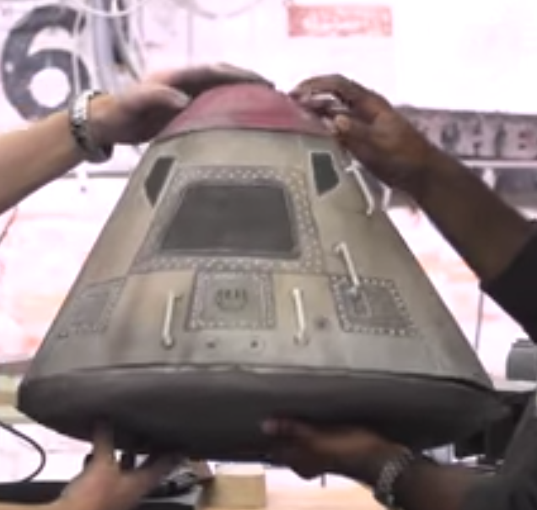
Apollo Re-entry
Challenge Workshop
https://www.tested.com/science/586803-features-not-standard-weather-balloon-launch-and-recovery/

Slide 3
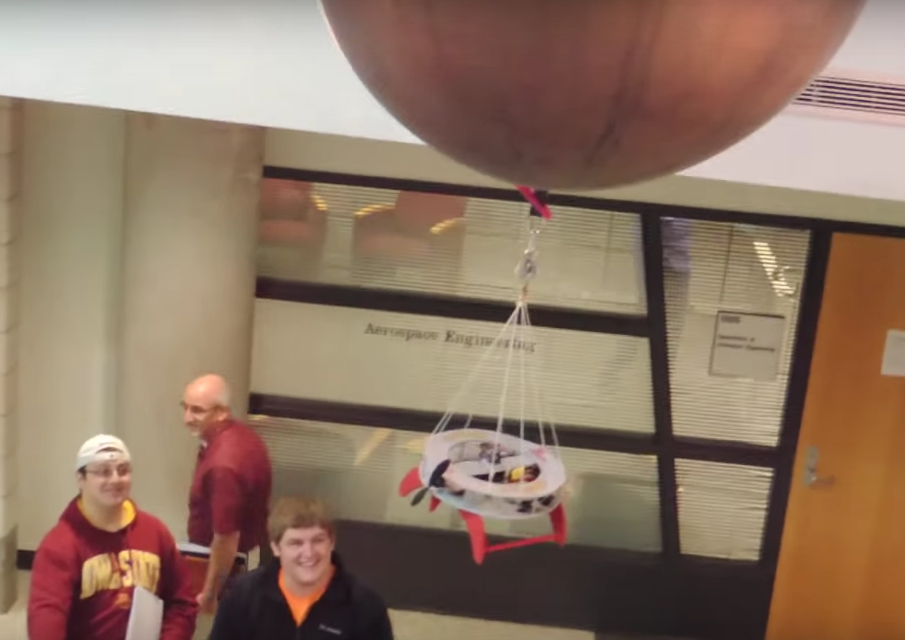
Lighter-Than-Air RC Vehicles
Iowa State: https://www.youtube.com/watch?v=IlKdPGPeIaI

Slide 4
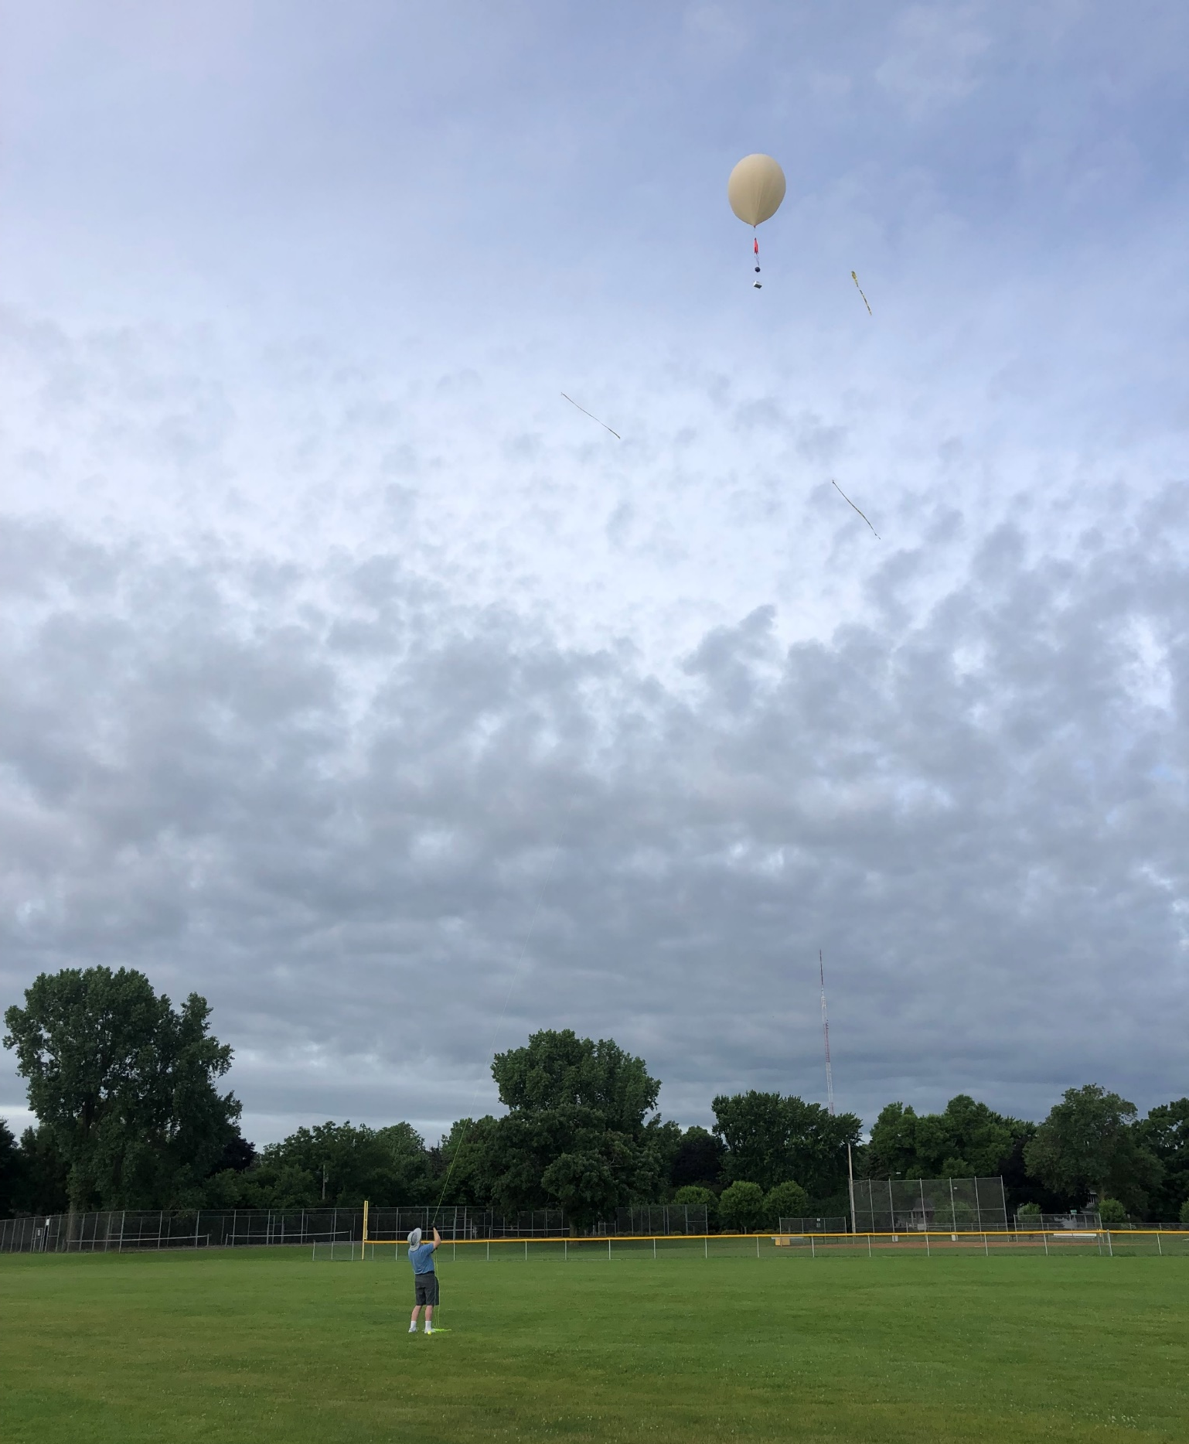
Tethered Ballooning
Image from U of MN MURI Ballooning Team

Slide 5
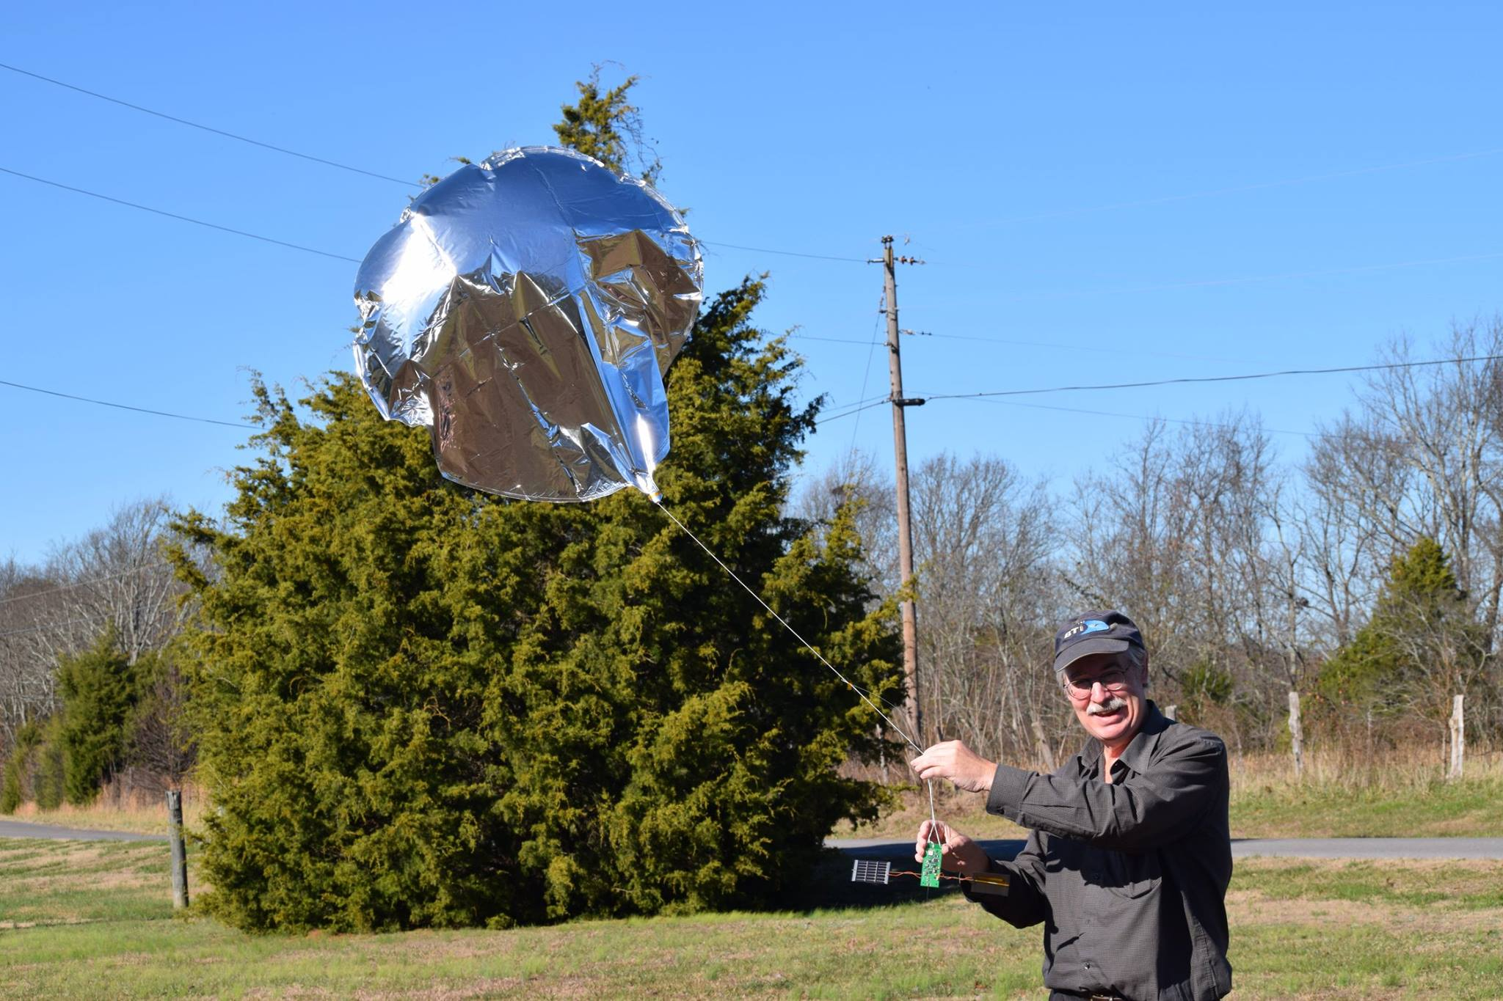
Around-the-World Pico-Ballooning
Bill Brown: http://www.wb8elk.com/

Slide 6
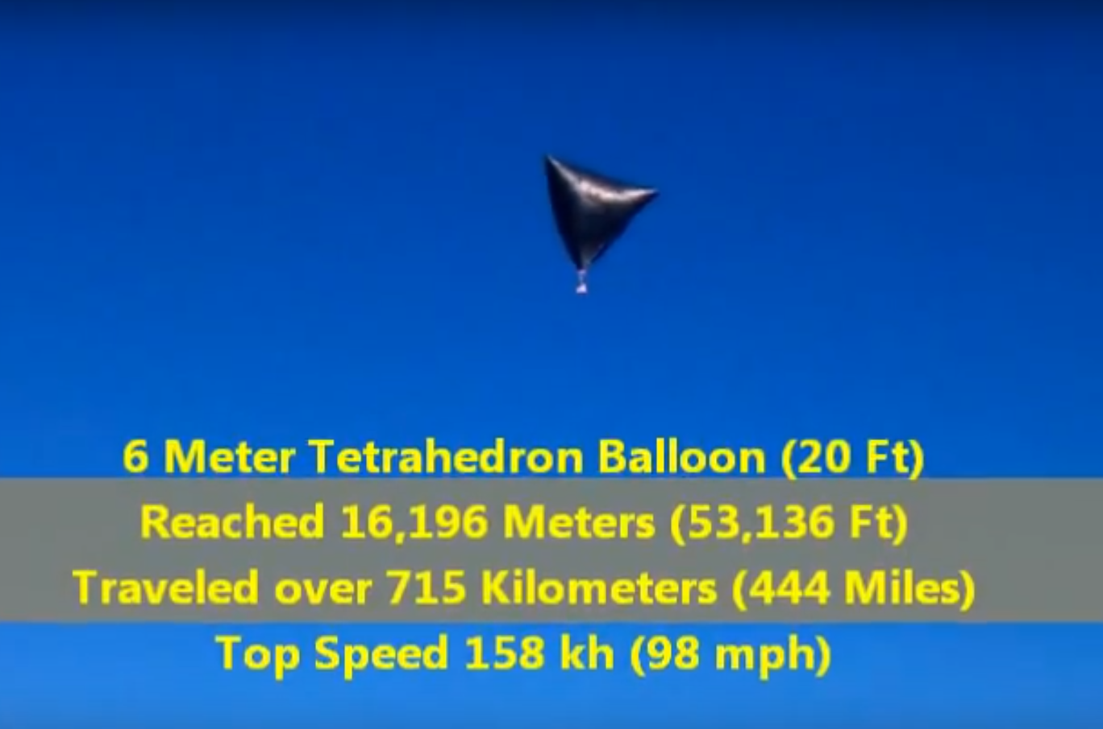
Solar-Heated Ballooning
Image from https://www.youtube.com/watch?v=NToL5NQms_Y

Slide 7
Pre-College Stratospheric Ballooning Competition
North Dakota Space Grant: https://ndspacegrant.wixsite.com/ballooning/2018-handbook

Slide 8
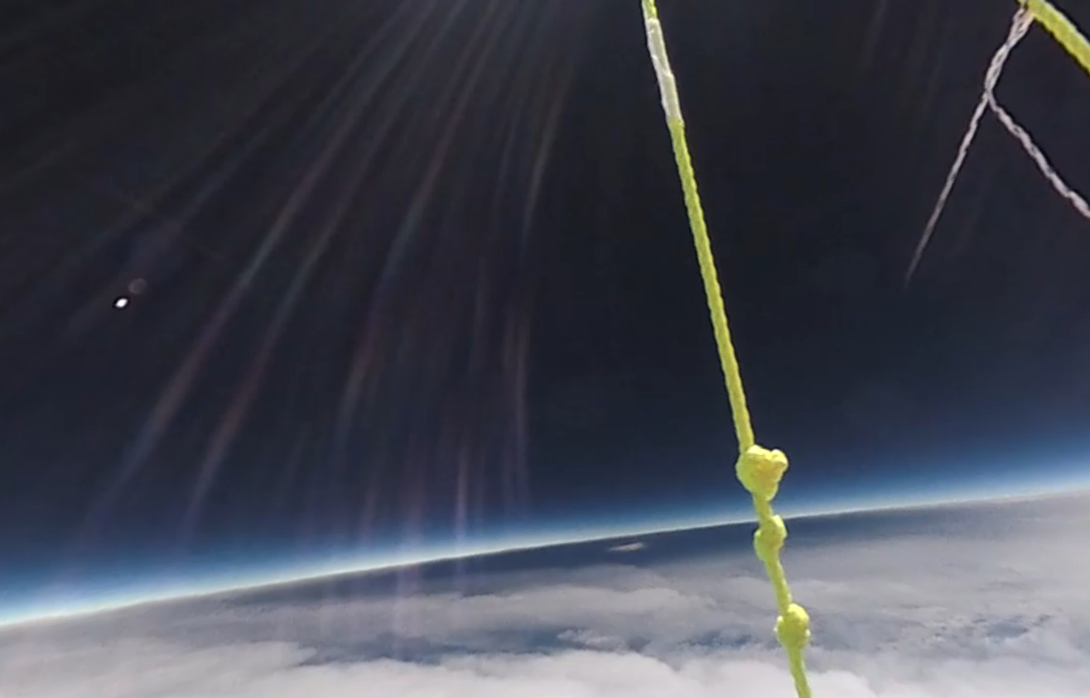
Discuss Plans for 4/8/2024 Eclipse Ballooning
Image from MN Space Grant U of MN Eclipse Ballooning Team

Slide 9
AHAC 2020
Workshop: June 22-23 Expo & Conf: June 24-26
Iowa State, Ames, IA
We hope you join us!
Conference website: https://www.stratoballooning.org/ahac/
Contact: Matthew Nelson mnelson@stratoballooning.org

