Slide 1
SG Industry Program Discussion
Kevin Crosby
Midwest Regional Space Grant Meeting
October 1, 2019

Slide 2
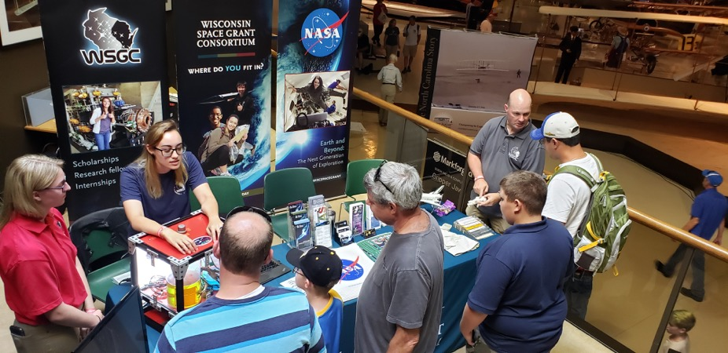
Overview of WI SG Industry Program
Goal: promote a fledgling aerospace economy in a state not known for one; move the needle on the brain drain
Objectives:
Place students in cost-shared industry internships
Connect faculty with industry partners for research collaborations
Provide/Support visible nexus events between industry and academia (symposia, job fairs, etc.)
Support state economic development efforts around aerospace and STEM employment
Notes:
Share similar goals:
Promote an aerospace economy in a state not known for one. Move the needle on the Brain Drain
Objectives:
place a number of students in capstone experiences such as commercial and NASA internships that are cost-shared with industry partners.
Connect faculty with industry partners for research support and collaboration on work of mutual interest.
Provide visible nexus events between industry and academia (symposia, job fairs, etc.)

Slide 3
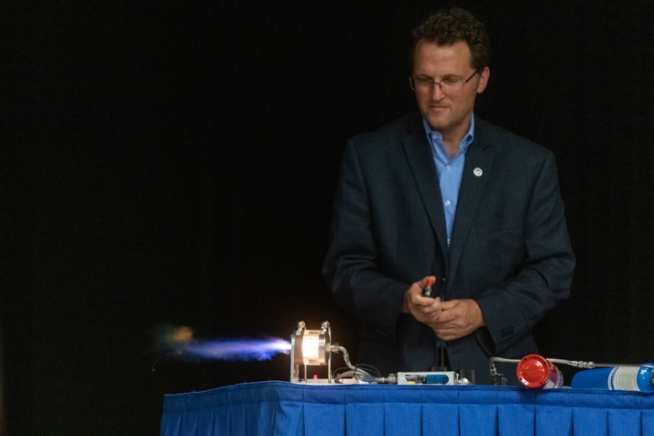
Overview of WI SG Industry Program
Strategies ... We’re still figuring these out.
Strategy Overview:
Seek program integrations everywhere! RockSat, CubeSat, Undergraduate Research Awards, etc.
Connect with state economic development efforts
Piggyback on campus innovation and entrepreneurship centers
Use state legislative offices to connect to potential partners

Slide 4
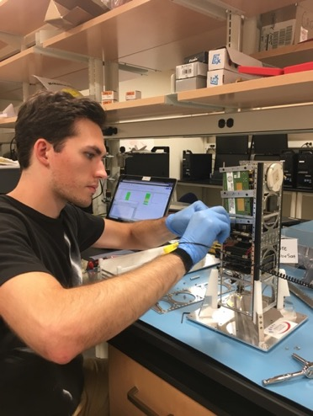
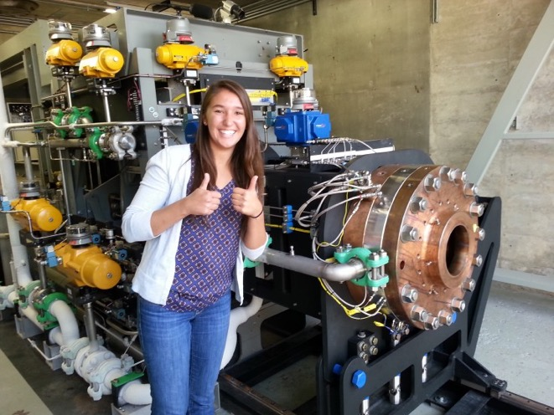
Overview of WI SG Industry Program
Strategy Example: Program Integrations
Notes:
Share similar goals:
Promote an aerospace economy in a state not known for one. Move the needle on the Brain Drain
Objectives:
place a number of students in capstone experiences such as commercial and NASA internships that are cost-shared with industry partners.
Connect faculty with industry partners for research support and collaboration on work of mutual interest.
Provide visible nexus events between industry and academia (symposia, job fairs, etc.)

Slide 5
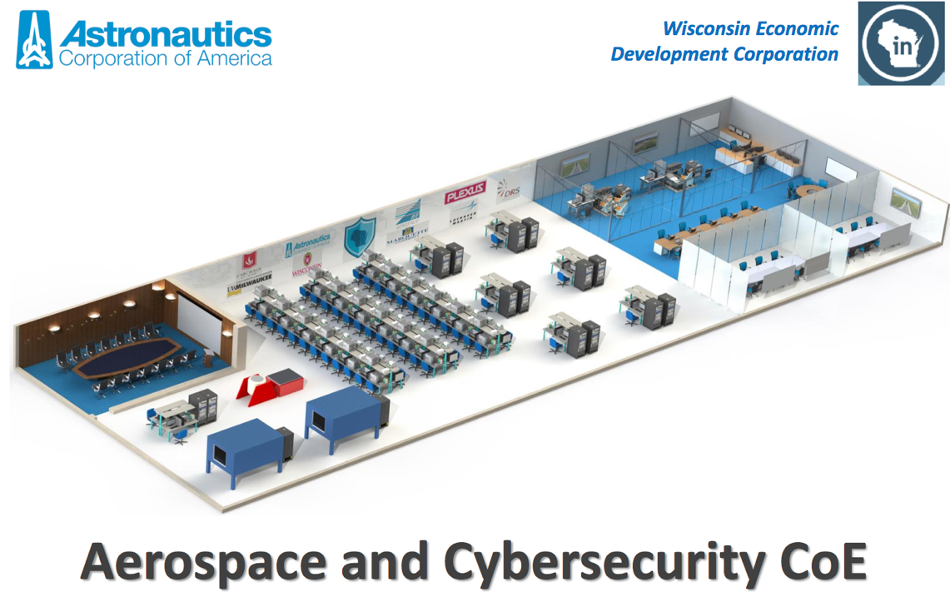
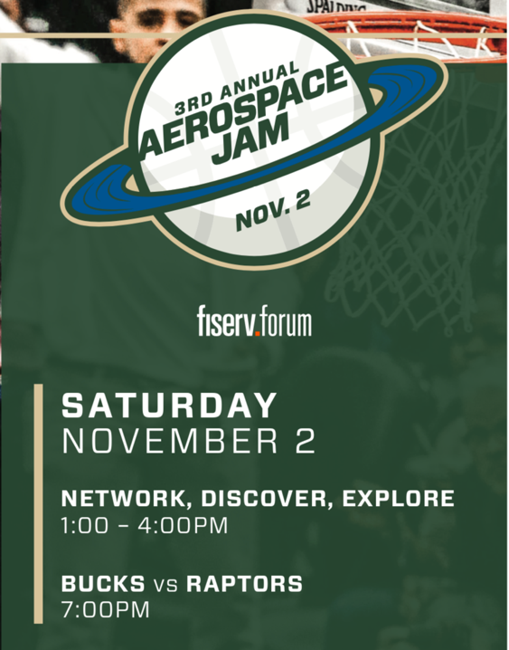
Overview of WI SG Industry Program
Strategy Example: Connect with State Economic Development Efforts
Notes:
Share similar goals:
Promote an aerospace economy in a state not known for one. Move the needle on the Brain Drain
Objectives:
place a number of students in capstone experiences such as commercial and NASA internships that are cost-shared with industry partners.
Connect faculty with industry partners for research support and collaboration on work of mutual interest.
Provide visible nexus events between industry and academia (symposia, job fairs, etc.)

Slide 6
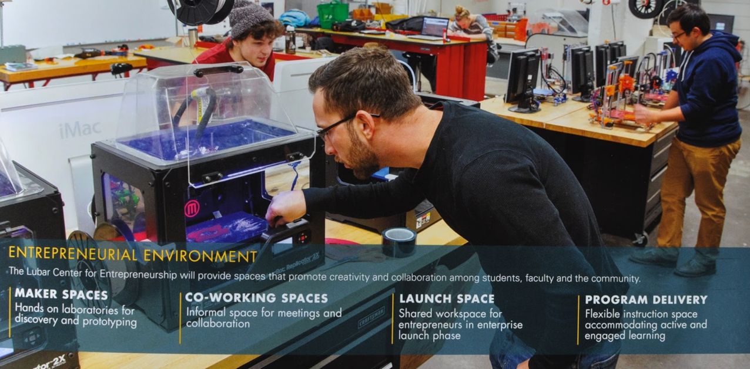
Overview of WI SG Industry Program
Strategy Example: Piggyback on Campus Innovation and Entrepreneurship Centers
Notes:
Share similar goals:
Promote an aerospace economy in a state not known for one. Move the needle on the Brain Drain
Objectives:
place a number of students in capstone experiences such as commercial and NASA internships that are cost-shared with industry partners.
Connect faculty with industry partners for research support and collaboration on work of mutual interest.
Provide visible nexus events between industry and academia (symposia, job fairs, etc.)

Slide 7
Overview of WI SG Industry Program
Strategy Example: Use state legislative offices to connect to potential partners
Notes:
Share similar goals:
Promote an aerospace economy in a state not known for one. Move the needle on the Brain Drain
Objectives:
place a number of students in capstone experiences such as commercial and NASA internships that are cost-shared with industry partners.
Connect faculty with industry partners for research support and collaboration on work of mutual interest.
Provide visible nexus events between industry and academia (symposia, job fairs, etc.)

Slide 8
Lessons Learned
Problems:
We’re too small to matter to large companies (we don’t make a compelling business case).
Many companies have “collaboration and consortium fatigue.”
Our paperwork/reporting requirements can deter potential partners.
Solutions:
Build relationships with persons who are mission-driven and will carry the SG flag within a company.
Diversify partnership efforts outside traditional STEM employment sectors.
Arguments that perk ears:
ability to address recruiting challenges
Commitment to plugging the state’s brain drain
SG Consortia can single-source the state’s best STEM students

Slide 9
Your turn!
Do you have clear objectives for your Industry program aside from internship placements?
Do you have success stories that can be translated to other states?
Can we identify different approaches to engaging industry partners?
Has anyone made useful connections with state industry consortia?

