Slide 1
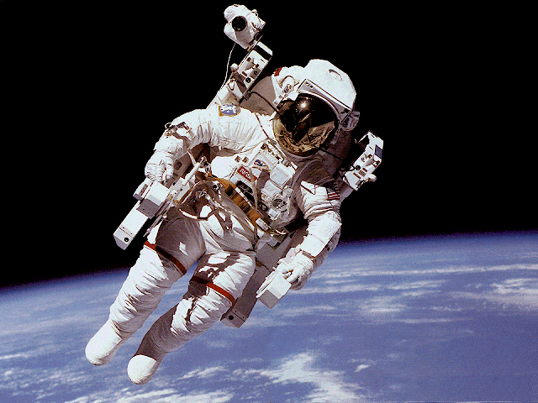
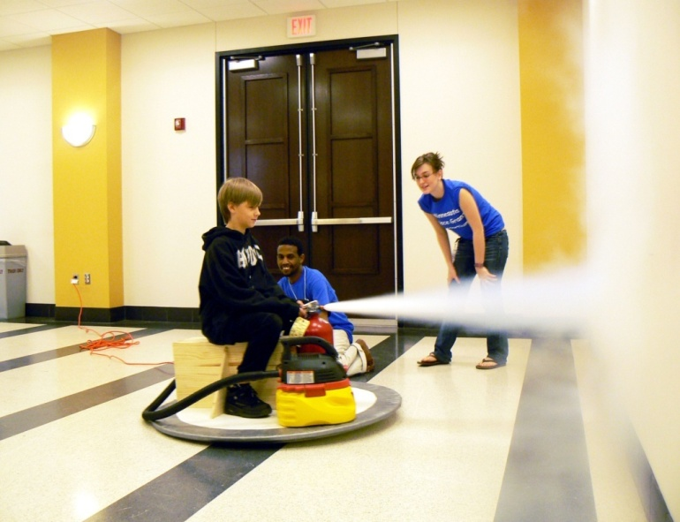
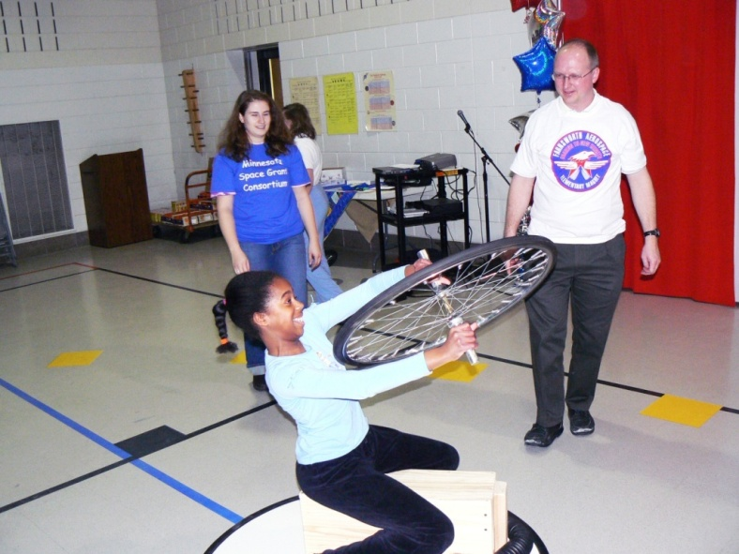
Hovercraft Astronauts
Professor James Flaten
NASA’s MN Space Grant Consortium
Department of Aerospace Engineering and Mechanics
U of MN – Minneapolis campus

Slide 2
What are some of the main differences between orbiting in outer space and being on the surface of the Earth?
No air to breathe – bring your own!
Free-fall (feels like no gravity)
  No friction

Slide 3
How can astronauts train for being in continuous free-fall in orbit (sometimes described as “weightlessness”)?
Temporary free-fall in airplanes
Neutral buoyancy underwater
No friction with hovercraft

Slide 4
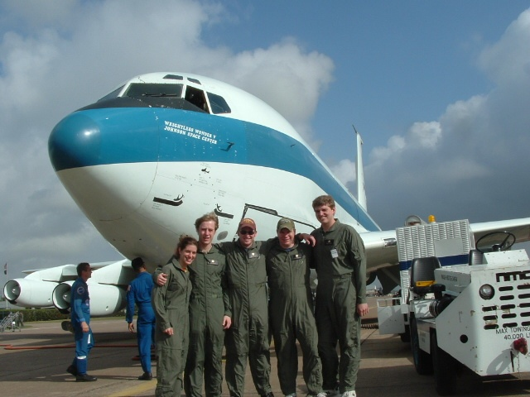
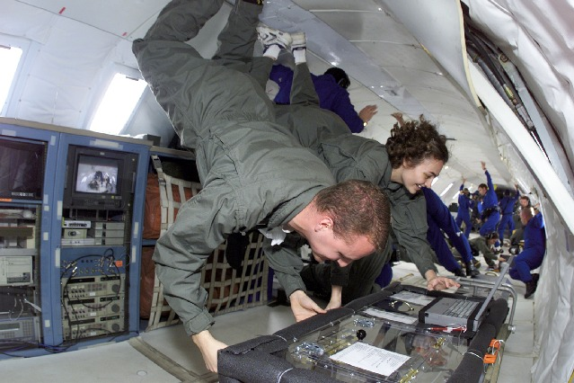
Astronauts (and U of MN student teams) fly on NASA’s “Reduced-Gravity” aircraft which flies parabolas to give 20 – 30 seconds of free-fall (then high-g recovery).
This plane is more often
called the “vomit comet”!

Slide 5
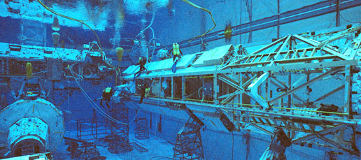
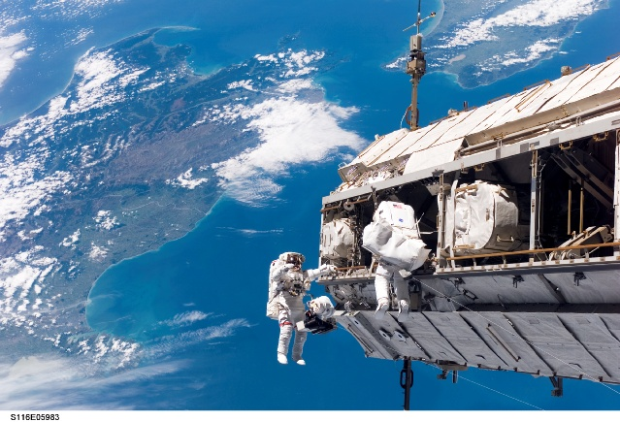
Astronauts also train in spacesuits underwater in a deep swimming pool
(Neutral Buoyancy Lab).
Here are astronauts actually constructing the International Space Station (ISS).

Slide 6
We do “astronaut training” using a hovercraft
( i.e. become a Hovercraft Astronaut )
Astronauts need to learn how to get around
and do tasks without making use of friction.
Hovercraft provide a no-friction environment
similar to that which astronauts experience
in continuous free-fall while in orbit.

Slide 7
Hovercraft
astronaut
demonstrations

Slide 8
Things you can learn with a hovercraft…
Without friction it is harder to do certain tasks but easier to understand Newton’s Three “Laws of Motion”
  Objects move in a straight line at a constant speed unless a force causes them to change their velocity. (Newton’s 1st Law) (Rotational analog: Objects spin at a constant rate unless a torque causes them to change their rotational state.)
  The more massive an object, the harder it is to change its state of motion. (Newtons’ 2nd Law)
  If you apply a force to an object it will react by forcing you equally hard, but in the opposite direction. (Newton’s 3rd Law)
You can use the fact that spinning objects don’t like to tip over to gain “attitude” (direction-pointing) control.
You can use a CO₂ fire extinguisher to become familiar with how rocket thrusters are used for propulsion.

Slide 9
After hovercraft training, astronauts are ready to use NASA’s Manned Maneuvering Unit (MMU).

Slide 10


Hovercraft Astronauts

