Slide 1
The Random Guys
Flight Readiness Review
Philip Hansen
Ryan Lemerond
Jens Heig
Ayo Akindumila
Olani Aga
AEM 1905November 20, 2008

Slide 2
Mission Overview
Our main objective for this mission is the Geiger counter experiment. We want to know how radiation exposure changes as you travel through the atmosphere.
We expect that the there will be more radiation as altitude increases.

Slide 3
Mission Overview
The video camera is our team’s secondary experiment. We want to see how the atmosphere layers affect the color of the sky.
We expect that has the balloon progresses through layers it will get darker.

Slide 4
Team Organization

Slide 5
Design
Flight computer
Geiger counter
Heater
DXG DXG-569V 5MPixel HD video camera with SD memory card
Weather station
Hobo temperature probe and hobo data logger
Battery packs for camera, flight computer, and heater
6’6’6 inch payload box
Switch plate

Slide 6
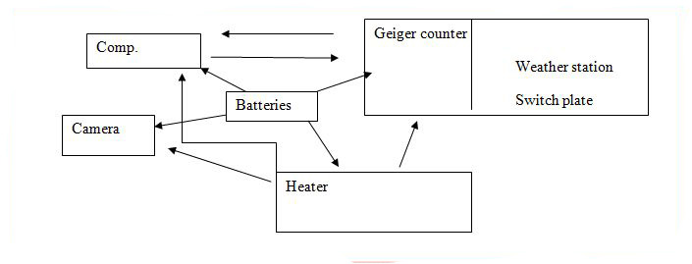
Flight system interaction design

Slide 7
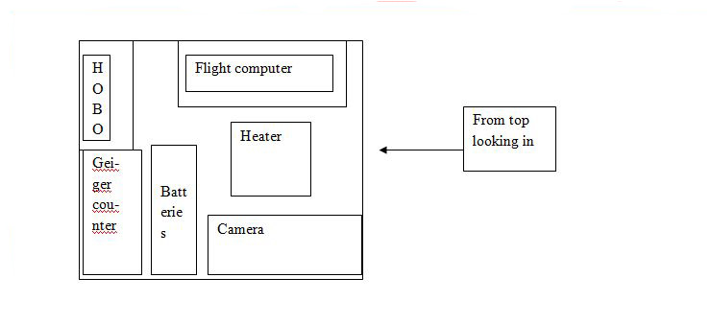
Inside the Payload

Slide 8
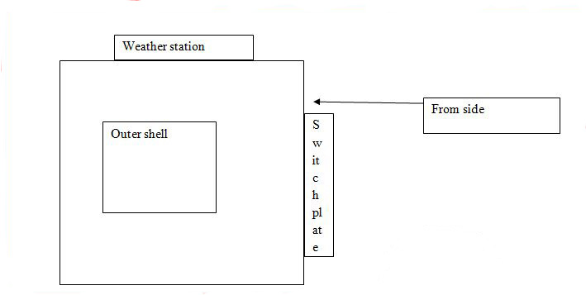
Outside of Box

Slide 9
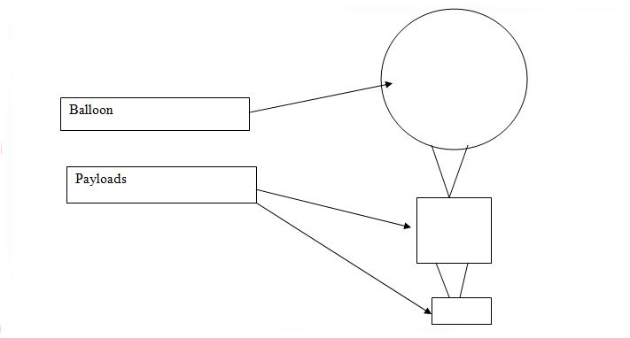
Launch conceptual design

Slide 10
Mass and Cost
Item | Mass(kg) | Cost($)
CanonPowershot | .223 | 166
Basic Stamp1 | .063 | 56
Batter Pack for Stamp1 | .11 | 5
6x6x6 box of foam | .18 | 7
Geiger Counter | .114 | 150
Basic Stamp2 | .123 | 70
Heater Circuitw/Switch | .027 | 5
Hobo data logger | .027 | 105
Batter Pack for heater | .150 | 6
Total | 1.1 | 570

Slide 11
Pre-Flight Testing
Flight Computers
Heater
Pressure Sensor
Switch
Payload Box

Slide 12
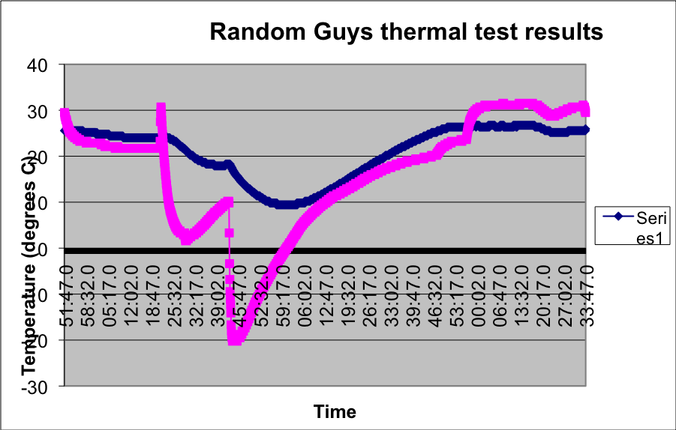
Thermal Test
Blue=Temp Inside Purple= Temp. Outside

Slide 13
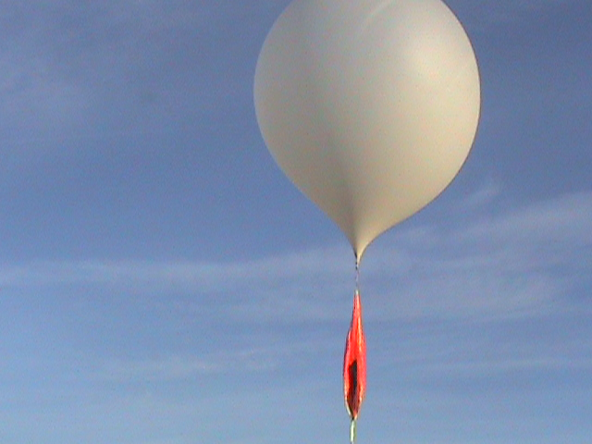
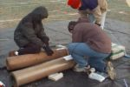
Materials
1500 grams latex (rubber) weather balloon.
10 feet in diameter
can lift 20 pounds
2 Helium tanks to fill

Slide 14
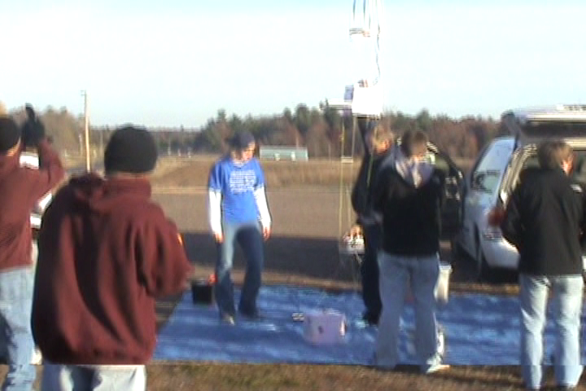
Launch Video

Slide 15
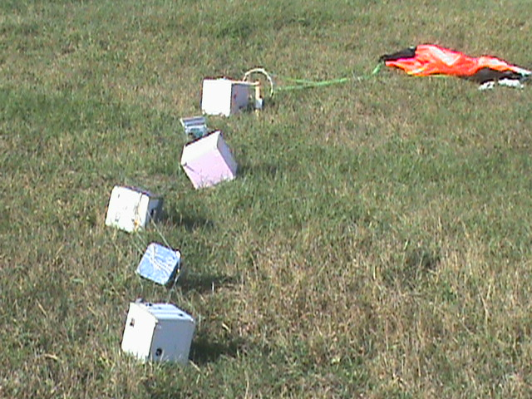
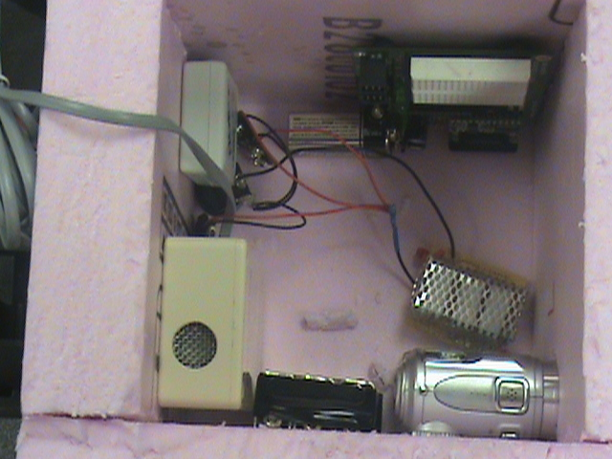
End of Launch
Flight lasted for 106 minutes.
We arrived 5 minutes within touchdown.

Slide 16
Expected Scientific Results
Geiger Counter- We expect the radiation to increase with altitude.
Temperature Sensor- We expect the temperature to drop extremely low, but then start to warm up.
Pressure Sensor- We expect the pressure to steadily drop with altitude.
Video Camera-We expect the sky to change from blue to black.

Slide 17
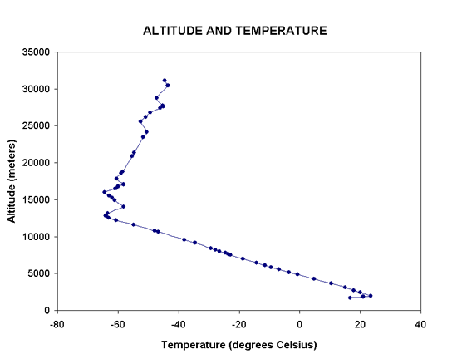
Temperature Vs. Altitude

Slide 18
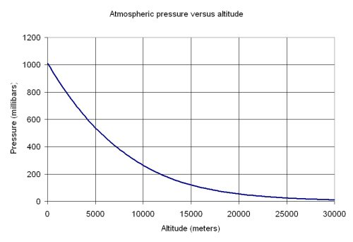
Pressure Vs. Altitude

Slide 19
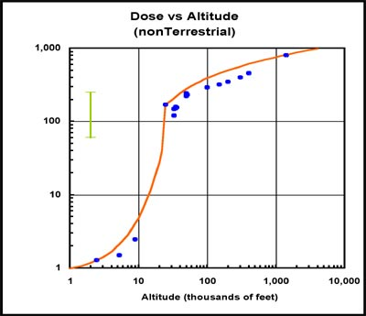
Radiation Vs. Altitude

Slide 21
Hobo Data Graphs

Slide 24
Basic stamp 1 flight Computer graphs

Slide 27
Geiger counter

Slide 30
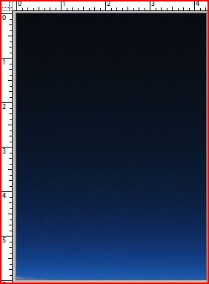
Photo Experiment
Utilizing Adobe Photoshop we measured the picture starting at zero and measuring the width every ¼ unit of measurement

Slide 31
Photo Result
2- ¾ | 1 ½
3 | 1 5/8
3- ¼ | 1 ¼
3- ½ | 1 1/8
3- ¾ | 1
4 | ¾
4- ¼ | 5/8
4- ½ | ¾
4- 3/4 | 3/8
5 | 3/8
5 ¼ | ¼
5 ½ | ¼
5 ¾ | ¼
Unit | thickness
0 | 2 ¼
¼ | 1 ½
2/4 | 2 1/8
¾ | 2
1 | 2 1/8
1- ¼ | 2 ¼
1- ½ | 2 ½
1- ¾ | 2 ½
2 | 2 ½
2- ¼ | 2 ¼
2-1/2 | 2

Slide 32
Conclusion
From our pressure sensor we learned that the pressure decrease exponentially with an increase in altitude.
Our temperature sensor showed that the temperature drops steadily for awhile, but then actually starts to increase again.
Our geiger counter experiment really didn’t work because the levels were so high that it maxed out the computer.

Slide 33
Conclusion
Our camera experiment didn’t work because for some reason it didn’t record anything.
If we were to change our payload and fly it again we would like to change how long the computer counted radiation hits so we could actually see how the radiation increases.

Slide 34
Words of Wisdom
Organize your team as soon as possible
Make sure that you don’t get behind
Don’t procrastinate

Slide 35
Thanks
We’d like to thank the Professor for helping us put this together and also giving us the chance to do something like this.
We’d also like to thank John who helped us with the geiger counter.

