Slide 1
Team Sweetness
Scott Luisi, Abe Fark, Trent Quick, Jack Szmanda, Tom Valkenberg
AEM 1905, 11/20/2008

Slide 2
Mission Overview
Our package is designed to survive the trip with the heater circuit, solid structure and tracking device
Basic equipment like our weather station and HOBO will take temperature and pressure readings- we expect to see temperature and pressure sharply decrease with altitude

Slide 3
Mission Overview
Camera will be mounted above a filter wheel with a 2x, 4x & empty slots for a greater variety of UV filtered photographs- We hope be able to spot areas of dense foliage and crops with our UV lenses, as well as to take some awesome looking pics
We’ll have solar panels mounted on the outside to measure voltage outputs as altitude increases- we expect to see that the output will increase with altitude

Slide 4
TEAM MANAGEMENT CHART
 | Building | Building | Building | Building | Testing | Callibration | Data | Project | Oral
 | Shell | Int Elec | Lens | Servo | All | Offsets | Analysis | Document | Presentations
Abe Fark | x | x | x |  | x | x | x | x | x
Jack Szmanda | x | x |  | x | x |  |  | x | x
Scott Luisi |  | x | x | x |  |  | x | x | x
Tom VanValkenburg | x | x |  | x | x |  | x | x | x
Trent Quick | x | x |  | x | x |  | x | x | x

Slide 5
Parts and Equipment List
Filter Wheel w/ 2x & 4x magnification UV lenses, and one empty slot
Servo
Still Camera- taking photos every 15 seconds
BASIC stamp flight computer- measuring temperature and pressure data
Weather Station- Temperature and Pressure sensors
HOBO- recording solar panel output and internal temperature
Solar panels- uncovered?
Heater Circuit
Switch Plate

Slide 6
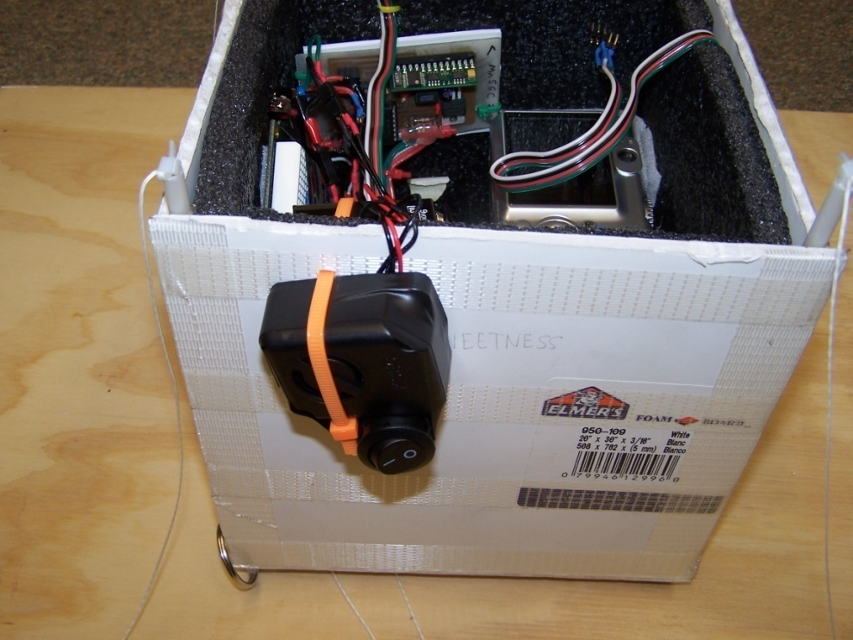
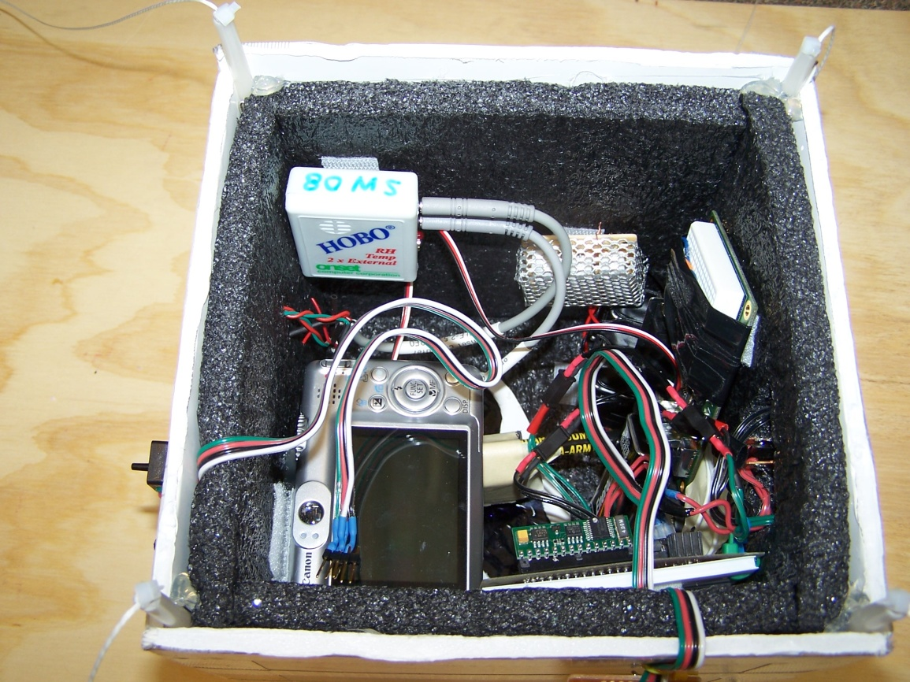
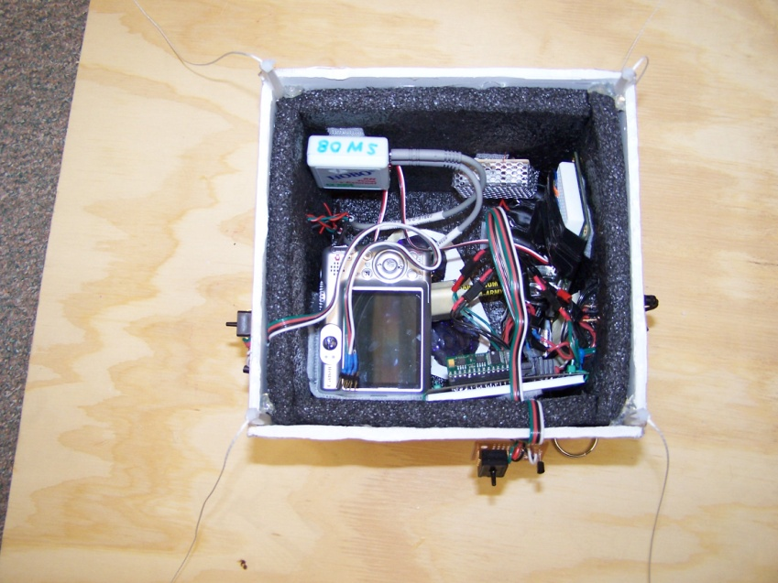
Box Construction Photos

Slide 7
Pay Load Lay Out

Slide 8
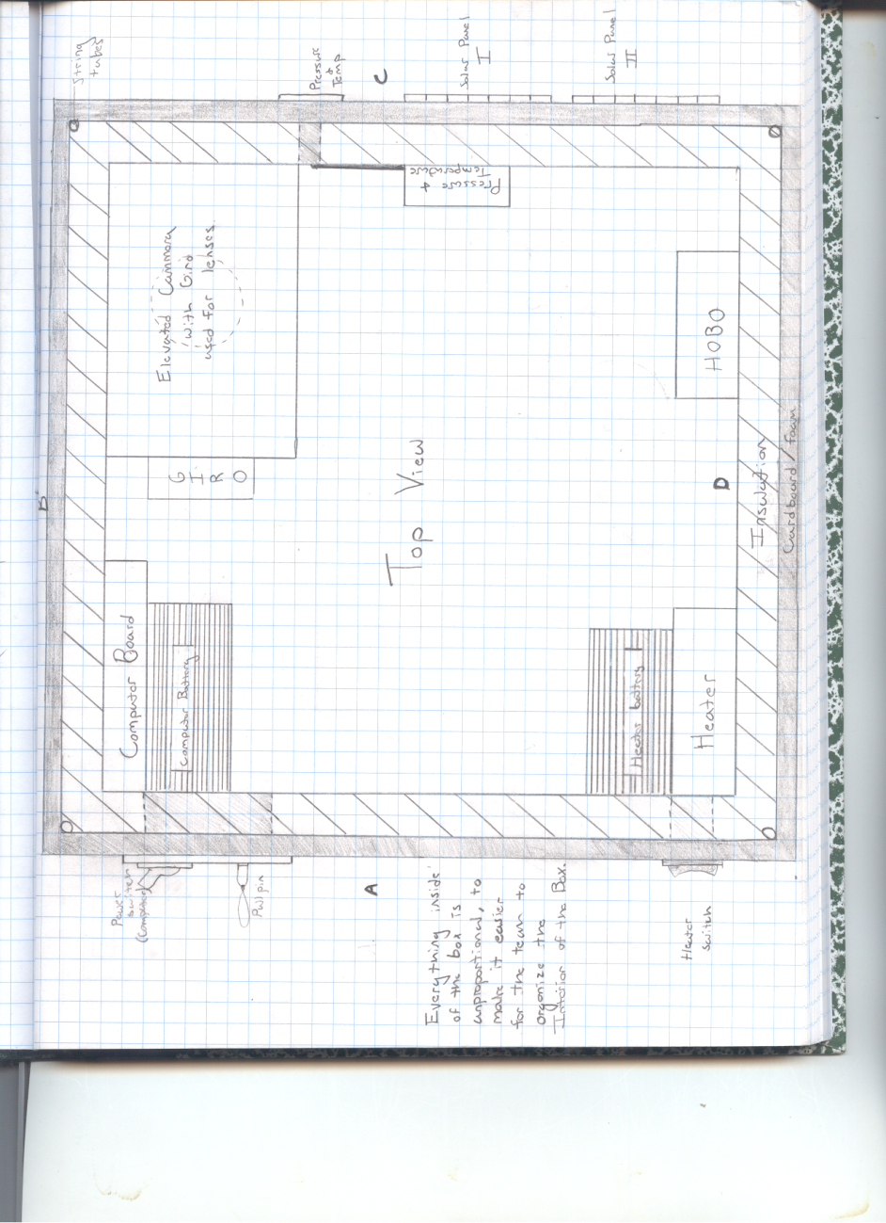
Box Layout

Slide 9
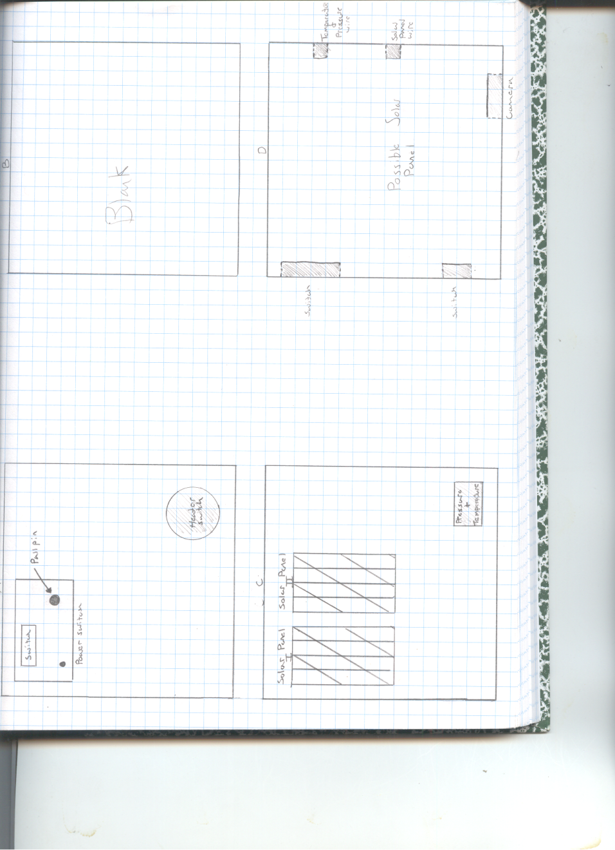
Box Layout

Slide 10
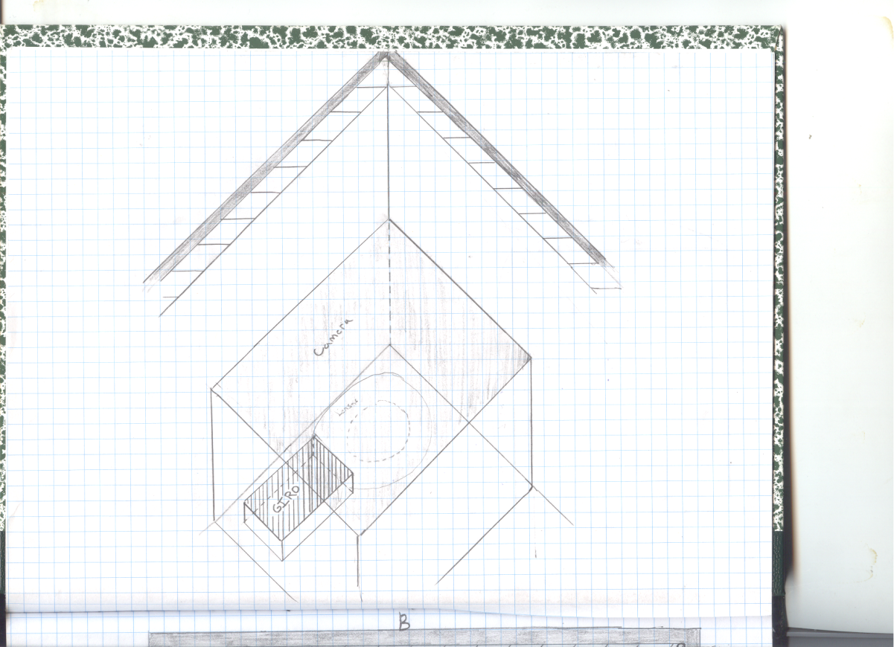
Box Layout

Slide 11
Cost and Mass Budget
Actual Masses:
Filter Wheel and servo
Camera
BASIC stamp flight computer
Weather station
HOBO
Solar Panels- uncovered
Voltage Panels
Mass- 2.261Kg
Money Budget
$166 - Camera
$56 - Flight Computer
$105 - HOBO Data Logger
$28 - HOBO Temperature Sensor Probe
$29 - Weather Station Sensor Pack
$8 - Mini Solar Panel
$5 - Heater Circuit and Switch
$5 - Battery Pack
Total: $402

Slide 12
Testing
Tests Run:
Thermal Testing
Run Flight computer
Run Weather Station through BASIC stamp
Tests we should have done:
Pictures present on camera
Timing of filter wheel vs. # of filtered shots on camera
Troubleshooting
Our flight computer and weather station had to be replaced

Slide 13
Thermal Test Results

Slide 14
Expected Science Results
Weather Station with Temperature and Pressure

Slide 15
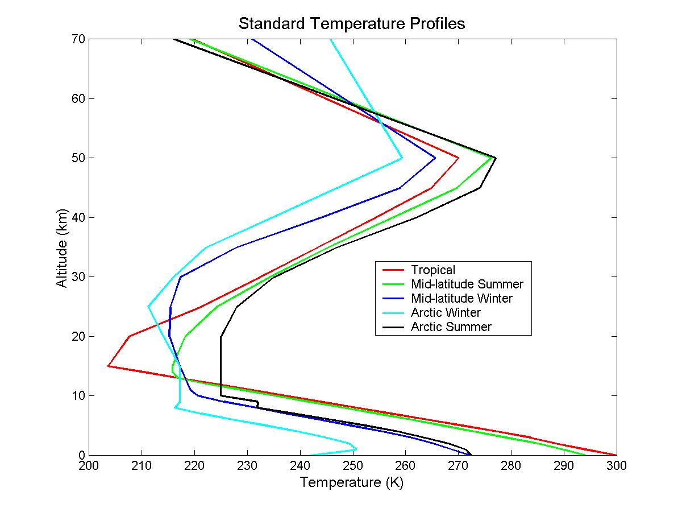
Expected Science Results
Expected Temperature Versus Altitude Plot
http://profhorn.meteor.wisc.edu/wxwise/wxpilot/lesson1/lesson1b.html

Slide 16
Expected Science Results
We also ran solar panels mounted to one side of our box, but we did not have the fresnel lens mounted on one of them like we had planned due to availability issues, therefore our results did not yield valuable results.
We had a filter wheel with UV filters, of 4 and 2x magnification as well as an empty slot spinning constantly throughout the flight
Our still camera was mounted about it
  The camera was programmed to take pictures every fifteen seconds for the duration of the flight
  We expected this to deliver pictures of the foliage below with different colors based on the amount of UV radiation absorbed by the particular plant

Slide 17
Science Results
Temp
Celsius
Time- Minutes

Slide 18
Science Results
PressurePsi
Time-Minutes

Slide 19
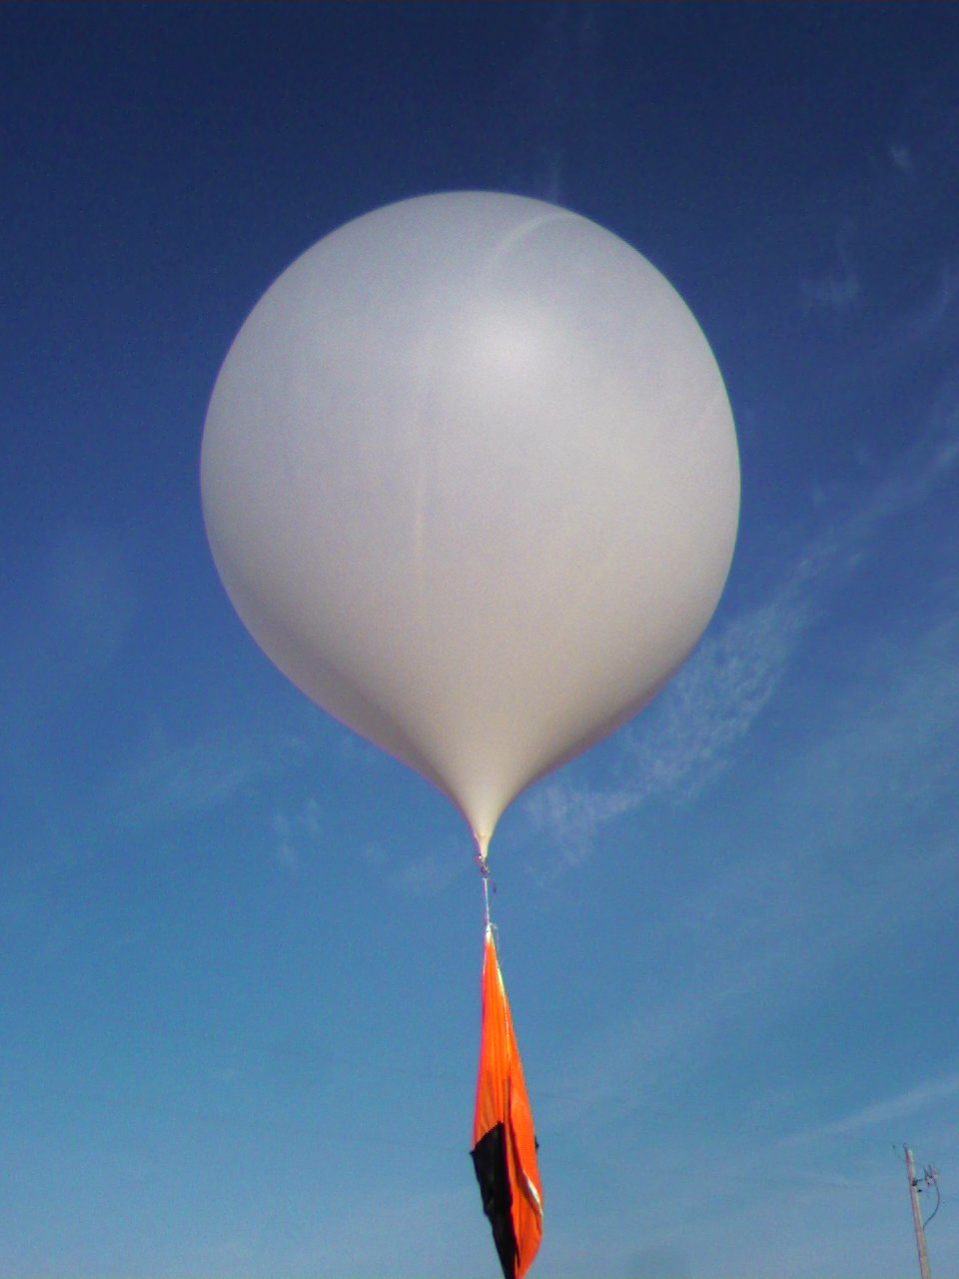
Flight Day
Flight preparations on launch day went smoothly & according to plan
In retrospect, there was some flaw with our camera set up because our camera did not get any pictures
It would have been better if more members of our group could have been present for the launch, but all but Scott were absent

Slide 20
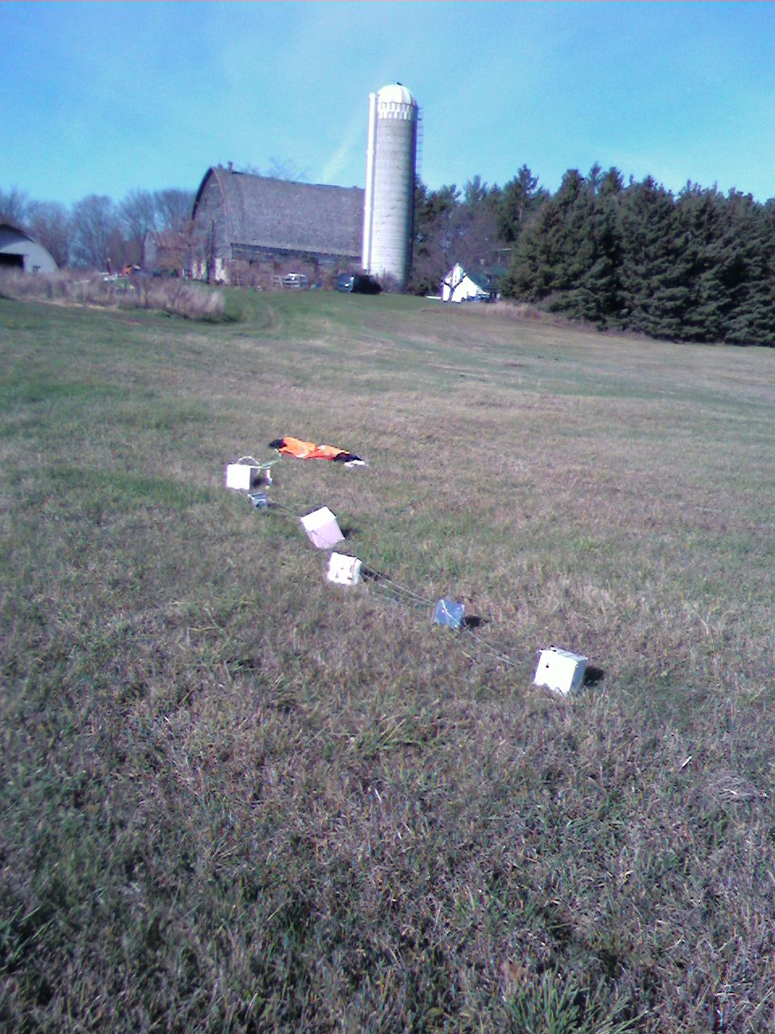
Flight Day
Our package landed in really pristine condition, lined up in the farmer’s field
When our package was opened I found everything to have a pretty thin layer of condensation on it
The pencil we had used to prop up our camera had broken and our filter wheel was no longer spinning
Other than that, our package was very much intact and as solid as when we launched it

Slide 21
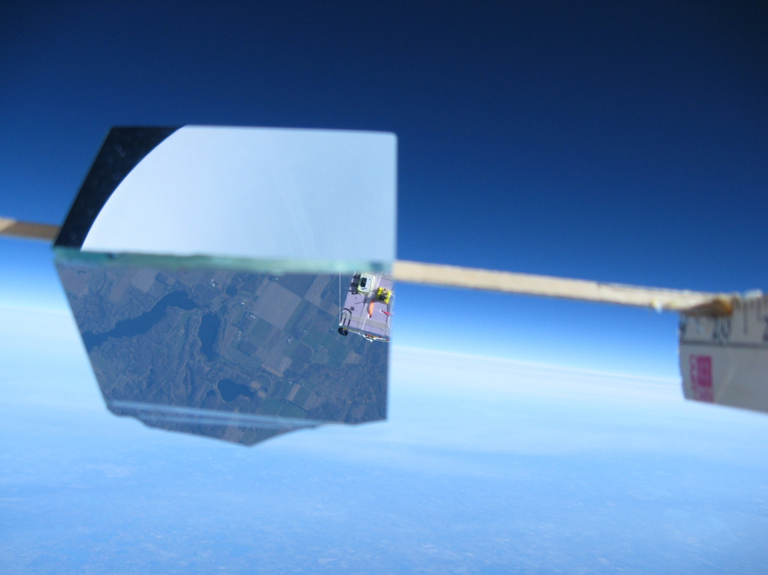
Blackness Picture

Slide 22
Blackness Evaluation
The flight lasted approximately 2 hours and during that time reached a height of approximately 89,000 feet.
According to the pictures taken the sky appears to begin to become black on the horizon approximately 74 minutes into the flight at an altitude of about 40,000 feet.
The picture shows the beginning blackness on the horizon at the top of the picture

Slide 23
Conclusions/Lessons Learned
The data collected from our HOBO gave us information about the pressure and temperature of different altitudes of the earth’s atmosphere. The results of pressure showed that as our payload rose the pressure dropped at an almost constant rate. The temperature on the other hand was not constant in our ascent. At around 67,000 feet it hits a small plateau, then actually rose before dropping again until we hit the climax of our flight. Then temperature raises linearly as the payload descended back at a more rapid rate.
On our first flight, our camera malfunctioned resulting in us not getting any data from it. Learning from this we decided to test the program it was supposed to run. We also put the UV filter wheel on the outside of the box to get clearer pictures for the second flight. Then we had a second flight this last weekend which we hope has some better results.
Our first flight also included an experiment of how altitude affects solar absorption rates in a solar panel. The original plan was to use a Fresnel lens to see if it increased the absorption rate. In the first flight our data showed a clear steady increase in the voltage absorbed at higher altitudes with no Fresnel lens. Our second flight included the Fresnel lens and hopefully the data will help us decipher if it helped the absorption rate or not.
Words of Wisdom from Team Sweetness: Make sure to get everything done before it is due. Testing is key. More than one meeting a week is better. Everyone should step up and lead.
Much thanks to Dan Anderson for helping us come up with unique ideas and programming our equipment. Professor Flaten for letting us fly a second time to see if we could get our experiments to work better.

