Slide 1
Minnesota Space Grant Consortium (MnSGC) and University of Minnesota – Twin Cities “Group 2” Payload (mission name TBA) Conceptual Design Review – Dec. 1, 2010
U of MN student team members
Kyle Marek-Spartz (team lead), Seth Frick, Cait Mantych, Mary Pattison, Alana Gedrose, Alex Knutson-Smisek, Philip Hansen, Chris Schumacher, Anthony Knutson
Participating high school teachers (tentative list)
Peter Grul, Washburn High School, Minneapolis, MN
Peter Pitman, White Bear Lake High School, White Bear, MN
Eric Colchin, Johnson High School, St. Paul, MN
U of MN faculty advisor: Dr. James Flaten
Consultant: Bryce Schaefer (MinnSpec team lead)

Slide 2
Contents
Section 1: Mission Overview
Mission Statement
Theory and Concepts
Mission Requirements
Concept of Operations
Expected Results
Section 2: Design Overview
Heritage Elements
Electrical Functional Block Diagrams
Mock Payload Tray Layouts
RockSat-C User’s Guide Compliance
Shared Can Logistics

Slide 3
Contents (Cont.)
Section 3: Management
Team Organization Chart
Schedule
Budget
Section 4: Conclusions/Summary

Slide 4
Mission Overview: Mission Statement
Our mission is three-fold:
Most important: to engage and motivate local high-school students, and their teachers, in the space sciences;
Also important: to determine the usability of hardware (mostly off-the-shelf, inexpensive, and quite user-friendly) used by the MnSGC High-Altitude Ballooning Team in suborbital applications;
Somewhat less important: collect and analyze science data from the experiments flown – this is less important because the data being collected is intentionally quite mundane rather than cutting-edge and there is educational value even if the experiments are unsuccessful

Slide 5
Mission Overview: Theory and Concepts
Providing educational aerospace opportunities to a wide range of students is a core part of the MnSGC’s mission
Advanced college students in the MnSGC already have the opportunity of working on a suborbital payload with the MinnSpec payload
The additional space allocation allowed us to respond to high school teachers who also expressed interest in becoming involved
The MnSGC High-Altitude Ballooning Team has an established ballooning program, with over 30 launches in the past 4 years
We have experience with off-the-shelf and adapted electronics and a desire to see how far that sort of hardware can be pushed

Slide 6
Mission Overview: Mission Requirements
Involve students from local high-schools and students new to the suborbital program (i.e. U of MN students not already working on MinnSpec) in experimental design, building, testing, and data analysis
Determine usability of hardware from our balloon program for suborbital applications
Verhage flight computers (BalloonSat Easy, BalloonSat Mini)
Basic Stamp computers (BASIC Stamp 1, BASIC Stamp 2)
HOBO data loggers (U12-013 data loggers, G logger pendants)
Flip video camera
Passive biological experiments (bacteria, brine shrimp, lichen)
Common weather sensors (Verhage weather station – temperature, pressure, relative humidity)
Accelerometers (RockOn-style and 2 home-built designs, one monitored visually and one, based on g-switches, monitored electrically)
Geiger counter (Aware Electronics RM-60)

Slide 7
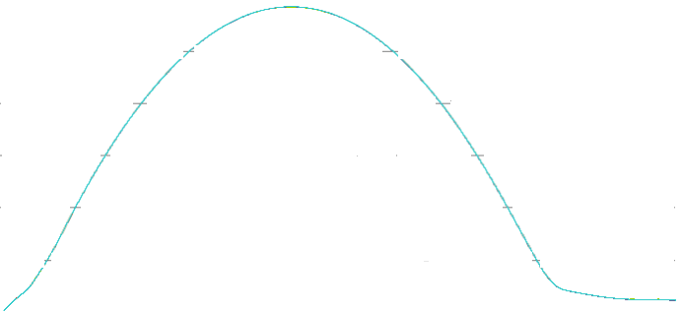
Concept of Operation: Profile of Suborbital Flight
Altitude
t ≈ 1.7 min
Altitude: 95 km
t ≈ 1.3 min
Altitude: 75 km
Apogee
t ≈ 2.8 min
Altitude: ≈115 km
t ≈ 4.0 min
Altitude: 95 km
t ≈ 4.5 min
Altitude: 75 km
End of Orion Burn
t ≈ 0.6 min
Altitude: 52 km
t ≈ 5.5 min
Chute Deploys
-Payload started 2 min prior to launch
-All systems on during launch
-Begin data collection
t = 0 min
t ≈ 15 min
Splash Down

Slide 8
Mission Overview: Expected Results
New people involved in the project will gain a basic understanding of spacecraft payload building and more appreciation of space science
If the hardware survives the launch, here is the data we will try to collect:
Verhage flight computers:
Temperature, pressure, relative humidity, acceleration, light intensity (for rocket spin)
BASIC Stamp computers:
Geiger counter data, light intensity, control LED’s, control linear actuators to turn on video
HOBO data loggers:
Temperature, pressure, relative humidity, acceleration, “g-switch accelerometer”
Flip video camera:
“visual accelerometer” (micro-gravity experiment)
Passive biological samples:
Bacteria – use Ames test (post-flight) to look for mutations, also fly brine shrimp & bio-fuel lichens at various stages in their life cycles to verify survivability
Hardware and experiments that collect usable data will be considered for use on future payloads

Slide 9
Design Overview: Heritage Elements
RockSat participation: MinnRock and MinnSpec payloads
Power supply (we will share it with them)
Structures team (we will join their stacked configuration)
Have made camera modifications (but we plan to fly an unmodified video camera)
High-Altitude Ballooning team
Verhage flight computers have been used for measuring temperature, pressure, relative humidity, acceleration
Basic Stamp computers have been used for controlling linear actuators, measuring cosmic radiation with Geiger counters, measuring light intensity
HOBO data loggers have been used for measuring temperature, pressure, relative humidity, acceleration, and monitoring Geiger counters
We have extensive experience with Flip video cameras (though not with turning them on remotely using linear actuators, as well as with programmable Canon Powershot still cameras
We have some experience running passive biological experiments looking for mutations in bacteria with post-flight testing

Slide 10
Design Overview: Electrical Functional Block Diagram
Flip video camera watching “visual accelerometer”
BASIC Stamps with sensors, including Geiger counter and linear actuator (touching video camera)
HOBOs with weather sensors and “g-switch accelerometer”
Verhage flight computers with weather sensors and accelerometers
Passive biological experiments (unpowered, stand-alone)
Power from MinnSpec

Slide 11
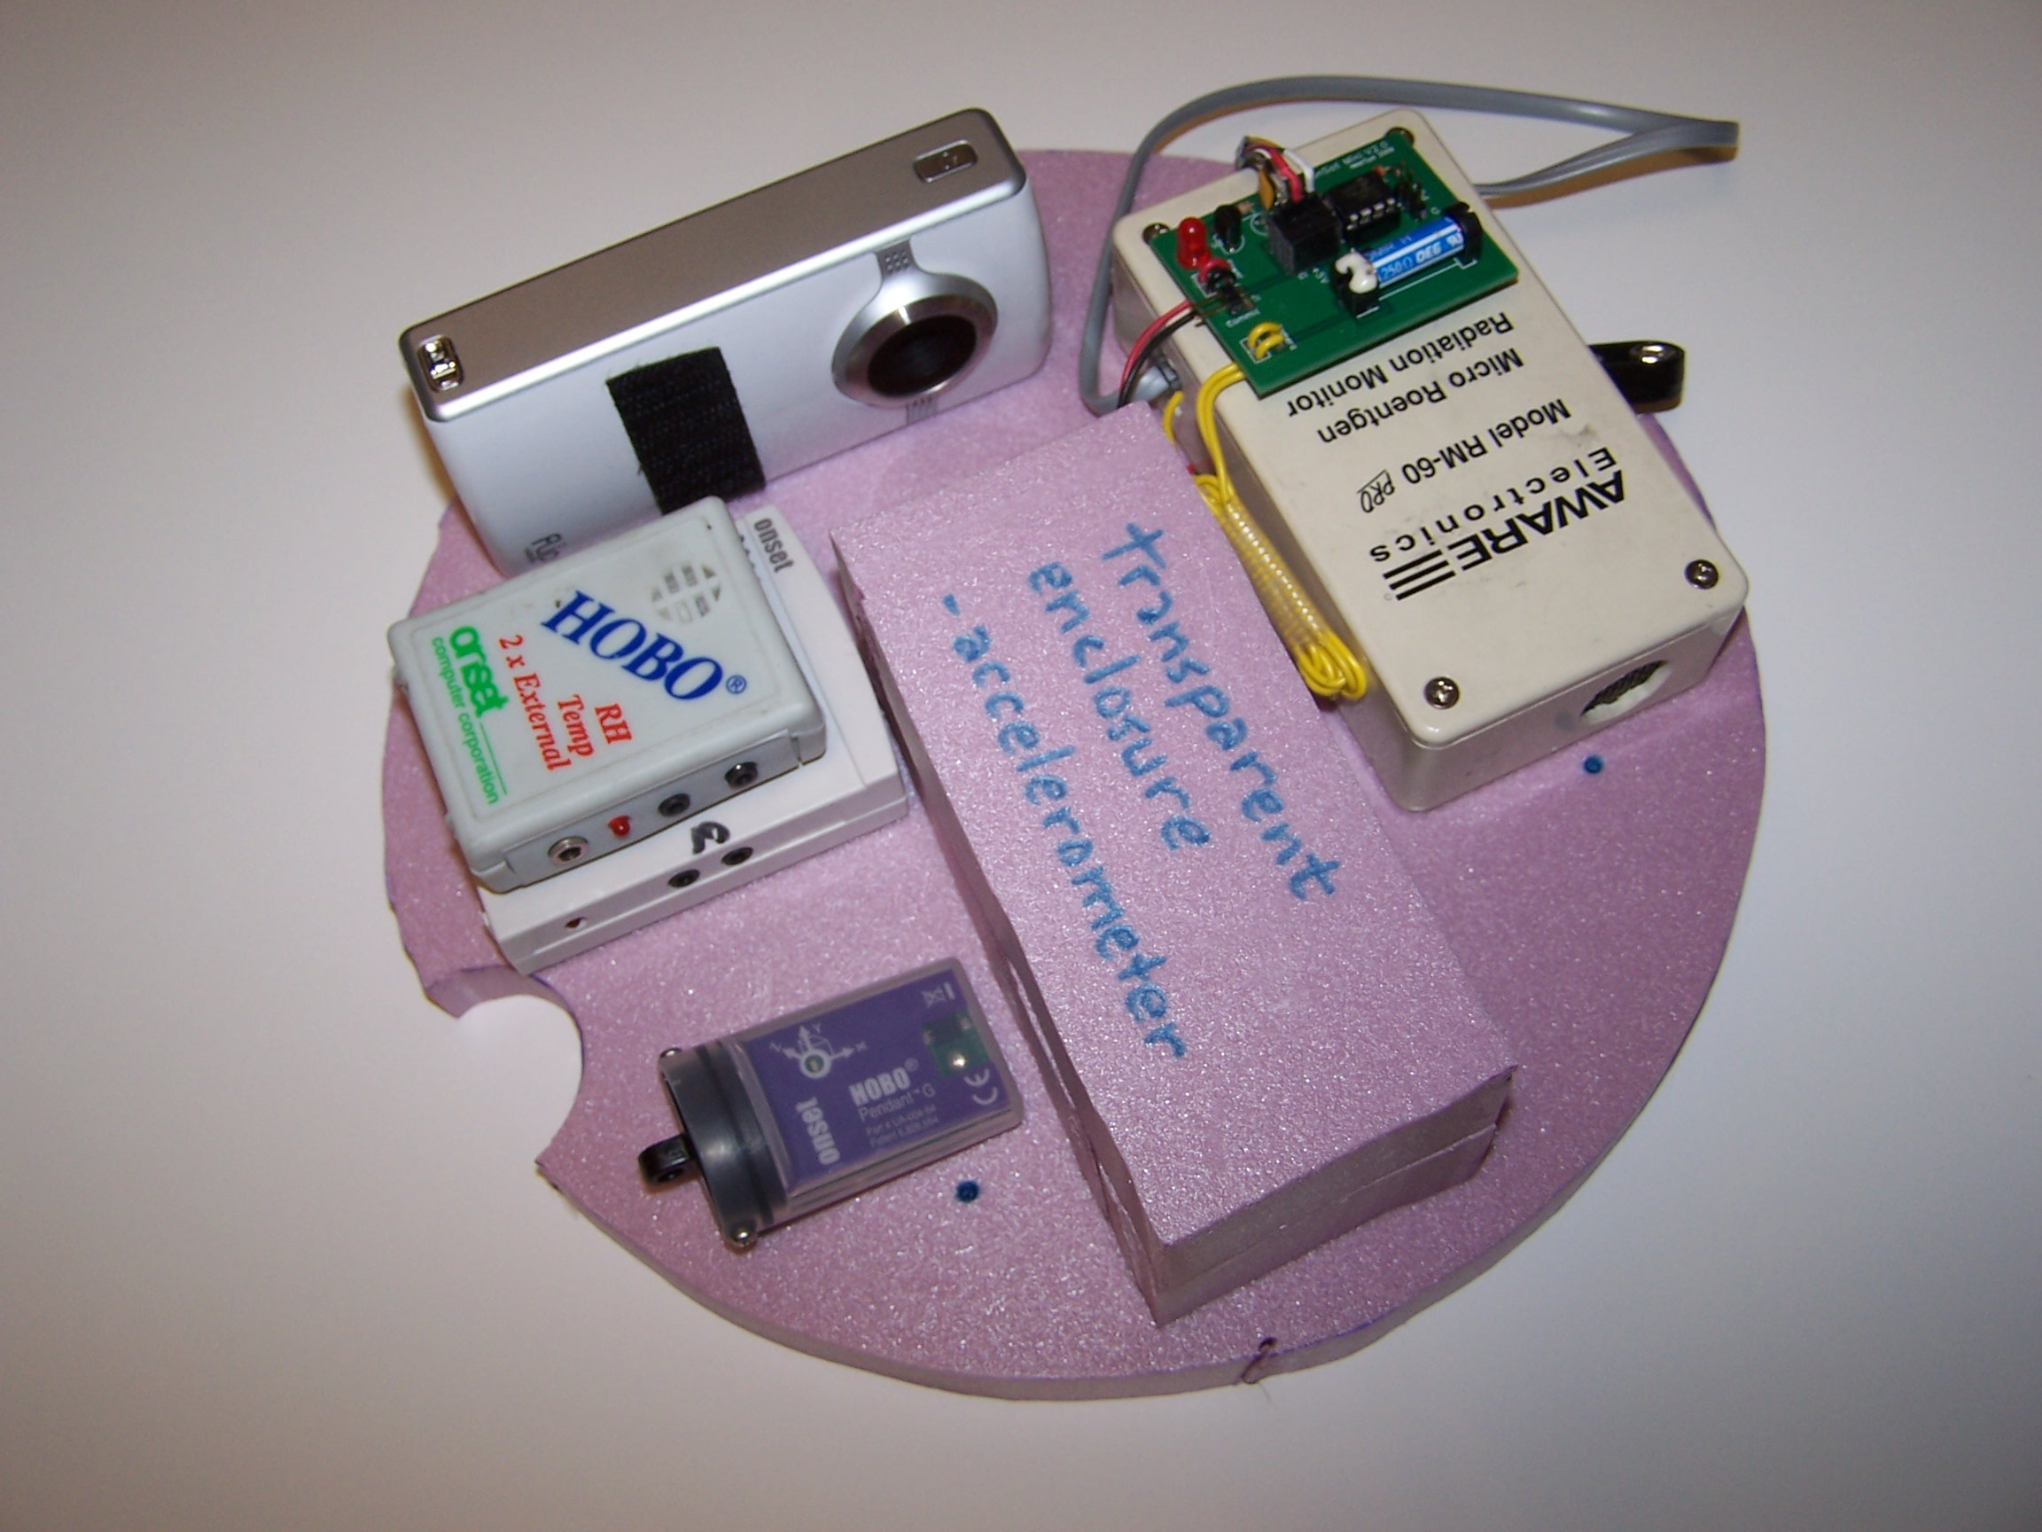
Design Overview:Mock Payload Tray Layouts (exact allocation TBD, based on which high school does what, but our ballooning team already owns most of the hardware we plan to fly)
Flip video camera (linear actuator
framework not shown)
RM-60 Geiger counter with
BalloonSat Mini flight computer
(biological samples not shown)
U12-013 HOBO data logger
(no sensors shown)
U08-007-02 (old) HOBO data
logger, also without sensors
Space reserved for “visual
accelerometer”
HOBO g pendant accelerometer

Slide 12
Mock Payload Tray Layouts (Cont.)
RockOn-style 3-D high range /
low range accelerometers
Space reserved for “g-switch
accelerometer”
BalloonSat Mini flight computer
with Verhage weather station
BalloonSat Easy flight computers
(old style and new style) without
sensors shown
BASIC Stamp 1 flight computer
to control video camera

Slide 13
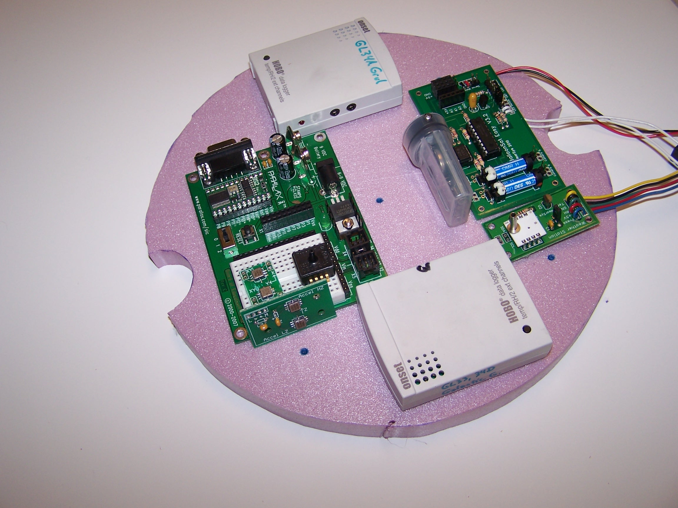
Mock Payload Tray Layouts (Cont.)
HOBO g pendant accelerometer
BalloonSat Easy flight computer
with Verhage weather station
U12-013 HOBO data loggers
(no sensors shown)
Pressure sensor
BASIC Stamp 2 flight computer
RockOn-style 3-D high range /
low range accelerometers

Slide 14
Design Overview: RockSat-C User’s Guide Compliance
Weight: < 10 lbs, including half of canister itself
Volume: < 1/2 canister
C.G: coordinated with MinnSpec to lie within 1” x 1” x 1” of geometric center of canister
Powered from MinnSpec – shared activation at T-2 min
Payload will be fully compliant with User’s Guide

Slide 15
Design Overview: Shared Can Logistics
Shared with MinnSpec (the U of MN/MnSGC original payload)
Our team members have some overlap with the MinnSpec project and are actively involved with their mission
Structure design for the whole canister will be overseen by the MinnSpec structures subteam
MinnSpec is using the all the ports of the canister
Our payload has redundancies (multiple HOBOs, multiple Verhage flight computers) so it can be scaled up or down to fit the space/mass available

Slide 16
Management: Team Organization Chart
Kyle Marek-Spartz
(Team Lead)
Biological Team
Mary Pattison (Lichens and brine shrimp)
Alex Knutson-Smisek (bacteria mutation and Ames Test)
Ballooning Hardware Team
Cait Mantych (Ballooning team lead and main high school liaison)
Seth Frick (HOBO and home-built accelerometer design specialist)
Bryce Schaefer (MinnSpec team lead)
MinnSpec Structures Team
High School Students/Teachers
Dr. James Flaten (Faculty advisor)
Philip Hansen (Verhage flight computer and BASIC Stamp specialist)

Slide 17
Management: Schedule
2010.12.01 | Conceptual Design Review (CoDR) Teleconference
2010.12.17 | Preliminary meetings with high school teachers
2011.01.07 | Final Down Select—Flights Awarded
2011.01.15 | Prep work with Structures team for CDR
2011.01.21 | Critical Design Review (CDR) Due
2011.01.24 | Critical Design Review (CDR) Teleconference
2011.01.31 | RockSat Payload Canisters Sent to Customers
2011.02.07 | Online Progress Report 3 Due
2011.02.14 | Individual Subsystem Testing Reports Due
2011.02.21 | Individual Subsystem Testing Reports Teleconference
2011.02.28 | Online Progress Report 4 Due
2011.03.26 | Balloon Test Flight with MinnSpec and Ballooning Team (maybe)

Slide 18
Management: Schedule (Cont.)
2011.03.28 | Payload Subsystem Integration and Testing Report Due
2011.04.04 | Payload Subsystem Integration and Testing Report Teleconference
2011.04.08 | Final Installment Due
2011.04.11 | Weekly Teleconference 1
2011.04.18 | Weekly Teleconference 2, First Full Mission Simulation Test Report Due
2011.04.25 | Weekly Teleconference 3(FMSTR)
2011.05.02 | Weekly Teleconference 4
2011.05.09 | Weekly Teleconference 5
2011.05.16 | Weekly Teleconference 6
2011.05.20 | Second Full Mission Simulation Test Report Due
2011.05.23 | Weekly Teleconference 7 (FMSTR 2)
2011.05.30 | Weekly Teleconference 7
2011.06.03 | Launch Readiness Review (LRR) Teleconference
2011.06.06 | Weekly Teleconference 8 (LRR)
2011.06.10 | Weekly Teleconference 9
2011.06.16 | Visual Inspections at Refuge Inn
06-(17-20)-2011 | Integration/Vibration at Wallops
2011.06.22 | Presentations to next year’s RockSat
2011.06.23 | Launch Day

Slide 19
Management: Budget
Group 2’s equipment (up to $1000) will be funded by the Minnesota Space Grant Consortium (MnSGC)
The trays will actually be designed/built/ tested by student volunteers, both at the U of MN and at several local high schools
We already own much of our equipment as part of our high-altitude ballooning program – extras we may need will be easy to acquire at relatively low-cost and we already know what vendors to use

Slide 20
Conclusions/Summary
Educate and involve additional (younger) students, especially from several local high schools
Test our high-altitude ballooning (mostly off-the-shelf) hardware for use in suborbital flights
If the hardware works, collect basic science data.
Issues, concerns, any questions:
What is the status of our inquiry about using pre-programmed HOBO data loggers on the flight?
How do we need to proceed to get permission to use an RM-60 Geiger counter on the flight? Presumably we will need to apply conformal coating (on the board(s) inside). Anything else?

