Slide 1
MEGA Arduino

Slide 2
Sensor List
MicroSD Shield
Real Time Clock
Analog Pressure
Analog Humidity
Analog Accelerometer
Analog Temperature
Digital Temperature
GPS
Magnetometer

Slide 3
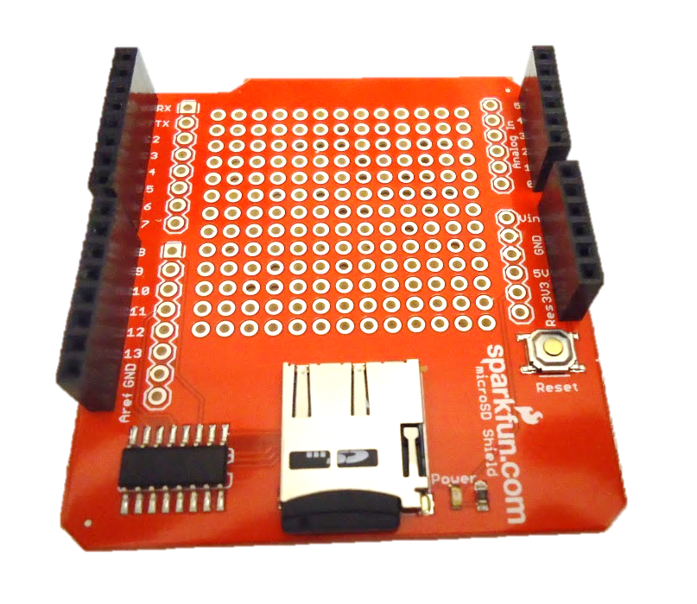
Sparkfun MicroSD Shield
Reserved Pins | Function
D8 | Chip Select
D10-D13 | SPI

Slide 4
Sparkfun Real Time Clock
Pin | Function | Attached To
SDA | Serial Data Line | 20
SCL | Serial Clock Line | 21
SQW | Outputs Square Wave | N/A
GND | Ground Input | GND
5V | 5V Power Input | 5V

Slide 5
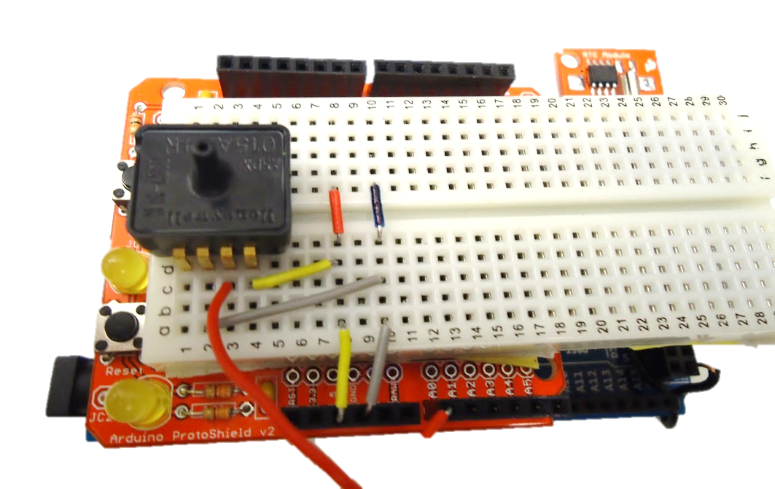
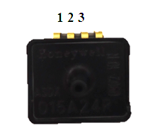
Pressure Sensor
Pin | Function | Attached To
1 | 5V Input | 5V
2 | Analog Output | A0
3 | Ground Input | GND

Slide 6
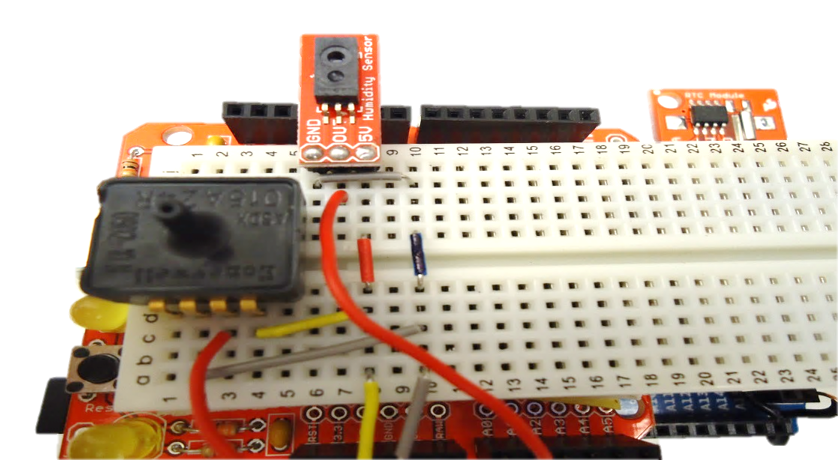
Humidity Sensor
Pin | Function | Attached To
GND | Ground Input | GND
0V | Analog Data Output | A1
5V | 5V Input | 5V

Slide 7
3-Axis Accelerometer
Pin | Description | Attached To
ST | Self Test Pin | N/A
GSEL | Input to select measurement level (1.5 or 6gs) | 3.3V
0GD | Output that provides a signal when all axis are at 0g | N/A
SLP | Input to enable Sleep Mode | 3.3V
XOUT | X Axis Analog Output | A2
YOUT | Y Axis Analog Output | A3
ZOUT | Z Axis Analog Output | A4
GND | Ground input | GND
VCC | Power input (3.3V) | 3.3V

Slide 8
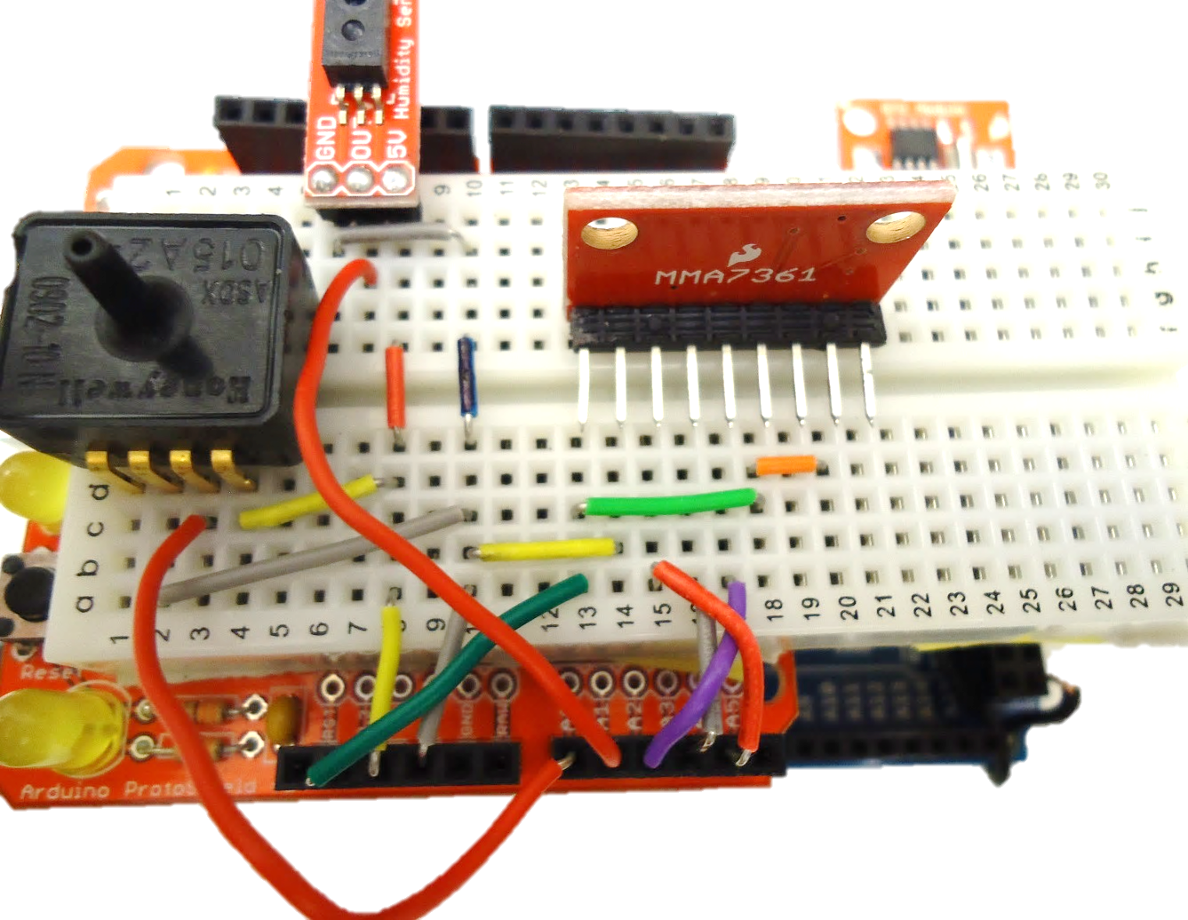
3-Axis Accelerometer

Slide 9
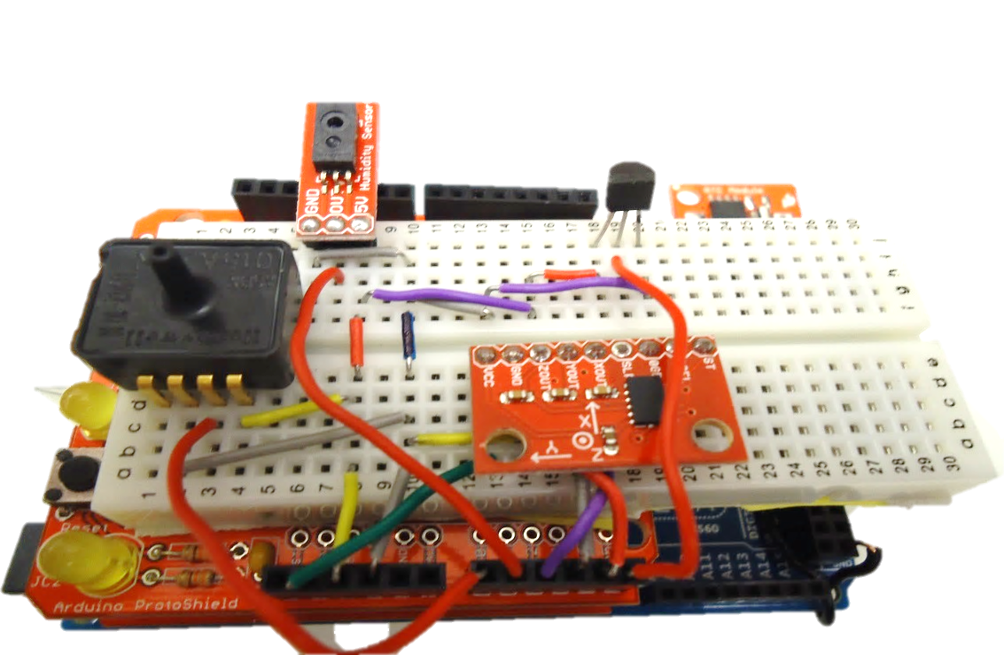
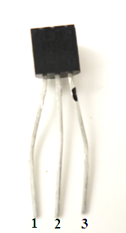
Analog Temperature Sensor
Pin | Function | Attached To
1 | 5V Input | 5V
2 | Analog Output | A5
3 | Ground | GND
Has “TMP” written on it

Slide 10
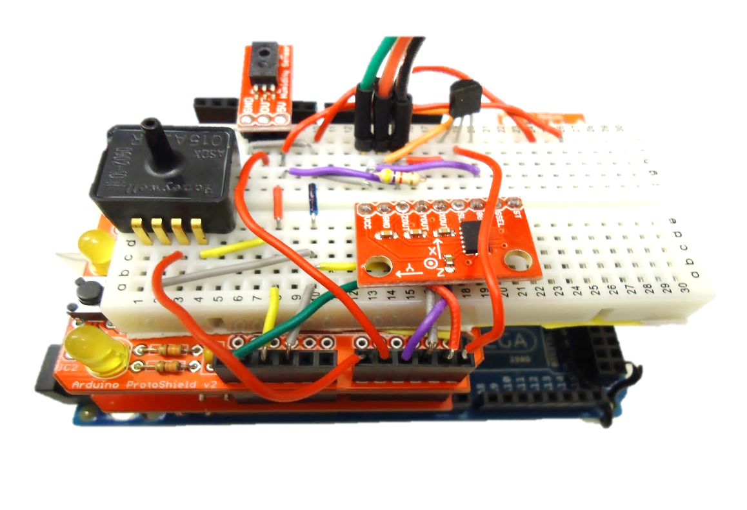
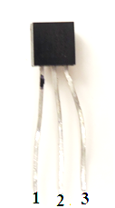
Digital Temperature Sensor
Pin | Function | Attached To
1 | Ground | GND
2 | Data Bus | Digital Pin 2, 4.7kΩ Resistor connected to 5V Power
3 | 5V Input | 5V
Has “Dallas Temperature” written on it

Slide 11
Adafruit Ultimate GPS
Pin | Function | Attached To
3.3V | Provides a 3.3V Output | N/A
EN | Enables Sleep Mode | N/A
VBAT | Allows battery input for RTC | N/A
FIX | Output at same time as fix LED | N/A
TX | Data Transmission | 17
RX | Data Reception | 16
GND | Ground | GND
VIN | 5V Input | 5V
PPS | Pulse per second output | N/A

Slide 12
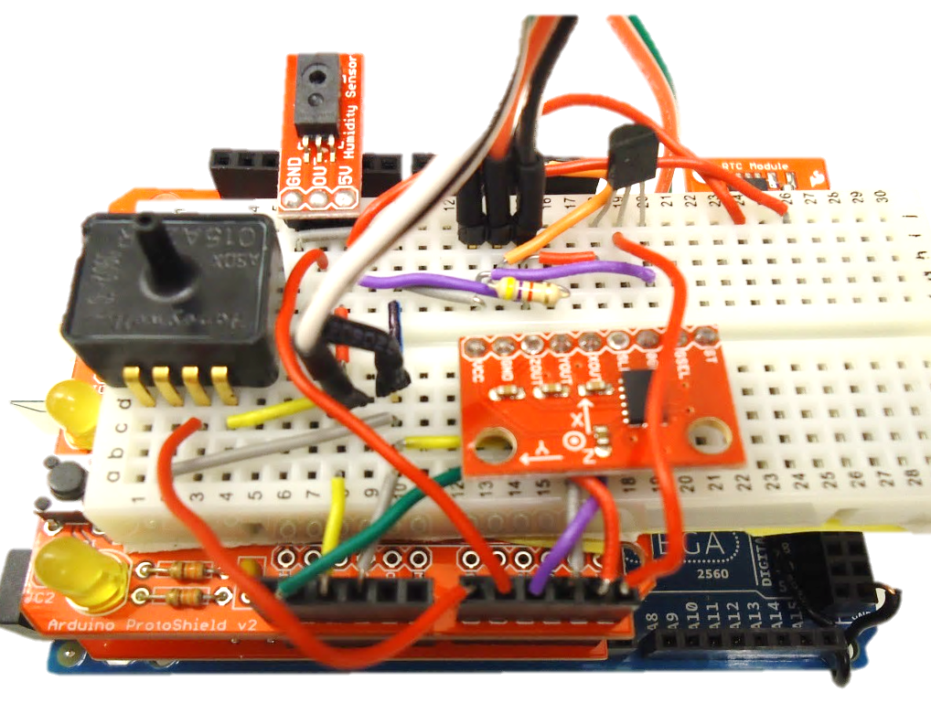
Adafruit Ultimate GPS

Slide 13
MicroMag Magnetometer
Pin | Function | Attached To
14 | Ground | GND
12 | 5V Input | 5V
1 | Serial Clock | 52
2 | Master In Slave Out | 50
3 | Master Out Slave In | 51
4 | Slave Select Line | 53
5 | Data Ready | N/A
6 | Reset | N/A
7 | Ground | GND

Slide 14
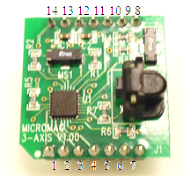
MicroMag Magnetometer

Slide 15
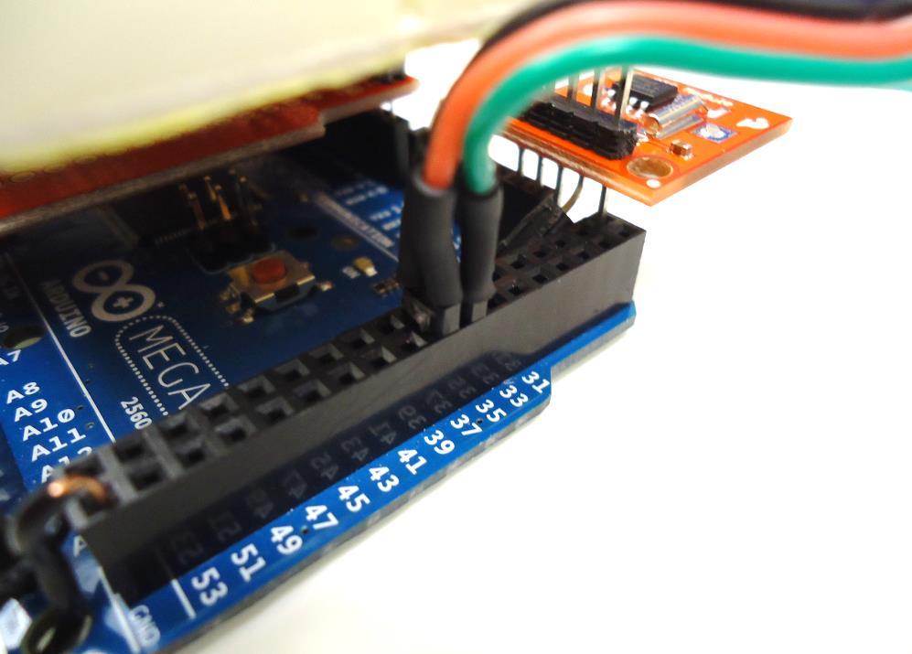
LEDs
LED | Positive Pin | Ground Pin:
Power | 35 | 36
Data Collection | 37 | 36

Slide 16
Flight Ready ?
Are all sensors working ?
Calibration ?
Is everything secure ?
Tape
String
Hot Glue

