Slide 1
Introduction Arduino
Ballooning Bundle

Slide 2
What is a Microcontroller?
Small computer with a processor core, memory and programmable input/output
Continuously repeats software commands
Example: Arduino

Slide 3
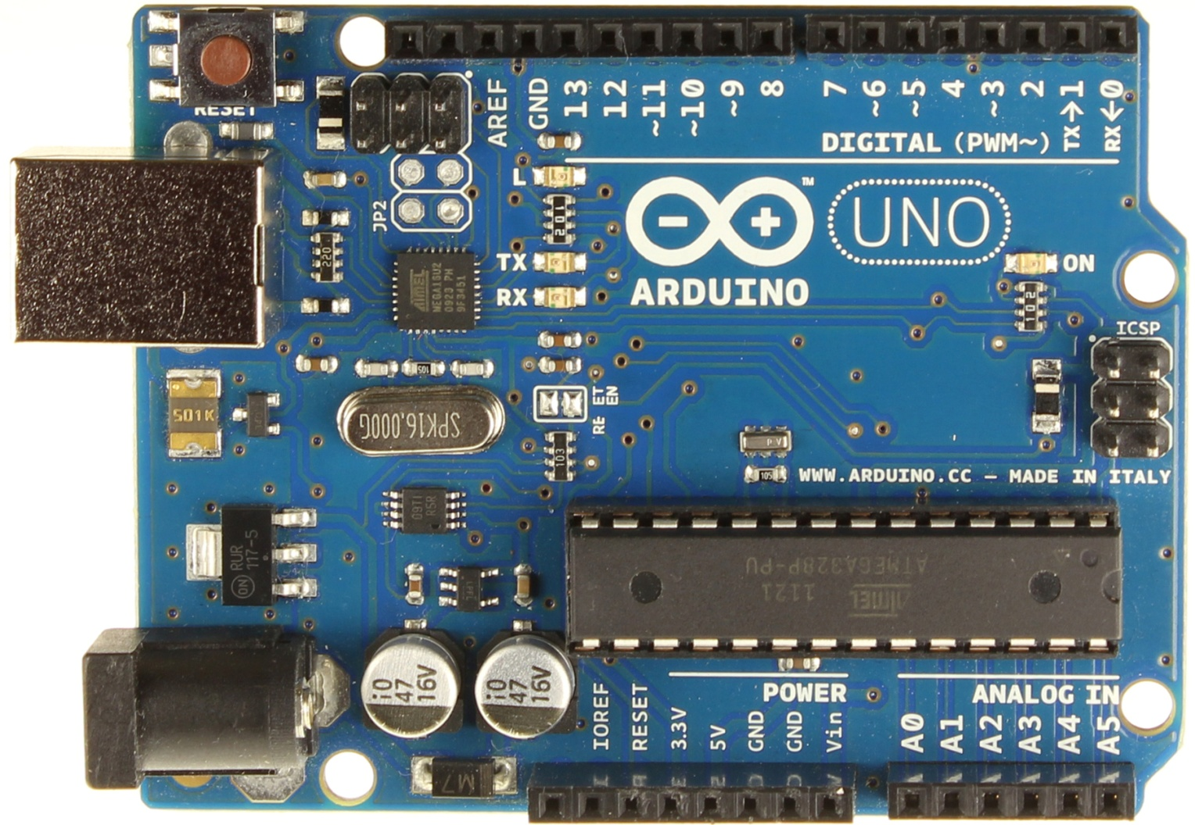
Arduino UNO
Digital Pins
USB Connector
Battery Connector
Analog Pins
Power Pins

Slide 4
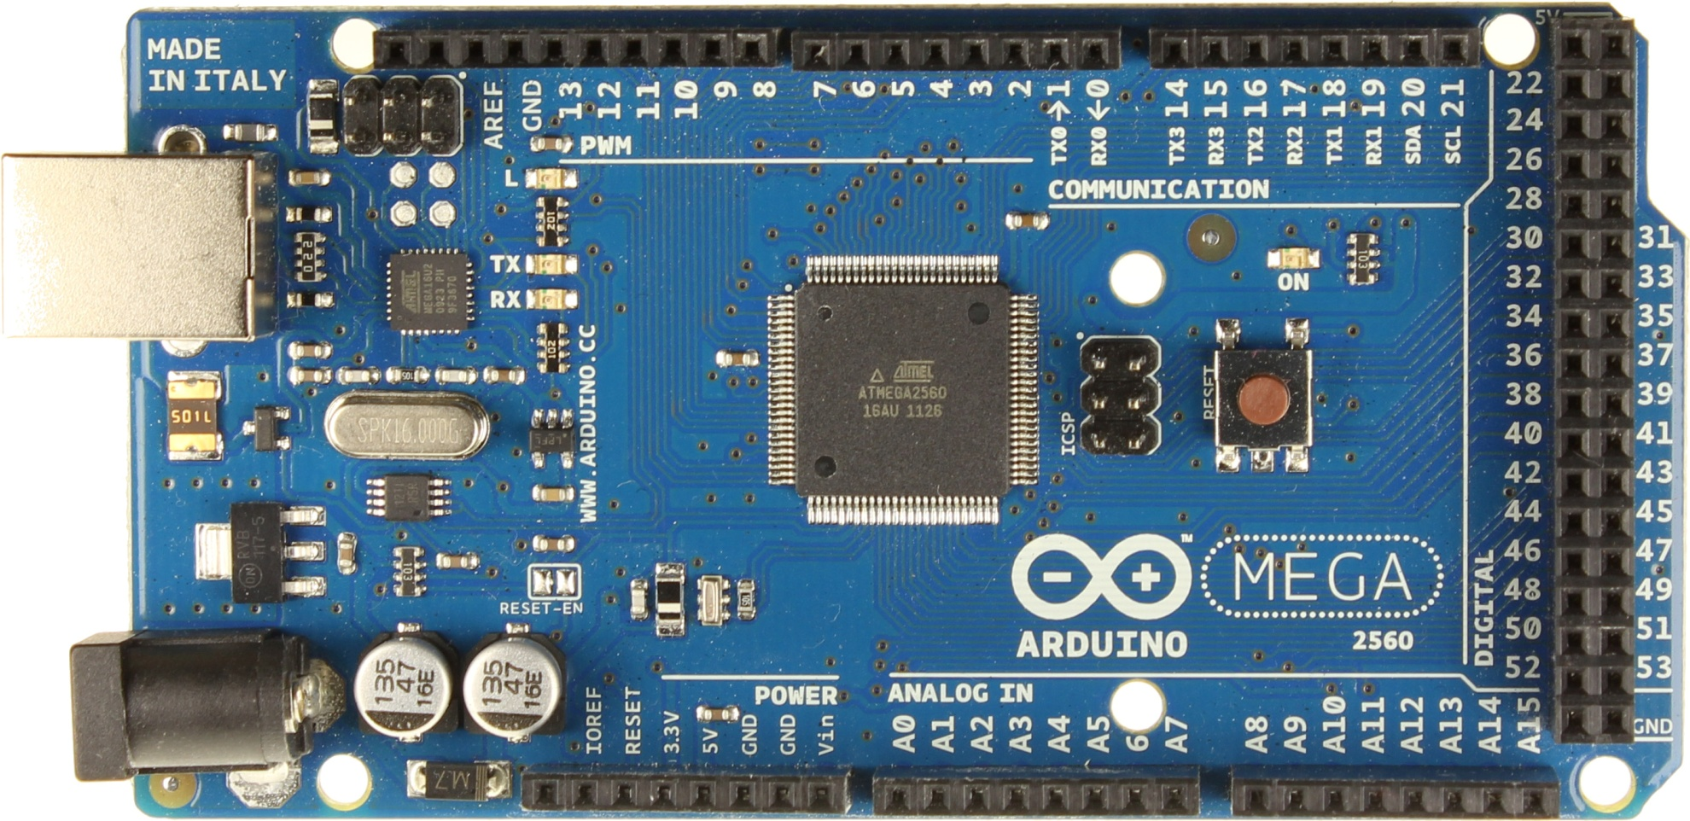
Arduino MEGA
Serial Pins
Digital Pins
USB Connector
Battery Connector
Power Pins
Analog Pins

Slide 5
Introduction to Software
Arduino has its own software development tool
  Can be downloaded for free
Comparable to C language
All programs must have setup and loop functions
Many things have off the shelf software prewritten
  Look online for example code and tutorials

Slide 6
BareMinimum
void setup() {
// put your setup code here, to run once:
}
void loop() {
// put your main code here, to run repeatedly:
}

Slide 7
Serial Communication
Transmit and Receive (TX and RX pins)
Arduino – Computer
GPS – Aduino

Slide 8
Specialized Pins: SPI
Serial Peripheral Interface
Is a synchronous serial data protocol
Used by microSD shield, and MicroMagnetometer

Slide 9
Specialized Pins: I²C Bus
Inter-Integrated Circuit
Uses two pins for communication
  SDA: Serial Data Line
  SCL: Serial Clock Line
On an Uno, pins A4 and A5 are used for I²C
Used by real time clock

Slide 10
1-Wire Digital Bus
Similar to I²C, only 1 digital pin used (1 wire)
Can support multiple sensors
Wire must be powered using 5V and a pull-up resistor to work
Used by digital temperature sensor

