Slide 1
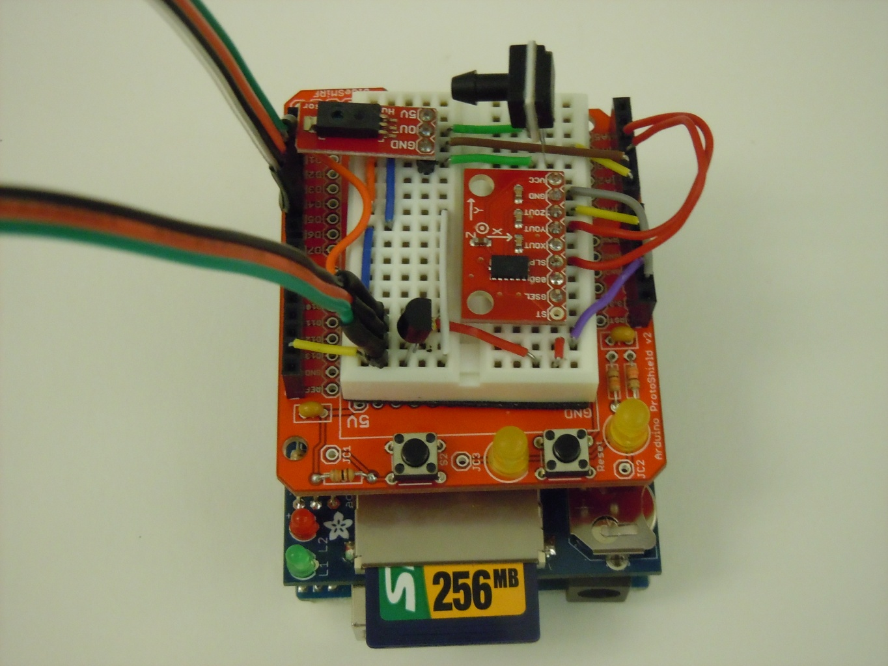
Simple Uno

Slide 2
Sensor List
Adafruit SD Shield/RTC
Analog Pressure
Analog Humidity
Analog Accelerometer (X and Z Axis)
Digital Temperature

Slide 3
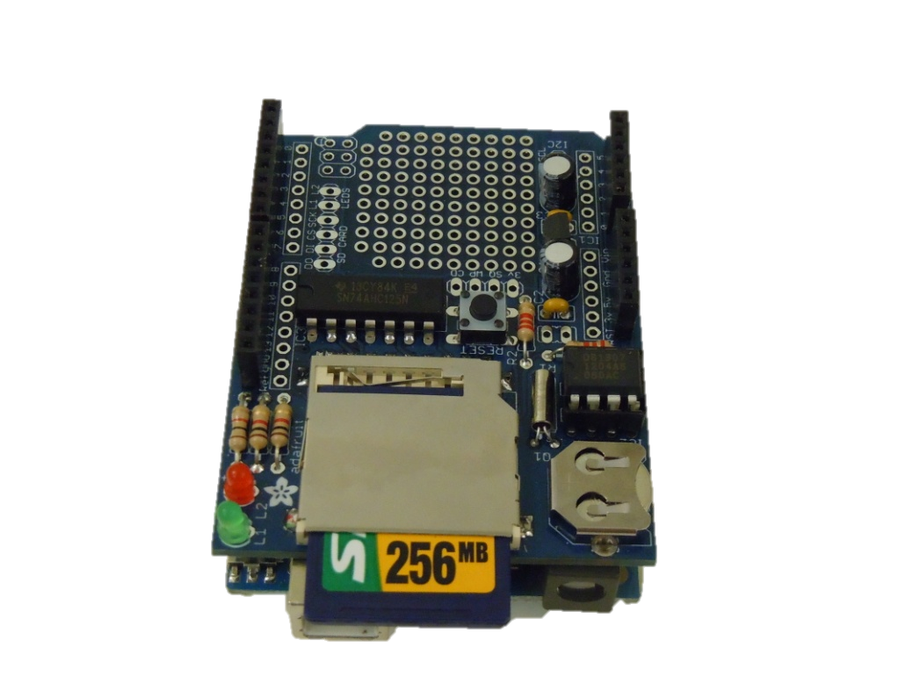
Adafruti SD Card Shield/RTC
Reserved Pins | Function | Attached To
D10-13 | SPI/Chip Select | D10-D13/D8
A4 | RSerial Data Line | A4
A5 | Serial Clock Line | A5

Slide 4
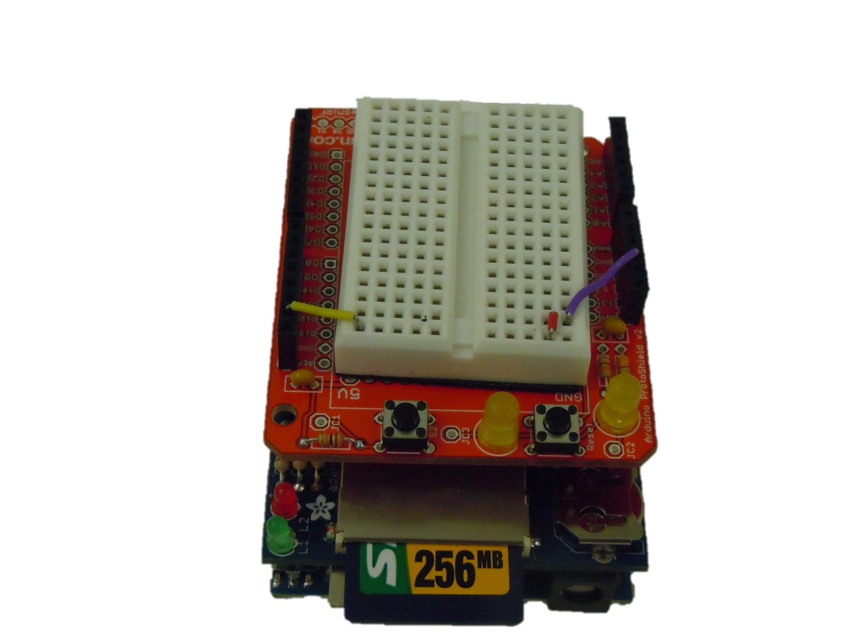
Sparkfun Proto Shield

Slide 5
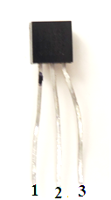
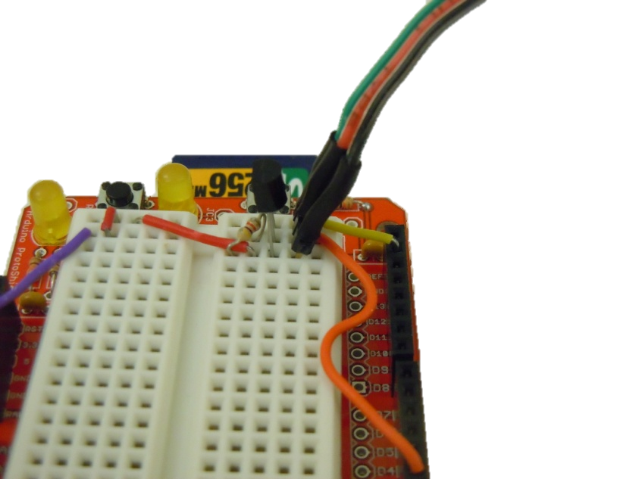
Digital Temperature Sensor
Pin | Function | Attached To
1 | Ground | GND
2 | Data Bus | Digital Pin 2, 4.7kΩ Resistor connected to 5V Power
3 | 5V Input | 5V

Slide 6
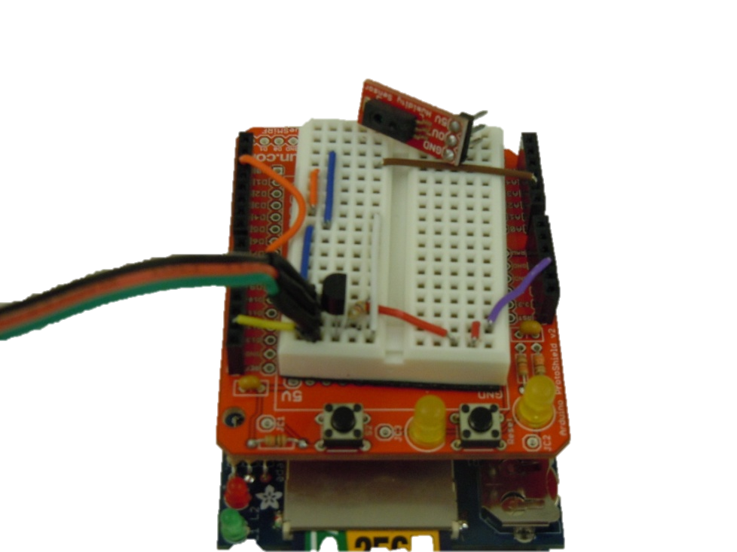
Humidity Sensor
Pin | Function | Attached To
GND | Ground Input | GND
OU | Analog Data Output | A1
5V | 5V Input | 5V

Slide 7
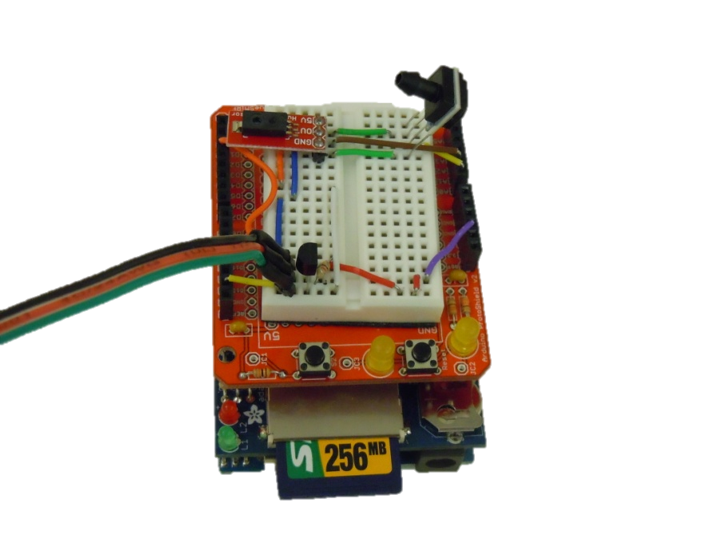
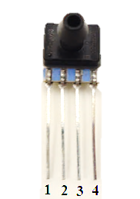
TruStability Pressure Sensor
Pin | Function | Attached To
1 | Nothing | N/A
2 | 5V Input | 5V
3 | Analog Output | A0
4 | Ground Input | GND

Slide 8
3-Axis Accelerometer
Pin | Description | Attached To
ST | Self Test Pin | N/A
GSEL | Input to select measurement level (1.5 or 6gs) | 3.3V
0GD | Output that provides a signal when all axis are at 0g | N/A
SLP | Input to enable Sleep Mode | 3.3V
XOUT | X Axis Analog Output | A2
YOUT | Y Axis Analog Output | N/A
ZOUT | Z Axis Analog Output | A3
GND | Ground input | GND
VCC | Power input (3.3V) | 3.3V

Slide 9
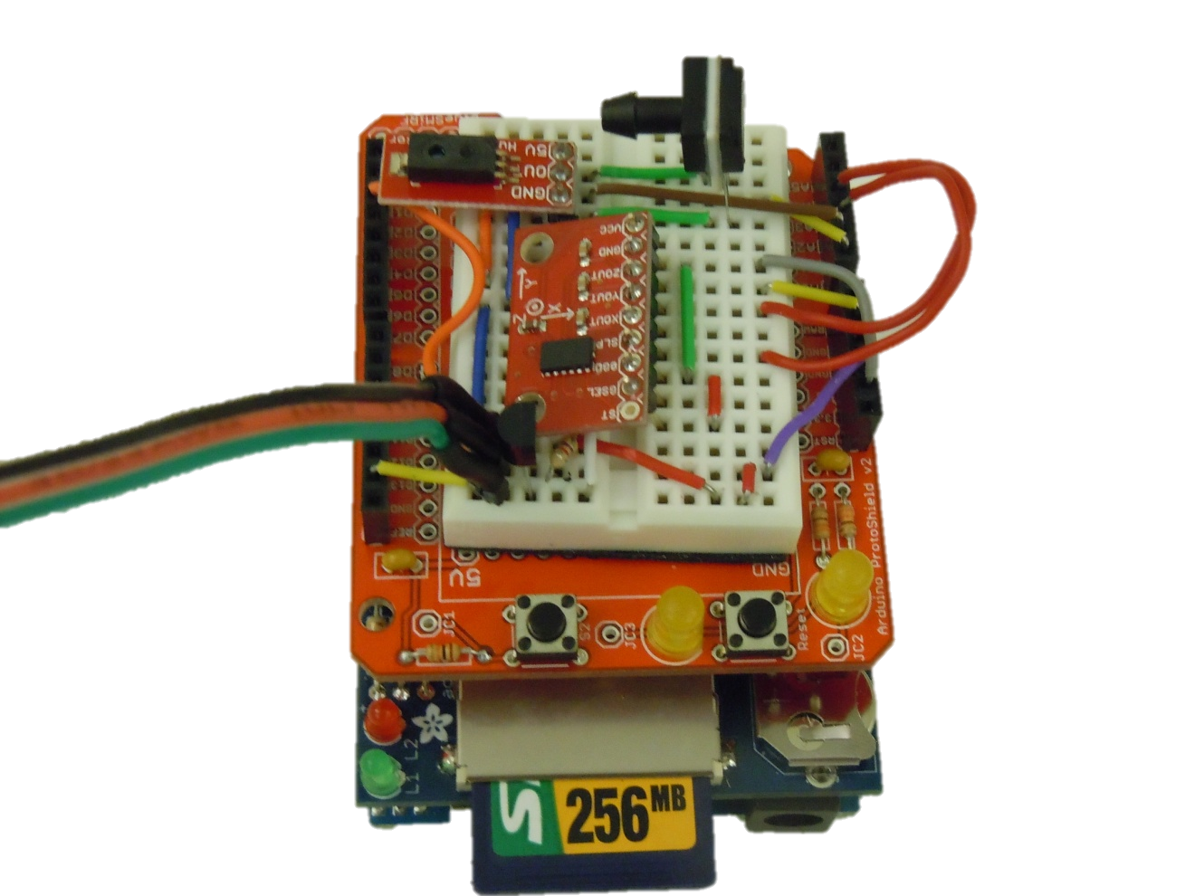
3-Axis Accelerometer

Slide 10
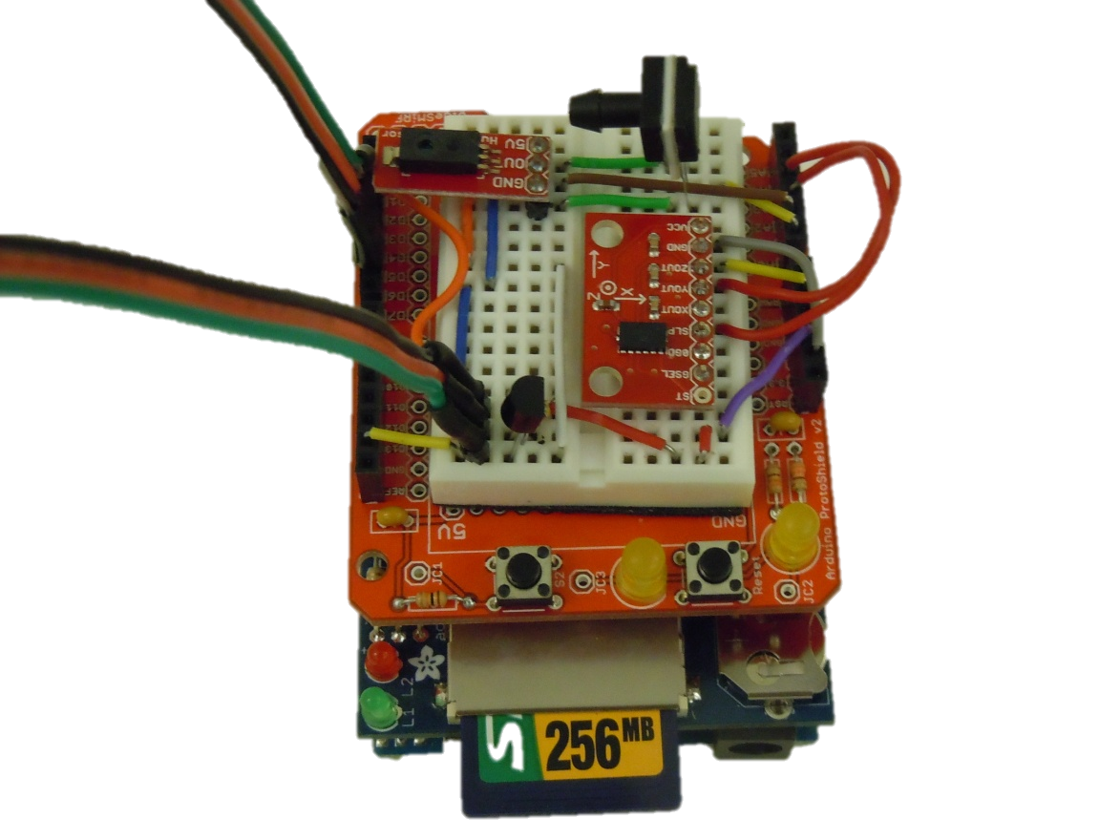
LEDs
LED | Positive Pin | Ground Pin
Power | 3 | 6
Data Collection | 5 | 6

Slide 11
Flight Ready ?
Are all sensors working ?
Calibration ?
Is everything secure ?
Tape
String
Hot Glue

