Slide 1
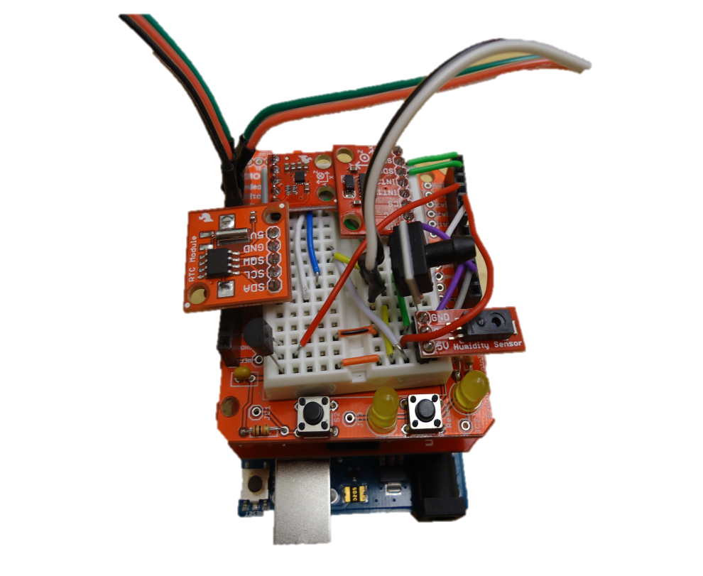
Super Uno

Slide 2
Sensor List
Analog Pressure
Analog Humidity
Analog Temperature
Digital Accelerometer
Digital Magnetometer
microSD Shield
RTC
GPS

Slide 3
ADXL345 3 Axis Accelerometer
Pin | Description | Attached To
GND | Ground Input | GND
VCC | Power Input | 3.3V
CS | Chip Select | 3.3V
INT 1 | Interrupt 1 Output | N/A
INT 2 | Interrupt 2 Output | N/A
SDO | Serial Data Output | N/A
SDA | Serial Data | A4
SCL | Serial Communications Clock | A5

Slide 4
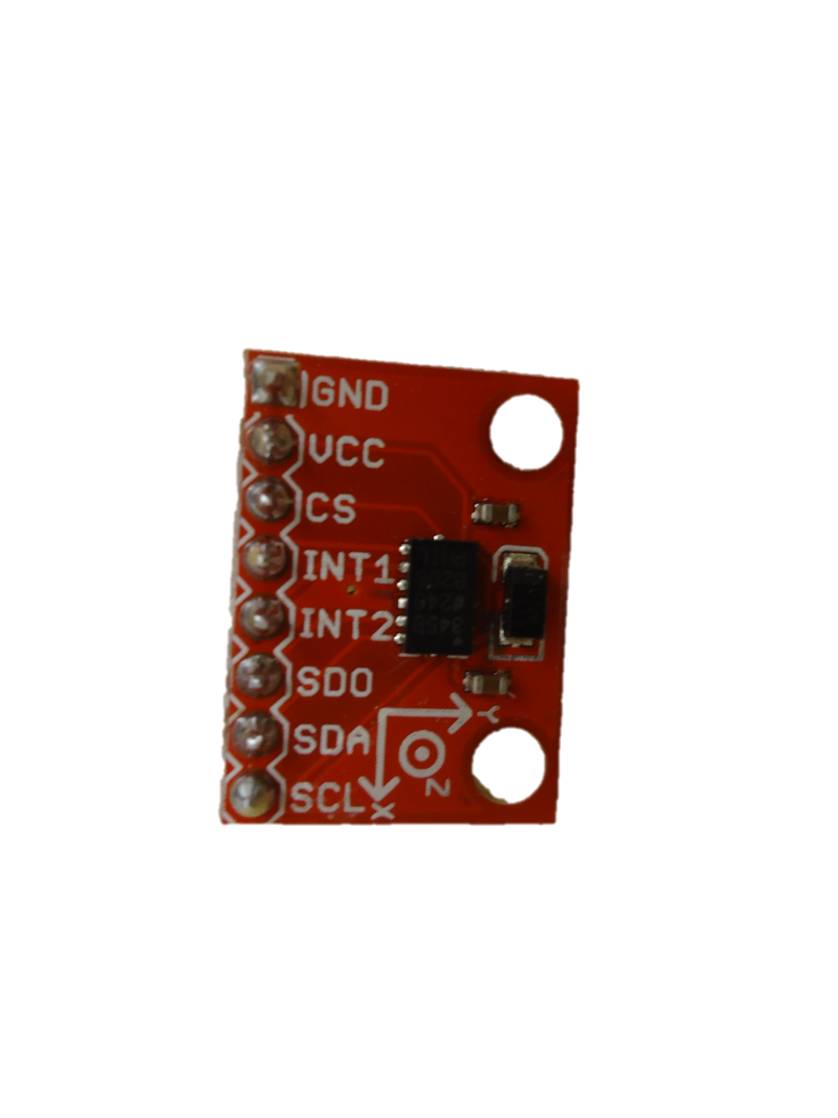
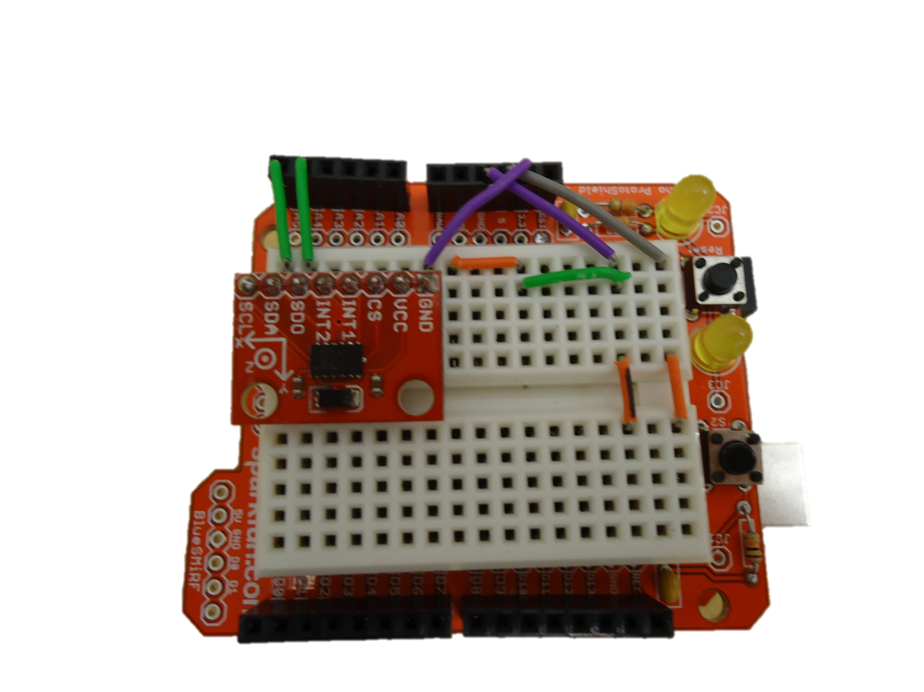
ADXL345 3 Axis Accelerometer

Slide 5
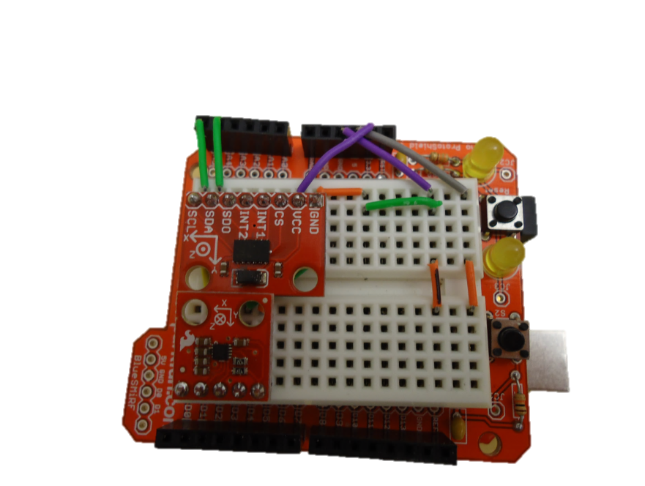
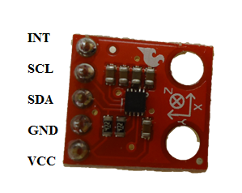
Sparkfun MAG3110 Magnetometer
Pin | Function | Attached To
VCC | Power Input | 3.3V
GND | Ground Input | GND
SDA | Serial Data Line | A4
SCL | Serial Clock Line | A5
INT | Interrupt Output | N/A

Slide 6
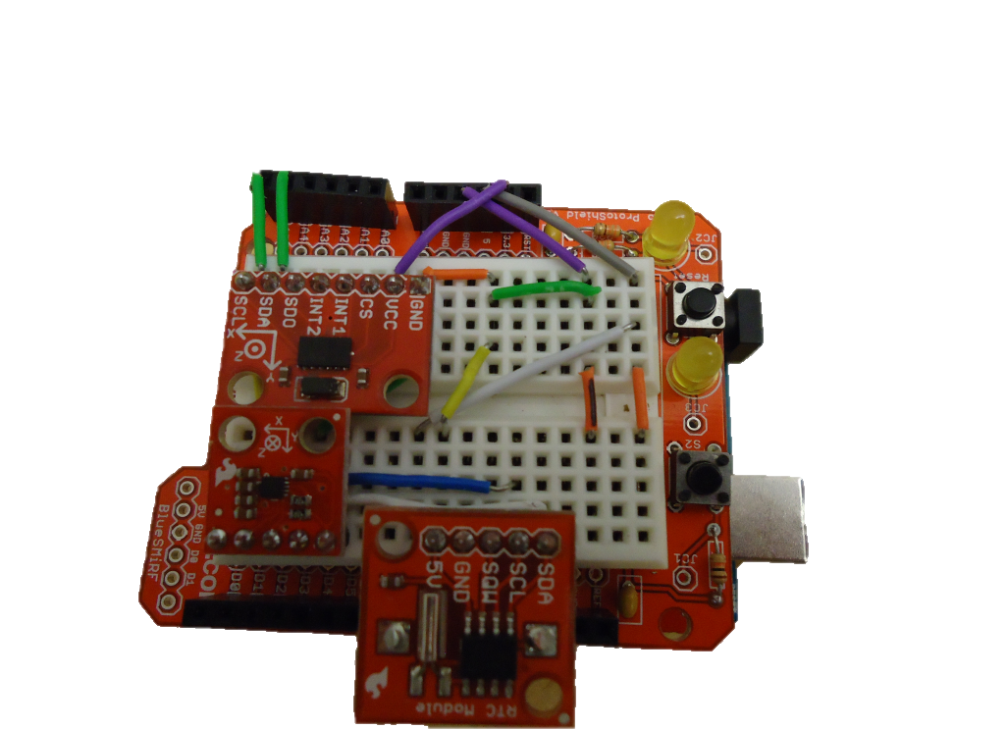
Sparkfun Real Time Clock
Pin | Function | Attached To
SDA | Serial Data Line | A4
SCL | Serial Clock Line | A5
SQW | Outputs Square Wave | N/A
GND | Ground Input | GND
5V | 5V Power Input | 5V

Slide 7
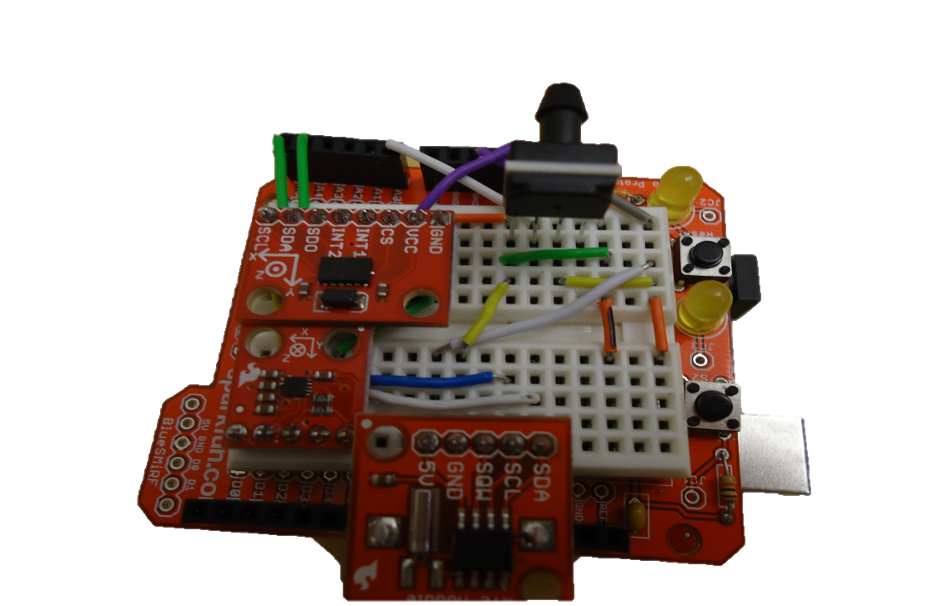
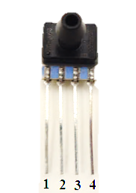
Pressure Sensor
Pin | Function | Attached To
1 | Nothing | N/A
2 | 5V Input | 5V
3 | Analog Output | A0
4 | Ground Input | GND

Slide 8
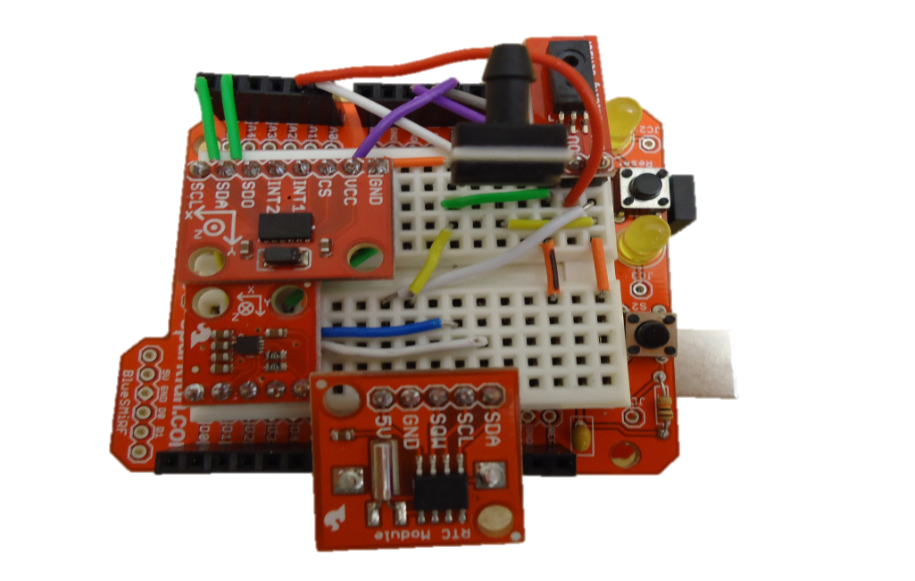
HIH-4030 Breakout Humidity Sensor
Pin | Function | Attached To
GND | Ground Input | GND
0V | Analog Data Output | A1
5V | 5V Input | 5V

Slide 9
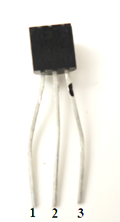
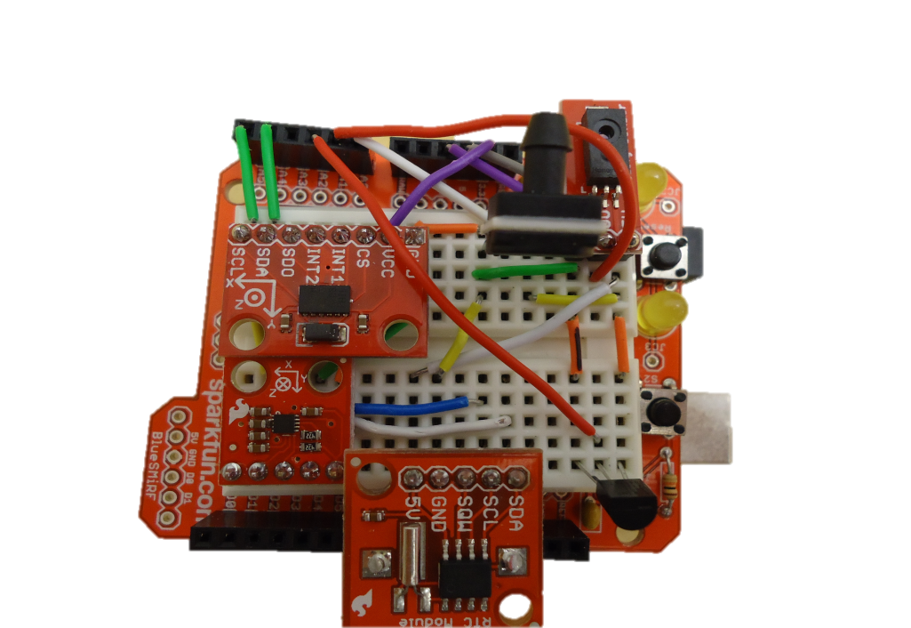
Analog Temperature Sensor
Pin | Function | Attached To
1 | 5V Input | 5V
2 | Analog Output | A2
3 | Ground | GND
Has “TMP” written on it

Slide 10
Adafruit Ultimate GPS Breakout
Pin | Function | Attached To
3.3V | Provides a 3.3V Output | N/A
EN | Enables Sleep Mode | N/A
VBAT | Allows battery input for RTC | N/A
FIX | Output at same time as fix LED | N/A
TX | Transmit | D2
RX | Receive | D3
GND | Ground | GND
VIN | 5V Input | 5V
PPS | Pulse per second output | N/A

Slide 11
Adafruit Ultimate GPS Breakout

Slide 12
LEDs
LED | Positive Pin | Ground Pin
Power | 4 | 6
Data Collection | 5 | 6

Slide 13
Flight Ready ?
Are all sensors working ?
Calibration ?
Is everything secure ?
Tape
String
Hot Glue

